Slide 1
ELEC-E8423 - Smart Grid Solar farms, their local grids and connection to the power system
Conny Arén
4.4.2023

Slide 2
Introduction
Availability of solar irradiation
Current installed capacity
Solar energy to AC
Grid connection
Effects on distribution system
Challenges

Slide 3
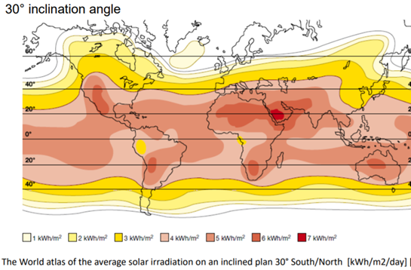
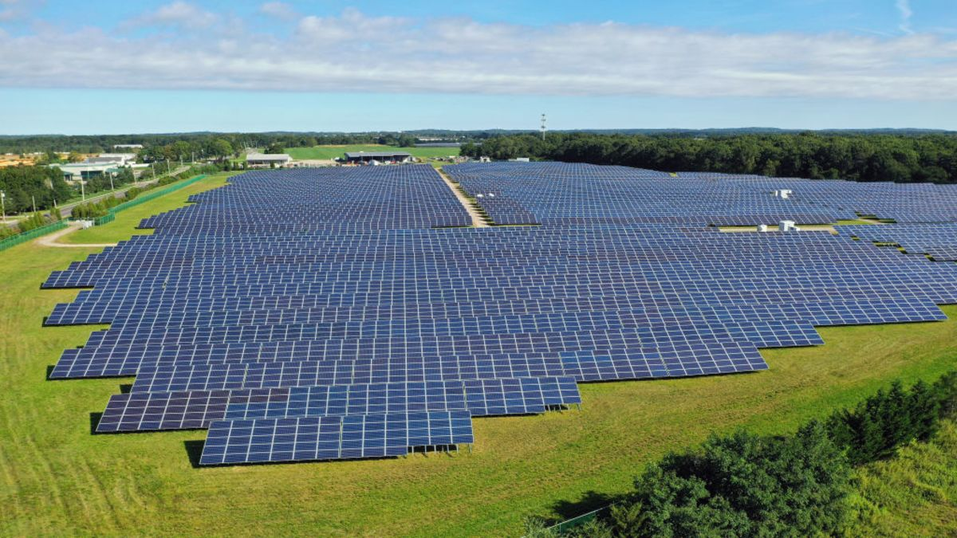
Availability and definition
Northern Europe, Russia and Canada has the worst potential
Less irradiation in the winter when the energy demand is higher
Sahara interesting option but; Transmission, infrastructure, politics, sandstorms
Solar farm:
Collection of solar panels
Have a PV efficiency around 20% which goes up to 30% for concentrated systems
Solar heat plants up to 90% efficiency
Notes:
Presentation focused on solar farms. Smaller collections of solar panels (for example on private roofs) have a lot of advantages over solar farms.

Slide 4
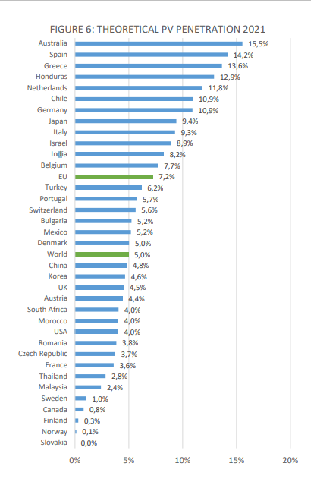
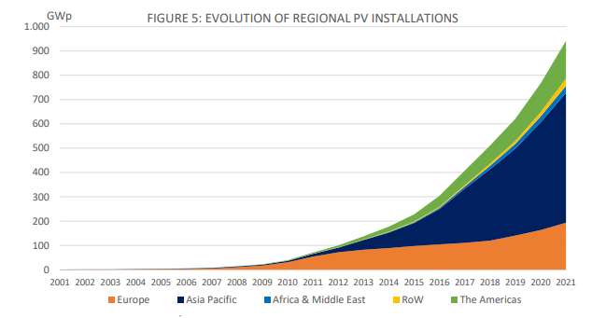
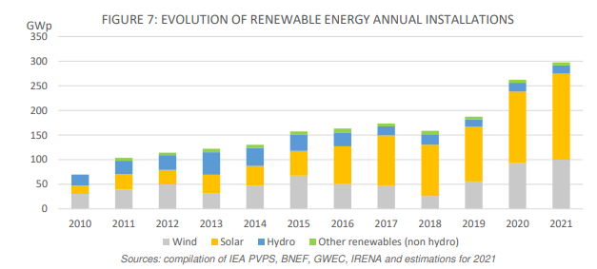
Current installed capacity and market share
Total PV production (of total electricity production) in 2021. 0.3% in Finland, 7.2% in EU and 5% worldwide
Asia (especially China) have increased their PV production significantly recently
Solar power is increasing more in popularity compared to other renewable energy sources

Slide 5
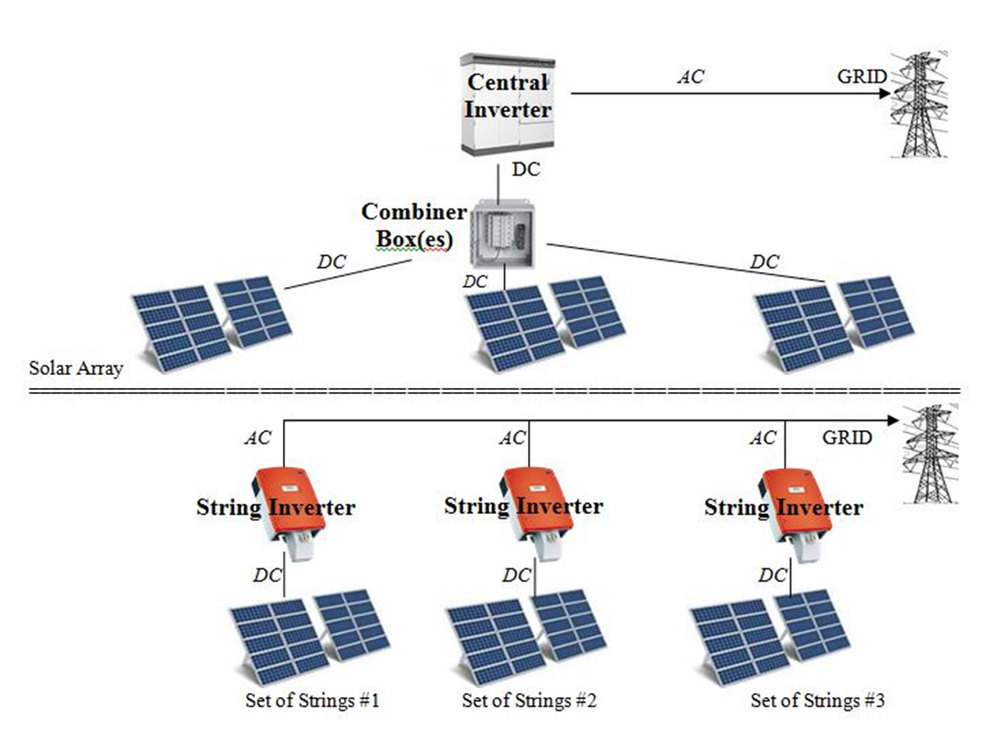
Solar energy to AC
The solar cell utilizes PV conversion to convert solar radiation into DC, which is inverted to AC
The inverter has an efficiency of 95%+
Central inverters lead the market with 49%, string
inverters have 44%
Central inverter; cheaper to build and maintain,
better off peak performance
String inverter; more flexible installation,
higher peak performance, failures less impactful
but more common
Notes:
MPPT-Maximum Power Point Tracking

Slide 6
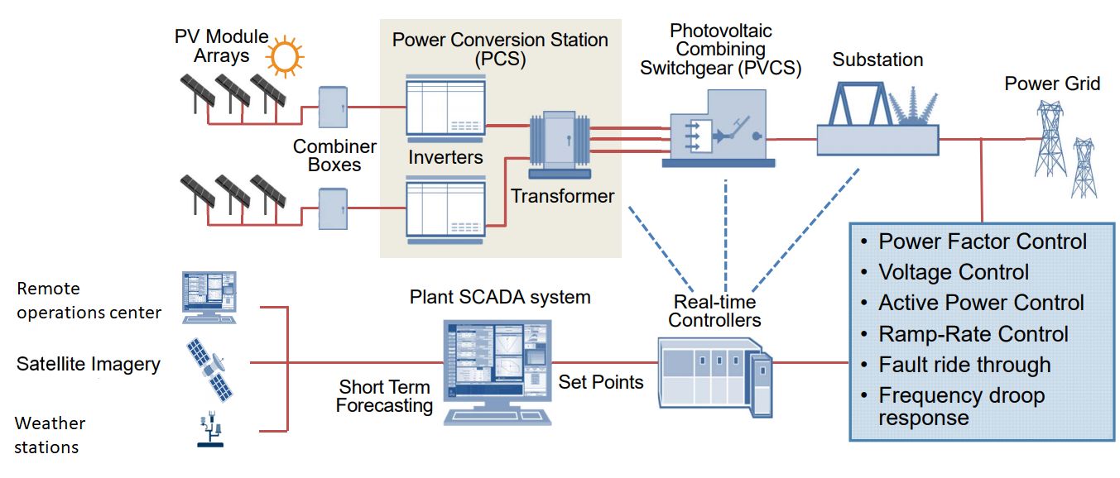
Grid connected PV system
SCADA-Supervisory control and data acquisition
Software, hardware, network and control subsystems
Controls the whole system to optimize power output
Minimize operation costs, maximize power production
It can also alarm irregularities and store data
Switchgear regulates output
Notes:
Coordinates for MPP is the coordinates of optimal current and voltage

Slide 7
Effects of PV Grid connected systems on a Distribution network
Reverse power flow: Net Production > Net Demand.
Overvoltage along distribution feeder: Reverse power flow leads to overvoltage along distribution feeder and protective device miscoordination
Voltage fluctuation: PV power output changes due to irradiation changes
Power Losses: If plant is far from the load.
Electromagnetic interference issues: Due to the high frequency converters.
Increased reactive power in grid: In PV system, inverters are openly operating at unity power factor to maximize active power generation. This reduces active power supply by the utility. However, reactive power is still same, thus, distribution transformer operate at low power factor and it reduces overall system efficiency.
Anti islanding: PV system needs to have anti islanding functions, which turns off the system when the grid is off to protect hardware like inverters (and workers in case of blackout).
Notes:
Anti-islanding features. Turns off the system during blackouts to prevent power going to the lines and potentially damage workers or the inverters

Slide 8
Challenges
Production is weather dependent and can’t be adjusted to meet the demand (compare to conventional energy sources)
No inertial power generation
The rest of the power system needs to be built around the unpredictable and irregular power production of solar (and wind), when their shares become big enough. Other systems like DR and storages need to provide flexibility and stability.
Intermittent nature and location
Environmental issues; Land degradation, habitat loss, hazardous materials
Notes:
As the share of RES becomes bigger, smart grid becomes absolutely necessary.

Slide 9
Conclusions
Solar power is highly variable and irregular. When the share of unpredictable renewable energy sources become big enough, smart grids becomes absolutely necessary
Inverters and SCADA have important roles in producing good quantities and quality of power
Irregular power production and peaks can lead to reverse power flow, overvoltage and voltage fluctuations

Slide 10
Source material used
Solar photovoltaics: current state and trends
https://iopscience.iop.org/article/10.3367/UFNe.2016.02.037703/meta
An overview of solar power (PV systems) integration into electricity grids
https://www.sciencedirect.com/science/article/pii/S2589299119300576?via%3Dihub
Snapshot of global PV market
https://iea-pvps.org/snapshot-reports/snapshot-2022/
Fahrenbruch, R. Bube, Fundamentals of solar cells: photovoltaic solar energy conversion, Elsevier, p. 1-25, 2012
Performance of grid-tied PV facilities based on real data in Spain: Central inverter versus string system
https://www.sciencedirect.com/science/article/pii/S0196890414006128
Impact of Reverse Power Flow Due to High Solar PV Penetration on Distribution Protection System
https://link.springer.com/chapter/10.1007/978-981-16-9033-4_1

