Slide 1
ELEC-E8423 - Smart Grid Supergrids
Antonin Canal
Julian Bratzke
18.04.2023

Slide 2
Introduction
What are Supergrids?
How are Supergrids realized?
Benefits & Challenges
Current Supergrid Solutions & Projects
Future Supergrid Solutions & Projects
Conclusion
18.04.2023

Slide 3
What are Supergrids?
Large technical Infrastructures for creating interconnections of countries and continents
Interconnect large and especially various power systems
Mainly based on HVDC Technology
They could be one solution for preventing Energy shortage and accelerating the energy Transition
18.04.2023

Slide 4
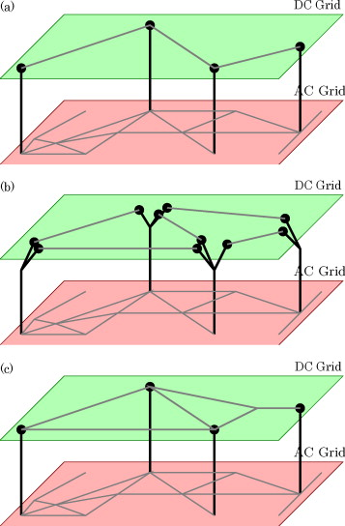
How are Supergrids realized?
HVDC with a voltage of +500kV or UHVDC with +800kV
Advanced HVDC Technology
a) Single DC line and multi-terminal AC-DC interconnection
No redundancy
b) AC terminals and independent DC grid
Simple to utilize existing HVDC lines in new DC grid
c) Meshed DC grid and multi-terminal AC-DC interconnection
More reliable than the single DC line system
18.04.2023

Slide 5
Benefits
Challenges
Provides the possibility to transfer electricity for long distances without much losses with HVDC lines
Dependence of climate conditions for renewables leads to large distances between generation demand
Solution to fight climate change and integrate renewables energies
Provides flexibility and reliability for power systems
Large volume
Reduces the probabilistic effect of renewables
High investments costs
Challenges in technical constraints:
DC/DC converters
DC breakers
Political and economic arguments:
Who owns and pays the grid?
Challenges in national energy regulations and technical specifications:
Voltage quality
Power balance
18.04.2023

Slide 6
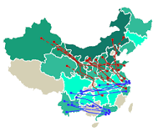
Current Supergrid Solutions & Projects
Development of new circuit breaker and converter technology for HVDC-lines to form a flexible power grid.
China is the leading country for development of UHVDC transmission network. The transition system at the moment comprises 50 000 km of UHVDC transmission lines and a transfer capacity of 170 GW. They are still planning to build more and more, for example, a 450 gigawatts line of wind and solar power capacity from the Gobi desert by 2030.
India & ABB have built an 800 kV UHVDC network from Central India to South India. The transmission line is 1830 km long and serves about 80 million people’s electricity needs. The aim is to transmit wind power from South India to the exceed energy demand in the North and transmit thermal power from North India to South India.
18.04.2023

Slide 7
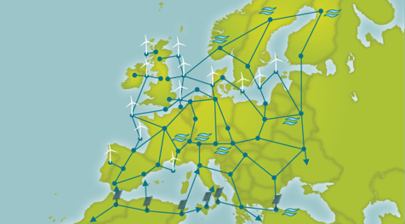
Future Supergrid Solutions & Projects
Supergrids voltage loss problems could be reduced by integrating Hydrogen distribution to the Supergrid to cool transmission cable with liquid hydrogen pipeline.
The Asian Supergrid: Project to establish an electrical power transmission network connecting China, South Korea, Taiwan, Mongolia, Russia, and Japan.
European Supergrid: Future project to interconnect the various European countries with a HVDC-power grid to transit and share energy from renewable energy sources.
18.04.2023

Slide 8
Conclusions
Major objective of Supergrids is to answer the global energy transition by transmitting renewable energy intercontinentally with the aim of improving the electricity supply, while achieving carbon neutrality.
Energy transition requires crucial modifications to the transmission system and Supergrids could be the answer.
Implementing Supergrids is possible in the future but it needs cooperation between different nations and technology companies.
18.04.2023

Slide 9
Thank you for your attention! Questions?
18.04.2023

Slide 10
References
https://www.sciencedirect.com/science/article/pii/S2211467X21000444
https://www.hitachienergy.com/news/press-releases/2021/07/hitachi-abb-power-grids-commissions-groundbreaking-uhvdc-project-in-india
https://www.economist.com/the-economist-explains/2017/01/17/what-is-a-supergrid
https://www.irena.org/-/media/Files/IRENA/Agency/Publication/2019/Sep/IRENA_Supergrids_2019.pdf?la=en&hash=4C6639C08B1BEC582B700609C6D3C3B2E126AE70
https://assets.kpmg/content/dam/kpmg/ie/pdf/2018/07/ie-super-grids-making-the-right-connections-for-a-sustainable-future.pdf
https://www.climatechangenews.com/2022/03/09/china-plans-huge-wind-and-solar-power-rollout-in-gobi-desert/
https://publications.parliament.uk/pa/cm201012/cmselect/cmenergy/1040/104005.htm
https://www.wiley.com/en-us/HVDC+Grids%3A+For+Offshore+and+Supergrid+of+the+Future-p-9781118859155
https://people.montefiore.uliege.be/ernst/uploads/news/id140/Global_Grid_RENE_final.pdf
18.04.2023

