Slide 1
ELEC-E8423 – Smart Grid Future Street Lights (FSL)
Jaan Rönkkö
Anna Laaksonen
28.03.2023

Slide 2
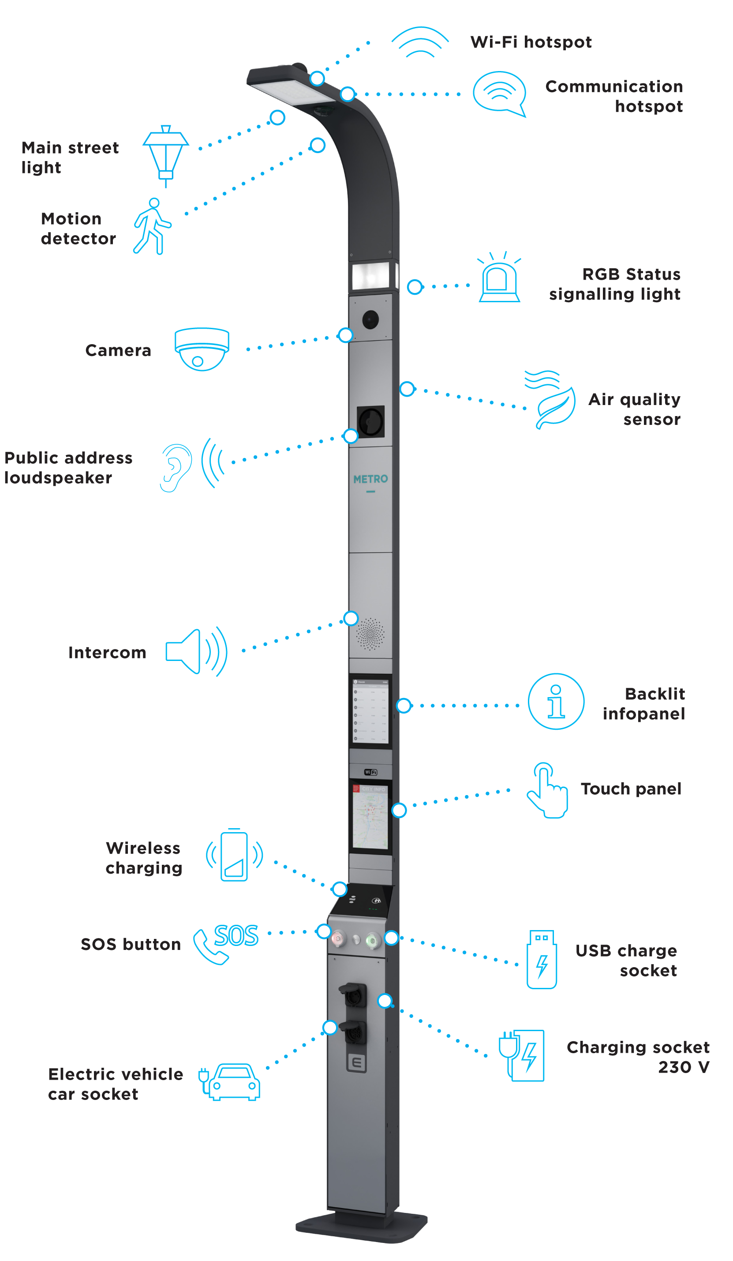
Introduction
The goal of smart street lighting is to optimize the problem of power consumption and illumination of the streets [1]
As street lights are powered throughout the night, a lot of power is wasted
Huge potential for improvements in emissions reductions and cost savings
Future street lights allow interaction with users and the city infrastructure
Street lighting serves as a major information gateway
IoT = Internet of Things
Enables many smart city applications
It is predicted that 89% of the planet’s 363 million streetlights will have adopted LED technology by 2027 [2]

Slide 3
The bigger picture of FSL
Energy savings up to 80% [3]:
(1) Smart dimming during quiet periods
(2) Replacing with LED lamps (not today's topic)
More data:
(3) Quick maintenance
(4) Road safety

Slide 4
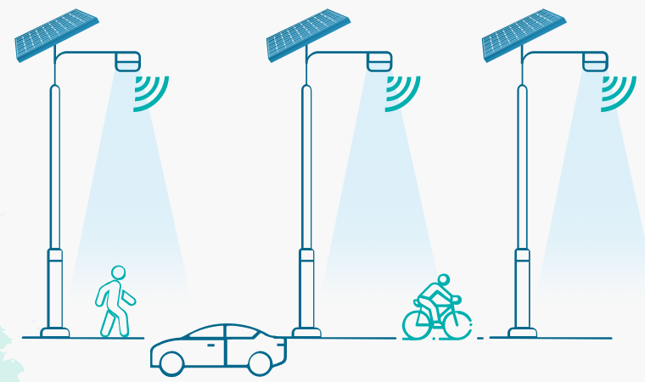
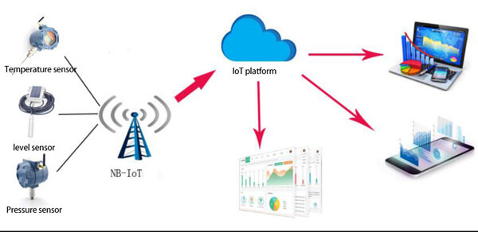
FSL for traffic in two parts
(1) Sensors (LOCAL TRAFFIC DATA)
Detect -> microcontroller -> dimmer
(2) Internet of Things (DATA TO SYSTEM)
Sensor -> transmitter -> web-monitor

Slide 5
Sensors are the Game Changer
Measures:
Light
Motion
Driving conditions
Other sensors
Allows:
Remote monitoring
Timed dimming
Maintenance alert
Emergency alert

Slide 7
Internet of Things
Possibly uses two channels [3]:
(1) Between lamps (for dimming)
ZigBee
Bluetooth
(2) Between the monitoring system and lamps
Wi-Fi
3G / 4G / 5G

Slide 8
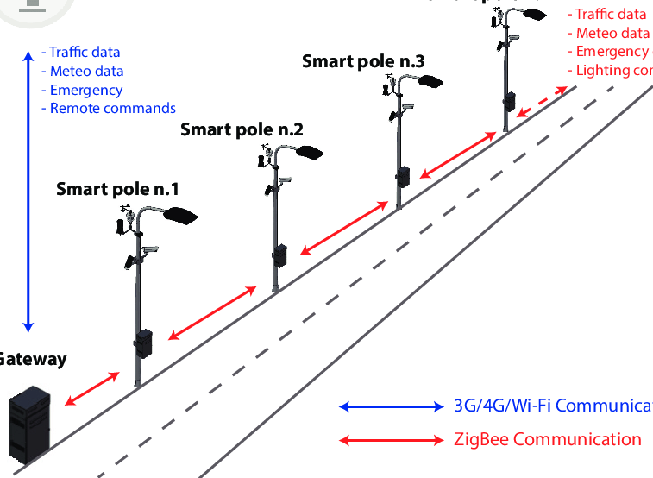
Image: https://www.researchgate.net/publication/346921017_Advanced_Adaptive_Street_Lighting_Systems_for_Smart_Cities

Slide 9
More advantages of FSL
(1) Remote Monitoring
Less physical maintenance [4]
Reduced downtime [4]
More data
(2) Additional safety (e.g. bad weather or car accident)
Add lighting [4]
Lower the local speed limit using IoT [4]
(3) Less light pollution

Slide 10
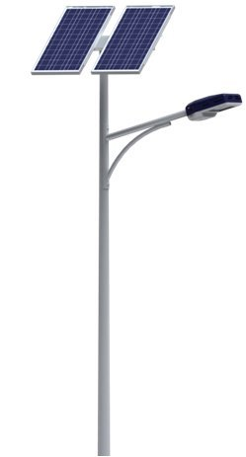
Smart solar street lighting
Solar-powered street lights are entering the market and becoming more popular
Benefits of solar street lights [5]:
Cost-effectiveness –> low operation and maintenance costs
Do not require electrical wiring or connection to a power source
--> ideal for remote areas where electricity is not available or is unreliable
Do not require any fossil fuels to operate
--> do not emit any greenhouse gases

Slide 11
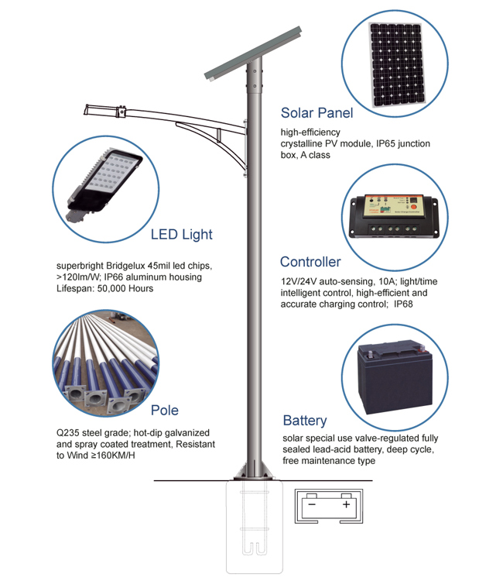
Solar street lighting – key technology
Solar street lights use solar cells to convert sunlight into elecricity, which is then stored in batteries for use at night
At night, the controller activates the LED lamps
Solar street lights typically consist of:
A solar panel
A battery
A controller
One or more LED lamps

Slide 12
Challenges and threats
In considering the networked devices in a smart city such as streetlights, traffic lights, sensors, and more, security is a foremost concern
Multiple cyber-security challenges (e.g. denial of service or unauthorized control) [6]
Lack of security standardization and regulation in IoT devices [6]
Posing potential threats to the system security and households
The public's lack of sense of safety and trust to use such networked cyber-physical systems [6]

Slide 13
Conclusions
Smart street lights, composed of LED lights with networking components and sensors, are a key member of smart cities
Allows a wide range of data to be collected
Great potential to reduce costs and emissions
Enhances public safety
Motivates many innovative smart applications
Large-scale deployment of street lights and related smart city applications requires strong technical foundations and guidance of cyber-security [6]

Slide 14
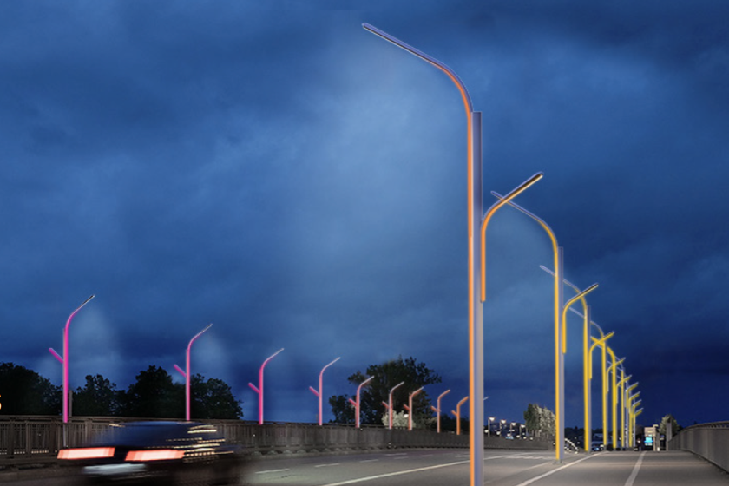
Thank you!
Thank you!
Image: https://www.google.com/url?sa=i&url=https%3A%2F%2Fwww.latimes.com%2Fentertainment-arts%2Fstory%2F2020-09-03%2Fla-new-streetlight-design&psig=AOvVaw2f_8Hv6shDCZaiM4xKjUsV&ust=1679943472309000&source=images&cd=vfe&ved=0CBAQjRxqFwoTCLivsKGj-v0CFQAAAAAdAAAAABAO

Slide 15
Source material used
[1] https://ieeexplore-ieee-org.libproxy.aalto.fi/document/6757123
[2] https://designinglighting.com/2021/11/15/street-lighting-the-future-is-smart/
[3] https://www.sciencedirect.com/science/article/pii/S2405844021024324
[4] https://intelilight.eu/smart-street-lighting/
[5] https://www.gsma.com/iot/wp-content/uploads/2017/03/Smart-Street-Lighting-Case-study-webv1.pdf
[6] https://www-sciencedirect-com.libproxy.aalto.fi/science/article/pii/S1040619016302172

