Slide 1
ELEC-E8423 - Smart Grid Deep heat energy wells for ground source heat pump systems
Markus Kanerva
Juho Laine-Ylijoki
21.3.2023

Slide 2
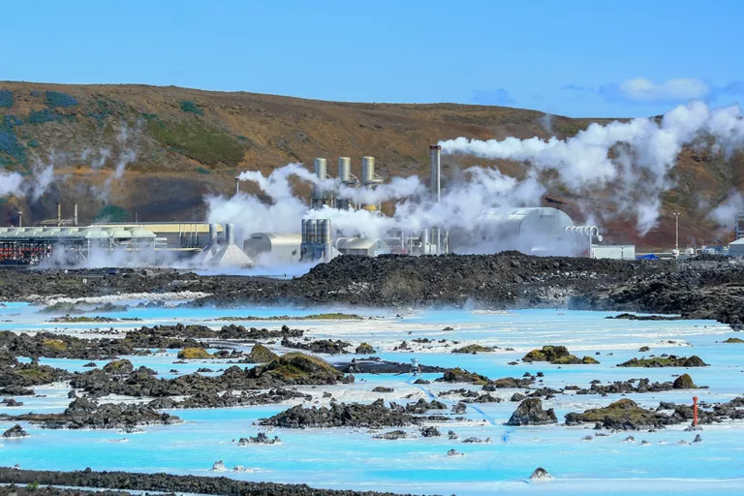
Motivation
Increasing amounts of renewable electricty is pushing the electrification of heating sector, and heat pumps are recognized as a critical technology. [1]
Deep heat energy wells connected with heat pumps could provide a solution which utilizes natural clean energy source.
With deep heat energy well, we mean approximately 1-3 km deep wells. This is compared to the state-of-art commercial geothermal wells which are about 50-400m deep. [2]
With deep wells, we could extract more heat from a smaller area.
Geothermal plant in Blue Lagoon, Iceland​ [3]

Slide 3
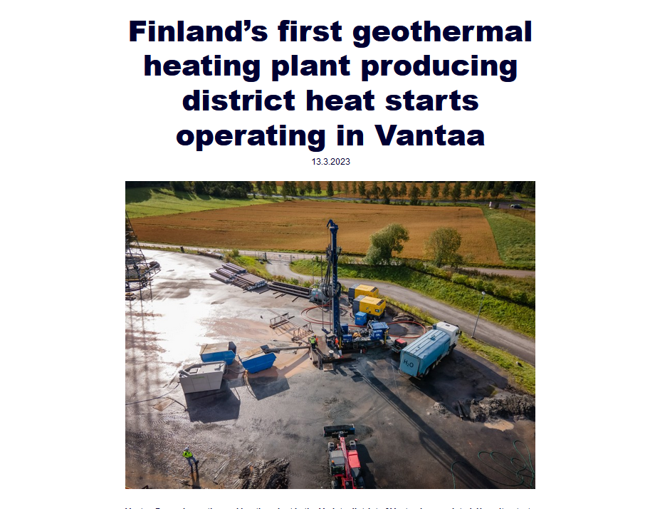
Geothermal Energy in General
Originates from nuclear reactions in the rock, radioactive decays and magma inside earth. [2]
Available basically everywhere on earth. Does not cause pollution but requires power to extract. [2]
Way of utilization depends on geological conditions. [2]
Heat pump needed where ground is colder
In Finland, 6-7km deep wells needed for direct harnessing
Water circulation necessary for dry areas
Vantaan Energia’s deep heat project in Varisto. [4]

Slide 4
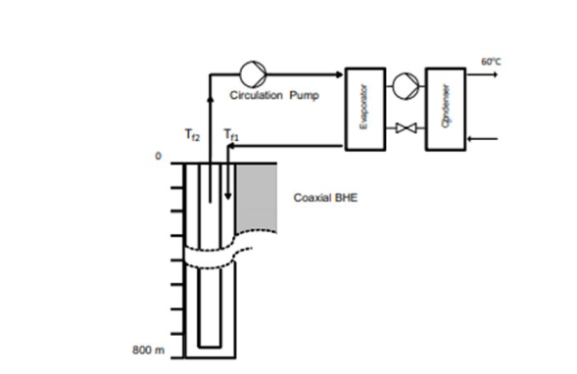
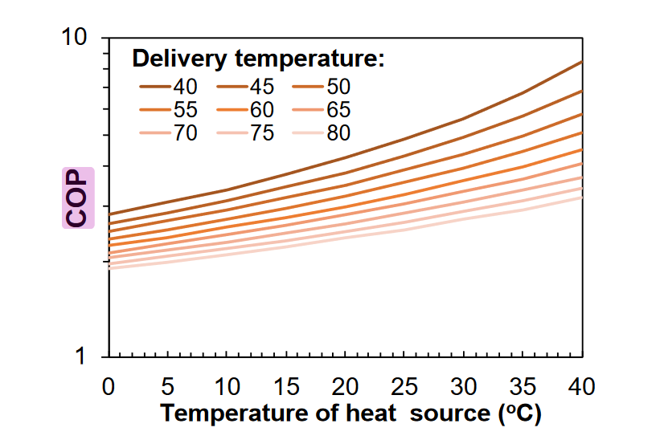
Operation Principle of a Deep Heat Energy Well
Basic components
Heat exchanger
Coaxial pipe
U-tube collector
Heatpump
COP-value 4 – 6
Coaxial system
Allows higher massflow rates
Reduces thermal short circuiting
Illustration of deep heat energy well. [2]
COP of system [2]
Notes:
The overall efficiency of the plant is really good, the COP value is usually between 3 and 6. The COP value tells us how many units of energy we get out of the plant if we use 1 unit of electricity. In this case the efficiency would be 300 to 600 percent.
The collector pipes are the main ground breaking technology that enables these kinds of plants. Some of you may currently live in ground heated apartment, which has collector pipes somewehere around 300 meters below ground. In deep heating systems they go much further, from 1 to some cases even 10 kilometers deep into the bedrock. The collector pipe diameter is around 15 - 30 cm. There are two main collector types, coaxial and U-tube. Coaxial pipes are usually used in deeper holes, which we are talking about today and u-tube is seen in shallow geothermal projects, where the collector pipes are drilled 300 meters below ground. Iiro Will tell you more about the collector pipers next.

Slide 5
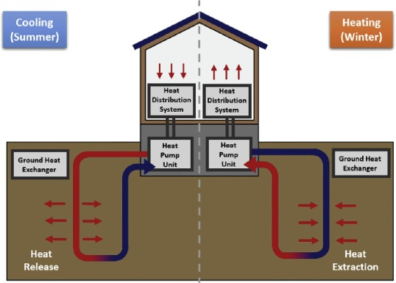
Charging and Discharging in a Deep Heat Well
Stable operation of a deep heat well [5]
Extracted energy from the well over the year must equal the transferred energy into the well
Imbalance of the system leads to decreased efficiency
Ground acts as a seasonal heat storage [5]
Storing excess heat during summer
No transportation costs
No storage costs
Sustainable [5]
Natural charging
Charging using excess heat from a heat sink
Ground Source Heat Pump (GSHP) operated using renewable energy sources
Seasonal cooling and heating
Notes:
The giant storage can also be recharged relatively easily. All newly built residential and commercial buildings must have heat recovery systems installed, which collect the waste heat that would otherwise be lost via ventilation. Usually these systems are in place to increase the overall thermal efficicency of a building and go unutilized during summer time when heating isnt needed. With geothermal solutions the heat recovery can be used to direct the waste heat back into the ground to recharge the ground. This combined with the continous radioactive decay, which heats the ground naturally, makes deep heating renewable.
Lastly, rechargingopens an option to use geothermal to cool down the buildings, which in a way solves 2 problem in once. Cooling can be achieved by switching the direction of the liquid inside the collector pipe during summer.
I want to say a few words about sustainability. Some of you may have a question, if the core of our planet could cool down from excess usage of geothermal solutions. Its a fair point in local sense, as the ground can cool down around the collector pipe faster than the natural heat dissipation and nuclear decay could heat it up. This can be avoided by measurements and planning so we dont build too many collector pipes in one area. Even if the area happens to get depleted from heat, it would be only a problem in a small area, which will eventually heat up again. Globally the heat is regerating at a rate of 30 terawatts, which is more than double the current total energy consumption around the world. Geothermal heating is overall really safe and causes no pollutants during the production of energy, as long as the electricity used in the pumps is produced renewably. For example, the plant can power itself once it is started.

Slide 6
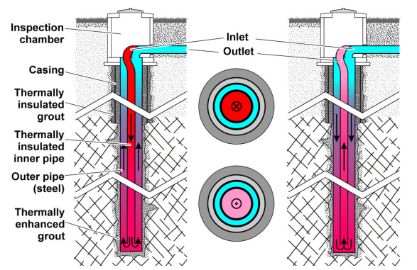
Borehole Heat Exchanger (BHE)
Charging Phase [5]
Hot water injected into the BHE to heat up the reservoir
Working fluid injected to the bottom of the borehole in an insulated inner pipe
Extraction Phase [5]
Cold water pumped into BHE to retrieve stored thermal energy from the hot formation
Cold fluid into the outer pipe to utilize the borehole wall as a heat exchanger
Heated water circulated back in the insulated inner pipe to reduce heat losses

Slide 7
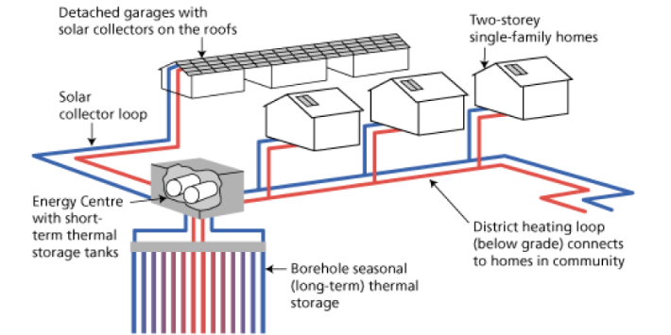
Deep Heat Energy Well as a Heat Storage
High thermal capacity of the ground [5]
Low thermal conductivity of the surrounding rock [5]
Can be constructed almost everywhere [5]
Neither naturally occuring thermal aquifer systems or special geological structures needed
Negligible groundwater flow at reservoir depth required
Storage efficiency can reach up to 80 % [6] [7]
Presence of groundwater flow can reduce the efficiency 10-13 %

Slide 8
Ground Source Heat Pumps in a Smart Grid
Increased flexibility in a smart grid [8]
Using deep heat energy wells as thermal energy storages
Heat demand management from GSHP combined with the thermal mass of the building
Use of GSHP for voltage control and congestion management
Efficient Power-to-Heat application [9]
Allow for more integration of renewable energy sources into the system
Decrease fluctuations and peaks both in electricity and heat demand
Reduced need of peak power plants [8]
Providing electricity reserves for a grid [8]

Slide 9
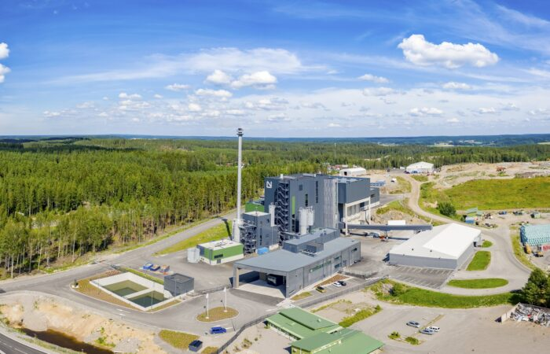
Case QHeat
A Finnish technology company that develops geothermal technology and drills medium-deep geothermal wells [10]
Drilled thermal wells approxiamtely 1-2 km deep, Temperatures: 30-40 degrees
Use of thermal energy of the soil for heating and cooling
Thermal wells also suitable for energy storage
Technology based on coaxial flow of water
Reducing carbon dioxide emissions of properties by 95 % compared to fossil fuels [10]
Projects [11]
Niittykumpu, Espoo: Completion in January 2023, 4 Heat energy wells
Lounavoima, Salo: Project still ongoing, Up to 6 Heat energy wells
Martinlaakso, Vantaa: Completion in January 2023, 4 Heat energy Wells

Slide 10
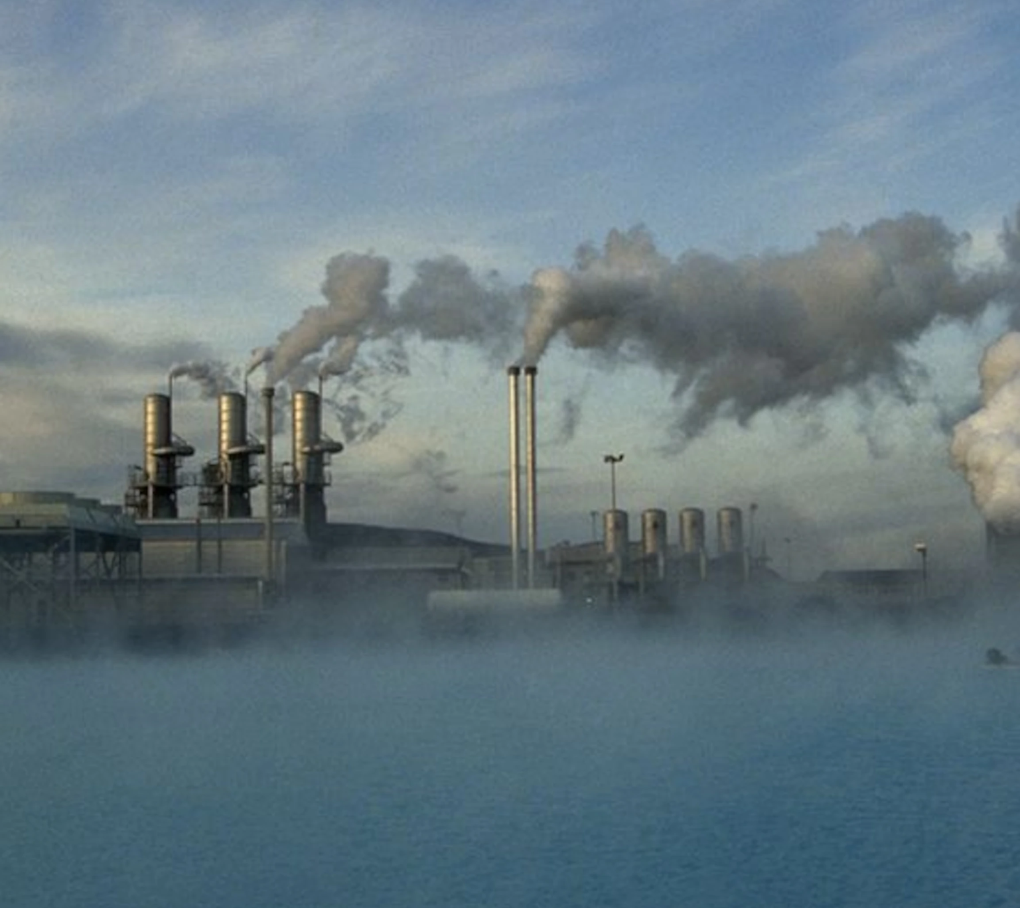
Conclusions
Availability depends on geological conditions
In Finland, heat pumps are needed to increase the temperature.
Components
Coaxial pipe is preferred in deep wells.
Charging and discharging
Balance of the system
Use of deep heat energy well as energy storage
High efficiency and high thermal capacity
Smart grid
Increased flexibility
Allow for more renewable energy integration
Vantaan Energia’s deep heat project in Varisto.

Slide 11
References
[1] IEA. 2022. Heat Pumps. Available at: https://www.iea.org/reports/heat-pumps
[2] Lund, A. 2019. Master thesis. Analysis of Deep Heat Energy Wells for Heat Pump Systems.
[3] Treehugger. 2022. What is Geothermal Energy?. Available at: https://www.treehugger.com/what-is-geothermal-energy-5105305
[4] Vantaan energia. 2023. Finlands first geothermal heating plant productn district heat starts operating in Vantaa. Available at: https://www.vantaanenergia.fi/en/finlands-first-geothermal-heating-plant-producing-district-heat-starts-operating-in-vantaa/
[5] Bär et al. 2015. Seasonal high temperature heat storage with medium deep borehole heat echangers. 10.1016/j.egypro.2015.07.841
[6] Nguyen et al. 2017. Borehole thermal energy storage systems under the influence of groundwater flow and time-varying surface temperature. 10.1016/j.geothermics.2016.11.002
[7] Welsch et al. 2018. Environmental and economic assessment of borehole thermal energy storage in district heating systems. 10.1016/j.apenergy.2018.02.011
[8] Fischer & Madami. 2017. On heat pumps in smart grids: A review. 10.1016/j.rser.2016.11.182
[9] Carvalho et al. 2015. Ground source heat pumps as high efficient solutions for building space conditioning and for integration in smart grids. 10.1016/j.enconman.2015.07.032
[10] Qheat. Etusivu. Available at: https://www.qheat.fi/fi/etusivu/
[11] Qheat. Projektit. Available at: https://www.qheat.fi/fi/projektit/
[12] Vantaan energia. 2020. Construction of Vantaa Energy’s geothermal heating plant started. Available at:
https://www.vantaanenergia.fi/en/construction-of-vantaa-energys-geothermal-heating-plant-started/

