Slide 1
ELEC-E8423 - Smart Grid Electric Buses and Their Charging Solutions
Miku Männistö
25.4.2023

Slide 2
Introduction
The benefits
Implementation barriers
Range anxiety
Charging
High cost
Conclusions
This presentation focuses on battery electric buses (BEB) and their operation in the Helsinki region
(Esa Niemelä 2019)

Slide 3
The Benefits
Efficiency
Lower operation costs
Not dependent on oil (energy security)
No tailpipe emissions
Very low life cycle emissions compared to traditional ICE buses if green electricity is used
Passenger comfortability
Less noise and vibrations
…but nothing good without something bad…

Slide 4
Implementation Barriers
Range anxiety: driving range on average only 280 km
Cold winters are a huge issue in Finland
Driving style has an impact on consumption and thus available range
Logistic issues with charging
Charging times need to be considered in the timetables – what if the bus is running late?
Charging stations are not always interoperable
Batteries are still costly which results in high investment costs

Slide 5
Range Anxiety: Weather Conditions
Range reduction in freezing temperatures up to almost 40 %
Consumption when below freezing is 40…45 % higher than in the summer according to a case study done in Tampere
Not only does the battery have a lower charge capacity, heating uses energy too
Cooling uses considerably less energy than heating
(Image courtesy of HSL)

Slide 6
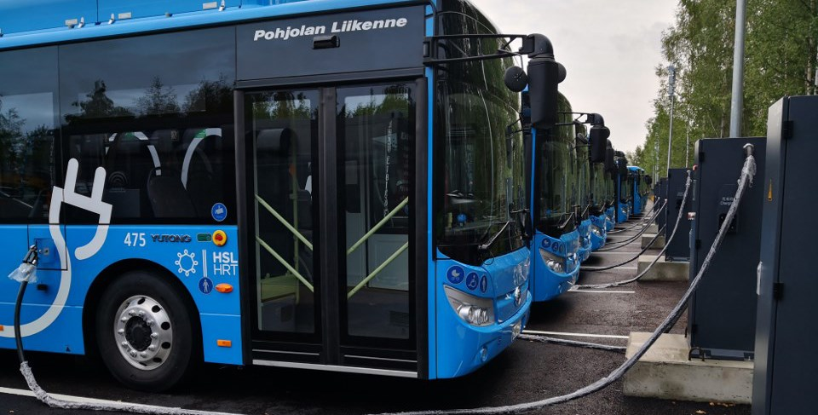
Charging: Current Solutions
Slow and fast plug-in charging, pantograph charging, wireless charging
HSL charges buses during the night at the depot and during the day at terminus
Newer buses are required to run for 4 hours with one battery charge
Long charging times or infrastructure too sparse
High energy demand affects the grid
Negatively: demand peaks, harmonics
Positively: better power management, renewables
(Image courtesy of HSL)

Slide 7
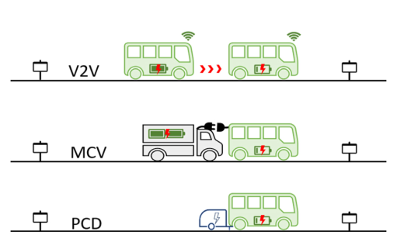
Charging: The Future?
Vehicle-to-Vehicle
Mobile Charging Vehicle
Portable Charging Vehicle
(Zeng 2023)

Slide 8
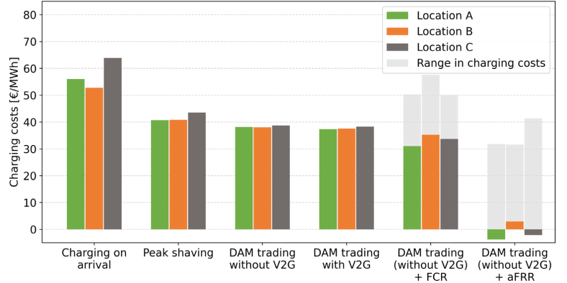
High Costs: Ancillary Services
The buses act as an energy storage and can participate in day ahead trading or frequency reserve markets
Savings in charging costs and even negative costs possible with aFRR
(Fei 2023)

Slide 9
Conclusions
Current charging solutions are heavily grid dependent and can cause negative impacts such as demand peaks and harmonic pollution on the power grid
Future charging solutions could be wireless and en route
Electric buses can serve as an energy storage and bring additional revenue by selling electricity back to the market when the price is high

Slide 10
Source material used
Brinkel, N. & et. al. A comparative analysis of charging strategies for battery electric buses in wholeshale electricity and ancillary services markets. Transportation Research Part E. 2023, vol. 172. Available at: doi:10.1016/j.tre.2023.103085
Fei, F. & et. al. Exploring the profitability of using electric bus fleets for transport and power grid services. Transportation Research Part C: Emerging Technologies. 2023, vol. 149. Available at: doi:10.1016/j.trc.2023.104060
Rodrigues, A. L. P. & Seixas, S. R. C. Battery-electric buses and their implementation barriers: Analysis and prospects for sustainability. Sustainable Energy Technologies and Assessments. 2022, vol. 51. Available at: doi:10.1016/j.seta.2021/101896
Vehviläinen, M. & et. al. Setting Up and Operating Electric City Buses in Harsh Winter Conditions. Applied Science. 2022, vol. 12. Available at: doi:10.3390/app12062762
Zeng, Z. & Qu, X. What’s next for battery electric bus charging systems. Communications in Transportation Research. 2023, vol. 3. Available at: doi:10.1016/j.commtr.2023.100094
https://www.hsl.fi/en/hsl/electric-buses

