Slide 1
ELEC-E8423 - Smart Grid Compressed Air Energy Storage (CAES)
Eetu Keino and Phong Nguyen
07.03.2023

Slide 2
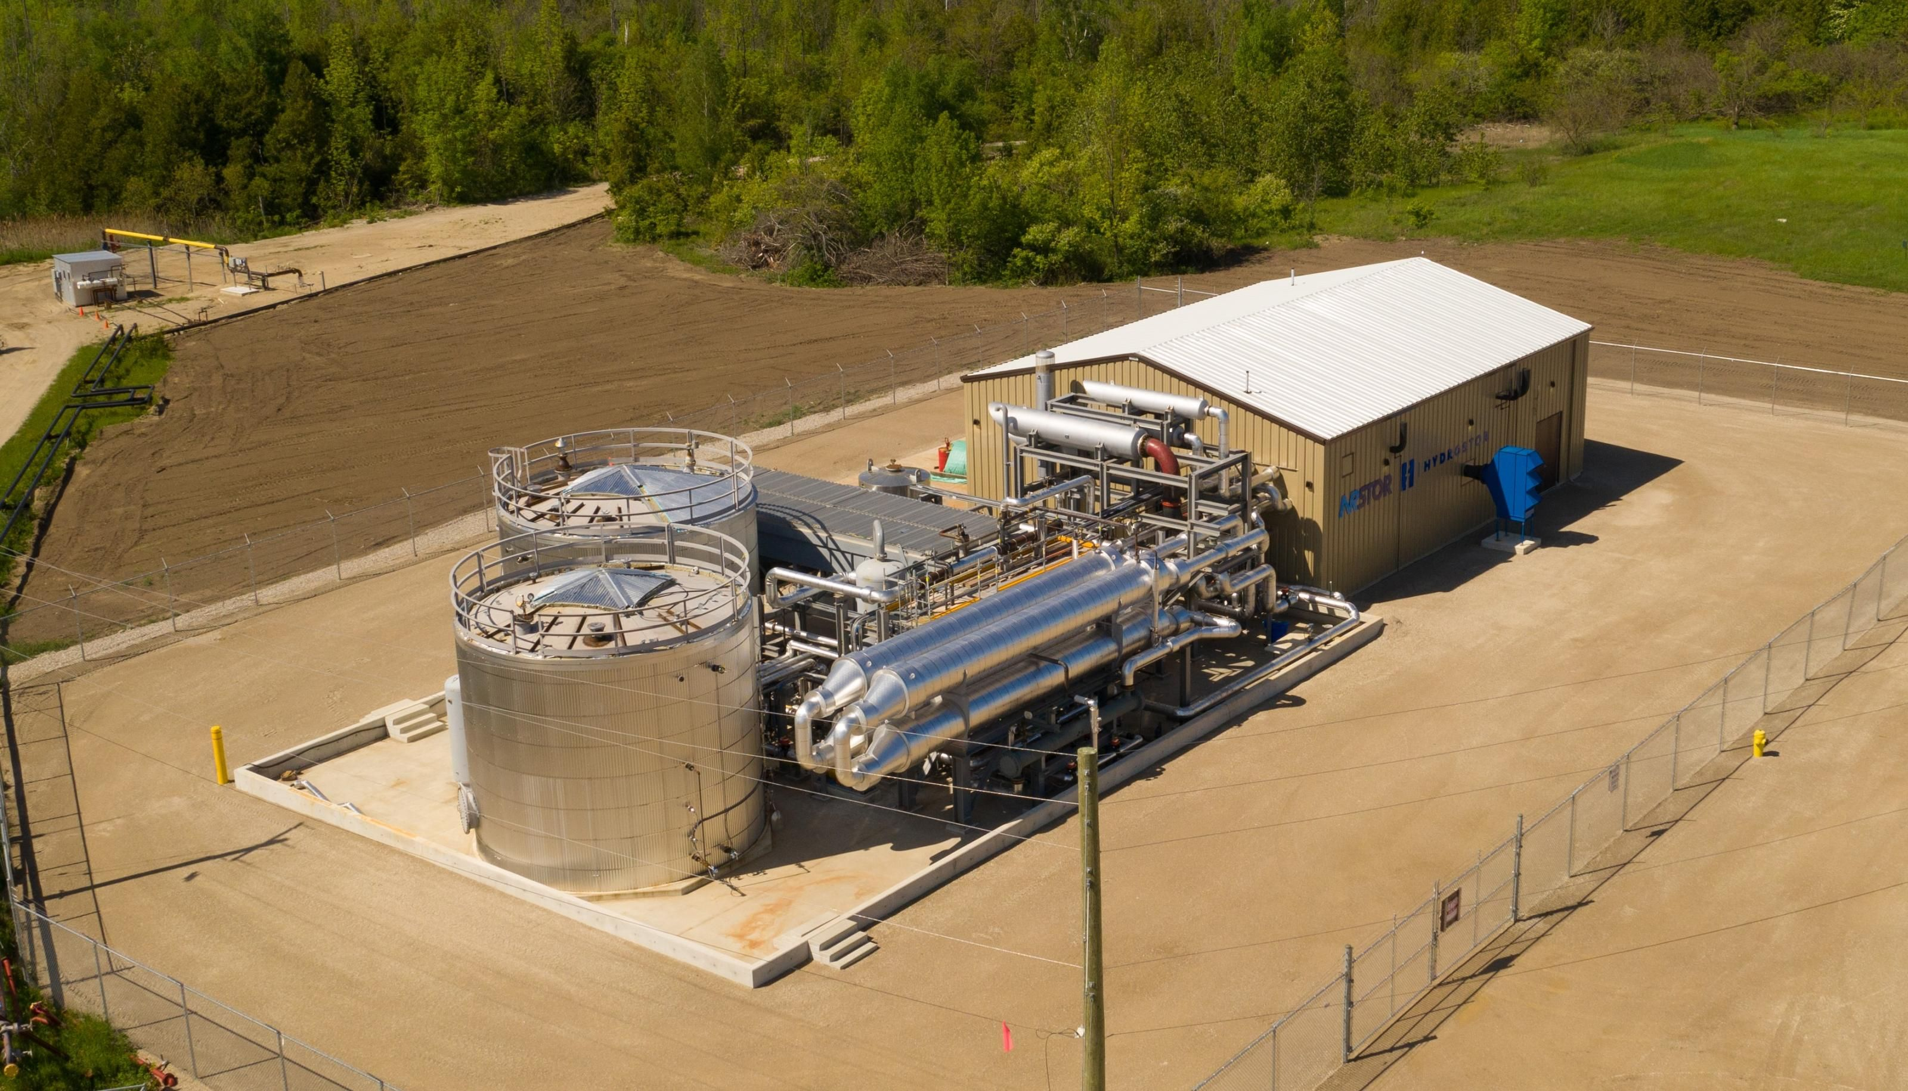
Introduction

Slide 3
Outline
History
Fundamental aspects of CAES
Technical specifications
Suitability
Economics
SWOT analysis

Slide 4
History
Concept was found in early 1940’s by F.W. Gay
Was not utilized until late 1960’s, due to lack of storage need in grids
First notable CAES built in Huntorf, Germany in 1978.
Biggest CAES by storage capacity is McIntosh CAES plant with size of 2860 MWh
Research and development in Europe started in early 2000’s
Biggest CAES Bethel Energy Center in Texas (output of 317 MW, capacity 16 000 MWh) by 2025

Slide 5
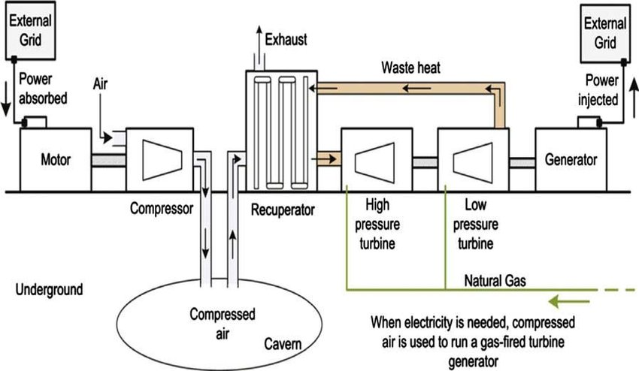
Fundamental aspects of CAES

Slide 6
Technical specifications and comparison
Storage type | Energy density (Wh/dm³) | Power rating (MW) | Storage duration | Lifetime of storage | Discharge time | Cycles
CAES | 2-6 | >300 | Hours to months | 20-40 years | 1-24 hours | 10 000
PHS (Pumped hydro storage) | 0.5-2 | 30-5000, dependent on height | Hours to months | 40-60 | 1-24 hours | 10000-30000

Slide 7
Suitability
Where?
Underground salt mines, hard rock caves, or porous caverns.
When?
Integration of variable renewable energy (VRE)
Demand Side Management
Smart Grid

Slide 8
Economics
Power capital cost ($/kW) | Energy capital cost ($/kWh) | O&M cost | Cost for power related components | Cost for energy storage related components
400-1000 | 2-120 | 0.003 $/kWh 19-25 $/kW/year | 350 $/kW | Salt cavern: 1 $/kWh Hard rock cavern: 30 $/kWh
CAES are costly projects, but the advantages such as negligible losses, high capacity and low cost per kWh makes it lucrative energy storage system, if the cavern already exists for it.

Slide 9
SWOT Analysis
Strenghts: CAES has a high generation capacity and high storage
capacity, with low cost/kWh.
Weaknesses: Very dependent on location, requires a cavern that either
has to be a natural cavern or a built one. Usually not beneficial to build a
cavern, since it costs so much.
Opportunities: Future possibility of Advanced Adiabatic CAES (AA-CAES),
which does not require any fuel (natural gas) to heat up the air, since it
has a separate thermal storage that can be used during expansion.
Threats: Dependent on natural gas as an energy source for re-heating
cooled air to the generator. Natural gas price is a major factor in the CAES
economics currently.

Slide 10
Conclusions
List three most important key points of presentation here
Suitable for long term applications of energy storing
High investment costs but low expenses in usage
Enables the usage of Smart Grid, when excess VRE can be stored to the CAES

Slide 11
Source material used
Hossain, Eklas & Faruque, Hossain Mansur Resalat & Sunny, Md. Samiul & Mohammad, Naeem & Nawar, Nafiu. (2020). A Comprehensive Review on Energy Storage Systems: Types, Comparison, Current Scenario, Applications, Barriers, and Potential Solutions, Policies, and Future Prospects. Energies. 13. 3651. 10.3390/en13143651
Wu, F. B., Yang, B., & Ye, J. L. (Eds.). (2019). Grid-scale energy storage systems and applications. Academic Press.
Wang, J., Lu, K., Ma, L., Wang, J., Dooner, M., Miao, S., Li, J., et al. (2017). Overview of Compressed Air Energy Storage and Technology Development. Energies, 10(7), 991. MDPI AG. Retrieved from http://dx.doi.org/10.3390/en10070991
Dehghani-Sanji, A.R & Tharumalingam, E. & Dusseault, M.B & Fraser, R. (2019). Study of energy storage systems and environmental challenges of batteries. Renewable and Sustainable Energy Reviews. Table 2, Available at: https://doi.org/10.1016/j.rser.2019.01.023
https://www.researchgate.net/profile/Dirk-Van-Hertem/publication/237327418_SWOT_analysis_of_utility-side_energy_storage_technologies/links/00b7d5299f8787d923000000/SWOT-analysis-of-utility-side-energy-storage-technologies.pdf
http://www.apexcaes.com/bethel-energy-center

Slide 12
Thank you for your interest

