Slide 1
ELEC-E8423 - Smart Grid 6. Pumped Hydro Energy Storage
Oskari Kettunen
Klaus Moilanen
07.03.2023

Slide 2
Introduction
This kinds of storage system technology stores the energy in the potential energy of water mass
Round trip efficiency is around 70-85 %
Usual storage capacity is around 1000-1500 MW
Worldwide there has been 180 GW installed, which is approximately 95 % of all energy storage installed
Notes:
-Pumped hydro storage system stores energy in water mass via potential energy

Slide 3
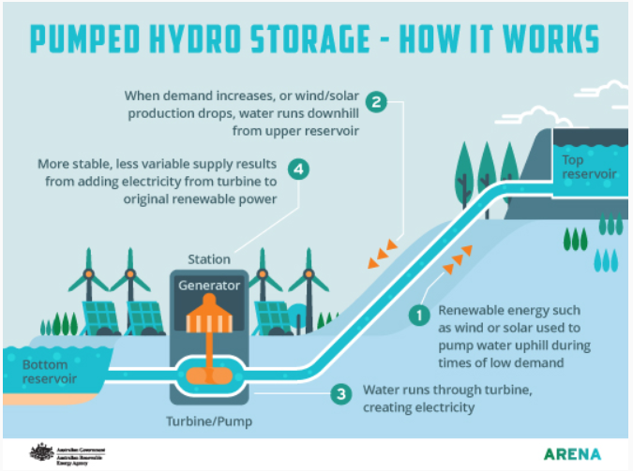
Notes:
-1. Renewable energy such as wind or solar energy is used to pump water from the bottom reservoir uphill to the top reservoir during times of low electricity demand
-2. when electricity demand increases, or wind and solar production drops, water runs downhill from the upper reservoir
-3. water runs through the turbine and creates electricity

Slide 4
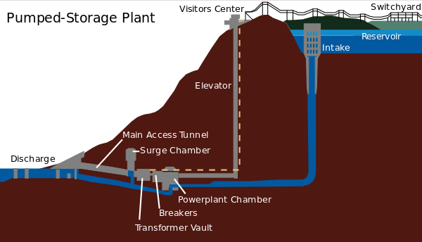
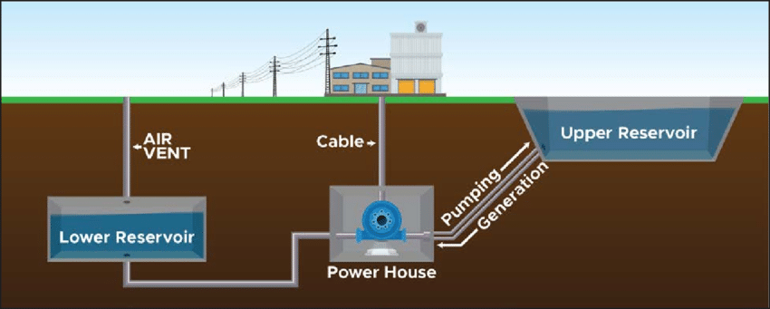
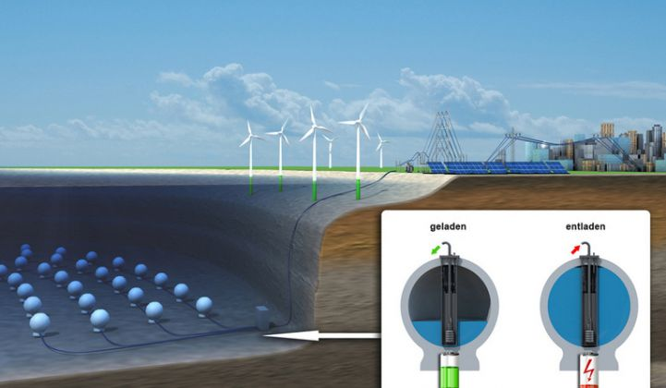
Storage technologies
Pumped storage plant on the surface
The most common in use
Requires high elevation difference
Plant size can be over 3000 MW
Underground reservoirs
Usually used in unused underground facilities, such as mines
Usable in flat regions
Underwater reservoirs
Usage of pressure at the sea bottom
When power is needed, water is let in
When there is an electricity surplus, water is pumped out
Notes:
-Pumped hydro storages have 3 different technologies: Pumped hydro storage plant on the surface, underground, or even underwater
-charge and discharge
-Then Oskari continues with the advantages and disadvantages of pumped hydro storage systems

Slide 5
Advantages and Disadvantages
+ Advantages
Has long asset life anywhere from 50 to 100 years
Simple and reliable technology
Helps integrate renewable energy
Easy energy balancing
Good round trip efficiency
- Disadvantages
High capital costs
Geographical limitations
Elevation between the two reservoirs
Large size of one storage system
Environmental ones
Notes:
The environmental impact of PHES primarily relates to flooding of land within the reservoirs. If the reservoirs are located in a river valley then environmental impacts are likely to be more severe than for an off-river system located away from rivers. Other environmental impacts include construction of roads, pipes or tunnels for water conveyance, a powerhouse and switchyard, and high voltage transmission lines. Since there are far more potential off-river than on-river sites it is much easier to choose an off-river site that minimizes environmental impact.

Slide 6
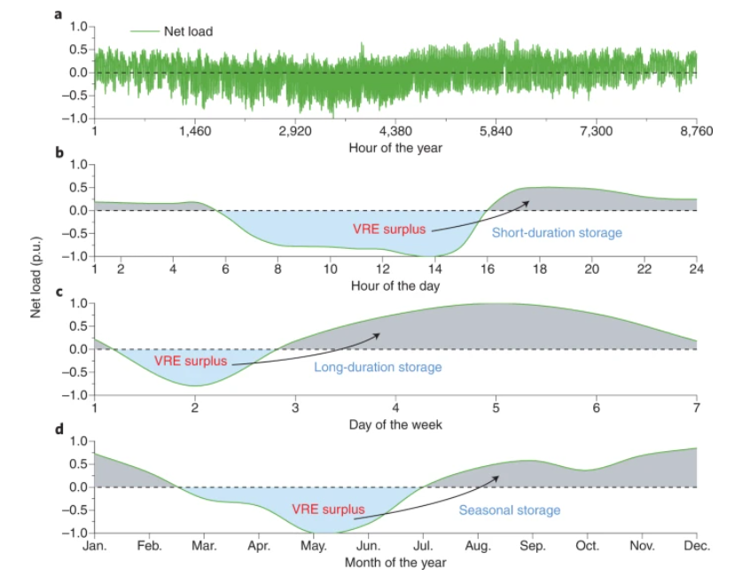
Applications
Energy storing
Long- and short-term storage
Energy balancing
Balance high load peaks and unexpected loads
Large emergency reserve

Slide 7
Conclusions
Pumped hydro energy storage comprises roughly 95% of installed global storage power capacity
Simple and reliable technology
With developments in new technology, it could bring much easier access to non-mountainous regions

Slide 9
References
https://arena.gov.au/blog/what-is-pumped-hydro-and-how-does-it-work/
Koohi-Fayegh and Rosen, 2020, A review of energy storage types, applications and recent developments.
https://i.pinimg.com/originals/e4/f8/6c/e4f86c4c39c75a624f8f824e31703ff0.jpg
https://www.researchgate.net/figure/Conceptual-diagram-of-an-underground-pumped-storage-hydropower-project-Source-Based-on_fig5_340716067
https://www.nature.com/articles/s41560-021-00837-2
https://upload.wikimedia.org/wikipedia/commons/thumb/8/89/Raccoon_Mountain_Pumped-Storage_Plant.svg/600px-Raccoon_Mountain_Pumped-Storage_Plant.svg.png
https://www.greentechmedia.com/articles/read/fraunhofer-races-hydrostor-for-underwater-storage

