Slide 1
ELEC-E8423 - Smart Grid Power to Gas Applications
Amin Moghimy Fam
02.05.2023

Slide 2
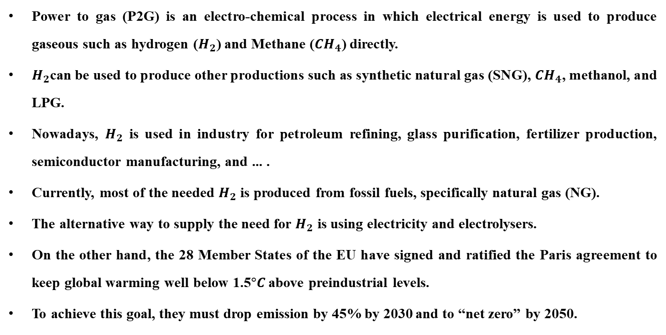
Introduction
Power to gas (P2G) is an electro-chemical process in which electrical energy is used to produce gaseous such as hydrogen ($H_{2}$) and Methane (${CH}_{4}$) directly.
$H_{2}$can be used to produce other productions such as synthetic natural gas (SNG), ${CH}_{4}$, methanol, and LPG.
Nowadays, $H_{2}$ is used in industry for petroleum refining, glass purification, fertilizer production, semiconductor manufacturing, and ... .
Currently, most of the needed $H_{2}$ is produced from fossil fuels, specifically natural gas (NG).
The alternative way to supply the need for $H_{2}$ is using electricity and electrolysers.
On the other hand, the 28 Member States of the EU have signed and ratified the Paris agreement to keep global warming well below 1.5$°C$ above preindustrial levels.
To achieve this goal, they must drop emission by 45% by 2030 and to “net zero” by 2050.

Slide 3
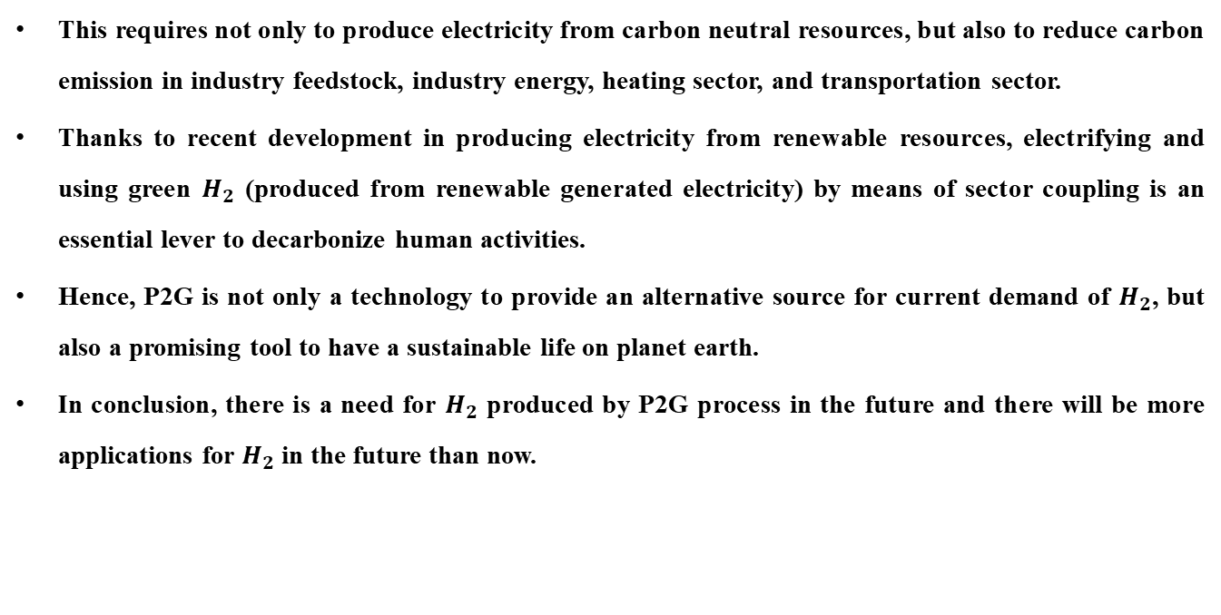
Introduction
This requires not only to produce electricity from carbon neutral resources, but also to reduce carbon emission in industry feedstock, industry energy, heating sector, and transportation sector.
Thanks to recent development in producing electricity from renewable resources, electrifying and using green $H_{2}$ (produced from renewable generated electricity) by means of sector coupling is an essential lever to decarbonize human activities.
Hence, P2G is not only a technology to provide an alternative source for current demand of $H_{2}$, but also a promising tool to have a sustainable life on planet earth.
In conclusion, there is a need for $H_{2}$ produced by P2G process in the future and there will be more applications for $H_{2}$ in the future than now.

Slide 4
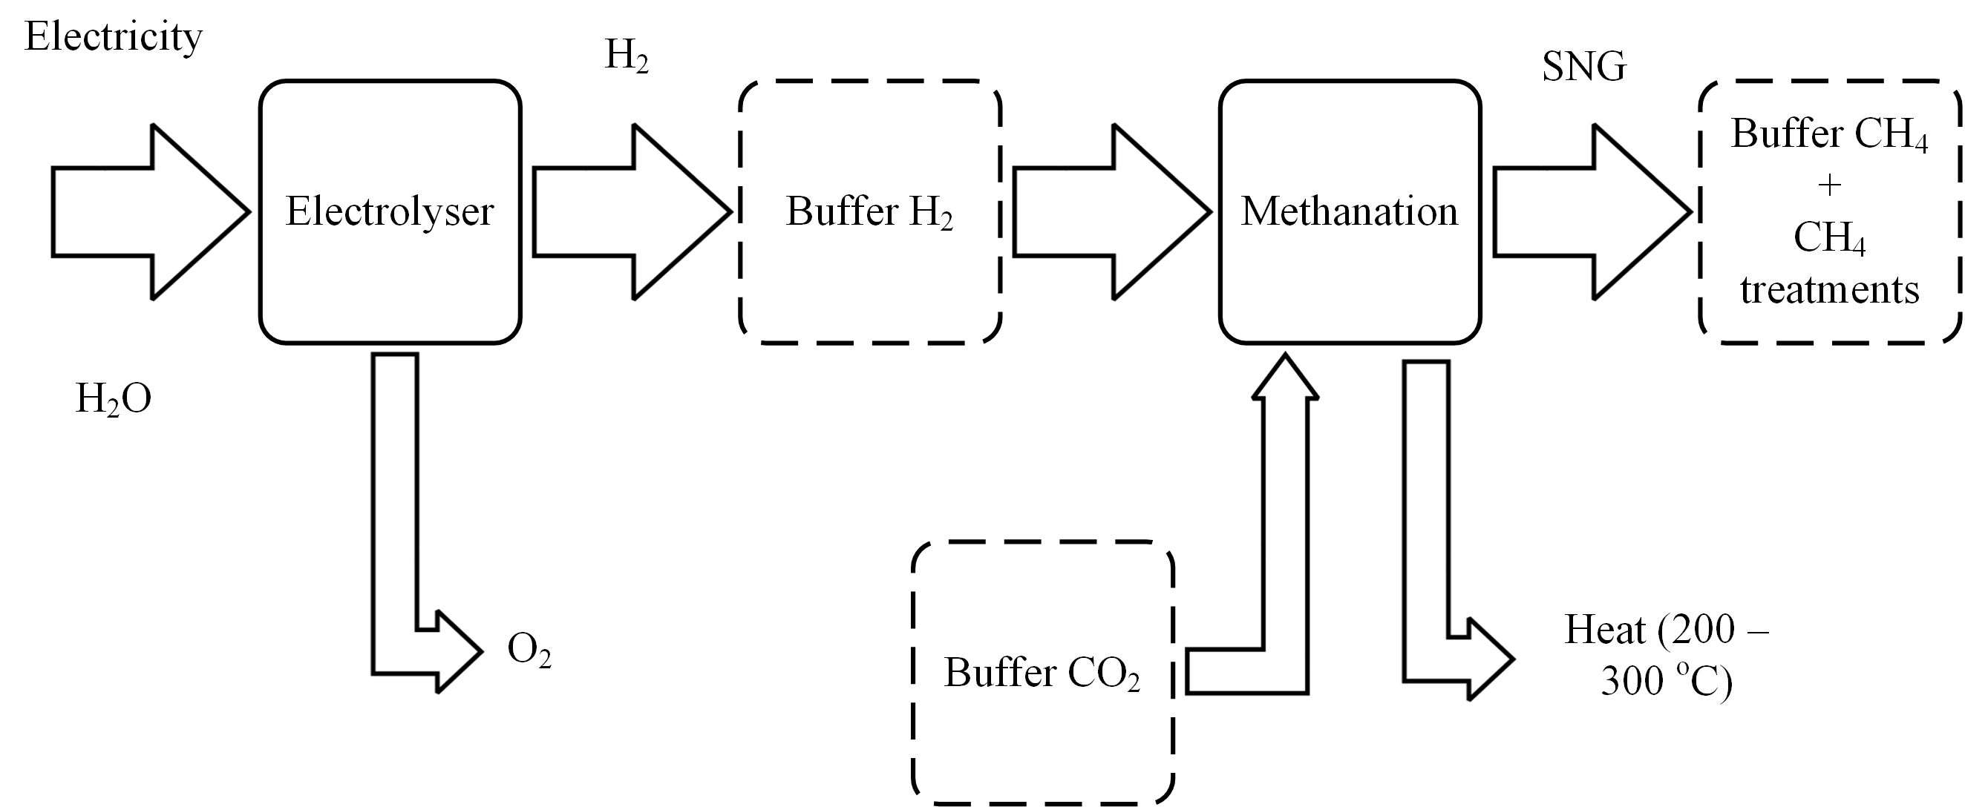
P2G Process

Slide 5
Electrolyser

Slide 6
Power System
Generation & Transmission
Enabling more renewable energy
Less curtailment
Ancillary services
Combined Heat and Power
Adding flexibility
Power balance
New scheme for planning

Slide 7
Heat and Gas Sector
New scheme for Combined Heat and Power
Producing SNG for Gas network
Decarbonizing Heat and Gas sector
Industrial Heat

Slide 8
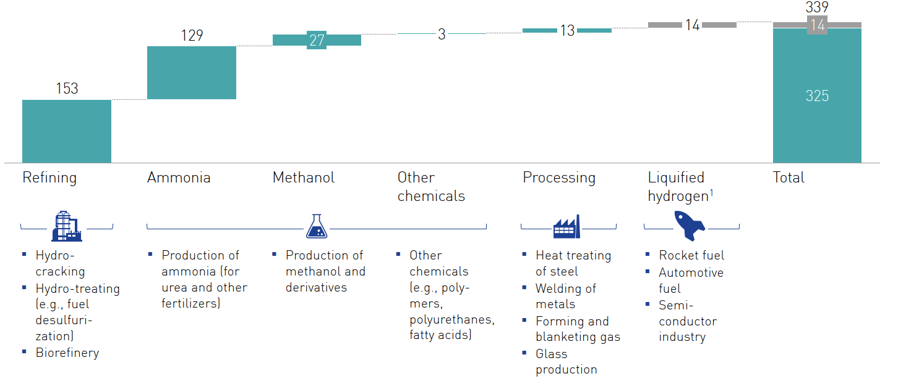
Industry Feedstock
Refining
Ammonia
Methanol
Processing
Liquified H₂

Slide 9
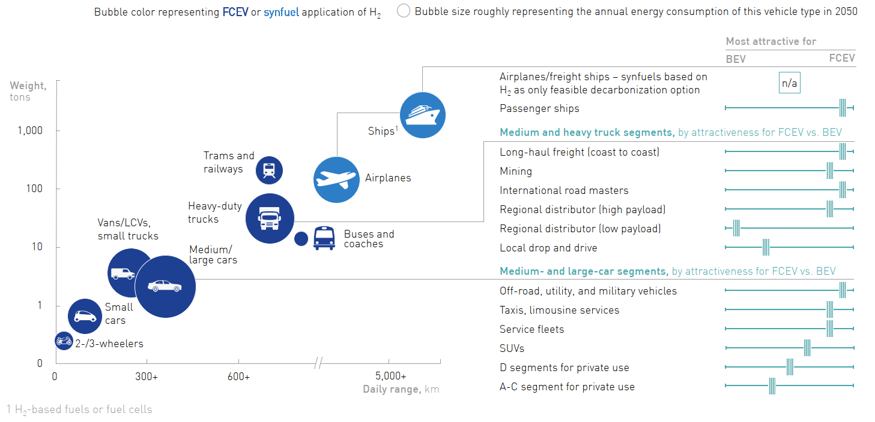
Transportation
Green Electricity
Hydrogen
Medium/Small cars
Busses
Heavy trucks
Trams and railways
Synfuel
Airplanes
Ships

Slide 10
Smart Grid
A Smart Grid is an electrical grid which includes advanced metering infrastructure and smart and remote-controlled components.
Data
Remote-control
Control and coordinate systems fast, secure, and precise.
Enables sector coupling
Is essential for normal operation of the system

Slide 11
Conclusion
Smart Grid infrastructure enables integrating new technologies into energy sector and having a sustainable life.
P2G is not only an alternative way to supply current for H₂, but also a promising tool to decarbonize human activities.
In the future, P2G will play a great role in most sectors, including electricity, heat, gas, transportation, and … .

Slide 12
References
[1] Undertaking, Hydrogen Joint. "Hydrogen roadmap Europe: A sustainable pathway for the European Energy Transition." (2019).
[2] EC, EC. "Communication from the Commission to the European Parliament, the Council, the European Economic and Social Committee and the Committee of the Regions." A hydrogen strategy for a climate-neutral Europe (2020).
[3] Koirala, Binod, et al. "Integrated electricity, hydrogen and methane system modelling framework: Application to the Dutch Infrastructure Outlook 2050." Applied Energy 289 (2021): 116713.
[4] Ozturk, Merve, and Ibrahim Dincer. "A comprehensive review on power-to-gas with hydrogen options for cleaner applications." International Journal of Hydrogen Energy 46.62 (2021): 31511-31522.
[5] Mazza, Andrea, Ettore Bompard, and Gianfranco Chicco. "Applications of power to gas technologies in emerging electrical systems." Renewable and Sustainable Energy Reviews 92 (2018): 794-806.
[6] Yue, Meiling, et al. "Hydrogen energy systems: A critical review of technologies, applications, trends and challenges." Renewable and Sustainable Energy Reviews 146 (2021): 111180.
[7] Li, Bo, et al. "Modeling integrated power and transportation systems: Impacts of power-to-gas on the deep decarbonization." IEEE Transactions on Industry Applications 58.2 (2021): 2677-2693.
[8] Wulf, Christina, Jochen Linßen, and Petra Zapp. "Review of power-to-gas projects in Europe." Energy Procedia 155 (2018): 367-378.
[9] Yapicioglu, Arda, and Ibrahim Dincer. "A review on clean ammonia as a potential fuel for power generators." Renewable and Sustainable Energy Reviews 103 (2019): 96-108.
[10] Jiang, Yuewen, and Liyun Guo. "Research on wind power accommodation for an electricity-heat-gas integrated microgrid system with power-to-gas." IEEE Access 7 (2019): 87118-87126.

Slide 13
Thanks for your attention!
Any Questions?
Amin Moghimy Fam
Amin.moghimyfam@aalto.fi

