Slide 1
ELEC-E8423 - Smart Grid 8. Thermal heat storages for daily and seasonal use
Helmi Härmä
Siiri Lappalainen
14.03.2023

Slide 2
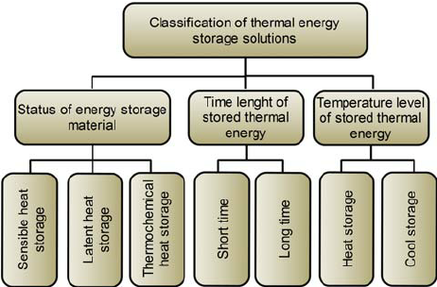
Introduction
Thermal heat storages are systems that store energy in the form of heat energy for later usage

Slide 3
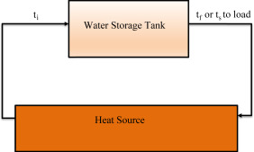
Sensible heat storage
The temperature of the storage medium (water, sand, molten salts) is changed without phase change. Stored heat is released when needed.
Wanted properties of the medium: high heat capacity, high density, high volumetric thermal capacity
Characterics:
Generally low costs (0,1-10 €/kWh)
High temperature variation
The simplest heat storage system,
most commonly used
Large volumes require
~50 kWh/m³ of material
Mostly low efficiencies
Storage medium
(Liquid, Solid)
Notes:
Daily storage and seasonal storage

Slide 4
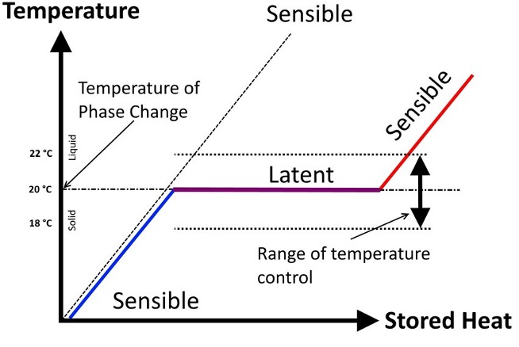
Latent heat storage
System in which the phase change of the material is used to store heat. Temperature of the material does not change.
Phase change materials (PCMs) are used:
Solid/liquid is most used -> heat is stored upon melting and released as the material solidifies
Liquid/vapor also used
Characteristics:
Medium costs (10-50 €/kWh)
small temperature variation
Medium volumetric density ~100 kWh/m³ of material
Flammable/corrosive PMCs
Low thermal conductivity of PCMs
More complex than Sensible
Notes:
Daily and seasonal storage

Slide 5
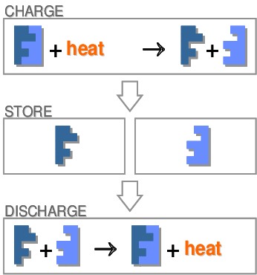
Thermochemical heat storage
System in which thermochemical materials are used in order to store and release heat by a reversible chemical reaction.
- Endothermic (charge) /exothermic (discharge) process
Characteristics:
High storage capacity and energy density
~500 kWh/m³ of reactant
Low heat loss
Comparatively high costs (8-100 €/kWh)
Low reliability
Potential toxicity
Issues about recyclability
Still under research
Notes:
Low heat loss -> materials can be stored in ambient temperature when storing
Suitable for Seasonal storage mainly
Most common reactions used for this process is the hydration of salts

Slide 6
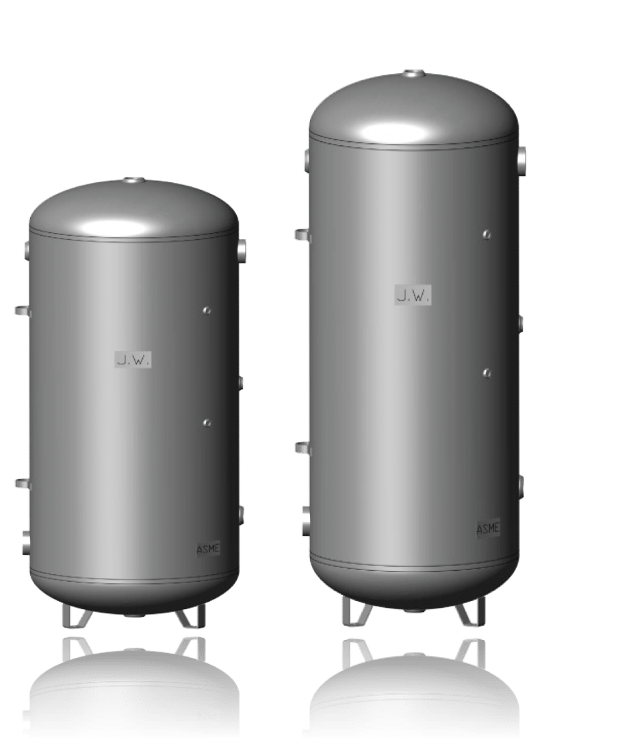
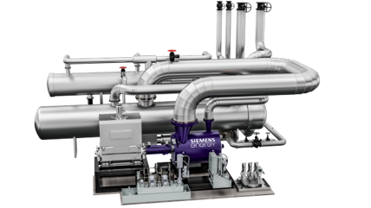
Daily use (Short term storage)
Used for the day-night cycle of fluctuations in demand and production and for production variability due to weather variations
Examples of daily use thermal heat storages solutions:
Water tanks
Heat pumps
Molten Salt
Kuva: https://woodboilers.com/tarm-biomass-products/thermal-storage-biomass-boiler-tanks/pressurized-thermal-storage-tanks/

Slide 7
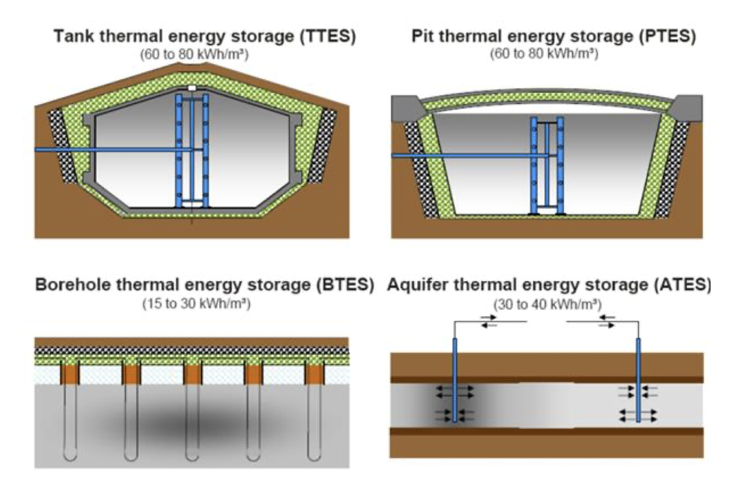
Seasonal use (Long term storage)
Balance the heat supply and demand between different seasons (winter/summer)
Heat demand up to 10 times bigger during winter than during summer
Storing solar heat is the main method for balancing the seasons
Examples of seasonal use thermal heat storage solutions:

Slide 8
Thermal heat storages in smart grids
Energy storages increase flexibility in energy systems
Thermal heat storages can help the integration of renewables into power system
Electricity demand regulation and price peak reductions: flexible energy storing
Increases grid reliability and power quality
Improves the efficiency of energy system
Energy storages are a requirement for further utilization of RES

Slide 9
Conclusions
Thermal energy storages can be divided to sensible, latent and thermochemical technologies and can be utilized for either daily or seasonal use
Using Thermal energy storages Increases the flexibility and efficiency of the energy system
TES are needed to fully utilize RES

Slide 10
Source material used
https://tracer-h2020.eu/wp-content/uploads/2019/10/TRACER_D2.1-Heat-Storages.pdf
https://www.sciencedirect.com/topics/engineering/latent-heat-storage
https://www.sciencedirect.com/topics/engineering/thermochemical-energy-storage
Socaciu, Lavinia. (2012). Thermal energy storage: an overview. Appl Math Mech. 55. 785-793. [Available at: https://www.researchgate.net/publication/272179305_Thermal_energy_storage_an_overview]
https://benthamopen.com/contents/pdf/TOREJ/TOREJ-4-42.pdf

