Slide 1
ELEC-E8423 - Smart Grid Fuel Cells as a Part of Power System
Onni Tikkanen & Simeon Seppälä
07.02.2018

Slide 2
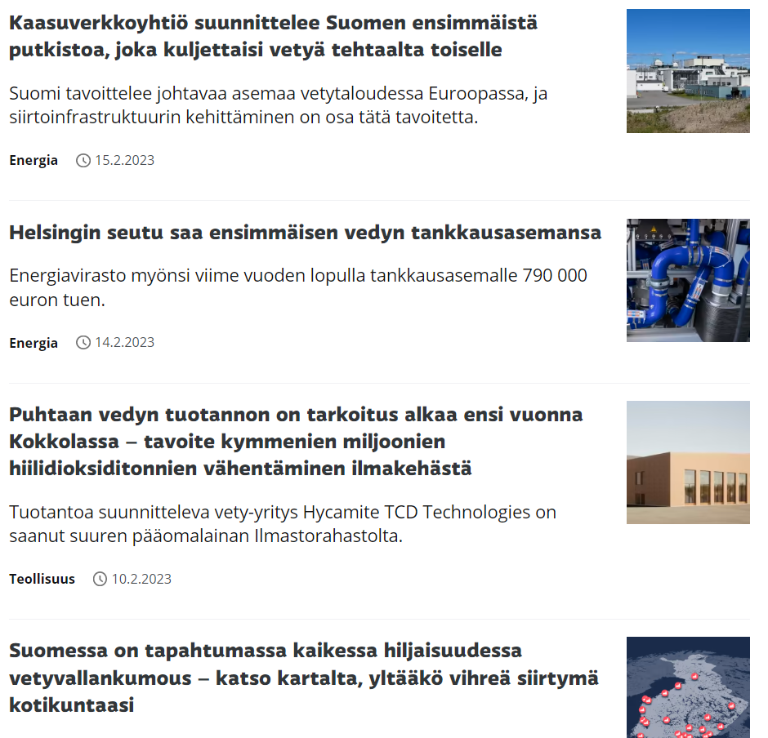
Introduction – What’s the Deal with Hydrogen?
Hydrogen is predicted to bring around 10 billion € investments to Finland
The fast growth of intermittent renewable energy production (=wind power) decreases the price of electricity, which further enables the economically feasible production of green hydrogen
Hydrogen can be used in many applicatons:
Carbon-free steel production and other industry processes
Fuel in transportation
Fuel in backup power plants
Energy storage
Energy carrier
Notes:
Before we talk about fuel cell technology itself, we’ll discuss the current state of FC applications such as hydrogen FCs a little bit. There’s a lot of fuss about hydrogen so what’s all that about: kalvot
-Why do we want to produce green hydrogen: We want to decarbonize the industry and the energy system and here we have some applications for hydrogen use
->Moving on to the fuel cell technology, how is Hydrogen produced?

Slide 3
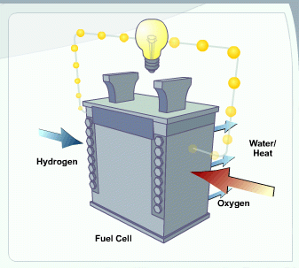
Fuel Cell Technology
A device that turns fuel (Hydrogen) and Oxygen directly into electricity and an end product (water) through an electrochemical reaction. Heat is produced as a byproduct.
Different fuels:
Hydrogen (H2)
Methane (CH4) and other hydrocarbons (internal reforming)
Ammonia (NH4)
Methanol, ethanol
Different FC technologies:
- Proton Exchange Membrane Fuel Cell (PEMFC)
- Solid Oxide Fuel Cell (SOFC)
- Direct Liquid-Fueled Fuel Cells (e.g., DMFC)
Reversible fuel cells (electrolyzers) can be used to produce Hydrogen from water using electricity
Notes:
PEM is currently most widely used. Pros: has the highest power density of all FCs, Cons: uses expensive platinum catalysts (and even more rare Iridium), requires active water injection meaning that operation temperature must be below 90 C
SOFC is researched a lot, can be used in reversible mode and in internal reforming. Pros: fuel flexibility, high operation temperature -> good for cogeneration, Cons: high temperature and material issues linked to it
DMFC (mostly based on PEM technology) Pros: high energy density due to fuel being liquid and not gas (easy storage too)

Slide 4
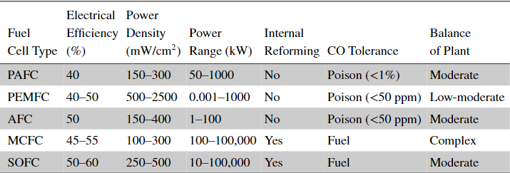
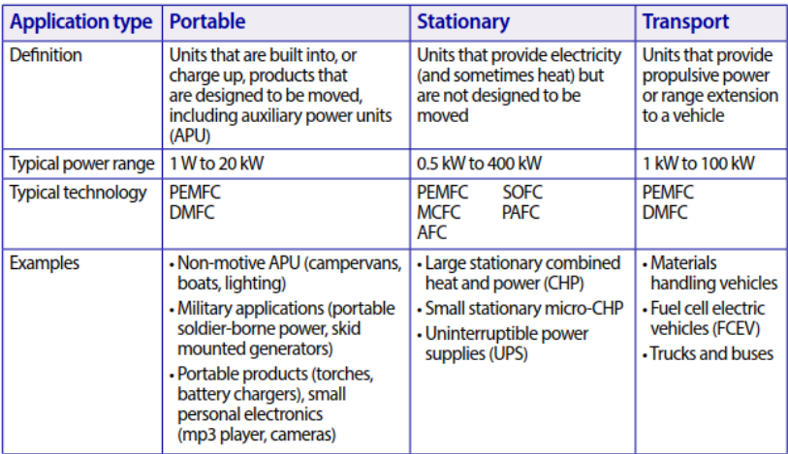
Overview of Different Fuel Cell types
Higher efficiency compared to ICE
Scalable: Cells can be stacked to increase the current and voltage
Efficiency of SOEC:74-81 %
Notes:
PAFC – Phosphoric acid fuel cell
PEMFC – photon exchange membrane (polymer electrolyte membrane) fuel cell
AFC – alkaline fuel cell
MCFC – molten carbonate fuel cell
SOEC – Solid Oxide Electrolyzer Cell

Slide 5
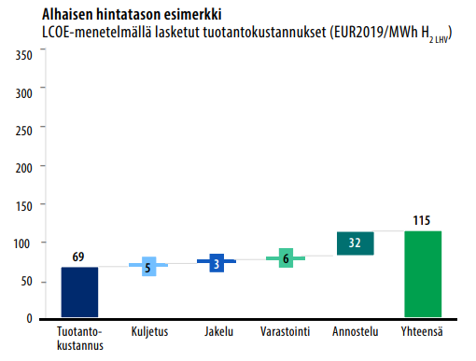
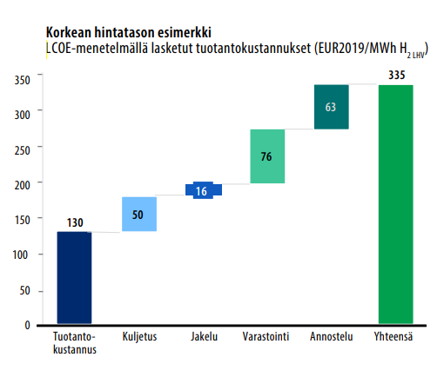
Economies of Fuel Cells
Technology | O&M cost €/MWh/y (Alexopoulous et al. 2021)
PEM | 72.5
SOFC | 89.8
AFC | 73
Investment cost: 1000 - 2000 €/kW (Alexopoulous et al. 2021)
LCOE of hydrogen production: 115 - 335 €/MWh
In comparison, pumped hydro storage LCOE is approximately 50 - 250 €/MWh

Slide 6
Fuel Cells in Power Systems
Higher proportion of wind and solar in power system causes challenges in a power system
More variable production: Matching demand and production is more difficult
Further RES penetration in power systems will need more flexible production and energy storage
Many studies propose fuel cells and P2X to be included to power system with high amount of wind and solar.
Deeper GHG emission reductions in power systems
Reduces problems related to production variation of wind and solar
Proposed power system applications
Energy storage and peak power production
Distributed production and storage in residential buildings
Could enable high wind and solar off-grid systems
Marine applications: Deeper CO₂ reductions in ships
Notes:
As we are seeing more wind and solar in our power systems, the challenges related to intermittency of wind and solar production will increase.

Slide 7
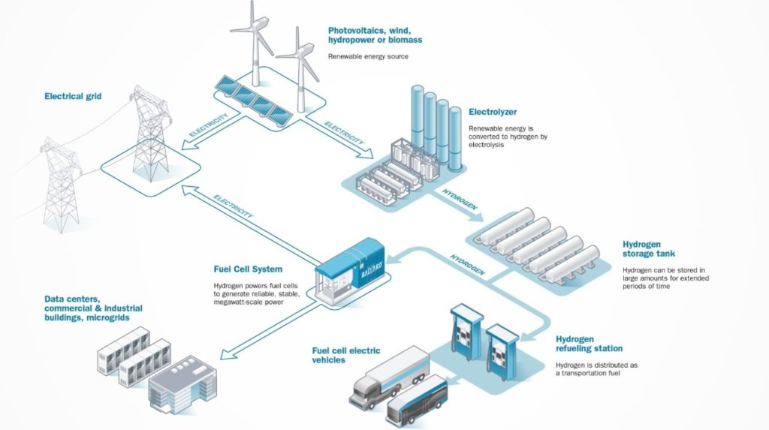
Fuel Cells in Power Systems
Figure: Illustration of wind + solar + fuel cell power system. Image source: FuelCellWorks

Slide 8
Problems with fuel cells in power systems
Emissions
Utilization of natural gas or “gray hydrogen” should be avoided to minimize GHG emissions
Hydrogen produced from wind energy could lower life cycle emissions to 50 g CO_{2,eq}/kWh (Bicer & Khalid 2018)
Availability of rare earth metals
Large-scale production would not have enough iridium for catalyst layers
New designs attempt to replace or reduce the rare materials
Relatively low life-cycle
On/Off cycles degrade the fuel cell: disadvantage in demand response
Relatively low operating hours: Less viable economically and higher life cycle emissions
Notes:
Fuel Cells can utilize natural gas or ´”gray hydrogen” which is produced from natural gas with steam reforming process will cause high emissions
P2X fuel should be utilized to minimize CO2 emissions
- Large scale PEMFC production would require 200 % of current annual iridium production assuming current iridium production estimates
- Also, platinum consumption would be considerable
- SOFC (Solid oxide fuel cells) are proposed to solve many of the problems related to consumption of rare earth metals
- PEMFC could reduce the Iridium density in catalysts

Slide 9
Conclusions
Fuel Cells enable the hydrogen economy in power systems
Could reduce the effects of intermittent wind and solar power production in power systems
Still challenges related to FC reliability, economics and environmental impacts
Multiple promising technologies which could assess the current challenges

Slide 10
References
https://yle.fi/aihe/t/18-65114
https://www.energy.gov/eere/fuelcells/fuel-cell-animation-text-version
https://doi.org/10.1002/9781119191766.ch10
Halme Janne. PHYS-E6571 - Fuel Cells and Hydrogen Technology D Course Materials
http://urn.fi/URN:ISBN:978-952-383-413-2
https://doi.org/10.1016/j.egyr.2021.09.050
https://www.researchgate.net/figure/Levelized-cost-of-electricity-LCOE-estimates-for-lithiumion-batteries-using-nickel_fig2_363191266
https://www.sciencedirect.com/science/article/pii/S2352484721008568
https://www.sciencedirect.com/science/article/pii/S2352484721008568
https://www.sciencedirect.com/science/article/pii/S2352484723001294
https://www.sciencedirect.com/science/article/pii/S0378779618304176
https://www.sciencedirect.com/science/article/pii/S0360319918337248
https://www.sciencedirect.com/science/article/pii/S2542435121005894

