Slide 1
Thermodynamics
An Engineering Approach
Lecture 8: Fundamentals of Heat Conduction
Qiang Cheng (Jonny)

Slide 2
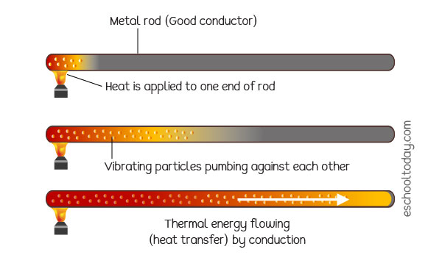
Conduction
Conduction is the transfer of energy from the more energetic particles of a substance to the adjacent less energetic ones as a result of interactions between the particles.
In gases and liquids, conduction is due to the collisions and diffusion of the molecules during their random motion.
In solids, it is due to the combination of vibrations of the molecules in a lattice and the energy transport by free electrons.
The rate of heat conduction through a medium depends on the geometry of the medium, its thickness, and the material of the medium, as well as the temperature difference across the medium.

Slide 3
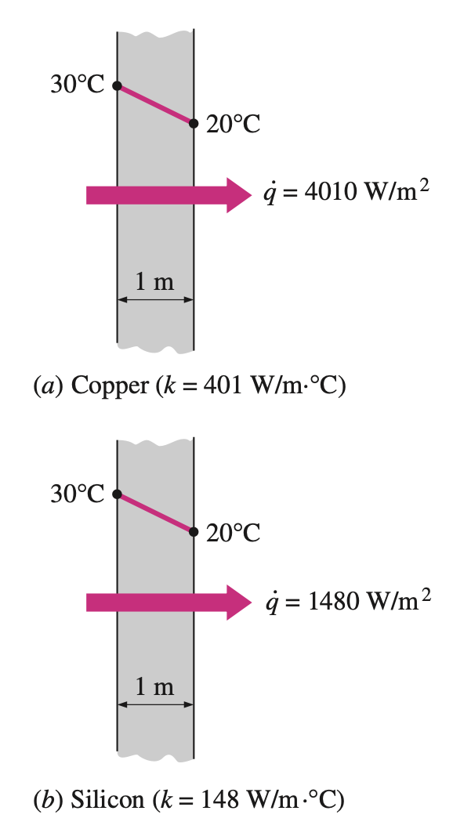
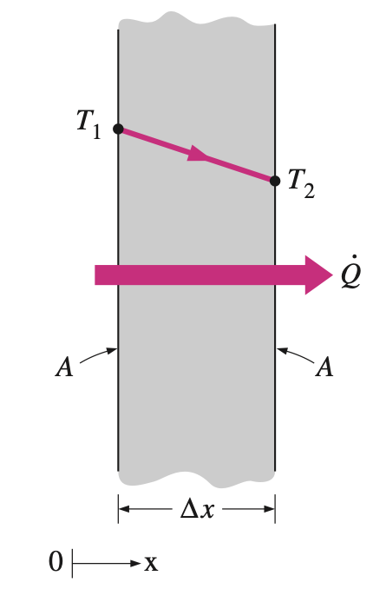
Fourier’s law of heat conduction
The rate of heat conduction through a plane layer is proportional to the temperature difference across the layer and the heat transfer area, but is inversely proportional to the thickness of the layer.
In the limiting case of x → 0, the equation above reduces to the differential form
Heat conduction through a large plane wall of thickness x and area A.
The rate of heat conduction through a solid is directly proportional to its thermal conductivity.

Slide 4
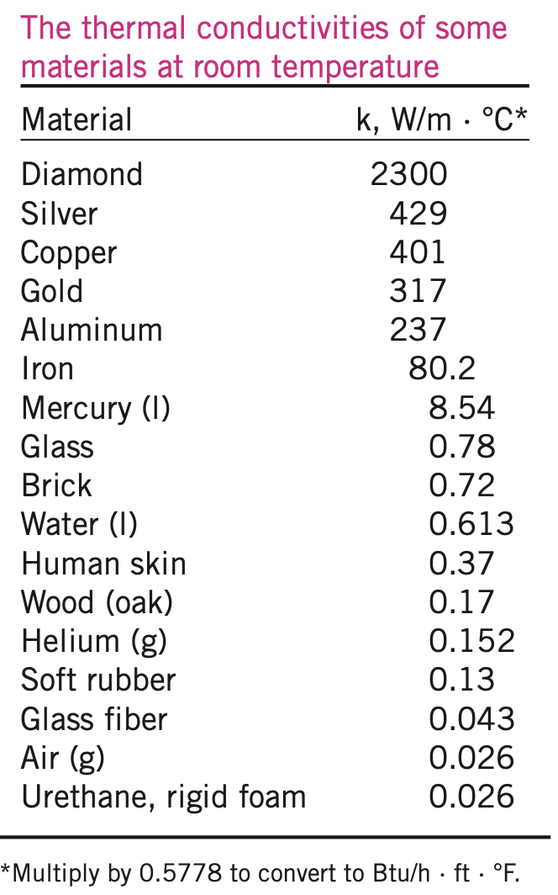
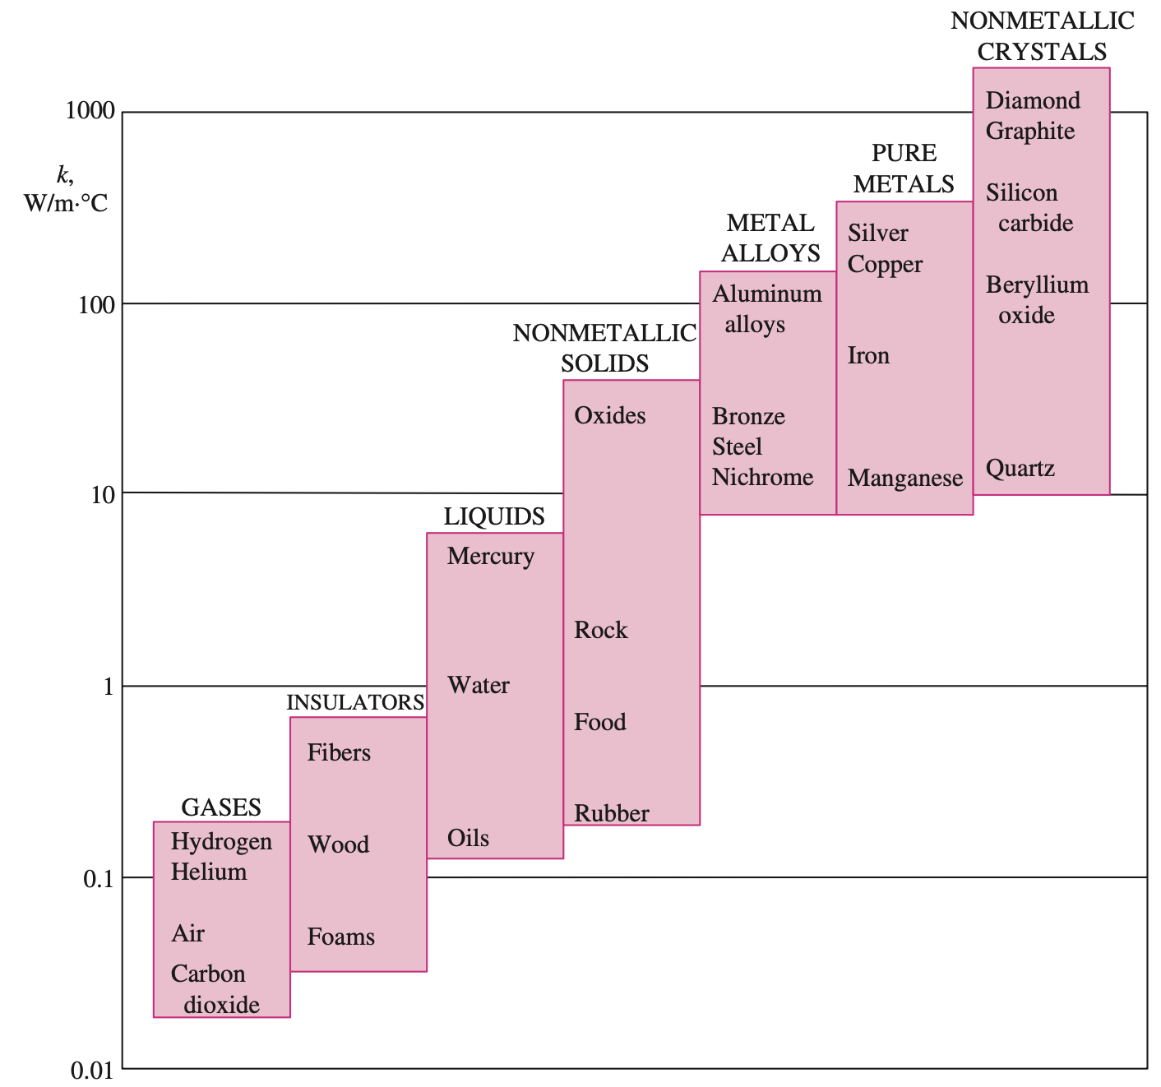
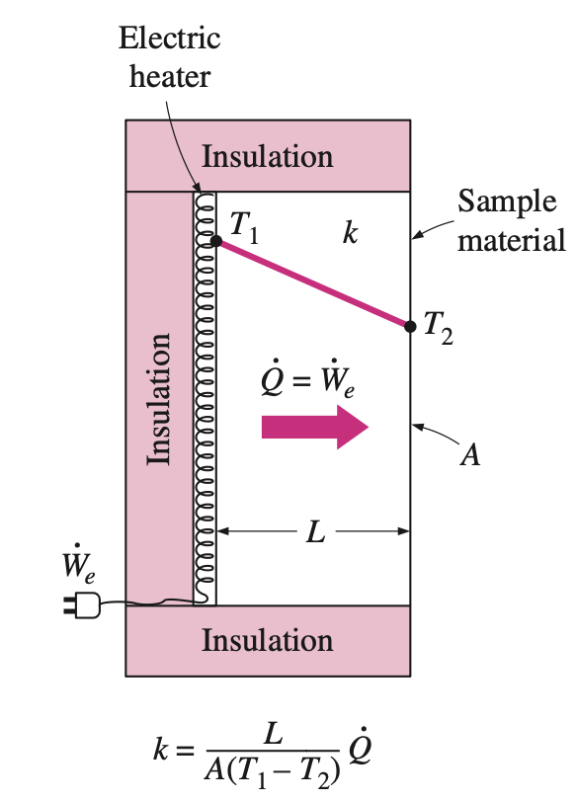
Thermal Conductivity
Thus the thermal conductivity of a material can be defined as the rate of heat transfer through a unit thickness of the material per unit area per unit temperature difference.
The thermal conductivity of a material is a measure of the ability of the material to conduct heat.
A simple experimental setup to determine the thermal conductivity of a material.
A high value for thermal conductivity indicates that the material is a good heat conductor, and a low value indicates that the material is a poor heat conductor or insulator.

Slide 5
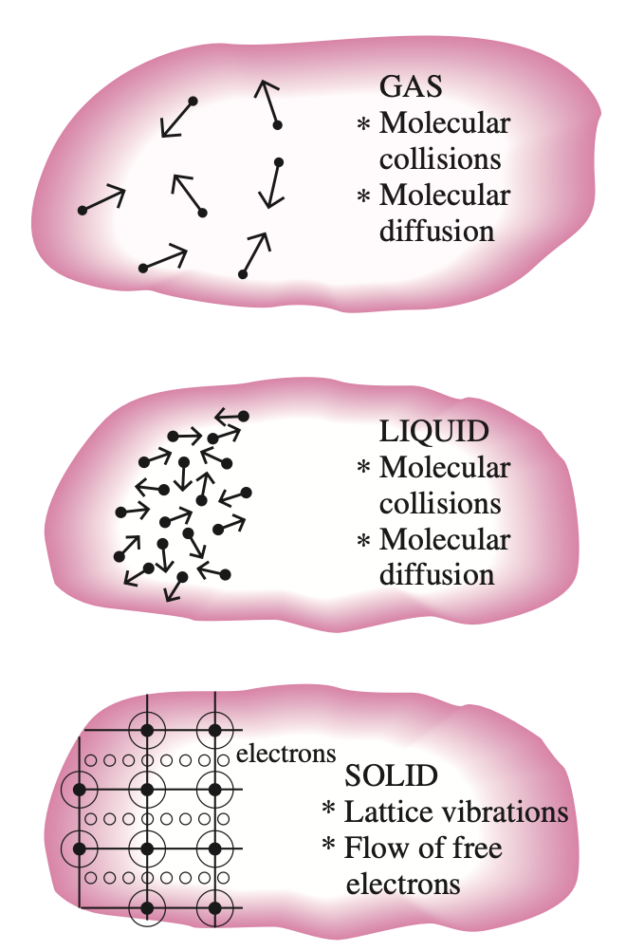
Thermal Conductivity
Temperature is a measure of the kinetic energies of the particles such as the molecules or atoms of a substance.
In a liquid or gas, the kinetic energy of the molecules is due to their random translational motion as well as their vibrational and rotational motions.
The mechanism of heat conduction in a liquid is complicated by the fact that the molecules are more closely spaced, and they exert a stronger intermolecular force field. The thermal conductivities of liquids usually lie between those of solids and gases. The thermal conductivity of a substance is normally highest in the solid phase and lowest in the gas phase. Unlike gases, the thermal conductivities of most liquids decrease with increasing temperature, with water being a notable exception.
In solids, heat conduction is due to two effects: the lattice vibrational waves induced by the vibrational motions of the molecules positioned at relatively fixed positions in a periodic manner called a lattice, and the energy transported via the free flow of electrons in the solid.
The mechanisms of heat conduction in different phases of a substance.

Slide 6
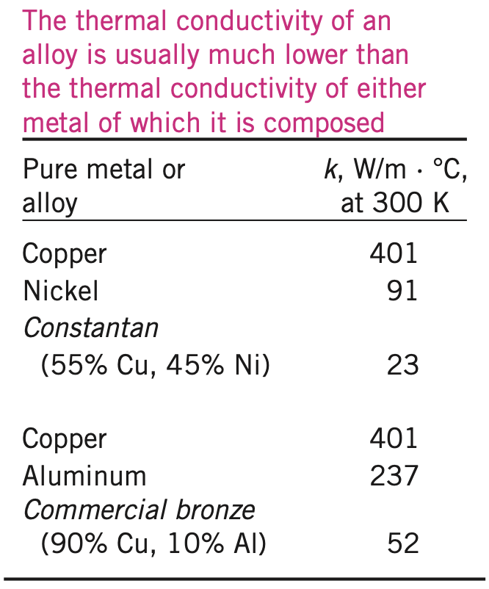
Thermal Conductivity
The thermal conductivity of an alloy of two metals is usually much lower than that of either metal.
Even small amounts in a pure metal of “foreign” molecules that are good conductors themselves seriously disrupt the flow of heat in that metal.

Slide 7
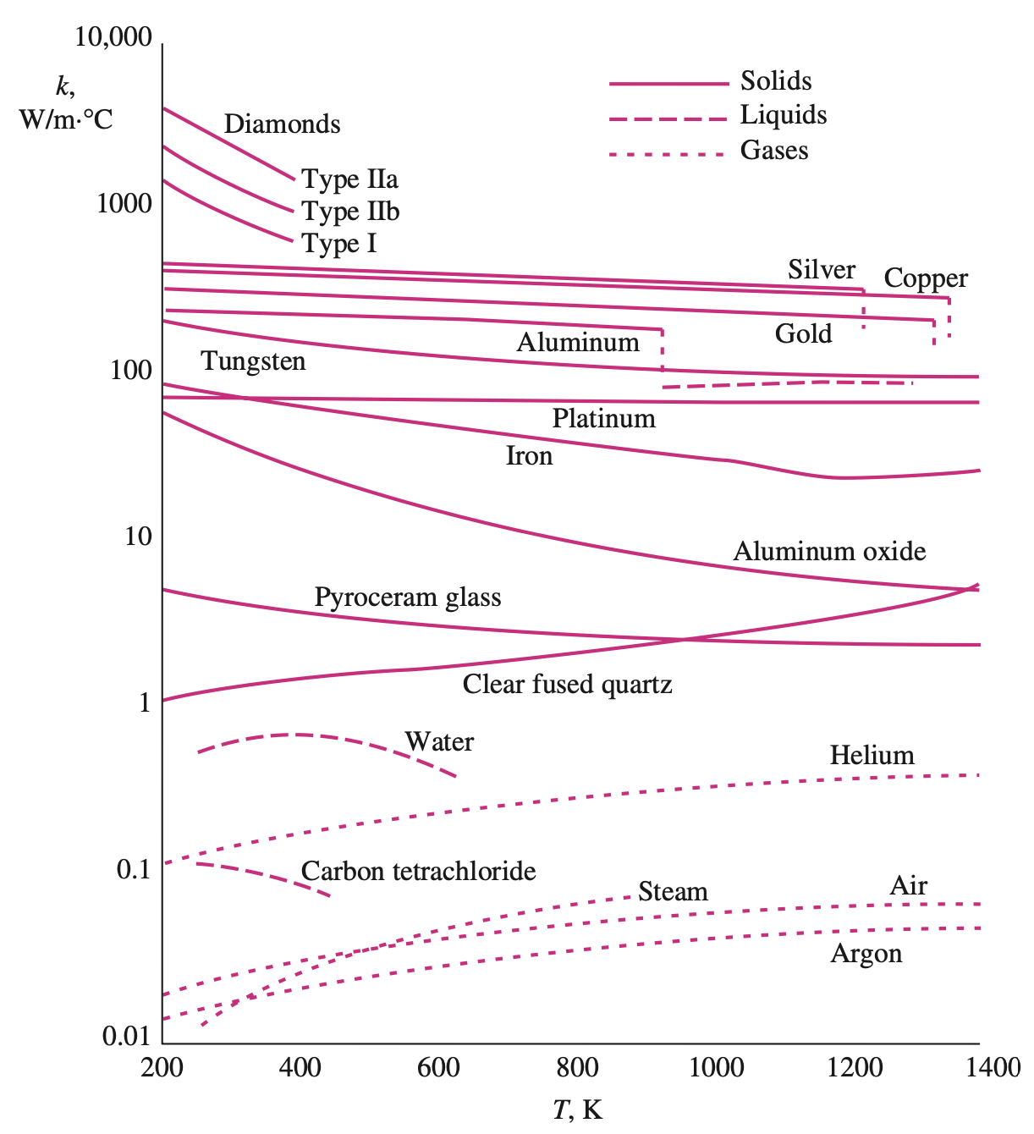
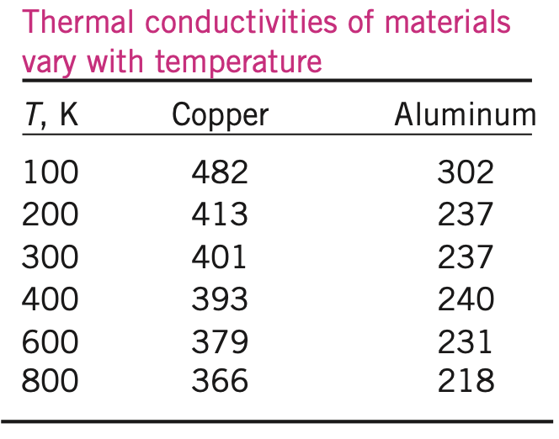
Thermal Conductivity
The thermal conductivities of materials vary with temperature.
The variation of thermal conductivity over certain temperature ranges is negligible for some materials, but significant for others
The temperature dependence of thermal conductivity causes considerable complexity in conduction analysis. Therefore, it is common practice to evaluate the thermal conductivity k at the average temperature and treat it as a constant in calculations.
The variation of the thermal conductivity of various solids, liquids, and gases with temperature

Slide 8
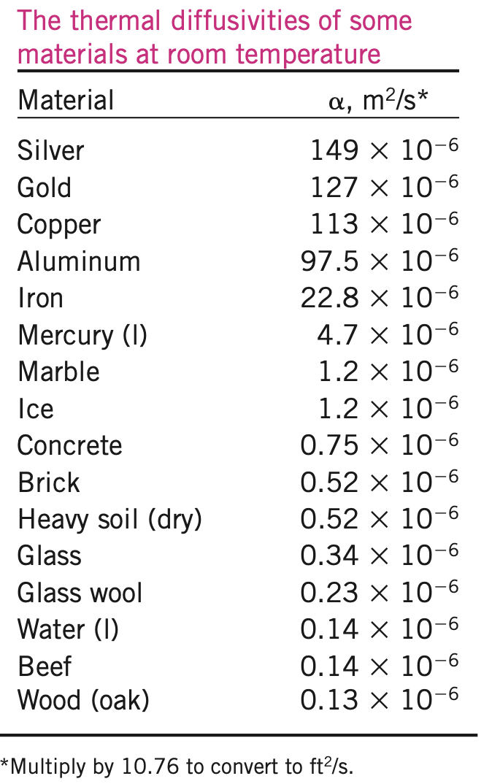
Thermal Diffusivity
Another material property that appears in the transient heat conduction analysis is the thermal diffusivity, which represents how fast heat diffuses through a material and is defined as
Note that the thermal conductivity k represents how well a material conducts heat, and the heat capacity Cp represents how much energy a material stores per unit volume.
Therefore, the thermal diffusivity of a material can be viewed as the ratio of the heat conducted through the material to the heat stored per unit volume.

Slide 9
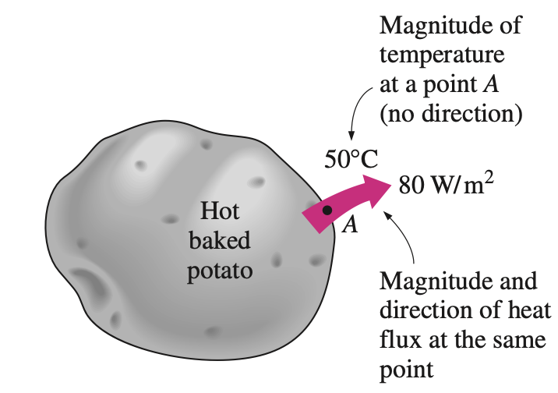
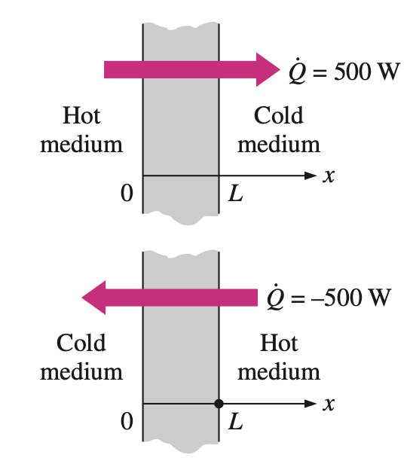
Heat Transfer Modeling
Although heat transfer and temperature are closely related, they are of a different nature. Unlike temperature, heat transfer has direction as well as magnitude, and thus it is a vector quantity
Heat transfer has direction as well as magnitude, and thus it is a vector quantity.
The driving force for any form of heat transfer is the temperature difference, and the larger the temperature difference, the larger the rate of heat transfer.
Indicating direction for heat transfer (positive in the positive direction; negative in the negative direction)
Notes:
https://www.thoughtco.com/list-of-phase-changes-of-matter-608361

Slide 10
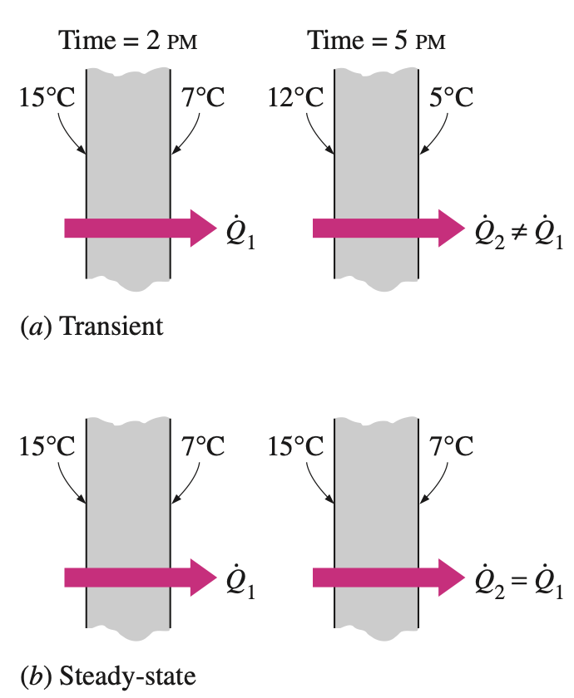
Steady versus Transient Heat Transfer
Heat transfer problems are often classified as being steady (also called steady-state) or transient (also called unsteady). The term steady implies no change with time at any point within the medium, while transient implies variation with time or time dependence.
Most heat transfer problems encountered in practice are transient in nature, but they are usually analyzed under some presumed steady conditions since steady processes are easier to analyze, and they provide the answers to our questions.
Steady and transient heat conduction in a plane wall.
Notes:
https://www.thoughtco.com/list-of-phase-changes-of-matter-608361

Slide 11
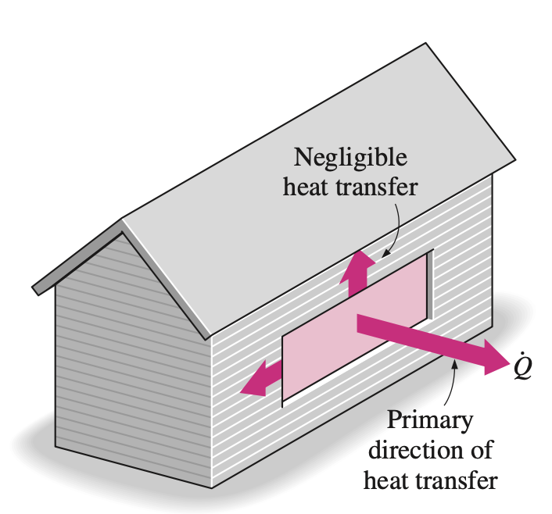
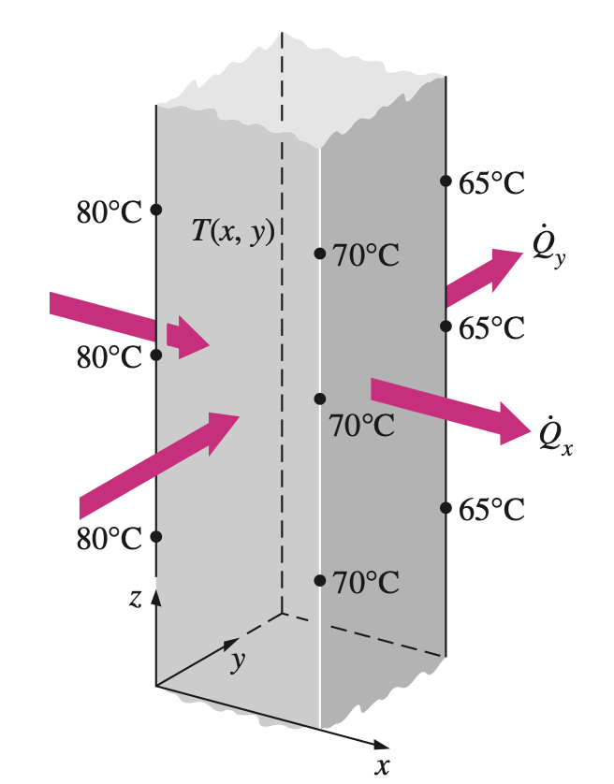
Multidimensional Heat Transfer
Heat transfer problems are also classified as being one-dimensional, two- dimensional, or three-dimensional, depending on the relative magnitudes of heat transfer rates in different directions and the level of accuracy desired.
Heat transfer through the window of a house can be taken to be one-dimensional.
A heat transfer problem is said to be one-dimensional if the temperature in the medium varies in one direction only and thus heat is transferred in one direction, and the variation of temperature and thus heat transfer in other directions are negligible or zero.
The temperature in a medium, in some cases, varies mainly in two primary directions, and the variation of temperature in the third direction (and thus heat transfer in that direction) is negligible. A heat transfer problem in that case is said to be two-dimensional.
Two-dimensional heat transfer in a long rectangular bar.
In the most general case, heat transfer through a medium is three-dimensional. That is, the temperature varies along all three primary directions within the medium during the heat transfer process.

Slide 12
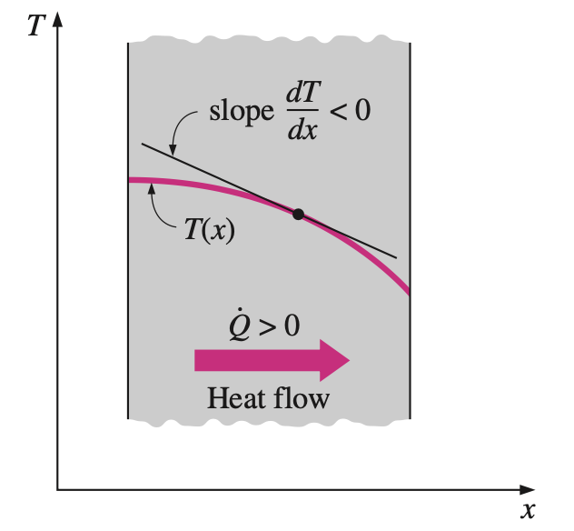
Fourier’s law of heat conduction
The rate of heat conduction through a medium in a specified direction (say, in the x-direction) is proportional to the temperature difference across the medium and the area normal to the direction of heat transfer, but is inversely proportional to the distance in that direction. This was expressed in the differential form by Fourier’s law of heat conduction for one-dimensional heat conduction as
where k is the thermal conductivity of the material, which is a measure of the ability of a material to conduct heat, and dT/dx is the temperature gradient, which is the slope of the temperature curve on a T-x diagram
The temperature gradient dT/dx is simply the slope of the temperature curve on a T-x diagram.
The negative sign in Eq. ensures that heat transfer in the positive x-direction is a positive quantity.

Slide 13
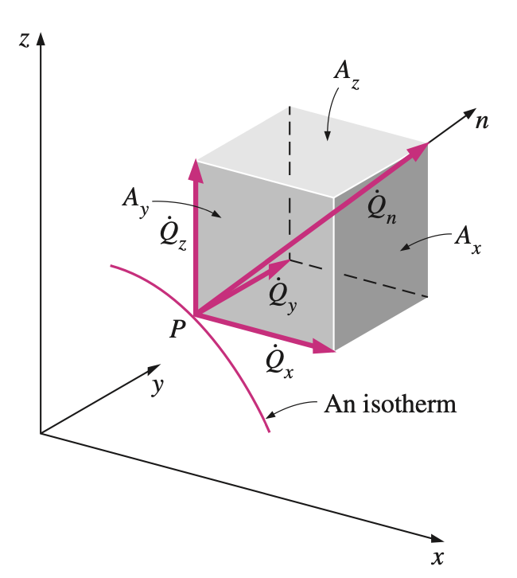
General Relation for Fourier’s Law of Heat Conduction
To obtain a general relation for Fourier’s law of heat conduction, consider a medium in which the temperature distribution is three-dimensional.
In rectangular coordinates, the heat conduction vector can be expressed in terms of its components as
where $\vec{i}$, $\vec{j}$, and $\vec{k}$ are the unit vectors, and ${\dot{Q}}_{x}$, ${\dot{Q}}_{y}$, and ${\dot{Q}}_{z}$ are the magnitudes of the heat transfer rates in the x-, y-, and z-directions, which again can be de- termined from Fourier’s law as
The heat transfer vector is always normal to an isothermal surface and can be resolved into its components like any other vector.
Here $A_{x}$, $A_{y}$ and $A_{z}$ are heat conduction areas normal to the x-, y-, and z-directions, respectively

Slide 14
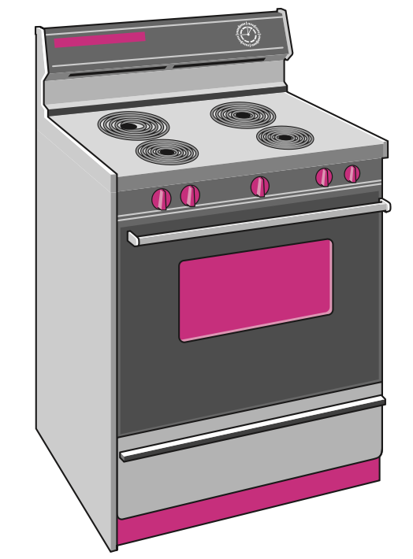
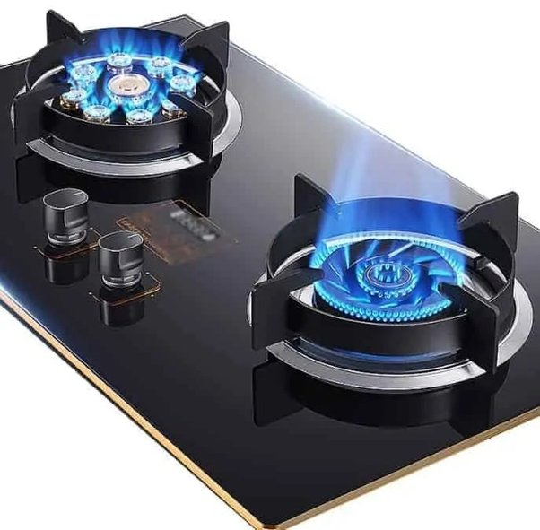
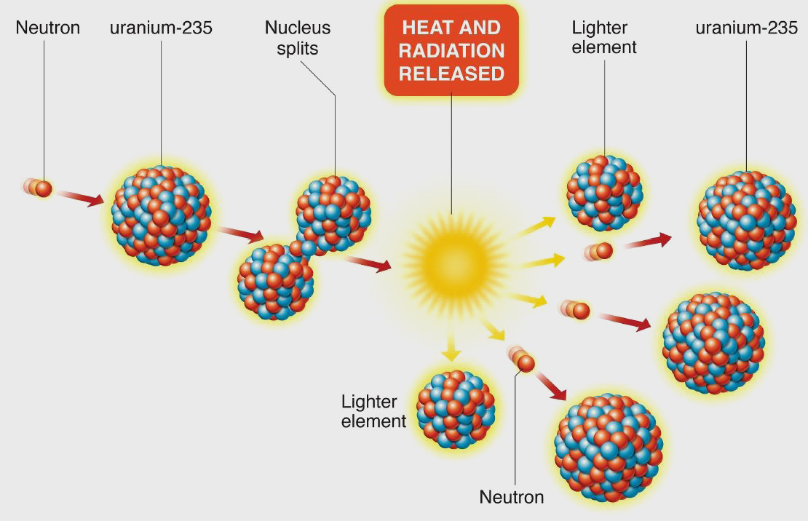
Heat Generation
A medium through which heat is conducted may involve the conversion of electrical, nuclear, or chemical energy into heat (or thermal) energy. In heat conduction analysis, such conversion processes are characterized as heat generation.
The rate of heat generation in a medium may vary with time as well as position within the medium. When the variation of heat generation with position is known, the total rate of heat generation in a medium of volume V can be determined from
Heat is generated in the heating coils of an electric range as a result of the conversion of electrical energy to heat.

Slide 15
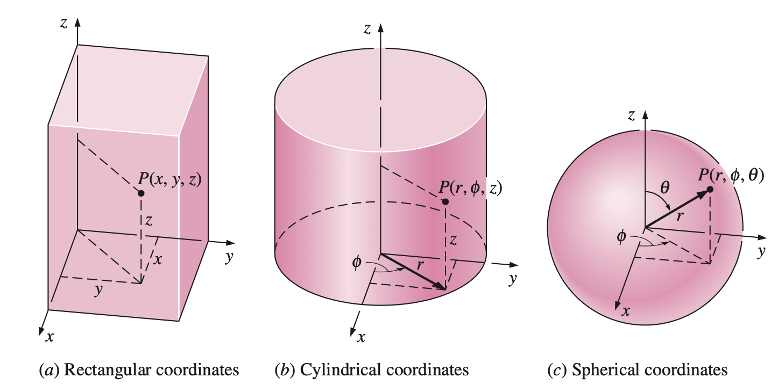
Heat Transfer Modeling
Some heat transfer problems in engineering require the determination of the temperature distribution (the variation of temperature) throughout the medium in order to calculate some quantities of interest such as the local heat transfer rate, thermal expansion, and thermal stress at some critical locations at specified times.
The specification of the temperature at a point in a medium first requires the specification of the location of that point. This can be done by choosing a suitable coordinate system such as the rectangular, cylindrical, or spherical coordinates, depending on the geometry involved, and a convenient reference point (the origin).
The various distances and angles involved when describing the location of a point in different coordinate systems.
Notes:
https://www.thoughtco.com/list-of-phase-changes-of-matter-608361

Slide 16
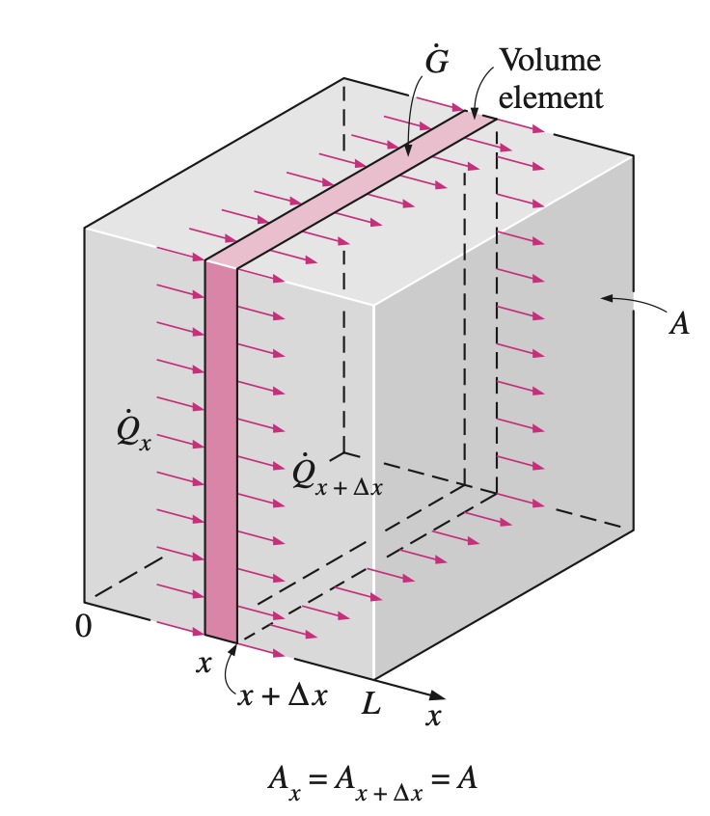
One-dimensional Heat Conduction Equation
An energy bal- ance on this thin element during a small time interval t can be expressed as
One-dimensional heat conduction through a volume element in a large plane wall.

Slide 17
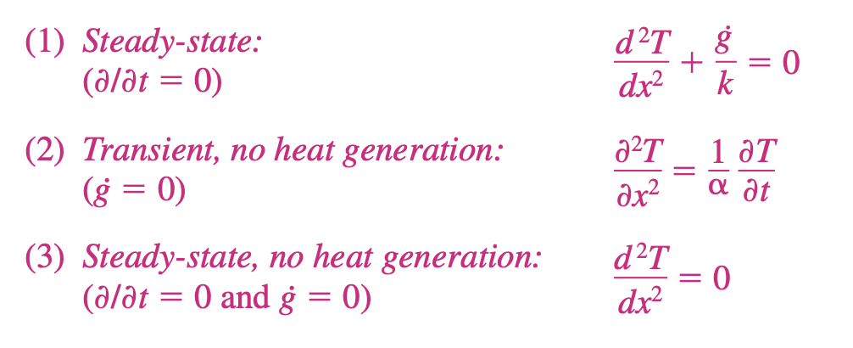
One-dimensional Heat Conduction Equation
Dividing by $AΔx$ gives
Noting that the area A is constant for a plane wall, the one-dimensional transient heat conduction equation in a plane wall becomes
Taking the limit as x → 0 and t → 0 yields
since, from the definition of the derivative and Fourier’s law of heat conduction,

Slide 18
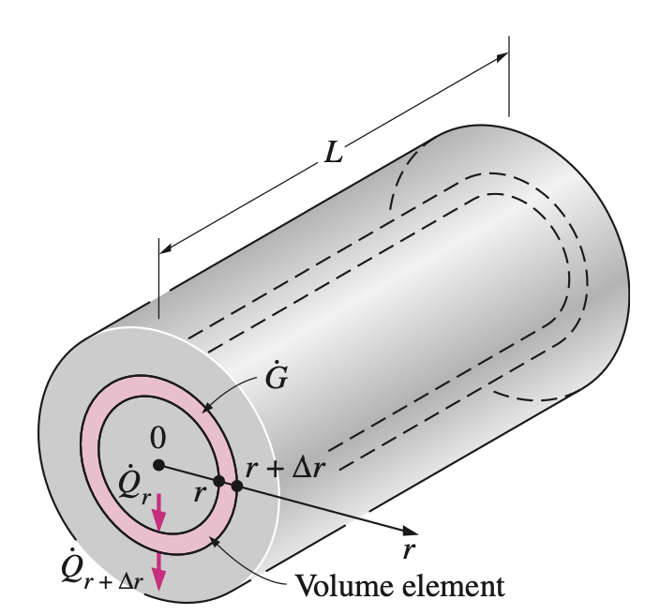
Heat Conduction Equation in a Long Cylinder
An energy balance on this thin cylindrical shell element during a small time interval t can be expressed as
One-dimensional heat conduction through a volume element in a long cylinder.

Slide 19
Heat Conduction Equation in a Long Cylinder
Dividing by $AΔr$ gives
Noting that the area $A=2πrL$ is constant for a plane wall, the one-dimensional transient heat conduction equation in a plane wall becomes
Taking the limit as $Δ$r → 0 and $Δ$t → 0 yields
since, from the definition of the derivative and Fourier’s law of heat conduction,

Slide 20
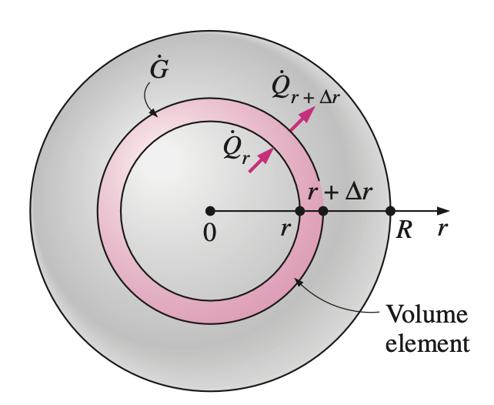
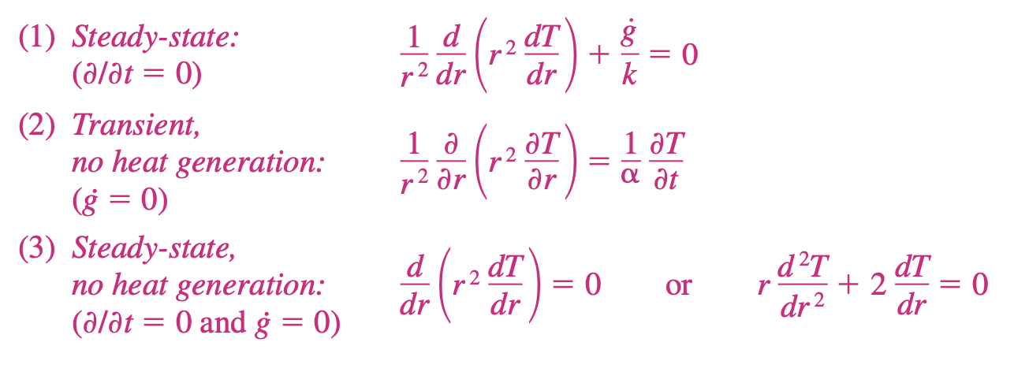
Heat Conduction Equation in a Sphere
By considering a thin spherical shell element of thickness r and repeating the approach described above for the cylinder by using $A=4πr^{2}$ instead of $A=2πrL$, the one-dimensional transient heat conduction equation for a sphere is determined to be
One-dimensional heat conduction through a volume element in a sphere.

Slide 21
Heat Conduction Equation in a Long Cylinder
Dividing by $AΔr$ gives
Noting that the area $A=2πrL$ is constant for a plane wall, the one-dimensional transient heat conduction equation in a plane wall becomes
Taking the limit as $Δ$r → 0 and $Δ$t → 0 yields
since, from the definition of the derivative and Fourier’s law of heat conduction,

Slide 22
Combined One-Dimensional
Heat Conduction Equation
An examination of the one-dimensional transient heat conduction equations for the plane wall, cylinder, and sphere reveals that all three equations can be expressed in a compact form as
where n 0 for a plane wall, n 1 for a cylinder, and n 2 for a sphere. In the case of a plane wall, it is customary to replace the variable r by x. This equation can be simplified for steady-state or no heat generation cases as described before.

Slide 23
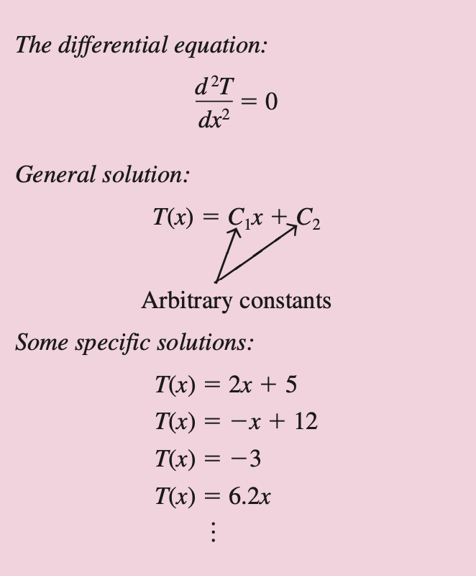
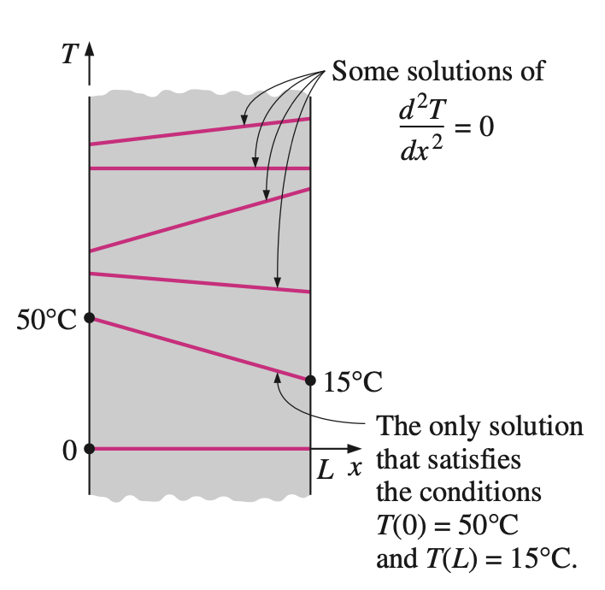
Boundary and Initial Conditions
The heat conduction equations above were developed using an energy balance on a differential element inside the medium, and they remain the same regardless of the thermal conditions on the surfaces of the medium.
That is, the differential equations do not incorporate any information related to the conditions on the surfaces such as the surface temperature or a specified heat flux.
The mathematical expressions of the thermal conditions at the boundaries are called the boundary conditions.
To describe a heat transfer problem completely, two boundary conditions must be given for each direction along which heat transfer is significant.
The general solution of a typical differential equation involves arbitrary constants, and thus an infinite number of solutions.

Slide 24
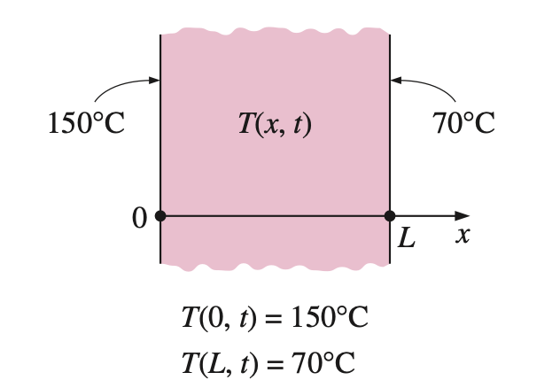
Specified Temperature Boundary Condition
The temperature of an exposed surface can usually be measured directly and easily. Therefore, one of the easiest ways to specify the thermal conditions on a surface is to specify the temperature.
For one-dimensional heat transfer through a plane wall of thickness L, for example, the specified temperature boundary conditions can be expressed as
Specified temperature boundary conditions on both surfaces of a plane wall.

Slide 25
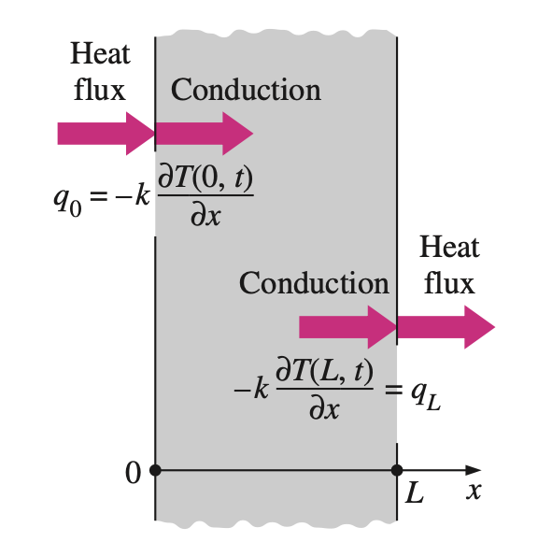
Specified Heat Flux Boundary Condition
The heat flux in the positive x-direction anywhere in the medium, including the boundaries, can be expressed by Fourier’s law of heat conduction as
Then the boundary condition at a boundary is obtained by setting the specified heat flux equal to $k(∂T/∂x)$ at that boundary. The sign of the specified heat flux is determined by inspection: positive if the heat flux is in the positive di- rection of the coordinate axis, and negative if it is in the opposite direction.
Specified heat flux boundary conditions on both surfaces of a plane wall.

