Slide 1
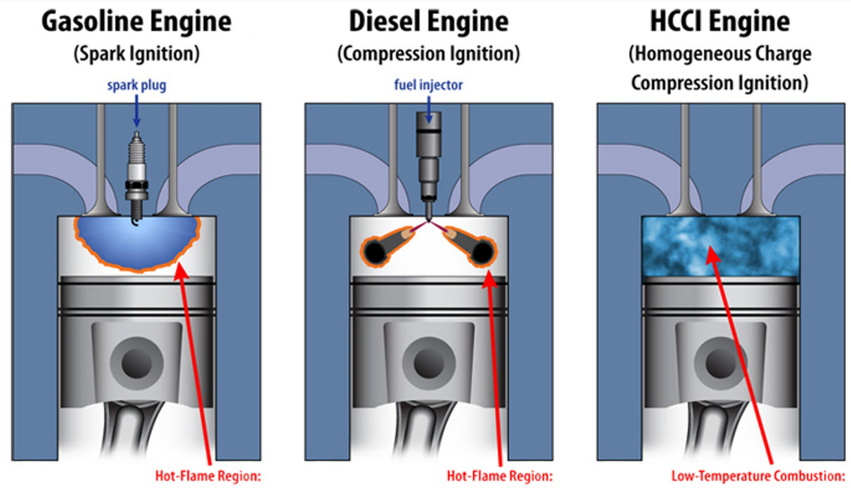
Thermodynamics
An Engineering Approach
Lecture 5: Energy Systems
Qiang Cheng (Jonny)

Slide 2
Learning Outcomes
When you complete your study of this chapter, you will be able to…
Explain the basic principles of vapor power plants.
Develop and analyze thermodynamic models of vapor power plants based on the Rankine cycle and its modifications, including
Sketching schematic and accompanying T-s diagrams.
Applying mass, energy, and entropy balances for the basic processes.
Evaluating property data at principal states in the cycle.
Determining power cycle performance, thermal efficiency, net power output, and mass flow rates.
Describe the effects of varying key parameters on Rankine cycle performance.
Notes:
Heat is energy can be converted from one form to another, or transferred from one object to another. For example, a stove burner converts electrical energy to heat and conducts that energy through the pot to the water. This increases the kinetic energy of the water molecules, causing them to move faster and faster. At a certain temperature (the boiling point), the atoms have gained enough energy to break free of the molecular bonds of the liquid and escape as vapor.

Slide 3
Vapor power Systems

Slide 4
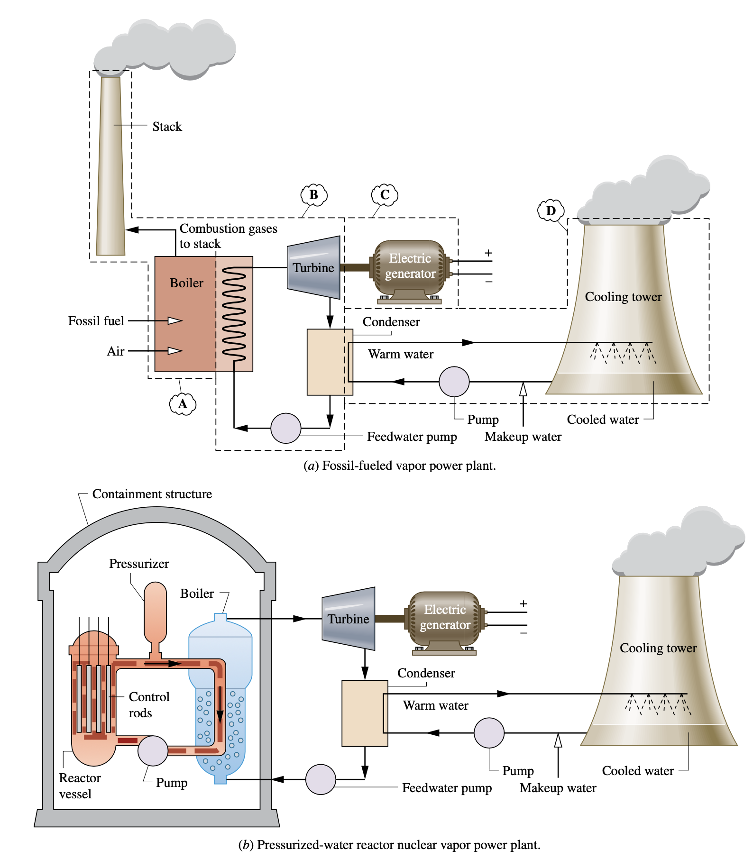
Vapor power plants
Vaporization is accomplished in fossil-fueled plants by heat transfer to water passing through the boiler tubes from hot gases produced in the combustion of the fuel,. This is also seen in plants fueled by biomass, municipal waste (trash), and mixtures of coal and biomass.
In nuclear plants, energy required for vaporizing the cycle working fluid originates in a controlled nuclear reaction occurring in a reactor-containment structure.
The pressurized- water reactor has two water loops: One loop circulates water through the reactor core and a boiler within the containment structure; this water is kept under pressure so it heats but does not boil.
A separate loop carries steam from the boiler to the turbine. Boiling-water reactors (not shown in Fig) have a single loop that boils water flowing through the core and carries steam directly to the turbine.

Slide 5
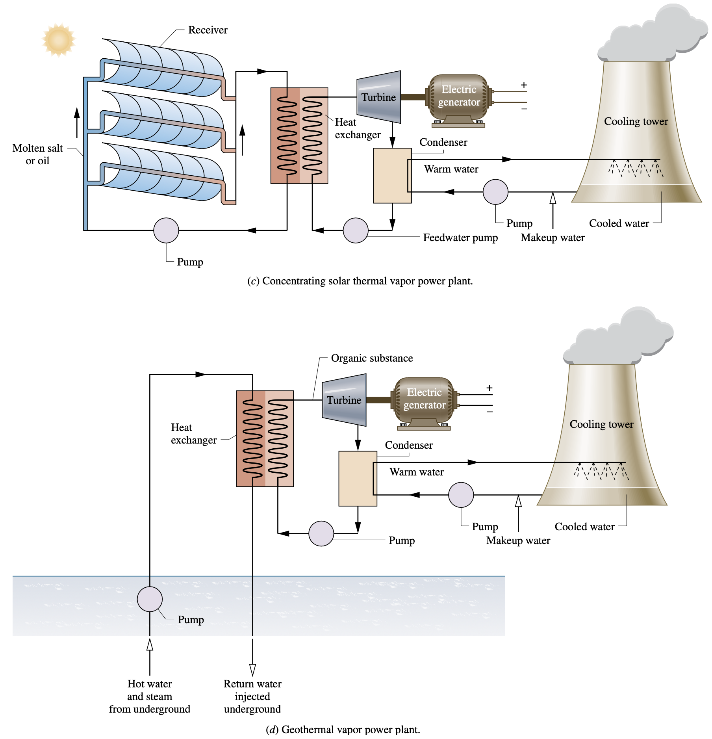
Vapor power plants
Solar power plants have receivers for collecting and concentrating solar radiation. A suitable substance, molten salt or oil, flows through the receiver, where it is heated, directed to an interconnecting heat exchanger that replaces the boiler of the fossil- and nuclear-fueled plants, and finally returned to the receiver. The heated molten salt or oil provides energy required to vaporize water flowing in the other stream of the heat exchanger. This steam is provided to the turbine.
The geothermal power plant also uses an interconnecting heat exchanger. In this case hot water and steam from deep below Earth’s surface flows on one side of the heat exchanger. A secondary working fluid having a lower boiling point than the water, such as isobutane or another organic substance, vaporizes on the other side of the heat exchanger. The secondary working fluid vapor is provided to the turbine.

Slide 6
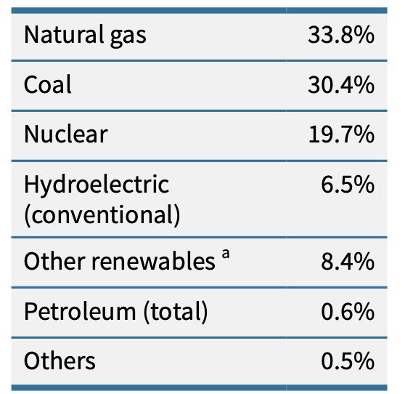
Vapor power plants
Referring to subsystem B of Fig. a again, observe that each unit of mass of working fluid periodically undergoes a thermodynamic cycle as it circulates through the series of interconnected components. This cycle is the Rankine cycle.
current u.s. Electricity generation by source
Important concepts introduced in previous chapters for thermodynamic power cycles generally also apply to the Rankine cycle:
The first law of thermodynamics requires that the net work developed by a system undergoing a power cycle must equal the net energy added by heat transfer to the system .
The second law of thermodynamics requires that the thermal efficiency of a power cycle must be less than 100%
a Renewable sources including solar, excluding hydroelectric Source: United States Energy Information Administration, 2016, Net Generation by Energy Source: total (All Sectors)

Slide 7
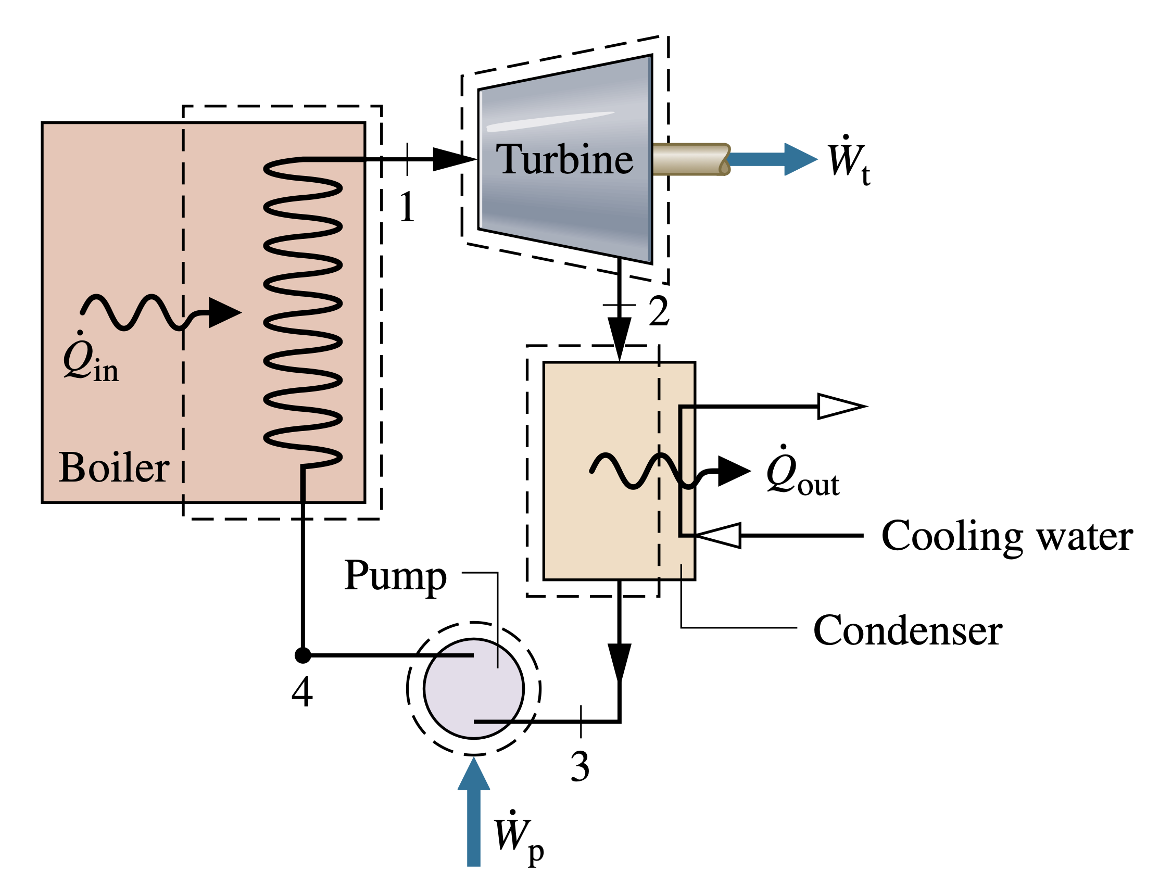
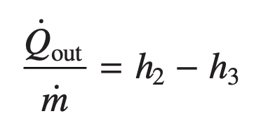
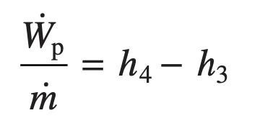
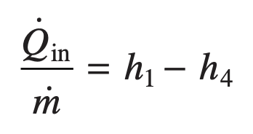
Modeling the Rankine Cycle
Turbine
Condenser
Pump
Boiler
Performance Parameters

Slide 8
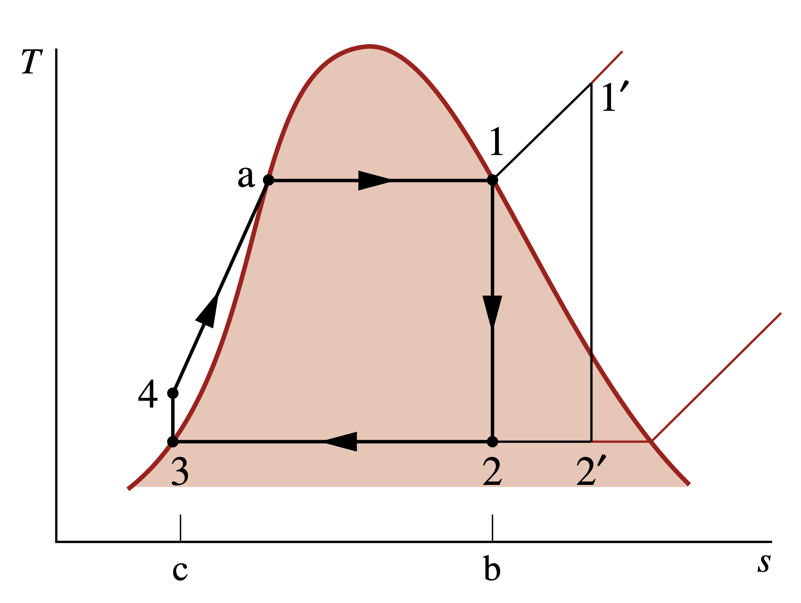
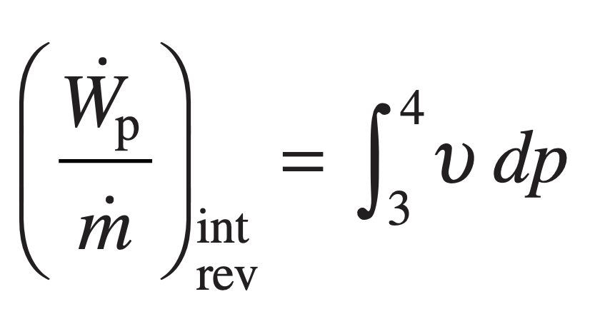
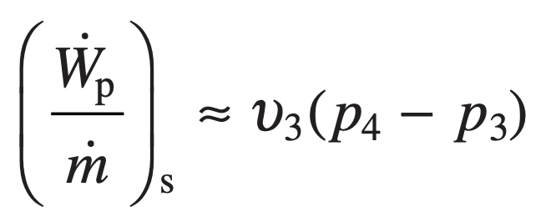
Ideal Rankine Cycle
If the working fluid passes through the various components of the simple vapor power cycle without irreversibilities, frictional pressure drops would be absent from the boiler and condenser, and the working fluid would flow through these components at constant pressure. Also, in the absence of irreversibilities and heat transfer with the surroundings, the processes through the turbine and pump would be isentropic. A cycle adhering to these idealizations is the ideal Rankine cycle
Process 1–2 Isentropic expansion of the working fluid through the turbine from saturated vapor at state 1 to the condenser pressure.
Process 2–3 Heat transfer from the working fluid as it flows at constant pressure through the condenser exiting as saturated liquid at state 3.
Process 3–4 Isentropic compression in the pump to state 4 in the compressed liquid region.
Process 4–1 Heat transfer to the working fluid as it flows at constant pressure through the boiler to complete the cycle.
Temperature–entropy diagram of the ideal Rankine cycle
Because the pump is idealized as operating without irreversibilities

Slide 9
principal Irreversibilities and Losses
Turbine
Frictional effects resulting in pressure reductions are additional sources of internal irreversibility as the working fluid flows through the boiler, condenser, and piping connecting the several components.
Pump
pump inlet state 3 falls in the liquid region and is not saturated liquid as in Fig. 8.3, giving lower average temperatures of heat addition and rejection.
Yet the most significant source of irreversibility by far for a fossil-fueled vapor power plant is associated with combustion of the fuel and subsequent heat transfer from hot combustion gases to the cycle working fluid.
Another effect occurring in the surroundings of subsystem B is energy discharged by heat transfer to cooling water as the working fluid condenses.
Notes:
https://www.thoughtco.com/list-of-phase-changes-of-matter-608361

Slide 10
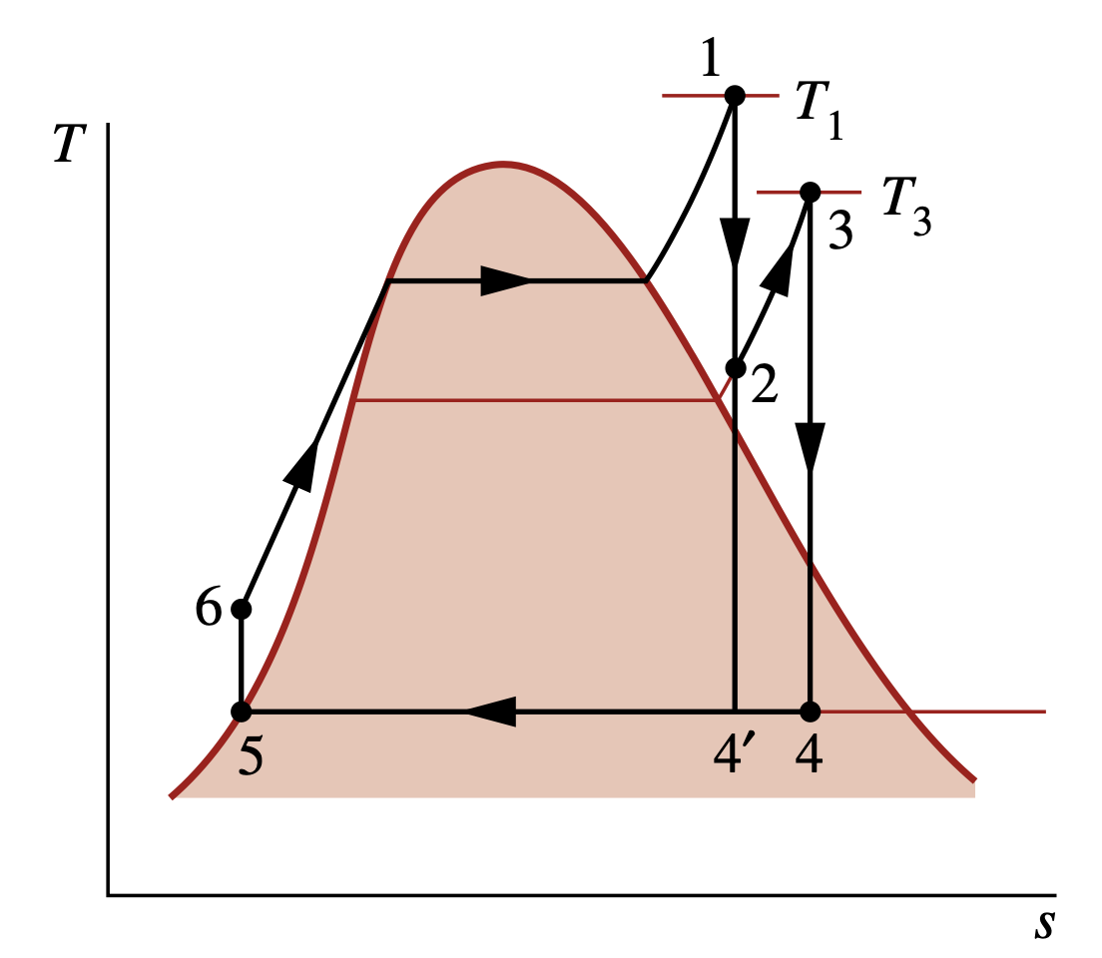
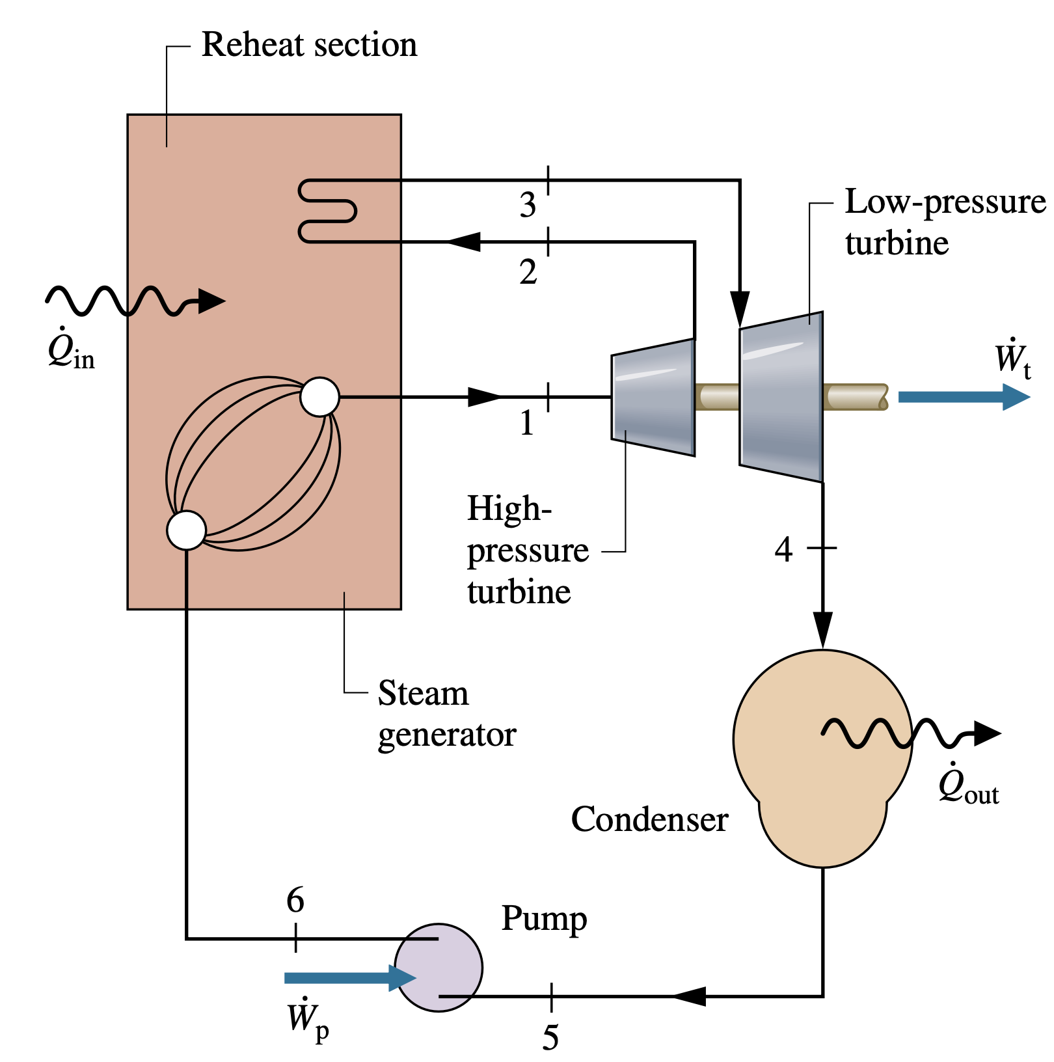
Improving performance—Superheat,
Reheat, and Supercritical
As we are not limited to having saturated vapor at the turbine inlet, further energy can be added by heat transfer to the steam, bringing it to a superheated vapor condition at the turbine inlet. This is accomplished in a separate heat exchanger called a superheater.
Superheat
Reheat A further modification normally employed in vapor power plants is reheat. With reheat, a power plant can take advantage of the increased efficiency that results with higher boiler pressures and yet avoid low-quality steam at the turbine exhaust.

Slide 11
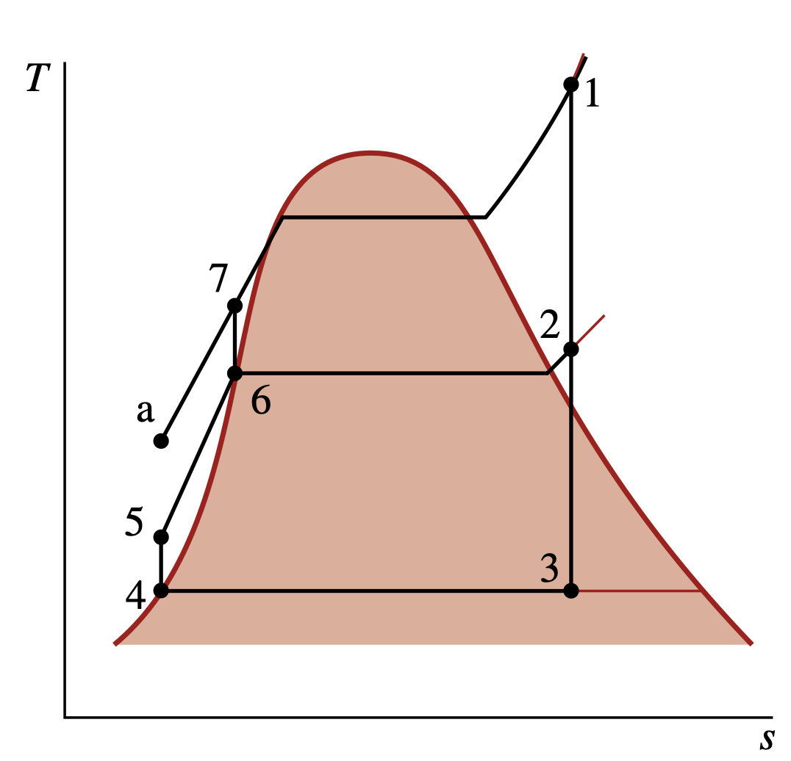
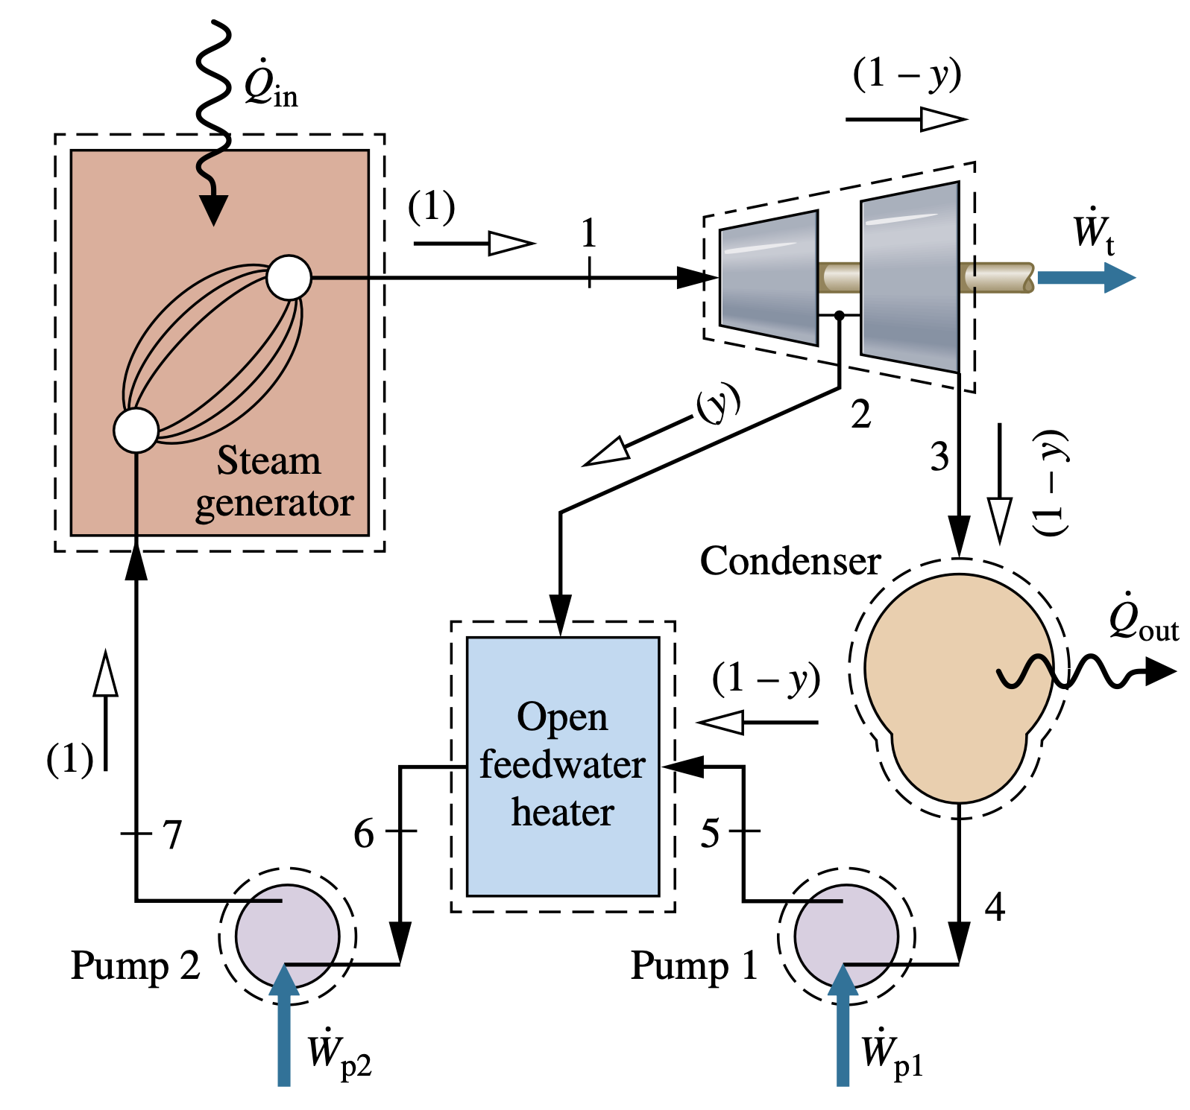
Improving performance—Regenerative Vapor power Cycle
Let us consider how regeneration can be accomplished using an open feedwater heater, a type of direct-contact heat exchanger in which streams at different temperatures mix to form a stream at an intermediate temperature.

Slide 12
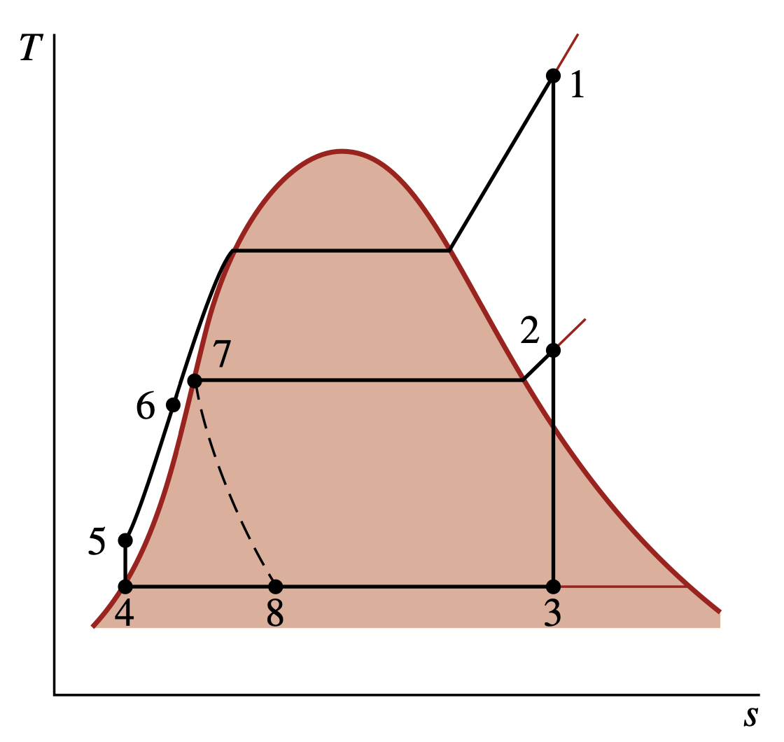
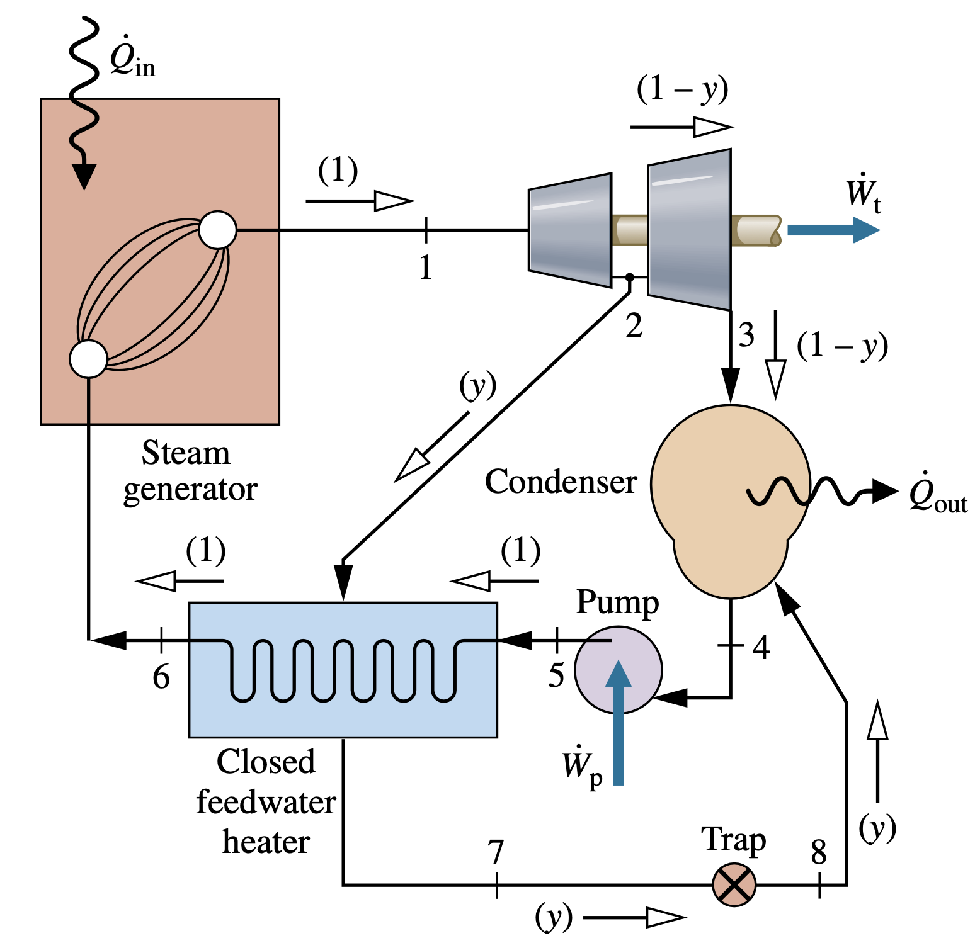
Closed Feedwater heaters
Regenerative feedwater heating also can be accomplished with closed feedwater heaters. Closed heaters are shell-and-tube-type recuperators in which the feedwater temperature in- creases as the extracted steam condenses on the outside of the tubes carrying the feedwater. Since the two streams do not mix, they can be at different pressures.

Slide 13
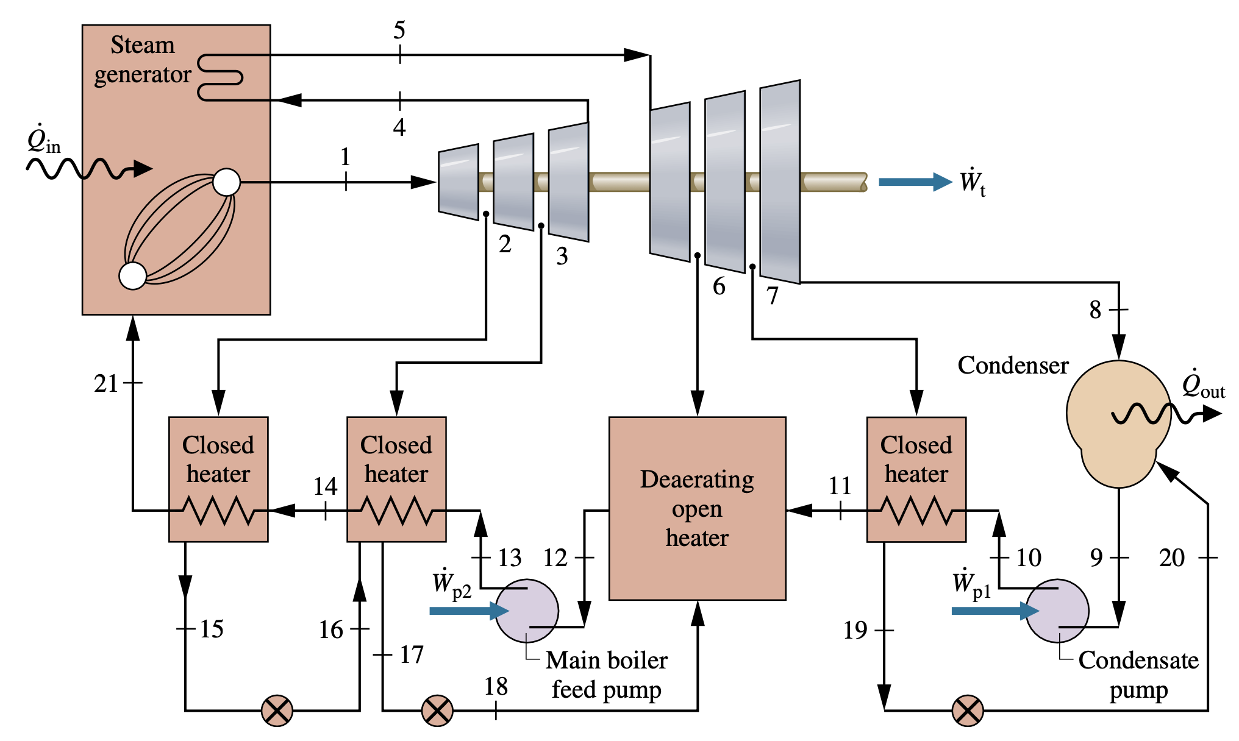
Multiple Feedwater heaters

Slide 14
Gas power Systems

Slide 15
Considering Internal Combustion Engines

Slide 16
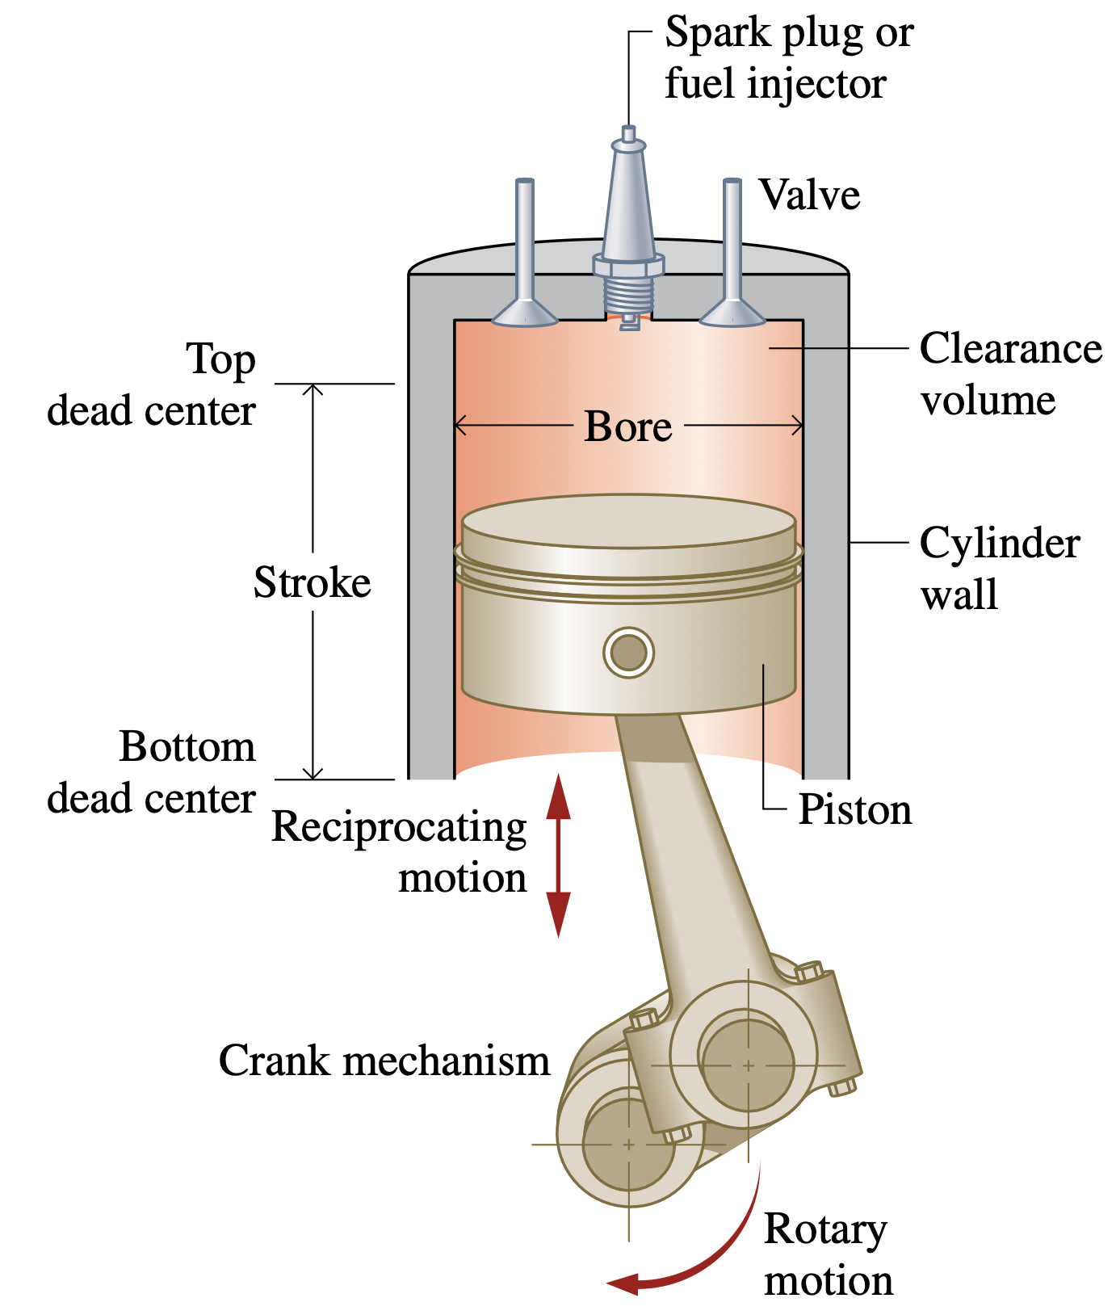
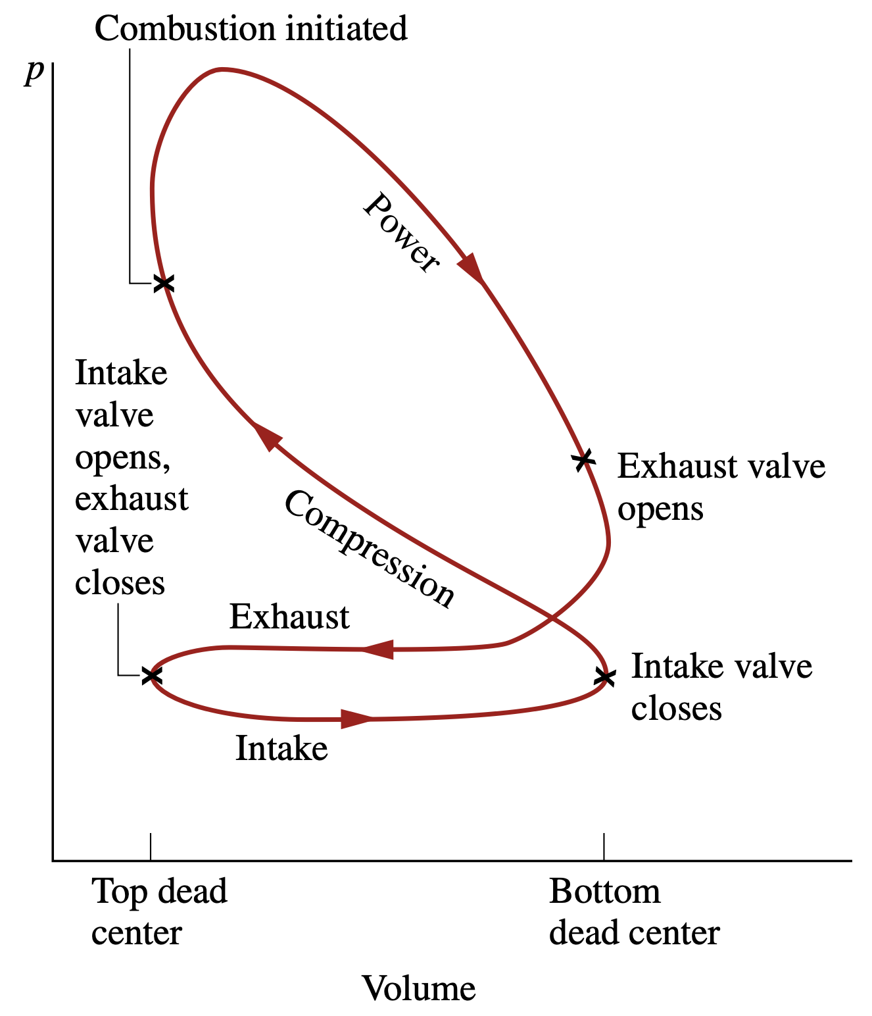
Considering Internal Combustion Engines

Slide 17
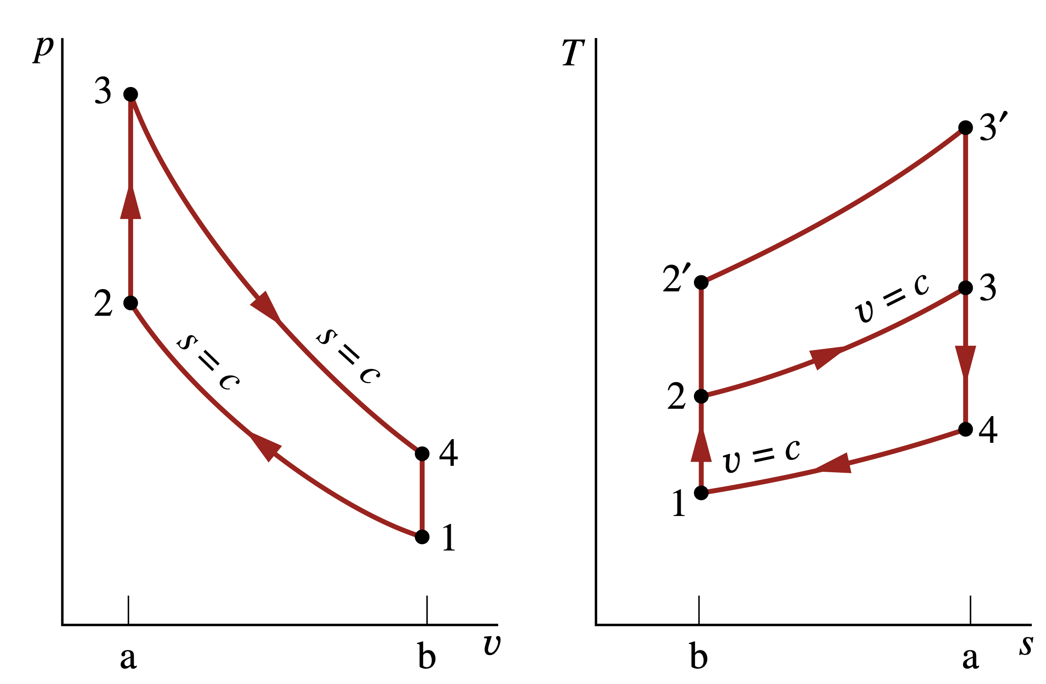
Air-Standard Otto Cycle
Process 1–2: An isentropic compression of the air as the piston moves from bottom dead center to top dead center.
Process 2–3: A constant-volume heat transfer to the air from an external source while the piston is at top dead center. This process is intended to represent the ignition of the fuel–air mixture and the subsequent rapid burning.
Process 3–4: An isentropic expansion (power stroke). Process 4–1: Completes the cycle by a constant-volume process in which heat is rejected
from the air while the piston is at bottom dead center.
p–υ and T–s diagrams of the air-standard Otto cycle.

Slide 18
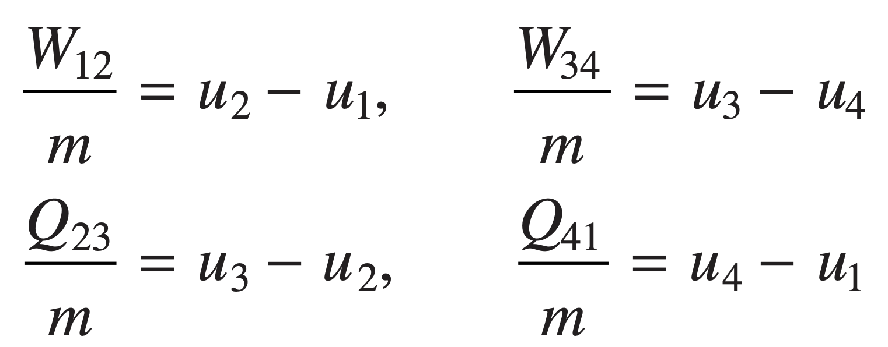
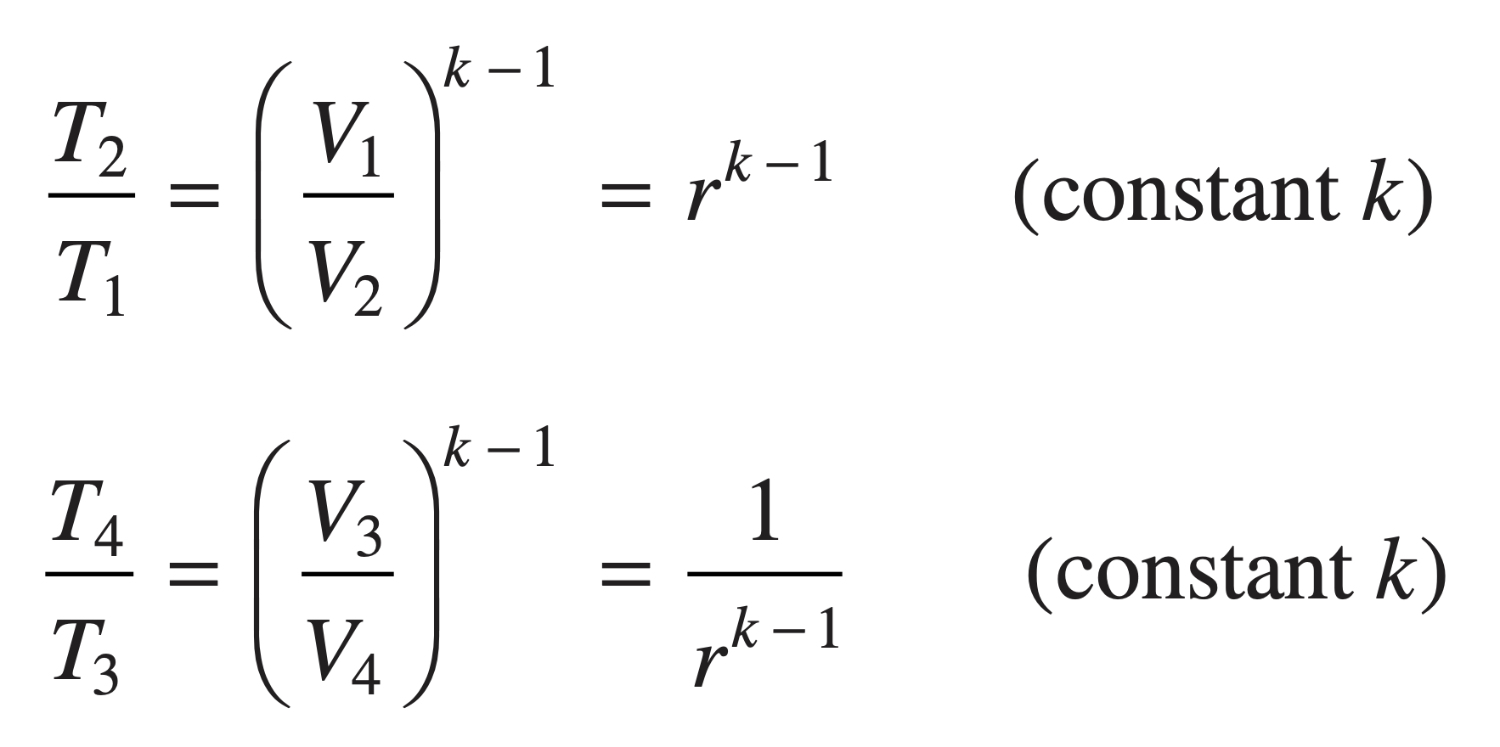
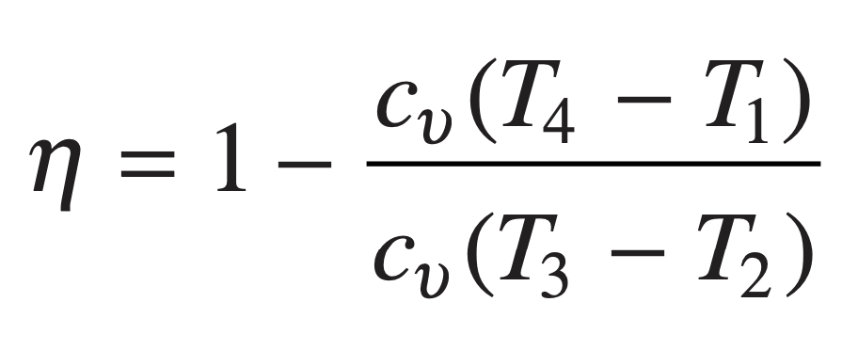
Cycle Analysis
The thermal efficiency is the ratio of the net work of the cycle to the heat added.
When analyzing air-standard cycles, it is frequently convenient to regard all work and heat transfers as positive quantities and write the energy balance accordingly.
compression ratio
The net work of the cycle is expressed as
where k is the specific heat ratio, k = cp/cυ.
the net heat added

Slide 19
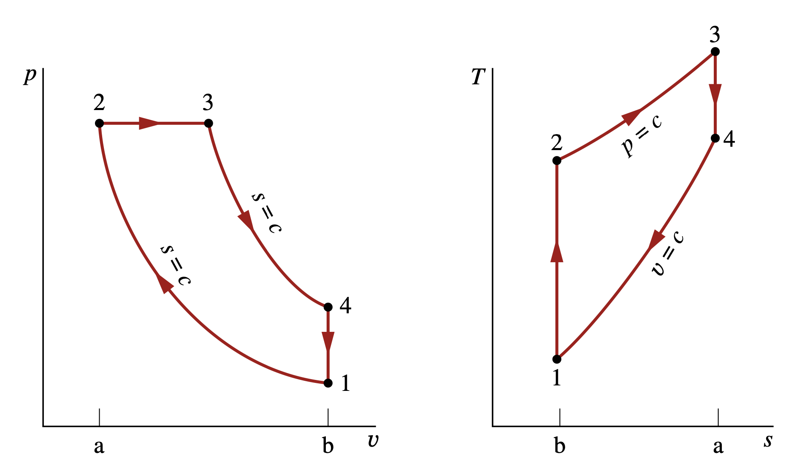
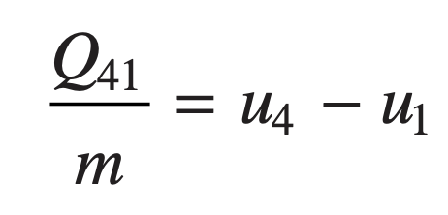
Air-Standard Diesel Cycle
Cycle Analysis In the Diesel cycle the heat addition takes place at constant pressure.
The heat added in Process 2–3 can be found by applying the closed system energy balance
p–υ and T–s diagrams of the air-standard Diesel cycle.

Slide 20
Gas turbine power plants

Slide 21
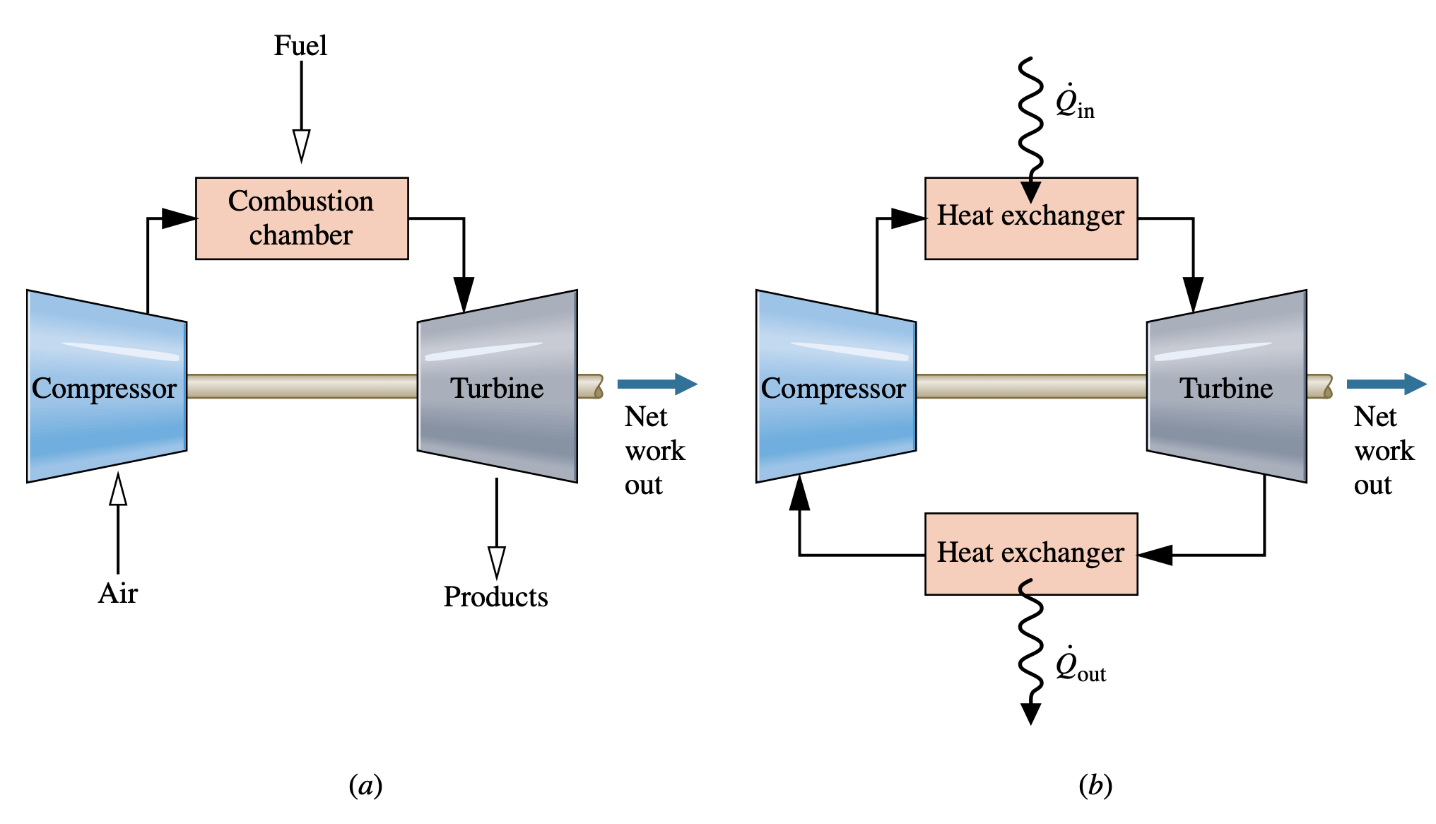
Modeling Gas turbine power plants
Simple gas turbine. (a) Open to the atmosphere. (b) Closed.

Slide 22
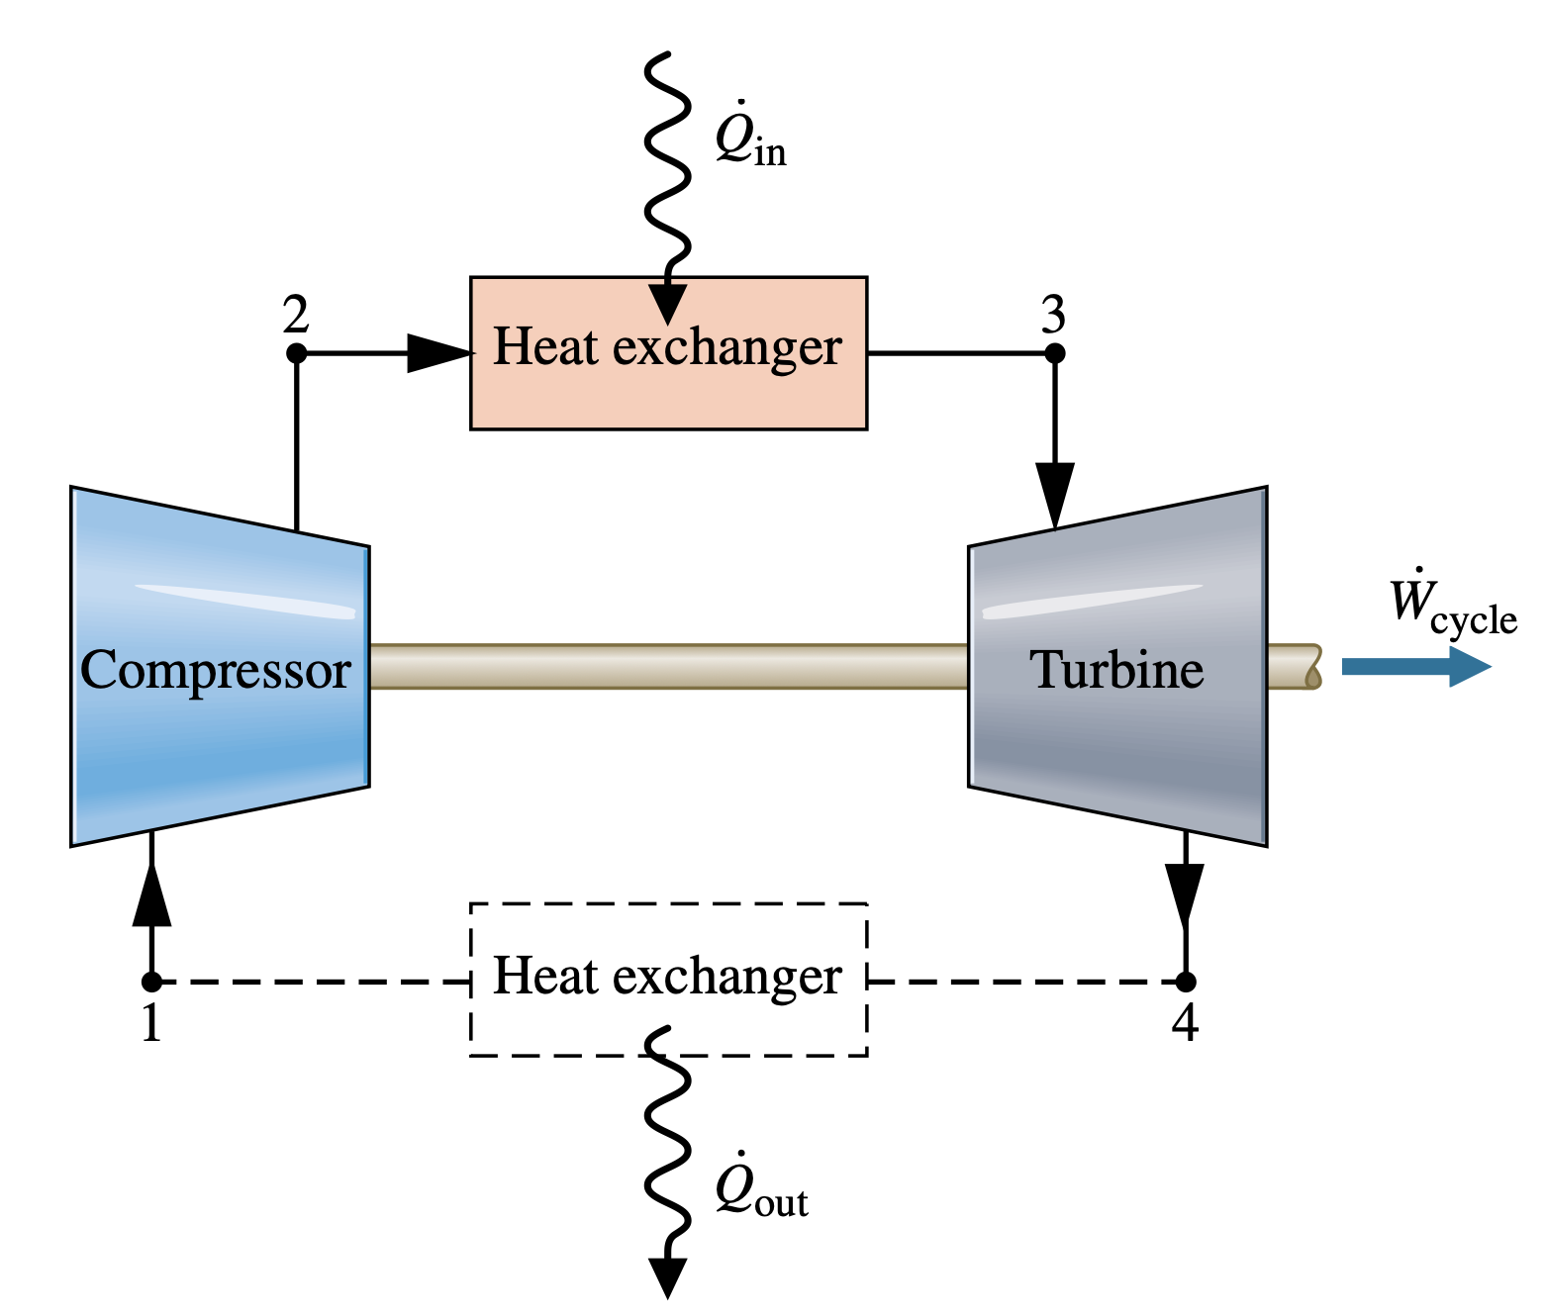
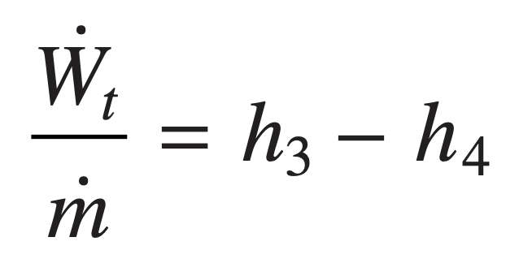
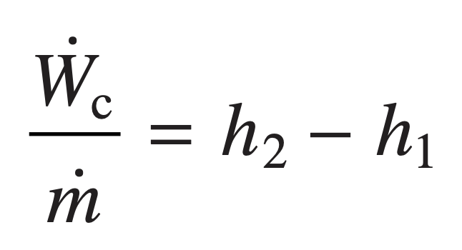
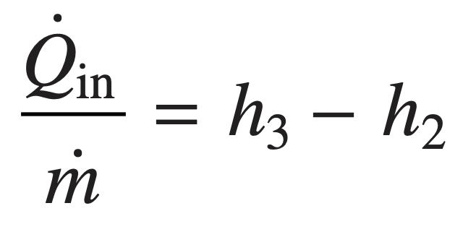
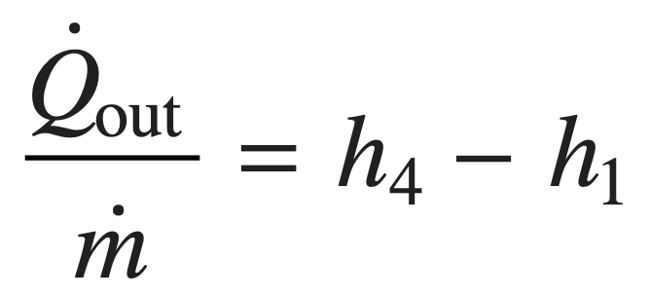
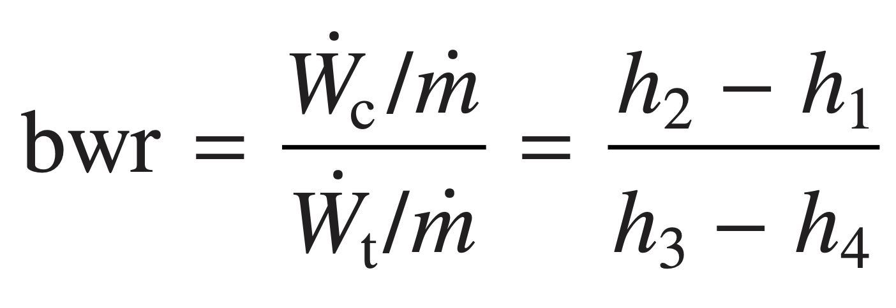
Air-Standard Brayton Cycle
Assuming the turbine and compressor operates adiabatically and with negligible effects of kinetic and potential energy, the work developed per unit of mass flowing is
turbine
Compressor
The heat added and rejected to the cycle per unit of mass is
added
Rejected
Air-standard gas turbine cycle.
The back work ratio for the cycle is

Slide 23
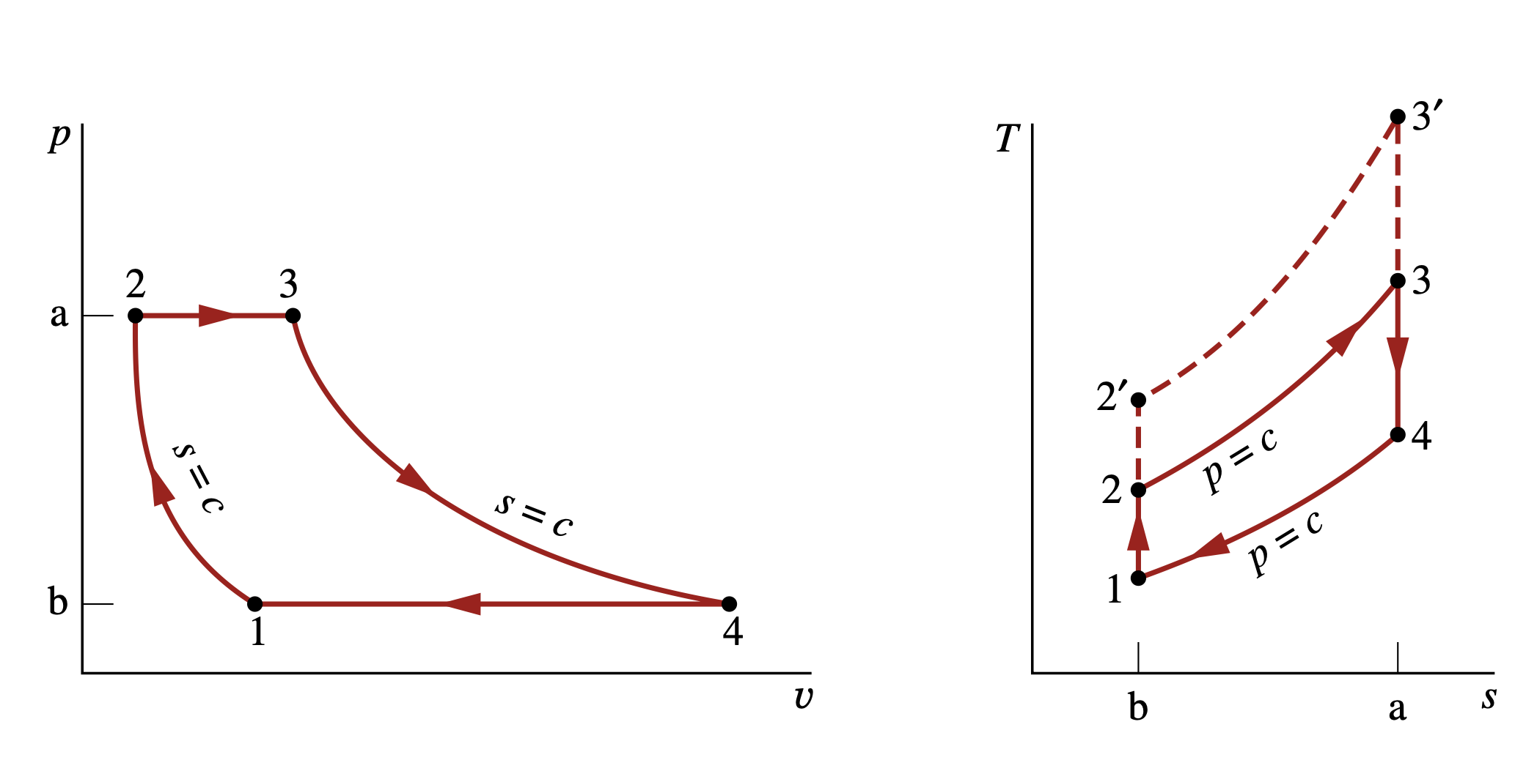
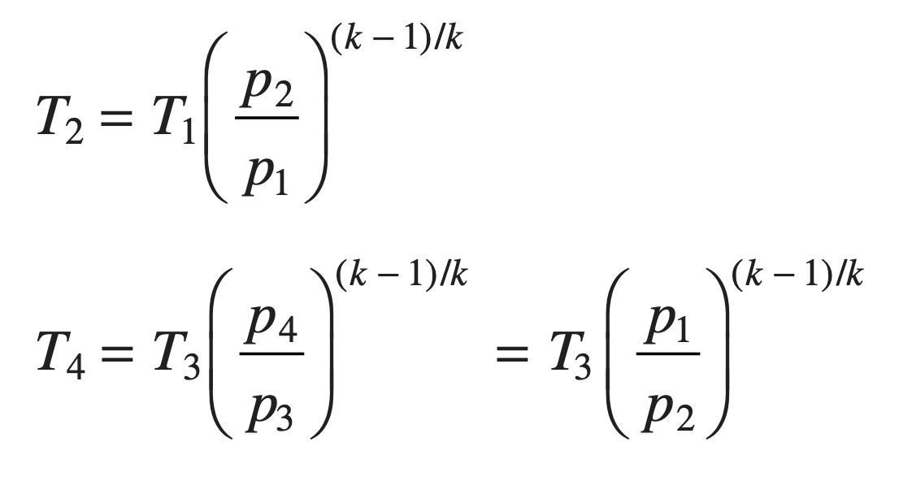
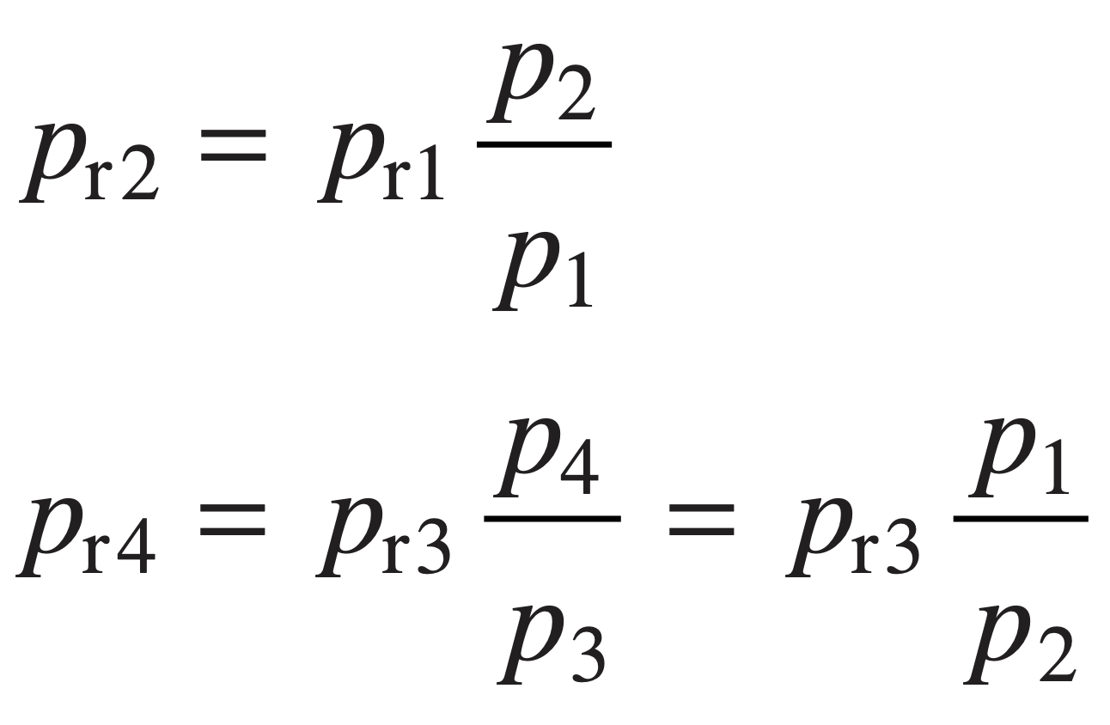
Ideal Air-Standard Brayton Cycle
When an ideal Brayton cycle is analyzed on a cold air-standard basis, the specific heats are taken as constant.
Air-standard ideal Brayton cycle.
When air table data are used to conduct an analysis involving the ideal Brayton cycle, the following relationships, apply for the isentropic processes 1–2 and 3–4:

Slide 24
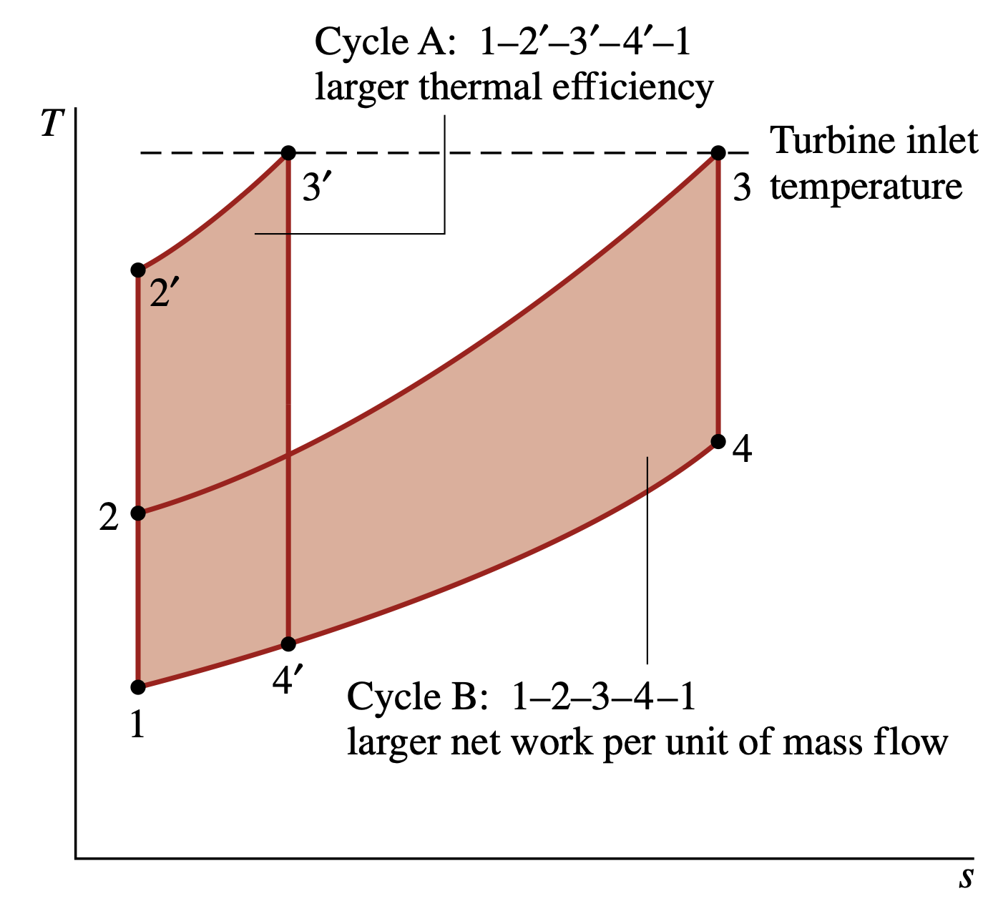
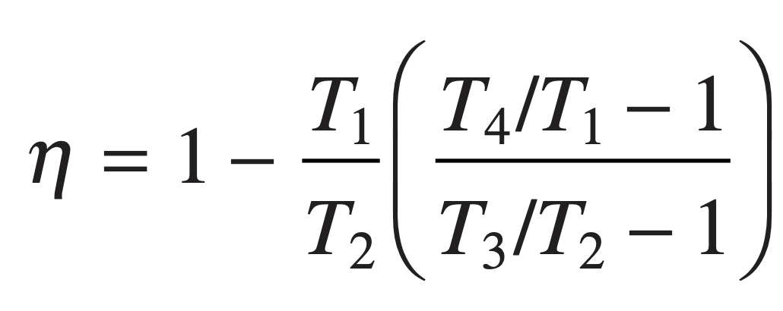
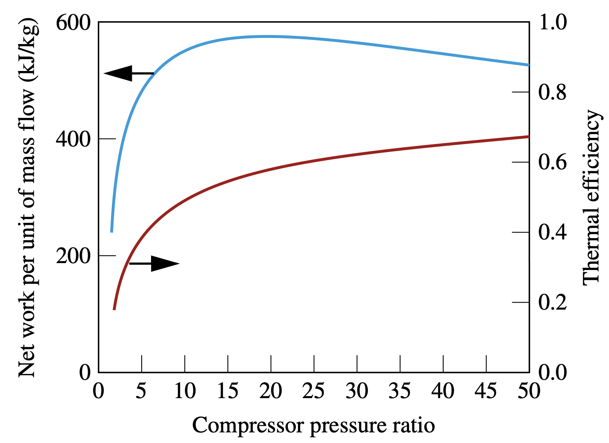
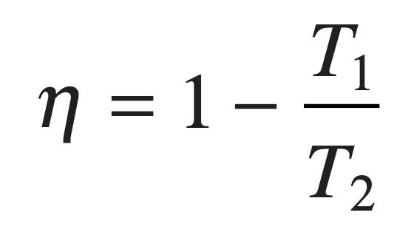
Ideal Air-Standard Brayton Cycle
Effect of compressor Pressure Ratio on Performance
The increase in thermal efficiency with the pressure ratio across the compressor is also brought out simply by the following development, in which the specific heat cp and, thus, the specific heat ratio k are assumed constant. For constant cp
Ideal Brayton cycle thermal efficiency and net work per unit of mass flow versus compressor pressure ratio for k = 1.4, a turbine inlet temperature of 1700 K, and a compressor inlet temperature of 300 K.
Since T4/T1 = T3/T2
Ideal Brayton cycles with different compressor pressure ratios and the same turbine inlet temperature.

Slide 25
Gas turbine–Based Combined Cycles

Slide 26
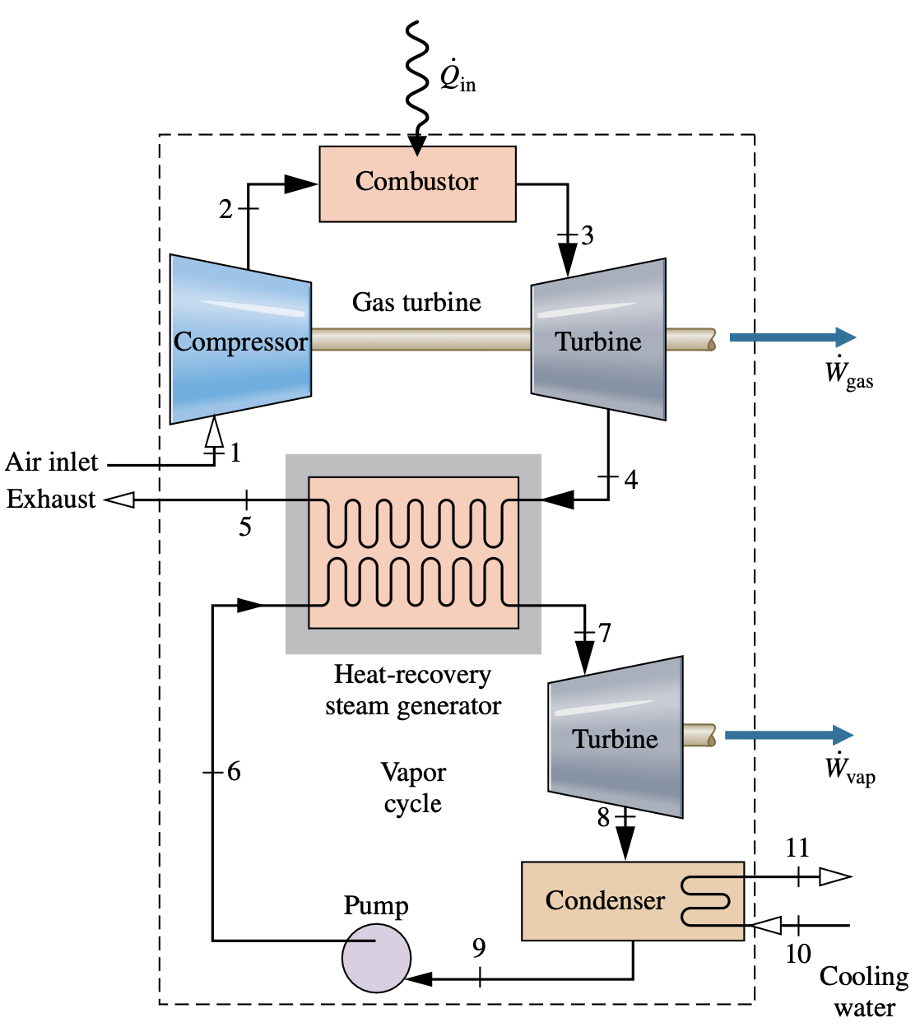
Combined Gas turbine–Vapor power Cycle

Slide 27
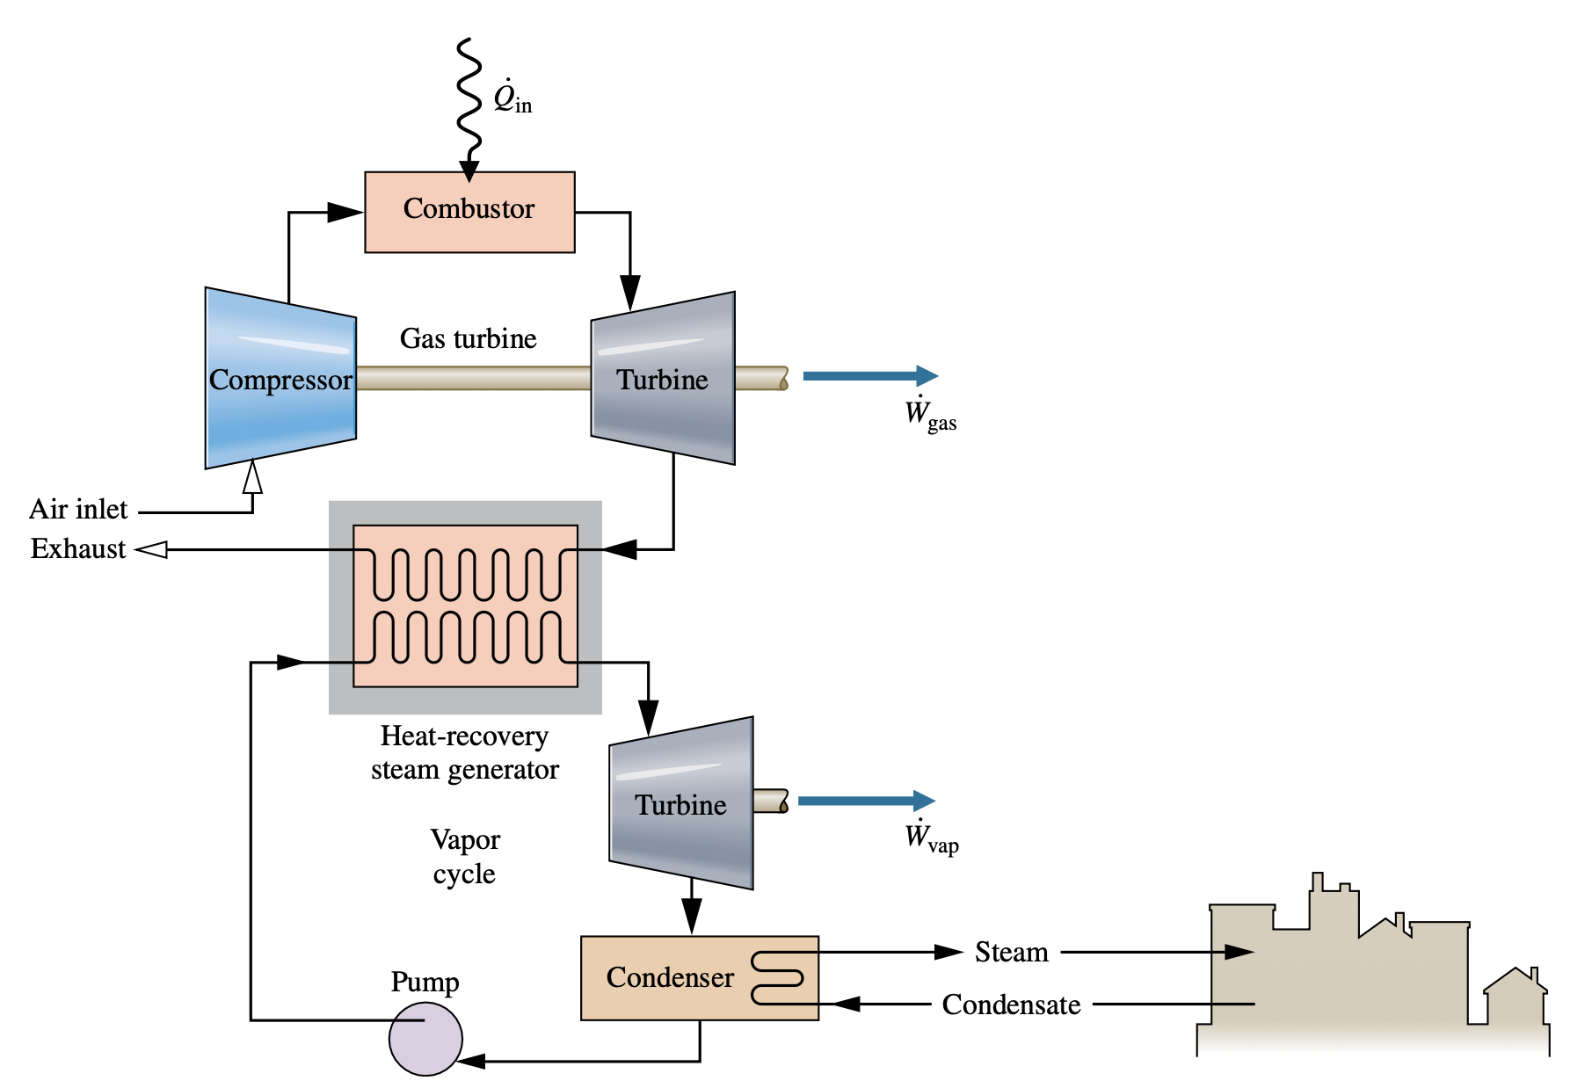
Combined-cycle district heating plant

Slide 28
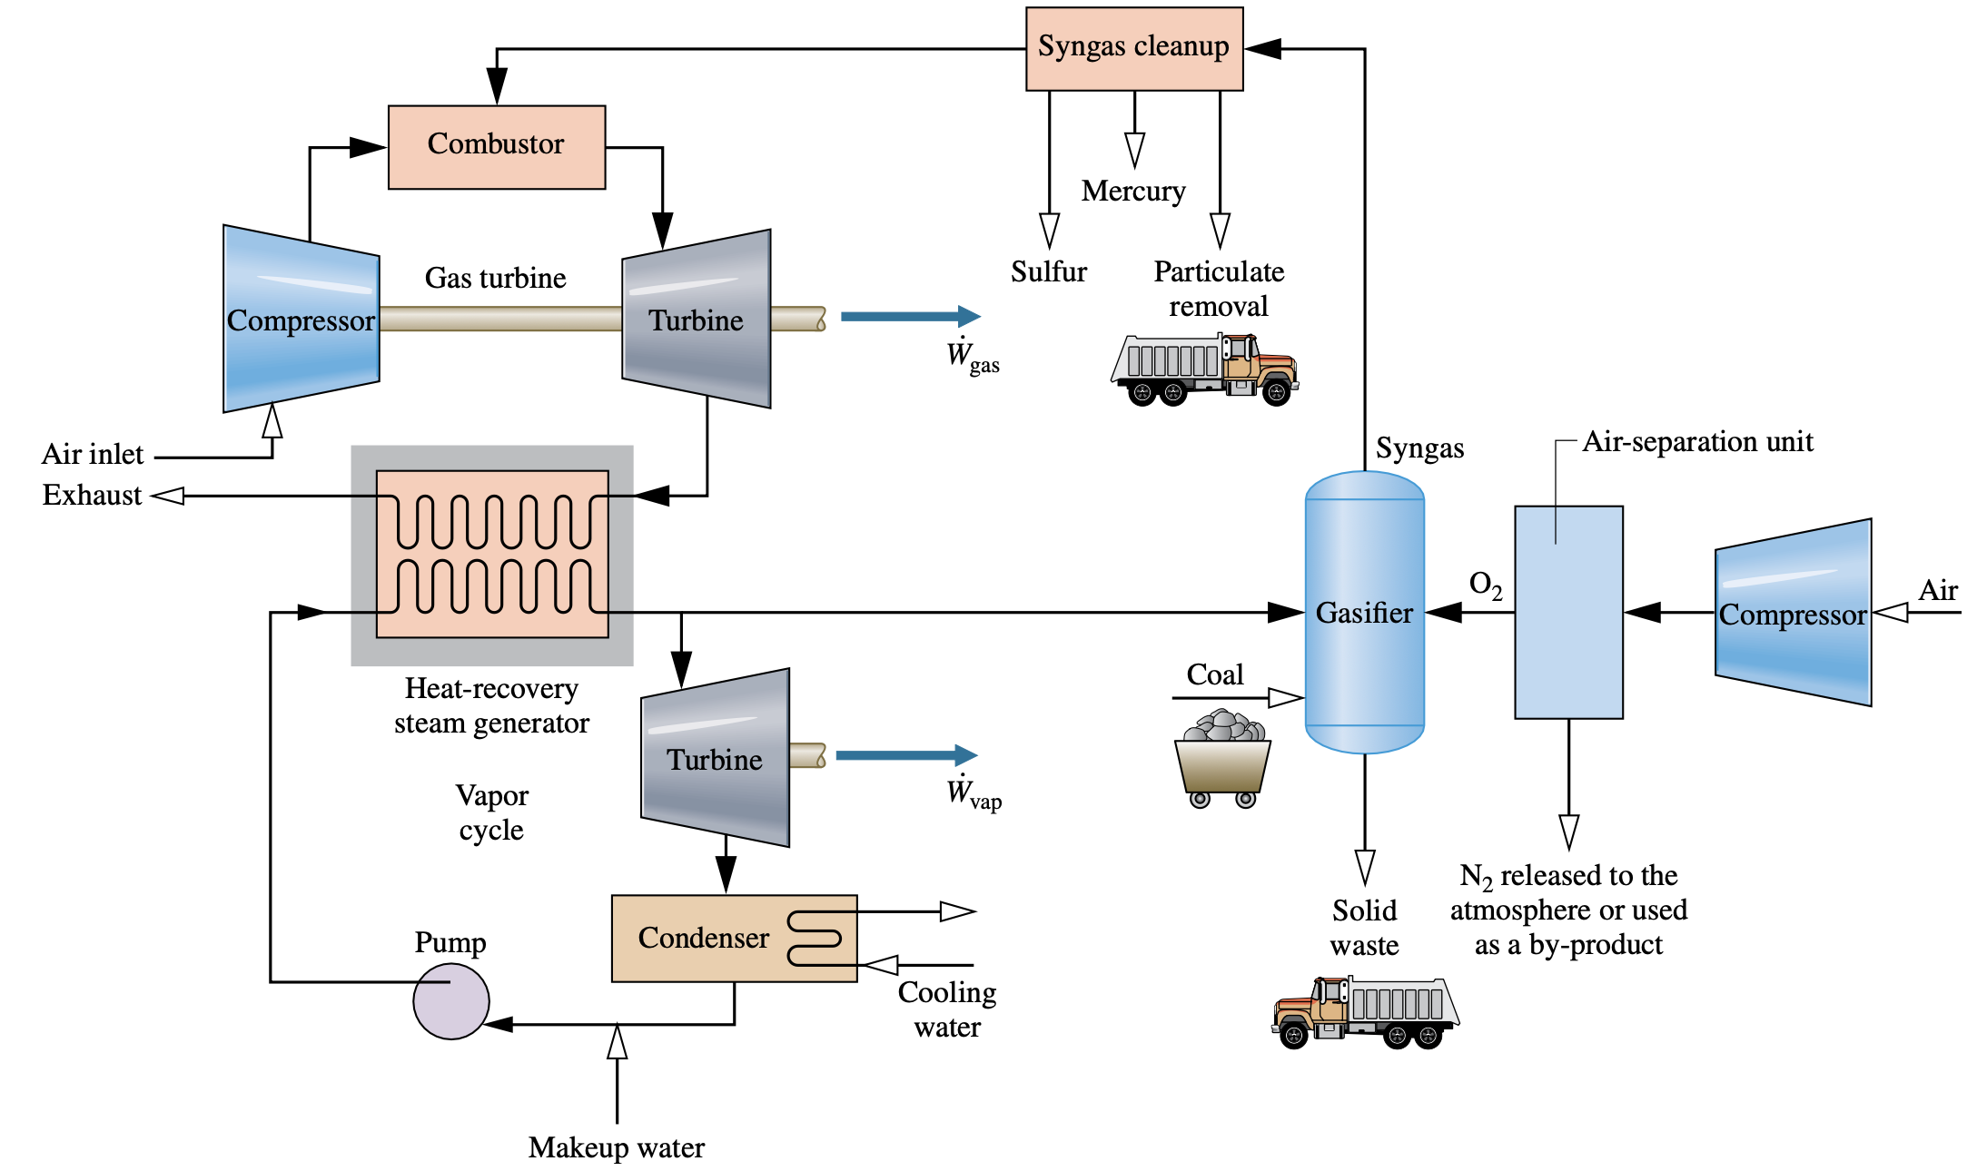
Integrated Gasification Combined-Cycle power plants

Slide 29
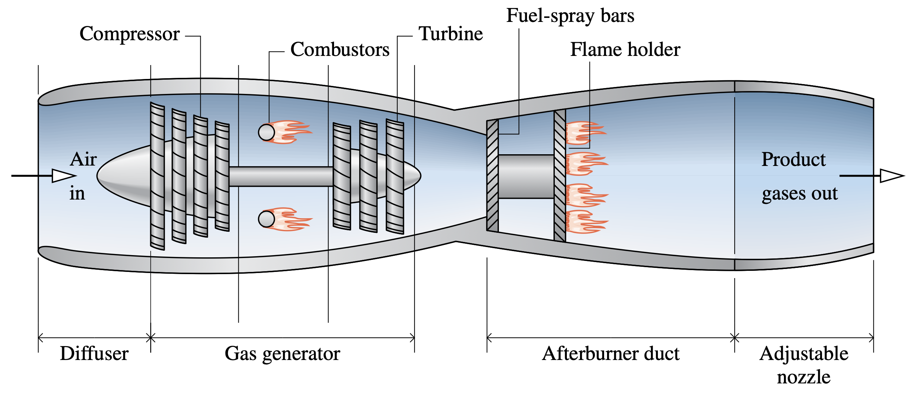
Gas turbines for Aircraft propulsion
Schematic of a turbojet engine with afterburner.

Slide 30
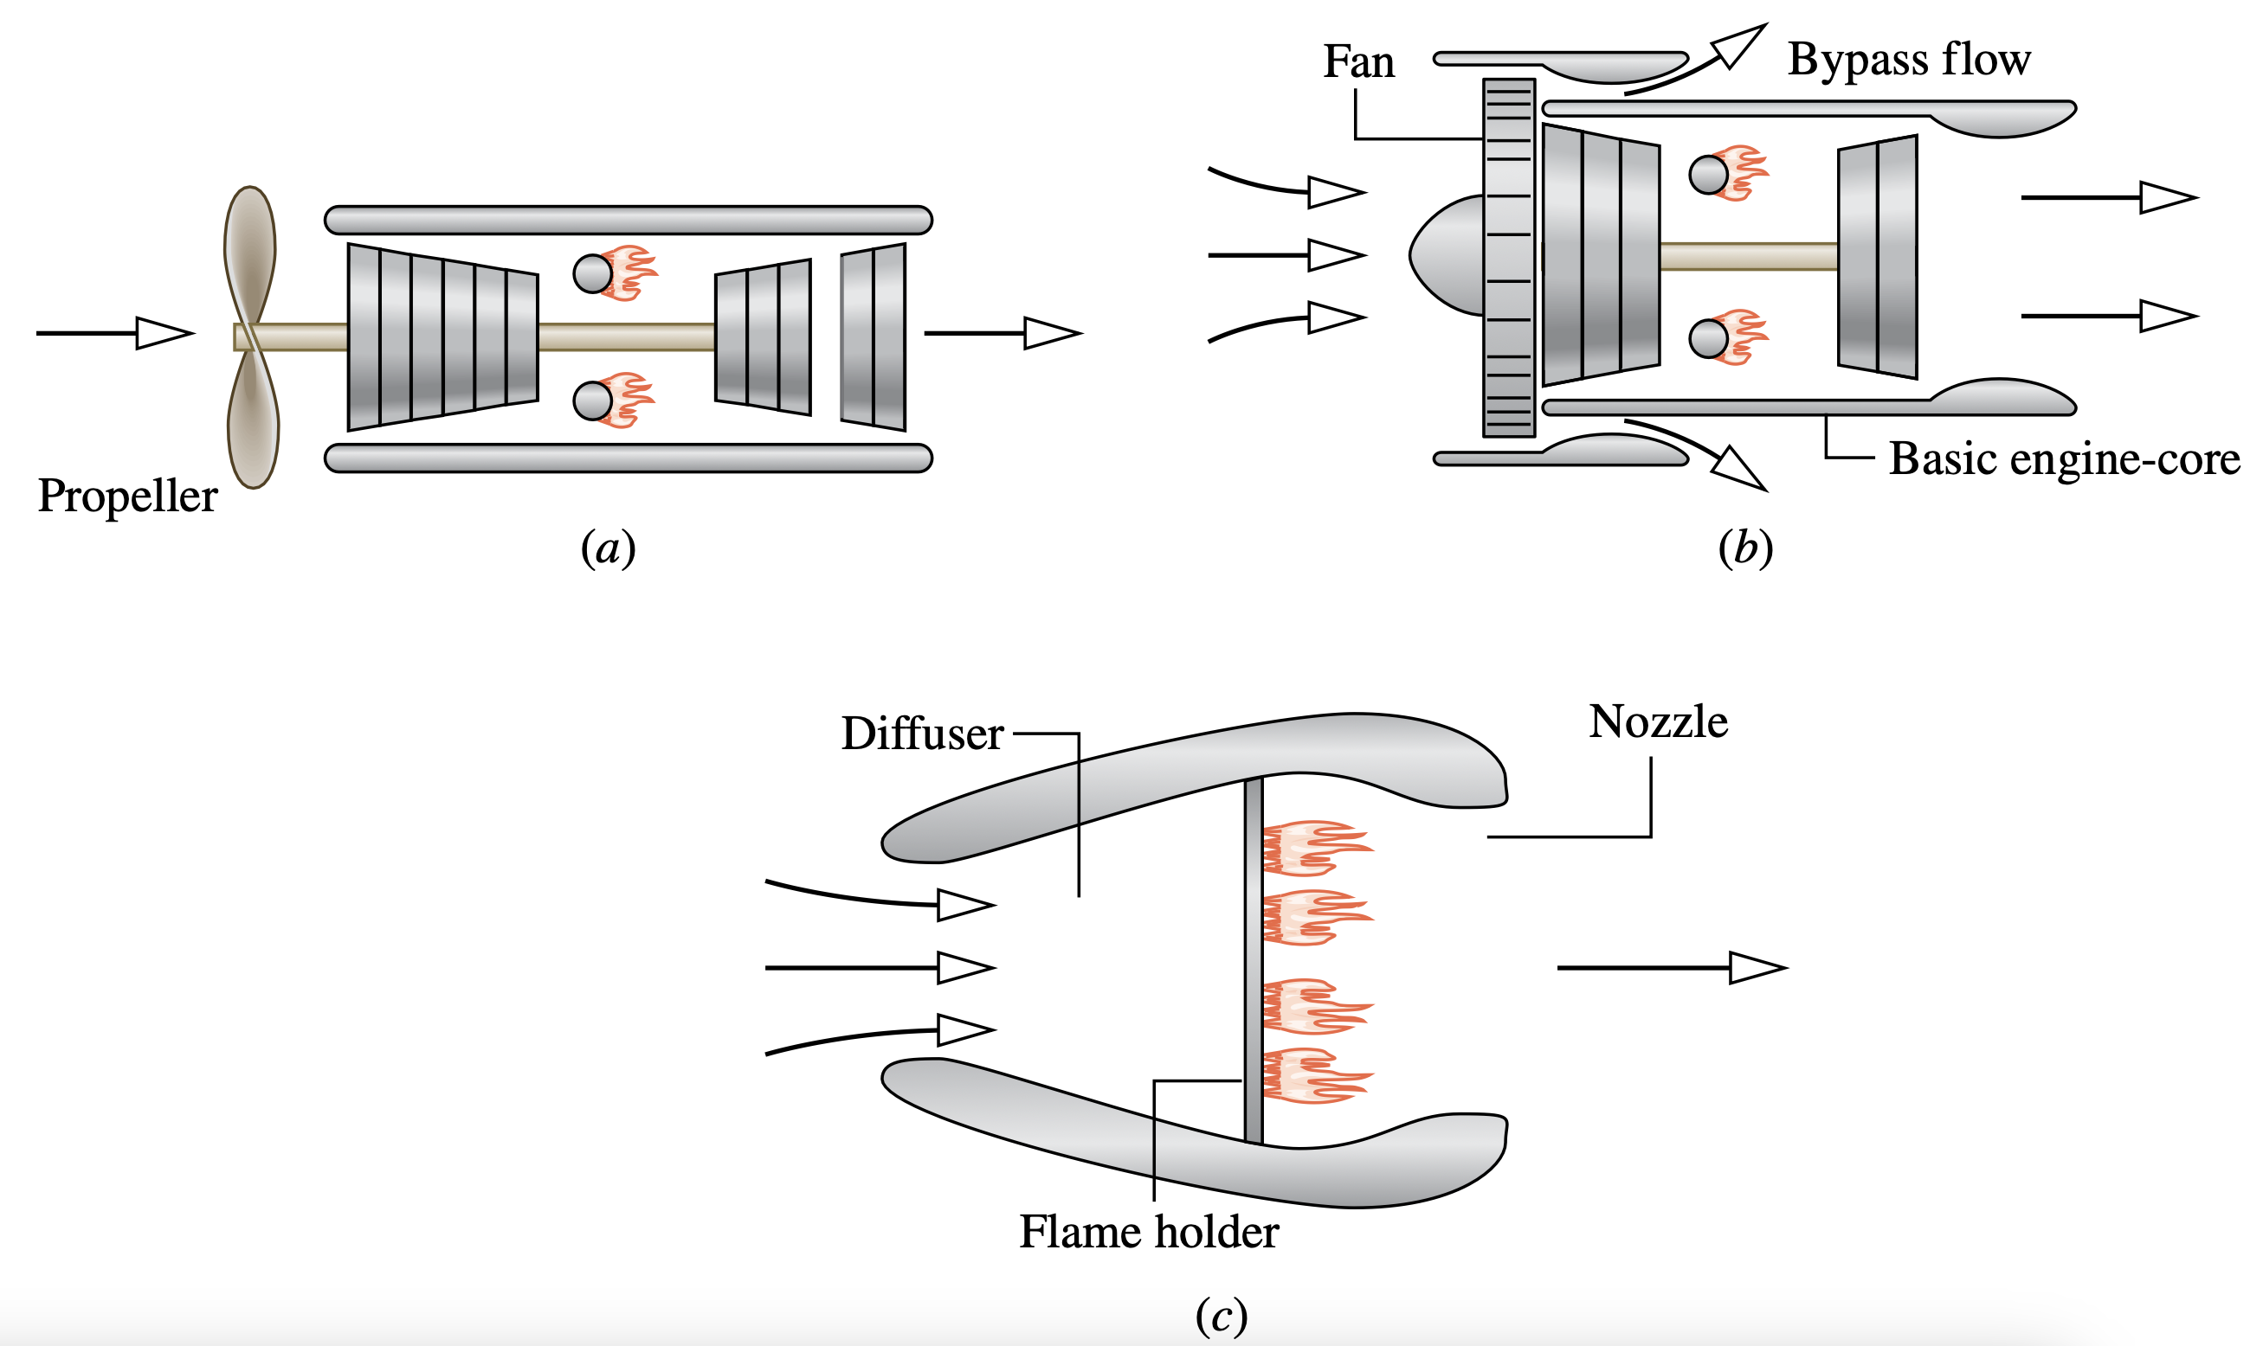
Applications of the Rate Balances to Control Volumes at Steady State
Other examples of aircraft engines. (a) Turboprop. (b) Turbofan. (c) Ramjet.

Slide 31
Refrigeration

Slide 32
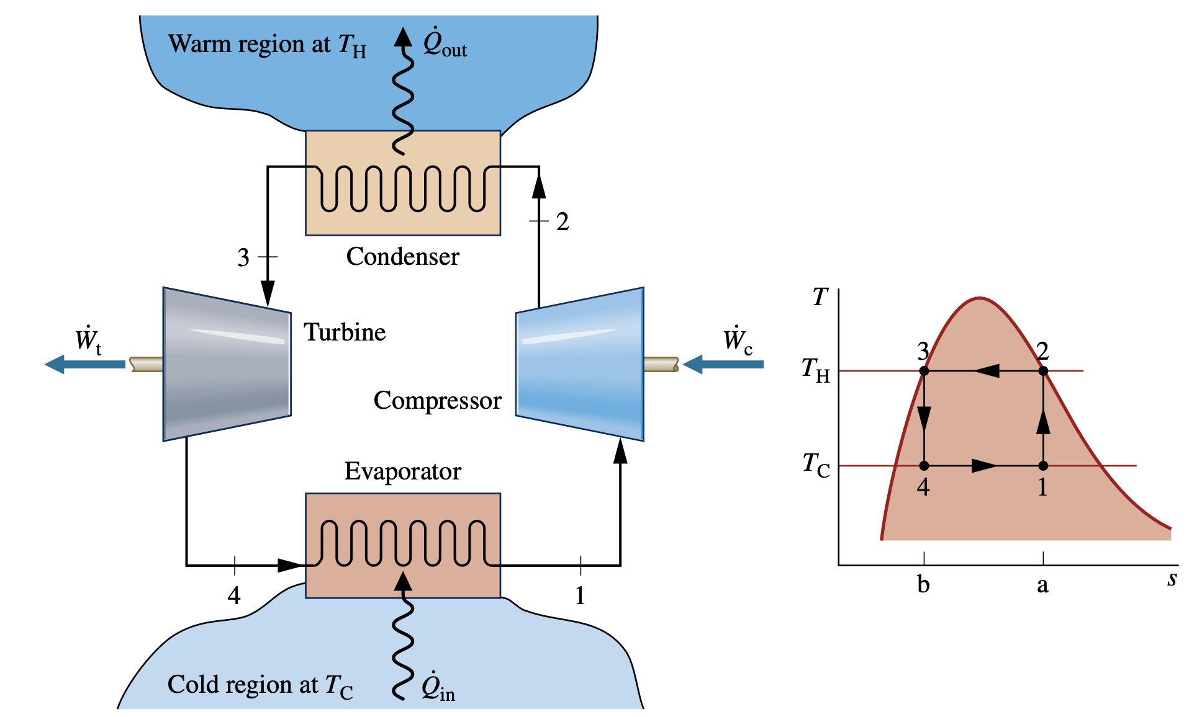
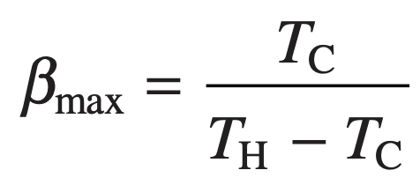
Vapor refrigeration Systems
The coefficient of performance β of any refrigeration cycle is the ratio of the refrigeration effect to the net work input required to achieve that effect. For the Carnot vapor refrigeration cycle shown in Fig. 10.1, the coefficient of performance is
Carnot vapor refrigeration cycle

Slide 33
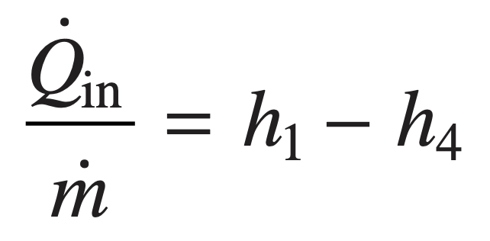
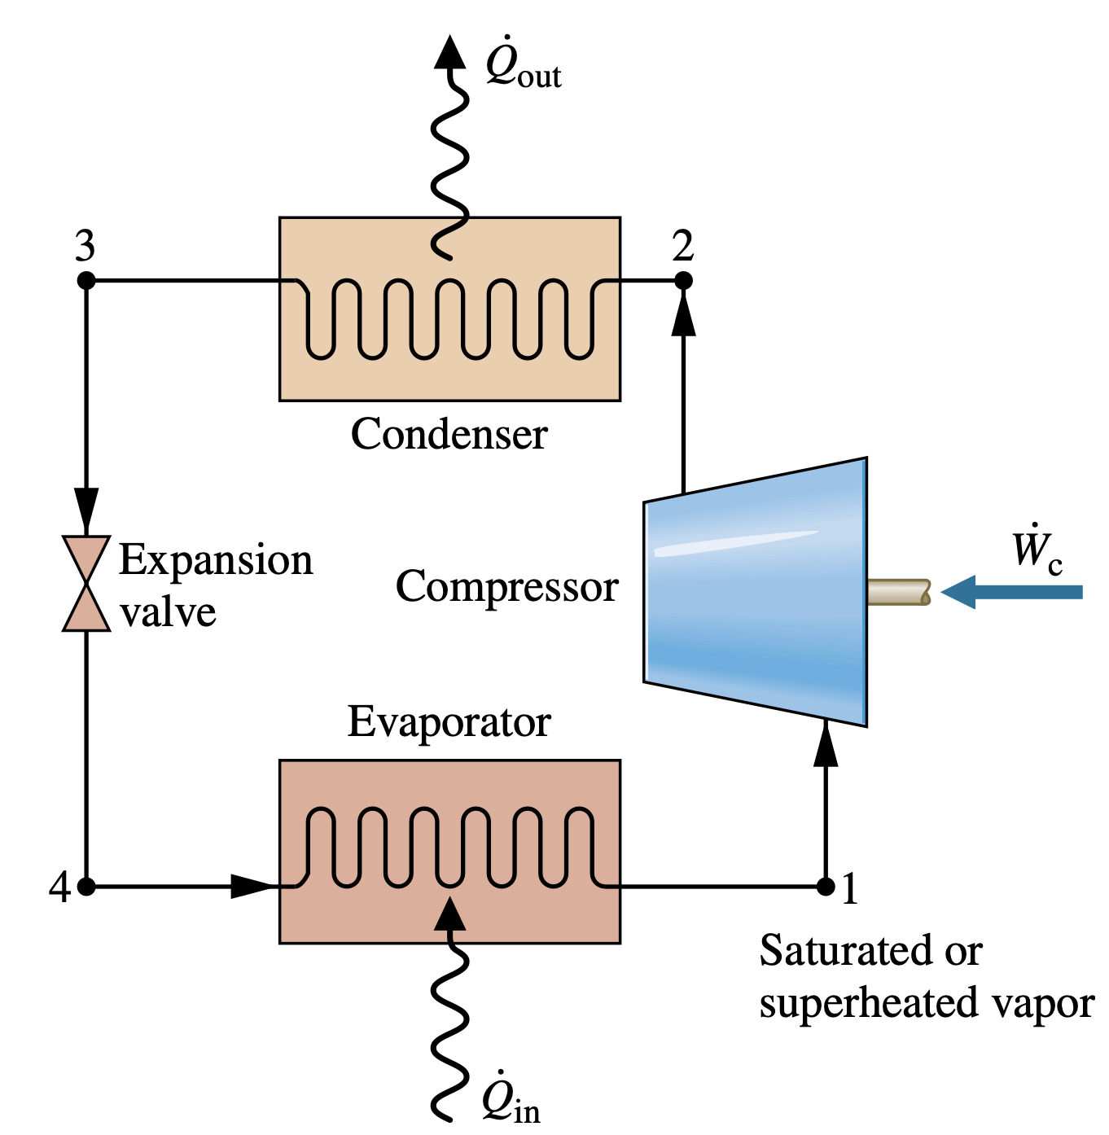
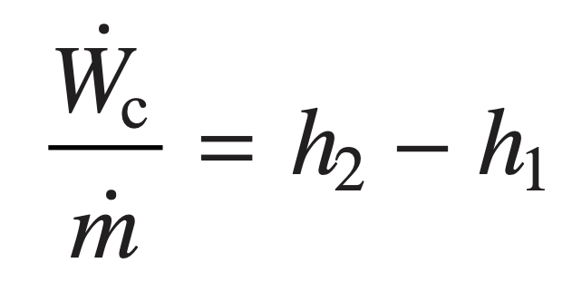
Analyzing Vapor-Compression refrigeration Systems
For a control volume enclosing the refrig- erant side of the evaporator, the mass and energy rate balances reduce to give the rate of heat transfer per unit mass of refrigerant flowing as
Vapor-compression refrigeration systems are the most common refrigeration systems in use today. The objective of this section is to introduce some important features of systems of this type and to illustrate how they are modeled thermodynamically.
Assuming no heat transfer to or from the compressor, the mass and energy rate balances for a control volume enclosing the compressor give
For a control volume enclosing the refrigerant side of the condenser, the rate of heat transfer from the refrigerant per unit mass of refrigerant flowing is

Slide 34
Selecting refrigerants
Environmental Considerations
Because of the molecular stability of the CFC and HCFC molecules, their adverse effects are long-lasting.
Natural Refrigerants
Nonsynthetic, naturally occurring substances also can be used as refrigerants. Called natural refrigerants, they include carbon dioxide, ammonia, and hydrocarbons.
Refrigeration with No Refrigerant Needed
Alternative cooling technologies aim to achieve a refrigerating effect without use of refrigerants, thereby avoiding adverse effects associated with release of refrigerants to the atmosphere. One such technology is thermoelectric cooling.

Slide 35
Heat Pump

Slide 36
Heat pump Systems
The objective of a heat pump is to maintain the temperature within a dwelling or other building above the temperature of the surroundings or to provide a heat transfer for certain industrial processes that occur at elevated temperatures.
A reversible process is one which can be made to "retrace" its path exactly.
A process is reversible when the successive states of the process are Infinitesimally close to Equilibrium States. i.e. the process is quasi-equilibrium.
With a reversible process it is possible to restore the system to its original state without needing an external agent or changing its surroundings.
Reversible processes are an abstraction that aids the analysis of real processes.
A reversible process is a standard of comparison for an actual system.
Truly reversible thermal processes would require an infinite amount of time for completion.
Carnot heat pump Cycle
CARNOT'S THEOREM
"The efficiency of all reversible engines operating between the same two temperatures is the same, and no irreversible engine operating between these temperatures can have a greater efficiency than this"
Nicolas Léonard Sadi Carnot (1796–1832)

Slide 37
Carnot Cycle
The Carnot cycle is an ideal reversible cyclic process involving the expansion and compression of an ideal gas, which enables us to evaluate the efficiency of an engine utilizing this cycle.
At steady state, the rate at which energy is supplied to the warm region by heat transfer is the sum of the energy supplied to the working fluid from the cold region, Qin, and the net rate of work input to the cycle, Wnet. That is,
The coefficient of performance of any heat pump cycle is defined as the ratio of the heat- ing effect to the net work required to achieve that effect.

Slide 38
Vapor-Compression heat pumps
Air-source vapor-compression heat pump system
Example of an air-to-air reversing heat pump.

Slide 39
Gas refrigeration Systems

Slide 40
Brayton refrigeration Cycle
The method of analysis of the Brayton refrigeration cycle is similar to that of the Brayton power cycle. Thus, at steady state the work of the compressor and the turbine per unit of mass flow are, respectively,
Heat transfer from the cold region to the refrigerant gas circulating through the low-pressure heat exchanger, the refrigeration effect, is
The coefficient of performance is the ratio of the refrigeration effect to the net work input:
Brayton refrigeration cycle.

Slide 41
Additional Gas refrigeration Applications
A small amount of high-pressure air is extracted from the main jet engine compressor and cooled by heat transfer to the ambient.
The high-pressure air is then expanded through an auxiliary turbine to the pressure maintained in the cabin.
The air temperature is reduced in the expansion and thus is able to fulfill its cabin cooling function.
As an additional benefit, the turbine expansion can provide some of the auxiliary power needs of the aircraft.
An application of gas refrigeration to aircraft cabin cooling.

Slide 42
Automotive Air Conditioning Using Carbon Dioxide
Carbon dioxide enters the compressor as superheated vapor at state 1 and is compressed to a much higher temperature and pressure at state 2.
The CO2 passes from the compressor into the gas cooler, where it cools at constant pressure to state 3 as a result of heat transfer to the ambient.
The temperature at state 3 approaches that of the ambient, denoted on the figure by T_{H}.
CO2 is further cooled in the interconnecting heat exchanger at constant pressure to state 4, where the temperature is below that of ambient.
Cooling is provided by low-temperature CO2 in the other stream of the heat exchanger.
During this portion of the refrigeration cycle, the processes are like those seen in gas refrigeration.
Notes:
https://sciencestruck.com/difference-between-entropy-enthalpy-in-thermodynamics

