Slide 1
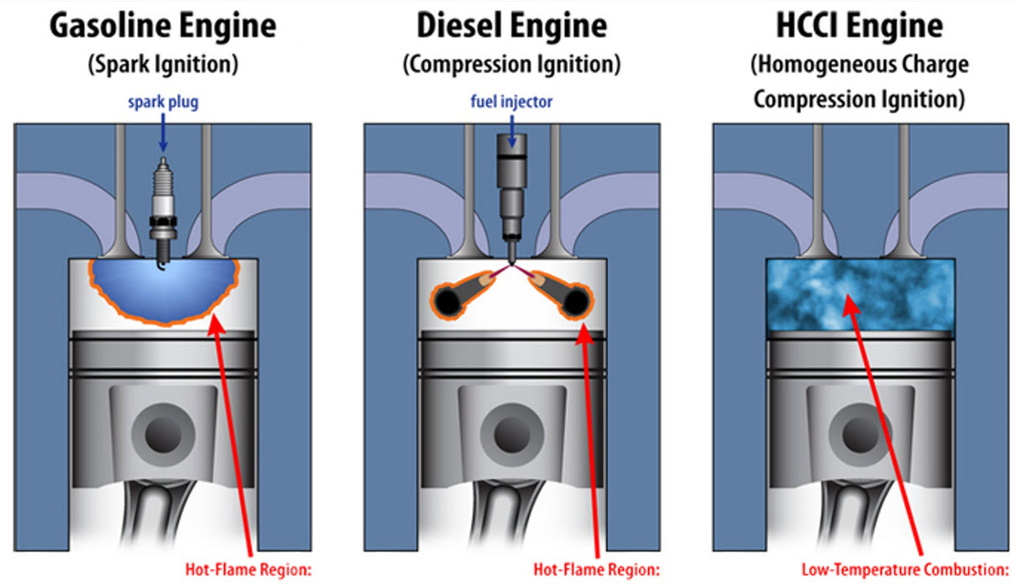
Thermodynamics
An Engineering Approach
Lecture 4: The Second Law of Thermodynamics
Qiang Cheng (Jonny)

Slide 2
Learning Outcomes
When you complete your study of this chapter, you will be able to…
Explain key concepts related to the second law of thermodynamics, including alternative statements of the second law, the internally reversible process, and the Kelvin temperature scale.
List several important irreversibilities.
Apply the Clausius inequality
Notes:
Heat is energy can be converted from one form to another, or transferred from one object to another. For example, a stove burner converts electrical energy to heat and conducts that energy through the pot to the water. This increases the kinetic energy of the water molecules, causing them to move faster and faster. At a certain temperature (the boiling point), the atoms have gained enough energy to break free of the molecular bonds of the liquid and escape as vapor.

Slide 3
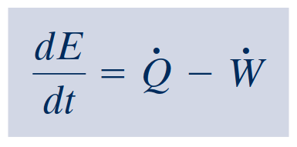
Recall the First Law of Thermodynamics
Energy Balance
time rate form of the energy balance

Slide 4
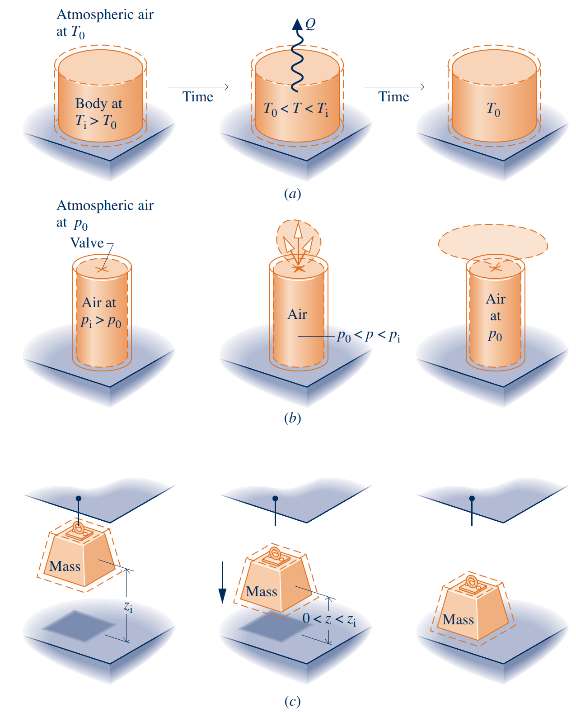
Introducing the Second Law
The foregoing discussion indicates that not every process consistent with the principle of energy conservation can occur.
Generally, an energy balance alone neither enables the preferred direction to be predicted nor permits the processes that can occur to be distinguished from those that cannot.
In elementary cases, such as the ones considered in right Fig., experience can be drawn upon to deduce whether particular spontaneous processes occur and to deduce their directions.
For more complex cases, where experience is lacking or uncertain, a guiding principle is necessary. This is provided by the second law.
The foregoing discussion also indicates that when left alone systems tend to undergo spontaneous changes until a condition of equilibrium is achieved, both internally and with their surroundings. In some cases equilibrium is reached quickly, whereas in others it is achieved slowly.

Slide 5
Introducing the Second Law

Slide 6
Aspects of the Second Law
Aspects of the Second Law
5. defining a temperature scale independent of the properties of any thermometric substance.
We conclude our introduction to the second law by observing that the second law
and deductions from it have many important uses, including means for
6. developing means for evaluating properties such as u and h in terms of properties
The six points listed can be thought of as aspects of the second law of thermodynamics and not as independent and unrelated ideas. Nonetheless, given the variety of these topic areas, it is easy to understand why there is no single statement of the second law that brings out each one clearly. There are several alternative, yet equivalent, formulations of the second law.
1. predicting the direction of processes.
2. establishing conditions for equilibrium.
3. determining the best theoretical performance of cycles, engines, and other devices.
4. evaluating quantitatively the factors that preclude the attainment of the best theoretical performance level.

Slide 7
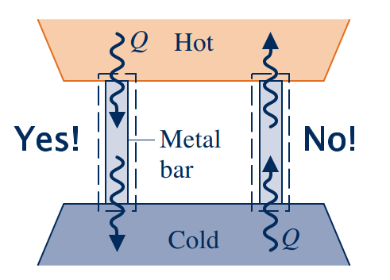
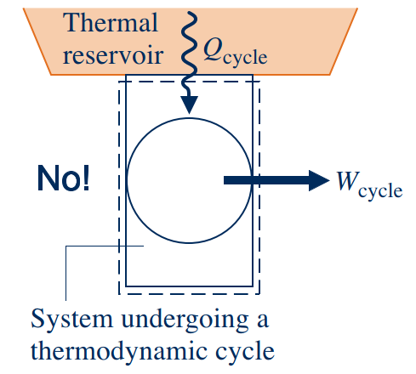
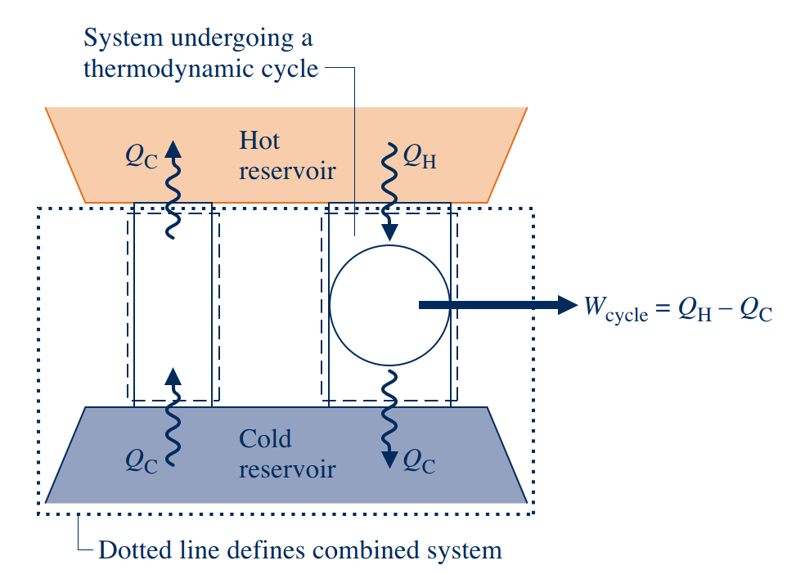
Statements of the Second Law
Clausius Statement of the Second Law
It is impossible for any system to operate in such a way that the sole result would be an energy transfer by heat from a cooler to a hotter body.
Kelvin–Planck Statement of the Second Law
It is impossible for any system to operate in a thermodynamic cycle and deliver a net amount of energy by work to its surroundings while receiving energy by heat transfer from a single thermal reservoir.
Entropy Statement of the Second Law
Notes:
https://www.thoughtco.com/list-of-phase-changes-of-matter-608361

Slide 8
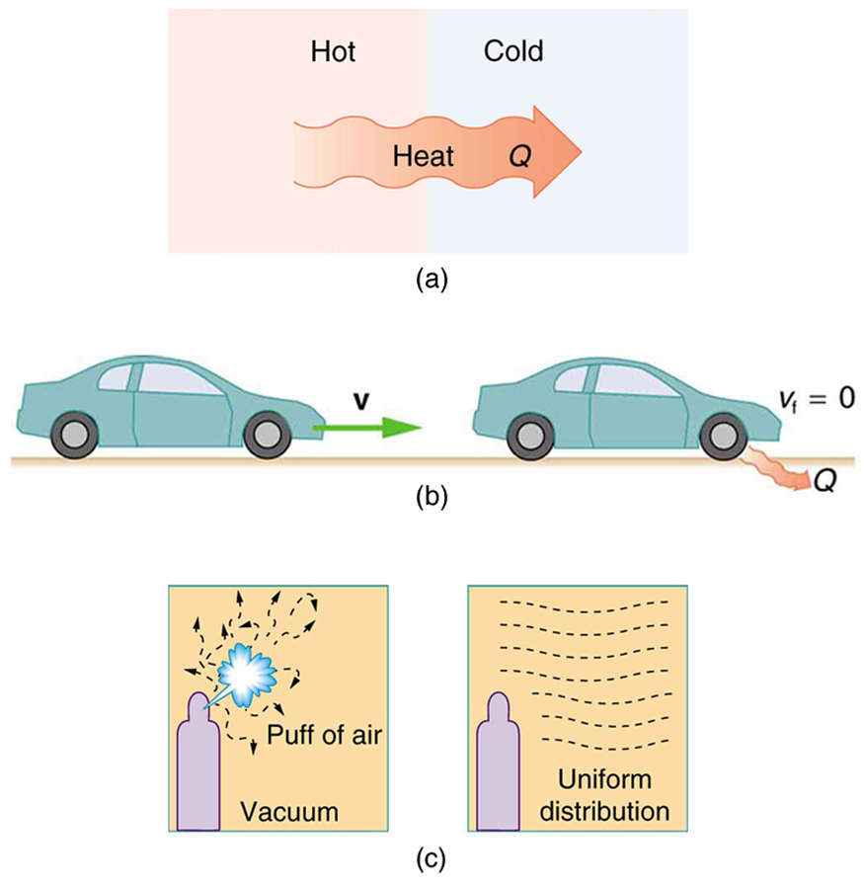
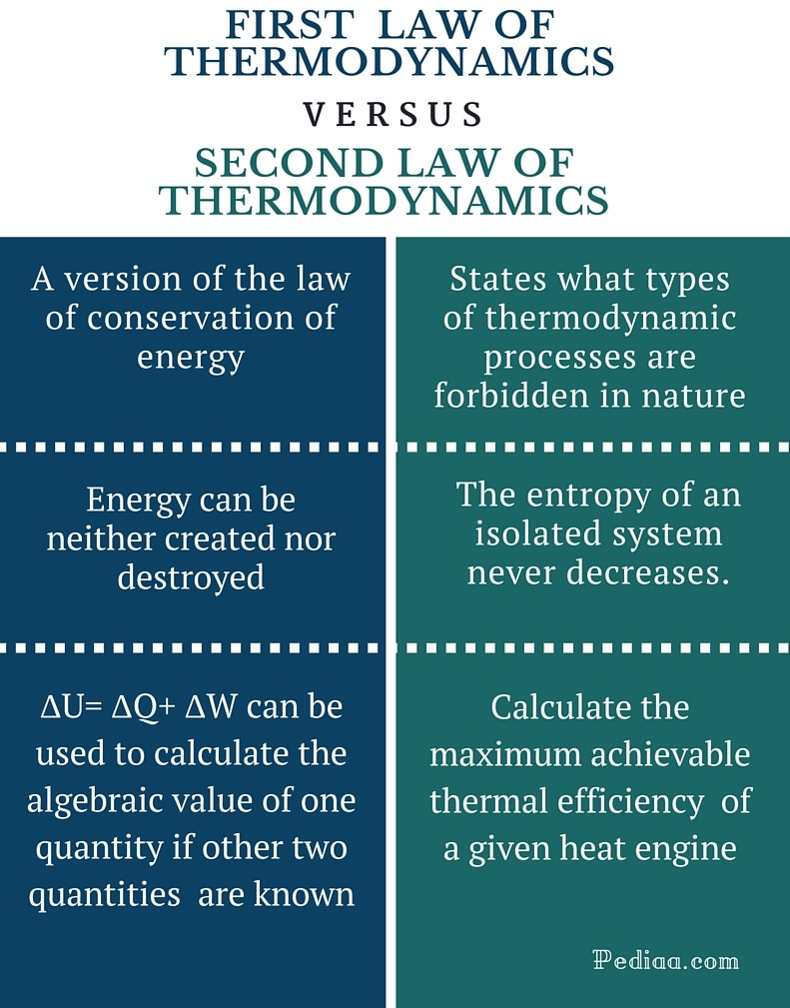
Comparison of the First and Second Law of Thermodynamics

Slide 9
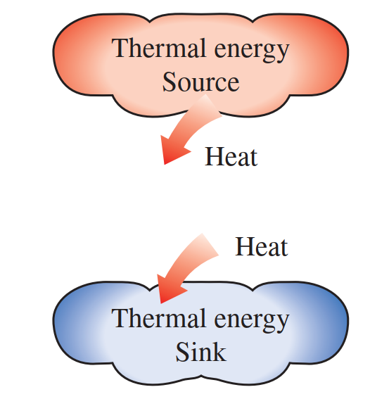
Thermal Energy Reserviors
In the development of the second law of thermodynamics, it is very convenient to have a hypothetical body with a relatively large thermal energy capacity (mass × specific heat) that can supply or absorb finite amounts of heat without undergoing any change in temperature. Such a body is called a thermal energy reservoir.
Thermal energy reservoirs are often referred to as heat reservoirs since they supply or absorb energy in the form of heat.
A reservoir that supplies energy in the form of heat is called a source, and one that absorbs energy in the form of heat is called a sink.
A two-phase system can also be modeled as a reservoir since it can absorb and release large quantities of heat while remaining at constant temperature.
Heat transfer from industrial sources to the environment is of major concern to environmentalists as well as to engineers.
A body does not actually have to be very large to be considered a reservoir. Any physical body whose thermal energy capacity is large relative to the amount of energy it supplies or absorbs can be modeled as one.

Slide 10
Irreversible and Reversible Processes
irreversible process
A process is called irreversible if the system and all parts of its surroundings cannot be exactly restored to their respective initial states after the process has occurred.
1. Heat transfer through a finite temperature difference
2. Unrestrained expansion of a gas or liquid to a lower pressure
3. Spontaneous chemical reaction
4. Spontaneous mixing of matter at different compositions or states
5. Friction—sliding friction as well as friction in the flow of fluids
6. Electric current flow through a resistance
7. Magnetization or polarization with hysteresis
8. Inelastic deformation
reversible process
A process is reversible if both the system and surroundings can be returned to their initial states.
irreversible processes normally include one or more of the following irreversibilities:
Although the foregoing list is not exhaustive, it does suggest that all actual processes are irreversible. That is, every process involves effects such as those listed, whether it is a naturally occurring process or one involving a device of our construction, from the simplest mechanism to the largest industrial plant.

Slide 11
Irreversible and Reversible Processes

Slide 12
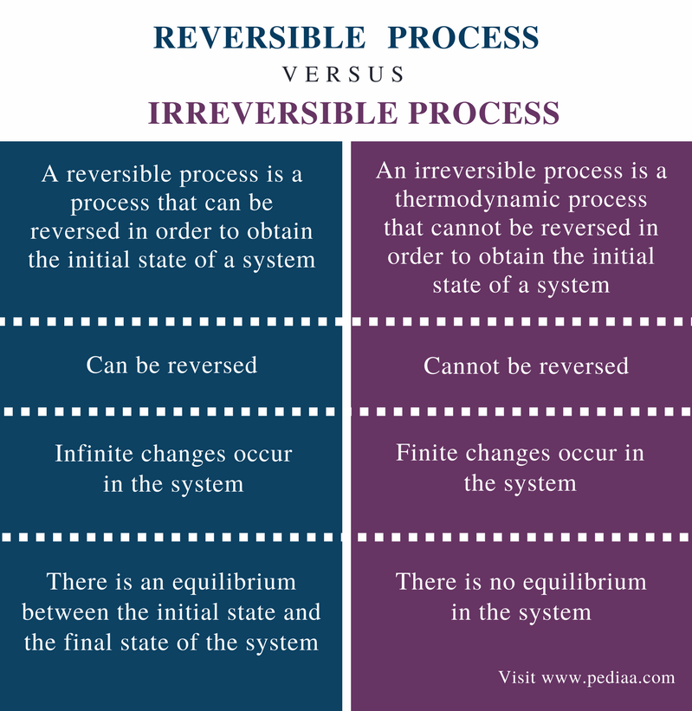
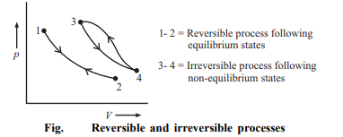
Reversible and Irreversible Processes
Reversible Process
A thermodynamic process is reversible if the process can return back in such a that both the system and the surroundings return to their original states, with no other change anywhere else in the universe.
Irreversible Process
An irreversible process is a thermodynamic process that departs from equilibrium.

Slide 13
Using Entropy

Slide 14
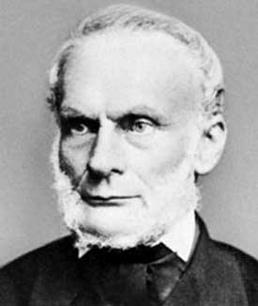
Background
Entropy is a scientific concept, as well as a measurable physical property that is most commonly associated with a state of disorder, randomness, or uncertainty. The term and the concept are used in diverse fields, from classical thermodynamics, where it was first recognized, to the microscopic description of nature in statistical physics, and to the principles of information theory. It has found far-ranging applications in chemistry and physics, biological systems and their relation to life, cosmology, economics, sociology, weather science and climate change, and information systems and the transmission of information in telecommunication.
Clausius realized in 1865 that he had discovered a new thermodynamic property, and he chose to name this property entropy. It is designated S and is defined as
Rudolf Clausius (1822–1888), originator of the concept of entropy

Slide 15
What is Entropy

Slide 16
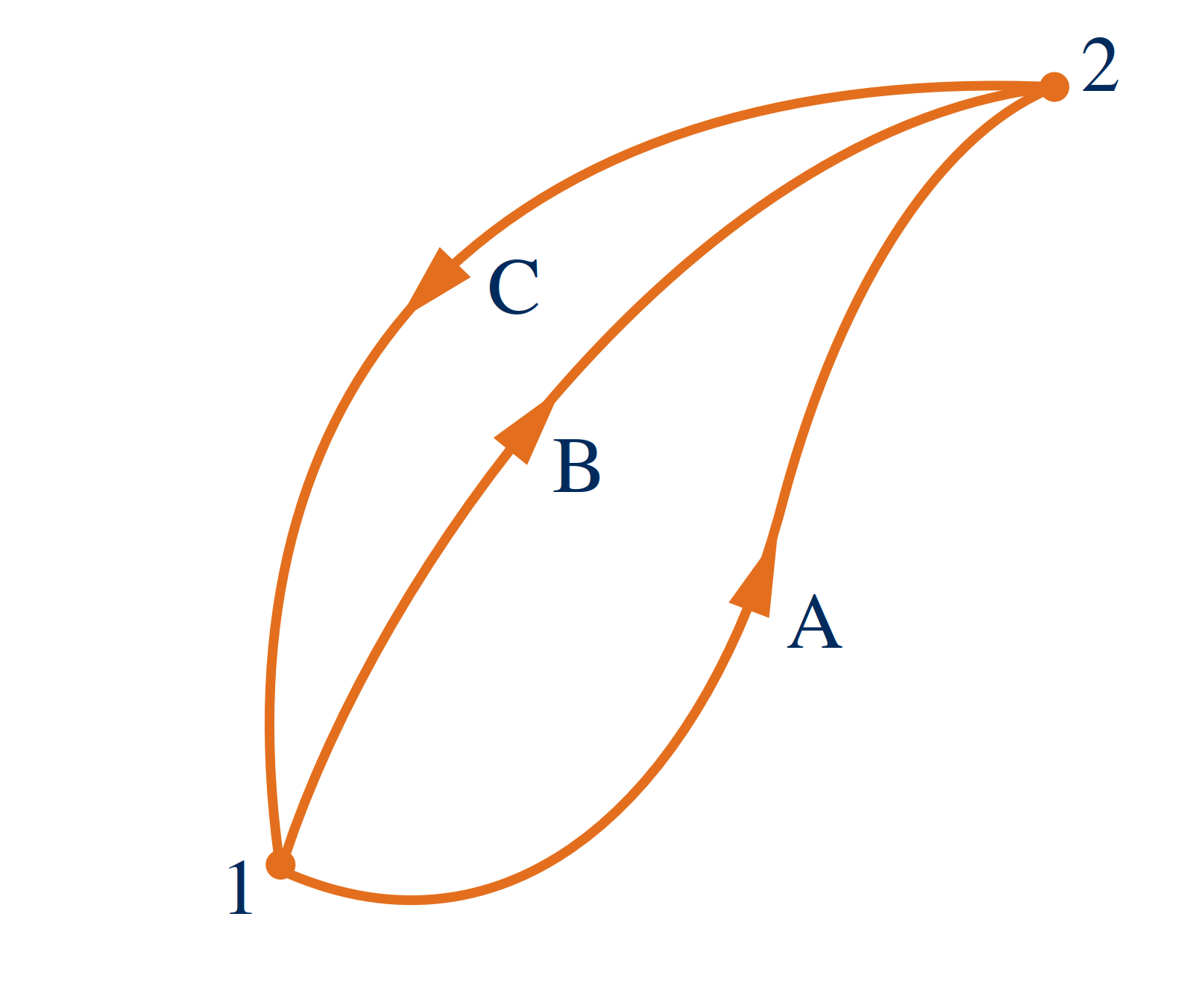
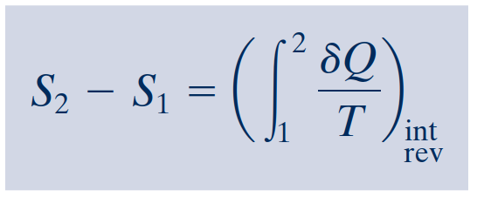
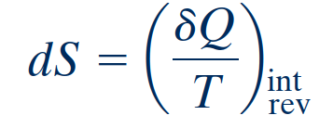
Entropy–A System Property
For the first cycle
One cycle consists of an internally reversible process A from state 1 to state 2, followed by internally reversible process C from state 2 to state 1.
The other cycle consists of an internally reversible process B from state 1 to state 2, followed by the same process C from state 2 to state 1 as in the first cycle.
For the second cycle
definition of entropy change
Evaluating Entropy
On a differential basis
Entropy is an extensive property.
Notes:
This shows that the integral of δ Q/T is the same for both processes. Since A and B are arbitrary, it follows that the integral of δ Q/T has the same value for any internally reversible process between the two states. In other words, the value of the integral depends on the end states only. It can be concluded, therefore, that the integral represents the change in some property of the system.

Slide 17
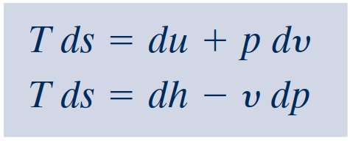
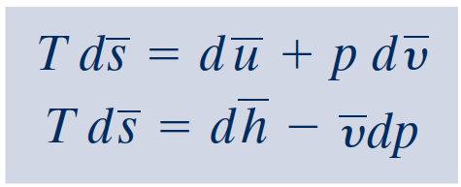
Introducing the T dS Equations
In the absence of overall system motion and the effects of gravity, an energy balance in differential form is
By definition of simple compressible system, the work is
On rearrangement, the heat transfer is
The first T dS equation results
The second $T dS$equation

Slide 18
Entropy Change of an Incompressible
Substance
For the incompressible substance model, we assume that the specific volume (density) is constant, and the specific internal energy depends solely on temperature. Thus, $du=c\left(T\right) dT$, where $c$ denotes the specific heat of the substance,
On integration, the change in specific entropy is
When the specific heat is constant, this becomes

Slide 19
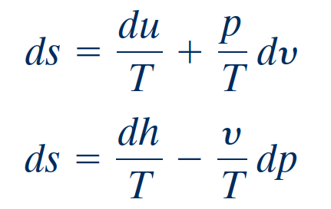
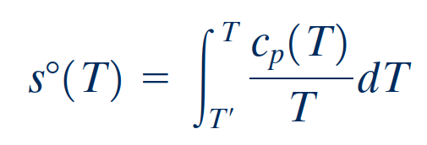
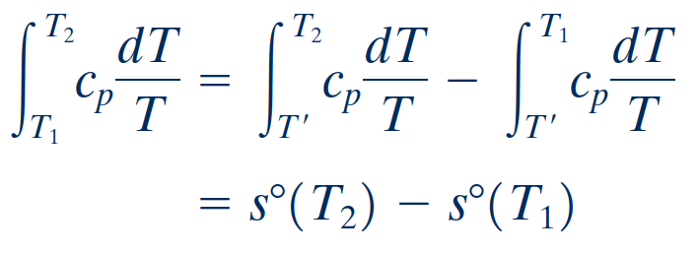
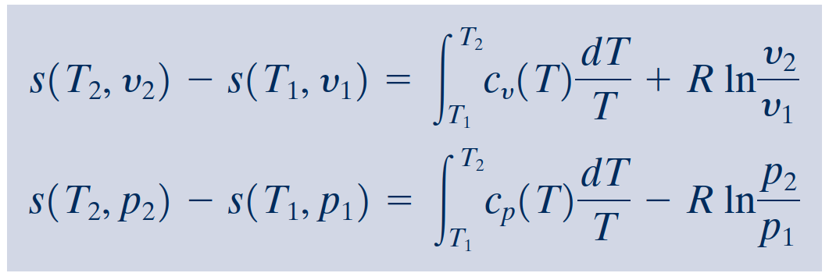
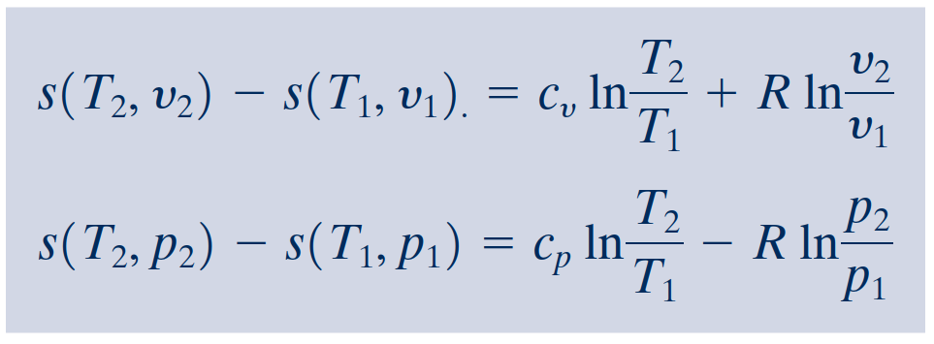
Entropy Change of an Ideal Gas
It is convenient to begin with
As for internal energy and enthalpy changes of ideal gases, the evaluation of entropy changes for ideal gases can be reduced to a convenient tabular approach. We begin by introducing a new variable $s^{o}(T)$ as
For an ideal gas, $du= c_{v} (T) dT$, $dh=c_{p} (T) dT$, and $pv=RT$. With these relations,
When the specific heats $c_{v}$ and $c_{p}$ are taken as constants,

Slide 20
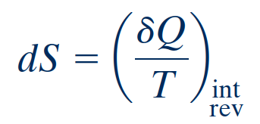
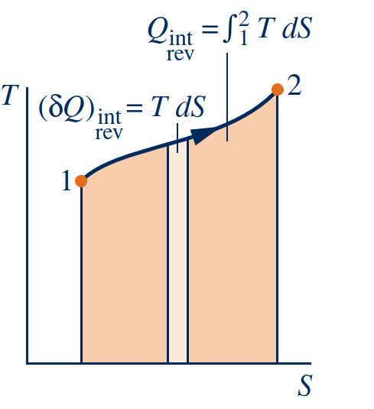
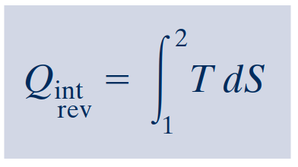
Entropy Change in Internally Reversible
Processes of Closed Systems
As a closed system undergoes an internally reversible process, its entropy can increase, decrease, or remain constant. This can be brought out using
The direction of the entropy transfer is the same as that of the heat transfer. In an adiabatic internally reversible process, entropy remains constant.
isentropic process
A constant-entropy process is called an isentropic process.
which indicates that when a closed system undergoing an internally reversible process receives energy by heat transfer, the system experiences an increase in entropy.
On rearrangement
Conversely, when energy is removed from the system by heat transfer, the entropy of the system decreases.
This can be interpreted to mean that an entropy transfer accompanies heat transfer.

Slide 21
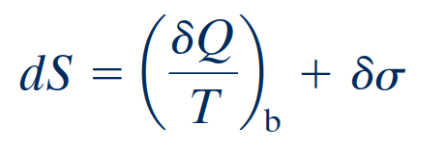
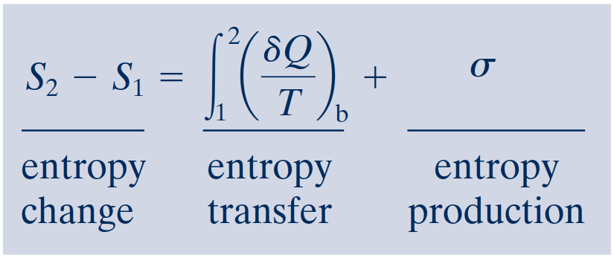
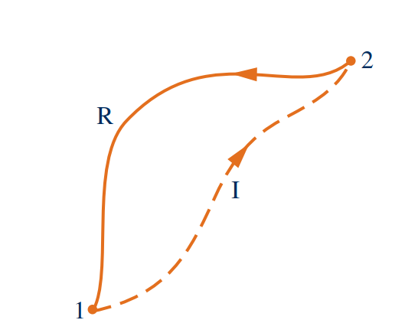
Entropy Balance for Closed Systems
Entropy balance
Closed system entropy balance
The entropy balance is an expression of the second law that is particularly effective for thermodynamic analysis.
It is sometimes convenient to use the entropy balance expressed in differential form
The second law of thermodynamics can be interpreted as requiring that entropy is produced by irreversibilities and conserved only in the limit as irreversibilities are reduced to zero.
Since σ measures the effect of irreversibilities present within the system during a pro- cess, its value depends on the nature of the process and not solely on the end states.
Cycle used to develop the entropy balance.

Slide 22
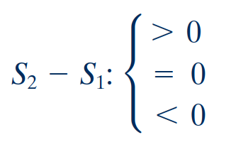
Interpreting the Closed System Entropy Balance
entropy transfer accompanying heat transfer
entropy production
If the end states are fixed, the entropy change on the left side can be evaluated independently of the details of the process. However, the two terms on the right side depend explicitly on the nature of the process and cannot be determined solely from knowledge of the end states.
The first term on the right side is associated with heat transfer to or from the system during the process. This term can be interpreted as the entropy transfer accompanying heat transfer.
The entropy change of a system is not accounted for solely by the entropy transfer but also is due in part to the second term on the right side of denoted by.
The term is positive when internal irreversibilities are present during the process and vanishes when no internal irreversibilities are present.
This can be described by saying that entropy is produced (or generated) within the system by the action of irreversibilities.
A positive value means that entropy is transferred into the system, and
a negative value means that entropy is transferred out.
When there is no heat transfer, there is no entropy transfer.

Slide 23
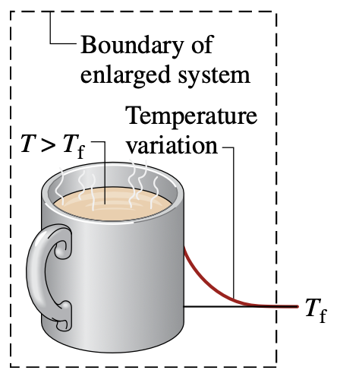
Directionality of Processes
An energy balance for the isolated system reduces to
Increase of entropy principle
Since entropy is produced in all actual processes, the only processes that can occur are those for which the entropy of the isolated system increases. This is known as the increase of entropy principle.
The increase of entropy principle is some-times considered an alternative statement of the second law.
Since energy is an extensive property, its value for the isolated sys- tem is the sum of its values for the system and surroundings, respectively
An entropy balance for the isolated system reduces to
Notice that this equation does not require the entropy change to be positive for both the system and surroundings but only that the sum of the changes is positive.
In either of these forms, the increase of entropy principle dictates the direction in which any process can proceed: Processes occur only in such a direction that the total entropy of the system plus surroundings increases.
Notes:
In the present discussion, we use the closed system energy and entropy balances to introduce the increase of entropy principle. Discussion centers on an enlarged system consisting of a system and that portion of the surroundings affected by the system as it undergoes a process. Since all energy and mass transfers taking place are included within the boundary of the en- larged system, the enlarged system is an isolated system.

Slide 24
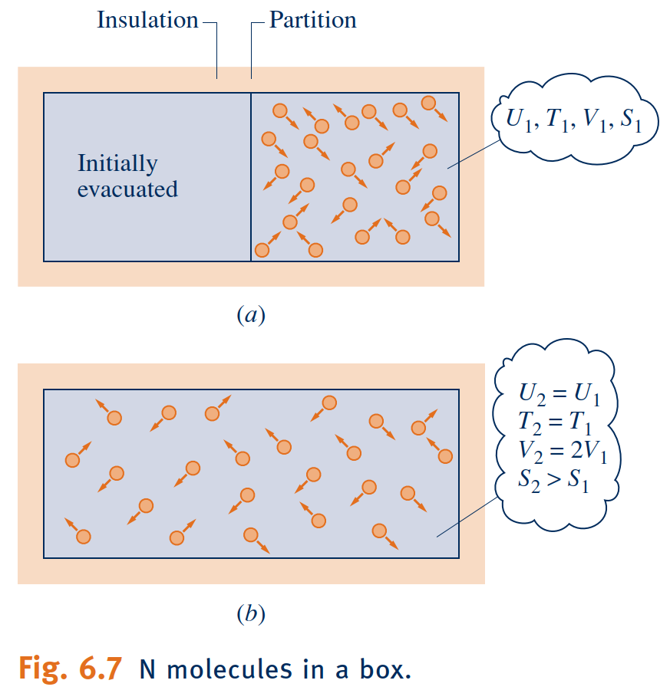
Statistical Interpretation of Entropy
Building on the increase of entropy principle, in this section we introduce an interpretation of entropy from a microscopic perspective based on probability.
Boltzmann relation
In statistical thermodynamics, entropy is associated with the notion of microscopic disorder.
We can evaluate the change in entropy for the process of right Fig., expressed in terms of volumes and on a molar basis. The entropy change for the constant-temperature process is
where the proportionality factor, k, is called Boltzmann’s constant.
Microstates thermodynamic probability
Through more complete molecular modeling and statistical analysis, the total number of positions and velocities-microstates-available to a single molecule can be calculated. This total is called the thermodynamic probability, $w$.
N molecules in a box.
Notes:
Consider N molecules initially contained in one half of the box shown in Fig. 6.7a. The entire box is considered an isolated system. We assume that the ideal gas model applies. In the initial condition, the gas appears to be at equilibrium in terms of temperature, pres- sure, and other properties. But, on the microscopic level the molecules are moving about randomly. We do know for sure, though, that initially all molecules are on the right side of the vessel.
Suppose we remove the partition and wait until equilibrium is reached again, as in Fig. 6.7b. Because the system is isolated, the internal energy U does not change: U2 = U1. Further, because the internal energy of an ideal gas depends on temperature alone, the temperature is unchanged: T2 = T1. Still, at the final state a given molecule has twice the volume in which to move: V2 = 2V1. Just like a coin toss, the probability that the molecule is on one side or the other is now 1⁄2, which is the same as the volume ratio V1/V2. In the final condition, we have less knowledge about where each molecule is than we did originally.

Slide 25
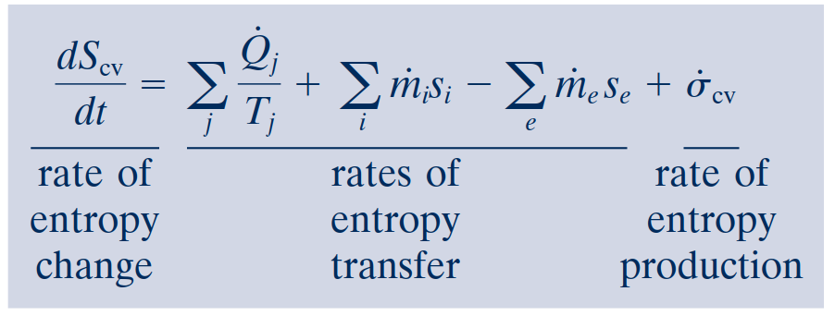
Entropy Rate Balance for Control Volumes
Control volume entropy rate balance
In addition, the terms accounting for entropy transfer accompanying mass flow can be expressed as integrals over the inlet and exit flow areas, resulting in the following form of the entropy rate balance
Integral Form of the Entropy Rate Balance
The rate of entropy transfer accompanying heat transfer can be expressed more generally as an integral over the surface of the control volume

Slide 26
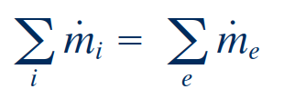
Rate Balances for Control Volumes at
Steady State
At steady state, the conservation of mass principle takes the form
One-Inlet, One-Exit Control Volumes at Steady State
The energy rate balance at steady state is
Steady-state entropy rate balance

Slide 27
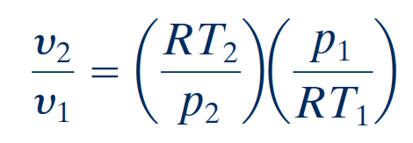
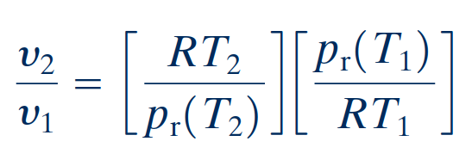
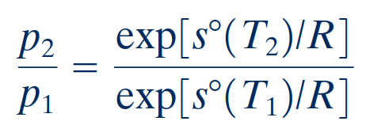
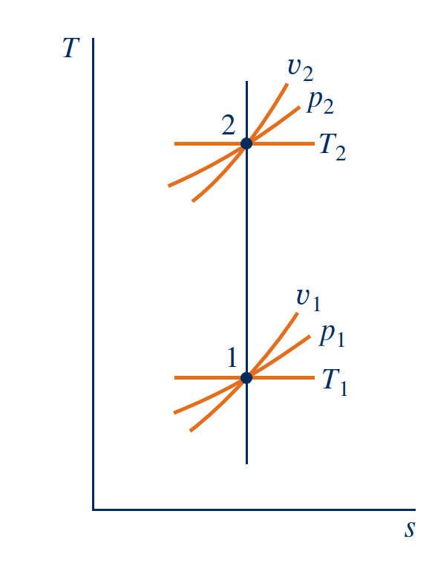
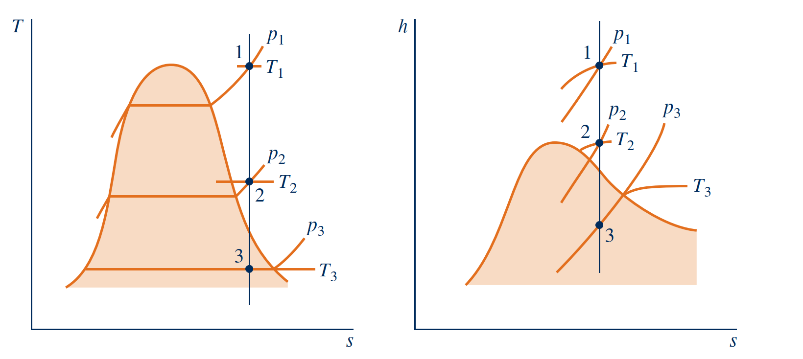
Isentropic Processes
Ideal Gas Tables
With the ideal gas equation of state, $v={RT}/p$, the ratio of the specific volumes is
For the special case of air modeled as an ideal gas
where pr1 = pr(T1) and pr2 = pr(T2). The function pr is sometimes called the relative pressure.
Two states of an ideal gas where s2 = s1.
T–s and h–s diagrams showing states having the same value of specific entropy.
Notes:
where pr1 = pr(T1) and pr2 = pr(T2). The function pr is sometimes called the relative pressure. Observe that pr is not truly a pressure, so the name relative pressure has no physical signif- icance. Also, be careful not to confuse pr with the reduced pressure of the compressibility diagram.

Slide 28
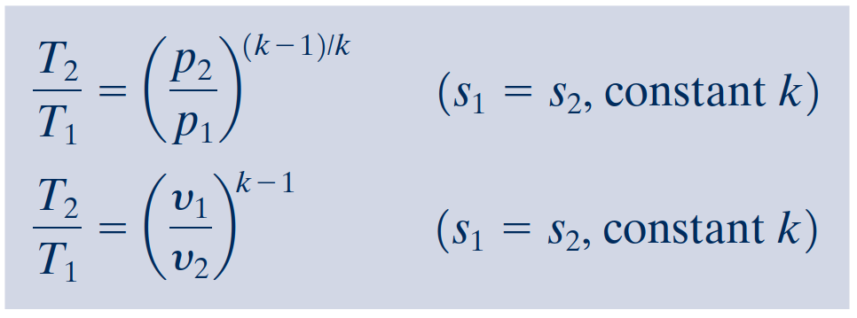
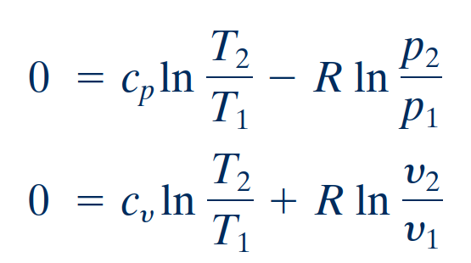
Isentropic Processes
Assuming Constant Specific Heats
Introducing the ideal gas relations

Slide 29
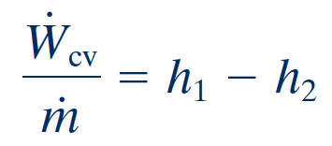
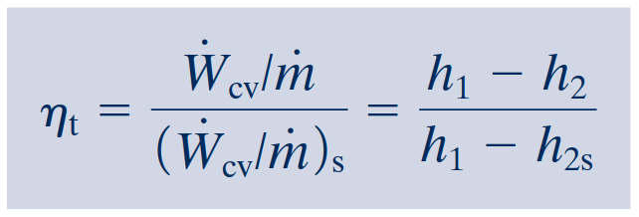
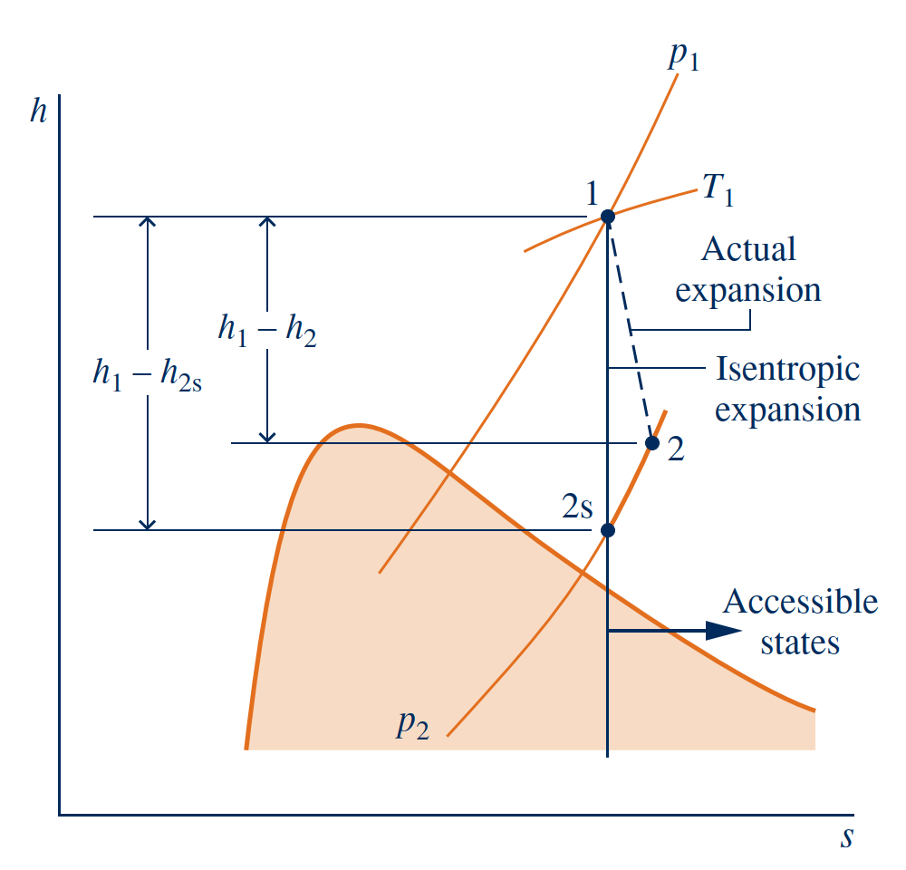
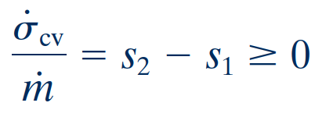
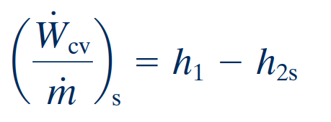
Isentropic Turbine Efficiency
With these assumptions, the mass and energy rate balances reduce, at steady state, to give the work developed per unit of mass flowing through the turbine
In an actual expansion through the turbine $h_{2},$ $h_{2s}$ , and thus less work than the maximum would be developed. This difference can be gauged by the isentropic turbine efficiency defined by
Since there is no heat transfer, the allowed exit states are constrained by
Therefore, the smallest allowed value for h2 corresponds to state 2s, and the maximum value for the turbine work is
Comparison of actual and isentropic expansions through a turbine.

Slide 30
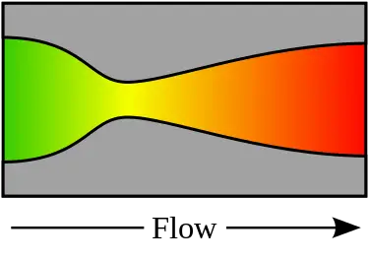
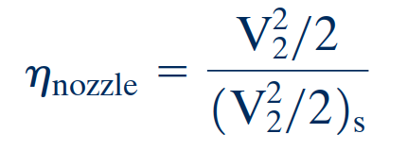
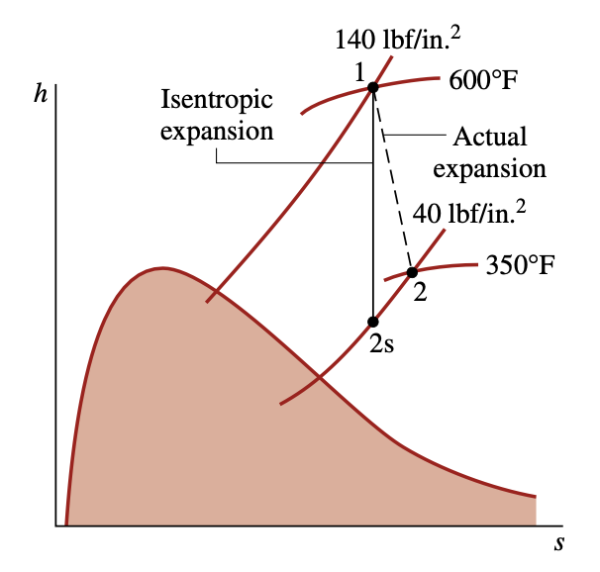
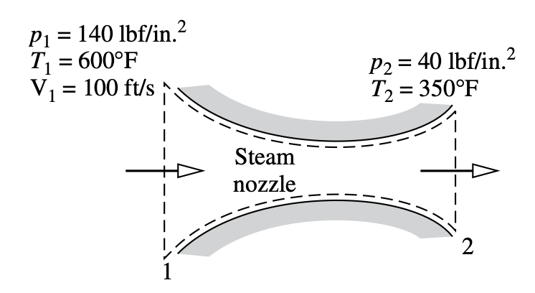
Isentropic Nozzle Efficiency
The isentropic nozzle efficiency is defined as the ratio of the actual specific kinetic energy of the gas leaving the nozzle, $V_{2}^{2}/2$, to the kinetic energy at the exit that would be achieved in an isentropic expansion between the same inlet state and the same exit pressure, ${\left(V_{2}^{2}/2\right)}_{s}$ . That is,
Nozzle efficiencies of 95% or more are common, indicating that well-designed nozzles are nearly free of internal irreversibilities.
Comparison of actual and isentropic expansions through a turbine.

Slide 31
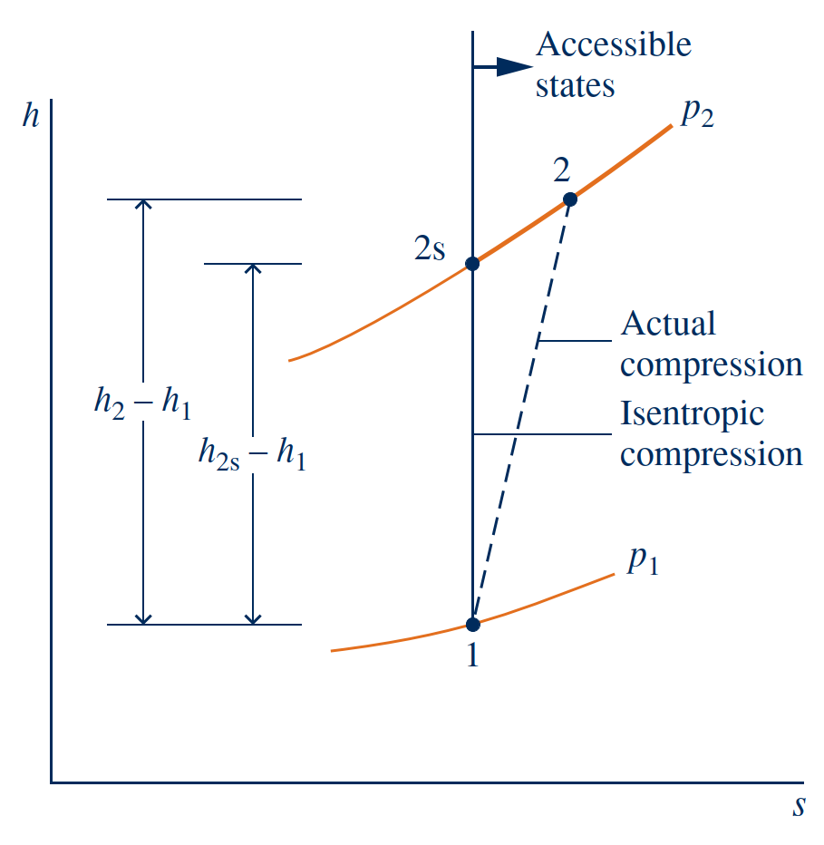
Isentropic Compressor and Pump Efficiencies
For negligible heat transfer with the surroundings and no appreciable kinetic and potential energy effects, the work input per unit of mass flowing through the compressor is
The minimum work input is given by
isentropic compressor efficiency
Comparison of actual and isentropic expansions through a turbine.

Slide 32
Heat Transfer and Work in Internally
Reversible, Steady-State Flow Processes
Heat Transfer
For a control volume at steady state in which the flow is both isothermal at temperature T and internally reversible, the appropriate form of the entropy rate balance is
Work
Area representation of heat transfer for an internally reversible flow process.
Area representation of $\int_{1}^{2}{vdp}$.

Slide 33
Work in Polytropic Processes
We have identified an internally reversible process described by pυn = constant, where n is a constant, as a polytropic process
For a polytropic process of an ideal gas,
For the case of an ideal gas,
Idea Gas Case

Slide 34
Enthalpy Vs. Entropy
Enthalpy, denoted by the symbol ‘H’, refers to the measure of total heat content in a thermodynamic system under constant pressure. Enthalpy is calculated in terms of change, i.e., ∆H = ∆U + P∆V(where E is the internal energy). The SI unit of enthalpy is joules (J).
Entropy, denoted by the symbol ‘S’, refers to the measure of the level of disorder in a thermodynamic system. It is measured as joules per kelvin (J/K). Entropy is calculated in terms of change, i.e., ∆S = ∆Q/T (where Q is the heat content and T is the temperature).
Entropy and Entropy Generation in Daily Life
https://www.youtube.com/watch?v=YM-uykVfq_E
Notes:
https://sciencestruck.com/difference-between-entropy-enthalpy-in-thermodynamics

