Slide 1
Thermodynamics
An Engineering Approach
Lecture 7: Summary of the Thermodynamics
Qiang Cheng (Jonny)

Slide 2
Basic Definitions

Slide 3
Defining Systems
System
System is used to identify the subject of the analysis. Once the system is defined and the relevant interactions with other systems are identified, one or more physical laws or relations are applied.
Surroundings Boundary
Everything external to the system is considered to be part of the system’s surroundings. The system is distinguished from its surroundings by a specified boundary, which may be at rest or in motion.

Slide 4
Closed System
Closed Systems
A closed system is defined when a particular quantity of matter is under study. There can be no transfer of mass across its boundary.
Isolated Systems
A special type of closed system that does not interact in any way with its surroundings is called an isolated system.

Slide 5
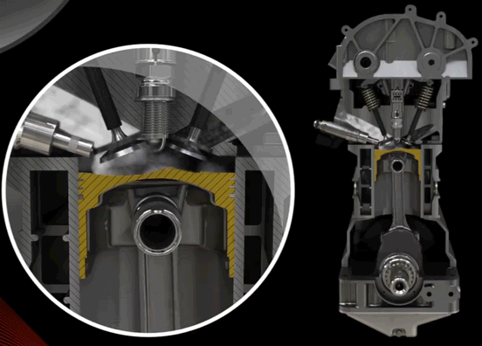
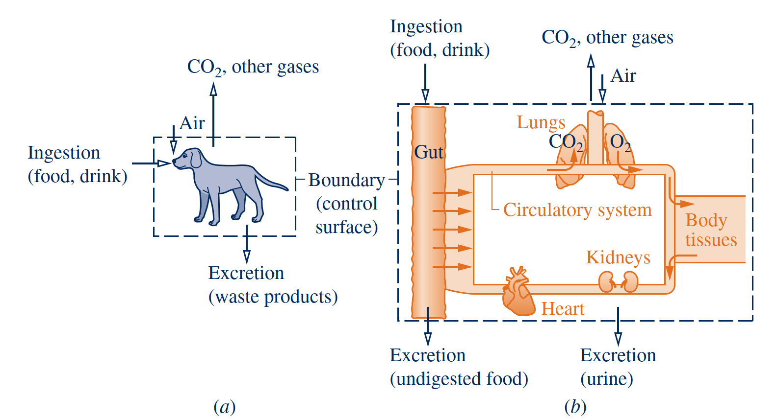
Control Volume Systems
Control Volumes
Mass and heat both cross the boundary of a system

Slide 6
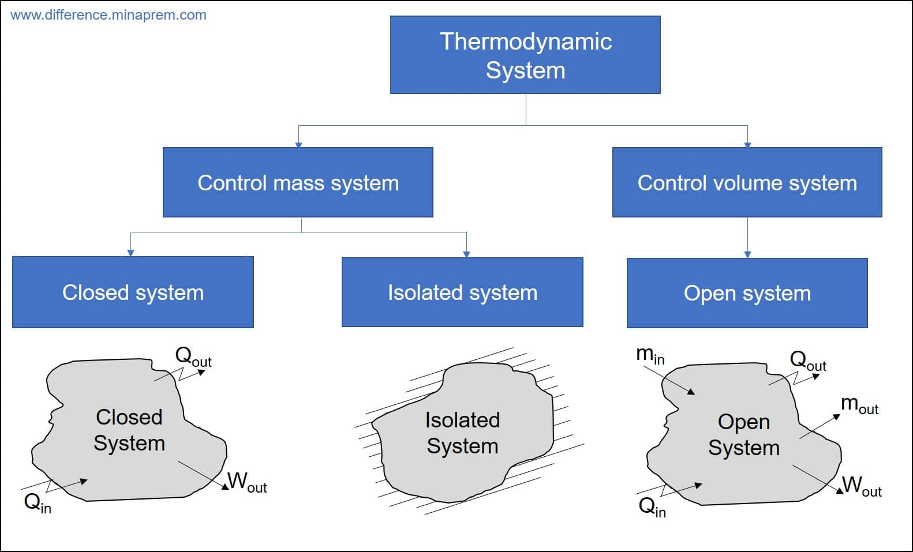
Colsed and Control Volume System
Isolated System – An isolated system cannot exchange energy and mass with its surroundings. The universe is considered an isolated system.
Closed System – Across the boundary of the closed system, the transfer of energy takes place but the transfer of mass doesn’t take place. Refrigerator, compression of gas in the piston-cylinder assembly are examples of closed systems.
Open System – In an open system, the mass and energy both may be transferred between the system and surroundings. A steam turbine is an example of an open system.

Slide 7
Property
Property
Intensive properties
A property is a macroscopic characteristic of a system such as mass, volume, energy, pressure, and temperature to which a numerical value can be assigned at a given time without knowledge of the previous behavior (history) of the system.
Intensive properties are not additive in the sense previously considered. Their values are independent of the size or extent of a system and may vary from place to place within the system at any moment.
Extensive properties
A property is called extensive if its value for an overall system is the sum of its values for the parts into which the system is divided. Mass, volume, energy, and several other properties introduced later are extensive.

Slide 8
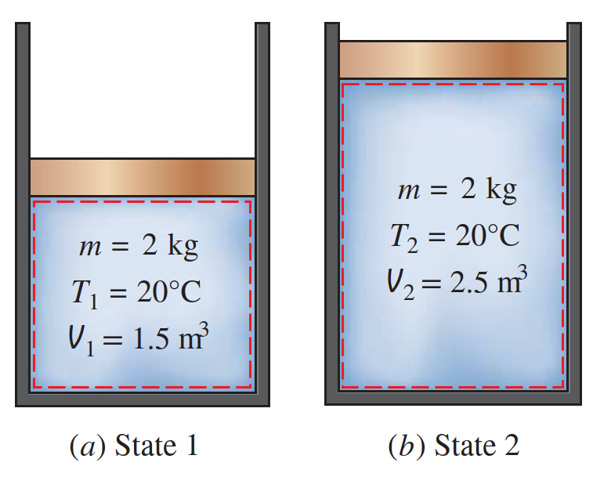
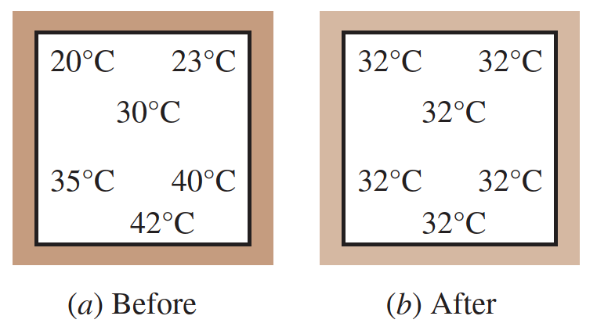
State and Process
State
Accordingly, several types of equilibrium must exist individually to fulfill the condition of complete equilibrium; among these are mechanical, thermal, phase, and chemical equilibrium.
The word state refers to the condition of a system as described by its properties.
Process
When any of the properties of a system changes, the state changes and the system
is said to undergo a process. A system is said to be at steady state if none of its
properties changes with time.
Equilibrium
Classical thermodynamics places primary emphasis on equilibrium states and changes from one equilibrium state to another.

Slide 9
First Law of Thermodynamics

Slide 10
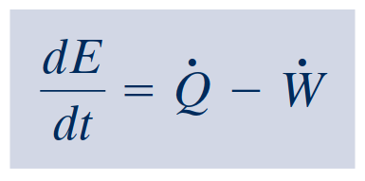
First Law of Thermodynamics
Energy Balance
Since the time rate of change of energy is given by
energy balance in differential form
or
time rate form of the energy balance

Slide 11
First Law of Thermodynamics

Slide 12
Phase of Pure Substance

Slide 13
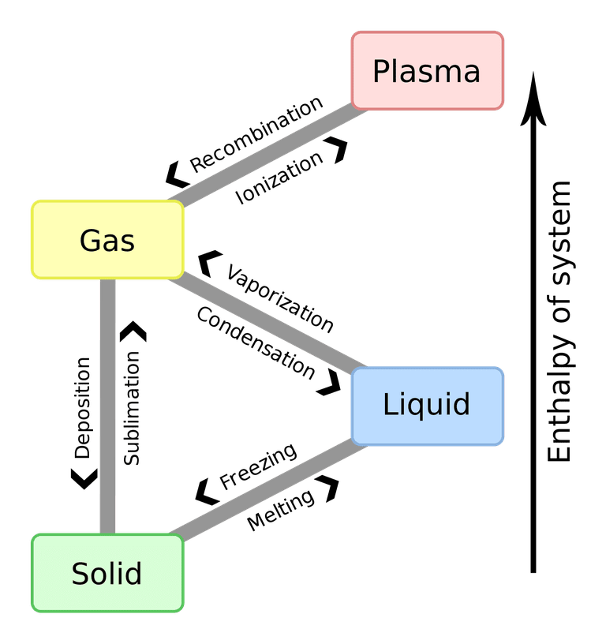
Pahse of Pure Substance
The most commonly known phase changes are those six between solids, liquids, and gasses. However, plasma also is a state of matter, so a complete list requires all eight total phase changes.
Phase changes typically occur when the temperature or pressure of a system is altered.
Phase Changes of States of Matter
Solids: Solids can melt into liquids or sublime into gases. Solids form by deposition from gases or freezing of liquids.
Liquids: Liquids can vaporize into gases or freeze into solids. Liquids form by condensation of gases and melting of solids.
Gases: Gases can ionize into plasma, condense into liquids, or undergo deposition into solids. Gases form from the sublimation of solids, vaporization of liquids, and recombination of plasma.
Plasma: Plasma can recombine to form a gas. Plasma most often forms from ionization of a gas, although if sufficient energy and enough space are available, it's presumably possible for a liquid or solid to ionize directly into a gas.
Notes:
https://www.thoughtco.com/list-of-phase-changes-of-matter-608361

Slide 14
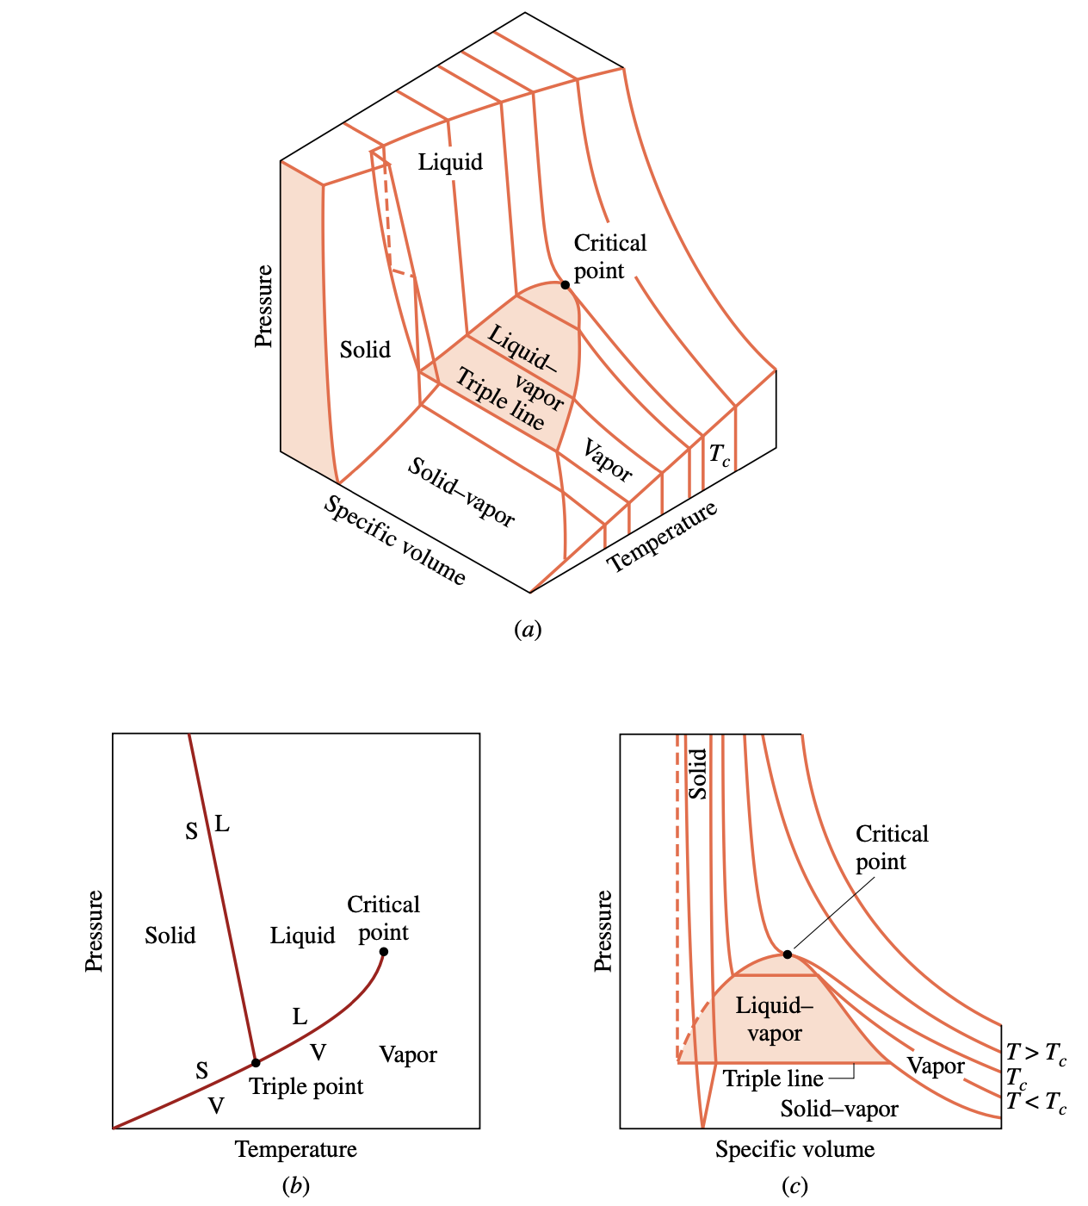
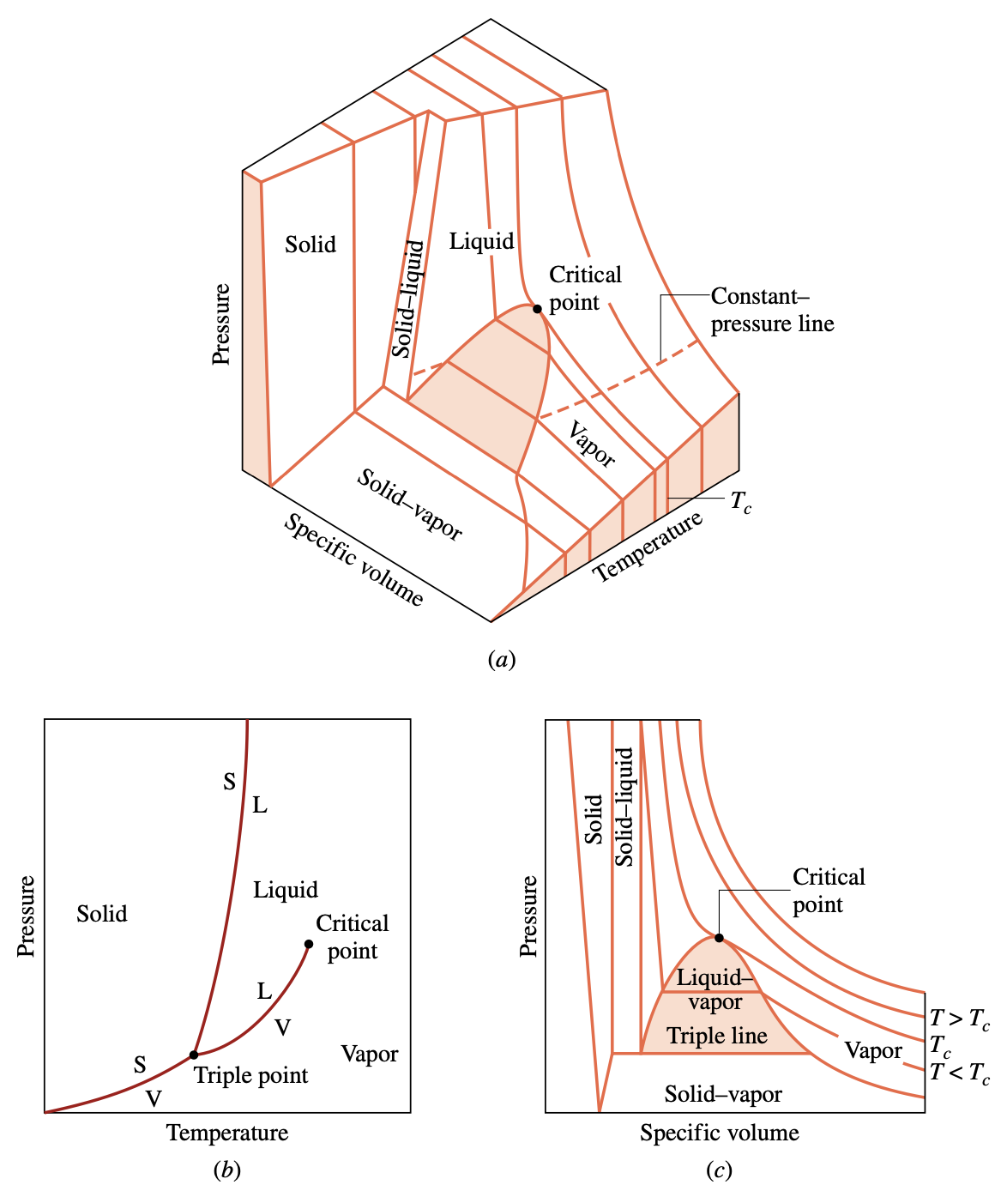
Evaluating Properties: General Considerations
p–υ–T surface and projections for a substance that expands on freezing. (a) Three-dimensional view. (b) Phase diagram. (c) p–υ diagram.
p–υ–T surface and projections for a substance that contracts on freezing. (a) Three-dimensional view. (b) Phase diagram. (c) p–υ diagram.
Notes:
We begin our study of the properties of pure, simple compressible substances and the relations among these properties with pressure, specific volume, and temperature. From experiment it is known that temperature and specific volume can be regarded as independent and pressure determined as a function of these two: p = p(T, υ). The graph of such a function is a surface, the p–υ–T surface.
Figure 3.1 is the p–υ–T surface of a substance such as water that expands on freezing. Figure 3.2 is for a substance that contracts on freezing, and most substances exhibit this characteristic. The coordinates of a point on the p–υ–T surfaces represent the values that pressure, specific volume, and temperature would assume when the substance is at equilibrium.
There are regions on the p–υ–T surfaces of Figs. 3.1 and 3.2 labeled solid, liquid, and vapor. In these single-phase regions, the state is fixed by any two of the properties: pressure, specific volume, and temperature, since all of these are independent when there is a single phase present. Located between the single-phase regions are two-phase regions where two phases exist in equilibrium: liquid–vapor, solid–liquid, and solid–vapor. Two phases can co- exist during changes in phase such as vaporization, melting, and sublimation. Within the two- phase regions pressure and temperature are not independent; one cannot be changed without changing the other. In these regions the state cannot be fixed by temperature and pressure alone; however, the state can be fixed by specific volume and either pressure or temperature. Three phases can exist in equilibrium along the line labeled triple line.

Slide 15
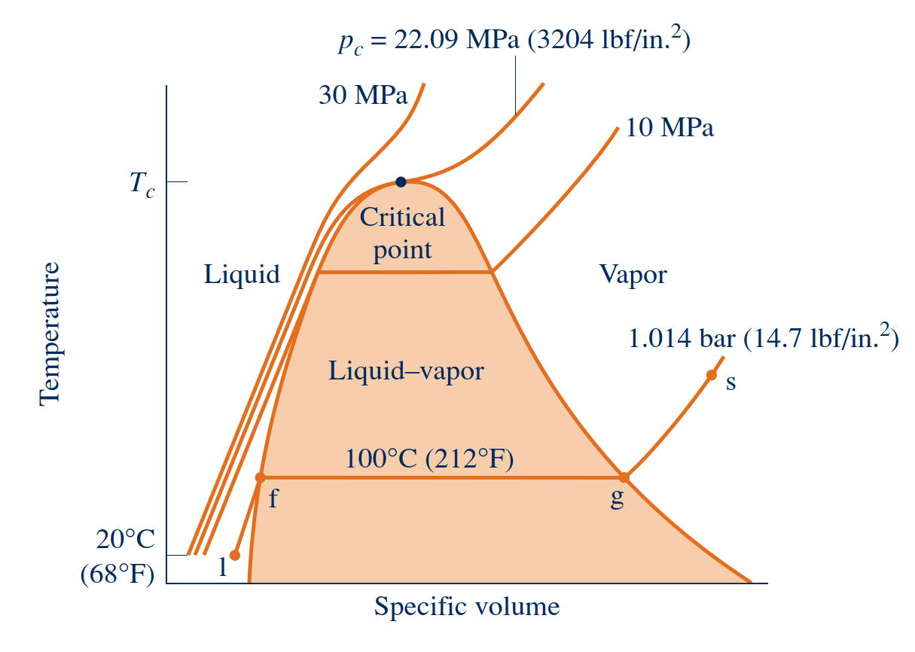
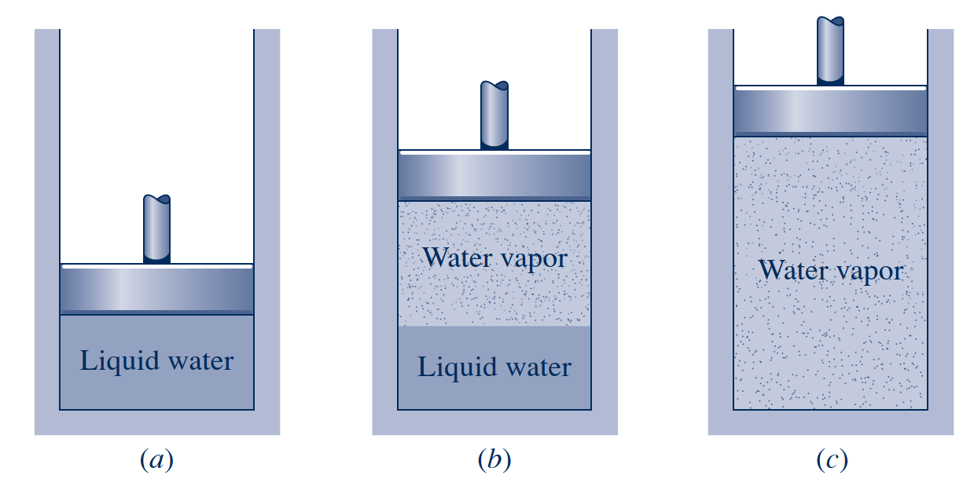
Studying Phase Change
Liquid States
The liquid states along the line segment l–f of right Fig. are sometimes referred to as subcooled liquid states because the temperature at these states is less than the saturation temperature at the given pressure.
These states are also referred to as compressed liquid states because the pressure at each state is higher than the saturation pressure corresponding to the temperature at the state. The names liquid, subcooled liquid, and compressed liquid are used interchangeably.
Sketch of a temperature–specific volume diagram for water showing the 20°C liquid, two-phase liquid–vapor, and vapor regions (not to scale).
https://www.youtube.com/watch?v=QqbrU3Nwab4
Illustration of constant-pressure change from liquid to vapor for water

Slide 16
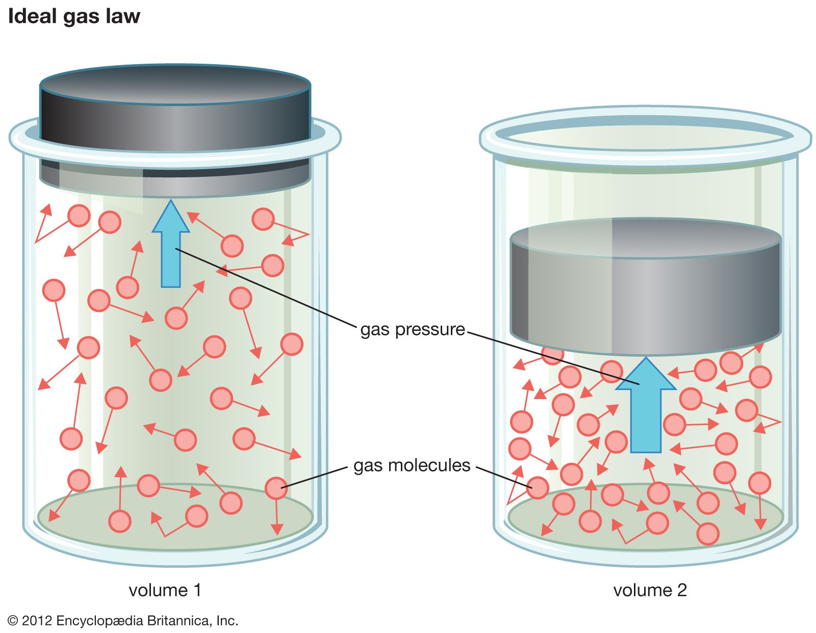
Idea Gas Law

Slide 17
Evaluating Specific Internal Energy and Enthalpy
Internal Energy
Data for specific internal energy $u$ and enthalpy $h$ are retrieved from the property tables in the same way as for specific volume. For saturation states, the values of $u_{f}$ and $u_{g},$ as well as $h_{f}$ and $h_{g}$, are tabulated versus both saturation pressure and saturation temperature. The specific internal energy for a two-phase liquid–vapor mixture is calculated for a given quality in the same way the specific volume is calculated:
Internal energy U of a system or a body with well defined boundaries is the total of the kinetic energy due to the motion of molecules and the potential energy associated with the vibrational motion and electric energy of atoms within molecules. Internal energy also includes the energy in all the chemical bonds.
Enthalpy
Because the sum $U+pv$ occurs so frequently in subsequent discussions, it is convenient to give the combination a name, enthalpy, and a distinct symbol, $H$. By definition
Similarly, the specific enthalpy for a two-phase liquid–vapor mixture is given in terms of the quality by

Slide 18
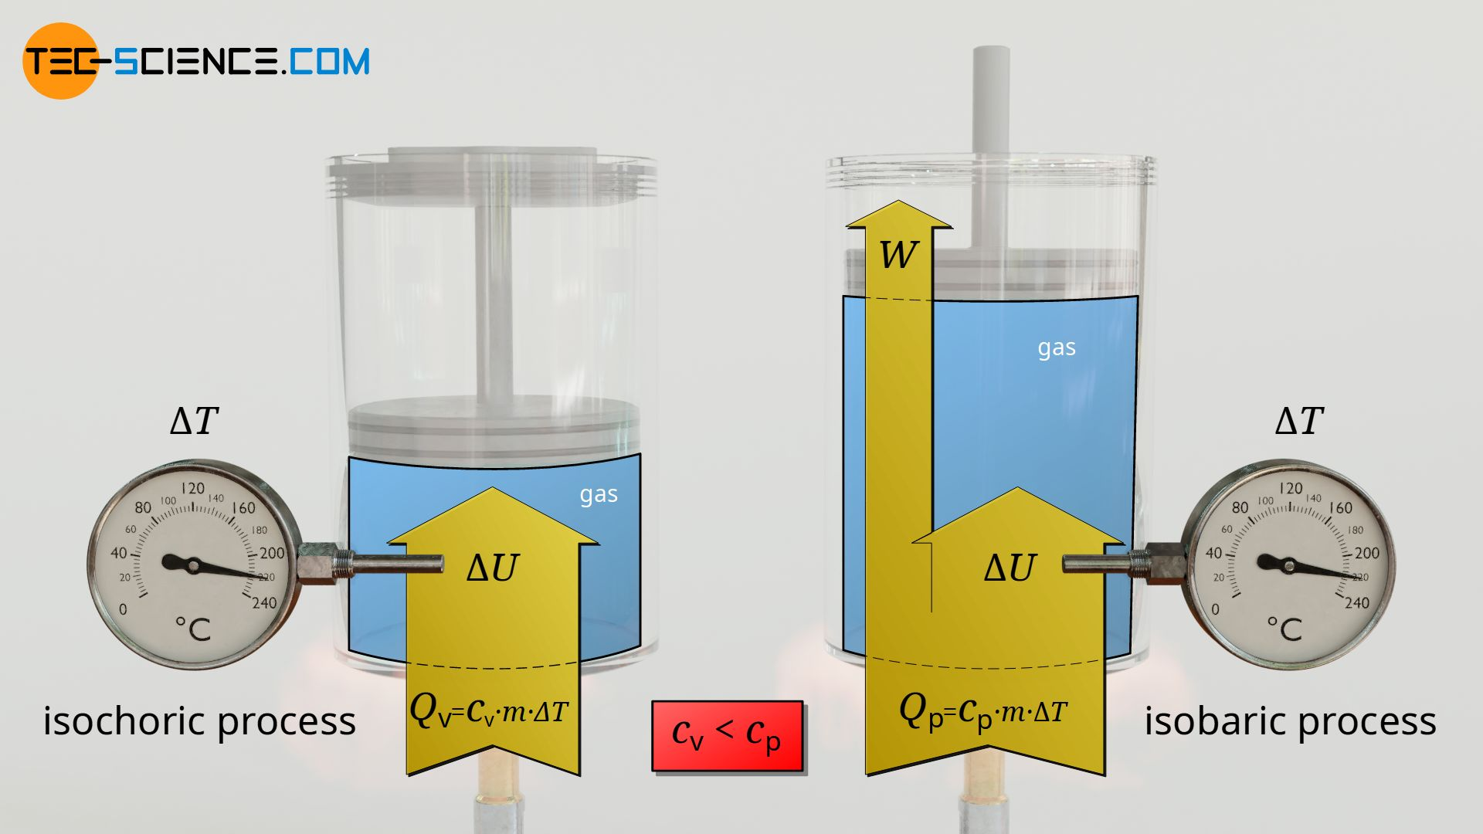
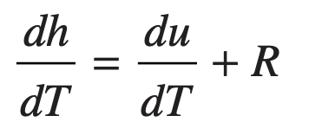
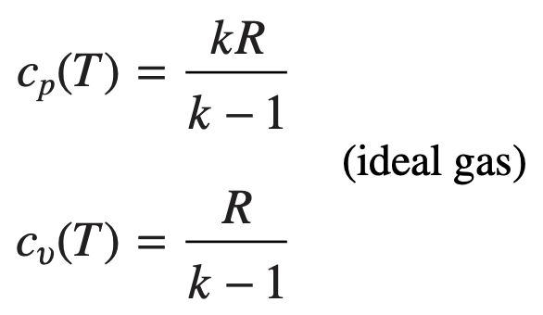
Specific Heats
The specific heat $c_{ν}$
Specific heat $c_{p}$
On integration, the change in specific internal energy and enthalpy are

Slide 19
Conservation of Mass and Energy

Slide 20
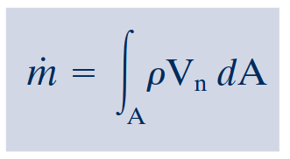
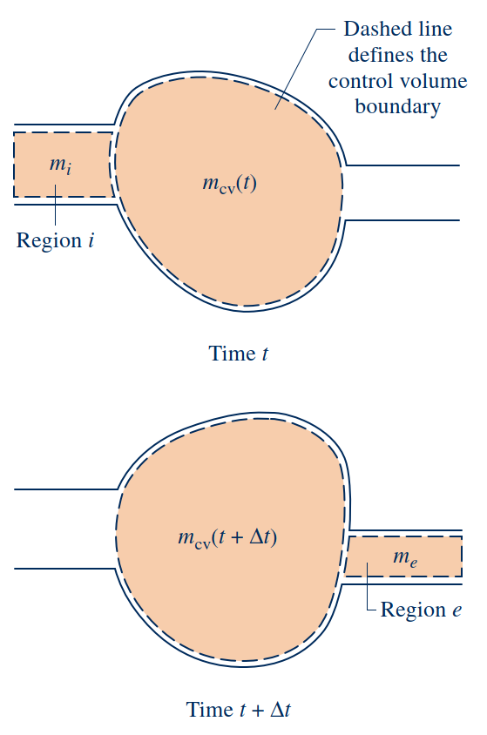
Conservation of Mass for a Control Volume
Conservation of Mass for a Control Volume
mass flow rates
Evaluating the Mass Flow Rate

Slide 21
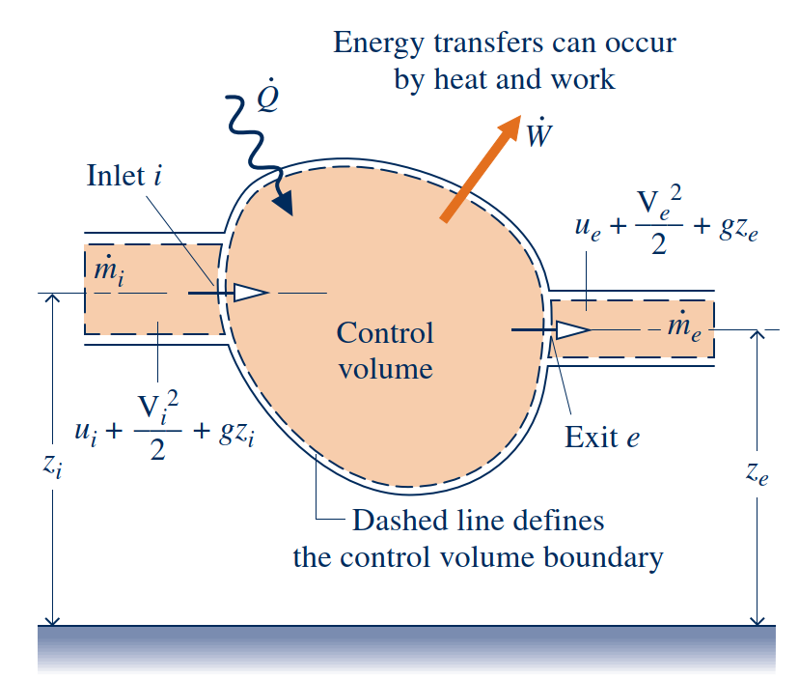
Conservation of Energy for a Control Volume
Conservation of energy
Flow work
Because work is always done on or by a control volume where matter flows across the boundary, it is convenient to separate the work term $\dot{W}$ of above equation into two contributions:
One contribution is the work associated with the fluid pressure as mass is introduced at inlets and removed at exits.
The other contribution, denoted by ${\dot{W}}_{\text{cv}}$, includes all other work effects, such as those associated with rotating shafts, displacement of the boundary, and electrical effects.

Slide 22
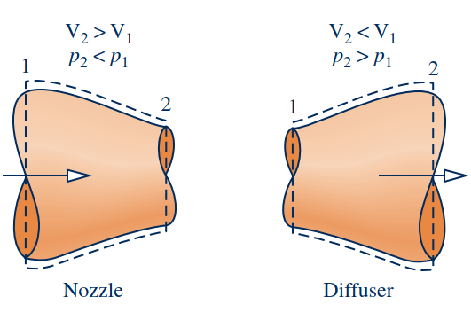
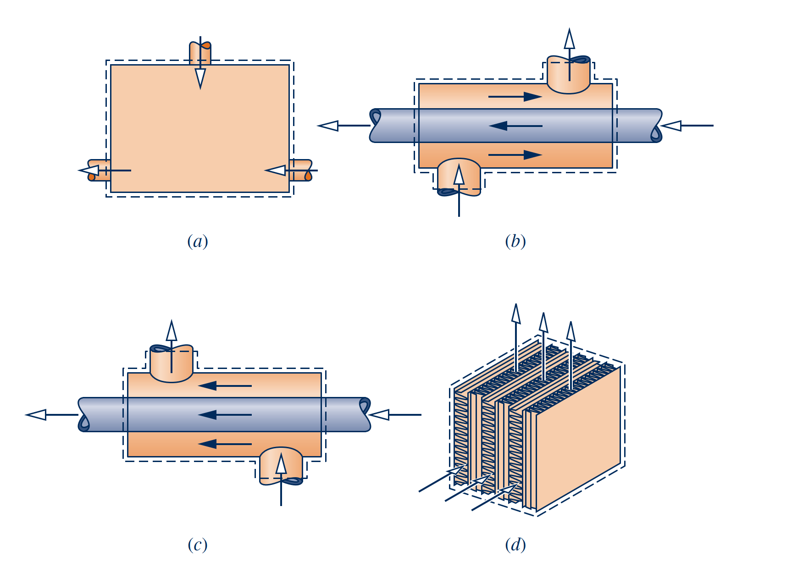
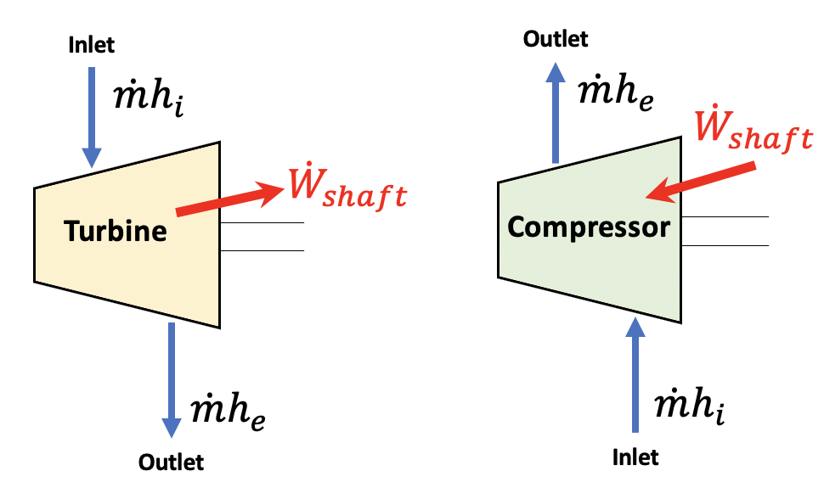
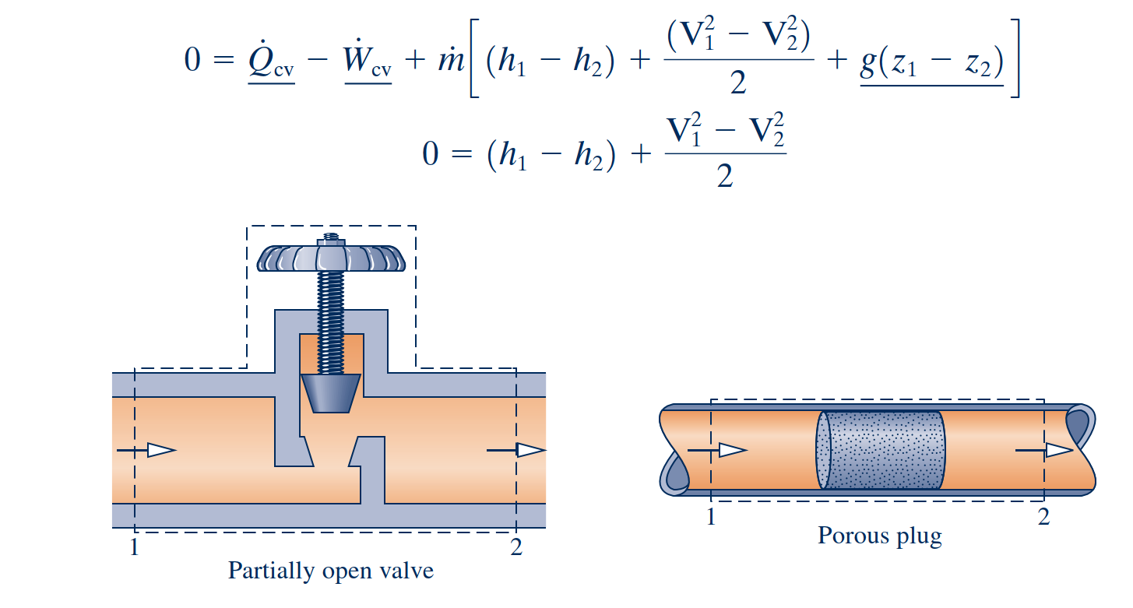
Energy Balance for Specific Control Volume System

Slide 23
Entropy and Second Law of Thermodynamics

Slide 24
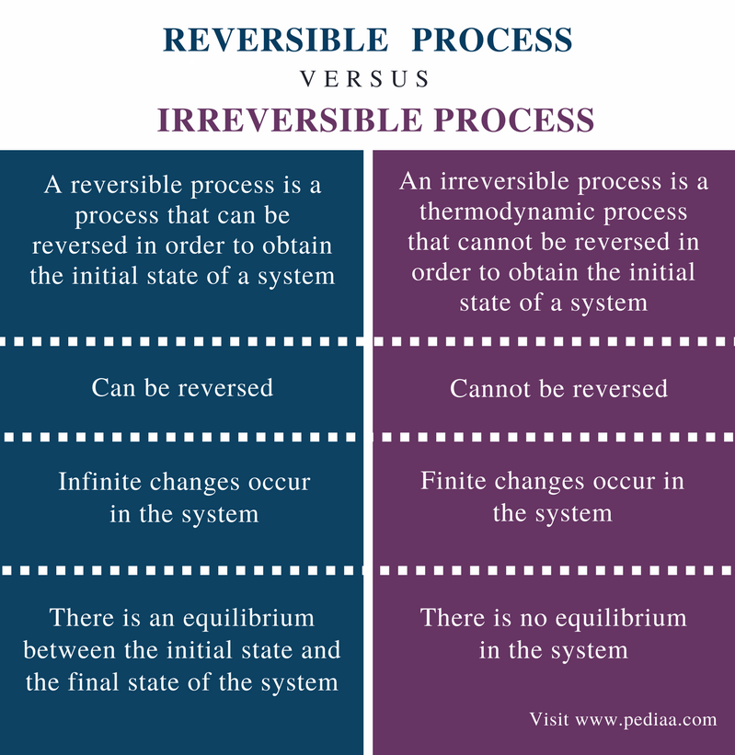
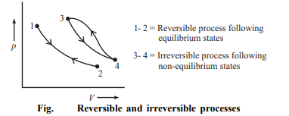
Reversible and Irreversible Processes
Reversible Process
A thermodynamic process is reversible if the process can return back in such a that both the system and the surroundings return to their original states, with no other change anywhere else in the universe.
Irreversible Process
An irreversible process is a thermodynamic process that departs from equilibrium.

Slide 25
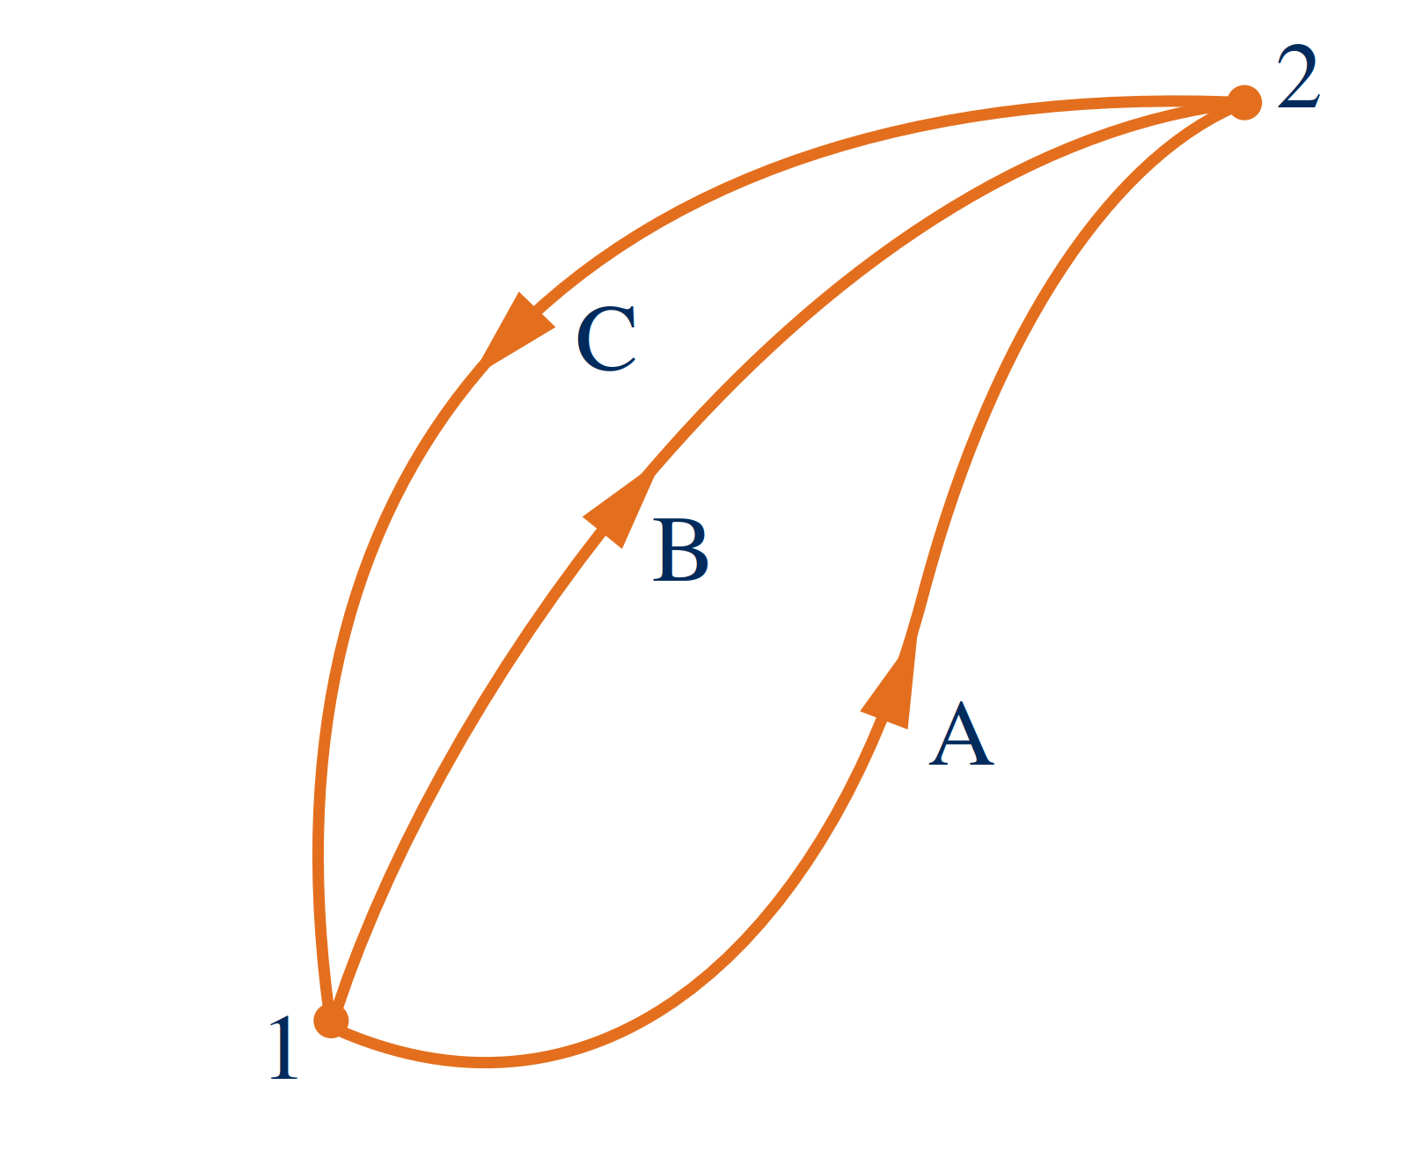
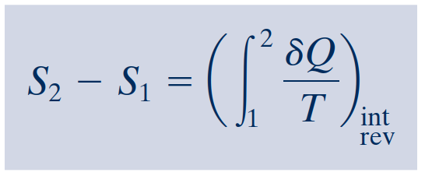
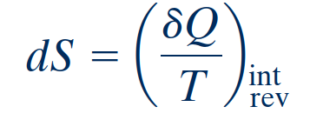
Entropy–A System Property
For the first cycle
One cycle consists of an internally reversible process A from state 1 to state 2, followed by internally reversible process C from state 2 to state 1.
The other cycle consists of an internally reversible process B from state 1 to state 2, followed by the same process C from state 2 to state 1 as in the first cycle.
For the second cycle
definition of entropy change
Evaluating Entropy
On a differential basis
Entropy is an extensive property.
Notes:
This shows that the integral of δ Q/T is the same for both processes. Since A and B are arbitrary, it follows that the integral of δ Q/T has the same value for any internally reversible process between the two states. In other words, the value of the integral depends on the end states only. It can be concluded, therefore, that the integral represents the change in some property of the system.

Slide 26
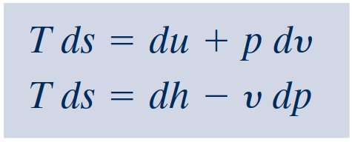
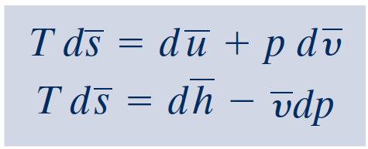
Introducing the T dS Equations
In the absence of overall system motion and the effects of gravity, an energy balance in differential form is
By definition of simple compressible system, the work is
On rearrangement, the heat transfer is
The first T dS equation results
The second $T dS$equation

Slide 27
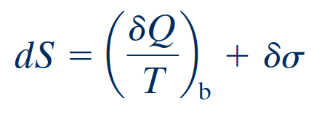
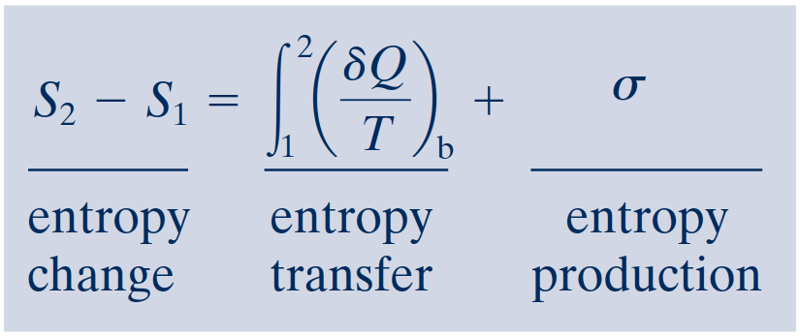
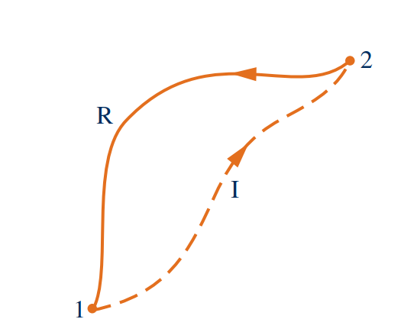
Entropy Balance for Closed Systems
Entropy balance
Closed system entropy balance
The entropy balance is an expression of the second law that is particularly effective for thermodynamic analysis.
It is sometimes convenient to use the entropy balance expressed in differential form
The second law of thermodynamics can be interpreted as requiring that entropy is produced by irreversibilities and conserved only in the limit as irreversibilities are reduced to zero.
Since σ measures the effect of irreversibilities present within the system during a pro- cess, its value depends on the nature of the process and not solely on the end states.
Cycle used to develop the entropy balance.

Slide 28
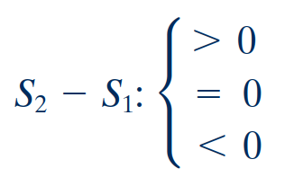
Interpreting the Closed System Entropy Balance
entropy transfer accompanying heat transfer
entropy production
If the end states are fixed, the entropy change on the left side can be evaluated independently of the details of the process. However, the two terms on the right side depend explicitly on the nature of the process and cannot be determined solely from knowledge of the end states.
The first term on the right side is associated with heat transfer to or from the system during the process. This term can be interpreted as the entropy transfer accompanying heat transfer.
The entropy change of a system is not accounted for solely by the entropy transfer but also is due in part to the second term on the right side of denoted by.
The term is positive when internal irreversibilities are present during the process and vanishes when no internal irreversibilities are present.
This can be described by saying that entropy is produced (or generated) within the system by the action of irreversibilities.
A positive value means that entropy is transferred into the system, and
a negative value means that entropy is transferred out.
When there is no heat transfer, there is no entropy transfer.

Slide 29
Enthalpy Vs. Entropy
Enthalpy, denoted by the symbol ‘H’, refers to the measure of total heat content in a thermodynamic system under constant pressure. Enthalpy is calculated in terms of change, i.e., ∆H = ∆U + P∆V(where E is the internal energy). The SI unit of enthalpy is joules (J).
Entropy, denoted by the symbol ‘S’, refers to the measure of the level of disorder in a thermodynamic system. It is measured as joules per kelvin (J/K). Entropy is calculated in terms of change, i.e., ∆S = ∆Q/T (where Q is the heat content and T is the temperature).
Entropy and Entropy Generation in Daily Life
https://www.youtube.com/watch?v=YM-uykVfq_E
Notes:
https://sciencestruck.com/difference-between-entropy-enthalpy-in-thermodynamics

Slide 30
Application of Thermodynamics

Slide 31
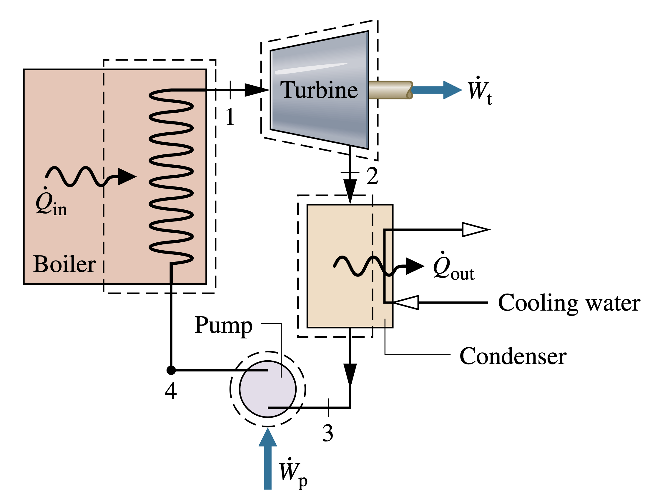
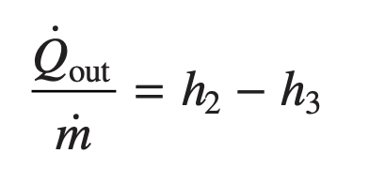
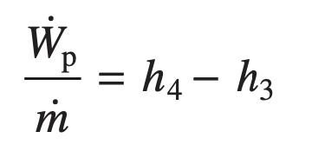
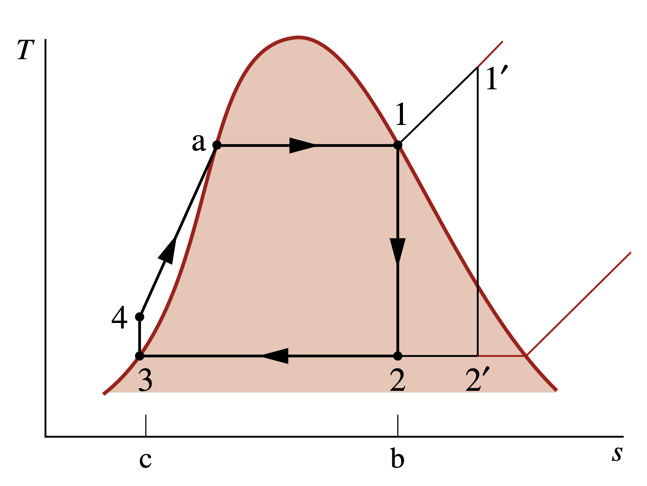
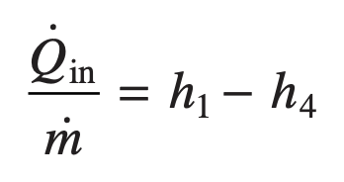
Modeling the Rankine Cycle (Vapor Power)
Turbine
Condenser
Pump
Boiler
Performance Parameters
Temperature–entropy diagram of the ideal Rankine cycle

Slide 32
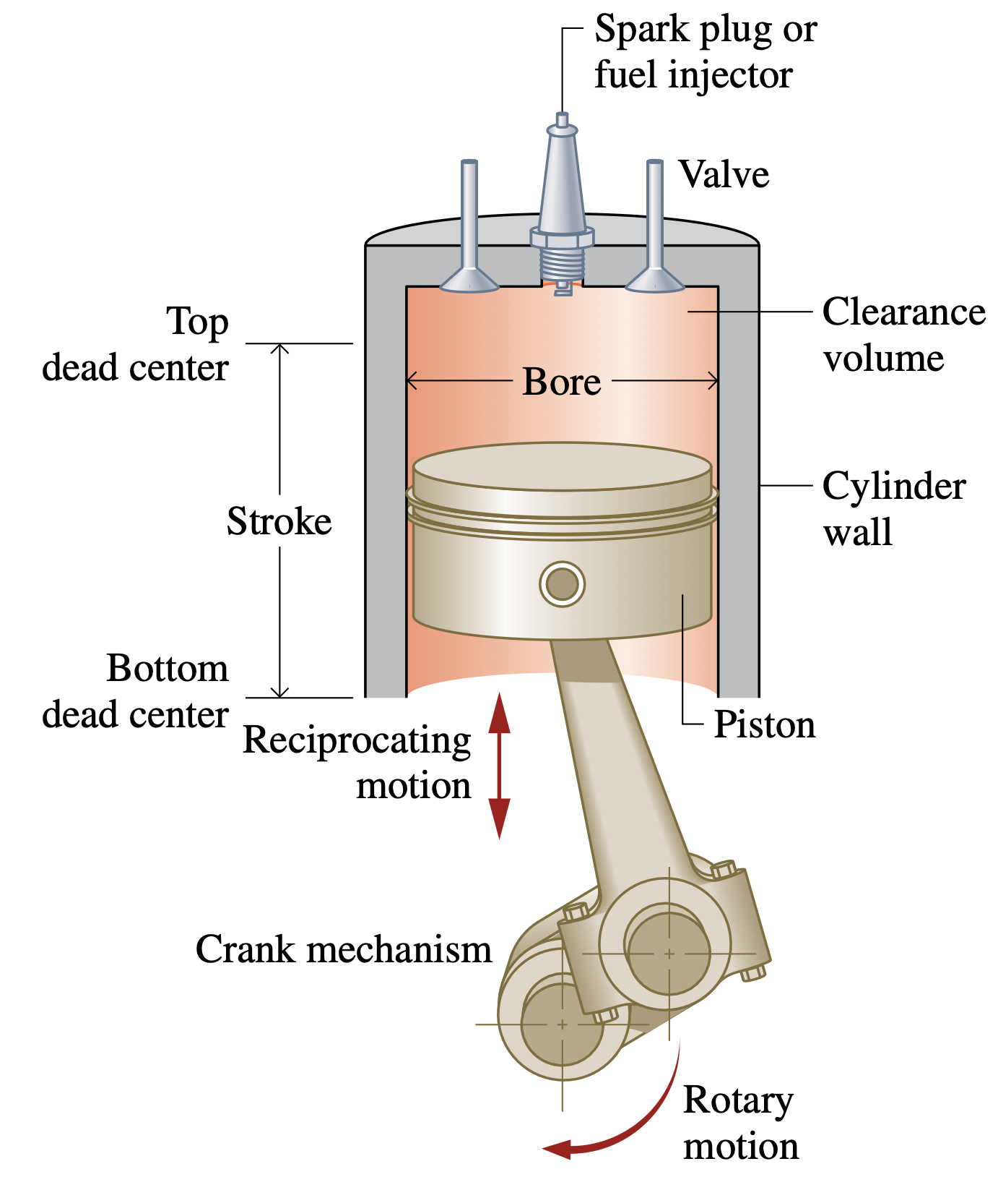
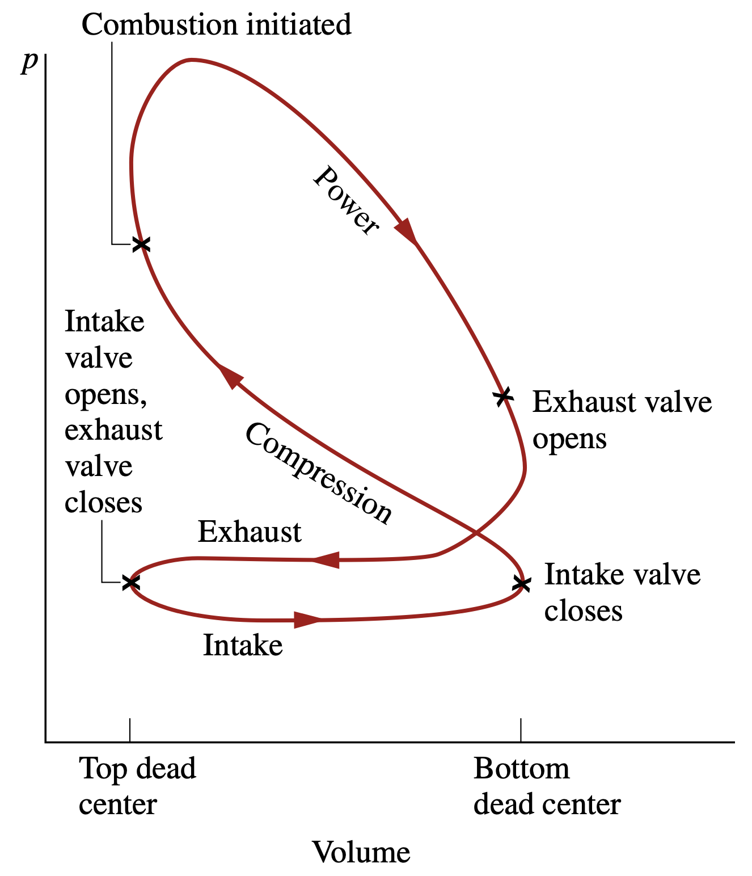
Otto and Diesel Cycle

Slide 33
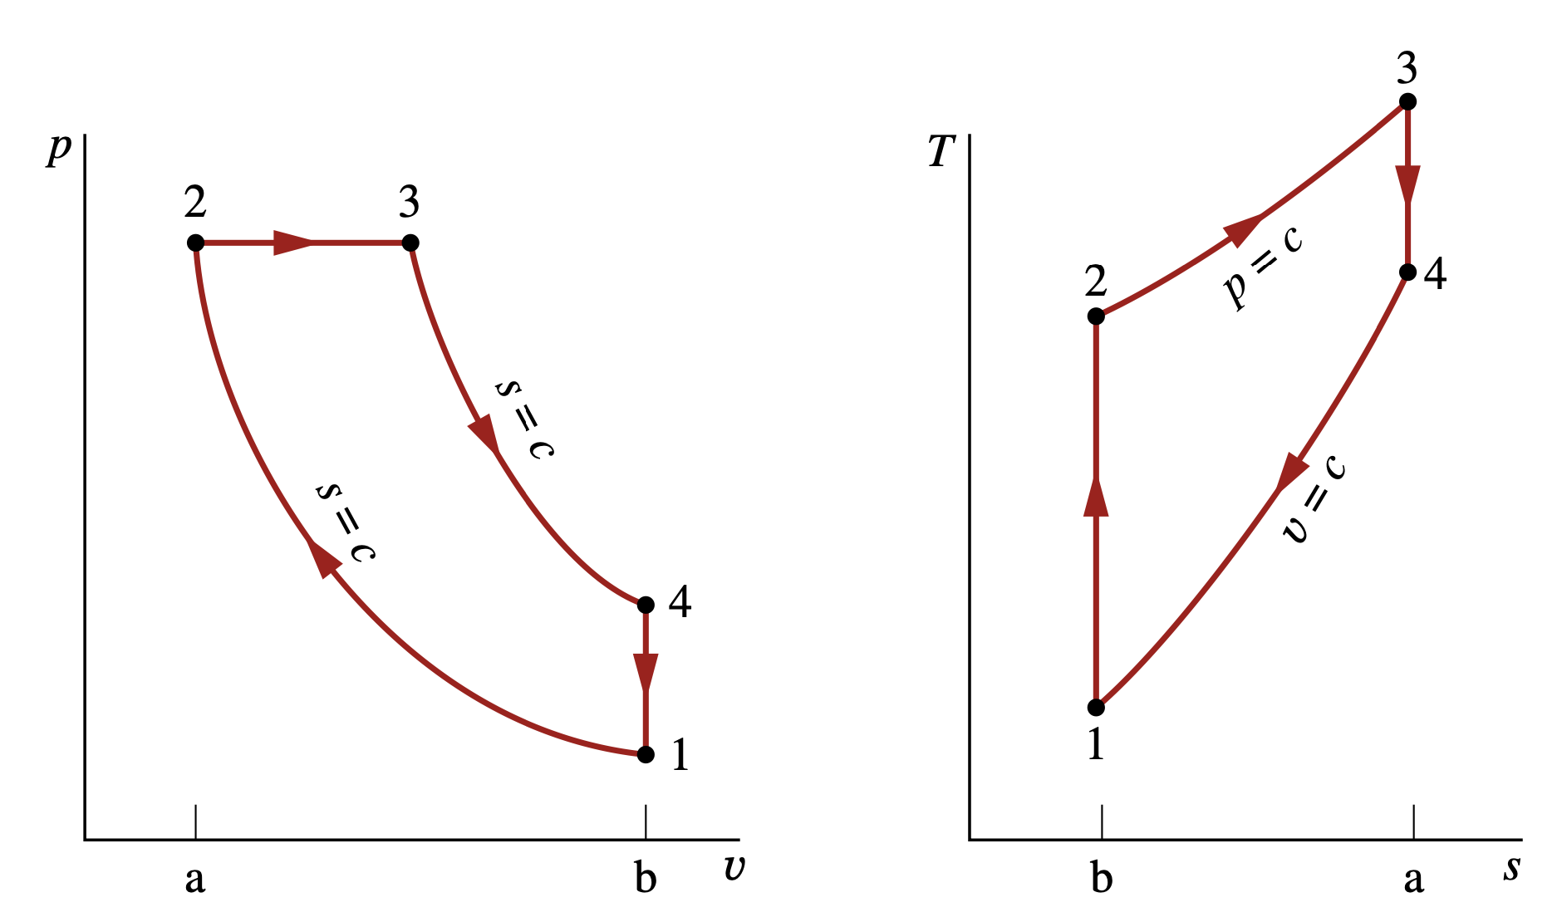
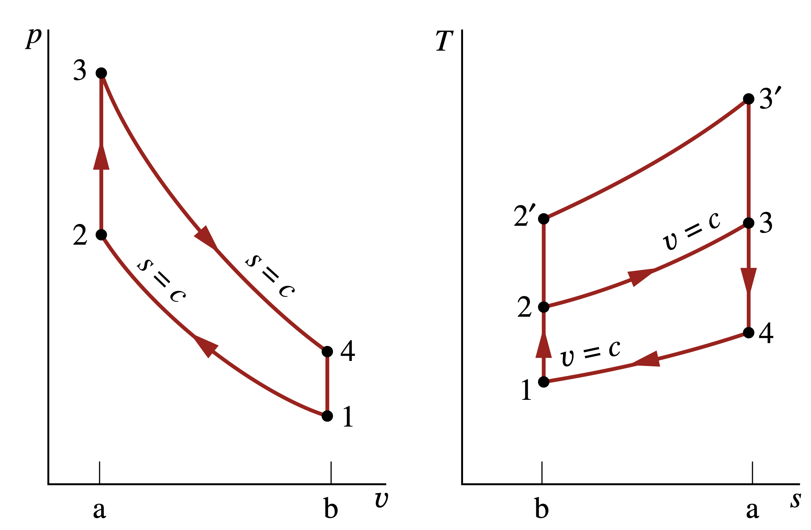
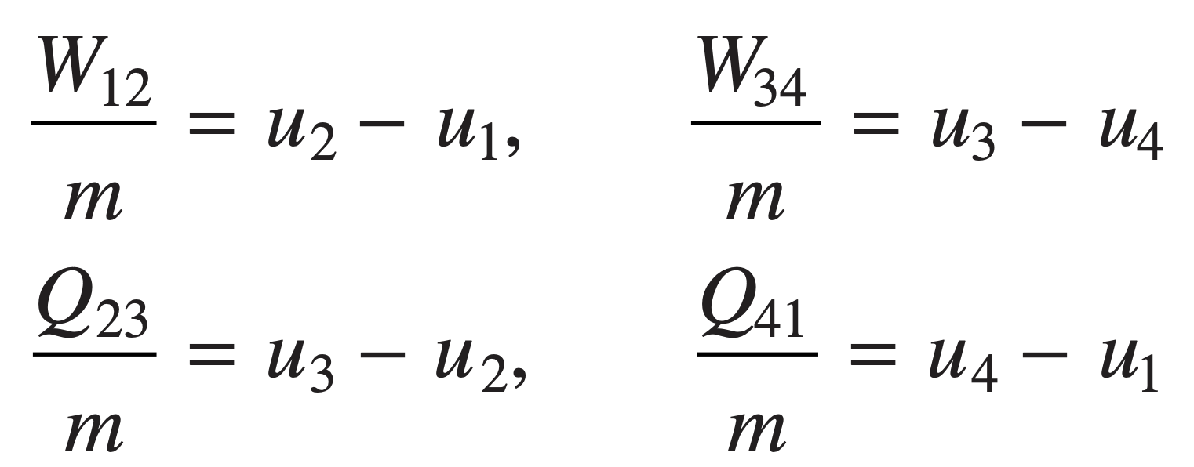
Otto and Diesel Cycle
p–υ and T–s diagrams of the air-standard Otto cycle.
p–υ and T–s diagrams of the air-standard Diesel cycle.

Slide 34
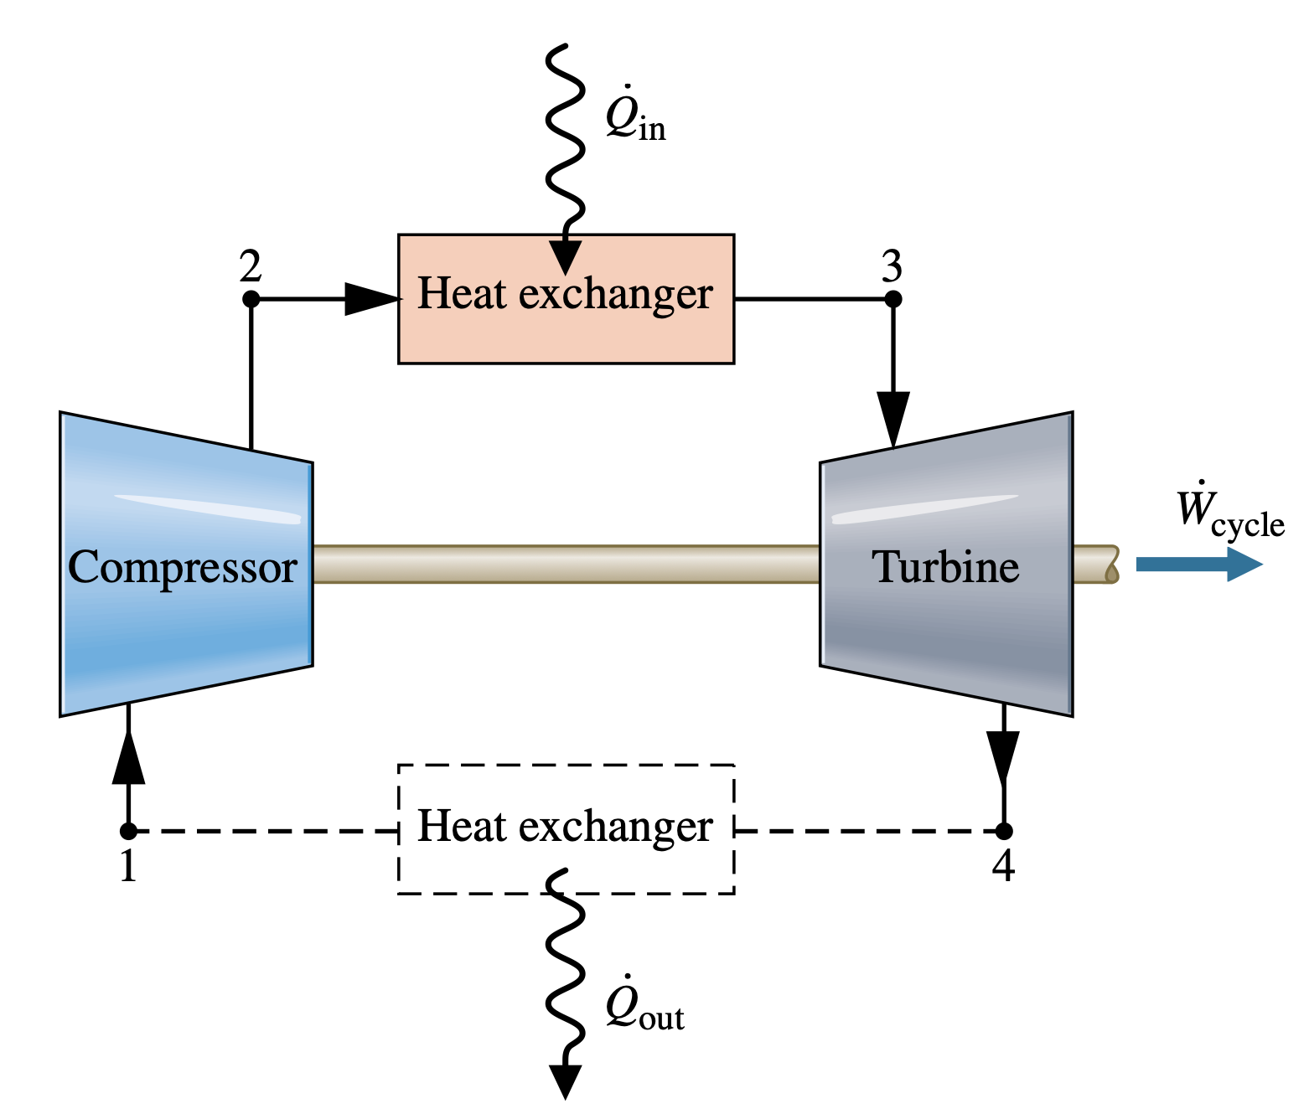
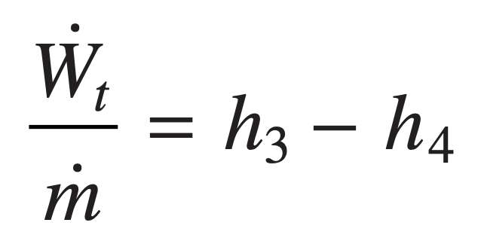
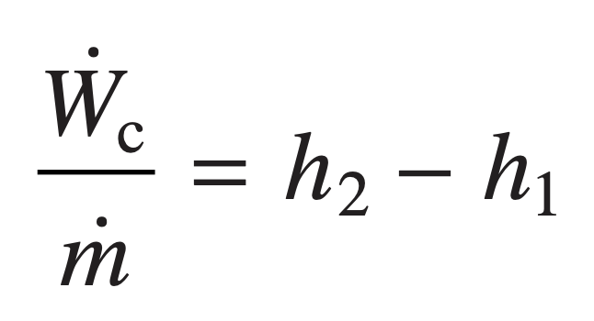
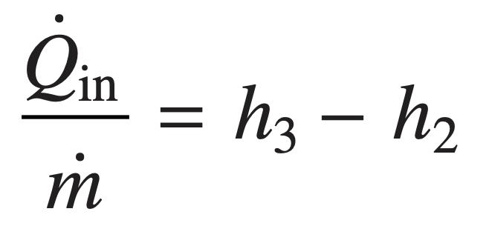
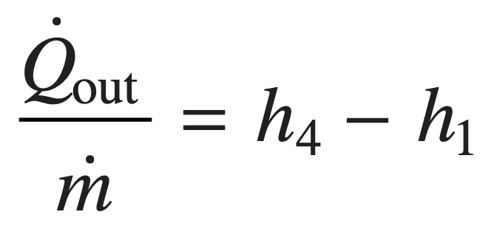
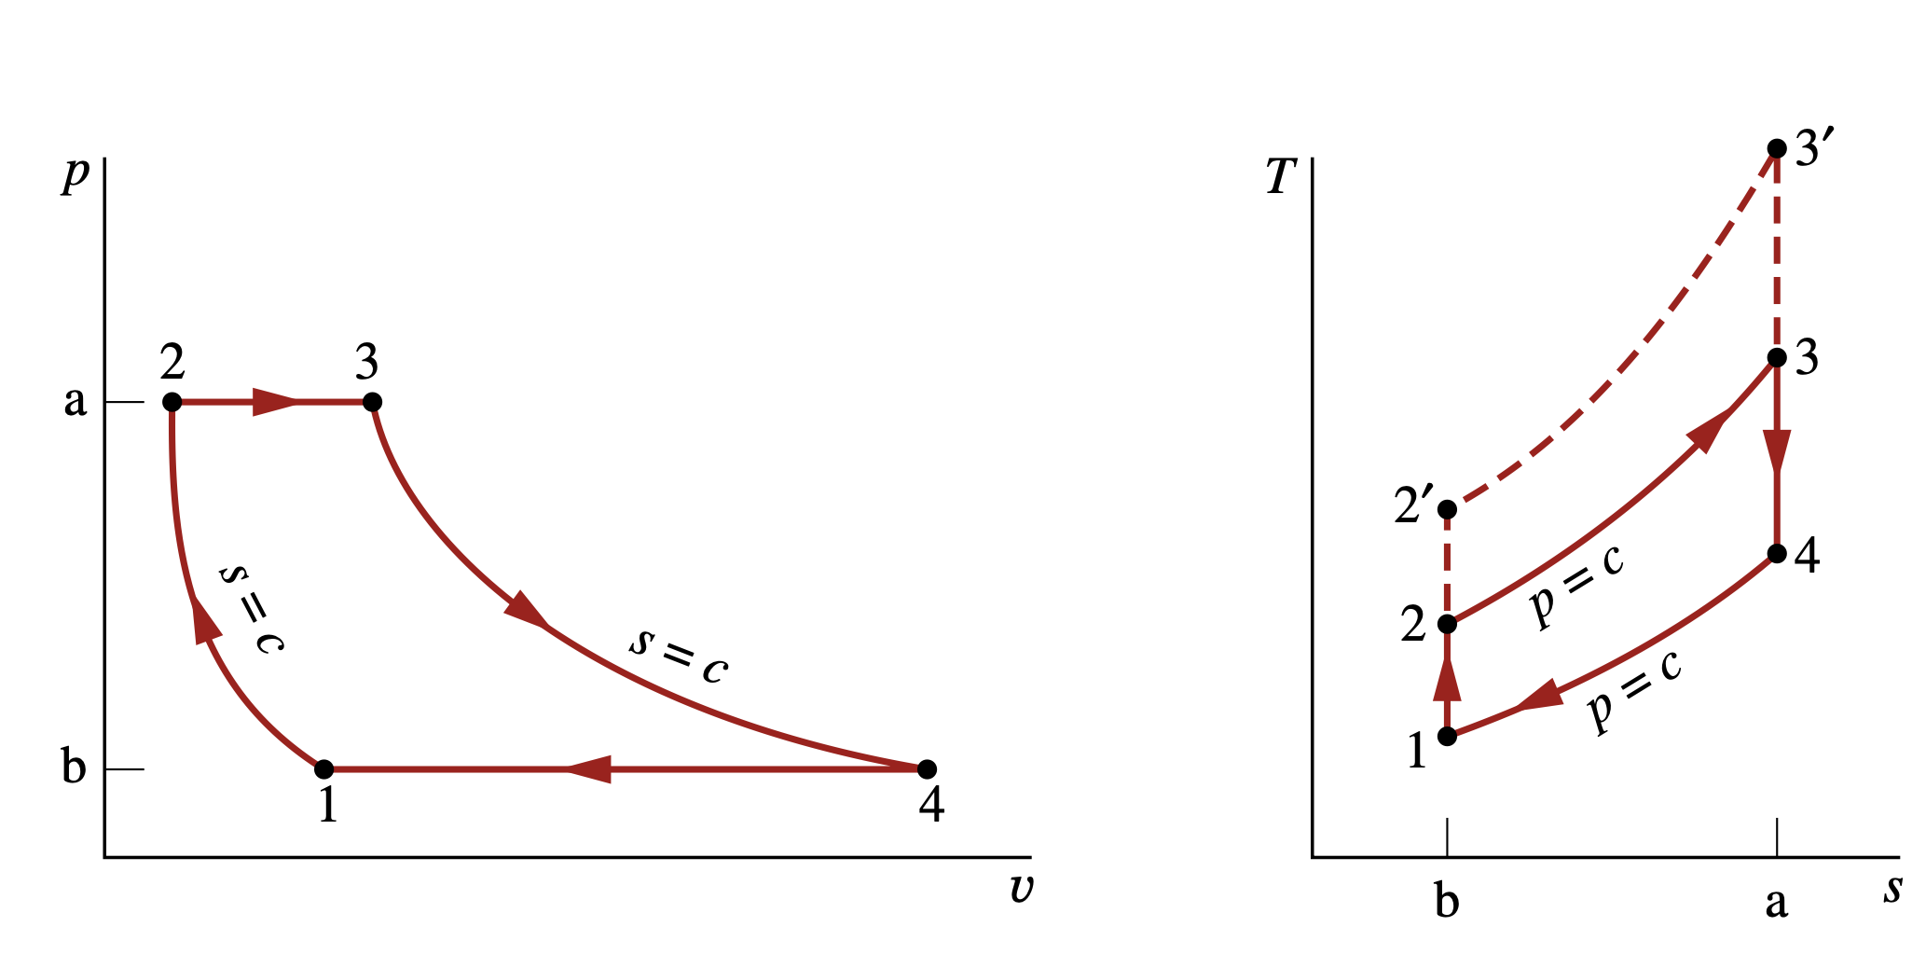
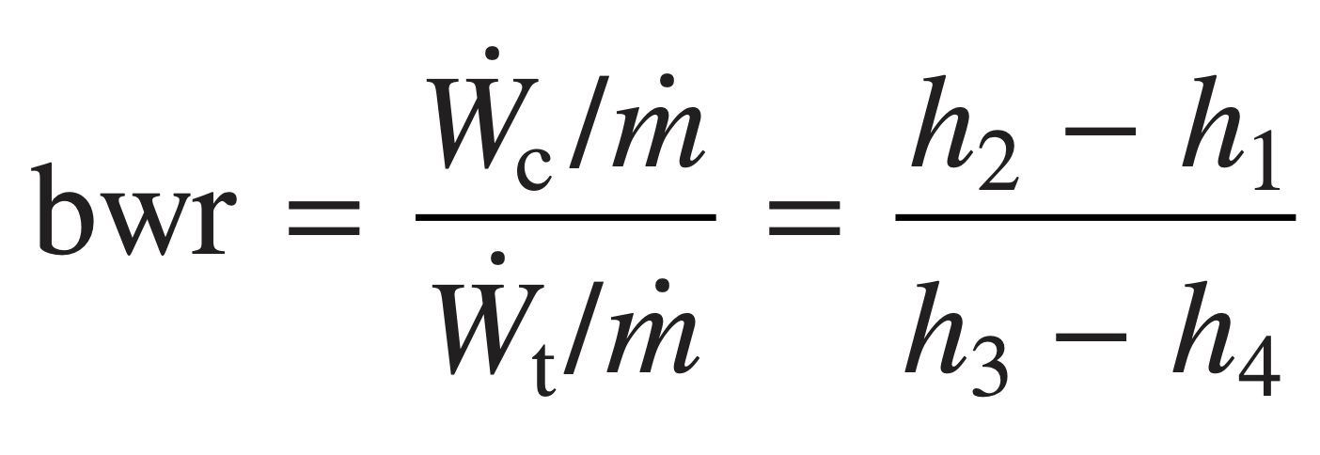
Air-Standard Brayton Cycle
Assuming the turbine and compressor operates adiabatically and with negligible effects of kinetic and potential energy, the work developed per unit of mass flowing is
turbine
Compressor
The heat added and rejected to the cycle per unit of mass is
Air-standard gas turbine cycle.
added
Rejected
The back work ratio for the cycle is

Slide 35
Ideal Air-Standard Brayton Cycle
When air table data are used to conduct an analysis involving the ideal Brayton cycle, the following relationships, apply for the isentropic processes 1–2 and 3–4:
Effect of compressor Pressure Ratio on Performance
The increase in thermal efficiency with the pressure ratio across the compressor is also brought out simply by the following development, in which the specific heat cp and, thus, the specific heat ratio k are assumed constant. For constant cp
When an ideal Brayton cycle is analyzed on a cold air-standard basis, the specific heats are taken as constant.

Slide 36
Vapor refrigeration Systems
The coefficient of performance β of any refrigeration cycle is the ratio of the refrigeration effect to the net work input required to achieve that effect. For the Carnot vapor refrigeration cycle shown in Fig. 10.1, the coefficient of performance is
Carnot vapor refrigeration cycle

Slide 37
Analyzing Vapor-Compression refrigeration Systems
For a control volume enclosing the refrig- erant side of the evaporator, the mass and energy rate balances reduce to give the rate of heat transfer per unit mass of refrigerant flowing as
Vapor-compression refrigeration systems are the most common refrigeration systems in use today. The objective of this section is to introduce some important features of systems of this type and to illustrate how they are modeled thermodynamically.
Assuming no heat transfer to or from the compressor, the mass and energy rate balances for a control volume enclosing the compressor give
For a control volume enclosing the refrigerant side of the condenser, the rate of heat transfer from the refrigerant per unit mass of refrigerant flowing is

Slide 38
Carnot Cycle
The Carnot cycle is an ideal reversible cyclic process involving the expansion and compression of an ideal gas, which enables us to evaluate the efficiency of an engine utilizing this cycle.
At steady state, the rate at which energy is supplied to the warm region by heat transfer is the sum of the energy supplied to the working fluid from the cold region, Qin, and the net rate of work input to the cycle, Wnet. That is,
The coefficient of performance of any heat pump cycle is defined as the ratio of the heat- ing effect to the net work required to achieve that effect.

Slide 39
Brayton refrigeration Cycle
The method of analysis of the Brayton refrigeration cycle is similar to that of the Brayton power cycle. Thus, at steady state the work of the compressor and the turbine per unit of mass flow are, respectively,
Heat transfer from the cold region to the refrigerant gas circulating through the low-pressure heat exchanger, the refrigeration effect, is
The coefficient of performance is the ratio of the refrigeration effect to the net work input:
Brayton refrigeration cycle.

Slide 40
Reacting Mixtures and Combustion

Slide 41
Modeling Combustion Air
Air–Fuel Ratio
Theoretical Air
The air–fuel ratio is simply the ratio of the amount of air in a reaction to the amount of fuel. The ratio can be written on a molar basis (moles of air divided by moles of fuel) or on a mass basis (mass of air divided by mass of fuel).
The minimum amount of air that supplies sufficient oxygen for the complete combustion of all the carbon, hydrogen, and sulfur present in the fuel is called the theoretical amount of air.
equivalence ratio
The equivalence ratio is the ratio of the actual fuel–air ratio to the fuel–air ratio for complete combustion with the theoretical amount of air.
where AF is the air–fuel ratio on a molar basis and AF is the ratio on a mass basis.

Slide 42
Energy Balances for reacting Systems
Analyzing Control Volumes at Steady State
With the foregoing idealizations, the mass and energy rate balances for the two-inlet, single-exit reactor can be used to obtain the following equation on a per mole of fuel basis:
Reactor at steady state.

Slide 43
Energy Balances for reacting Systems
Evaluating Enthalpy terms
The terms set to zero in this expression are the enthalpies of formation of oxygen and nitrogen.
Enthalpy for each component of the products
Enthalpy for each component of the combustible air
With the foregoing considerations,

Slide 44
Energy Balances for reacting Systems
Analyzing Closed Systems (Constant Volume)
A closed system with constant volume involving a combustion process with the absence of kinetic and potential energy effects, the appropriate form of the energy balance is
If the reactants and products form ideal gas mixtures, the energy balance can be expressed as

