Slide 1
Thermodynamics
An Engineering Approach
Lecture 6: Reacting Mixtures and Combustion
Qiang Cheng (Jonny)

Slide 2
Learning Outcomes
When you complete your study of this chapter, you will be able to…
Define complete combustion, theoretical air, enthalpy of formation, and adiabatic flame temperature, and compute values associated with each term.
Develop balanced reaction equations for combustion of hydrocarbon fuels.
Apply mass, energy, and entropy balances to closed systems and control volumes involving chemical reactions.
Notes:
Heat is energy can be converted from one form to another, or transferred from one object to another. For example, a stove burner converts electrical energy to heat and conducts that energy through the pot to the water. This increases the kinetic energy of the water molecules, causing them to move faster and faster. At a certain temperature (the boiling point), the atoms have gained enough energy to break free of the molecular bonds of the liquid and escape as vapor.

Slide 3
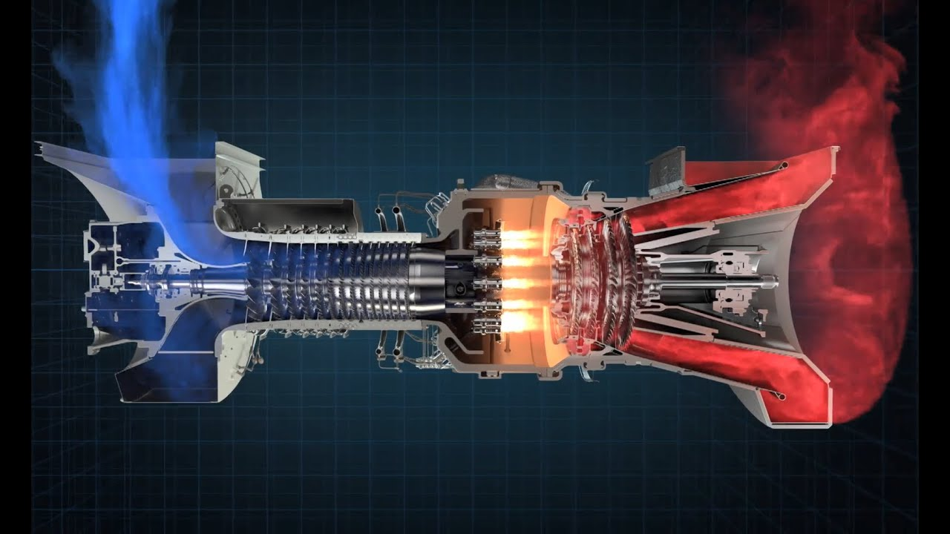
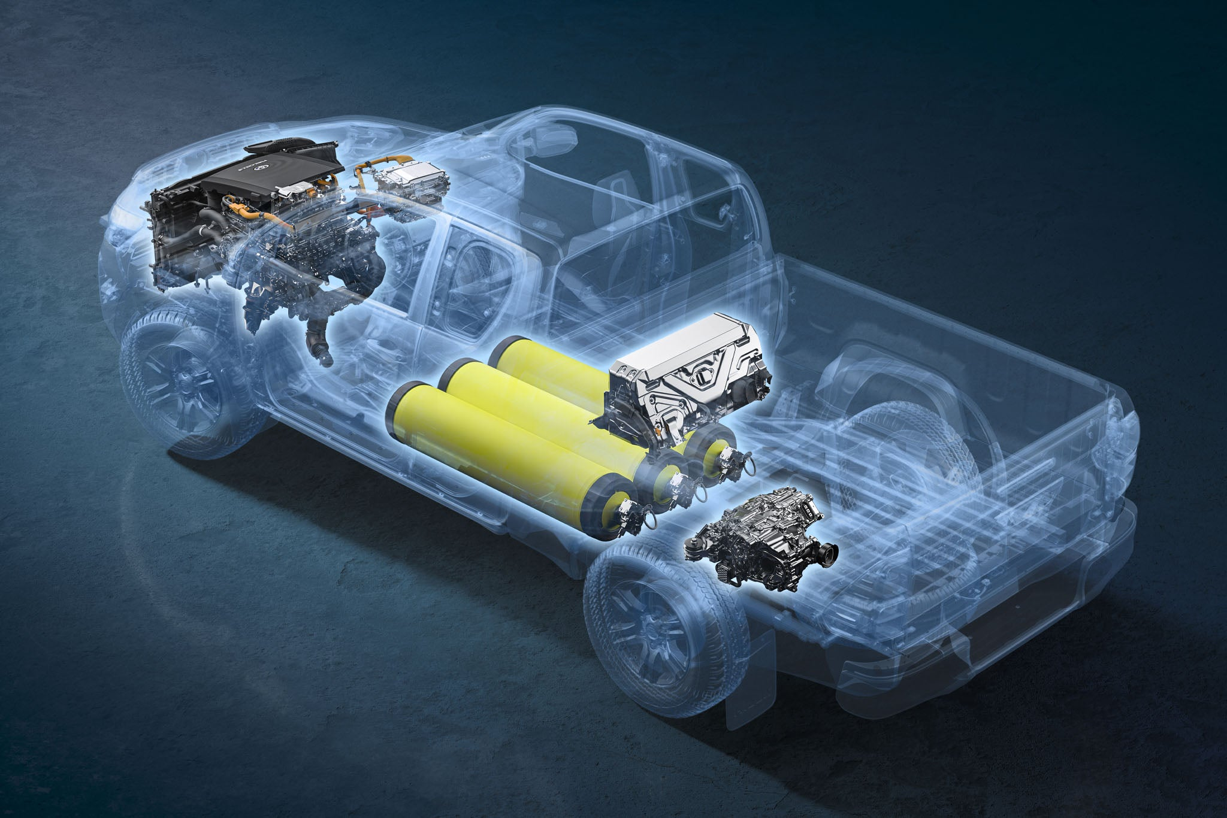
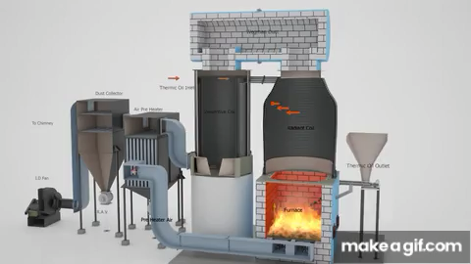
Application of the Combustion
Power Generation
Mobility&Transportation
Combustion is omnipresent!
But Because of emissions of
Harmful pollutants
Greenhouse gases
Design challenges
Industry& Household
Combustion extremely complex, multi-scale and multi-physics
Devices usually big and high power
Measurements difficult
AeroSpace
Computational engineering very important

Slide 4
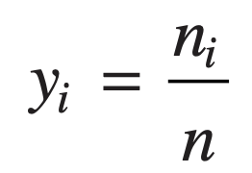
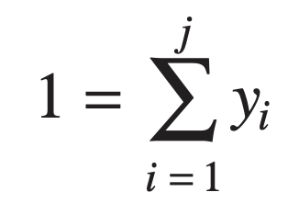
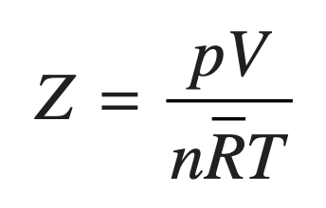
p–υ–T relations for Gas Mixtures
Many systems of interest involve mixtures of two or more components. The principles of thermodynamics introduced thus far are applicable to systems involving mixtures, but to apply such principles requires that mixture properties be evaluated.
Kay’s rule
number of moles
mole fractions
where Tc,i, pc,i, and yi are the critical temperature, critical pressure, and mole fraction of component i, respectively.
mixture Equation of state
Using Tc and pc, the mixture compressibility factor Z is obtained as for a single pure component.
mixture values of the constants a and b for use in the van der Waals and Redlich–Kwong equations would be obtained using relations of the form

Slide 5
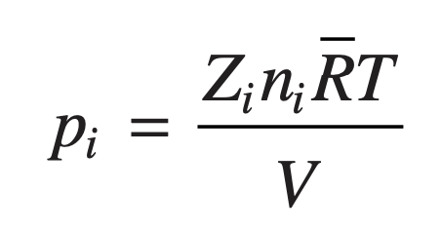
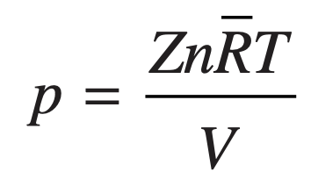
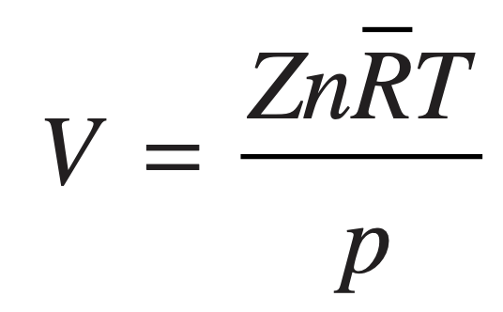
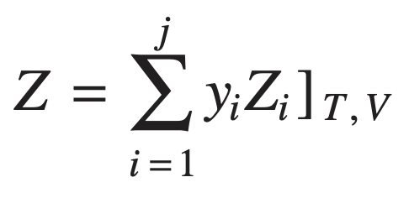
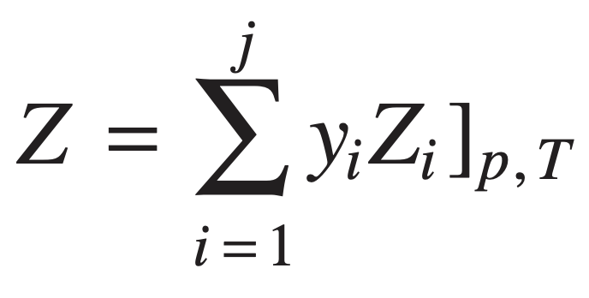
p–υ–T relations for Gas Mixtures
According to the additive pressure rule, the pressure of a gas mixture occupying volume V at temperature T is expressible as a sum of pressures exerted by the individual components:
The underlying assumption of the additive volume rule is that the volume V of a gas mixture at temperature T and pressure p is expressible as the sum of volumes occupied by the individual components:
Since component i is considered to be at the volume and temperature of the mixture, the compressibility factor Zi for this component is
Since component i is considered to be at the pressure and temperature of the mixture, the compressibility factor Zi for this component is
Similarly, for the mixture
Similarly, for the mixture

Slide 6
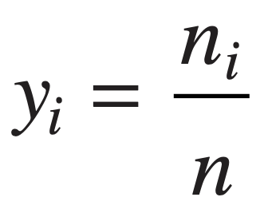
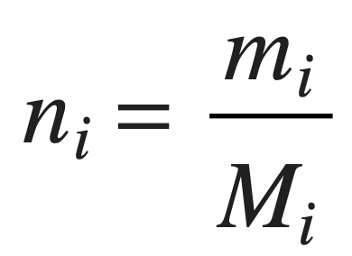
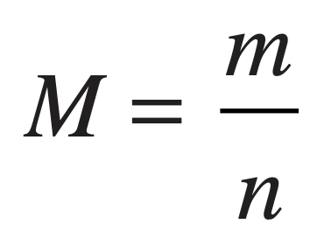
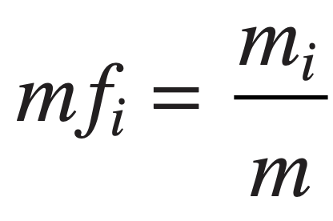
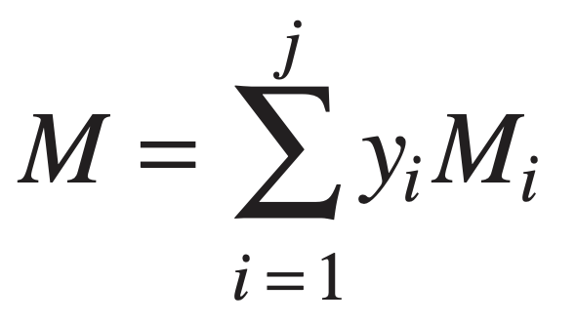
Describing Mixture Composition
The composition of the mixture can be described by giving the mass or the number of moles of each component present.
The mole fraction yi of component i is defined as
The apparent (or average) molecular weight
The total mass of the mixture
The mass fraction mfi of component i is defined as
The total number of moles in a mixture

Slide 7
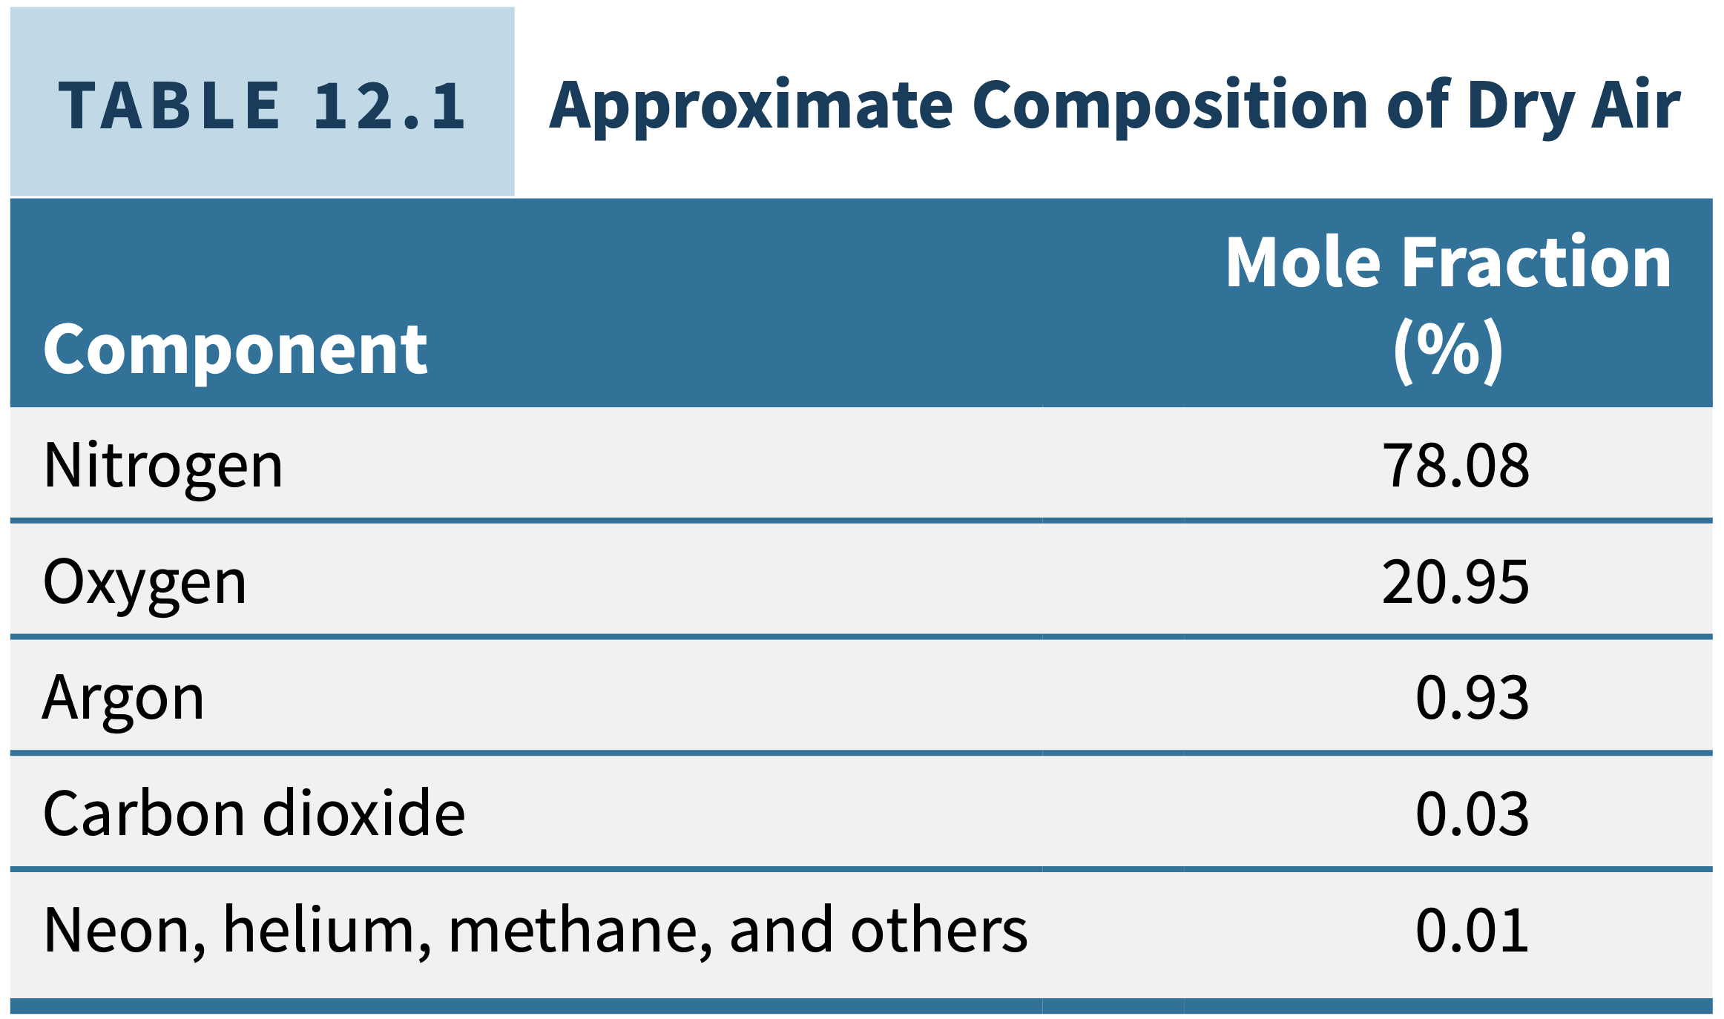
Considering Combustion with Air

Slide 8
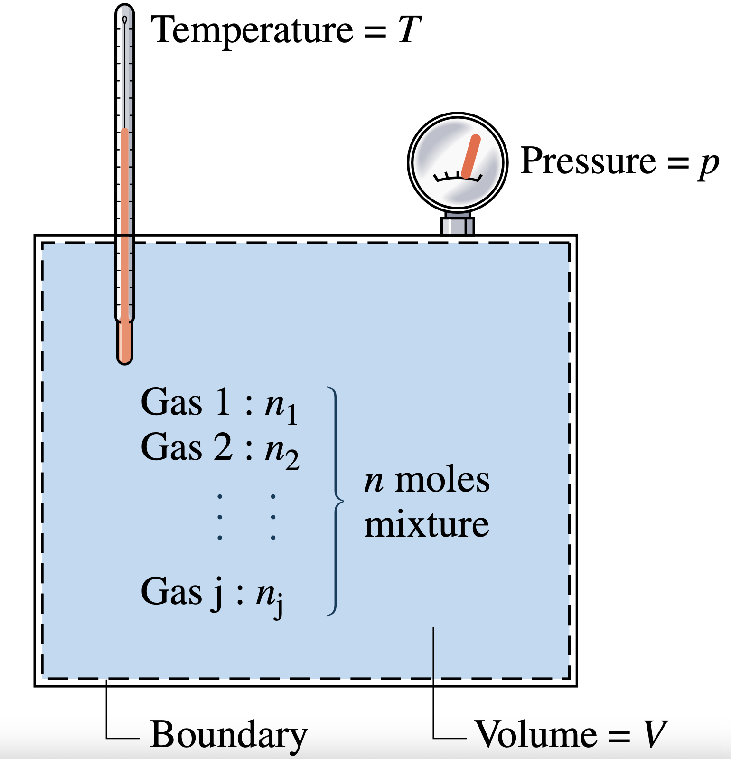
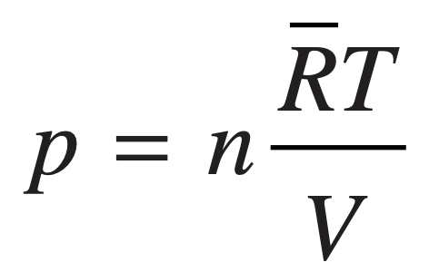
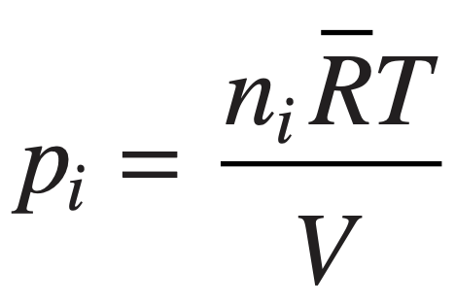
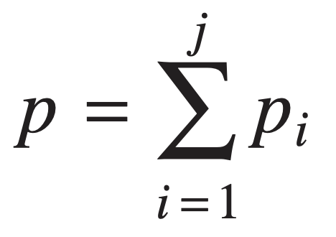
Relating p, V, and T for Ideal Gas Mixtures
The temperature of the gas mixture is T and the pressure is p. The overall mixture is considered an ideal gas, so p, V, T, and the total number of moles of mixture n are related by the ideal gas equation of state
In keeping with this simple picture, the Dalton model assumes that each mixture component behaves as an ideal gas as if it were alone at the temperature T and volume V of the mixture.
The partial pressure of component i

Slide 9
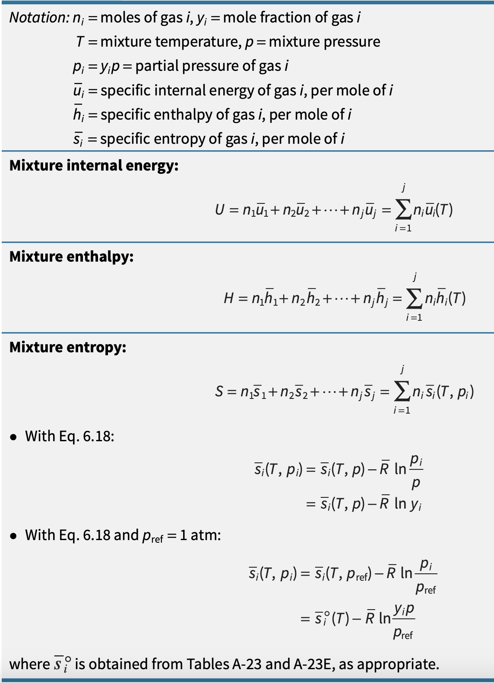
Internal Energy, Enthalpy, and Entropy for Ideal gas mixtures
An enthalpy datum for the study of reacting systems can be established by assigning arbitrarily a value of zero to the enthalpy of the stable elements at a state called the standard reference state and defined by Tref = 298.15 K (25°C) and pref = 1 atm.
The enthalpy of a compound at the standard state equals its enthalpy of formation, symbolized h°f . The enthalpy of formation is the energy released or absorbed when the compound is formed from its elements, the compound and elements all being at Tref and pref.

Slide 10
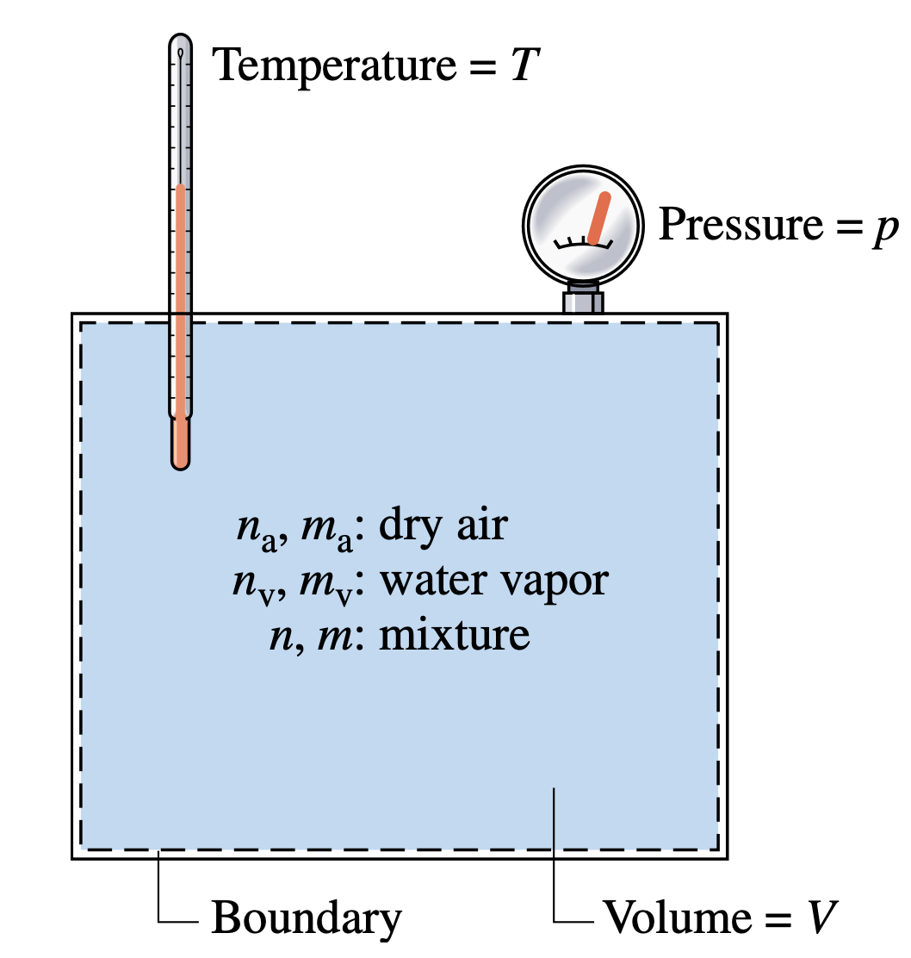
Introducing psychrometric principles
The term moist air refers to a mixture of dry air and water vapor in which the dry air is treated as if it were a pure component. As can be verified by reference to appropriate property data, the overall mixture and each mixture component behave as ideal gases at the states under present consideration.
The overall mixture is assumed to obey the ideal gas equation of state.
Using the ideal gas equation of state, the partial pressures pa and pv of the dry air and water vapor are, respectively,
Mixture of dry air and water vapor.

Slide 11
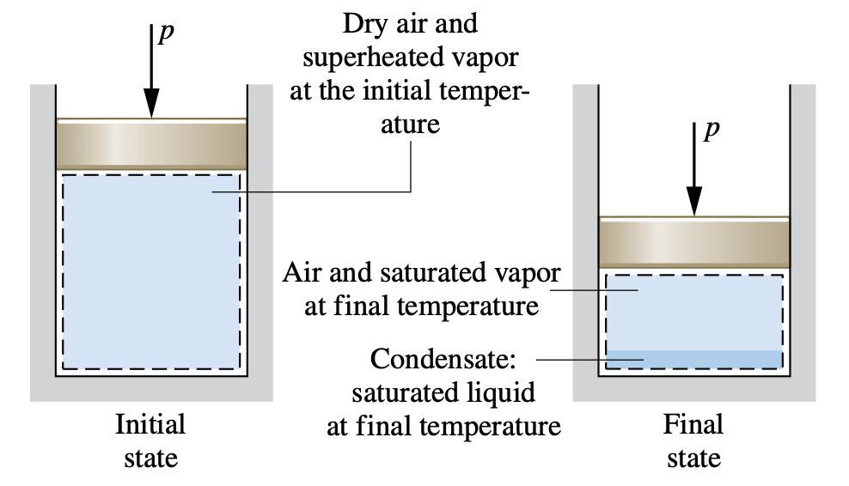
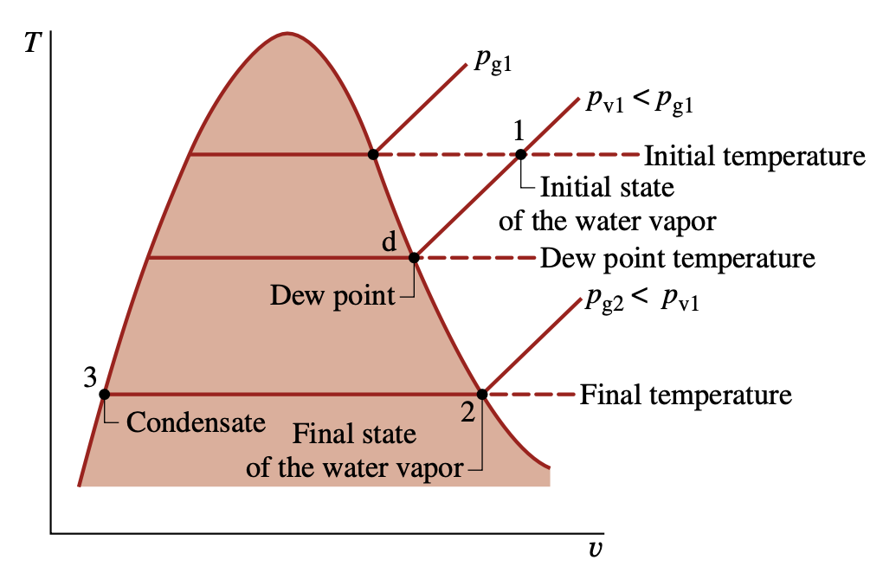
Evaluating the Dew point temperature
A significant aspect of the behavior of moist air is that partial condensation of the water vapor can occur when the temperature is reduced. This type of phenomenon is commonly encountered in the condensation of vapor on windowpanes and on pipes carrying cold water.
Evaluating humidity ratio Using the Adiabatic-Saturation temperature
The humidity ratio ω of an air–water vapor mixture can be determined, in principle, knowing the values of three mixture properties: the pressure p, the temperature T, and the adiabatic- saturation temperature Tas introduced in this section.

Slide 12
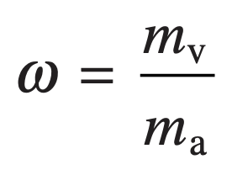
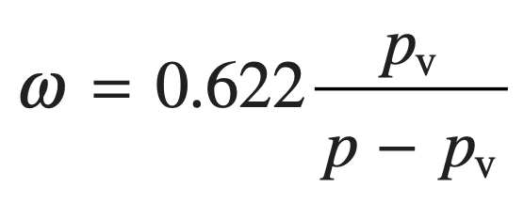
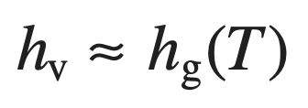
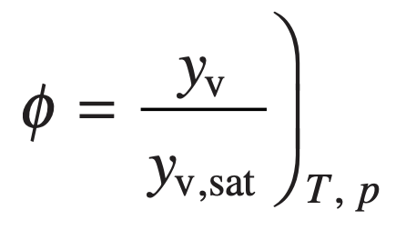
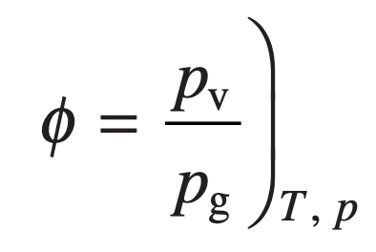
Humidity Ratio, Relative Humidity,
Mixture Enthalpy, and Mixture Entropy
The composition also can be indicated by means of the humidity ratio ω, defined as the ratio of the mass of the water vapor to the mass of dry air
the enthalpy H of a given moist air sample is
Dividing by ma and introducing the humidity ratio gives the mixture enthalpy per unit
mass of dry air
Moist air also can be described in terms of the relative humidity φ
the moist air mixture entropy has two contributions: water vapor and dry air.

Slide 13
Reacting Mixtures and Combustion

Slide 14
Introducing Combustion
When a chemical reaction occurs, the bonds within molecules of the reactants are broken, and atoms and electrons rearrange to form products.
In combustion reactions, rapid oxidation of combustible elements of the fuel results in energy release as combustion products are formed.
The three major combustible chemical elements in most common fuels are carbon, hydrogen, and sulfur.
Sulfur is usually a relatively unimportant contributor to the energy released, but it can be a significant cause of pollution and corrosion problems.
Combustion is complete when all the combustible elements are fully oxidized.
reactants → products
fuel + oxidizer → products
Fuels
Liquid hydrocarbon fuels are commonly derived from crude oil through distillation and cracking processes.
For simplicity in combustion calculations, gasoline is often modeled as octane, C8H18, and diesel fuel as dodecane, C12H26.
Gaseous hydrocarbon fuels are obtained from natural gas wells or are produced in certain chemical processes.
Coal is a familiar solid fuel.
Hydrogen and ammonia nowadays are very attractive fuels due to their nature of carbon-free.
we deal with combustion reactions expressed by chemical equations of the form

Slide 15
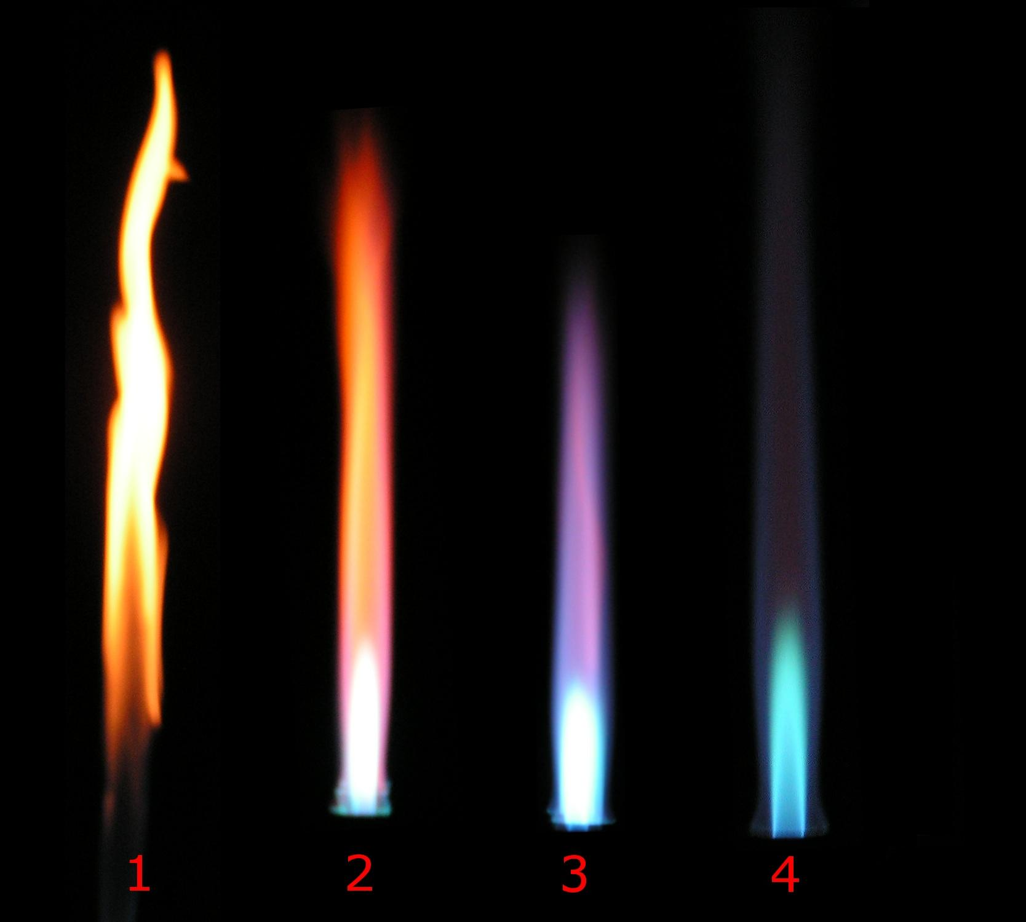
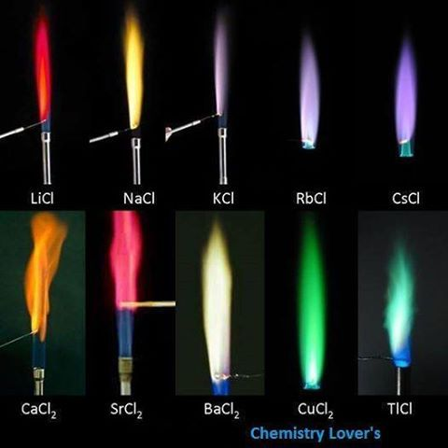
Different Fuels
Different Bunsen flames. 1. air hole closed (safety flame, incomplete combustion), 2. air hole slightly open, 3. air hole half open, 4. air hole fully open (roaring blue flame, complete combustion).

Slide 16
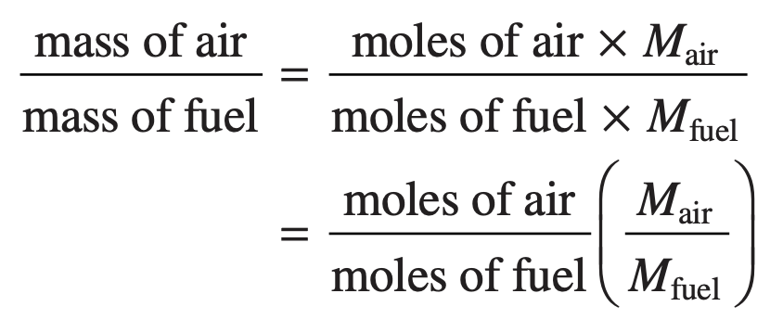
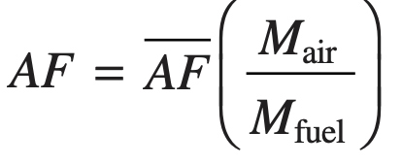
Modeling Combustion Air
Air–Fuel Ratio
Theoretical Air
The air–fuel ratio is simply the ratio of the amount of air in a reaction to the amount of fuel. The ratio can be written on a molar basis (moles of air divided by moles of fuel) or on a mass basis (mass of air divided by mass of fuel).
The minimum amount of air that supplies sufficient oxygen for the complete combustion of all the carbon, hydrogen, and sulfur present in the fuel is called the theoretical amount of air.
equivalence ratio
The equivalence ratio is the ratio of the actual fuel–air ratio to the fuel–air ratio for complete combustion with the theoretical amount of air.
where AF is the air–fuel ratio on a molar basis and AF is the ratio on a mass basis.

Slide 17
Example
Let us determine the theoretical amount of air for the complete combustion of methane. For this reaction, the products contain only carbon dioxide, water, and nitrogen. The reaction is
CH4 + a(O2 + 3.76N2 ) → bCO2 + cH2O + dN2
where a, b, c, and d represent the numbers of moles of oxygen, carbon dioxide, water, and nitrogen.
Consider the complete combustion of methane with 150% theoretical air (50% excess air). The balanced chemical reaction equation is
CH4 + (1.5)(2)(O2 + 3.76N2) → CO2 + 2H2O + O2 + 11.28N2

Slide 18
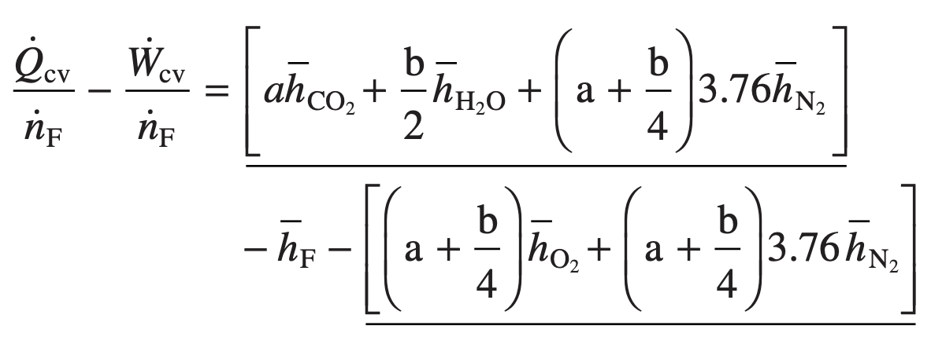
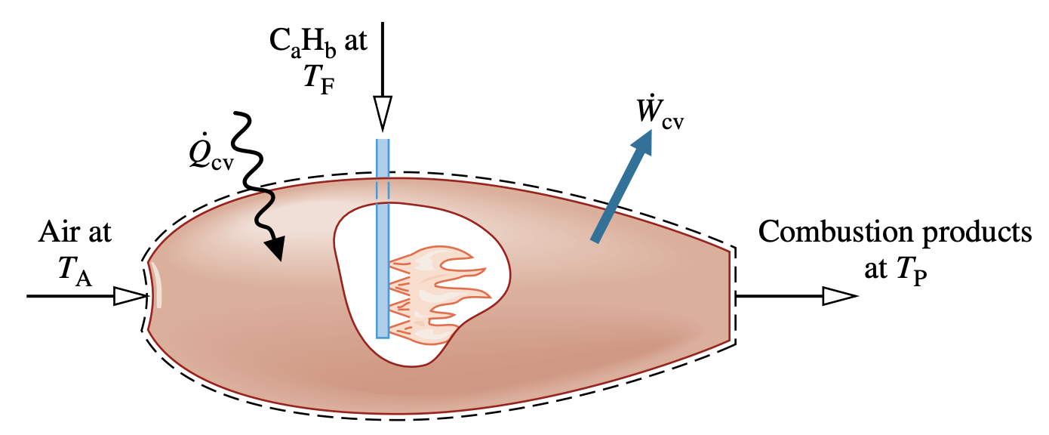
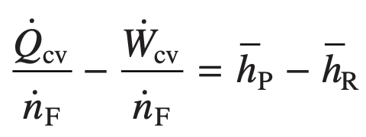
Energy Balances for reacting Systems
Analyzing Control Volumes at Steady State
Reactor at steady state.
With the foregoing idealizations, the mass and energy rate balances for the two-inlet, single-exit reactor can be used to obtain the following equation on a per mole of fuel basis:

Slide 19
Energy Balances for reacting Systems
Evaluating Enthalpy terms
The terms set to zero in this expression are the enthalpies of formation of oxygen and nitrogen.
Enthalpy for each component of the products
Enthalpy for each component of the combustible air
With the foregoing considerations,

Slide 20
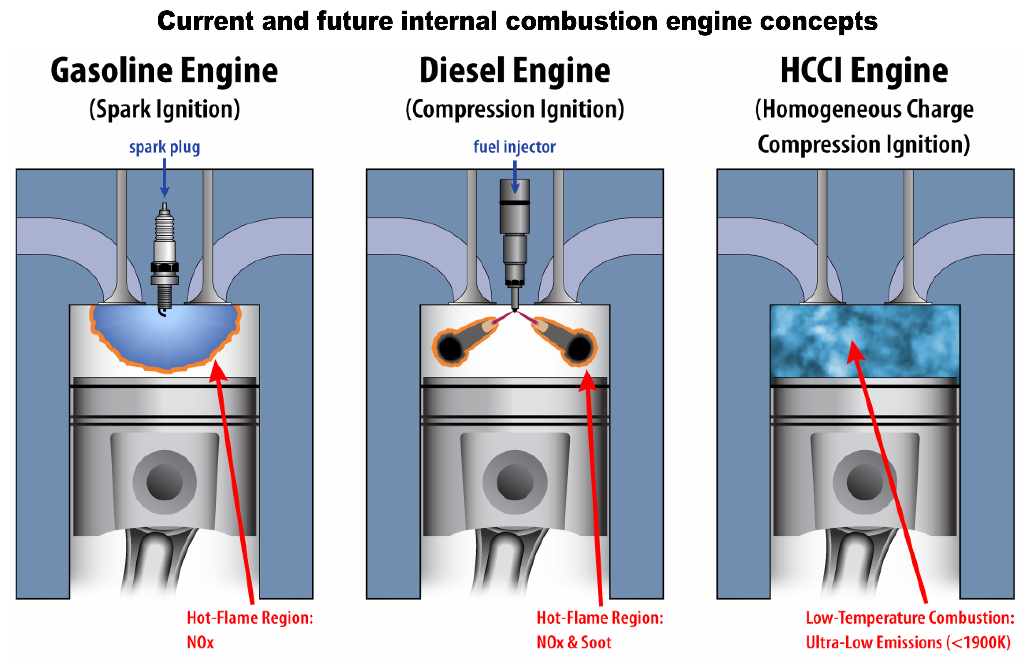
Energy Balances for reacting Systems
Analyzing Closed Systems (Constant Volume)
A closed system with constant volume involving a combustion process with the absence of kinetic and potential energy effects, the appropriate form of the energy balance is
If the reactants and products form ideal gas mixtures, the energy balance can be expressed as

Slide 21
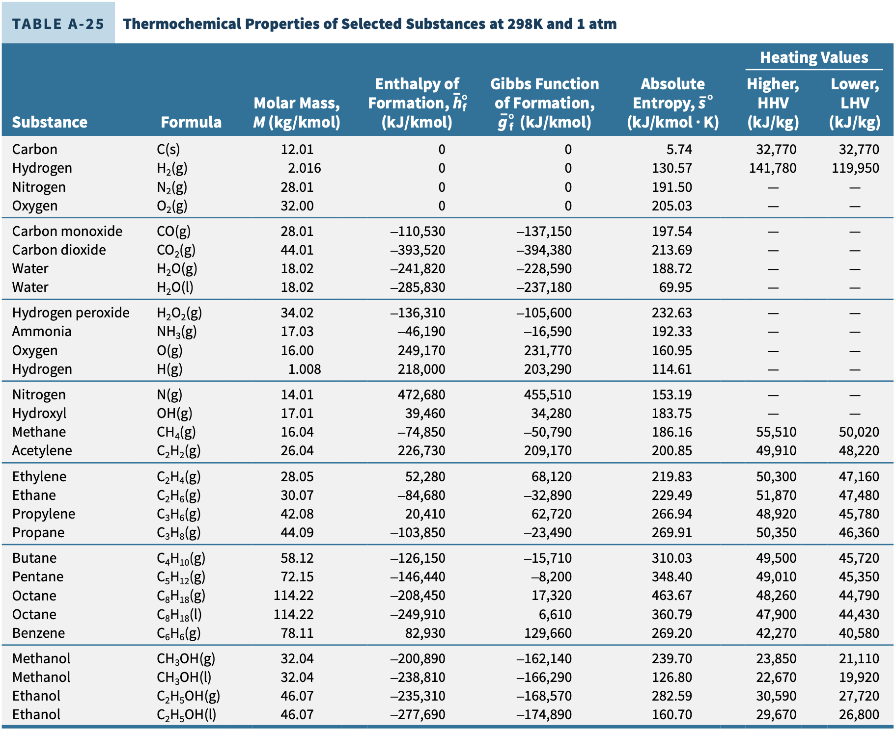
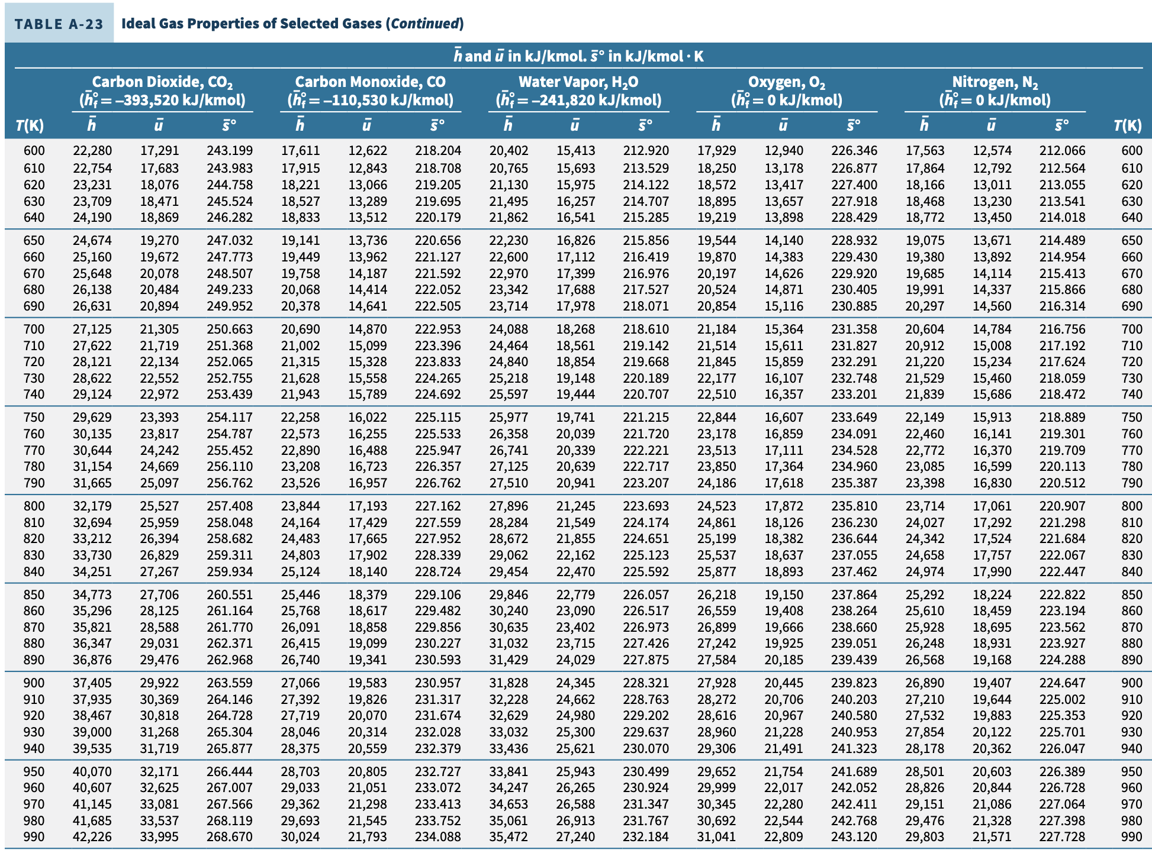
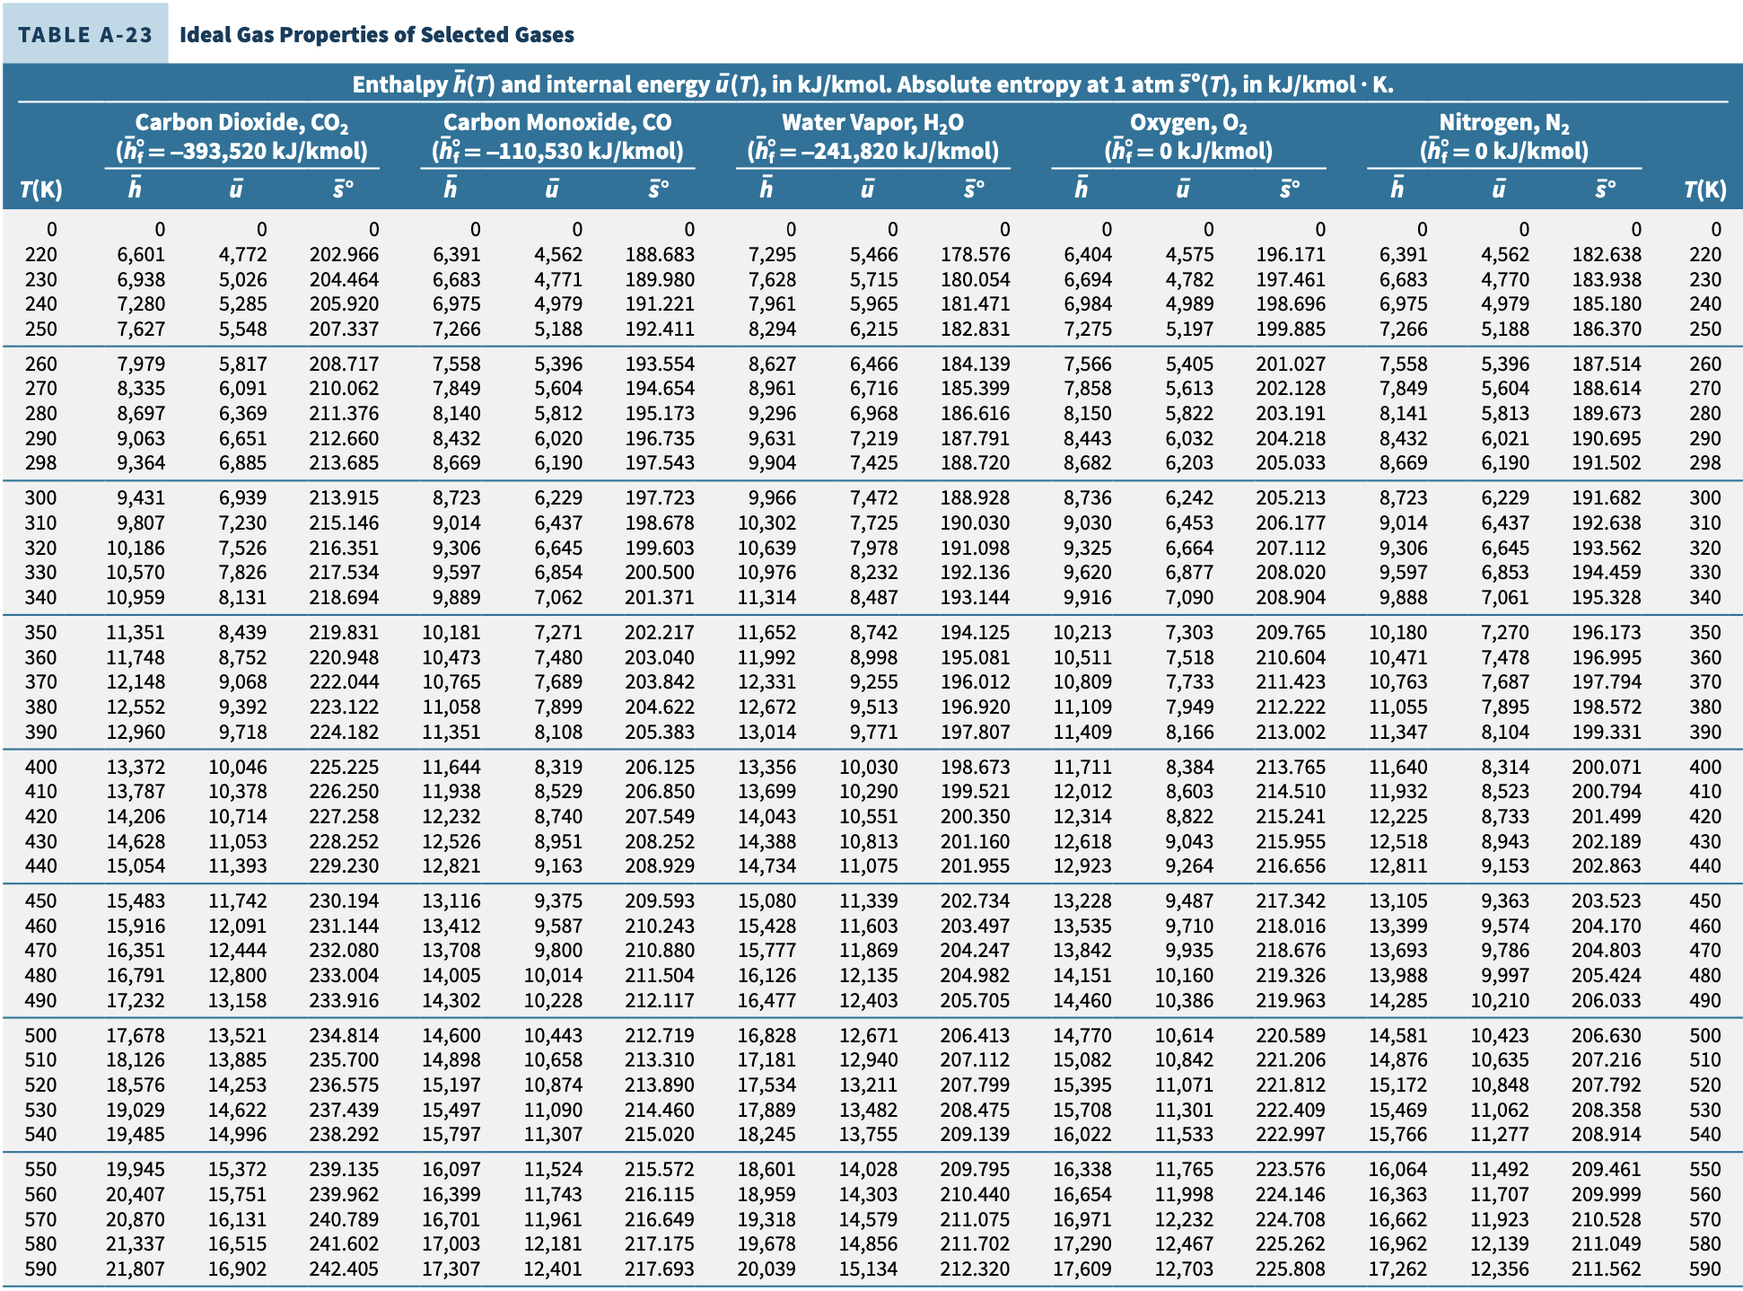
Example
Liquid octane (C8H18) enters an internal combustion engine operating at steady state with a mass flow rate of 0.0018 kg/s and is mixed with the theoretical amount of air. The fuel and air enter the engine at 298 K and 1 atm. The mixture burns completely and combustion products leave the engine at 889 K. The engine develops a power output of kW. Determine the rate of heat transfer from the engine, in kW, neglecting kinetic and potential energy effects.
C8H18 + 12.5O2 + 47N2 → 8CO2 + 9H2O(g) + 47N2
The energy rate balance reduces, with assumptions 1–3, to give

Slide 22
Fuel Cells

Slide 23
Fuel Cell

Slide 24
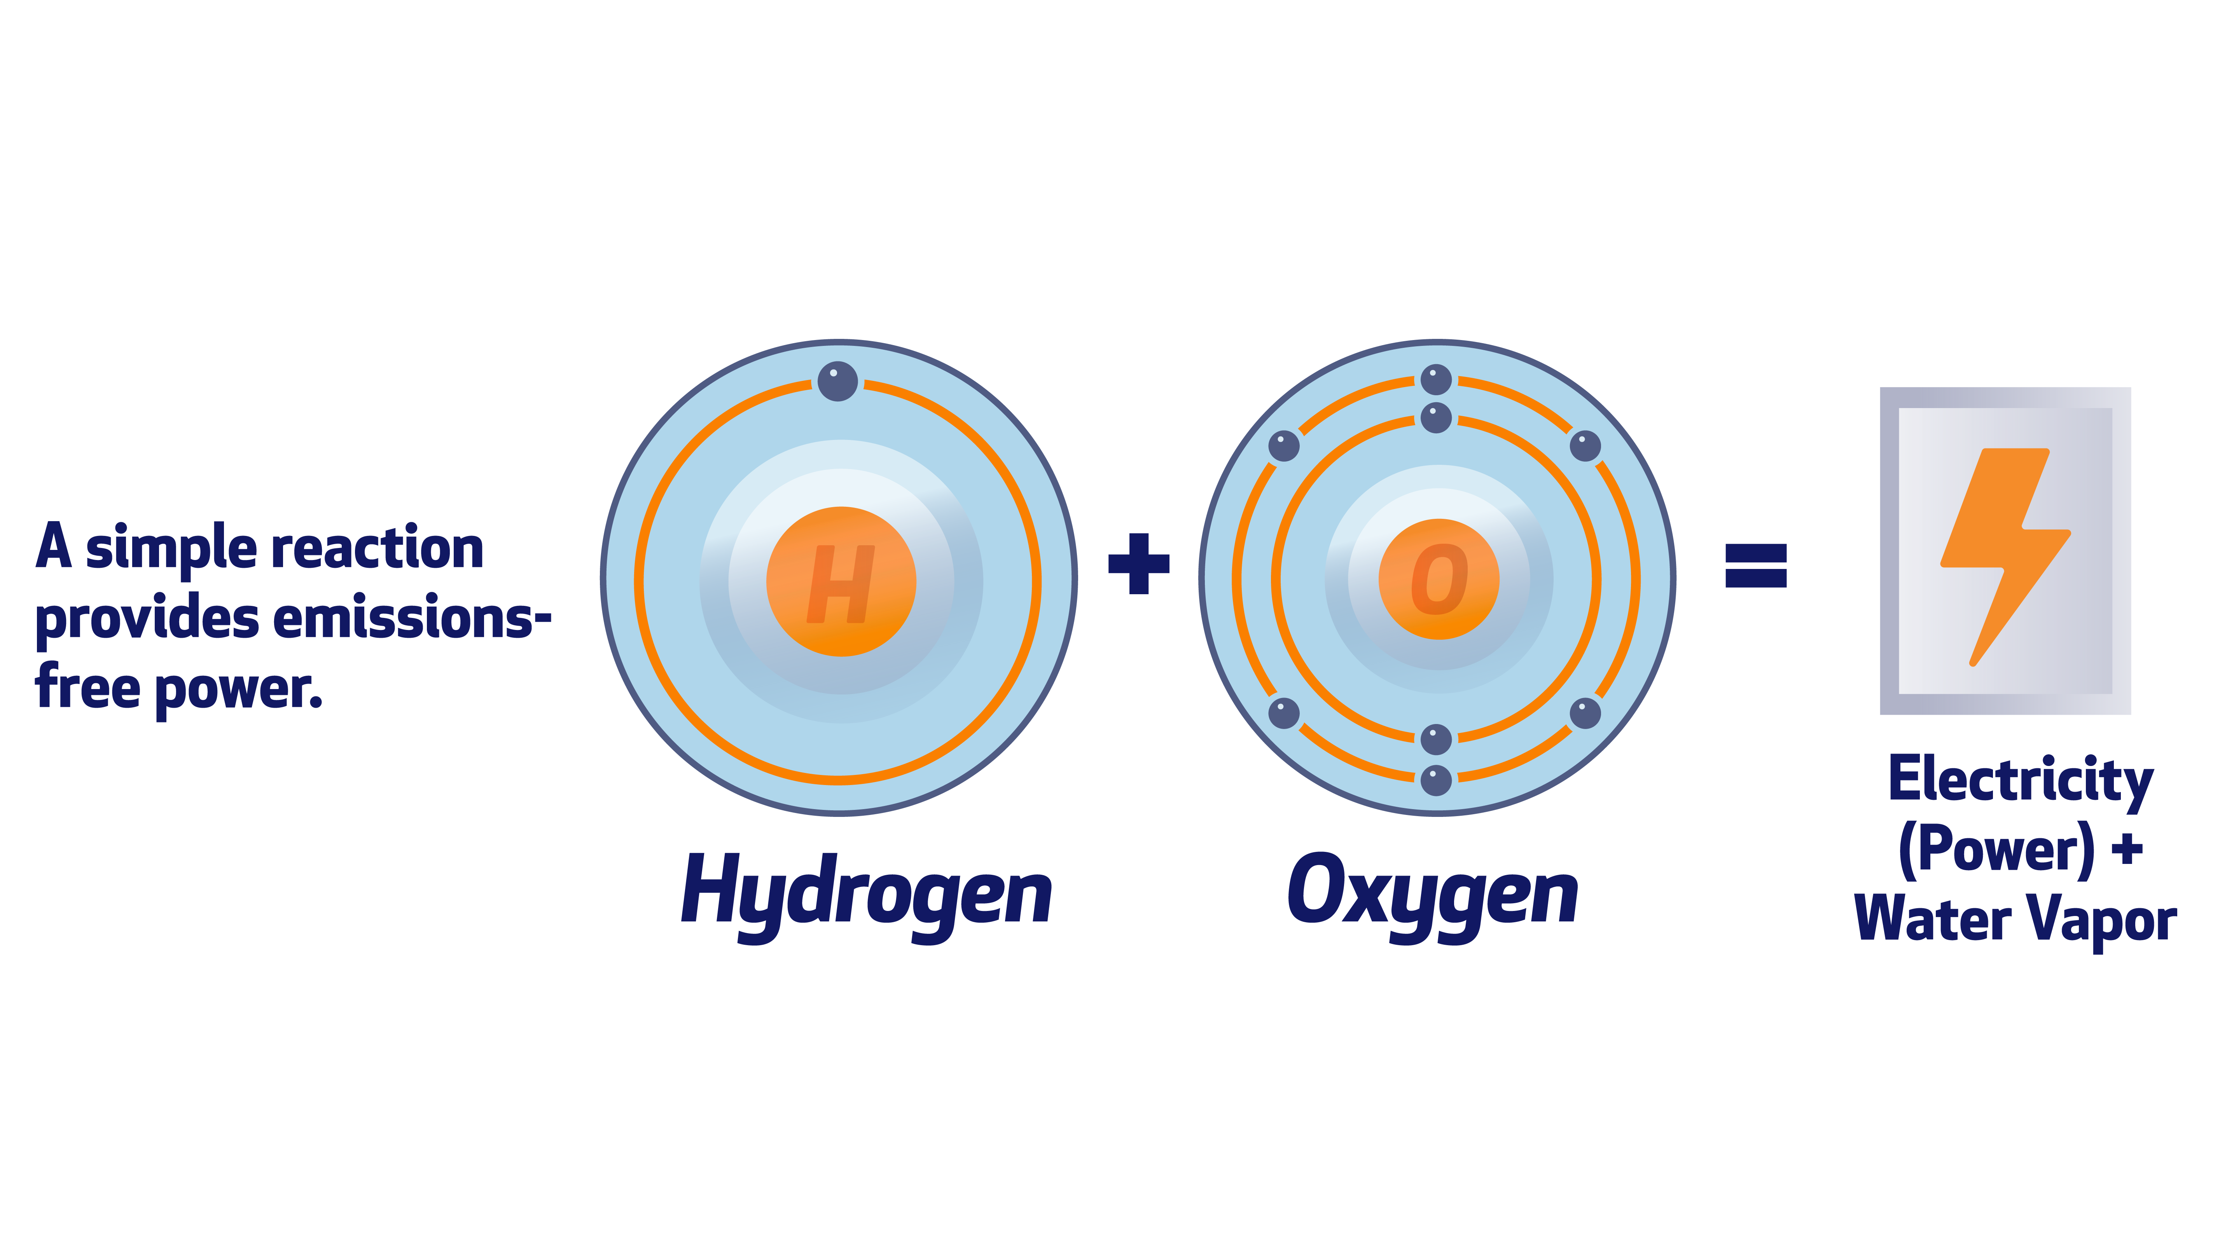
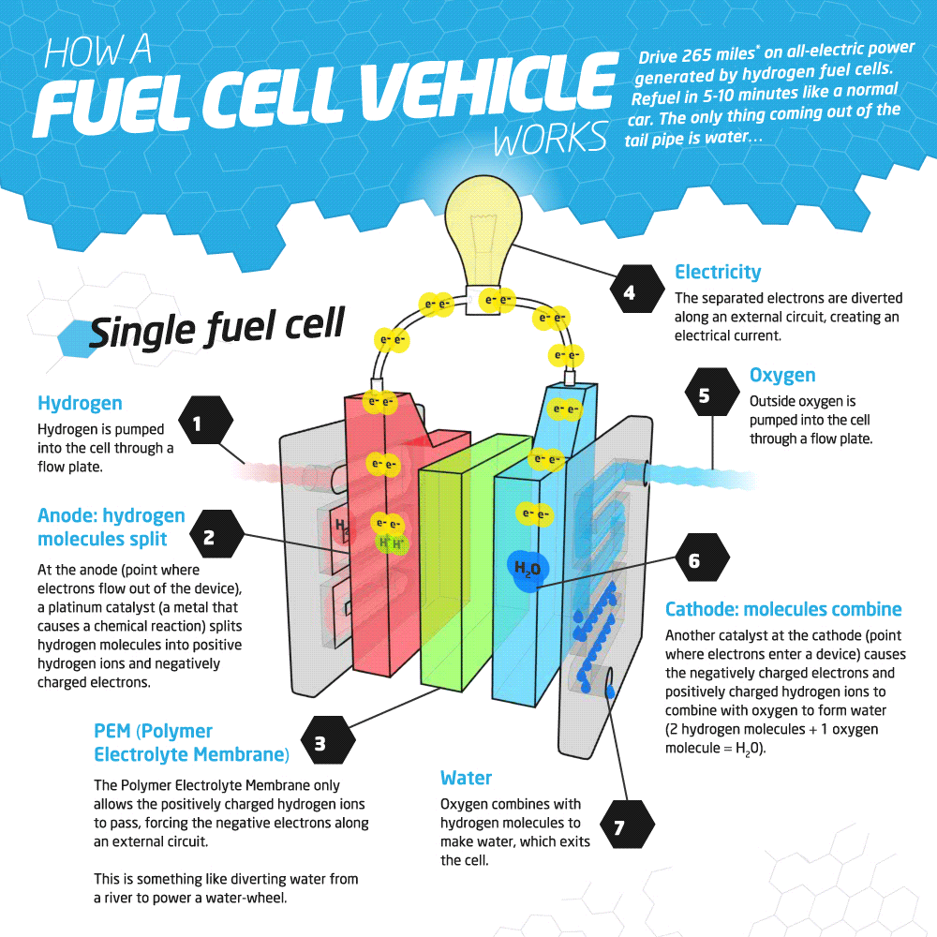
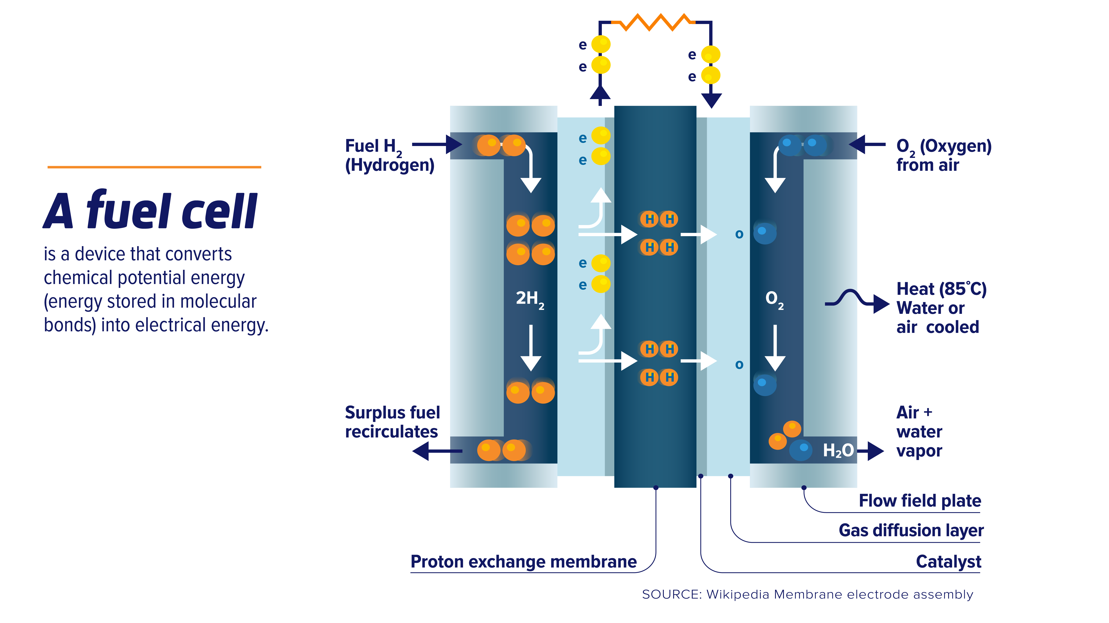
Fuel Cell
A fuel cell is an electrochemical device in which fuel and an oxidizer (normally oxygen from air) undergo a chemical reaction, providing electrical current to an external circuit and producing products.
The fuel and oxidizer react catalytically in stages on separate electrodes: the anode and the cathode.
An electrolyte separating the two electrodes allows passage of ions formed by reaction.
Depending on the type of fuel cell, the ions may be positively or negatively charged.
Individual fuel cells are connected in parallel or series to form fuel cell stacks to provide the desired level of power output.
https://www.chfca.ca/fuel-cells-hydrogen/about-fuel-cells/

Slide 25
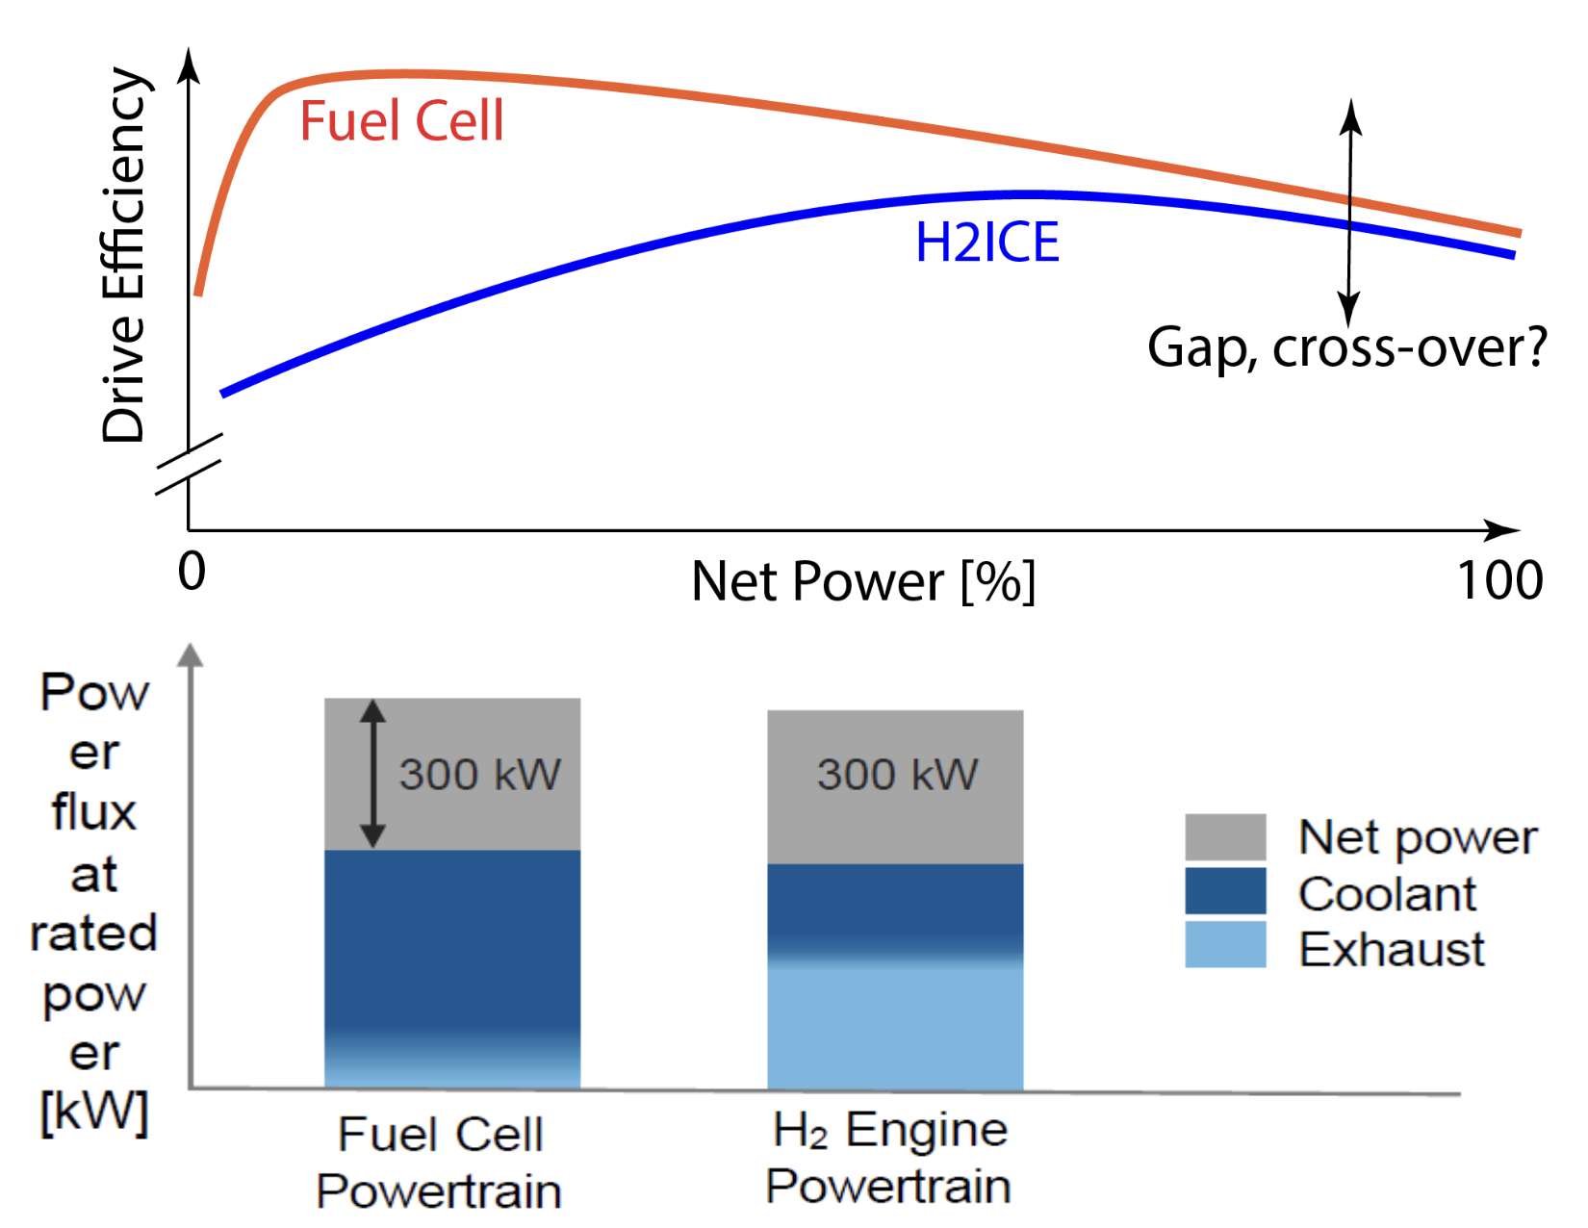
Fuel Cell
Rates of reaction in fuel cells are limited by the time it takes for diffusion of chemical species through the electrodes and the electrolyte and by the speed of the chemical reactions themselves.
The reaction in a fuel cell is not a combustion process.
These features result in fuel cell internal irreversibilities that are inherently less significant than those encountered in power systems employing combustion.
Thus, fuel cells have the potential of providing more power from a given supply of fuel and oxidizer than conventional internal combustion engines and gas turbines.

Slide 26
Fuel cell types
Fuel Cell Type | Common Electrolyte | Operating Temperature | Typical Stack Size | Electrical Efficiency (LHV) | Applications | Advantages | Challenges
Polymer electrolyte membrane (PEM) | Perfluorosulfonic acid | <120°C | <1 kW–100 kW | 60% direct H₂; ª 40% reformed fuel ^{b} | Backup power Portable power Distributed generation Transportation Specialty vehicles | Solid electrolyte reduces corrosion and electrolyte management problems Low temperature Quick start-up and load following | Expensive catalysts Sensitive to fuel impurities
Alkaline (AFC) | Aqueous potassium hydroxide soaked in a porous matrix, or alkaline polymer membrane | <100°C | 1–100 kW | 60% ^{c} | Military Space Backup power Transportation | Wider range of stable materials allows lower cost components Low temperature Quick start-up | Sensitive to CO₂ in fuel and air Electrolyte management (aqueous) Electrolyte conductivity (polymer)
Phosphoric acid (PAFC) | Phosphoric acid soaked in a porous matrix or imbibed in a polymer membrane | 150°–200°C | 5–400 kW, 100 kW module (liquid PAFC) <10 kW (polymer membrane) | 40% ^{d} | Distributed generation | Suitable for CHP Increased tolerance to fuel impurities | Expensive catalysts Long start-up time Sulfur sensitivity
Molten carbonate (MCFC) | Molten lithium, sodium, and/or potassium carbonates, soaked in a porous matrix | 600°–700°C | 300 kW–3 MW, 300 kW module | 50% ^{e} | Electric utility Distributed generation | High efficiency Fuel flexibility Suitable for CHP Hybrid/gas turbine cycle | High temperature corrosion and breakdown of cell components Long start-up time Low power density
Solid oxide (SOFC) | Yttria stabilized zirconia | 500°–1,000°C | 1 kW–2 MW | 60% ^{f} | Auxiliary power Electric utility Distributed generation | High efficiency Fuel flexibility Solid electrolyte Suitable for CHP Hybrid/gas turbine cycle | High temperature corrosion and breakdown of cell components Long start-up time Limited number of shutdowns
ª NREL Composite Data Product 8, "Fuel Cell System Efficiency" ^{b} Panasonic Headquarters News Release, "Launch of New 'Ene-Farm' Home Fuel Cell Product More Affordable and Easier to Install" ^{c} G. Mulder et al., "Market-ready stationary 6 kW generator with alkaline fuel cells," ECS Transactions 12 (2008) 743-758 ^{d} Doosan PureCell Model 400 Datasheet ^{e} FuelCell Energy DFC300 Product Specifications ^{f} Ceramic Fuel Cells Gennex Product Specifications

Slide 27
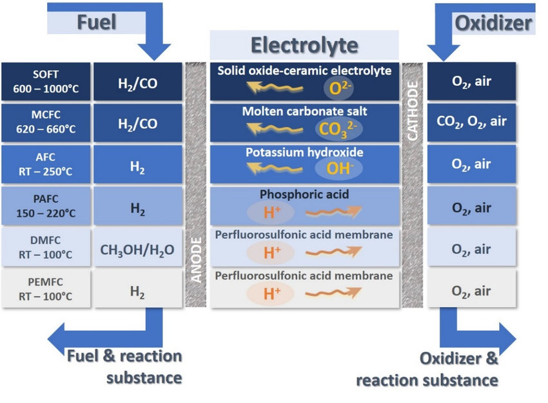
Fuel cell types
Overview of the various types of fuel cells with the following operation temperatures: polymer electrolyte membrane fuel cell (PEMFC) and direct methanol fuel cell (DMFC) RT-100 °C, phosphoric acid fuel cell (PAFC) 150-220 °C, alkaline fuel cell (AFC) RT-250 °C, molten carbonate fuel cell (MCFC) 620-660 °C, and solid oxide fuel cell (SOFC) 600-1000 °C. RT = room temperature.

Slide 28
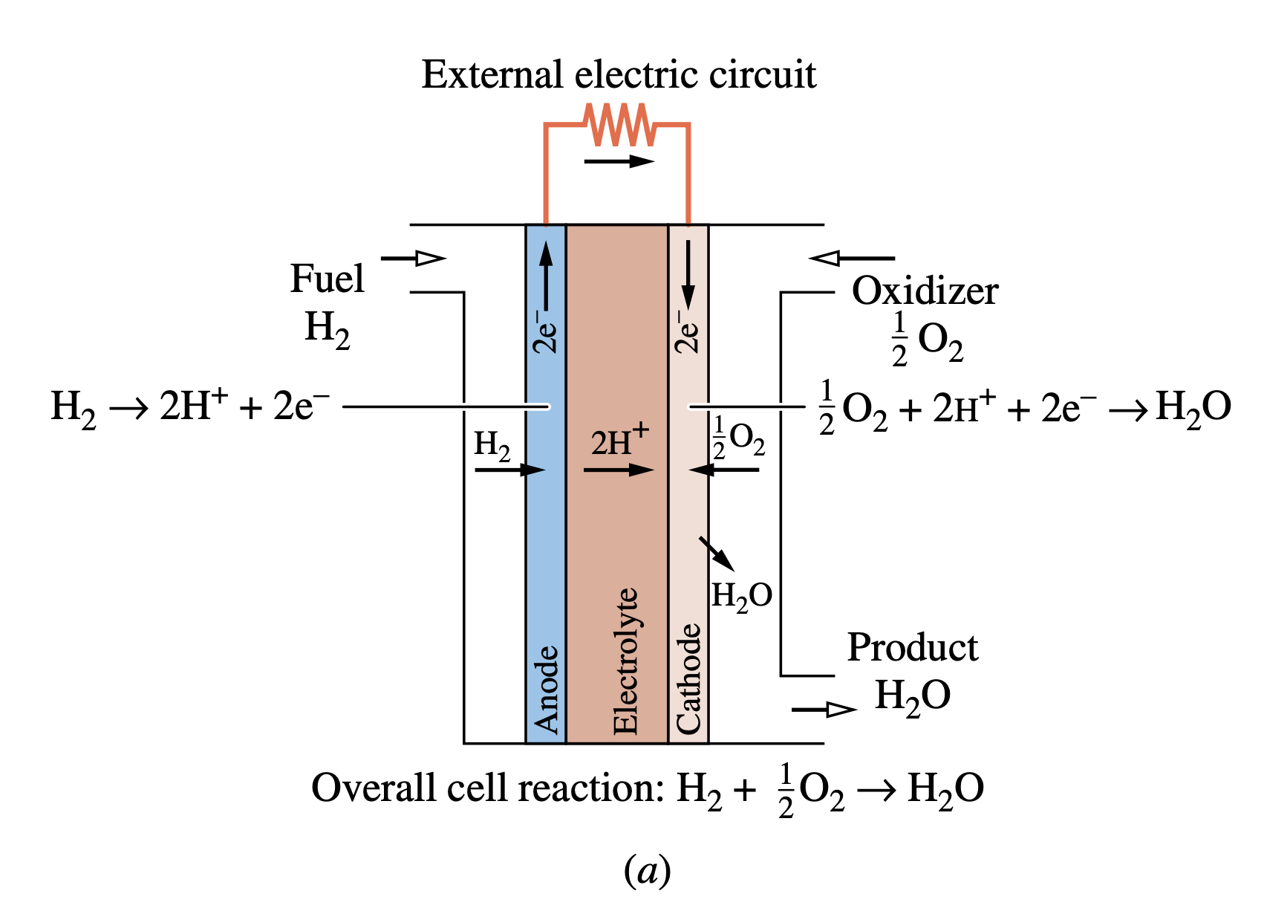
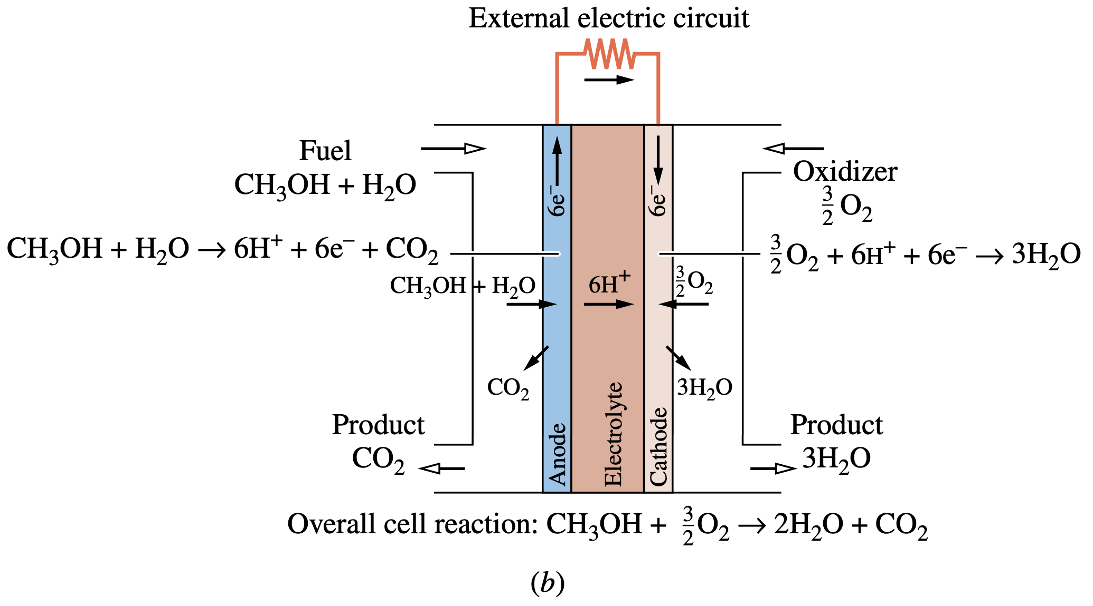
Proton Exchange Membrane Fuel Cell
Proton exchange membrane fuel cell. (a) Hydrogen fueled. (b) Humidified-methanol fueled.

Slide 29
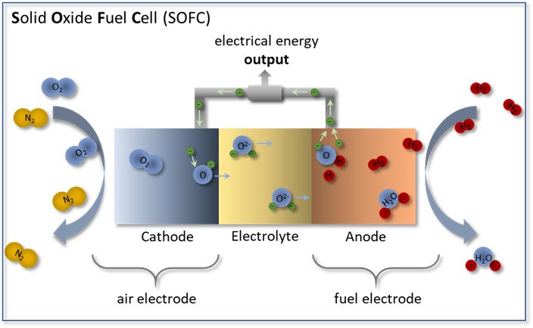
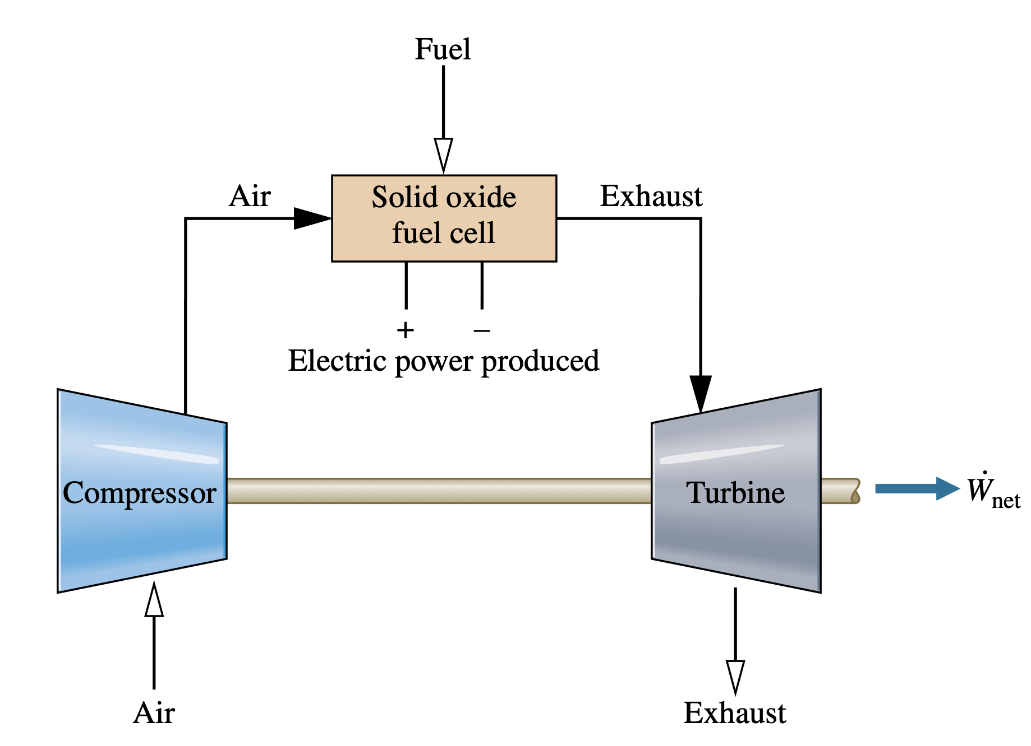
Solid oxide fuel cell
Solid oxide fuel cell–microturbine hybrid.

