Slide 1
Thermodynamics
An Engineering Approach
Lecture 10: FUNDAMENTALS OF THERMAL RADIATION
Qiang Cheng (Jonny)

Slide 2
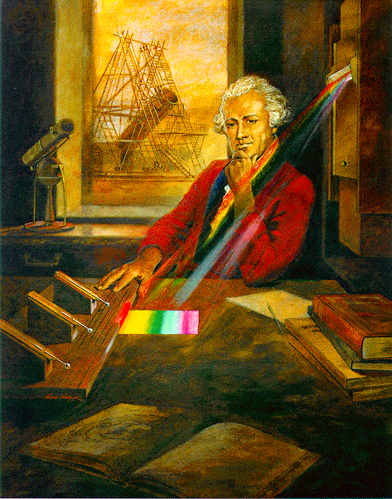
History of the Thermal Radiation
One of the first to recognize that heat radiation is related to light was the English astronomer William Herschel (1738–1822), who noticed in 1800 that if a thermometer was moved from one end of a prism produced spectrum to the other, the highest temperatures would register below the red band, where no light was visible. Because of this position, this form of radiation is called infrared (infra being the Latin word for below or within).
Sometimes this kind of radiation is called "heat waves" but this is a misnomer. Recall that heat is the transfer of internal energy from one region to another. As all forms of electromagnetic radiation transfer internal energy, they could all be called "heat waves".

Slide 3
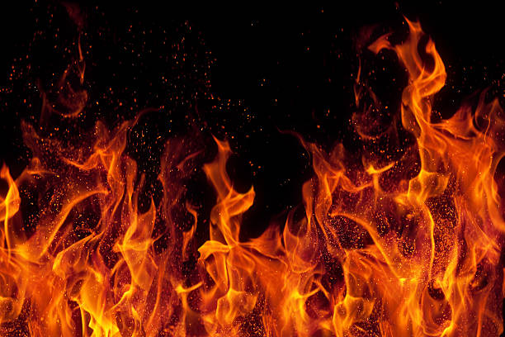
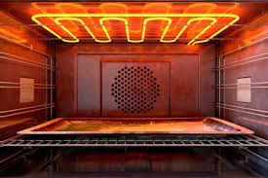
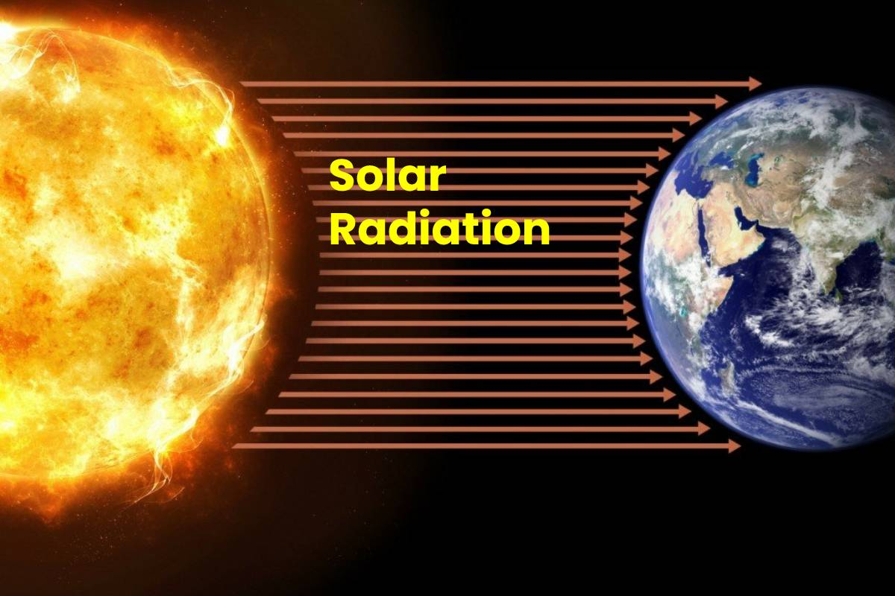
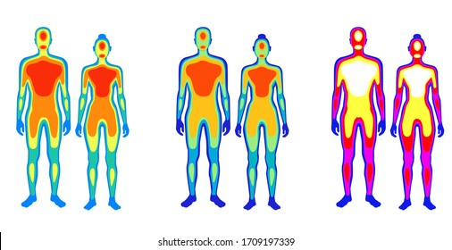
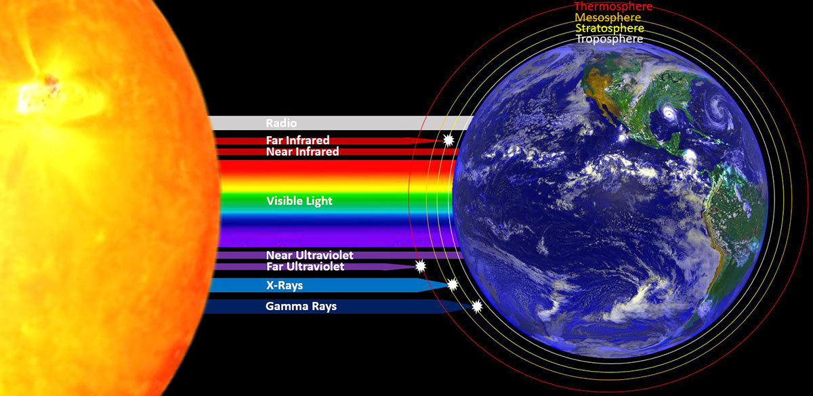
Facts of Thermal Radiation
You can feel the heat transfer from a fire and from the Sun. Similarly, you can sometimes tell that the oven is hot without touching its door or looking inside—it may just warm you as you walk by.
The space between the Earth and the Sun is largely empty, without any possibility of heat transfer by convection or conduction. In these examples, heat is transferred by radiation.
That is, the hot body emits electromagnetic waves that are absorbed by our skin: no medium is required for electromagnetic waves to propagate.
Different names are used for electromagnetic waves of different wavelengths: radio waves, microwaves, infrared radiation, visible light, ultraviolet radiation, X-rays, and gamma rays.

Slide 4
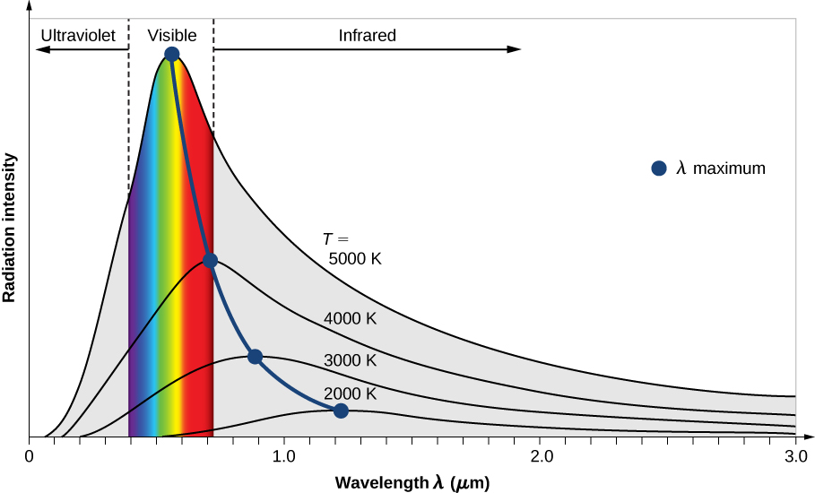
Facts of Thermal Radiation
The energy of electromagnetic radiation depends on the wavelength (color) and varies over a wide range: a smaller wavelength (or higher frequency) corresponds to a higher energy.
Because more heat is radiated at higher temperatures, a temperature change is accompanied by a color change. E.g., an electrical element on a stove, which glows from red to orange, while the higher-temperature steel in a blast furnace glows from yellow to white..
The radiation you feel is mostly infrared, which corresponds to a lower temperature than that of the electrical element and the steel. The radiated energy depends on its intensity, which is represented in Figure by the height of the distribution
The intensity of blackbody radiation versus the wavelength of the emitted radiation. Each curve corresponds to a different blackbody temperature, starting with a low temperature (the lowest curve) to a high temperature (the highest curve).

Slide 5
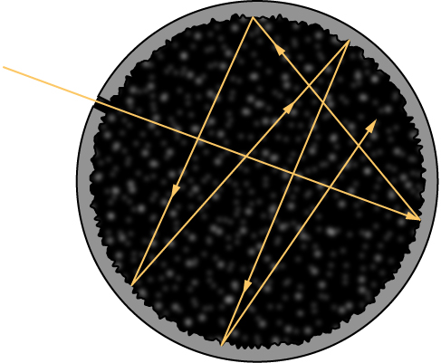
BlackBody
The temperature (T) of the object that emits radiation, or the emitter, determines the wavelength at which the radiated energy is at its maximum. For example, the Sun, whose surface temperature is in the range between 5000 K and 6000 K, radiates most strongly in a range of wavelengths about 560 nm in the visible part of the electromagnetic spectrum. Your body, when at its normal temperature of about 300 K, radiates most strongly in the infrared part of the spectrum.
Radiation that is incident on an object is partially absorbed and partially reflected. At thermodynamic equilibrium, the rate at which an object absorbs radiation is the same as the rate at which it emits it. Therefore, a good Absorber of radiation (any object that absorbs radiation) is also a good emitter. A perfect absorber absorbs all electromagnetic radiation incident on it; such an object is called a blackbody.
A blackbody is physically realized by a small hole in the wall of a cavity radiator.

Slide 6
Thermal Radiation Application

Slide 7
Wien’s Displacement Law and Stefan’s Law
The second experimental relation is Stefan’s law, which concerns the total power of blackbody radiation emitted across the entire spectrum of wavelengths at a given temperature. total power is represented by the area under the blackbody radiation curve for a given T. As the temperature of a blackbody increases, the total emitted power also increases. Quantitatively, Stefan’s law expresses this relation as
Two important laws summarize the experimental findings of blackbody radiation: Wien’s displacement law and Stefan’s law. Wien’s displacement law is illustrated in Figure 6.2.2 by the curve connecting the maxima on the intensity curves. In these curves, we see that the hotter the body, the shorter the wavelength corresponding to the emission peak in the radiation curve. Quantitatively, Wien’s law reads
where 𝜆𝑚𝑎𝑥 is the position of the maximum in the radiation curve. In other words, 𝜆𝑚𝑎𝑥 is the wavelength at which a blackbody radiates most strongly at a given temperature T. Note that in Equation the temperature is in K. Wien’s displacement law allows us to estimate the temperatures of distant stars by measuring the wavelength of radiation they emit.
where 𝐴 is the surface area of a blackbody, 𝑇 is its temperature (in kelvins), and σ is the Stefan–Boltzmann constant, 𝜎=5.670×10⁻⁸𝑊/(𝑚²⋅𝐾⁴). Stefan’s law enables us to estimate how much energy a star is radiating by remotely measuring its temperature.

Slide 8
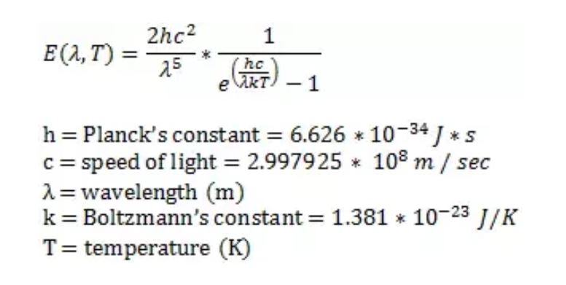
Planck’s Law
All objects with a temperature above absolute zero (0 K, -273.15 oC) emit energy in the form of electromagnetic radiation. A blackbody is a theoretical or model body which absorbs all radiation falling on it, reflecting or transmitting none.
It is a hypothetical object which is a “perfect” absorber and a “perfect” emitter of radiation over all wavelengths.
The spectral distribution of the thermal energy radiated by a blackbody (i.e. the pattern of the intensity of the radiation over a range of wavelengths or frequencies) depends only on its temperature.
The intensity of blackbody radiation versus the wavelength of the emitted radiation. Each curve corresponds to a different blackbody temperature, starting with a low temperature (the lowest curve) to a high temperature (the highest curve).
Planck’s Law of blackbody radiation, a formula to determine the spectral energy density of the emission at each wavelength (Eλ) at a particular absolute temperature (T).

Slide 9
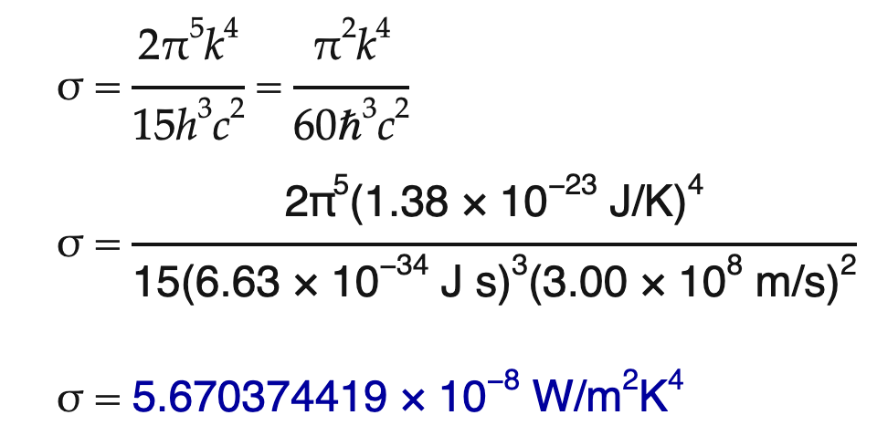
Stefan-Boltzmann’s law
Hot objects are "brighter" than cold objects. Dark objects lose and gain heat faster than light objects.
P = | net heat flow rate [W] emitted (+) or absorbed (−)
ε = | (epsilon) emissivity, a dimensionless (unitless) measure of a material's effective ability to emit or absorb thermal radiation from its surface; ranges from 0 (none) to 1 (maximal)
σ = | (sigma) Stefan's constant, 5.670 × 10⁻⁸ W/m²K⁴
A = | surface area [m²] of the object emitting or absorbing thermal radiation
T = | absolute temperature [K] of the object emitting or absorbing thermal radiation
T₀ = | absolute temperature [K] of the environment
The Stefan-Boltzmann law relates the heat flow rate emitted or absorbed from an object to its temperature (and surface area and darkness). It was empirically derived by the Austrian physicist Joseph Stefan in 1879 and theoretically derived by the Austrian physicist Ludwig Boltzmann in 1884. It is now derived mathematically from Planck's law.
Connect Stefan-Boltzmann law to Planck's law.

Slide 10
Blackbody Radiation Laws
The characteristics of can be described in terms of several laws:
Planck’s Law of blackbody radiation, a formula to determine the spectral energy density of the emission at each wavelength (Eλ) at a particular absolute temperature (T).
Wien’s Displacement Law, which states that the frequency of the peak of the emission (fmax) increases linearly with absolute temperature (T). Conversely, as the temperature of the body increases, the wavelength at the emission peak decreases.
Stefan–Boltzmann Law, which relates the total energy emitted (E) to the absolute temperature (T).

Slide 11
Example 1
Try these simple comparisons. Determine the peak wavelength and frequency for the thermal radiation coming from the Sun (T = 5,772 K). Using your favorite reference source determine the type of radiation and its color if it is visible.
The constants in Wien's displacement law are derived from spectral distributions over wavelength and frequency — basically, complicated probability distributions. Although wavelength and frequency are inversely proportional, their behavior as variables in spectral distributions do not transform so easily.
The peak wavelength, 502 nm, is in the green part of the visible spectrum — although in some cultures this wavelength might be considered blue. The peak frequency, 339 THz, is in the infrared — that statement is true for all human cultures.

Slide 12
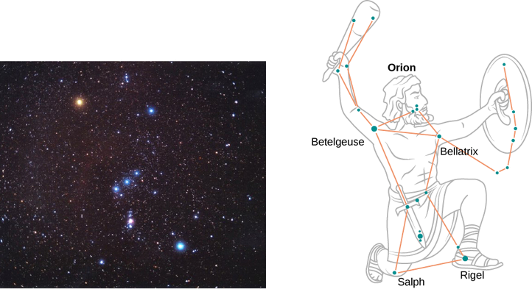
Example 2
We treat each star as a blackbody. Then according to Wien’s law, its temperature is inversely proportional to the wavelength of its peak intensity. The wavelength $λ_{max}^{(blue)}$of blue light is shorter than the wavelength $λ_{max}^{(red)}$of red light. Even if we do not know the precise wavelengths, we can still set up a proportion.
On a clear evening during the winter months, if you happen to be in the Northern Hemisphere and look up at the sky, you can see the constellation Orion (The Hunter). One star in this constellation, Rigel, flickers in a blue color and another star, Betelgeuse, has a reddish color, as shown in Figure. Which of these two stars is cooler, Betelgeuse or Rigel?
Writing Wien’s law for the blue star and for the red star, we have
When simplified, this gives
In the Orion constellation, the red star Betelgeuse, which usually takes on a yellowish tint, appears as the figure’s right shoulder (in the upper left). The giant blue star on the bottom right is Rigel, which appears as the hunter’s left foot. (credit left: modification of work by NASA c/o Matthew Spinelli)
Therefore, Betelgeuse is cooler than Rigel.
https://phys.libretexts.org/Bookshelves/University_Physics/University_Physics_%28OpenStax%29/University_Physics_III__Optics_and_Modern_Physics_%28OpenStax%29/06%3A_Photons_and_Matter_Waves/6.02%3A_Blackbody_Radiation

Slide 13
Example 3
A star such as our Sun will eventually evolve to a “red giant” star and then to a “white dwarf” star. A typical white dwarf is approximately the size of Earth, and its surface temperature is about 2.5×10⁴𝐾. A typical red giant has a surface temperature of 3.0×103𝐾and a radius ~100,000 times larger than that of a white dwarf. What is the average radiated power per unit area and the total power radiated by each of these types of stars? How do they compare?
Strategy
If we treat the star as a blackbody, then according to Stefan’s law, the total power that the star radiates is proportional to the fourth power of its temperature. To find the power radiated per unit area of the surface, we do not need to make any assumptions about the shape of the star because P/A depends only on temperature. However, to compute the total power, we need to make an assumption that the energy radiates through a spherical surface enclosing the star, so that the surface area is 𝐴=4𝜋𝑅², where R is its radius.
The power emitted per unit area by a white dwarf is about 5000 times that the power emitted by a red giant. Denoting this ratio by 𝑎=4.8×103
We see that the total power emitted by a white dwarf is a tiny fraction of the total power emitted by a red giant. Despite its relatively lower temperature, the overall power radiated by a red giant far exceeds that of the white dwarf because the red giant has a much larger surface area. To estimate the absolute value of the emitted power per unit area, we again use Stefan’s law. For the white dwarf, we obtain
A simple proportion based on Stefan’s law gives
The analogous result for the red giant is obtained by scaling the result for a white dwarf:

Slide 14
Solar Energy
The total global energy consumption of all the humans on the planet is about 1.4 × 10¹³ W or about one ten-thousandth the total energy from the Sun incident on the Earth.
The energy use per area in US metropolitan areas is roughly 2% of the incident solar energy.
3.828 × 10²⁶ W total solar luminosity
1,361 W/m² solar constant (energy perpendicular to direction of propagation) 0.297 albedo (latin albus, white), surface 0.04, atmosphere 0.26
340 W/m² effective solar constant (averaged over time and surface)

Slide 15
Introduction

Slide 16
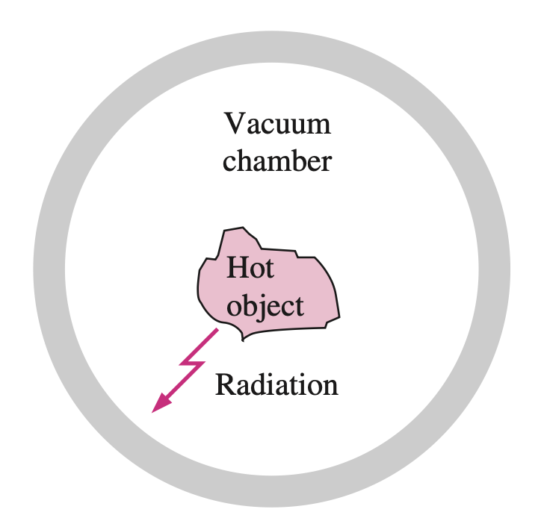
Introduction
Radiation differs from the other two heat transfer mechanisms in that it does not require the presence of a material medium to take place.
In fact, energy transfer by radiation is fastest (at the speed of light) and it suffers no attenuation in a vacuum. Also, radiation transfer occurs in solids as well as liquids and gases.
In most practical applications, all three modes of heat transfer occur concurrently at varying degrees. But heat transfer through an evacuated space can occur only by radiation. For example, the energy of the sun reaches the earth by radiation.
A hot object in a vacuum chamber loses heat by radiation only.

Slide 17
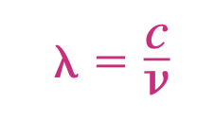
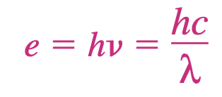
Introduction
The theoretical foundation of radiation was established in 1864 by physicist James Clerk Maxwell, who postulated that accelerated charges or changing electric currents give rise to electric and magnetic fields. These rapidly moving fields are called electromagnetic waves or electromagnetic radiation, and they represent the energy emitted by matter as a result of the changes in the electronic configurations of the atoms or molecules.
In 1887, Heinrich Hertz experimentally demonstrated the existence of such waves. Electromagnetic waves transport energy just like other waves, and all electromagnetic waves travel at the speed of light in a vacuum, which is $C_{0}=2.9979×{10}^{8}$ m/s. Electromagnetic waves are characterized by their frequency or wavelength . These two properties in a medium are related by
It has proven useful to view electromagnetic radiation as the propagation of a collection of discrete packets of energy called photons or quanta, as proposed by Max Planck in 1900 in conjunction with his quantum theory. In this view, each photon of frequency is considered to have an energy of

Slide 18
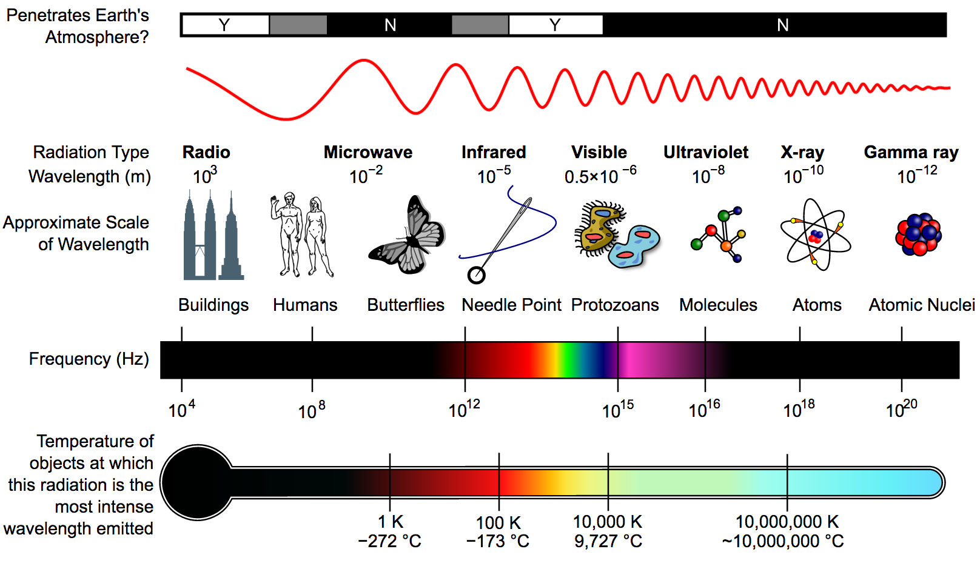
Thermal Radiation
Although all electromagnetic waves have the same general features, waves of different wavelength differ significantly in their behavior.
The electromagnetic radiation encountered in practice covers a wide range of wavelengths, varying from less than ${10}^{−10} μm$for cosmic rays to more than ${10}^{10} μm$ for electrical power waves.
The electromagnetic spectrum also includes gamma rays, X-rays, ultraviolet radiation, visible light, infrared radiation, thermal radiation, microwaves, and radio waves
A diagram of the electromagnetic spectrum, showing various properties across the range of frequencies and wavelengths, as well as the equivalent blackbody temperature
The type of electromagnetic radiation that is pertinent to heat transfer is the thermal radiation emitted as a result of energy transitions of molecules, atoms, and electrons of a substance.
https://en.wikipedia.org/wiki/Electromagnetic_spectrum#/media/File:EM_Spectrum_Properties_(Amplitude_Corrected,_Bitmap).png

Slide 19
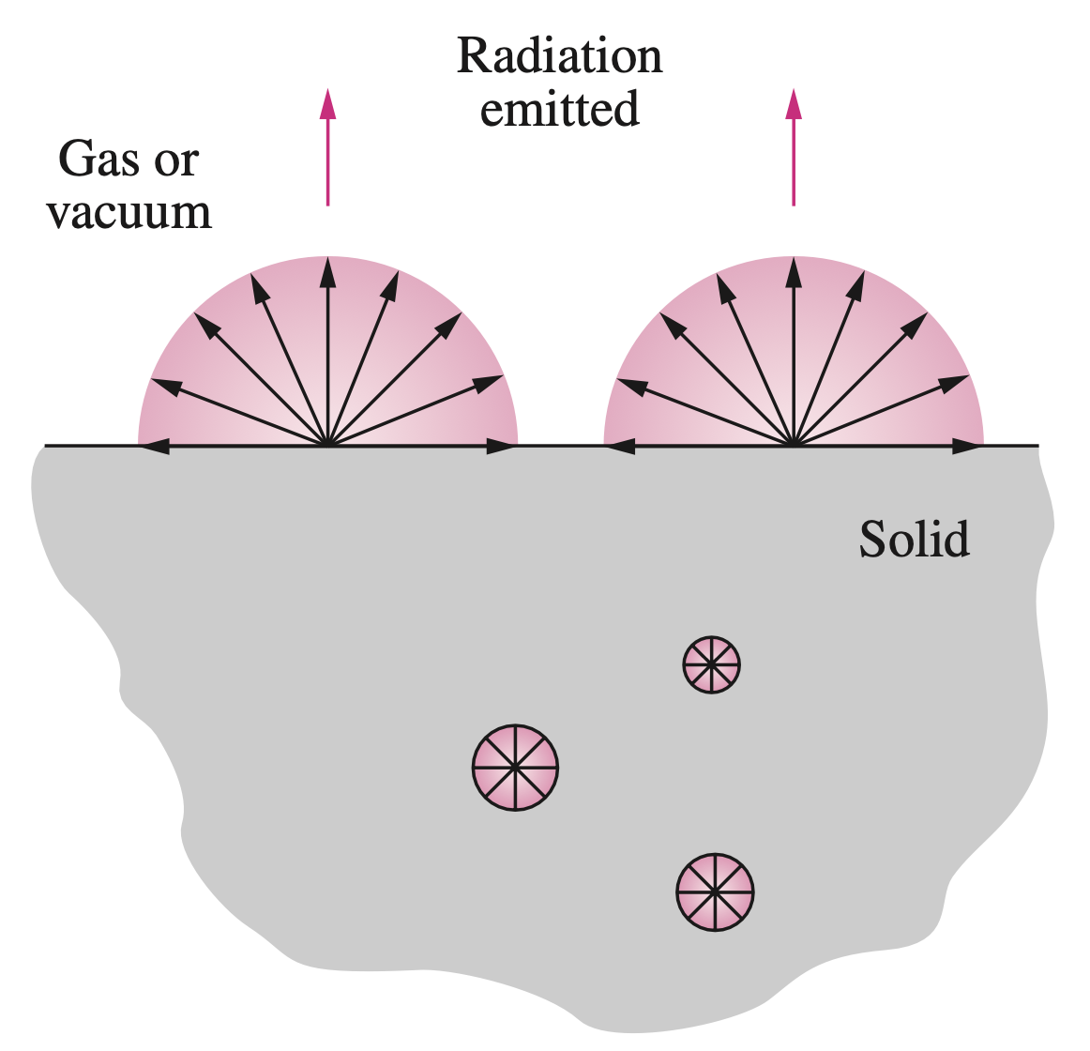
Blackbody Radiation
A body at a temperature above absolute zero emits radiation in all directions over a wide range of wavelengths.
The amount of radiation energy emitted from a surface at a given wavelength depends on the material of the body and the condition of its surface as well as the surface temperature. Therefore, different bodies may emit different amounts of radiation per unit surface area, even when they are at the same temperature.
Thus, it is natural to be curious about the maximum amount of radiation that can be emitted by a surface at a given temperature. Satisfying this curiosity requires the definition of an idealized body, called a blackbody, to serve as a standard against which the radiative properties of real surfaces may be compared.
Radiation in opaque solids is considered a surface phenomenon since the radiation emitted only by the molecules at the surface can escape the solid.

Slide 20
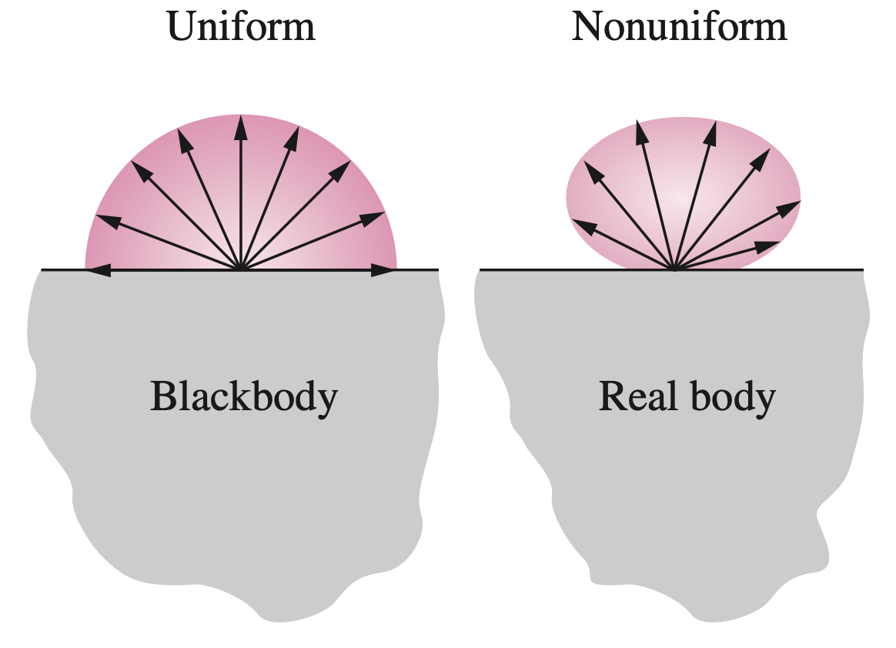
Blackbody Radiation
A blackbody is defined as a perfect emitter and absorber of radiation. At a specified temperature and wavelength, no surface can emit more energy than a blackbody.
A blackbody absorbs all incident radiation, regardless of wavelength and direction. Also, a blackbody emits radiation energy uniformly in all directions per unit area normal to direction of emission.
The radiation energy emitted by a blackbody per unit time and per unit surface area was determined experimentally by Joseph Stefan in 1879 and expressed as
A blackbody is said to be a diffuse emitter since it emits radiation energy uniformly in all directions.
where $σ=5.67×{10}^{−8} W/{m^{2}∙K^{4}}$ is the Stefan–Boltzmann constant and T is the absolute temperature of the surface in K. This relation was theoretically verified in 1884 by Ludwig Boltzmann.

Slide 21
Blackbody Radiation
The Stefan–Boltzmann law gives the total blackbody emissive power $E_{bλ}$, which is the sum of the radiation emitted over all wavelengths.
Sometimes we need to know the spectral blackbody emissive power, which is the amount of radiation energy emitted by a blackbody at an absolute temperature T per unit time, per unit surface area, and per unit wavelength about the wavelength .
T is the absolute temperature of the surface, is the wavelength of the radiation emitted, and $k=1.38065×{10}^{−23}J/K$ is Boltzmann’s constant. This relation is valid for a surface in a vacuum or a gas.
The relation for the spectral blackbody emissive power Eb was developed by Max Planck in 1901 in conjunction with his famous quantum theory. This relation is known as Planck’s law and is expressed as
For other mediums, it needs to be modified by replacing $C_{1}$ by ${C_{1}}/{n^{2}}$, where n is the index of refraction of the medium. Note that the term spectral indicates dependence on wavelength.

Slide 22
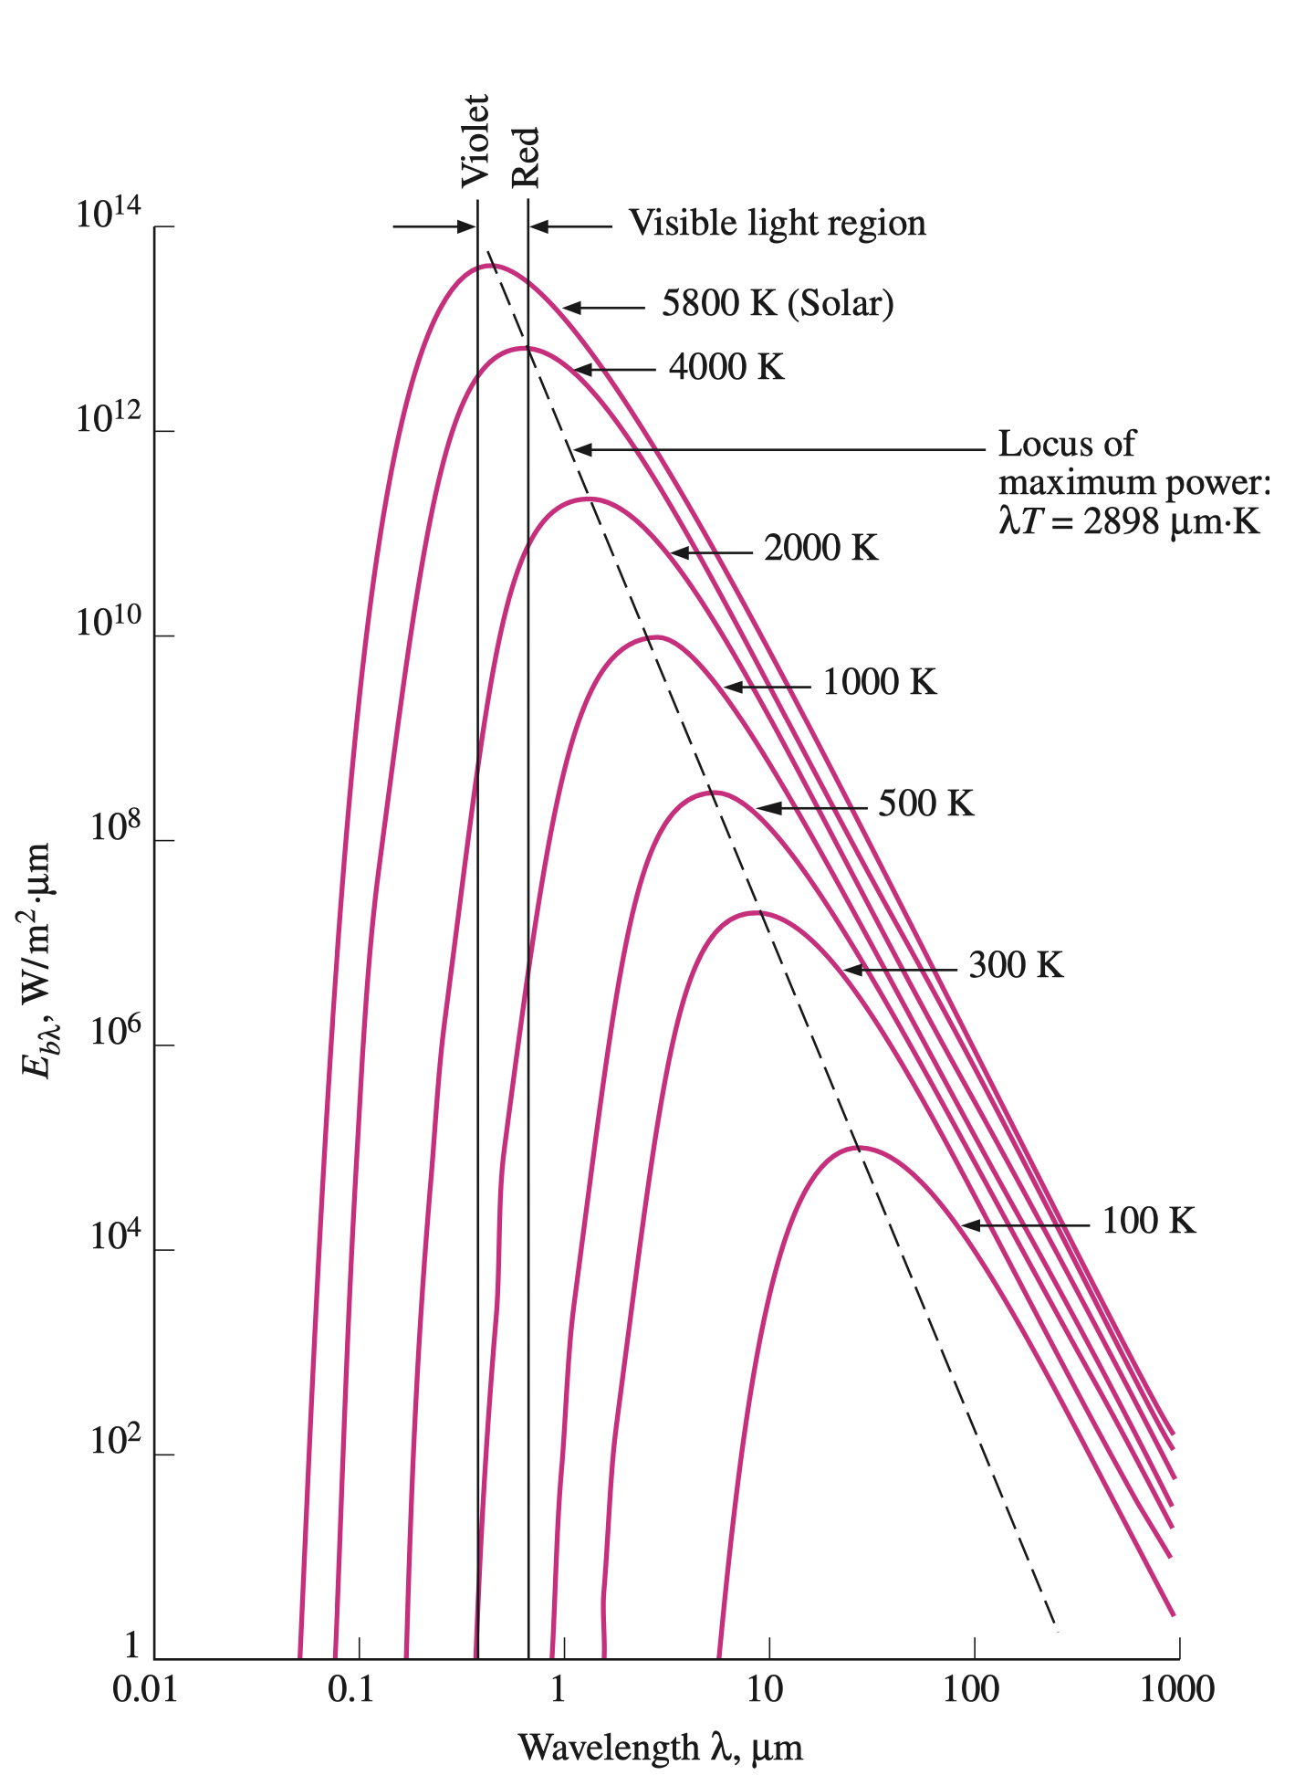
Blackbody Radiation
The emitted radiation is a continuous function of wavelength. At any specified temperature, it increases with wavelength, reaches a peak, and then decreases with increasing wavelength.
At any wavelength, the amount of emitted radiation increases with increasing temperature.
As temperature increases, the curves shift to the left to the shorter-wavelength region. Consequently, a larger fraction of the radiation is emitted at shorter wavelengths at higher temperatures.
The radiation emitted by the sun, which is considered to be a blackbody at 5780 K (or roughly at 5800 K), reaches its peak in the visible region of the spectrum. Therefore, the sun is in tune with our eyes. On the other hand, surfaces at T 800 K emit almost entirely in the infrared region and thus are not visible to the eye unless they reflect light coming from other sources.
The variation of the blackbody emissive power with wavelength for several temperatures.

Slide 23
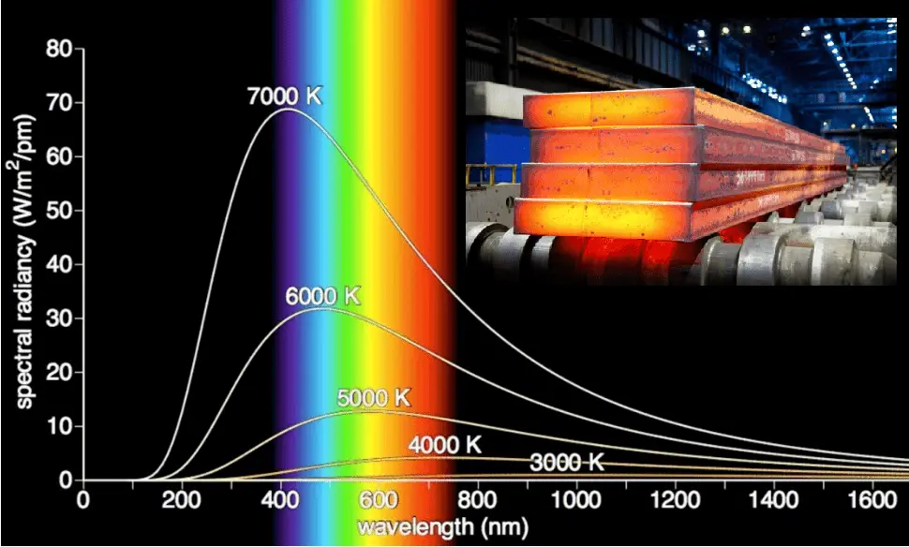
Blackbody Radiation
As the temperature increases, the peak of the curve in Figure shifts toward shorter wavelengths. The wavelength at which the peak occurs for a specified temperature is given by Wien’s displacement law as
As the temperature rises even more, the heater appears bright red and is said to be red hot. When the temperature reaches about 1500 K, the heater emits enough radiation in the entire visible range of the spectrum to appear almost white to the eye, and it is called white hot.
The peak of the solar radiation, for example, occurs at $λ={2897.8}/{5780}=0.5 μm$, which is near the middle of the visible range. The peak of the radiation emitted by a surface at room temperature (T=298 K) occurs at 9.72 $μm$, which is well into the infrared region of the spectrum.

Slide 24
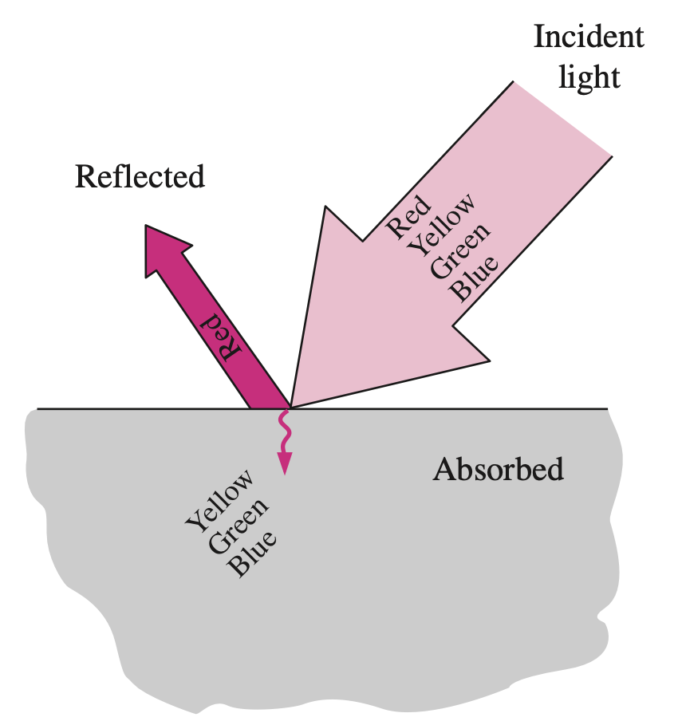
Blackbody Radiation
Although it cannot be sensed directly by the human eye, infrared radiation can be detected by infrared cameras, which transmit the information to microprocessors to display visual images of objects at night.
A surface that reflects all of the light appears white, while a surface that absorbs all of the light incident on it appears black.
It should be clear from this discussion that the color of an object is not due to emission, which is primarily in the infrared region, unless the surface temperature of the object exceeds about 1000 K.
Instead, the color of a surface depends on the absorption and reflection characteristics of the surface and is due to selective absorption and reflection of the incident visible radiation coming from a light source such as the sun or an incandescent lightbulb.
A surface that reflects red while absorbing the remaining parts of the incident light appears red to the eye.

Slide 25
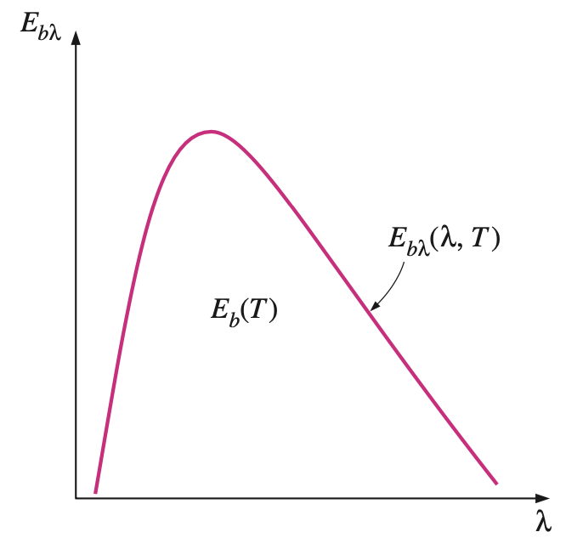
Blackbody Radiation
Integration of the spectral blackbody emissive power $E_{bλ}$ over the entire wavelength spectrum gives the total blackbody emissive power $E_{b}$ :
Thus, we obtained the Stefan–Boltzmann law (Eq. 11-3) by integrating Planck’s law (as below) over all wavelengths.
On an $E_{bλ}−λ$ chart, the area under a curve for a given temperature represents the total radiation energy emitted by a blackbody at that temperature.
Note that on an $E_{bλ}−λ$chart, $E_{bλ}$ corresponds to any value on the curve, whereas $E_{b}$corresponds to the area under the entire curve for a specified temperature. Also, the term total means “integrated over all wavelengths.”

Slide 26
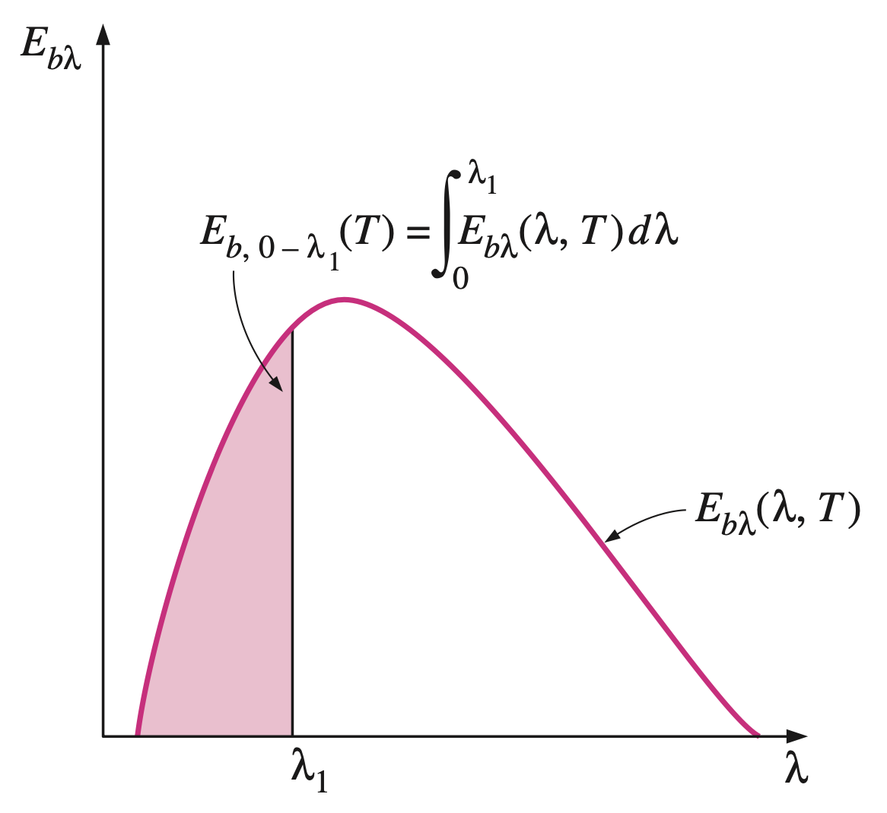
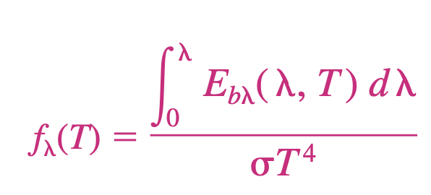
Blackbody Radiation
The Stefan-Boltzmann law $E_{b}\left(T\right)=σT^{4}$gives the total radiation emitted by a blackbody at all wavelengths from $λ=0$to $λ=∞$. But we are often interested in the amount of radiation emitted over some wavelength band. For example, an incandescent lightbulb is judged on the basis of the radiation it emits in the visible range rather than the radiation it emits at all wavelengths.
The radiation energy emitted by a blackbody per unit area over a wave- length band from $λ=0$ to $λ$ is determined from
But it turns out that this integration does not have a simple closed-form solution, and performing a numerical integration each time we need a value of $E_{b,0−λ}$is not practical. Therefore, we define a dimensionless quantity f called the blackbody radiation function as
On an Eb– chart, the area under the curve to the left of the 1 line represents the radiation energy emitted by a blackbody in the wavelength range 0–1 for the given temperature.

Slide 27
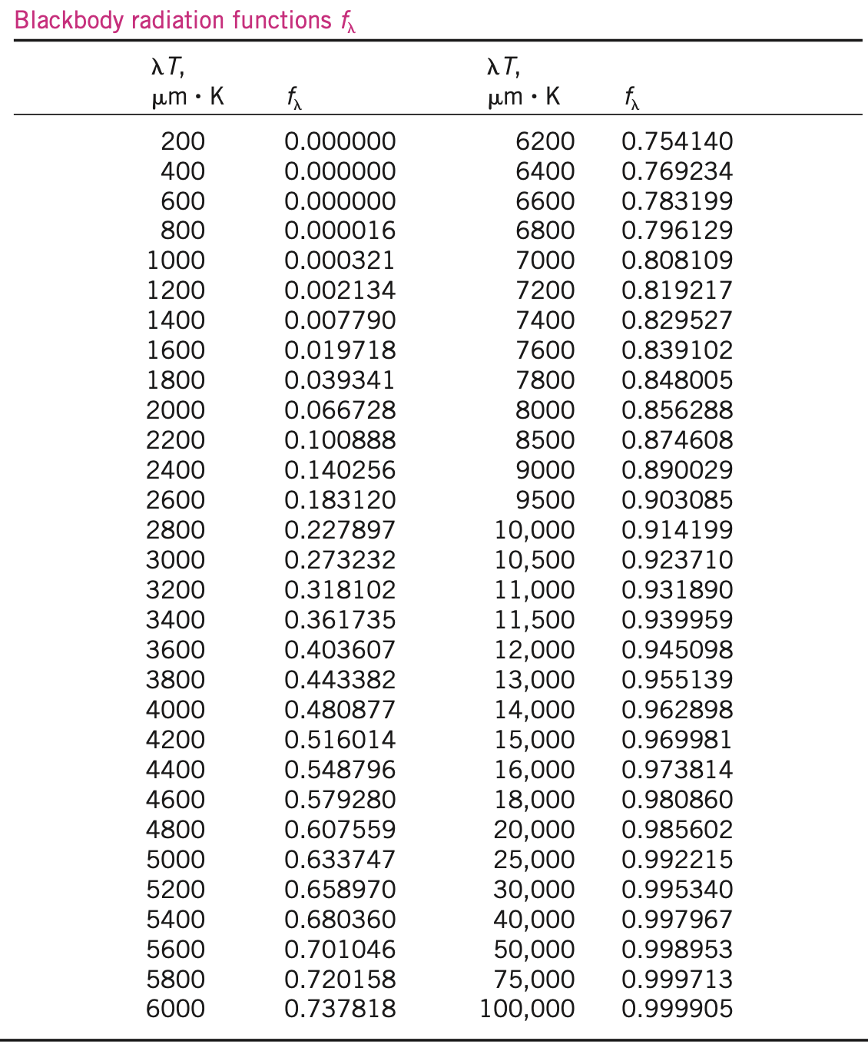
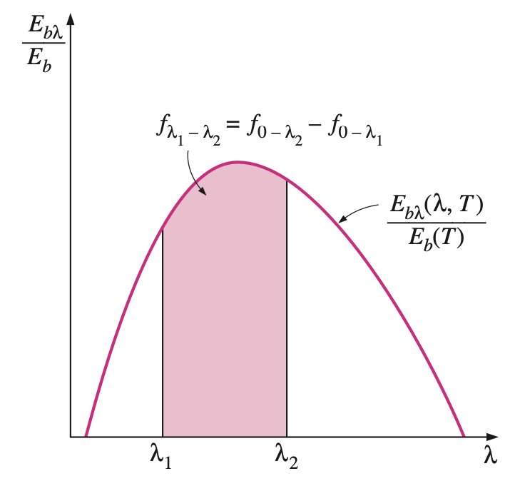
Blackbody Radiation
Blackbody radiation function
The function f represents the fraction of radiation emitted from a blackbody at temperature T in the wavelength band from $λ=0$ to $λ$ . The values of $f_{λ}$ are listed in Table as a function of $λT$, where $λ$ is in $μm$and T is in K.
The fraction of radiation energy emitted by a blackbody at temperature T over a finite wavelength band from $λ=λ_{1}$to $λ=λ_{2}$is determined from
where $f_{λ_{1}}\left(T\right)$and $f_{λ_{2}}\left(T\right)$are blackbody radiation functions corresponding to $λ_{1}T$and $λ_{2}T$, respectively.
Graphical representation of the fraction of radiation emitted in the wavelength band from $λ_{1}$ to $λ_{2}$.

Slide 28
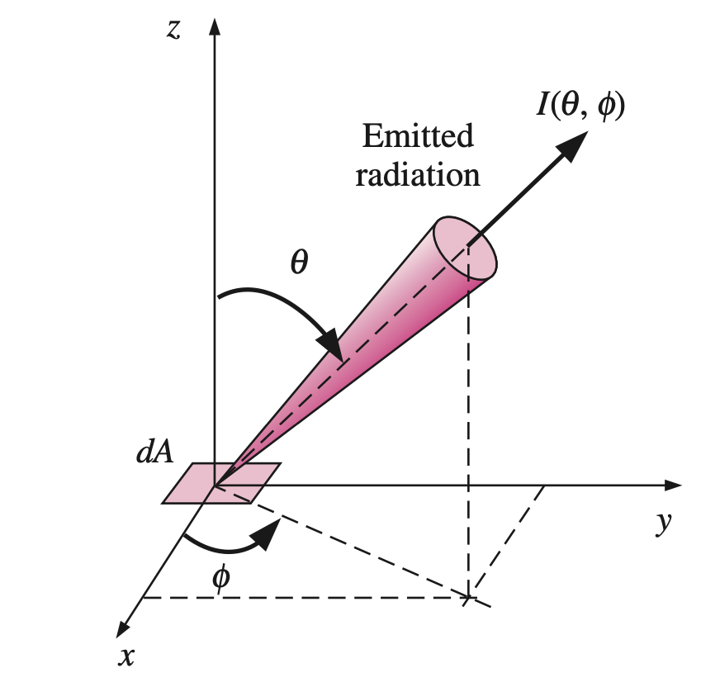
Radiation Intensity
Radiation is emitted by all parts of a plane surface in all directions into the hemisphere above the surface, and the directional distribution of emitted (or incident) radiation is usually not uniform. Therefore, we need a quantity that describes the magnitude of radiation emitted (or incident) in a specified direction in space.
This quantity is radiation intensity, denoted by I. Before we can describe a directional quantity, we need to specify direction in space.
The direction of radiation passing through a point is best described in spherical coordinates in terms of the zenith angle $θ$and the azimuth angle $φ$, as shown in right Fig.
Radiation intensity is used to describe how the emitted radiation varies with the zenith and azimuth angles.
Radiation intensity is used to describe the variation of radiation energy with direction.

Slide 29
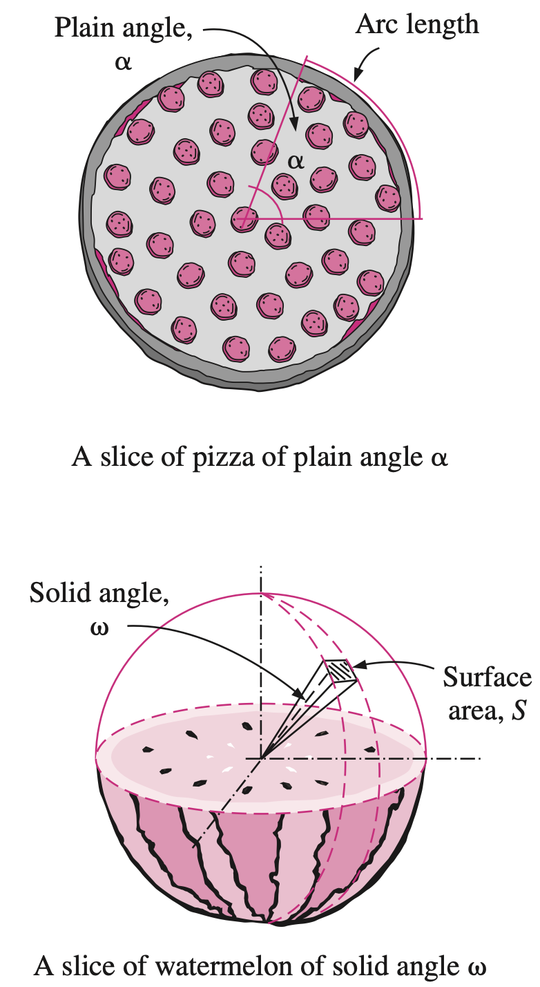
Solid Angle
Connecting all points at the edges of the slice to the center in this case will form a three-dimensional body (like a cone whose tip is at the center), and thus the angle at the center in this case is properly called the solid angle. The solid angle is denoted by $ω$, and its unit is the steradian (sr). In analogy to plane angle, we can say that the area of a surface on a sphere of unit radius is equivalent in magnitude to the solid angle it subtends (both are 4$π$ for a sphere of radius r =1).
The differential solid angle d subtended by a differential area dS on a sphere of radius r can be expressed as
Note that the area dS is normal to the direction of viewing since dS is viewed from the center of the sphere. In general, the differential solid angle d subtended by a differential surface area dA when viewed from a point at a distance r from dA is expressed as
Describing the size of a slice of pizza by a plain angle, and the size of a watermelon slice by a solid angle.

Slide 30
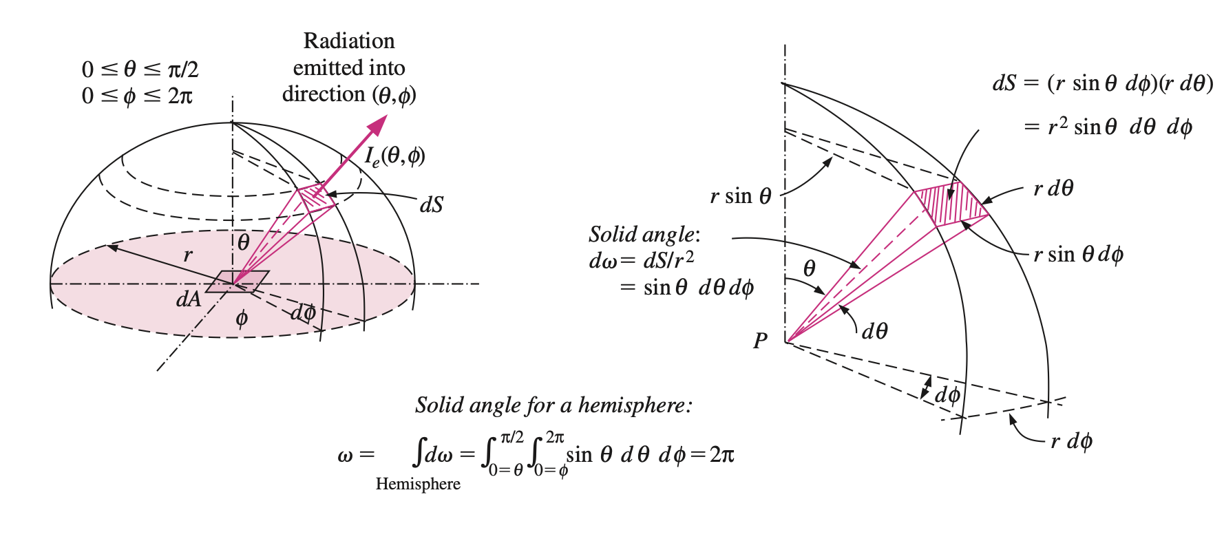
Solid Angle
The emission of radiation from a differential surface element into the surrounding hemispherical space through a differential solid angle.

Slide 31
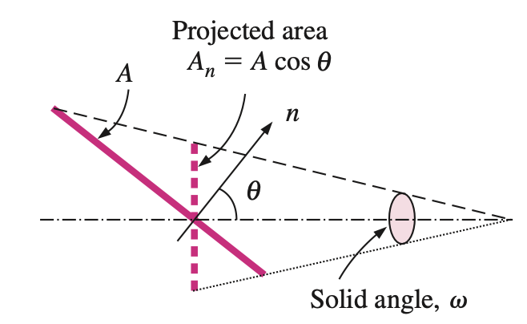
Intensity of Emitted Radiation
The radiation intensity for emitted radiation $I_{e}\left(θ,φ\right)$ is defined as the rate at which radiation energy $d{\dot{Q}}_{e}$is emitted in the $\left(θ,φ\right)$ direction per unit area normal to this direction and per unit solid angle about this direction. That is
Noting that the hemisphere above the surface will intercept all the radiation rays emitted by the surface, the emissive power from the surface into the hemisphere surrounding it can be determined by integration as
The radiation flux for emitted radiation is the emissive power E (the rate at which radiation energy is emitted per unit area of the emitting surface), which can be expressed in differential form as
Radiation intensity is based on projected area, and thus the calculation of radiation emission from a surface involves the projection of the surface.

Slide 32
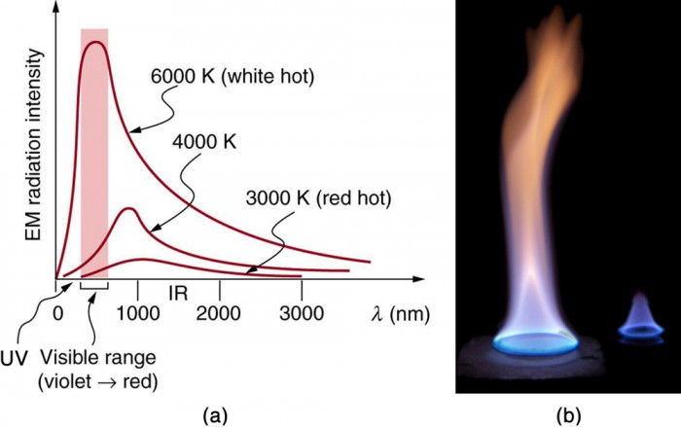
Intensity of Emitted Radiation
For a diffusely emitting surface, the intensity of the emitted radiation is independent of direction and thus Ie constant.
For a blackbody, which is a diffuse emitter,
where $E_{b}=σT^{4}$is the blackbody emissive power. Therefore, the intensity of the radiation emitted by a blackbody at absolute temperature T is
(a) A graph of the spectra of electromagnetic waves emitted from an ideal radiator at three different temperatures. The intensity or rate of radiation emission increases dramatically with temperature, and the spectrum shifts toward the visible and ultraviolet parts of the spectrum. The shaded portion denotes the visible part of the spectrum. It is apparent that the shift toward the ultraviolet with temperature makes the visible appearance shift from red to white to blue as temperature increases. (b) Note the variations in color corresponding to variations in flame temperature. (credit: Tuohirulla)
https://courses.lumenlearning.com/suny-physics/chapter/14-7-radiation/

Slide 33
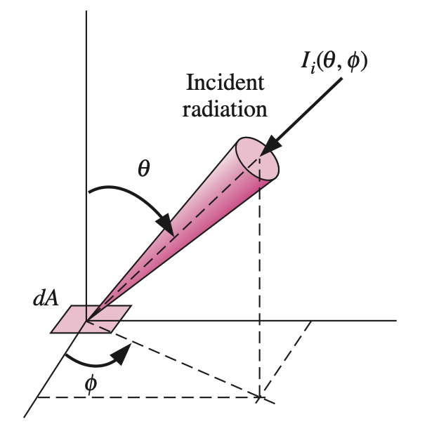
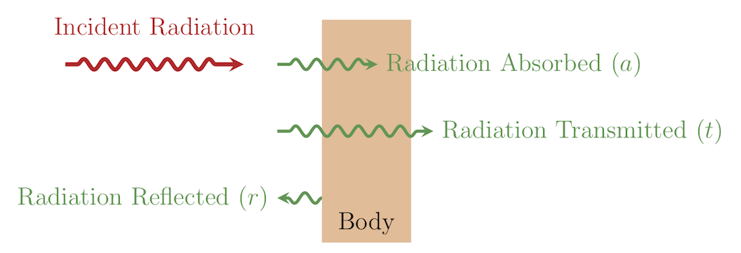
Incident Radiation
All surfaces emit radiation, but they also receive radiation emitted or reflected by other surfaces. The intensity of incident radiation $I_{i}\left(θ,φ\right)$is defined as the rate at which radiation energy dG is incident from the $\left(θ,φ\right)$direction per unit area of the receiving surface normal to this direction and per unit solid angle about this direction
The radiation flux incident on a surface from all directions is called irradiation G, and is expressed as
Radiation incident on a surface in the direction $\left(θ,φ\right)$.
Therefore irradiation represents the rate at which radiation energy is incident on a surface per unit area of the surface. When the incident radiation is diffuse and thus $I_{i}=constant$,

Slide 34
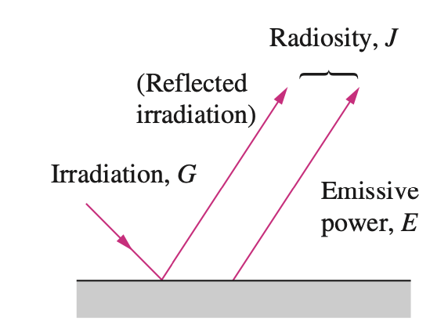
Radiosity
Surfaces emit radiation as well as reflecting it, and thus the radiation leaving a surface consists of emitted and reflected components, as shown in right Figure
For a blackbody, radiosity J is equivalent to the emissive power $E_{b}$ since a blackbody absorbs the entire radiation incident on it and there is no reflected component in radiosity.
The calculation of radiation heat transfer between surfaces involves the total radiation energy streaming away from a surface, with no regard for its origin. Thus, we need to define a quantity that represents the rate at which radiation energy leaves a unit area of a surface in all directions. This quantity is called the radiosity J, and is expressed as
where $I_{e+r}$ is the sum of the emitted and reflected intensities. For a surface that is both a diffuse emitter and a diffuse reflector, $I_{e+r}$ constant, and the radiosity relation reduces to
The three kinds of radiation flux (in $W/{m^{2}}$): emissive power, irradiation, and radiosity.

Slide 35
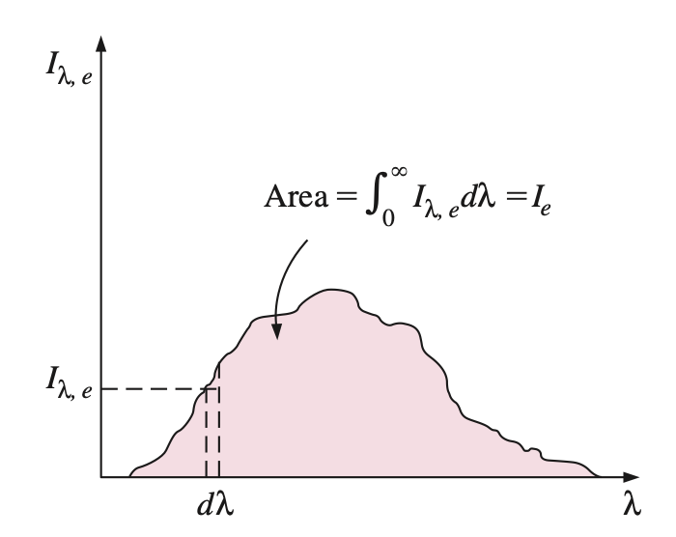
Spectral Quantities
Sometimes it is necessary to consider the variation of radiation with wavelength as well as direction, and to express quantities at a certain wavelength $λ$ or per unit wavelength interval $λ$about . Such quantities are referred to as spectral quantities to draw attention to wavelength dependence. The modifier “spectral” is used to indicate “at a given wavelength.”
Then the spectral emissive power becomes
The spectral radiation intensity $I_{λ}\left(λ,θ,φ\right)$, for example, is simply the total radiation intensity $I\left(θ,φ\right)$ per unit wavelength interval about . The spectral intensity for emitted radiation $I_{λ,e}\left(λ,θ,φ\right)$ can be defined as the rate at which radiation energy $d{\dot{Q}}_{e}$ is emitted at the wavelength in the $\left(θ,φ\right)$direction per unit area normal to this direction, per unit solid angle about this direction,
Integration of a “spectral” quantity for all wavelengths gives the “total” quantity.

Slide 36
Spectral Quantities
When the variation of spectral radiation intensity $I_{λ}$with wavelength $λ$ is known, the total radiation intensity I for emitted , incident, and emitted + reflected radiation can be determined by integration over the entire wavelength spectrum as
Similarly, when the variations of spectral radiation fluxes $E_{λ}$, $G_{λ}$, and $J_{λ}$ with wavelength $λ$are known, the total radiation fluxes can be determined by integration over the entire wavelength spectrum as
When the surfaces and the incident radiation are diffuse, the spectral radiation fluxes are related to spectral intensities as

Slide 37
Spectral Quantities
The spectral intensity of radiation emitted by a blackbody at an absolute temperature T at a wavelength has been determined by Max Planck, and is expressed as
where $h=6.6256×{10}^{−34} J∙s$is the Planck constant, $k=1.38065×{10}^{−23} J/K$ is the Boltzmann constant, and $c_{0}=2.9979×{10}^{8}m/s$ is the speed of light in a vacuum. Then the spectral blackbody emissive power is

