Slide 1
Thermodynamics and Heat Transfer
Lecture 3: Evaluating Properties and Control Volume analysis Using energy
Qiang Cheng (Jonny)

Slide 2
Learning Outcomes
When you complete your study of this chapter, you will be able to…
Explain key concepts, including phase and pure substance, state principle for simple compressible systems, p–ν–T surface, saturation temperature and saturation pressure, two-phase liquid–vapor mixture, quality, enthalpy, and specific heats.
Introduce the compressibility factor, which accounts for the deviation of real gases from ideal-gas behavior.
Apply mass and energy balances to control volumes.
Analyze closed systems, including applying the energy balance with property data.
Develop appropriate engineering models for control volumes, with particular attention to analyzing components commonly encountered in engineering practice such as nozzles, diffusers, turbines, compressors, heat exchangers, throttling devices, and integrated systems that incorporate two or more components.
Demonstrate the procedures for determining thermodynamic properties of pure substances from tables of property data.
Apply the ideal-gas equation of state in the solution of typical problems.
Notes:
Heat is energy can be converted from one form to another, or transferred from one object to another. For example, a stove burner converts electrical energy to heat and conducts that energy through the pot to the water. This increases the kinetic energy of the water molecules, causing them to move faster and faster. At a certain temperature (the boiling point), the atoms have gained enough energy to break free of the molecular bonds of the liquid and escape as vapor.

Slide 3
Properties of Pure Substance

Slide 4
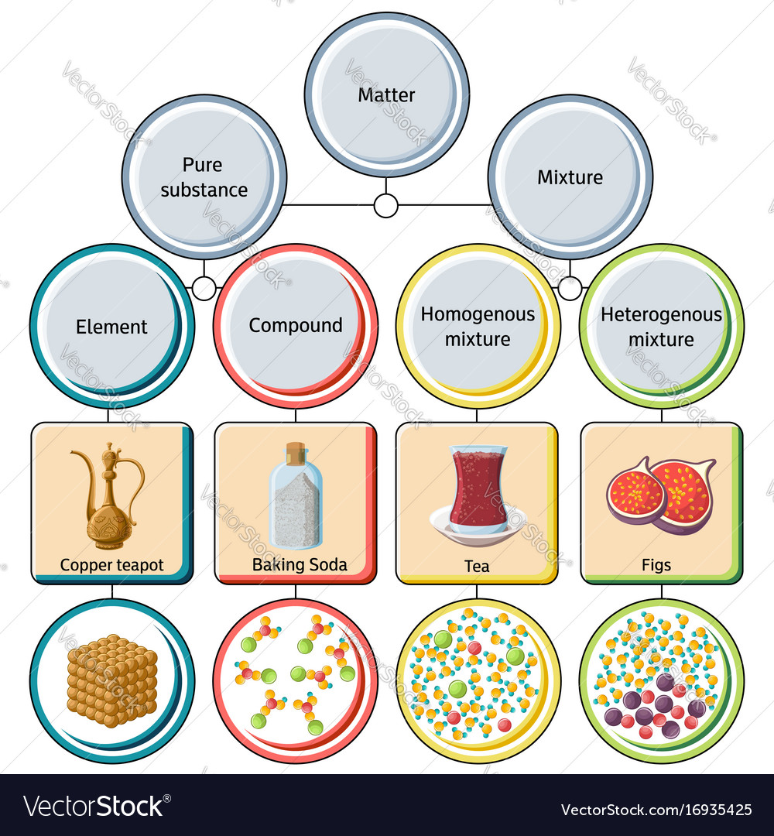
Phase and Pure Substance
Phase
The term phase refers to a quantity of matter that is homogeneous throughout in both chemical composition and physical structure.
Homogeneity in physical structure means that the matter is all solid, or all liquid, or all vapor (or equivalently all gas). A system can contain one or more phases.
Pure substance
A pure substance can exist in more than one phase, but its chemical composition must
be the same in each phase.
A pure substance is one that is uniform and invariable in chemical composition.

Slide 5
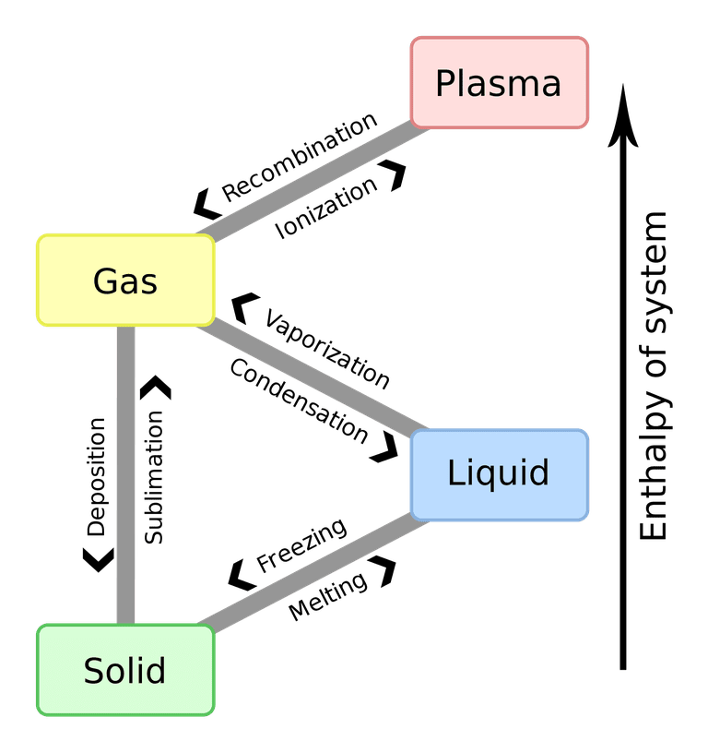
Pahse of Pure Substance
The most commonly known phase changes are those six between solids, liquids, and gasses. However, plasma also is a state of matter, so a complete list requires all eight total phase changes.
Phase changes typically occur when the temperature or pressure of a system is altered.
Phase Changes of States of Matter
Solids: Solids can melt into liquids or sublime into gases. Solids form by deposition from gases or freezing of liquids.
Liquids: Liquids can vaporize into gases or freeze into solids. Liquids form by condensation of gases and melting of solids.
Gases: Gases can ionize into plasma, condense into liquids, or undergo deposition into solids. Gases form from the sublimation of solids, vaporization of liquids, and recombination of plasma.
Plasma: Plasma can recombine to form a gas. Plasma most often forms from ionization of a gas, although if sufficient energy and enough space are available, it's presumably possible for a liquid or solid to ionize directly into a gas.
Notes:
https://www.thoughtco.com/list-of-phase-changes-of-matter-608361

Slide 6
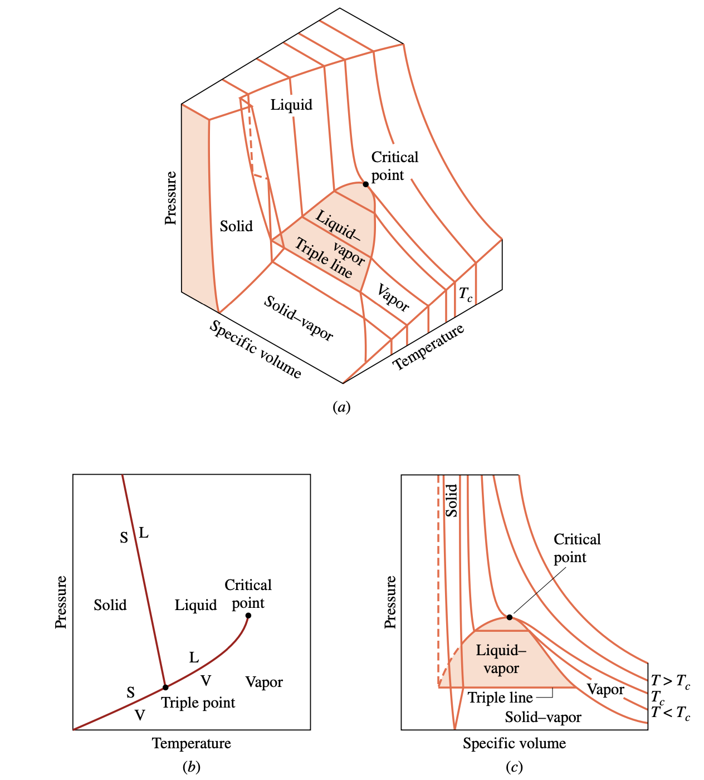
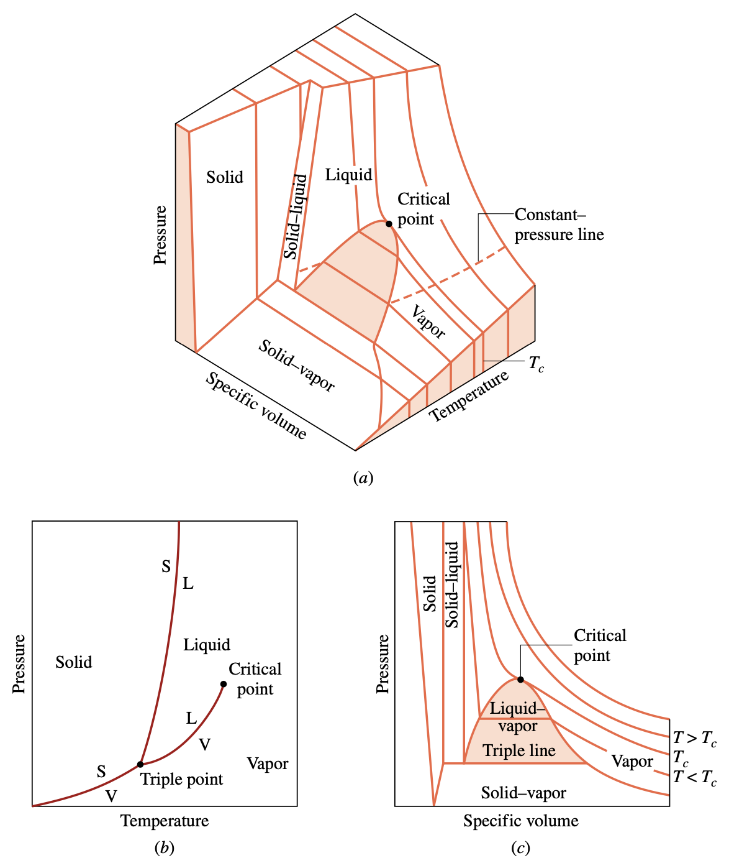
Evaluating Properties: General Considerations
p–υ–T surface and projections for a substance that expands on freezing. (a) Three-dimensional view. (b) Phase diagram. (c) p–υ diagram.
p–υ–T surface and projections for a substance that contracts on freezing. (a) Three-dimensional view. (b) Phase diagram. (c) p–υ diagram.

Slide 7
Evaluating Properties: General
Considerations
S$ingle−phase regions$
T$riple line$
In these single-phase regions, the state is fixed by any two of the properties: pressure, specific volume, and temperature, since all of these are independent when there is a single phase present.
Within the two-phase regions pressure and temperature are not independent; one cannot be changed without changing the other. In these regions the state cannot be fixed by temperature and pressure alone; however, the state can be fixed by specific volume and either pressure or temperature.
T$wo−phase regions$
Located between the single-phase regions are two-phase regions where two phases exist in equilibrium: liquid–vapor, solid–liquid, and solid–vapor. Two phases can coexist during changes in phase such as vaporization, melting, and sublimation.
Critical point
Three phases can exist in equilibrium along the line labeled triple line.
Saturation state
The critical temperature Tc of a pure substance is the maximum temperature at which liquid and vapor phases can coexist in equilibrium.
A state at which a phase change begins or ends is called a saturation state.

Slide 8
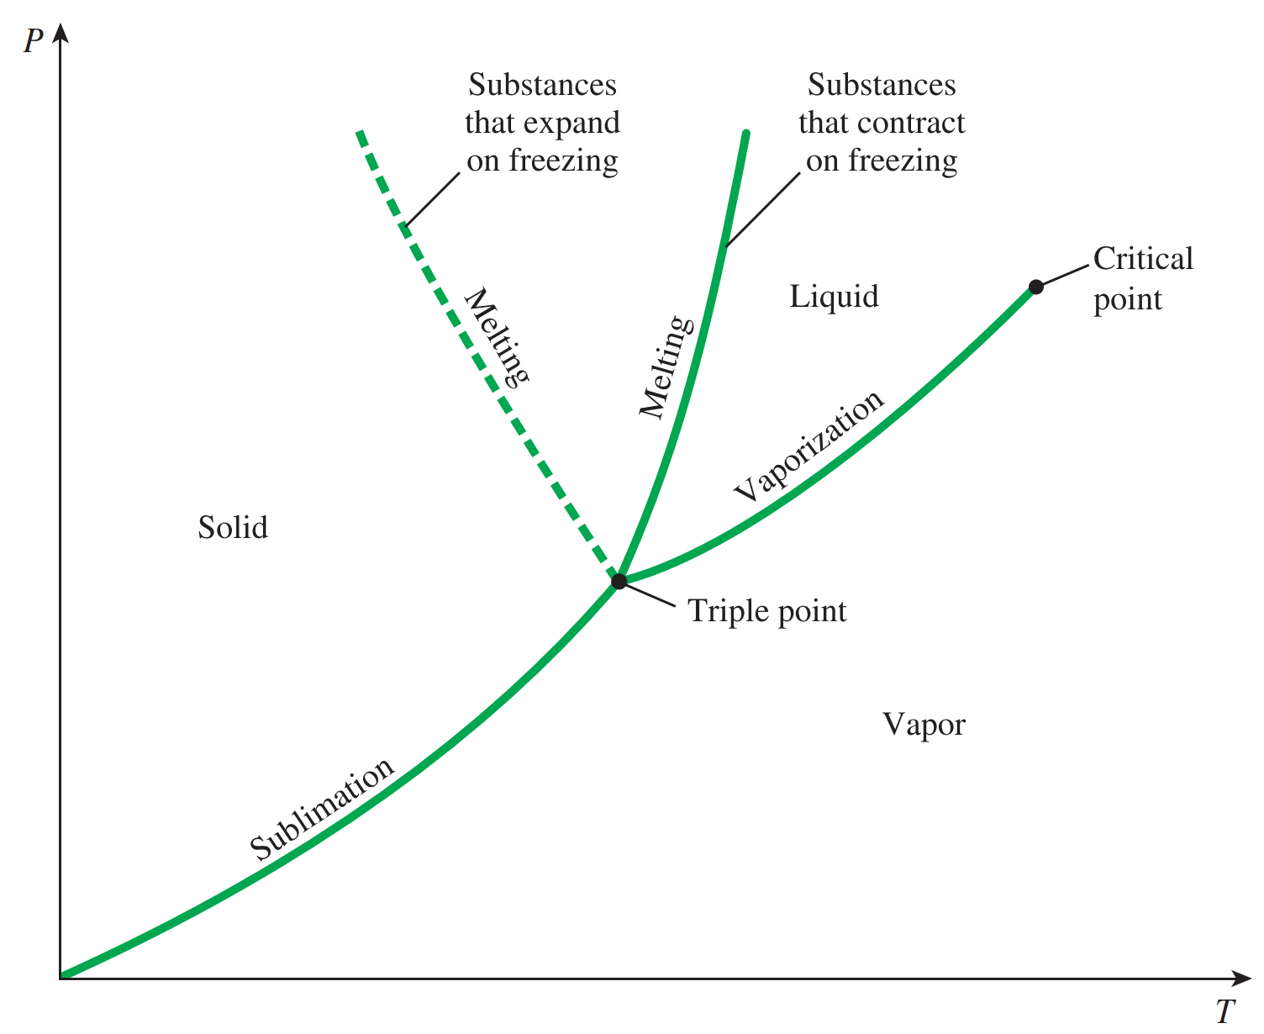
Projections of the p–ν–T Surface
Phase diagram
If the p–ν–T surface is projected onto the pressure–temperature plane, a property diagram known as a phase diagram results.
when the surface is projected in this way, the two-phase regions reduce to lines. A point on any of these lines represents all two-phase mixtures at that particular temperature and pressure.
Saturation temperature and pressure
The term saturation temperature designates the temperature at which a phase
change takes place at a given pressure, and this pressure is called the saturation pressure for the given temperature.
Triple point
The triple line of the three-dimensional p–ν–T surface projects onto a point on the phase diagram. This is called the triple point.

Slide 9
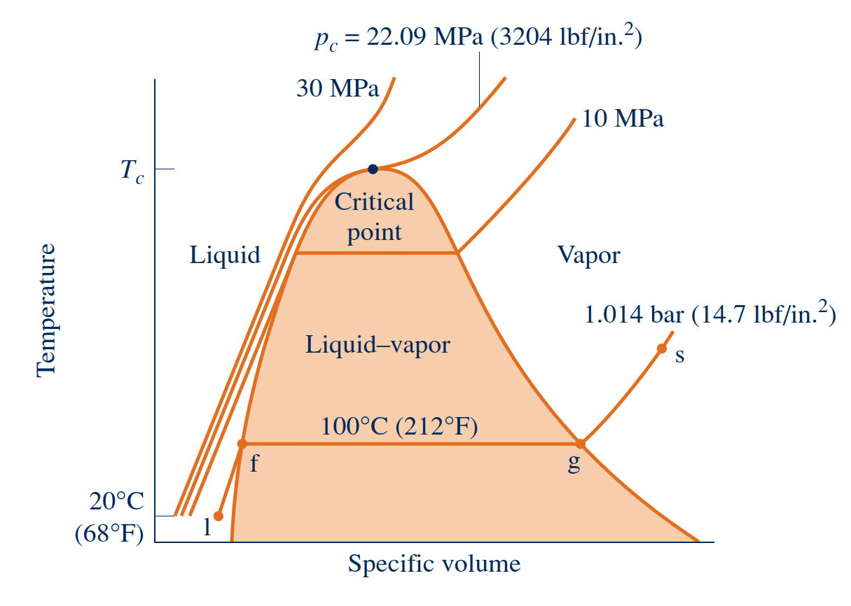
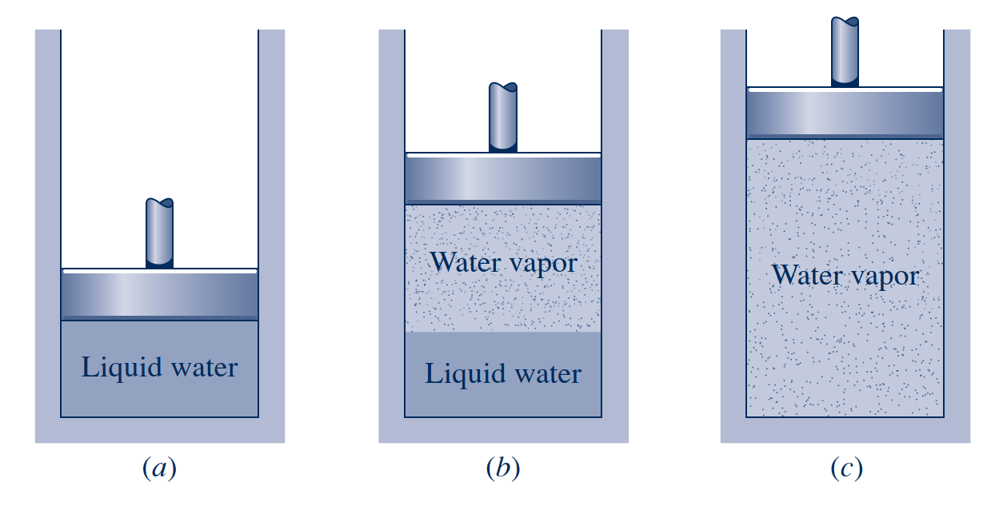
Studying Phase Change
Liquid States
The liquid states along the line segment l–f of right Fig. are sometimes referred to as subcooled liquid states because the temperature at these states is less than the saturation temperature at the given pressure.
These states are also referred to as compressed liquid states because the pressure at each state is higher than the saturation pressure corresponding to the temperature at the state. The names liquid, subcooled liquid, and compressed liquid are used interchangeably.
Sketch of a temperature–specific volume diagram for water showing the 20°C liquid, two-phase liquid–vapor, and vapor regions (not to scale).
Illustration of constant-pressure change from liquid to vapor for water

Slide 10
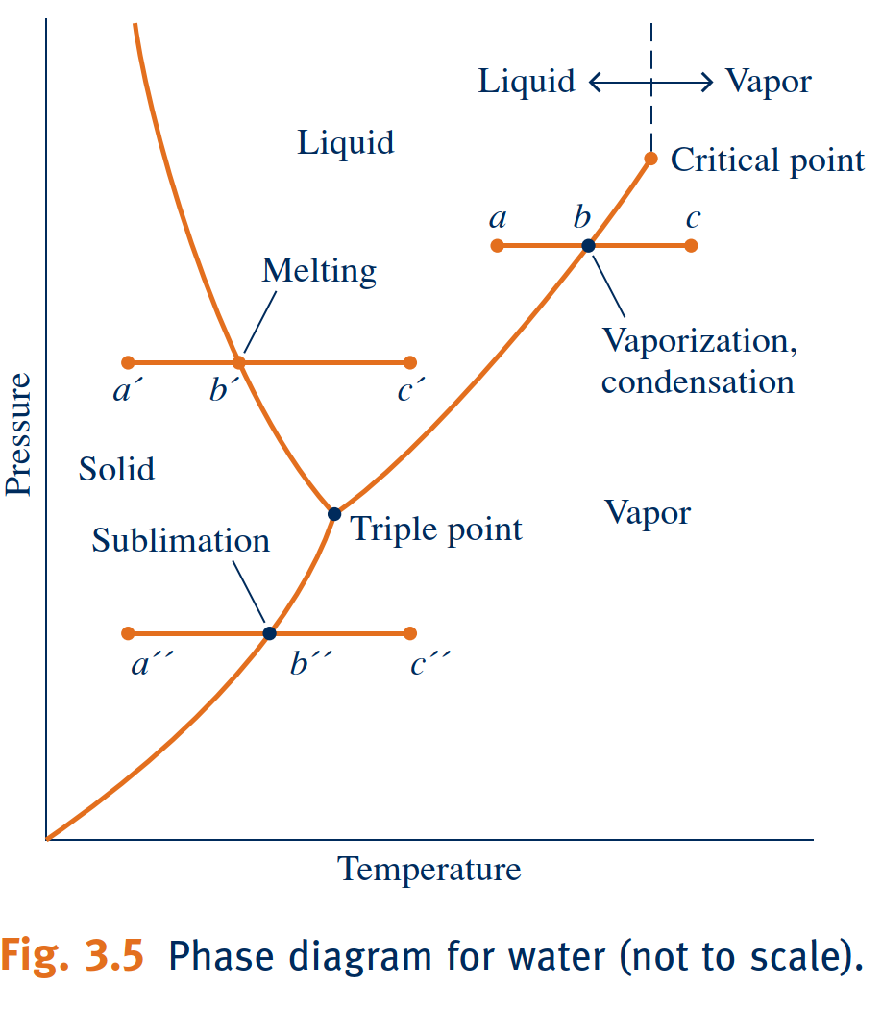
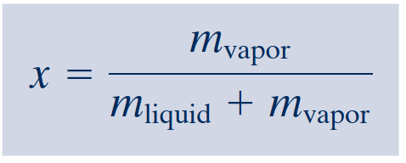
Studying Phase Change
Two-Phase Liquid–Vapor Mixture
Vapor States
When a mixture of liquid and vapor exists in equilibrium, the liquid phase is a saturated
liquid and the vapor phase is a saturated vapor. If the system is heated further until the last bit of liquid has vaporized, it is brought to point g on right figure, the saturated vapor state. The intervening two-phase liquid–vapor mixture states can be distinguished from one another by the quality, an intensive property.
When the system is at the saturated vapor state, further heating at fixed pressure results in increases in both temperature and specific volume.
Quality
For a two-phase liquid–vapor mixture, the ratio of the mass of vapor present to the total mass of the mixture is its quality, x. In symbols,
Phase diagram for water (not to scale).

Slide 11
Evaluating Specific Internal Energy and Enthalpy
Internal Energy
Data for specific internal energy $u$ and enthalpy $h$ are retrieved from the property tables in the same way as for specific volume. For saturation states, the values of $u_{f}$ and $u_{g},$ as well as $h_{f}$ and $h_{g}$, are tabulated versus both saturation pressure and saturation temperature. The specific internal energy for a two-phase liquid–vapor mixture is calculated for a given quality in the same way the specific volume is calculated:
Internal energy U of a system or a body with well defined boundaries is the total of the kinetic energy due to the motion of molecules and the potential energy associated with the vibrational motion and electric energy of atoms within molecules. Internal energy also includes the energy in all the chemical bonds.
Enthalpy
Because the sum $U+pv$ occurs so frequently in subsequent discussions, it is convenient to give the combination a name, enthalpy, and a distinct symbol, $H$. By definition
Similarly, the specific enthalpy for a two-phase liquid–vapor mixture is given in terms of the quality by

Slide 12
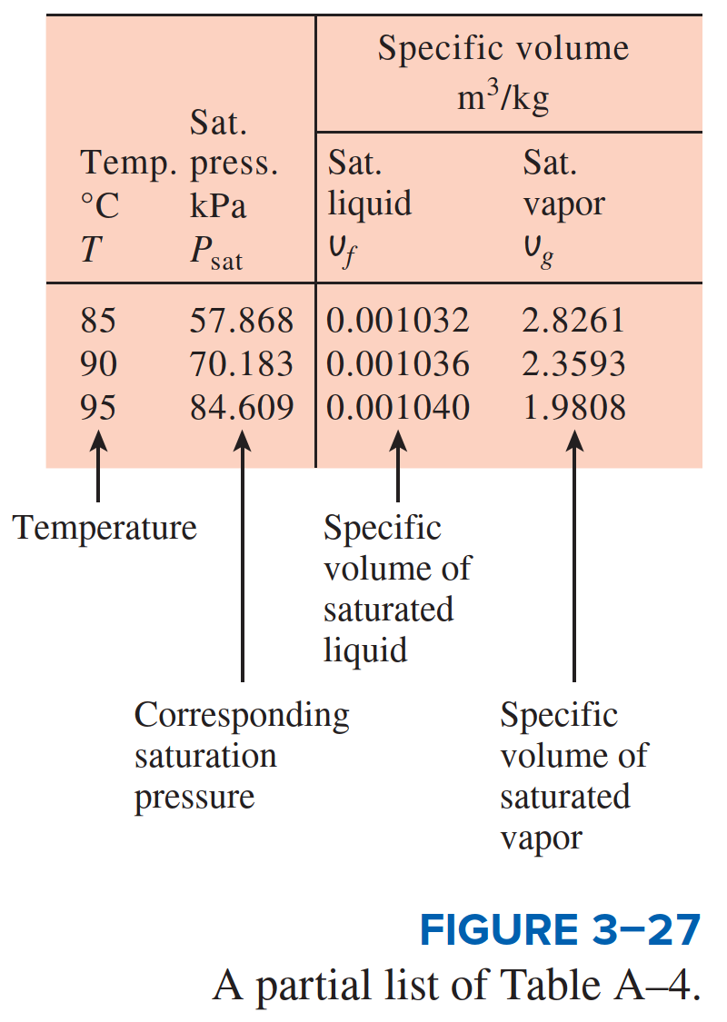
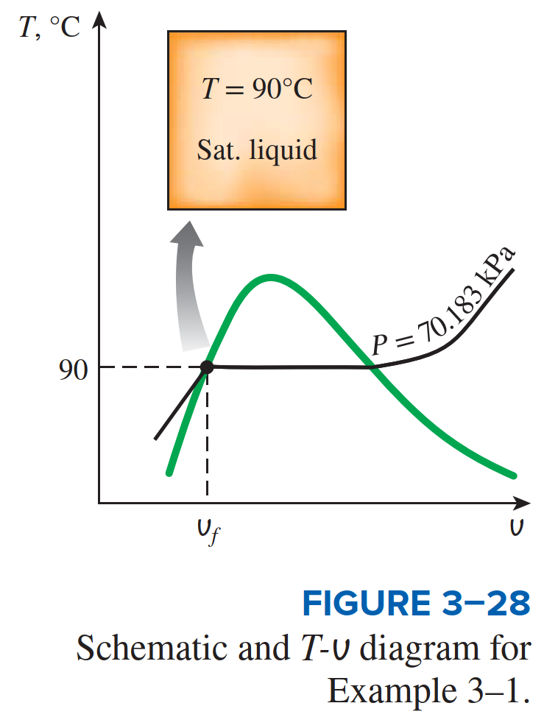
Evaluating Specific Internal Energy and Enthalpy

Slide 13
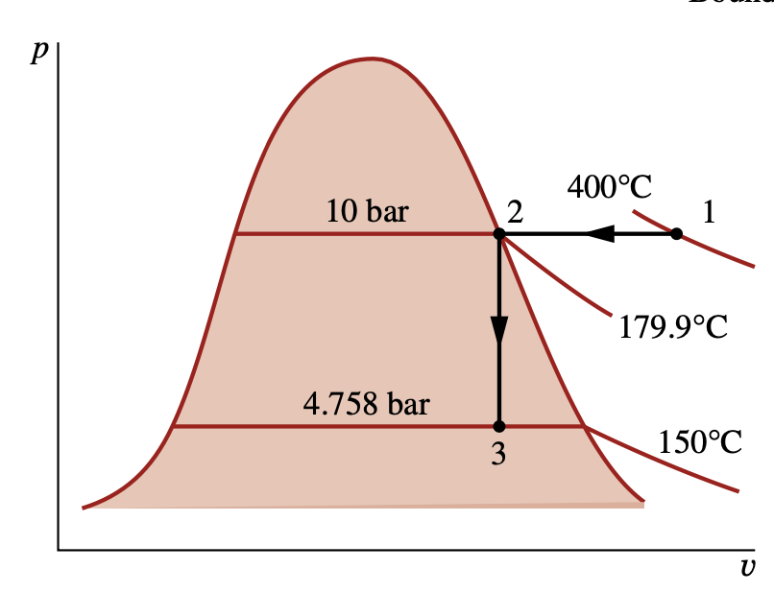
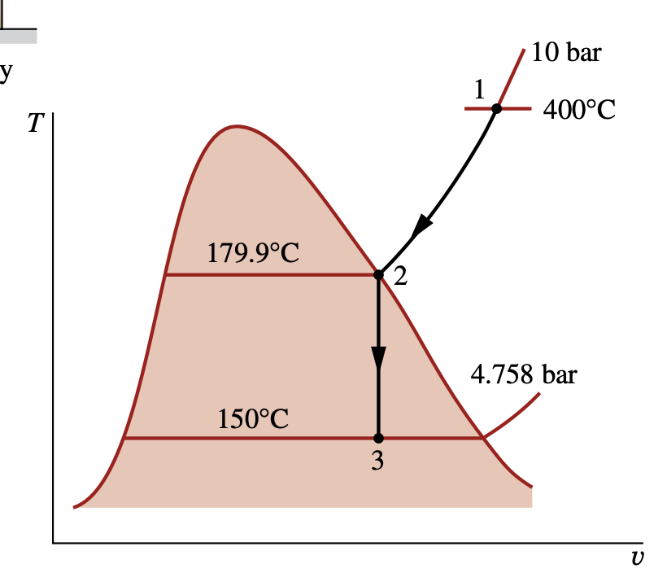
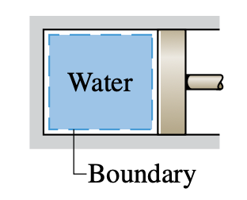
Example Analyzing Two processes in Series
Water contained in a piston–cylinder assembly undergoes two processes in series from an initial state where the pressure is 10 bar and the temperature is 400°C.
Process 1–2 The water is cooled as it is compressed at a constant pressure of 10 bar to the saturated vapor state.
Process 2–3 The water is cooled at constant volume to 150°C.
a. Sketch both processes on T–υ and p–υ diagrams. b. For the overall process determine the work, in kJ/kg.
c. For the overall process determine the heat transfer, in kJ/kg.

Slide 14
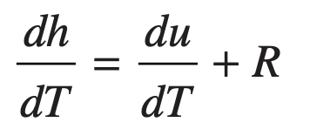
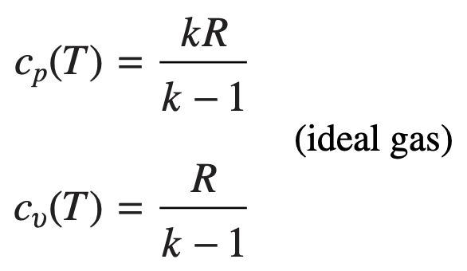
Internal Energy, Enthalpy, and Specific Heats of Ideal Gases
∆u, ∆h, cυ, and cp Relations
On integration, the change in specific internal energy and enthalpy are
In thermodynamics, we are interested in two kinds of specific heats: specific heat at constant volume c_{v} and specific heat at constant pressure c_{p}.
The specific heat $c_{ν}$
Specific heat $c_{p}$

Slide 15
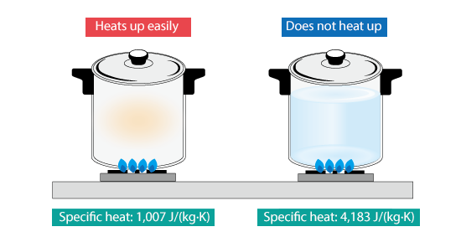
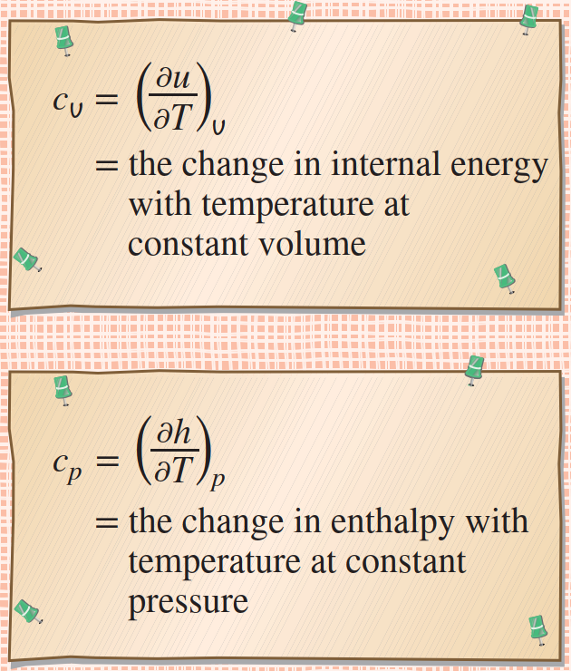
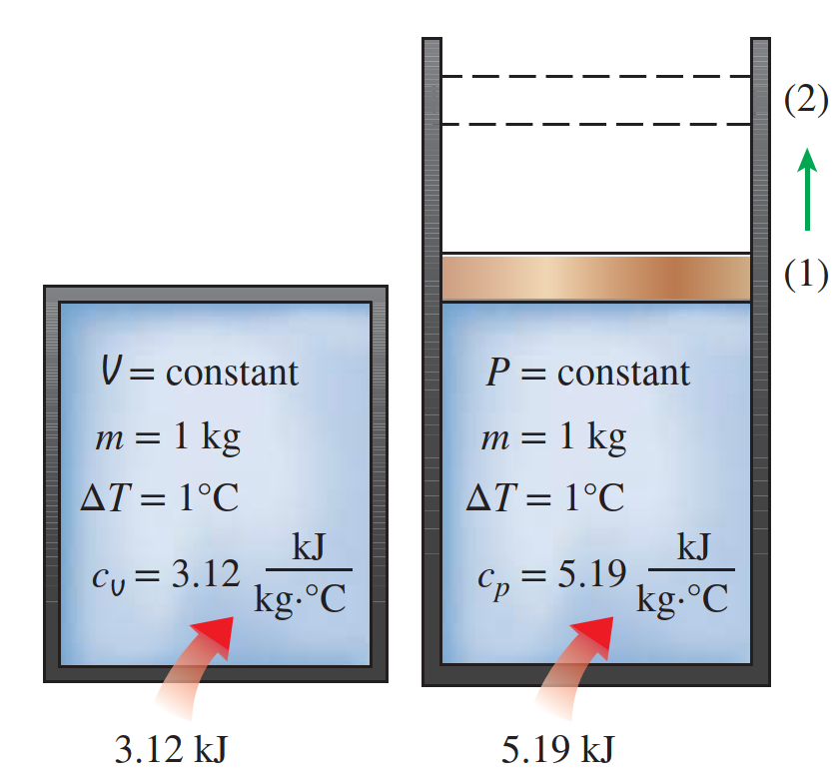
Internal Energy, Enthalpy, and Specific Heats of Ideal Gases
For a gas obeying the ideal gas model, specific internal energy depends only on temperature.
Similarly, for a gas obeying the ideal gas model, the specific enthalpy depends only on temperature

Slide 16
Introducing Specific Heats $c_{v}$and $c_{p}$
Specific heats
The specific heats, denoted $c_{v}$and $c_{p}$, are particularly useful for thermodynamic calculations involving the ideal gas model
The intensive properties c and cp are defined for pure, simple compressible substances as partial derivatives of the functions $u\left(T,ν\right)$and $h\left(T,p\right)$, respectively,
Specific heat ratio
cp of water vapor as a function of temperature and pressure.

Slide 17
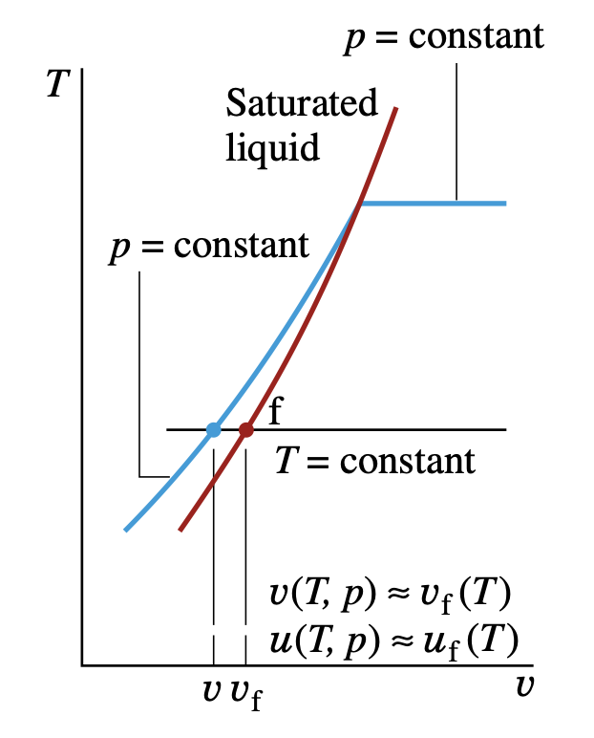
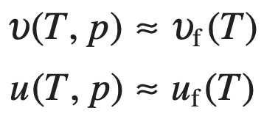
Evaluating properties of Liquids and Solids
Approximations for Liquids Using Saturated Liquid Data
Because the values of υ and u vary only gradually as pressure changes at fixed temperature, the following approximations are reasonable for many engineering calculations:

Slide 18
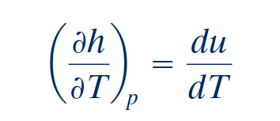
Incompressible Substance Model
Incompressible Substance Model
If the specific heat $c$ is taken as constant,
To simplify evaluations involving liquids or solids, the specific volume (density) is often assumed to be constant and the specific internal energy assumed to vary only with temperature. A substance idealized in this way is called incompressible.

Slide 19
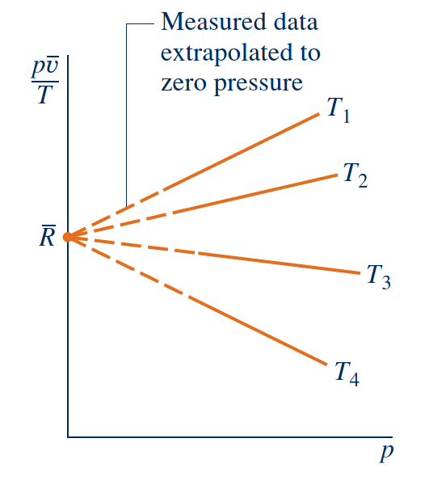
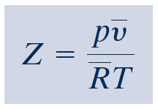
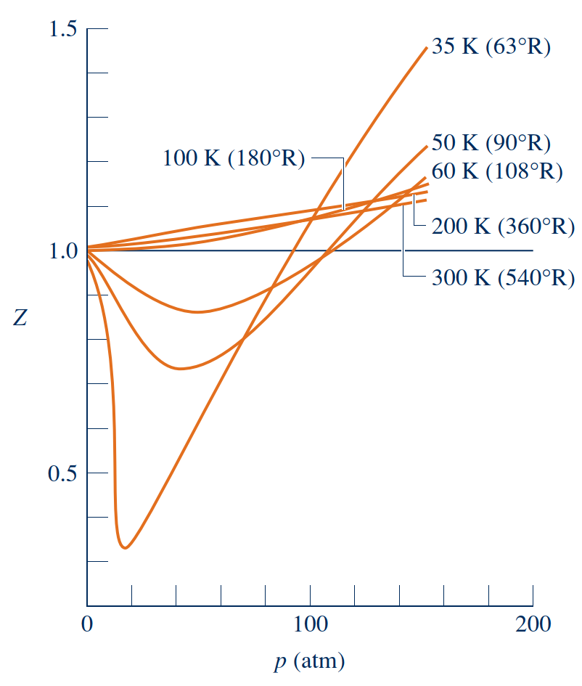
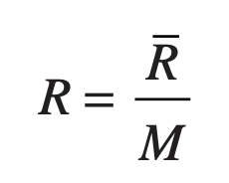
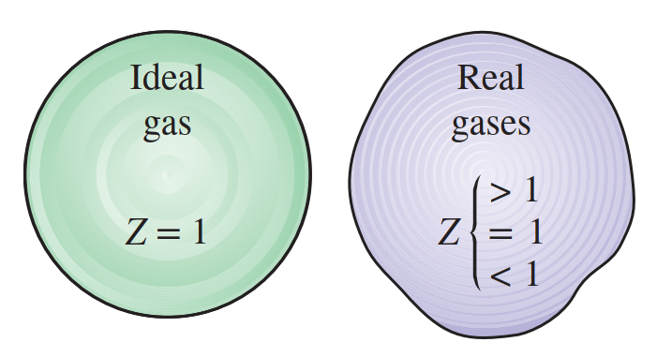
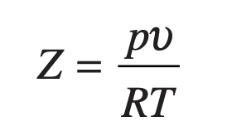
Generalized Compressibility Chart
Universal Gas Constant, $\overline{R}$
Sketch of pυ /T versus pressure for a gas at several specified values of temperature.
Compressibility Factor, Z
With $\overline{υ}=Mυ$, where M is the atomic or molecular weight, the compressibility factor can be expressed alternatively as
Variation of the compressibility factor of hydrogen with pressure at constant temperature.

Slide 20
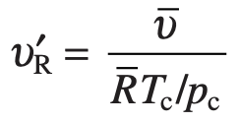
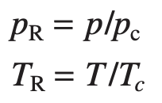
Generalized Compressibility Data, Z Chart
When these charts are studied, they are found to be qualitatively simi- lar. Further study shows that when the coordinates are suitably modified, the curves for several different gases coincide closely when plotted together on
Values of specific volume are included on the generalized chart through the variable υR′ , called the pseudoreduced specific volume, defined by
the same coordinate axes, and so quantitative similarity also can be achieved. This is re- ferred to as the principle of corresponding states. In one such approach, the compressibility factor Z is plotted versus a dimensionless reduced pressure pR and reduced temperature TR, defined as
The pseudoreduced specific volume gives a better correlation of the data than does the reduced specific volume υR = υ /υc , where υc is the critical specific volume.
where pc and Tc denote the critical pressure and temperature, respectively.

Slide 21
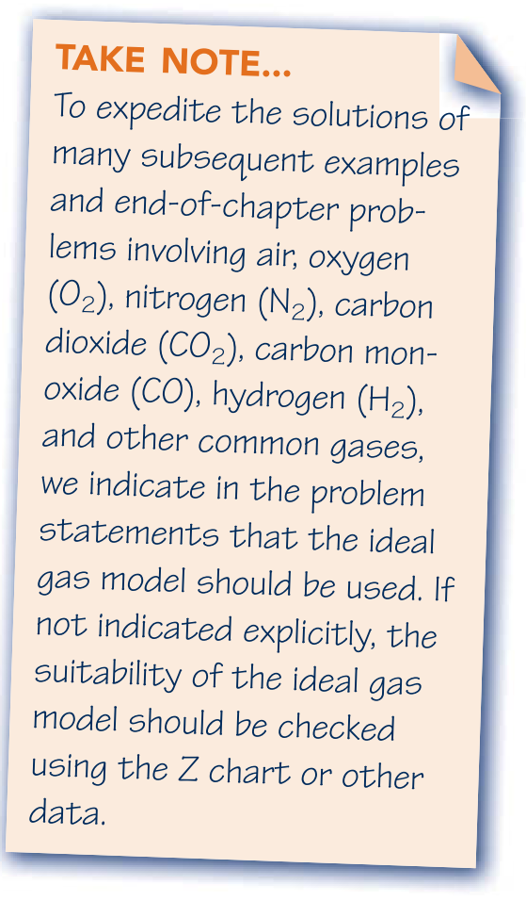
Evaluating Properties Using
the Ideal Gas Model
Ideal gas equation of state
with $υ = V/n$, as
ideal gas model

Slide 22
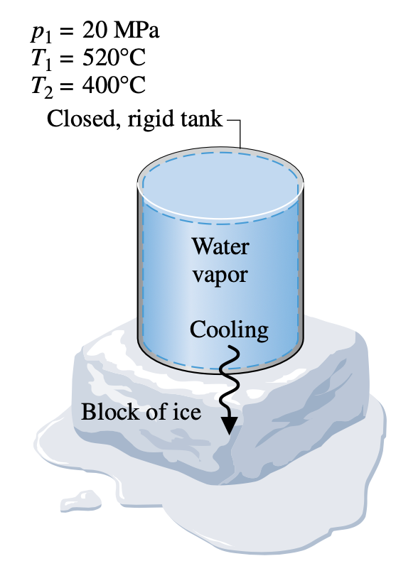
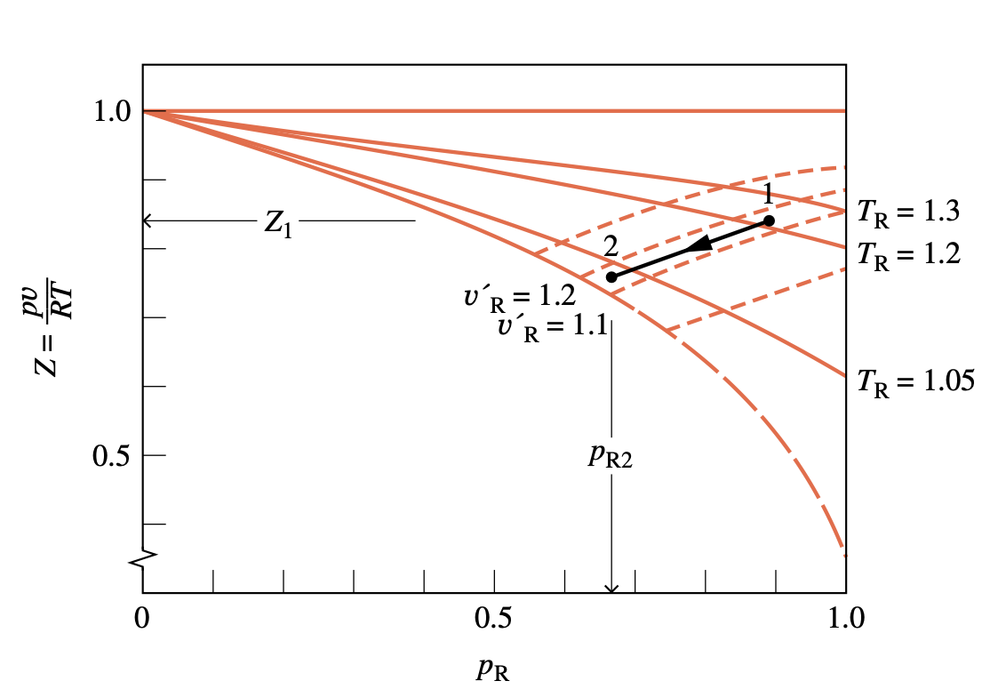
Example: Using the Generalized Compressibility Chart
A closed, rigid tank filled with water vapor, initially at 20 MPa, 520°C, is cooled until its temperature reaches 400°C. Using the compressibility chart, determine
a. the specific volume of the water vapor in m3/kg at the initial state.
b. the pressure in MPa at the final state. Compare the results of parts (a) and (b) with the values obtained from the superheated vapor table, Table A-4.

Slide 23
Mass and Energy Analysis of Control Volumes

Slide 24
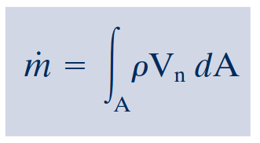
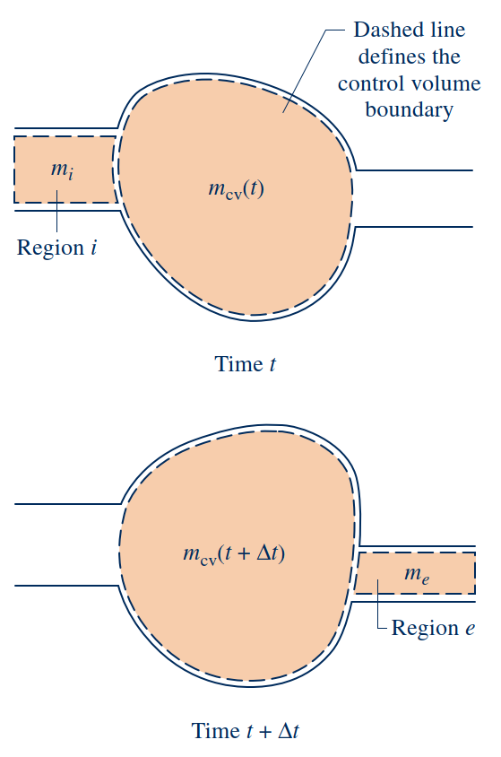
Conservation of Mass for a Control Volume
Conservation of Mass for a Control Volume
mass flow rates
Evaluating the Mass Flow Rate

Slide 25
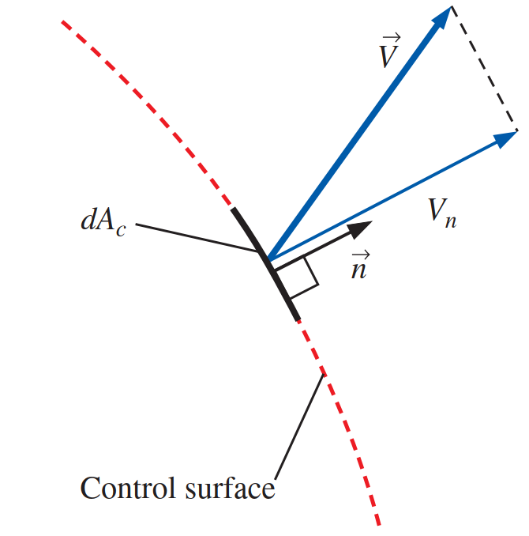
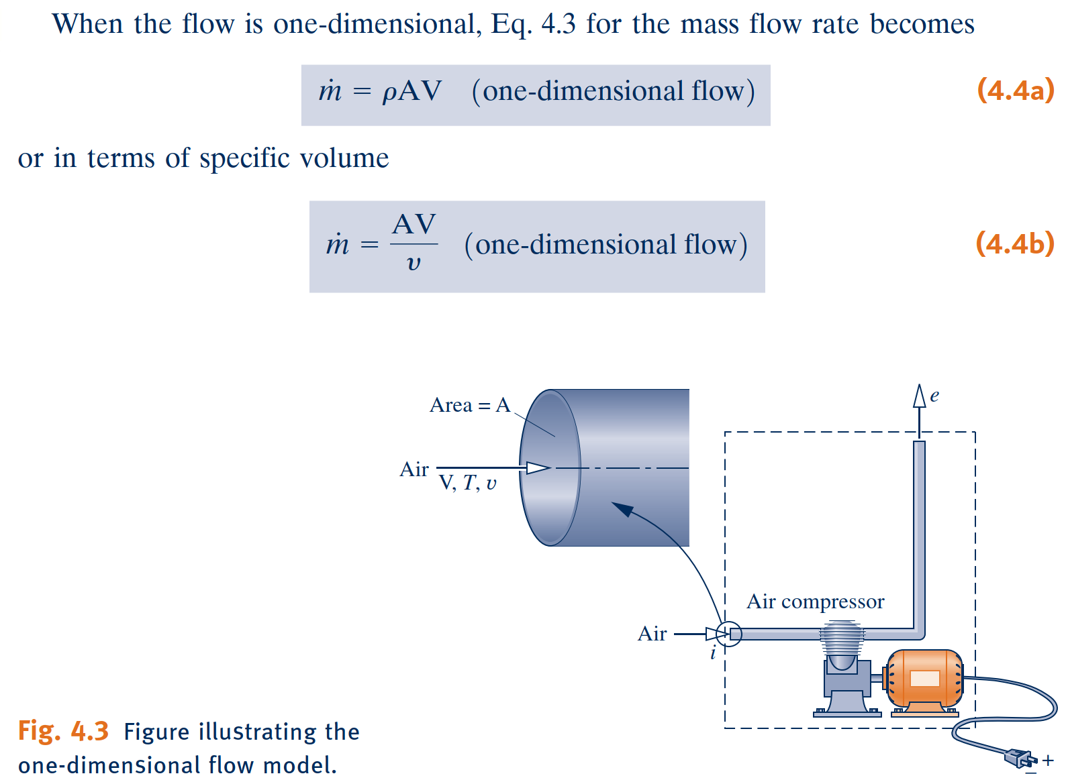
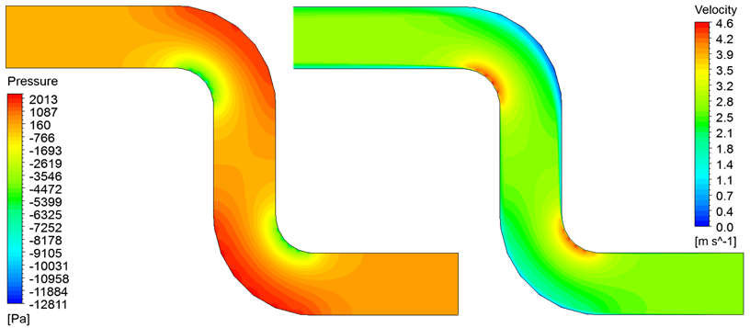
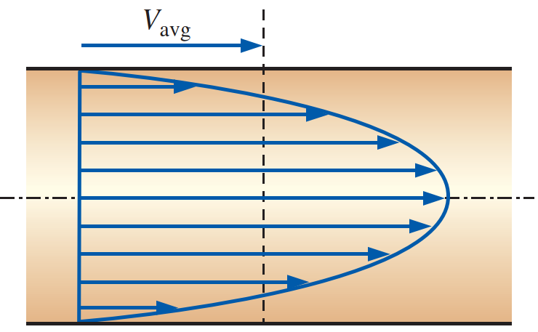
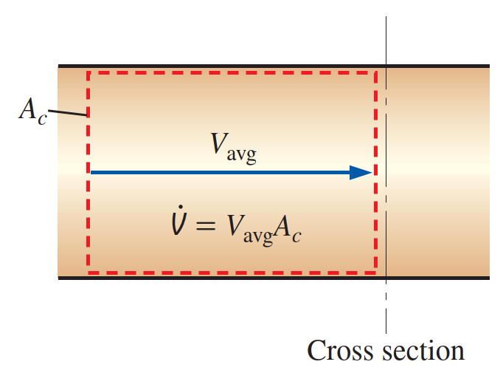
Forms of the Mass Rate Balance
One-Dimensional Flow Form of the Mass Rate Balance
When a flowing stream of matter entering or exiting a control volume adheres to the following idealizations, the flow is said to be one-dimensional:
The flow is normal to the boundary at locations where mass enters or exits the control volume.
All intensive properties, including velocity and density, are uniform with position (bulk average values) over each inlet or exit area through which matter flows.

Slide 26
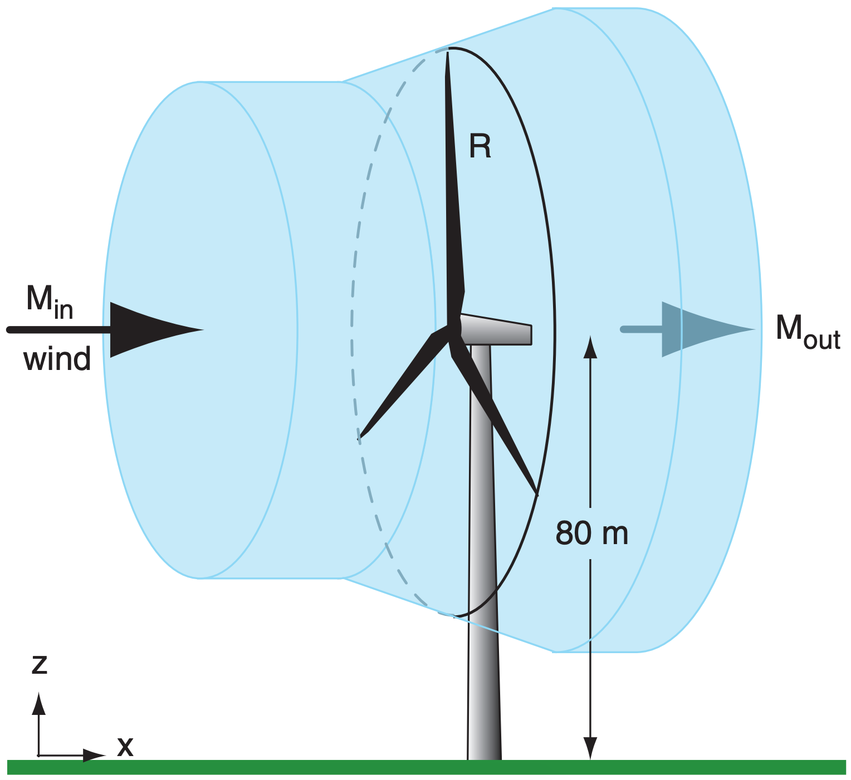
Forms of the Mass Rate Balance
Steady-State Form of the Mass Rate Balance
all properties are unchanging in time.
Integral Form of the Mass Rate Balance
The product $ρV_{n}$appearing in this equation, known as the mass flux, gives the time rate of mass flow per unit of area.
Notes:
https://www.thoughtco.com/list-of-phase-changes-of-matter-608361

Slide 27
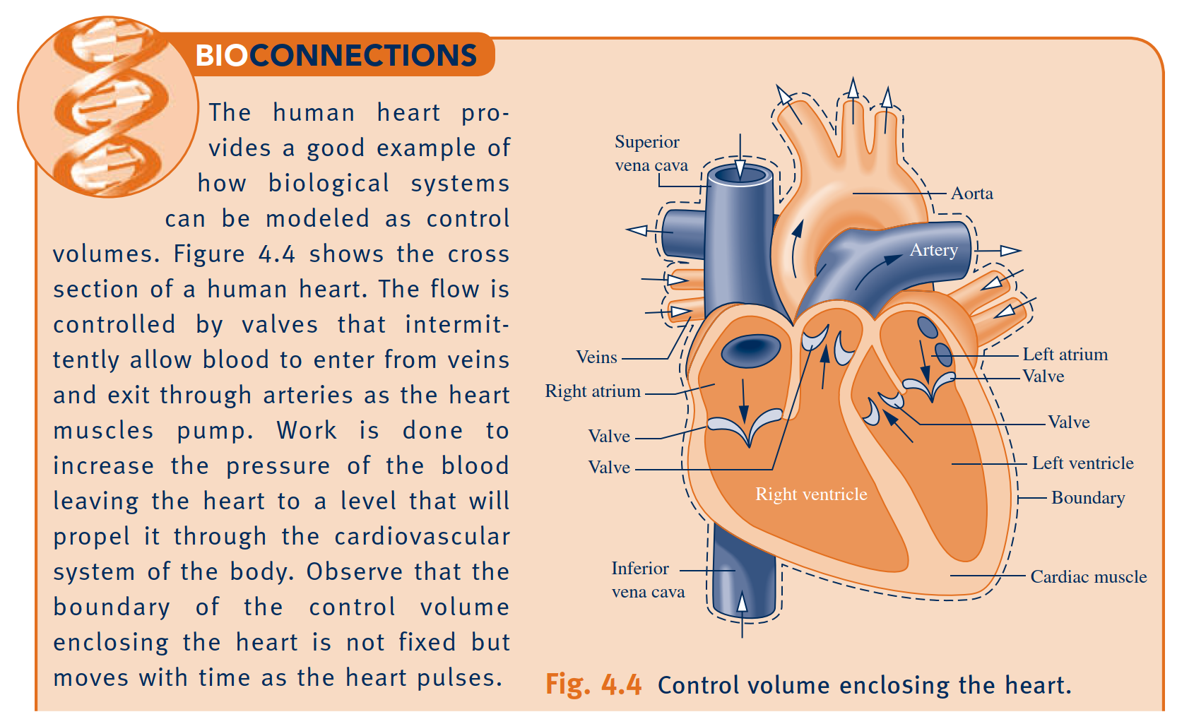
Applications of the Mass Rate Balance

Slide 28
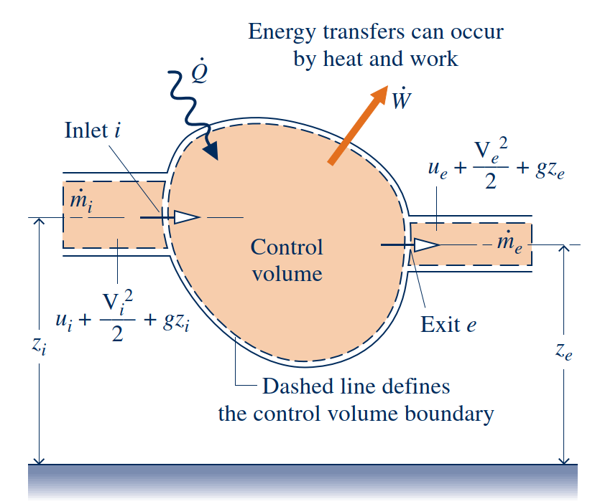
Conservation of Energy for a Control Volume
Conservation of energy
Flow work
Because work is always done on or by a control volume where matter flows across the boundary, it is convenient to separate the work term $\dot{W}$ of above equation into two contributions:
One contribution is the work associated with the fluid pressure as mass is introduced at inlets and removed at exits.
The other contribution, denoted by ${\dot{W}}_{\text{cv}}$, includes all other work effects, such as those associated with rotating shafts, displacement of the boundary, and electrical effects.

Slide 29
One-Dimensional Flow Form of the Control Volume Energy Rate Balance
Energy rate balance
Saturation temperature and pressure
Integral Form of the Control Volume Energy Rate Balance
One-inlet, one-exit control volumes at steady
state.
Steady-State Forms of the Mass and Energy Rate Balances

Slide 30
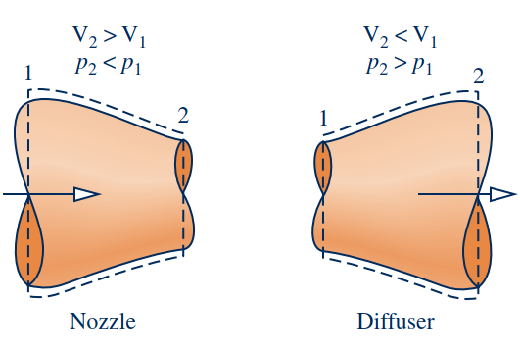
Nozzles and Diffusers
Nozzle
A nozzle is a flow passage of varying cross-sectional area in which the velocity of a gas or liquid increases in the direction of flow.
Diffuser
In a diffuser, the gas or liquid decelerates in the direction of flow.
Application to a Steam Nozzle
For a control volume enclosing a nozzle or diffuser, the only work is flow work at locations where mass enters and exits the control volume, so the term ${\dot{W}}_{cv}$ drops out of the energy rate balance. The change in potential energy from inlet to exit is negligible under most conditions.

Slide 31
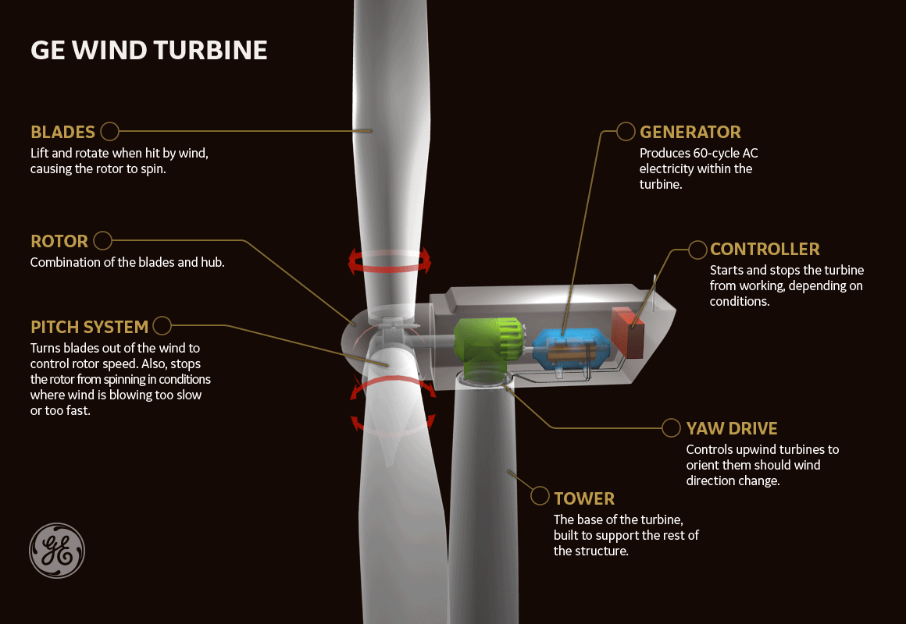
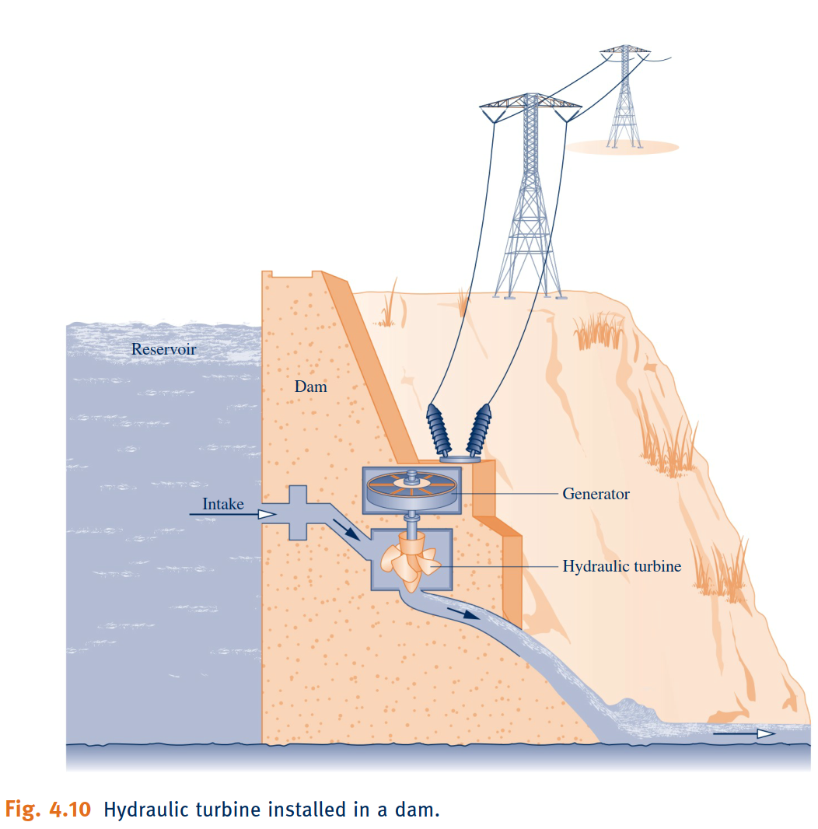
Turbines
Turbine
A turbine is a device in which power is developed as a result of a gas or liquid passing through a set of blades attached to a shaft free to rotate.

Slide 32
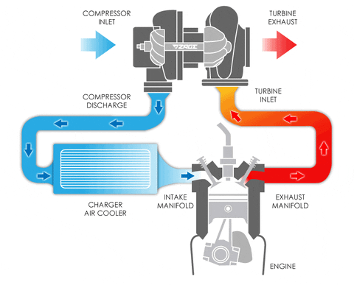
Compressors and Pumps
Compressors and pumps
Compressors and pumps are devices in which work is done on the substance flowing through them in order to change the state of the substance, typically to increase the pressure and/or elevation. The term compressor is used when the substance is a gas (vapor) and the term pump is used when the substance is a liquid.

Slide 33
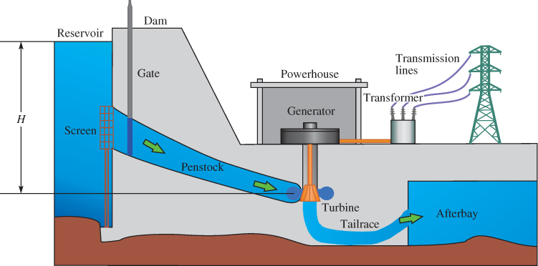
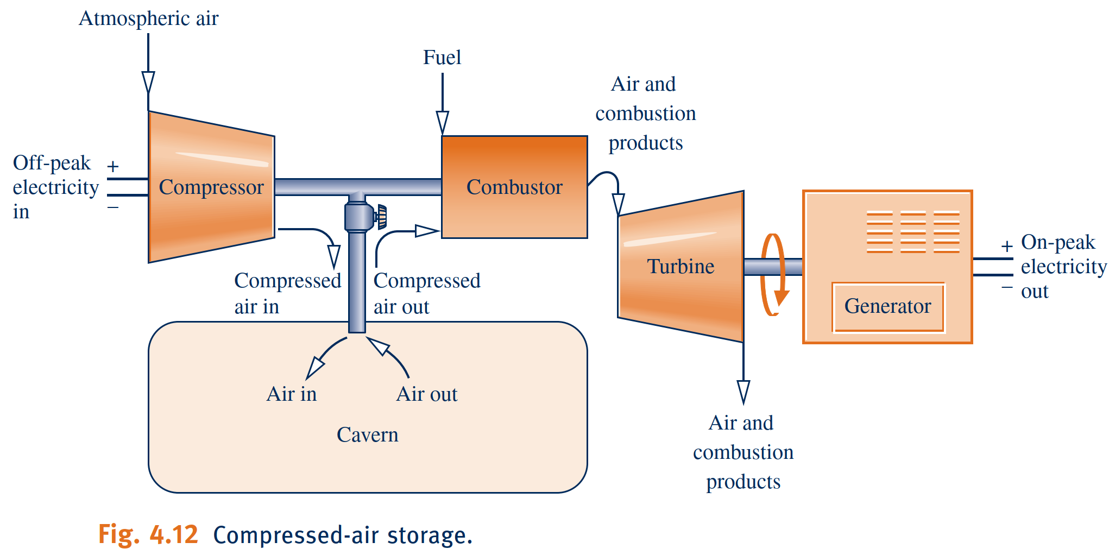
Pumped-Hydro and Compressed-Air Energy Storage
Owing to the dictates of supply and demand and other economic factors, the value of electricity varies with time. Both the cost to generate electricity and increasingly the price paid by consumers for electricity depend on whether the demand for it is on-peak or off-peak. The on-peak period is typically weekdays—for example, from
8 a.m. to 8 p.m., while off-peak includes nighttime hours, weekends, and major holidays. Consumers can expect to pay more for on-peak electricity. Energy storage methods benefiting from variable electricity rates include thermal storage and pumped-hydro and compressed-air storage introduced in the following box.

Slide 34
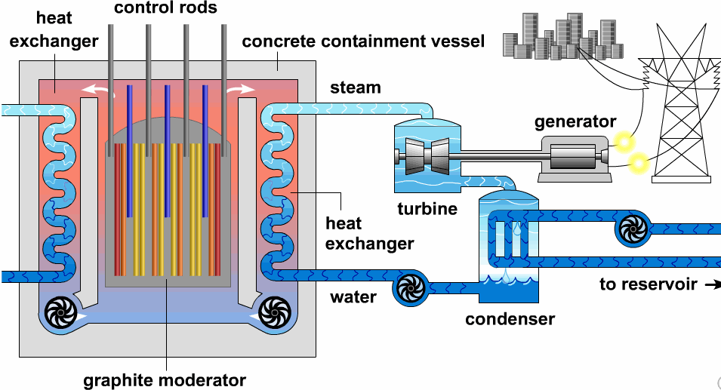
Heat Exchangers
Heat Exchangers
Heat exchangers have innumerable domestic and industrial applications, including use in home heating and cooling systems, automotive systems, electrical power generation, and chemical processing.
Common heat exchanger types. (a) Direct-contact heat exchanger. (b) Tube-within-a-tube counterflow heat exchanger. (c) Tube-within-a-tube parallel-flow heat exchanger. (d) Cross-flow heat exchanger.

Slide 35
Throttling Devices
Throttling Devices
throttling process
When the flow through the valve or other restriction is idealized in this way, the
process is called a throttling process.
A significant reduction in pressure can be achieved simply by introducing a restriction into a line through which a gas or liquid flows. This is commonly done by means of a partially opened valve or a porous plug.

Slide 36
System Integration
System integration
Engineers often must creatively combine components to achieve some overall objective, subject to constraints such as minimum total cost. This important engineering activity is called system integration.

Slide 37
Transient Analysis
Transient operation
Many devices undergo periods of transient operation during which the state changes with time.
First, we place the control volume mass balance in a form that is suitable for transient analysis. We begin by integrating the mass rate balance, from time 0 to a final time t.
This states that the change in the amount of mass contained in the control volume equals the difference between the total incoming and outgoing amounts of mass.

Slide 38
The Energy Balance in Transient Analysis
Next, we integrate the energy rate balance, ignoring the effects of kinetic and potential energy.
Another special case is when the intensive properties within the control volume are uniform with position at a particular time t. Accordingly, the specific volume and the specific internal energy are uniform throughout and can depend only on time—that is, υ(t) and u(t), respectively.
For the special case where the states at the inlets and exits are constant with time, the respective specific enthalpies, hi and he, are constant
https://learncheme.com/simulations/separations/adiabatic-flash-drum-with-binary-liquid-feed/

