Slide 1
Thermodynamics and Heat Transfer
Lecture 2: First Law of Thermodynamics
Qiang Cheng (Jonny)

Slide 2
Learning Outcomes
When you complete your study of this chapter, you will be able to…
Explain key concepts related to energy and the first law of thermodynamics . . . including internal, kinetic, and potential energy, work and power, heat transfer and heat transfer modes, heat transfer rate, power cycle, refrigeration cycle, and heat pump cycle.
Analyze closed systems including applying energy balances, appropriately modeling the case at hand, and correctly observing sign conventions for work and heat transfer.
Conduct energy analyses of systems undergoing thermodynamic cycles, evaluating as appropriate thermal efficiencies of power cycles and coefficients of performance of refrigeration and heat pump cycles.
Notes:
Heat is energy can be converted from one form to another, or transferred from one object to another. For example, a stove burner converts electrical energy to heat and conducts that energy through the pot to the water. This increases the kinetic energy of the water molecules, causing them to move faster and faster. At a certain temperature (the boiling point), the atoms have gained enough energy to break free of the molecular bonds of the liquid and escape as vapor.

Slide 3
Energy Transfer by Work

Slide 4
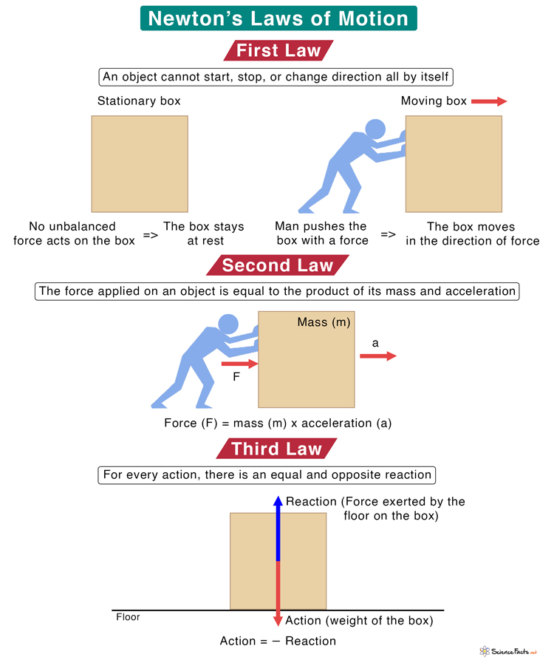
Newton’s Laws of Motion
Newton’s laws of motion
Three statements describing the relations between the forces acting on a body and the motion of the body, first formulated by English physicist and mathematician Isaac Newton, which are the foundation of classical mechanics.

Slide 5
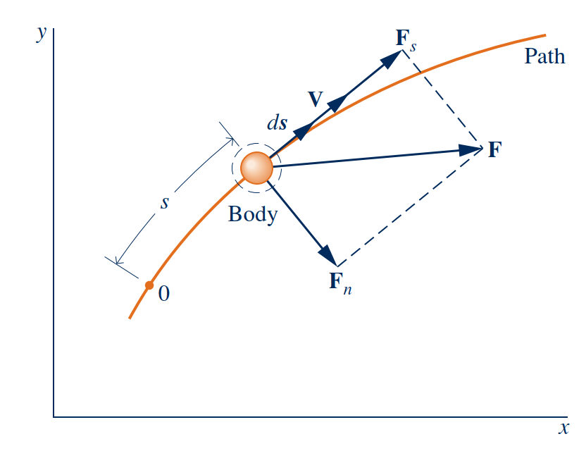
Reviewing Mechanical Concepts of Energy
Work and Kinetic Energy
By Newton’s second law of motion, the magnitude of the component Fs is related to the change in the magnitude of V by
$$F_{s}=m\frac{dV}{dt}$$
Using the chain rule, this can be written as
$$F_{s}=m\frac{dV}{ds}\frac{ds}{dt}=mV\frac{dV}{ds}$$
where V = ds/dt. Integrating from $s_{1}$ to $s_{2}$ gives
Forces acting on a moving system
$$\int_{V_{1}}^{V2}{mVdV=\int_{s_{1}}^{s_{2}}{F_{s}ds}}$$

Slide 6
Reviewing Mechanical Concepts of Energy
The integral on the left is evaluated as follows
$$\int_{V_{1}}^{V2}{mVdV={\left.\frac{1}{2}mV^{2}\right]}_{V_{1}}^{V_{2}}=\frac{1}{2}\left(V_{2}^{2}−V_{1}^{2}\right)}$$
The quantity $\frac{1}{2}mV^{2}$ is the kinetic energy, KE, of the body. Kinetic energy is a scalar quantity. The change in kinetic energy, ΔKE, of the body is
$$∆KE=KE_{2}−KE_{1}=\frac{1}{2}\left(V_{2}^{2}−V_{1}^{2}\right)$$
The integral on the right is the work of the force Fs as the body moves from s1 to s2 along the path. Work is also a scalar quantity.
$$\frac{1}{2}\left(V_{2}^{2}−V_{1}^{2}\right)=\int_{s_{1}}^{s_{2}}{F_{s}ds}$$
kinetic energy is a property of the body. Since kinetic energy is associated with the body as a whole, it is an extensive property.

Slide 7
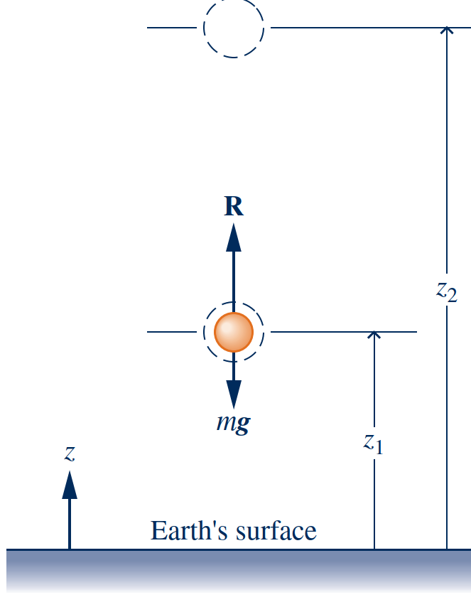
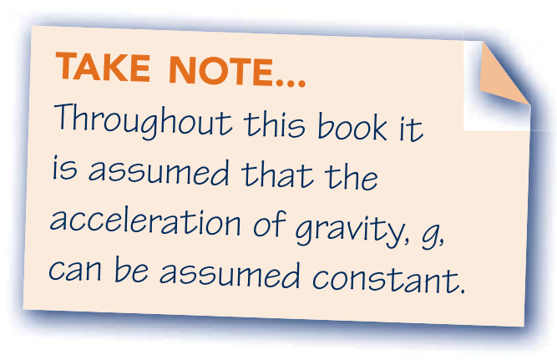
Potential Energy
Gravitational potential energy
where the acceleration of gravity has been assumed to be constant with elevation. By incorporating and re-arranging:
The quantity $mgz$ is the gravitational potential energy, PE. The change in gravitational potential energy, ΔPE, is
$$\frac{1}{2}\left(V_{2}^{2}−V_{1}^{2}\right)+mg\left(z_{2}−z_{1}\right)=\int_{z_{1}}^{z_{2}}{Rdz}$$
The work of each force acting on the body shown in right Fig. can be determined by using the definition previously given. The total work is the algebraic sum of these individual values. The total work equals the change in kinetic energy. That is,
$$\frac{1}{2}\left(V_{2}^{2}−V_{1}^{2}\right)=\int_{z_{1}}^{z_{2}}{Rdz−\int_{z_{1}}^{z_{2}}{mgdz}}$$
A minus sign is introduced before the second term on the right because the gravitational force is directed downward and z is taken as positive upward.
$$\int_{z_{1}}^{z_{2}}{mgdz=mg\left(z_{2}−z_{1}\right)}$$
Illustration used to introduce the potentioal energy

Slide 8
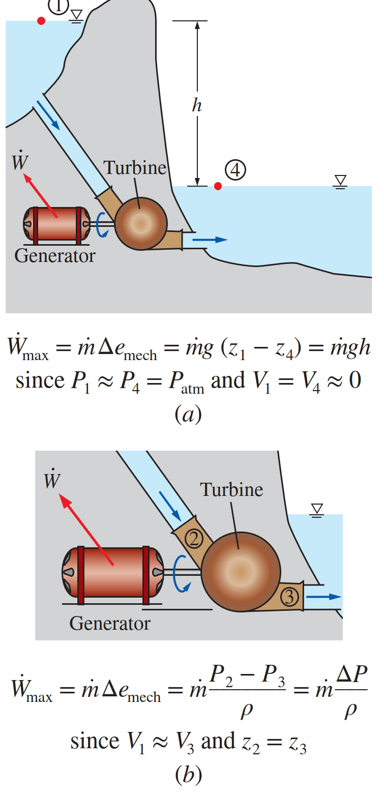
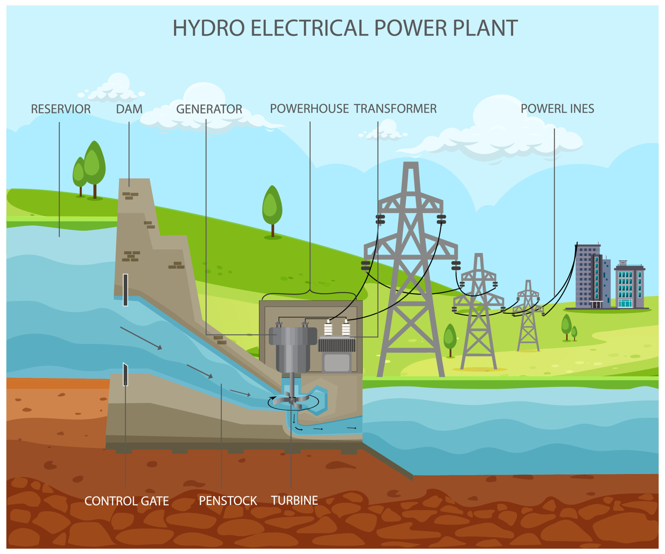
Potential Energy
Application of potential energy

Slide 9
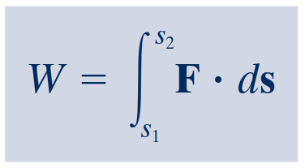
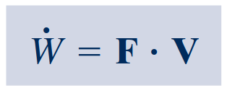
Broadening Our Understanding of Work
The work W done by, or on, a system evaluated in terms of macroscopically observable forces and displacements is
Power
The rate of energy transfer by work is called power and is denoted by $\dot{W}$.
Thermodynamic definition of work
When a work interaction involves a macroscopically observable force, the rate of energy transfer by work is equal to the product of the force and the velocity at the point of application of the force
Work is done by a system on its surroundings if the sole effect on everything external to the system could have been the raising of a weight.
Sign Convention and Notation
W > 0: work done by the system
W < 0: work done on the system

Slide 10
Expansion or Compression Work
The work done by the expansion or compression system as the piston is displaced a distance dx is
For a change in volume from $V_{1}$ to $V_{2}$, the work is obtained by integrating
$$δW=pAdx$$
$$W=\int_{V_{1}}^{V_{2}}{pdV}$$
The product $Adx$ in above equals the change in volume of the system, dV. Thus, the work expression can be written as
$$δW=pdV$$
Since dV is positive when volume increases, the work at the moving boundary is positive when the gas expands. For a compression, dV is negative. These signs are in agreement with the previously stated sign convention for work.
Expansion or compression of a gas or liquid.

Slide 11
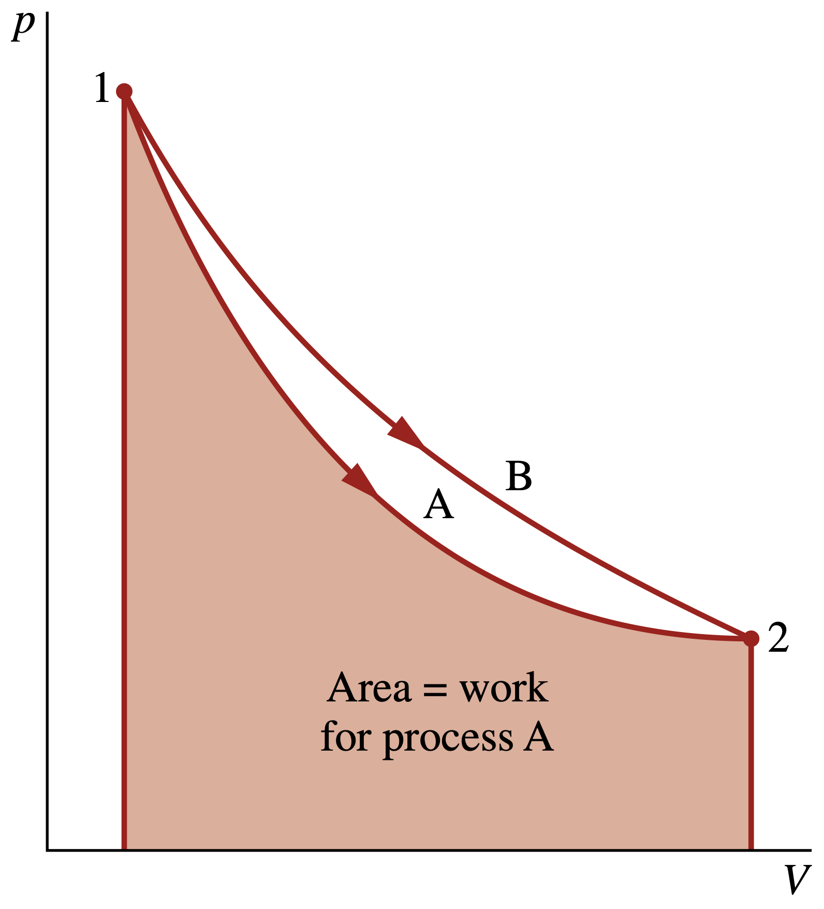
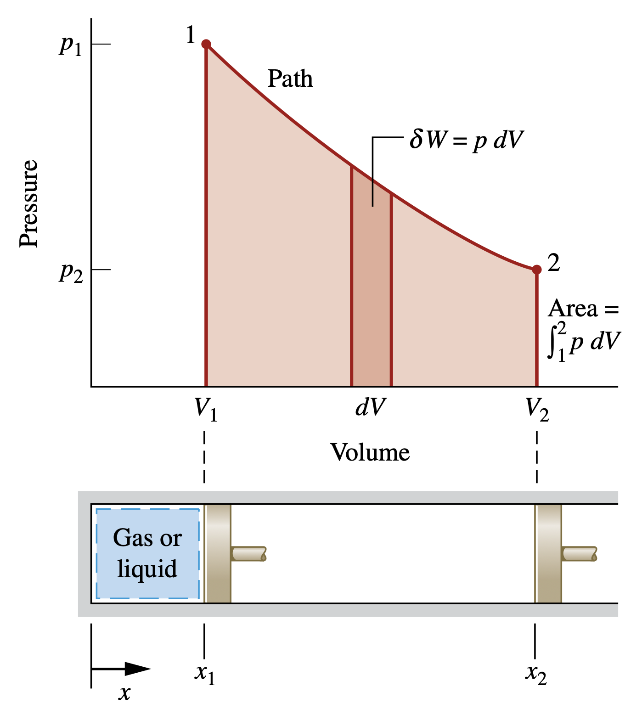
Expansion or Compression Work
Pressure–volume diagram (p–V diagram)
Illustration that work depends on the process
This brings out an important idea about work: The value of W depends on the details of the interactions taking place between the system and surroundings during a process and not just the initial and final states of the system. It follows that work is not a property of the system or the surroundings.
Work of a quasi-equilibrium expansion or compression process

Slide 12
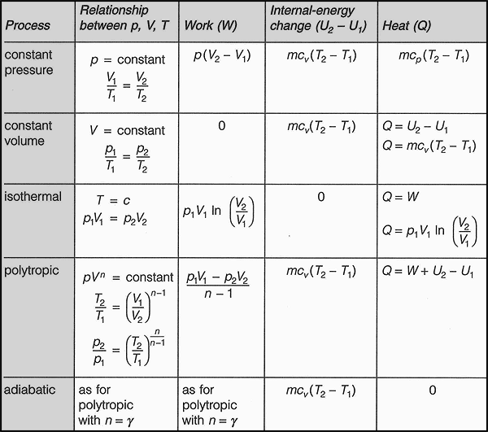
Expansion or Compression Work
The relation between pressure and volume, or pressure and specific volume, also can be described analytically.
A quasi-equilibrium process described by, or $pv^{n}$ = constant, where n is a $pV^{n} = constant$, is called a polytropic process. Additional analytical forms for the pressure–volume relationship also may be considered.

Slide 13
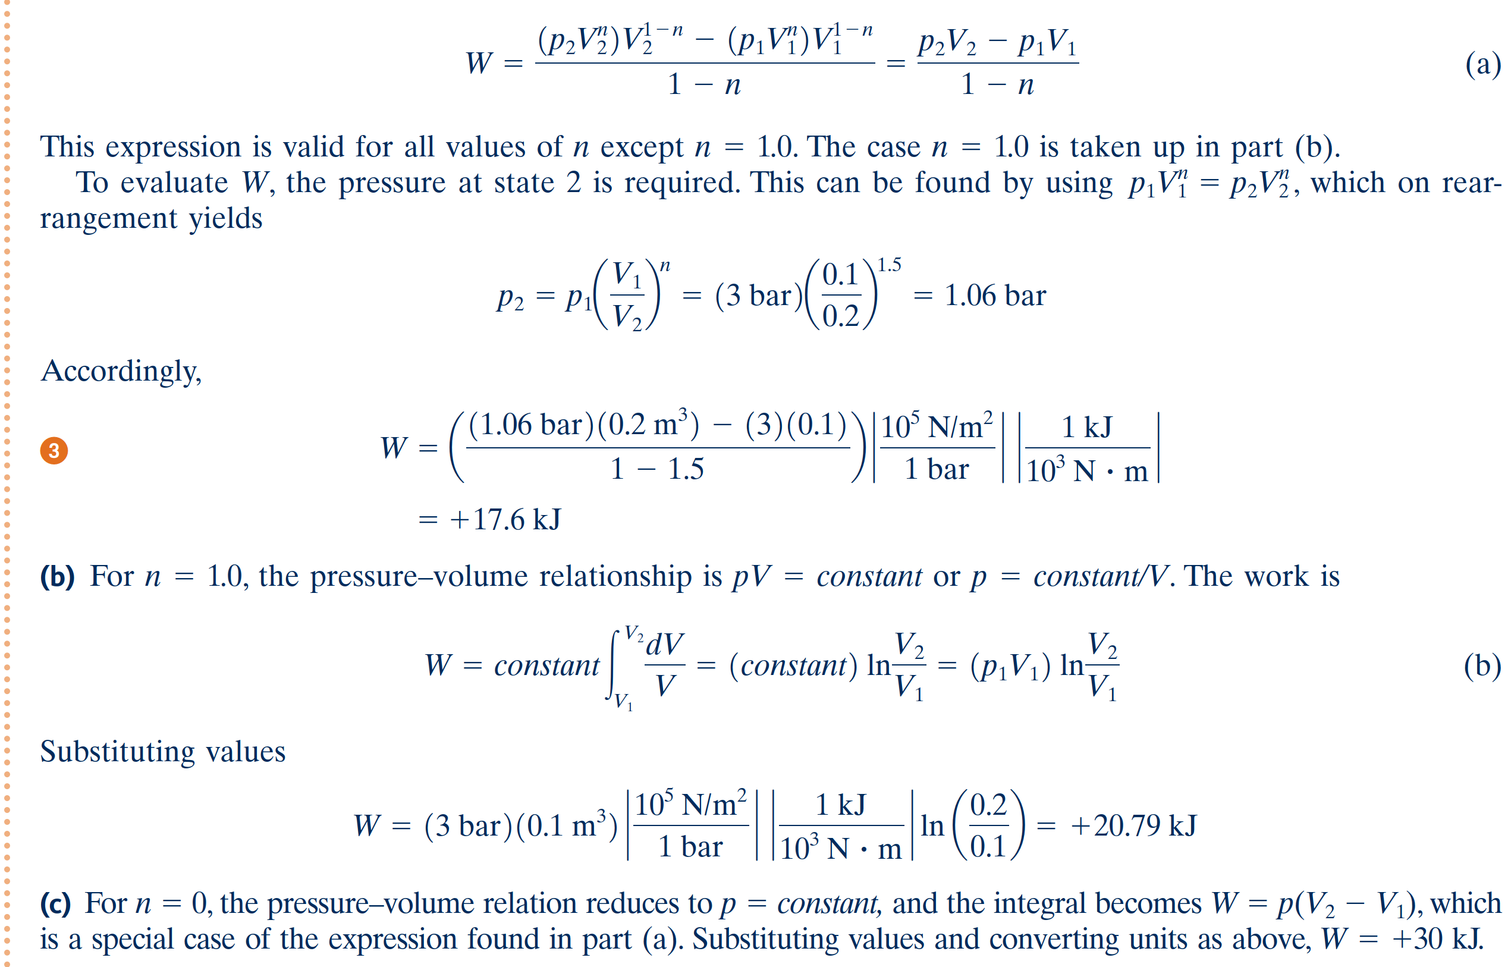
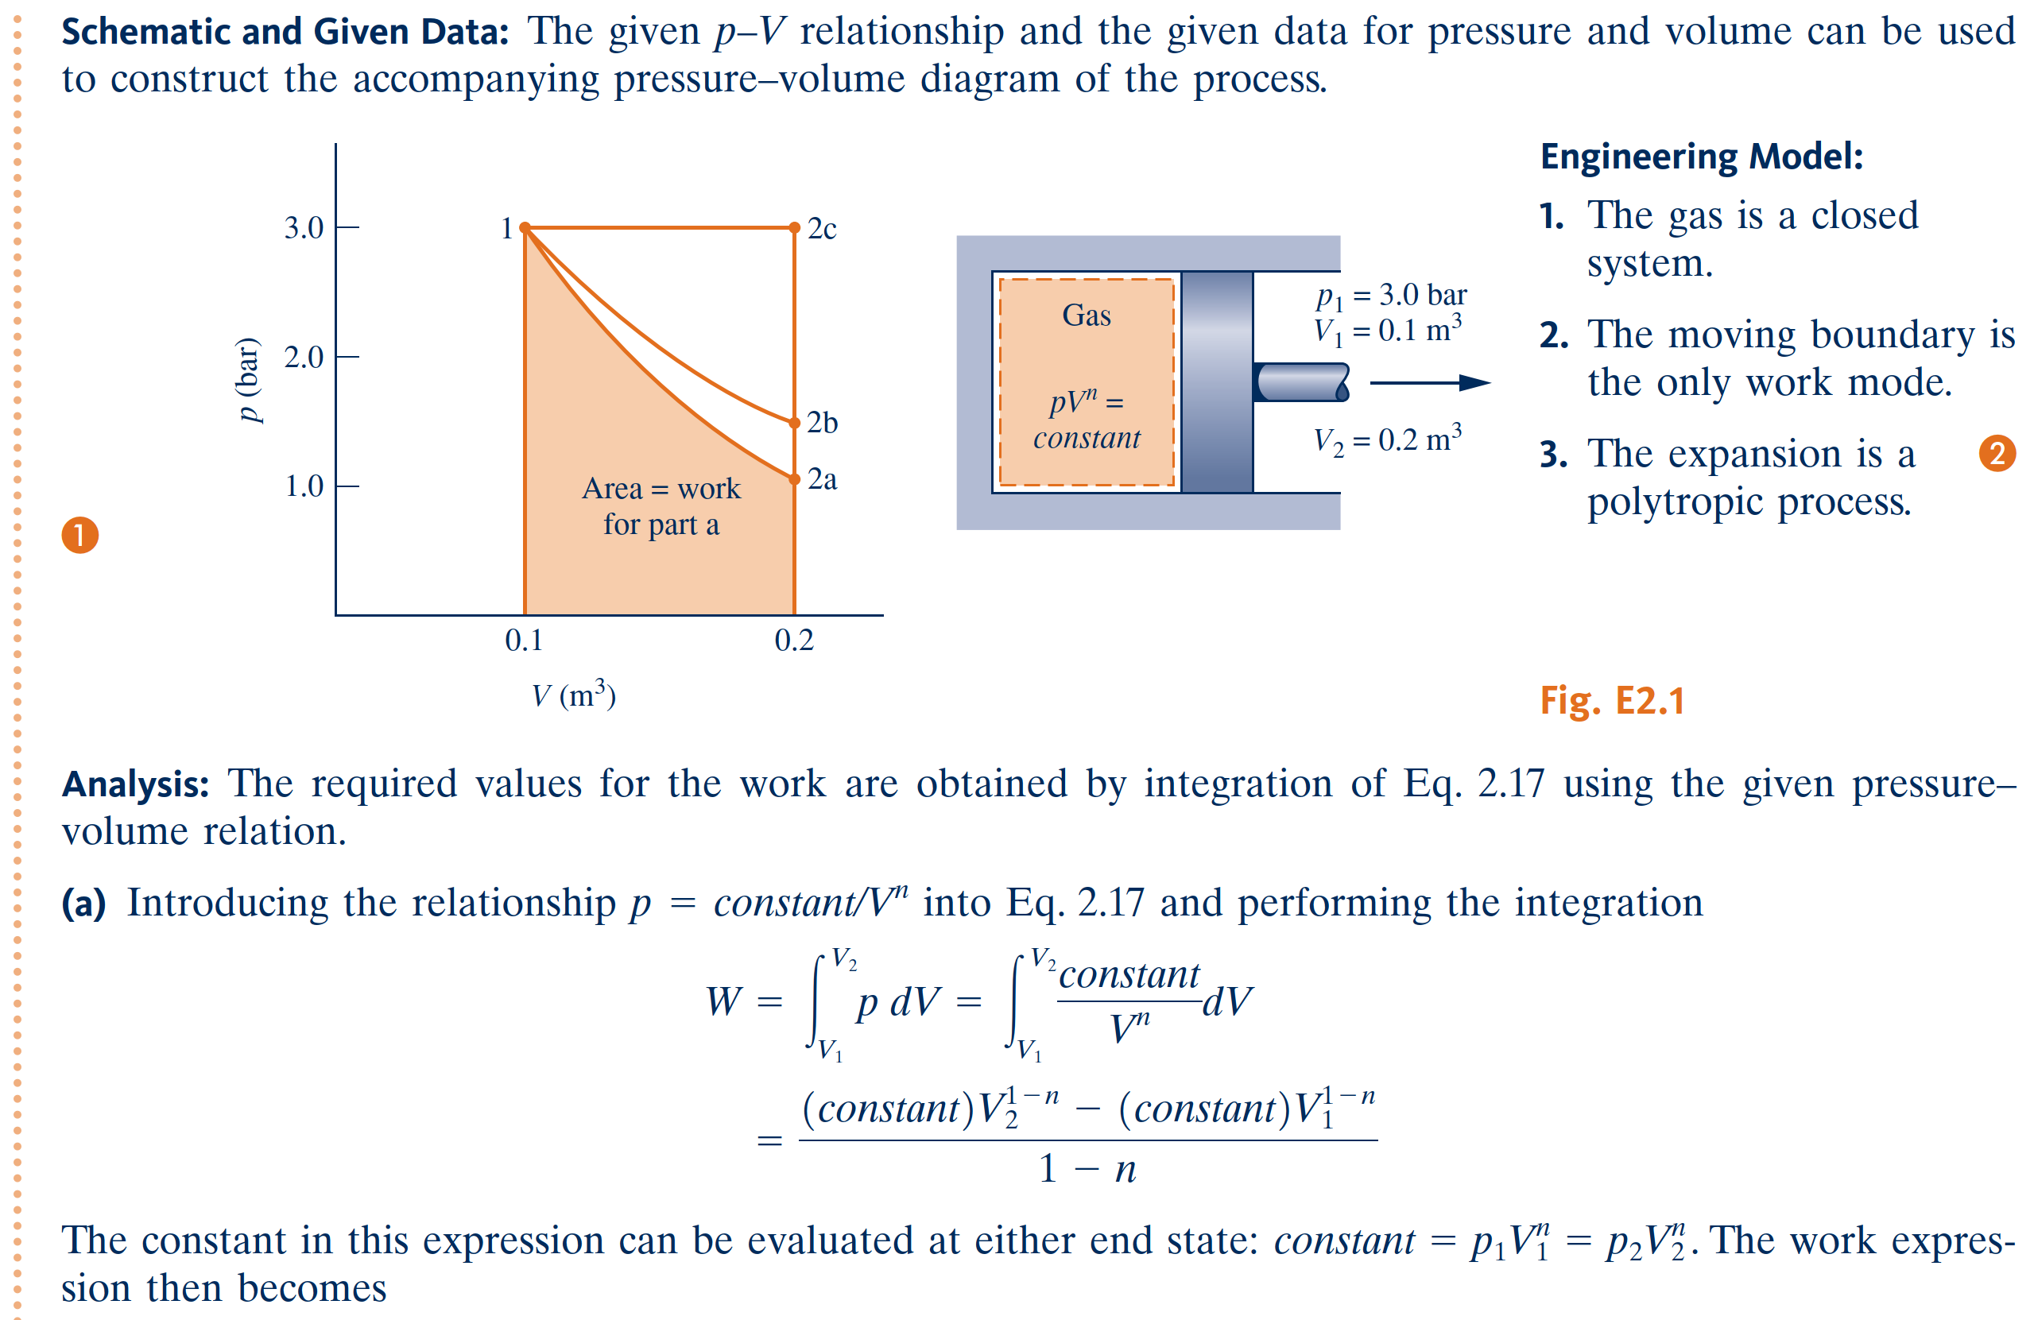
Review concepts of temperature, temperature scales, pressure, and absolute and gage pressure.

Slide 14
Energy Transfer by Heat

Slide 15
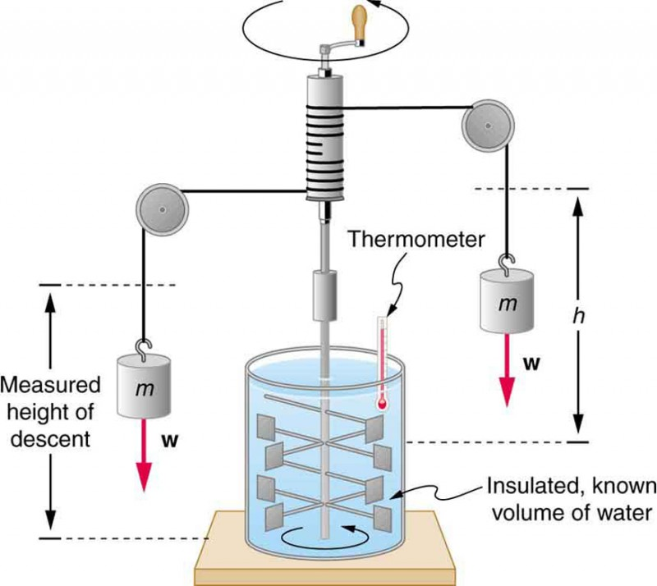
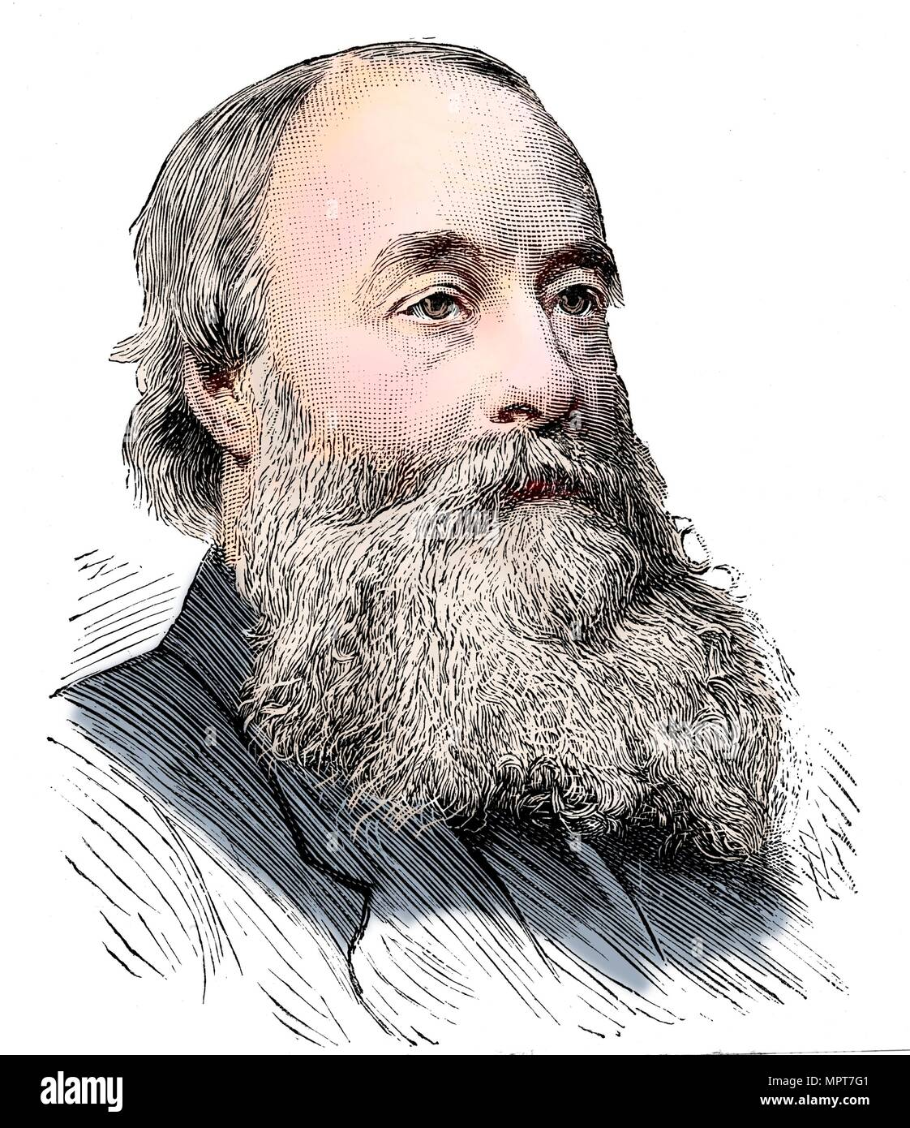
Energy Transfer by Heat
On the basis of experiment, beginning with the work of Joule in the early part of the 19th century, we know that energy transfers by heat are induced only as a result of a temperature difference between the system and its surroundings and occur only in the direction of decreasing temperature.
Schematic depiction of Joule’s experiment that established the equivalence of heat and work.
https://courses.lumenlearning.com/suny-physics/chapter/14-1-heat/

Slide 16
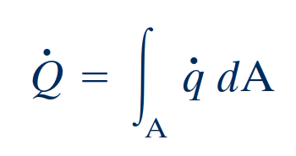
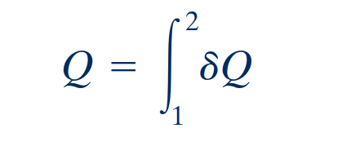
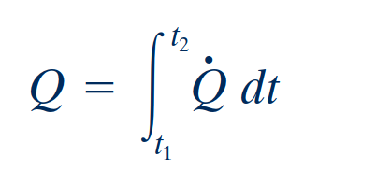
Sign Convention, Notation, and Heat Transfer Rate
Sign convention for heat transfer
The value of a heat transfer depends on the details of a process and not just the end states. Thus, like work, heat is not a property, and its differential is written as $δQ$. The amount of energy transfer by heat for a process is given by the integral
The symbol $Q$ denotes an amount of energy transferred across the boundary of a system in a heat interaction with the system’s surroundings. Heat transfer into a system is taken to be positive, and heat transfer from a system is taken as negative.
Rate of heat transfer
Q > 0: heat transfer to the system Q < 0: heat transfer from the system
the amount of energy transfer by heat during a period of time can be found by integrating from time t₁ to time t₂. In some cases, it is convenient to use the heat flux, q, which is the heat transfer rate per unit of system surface area.
Heat is not a property

Slide 17
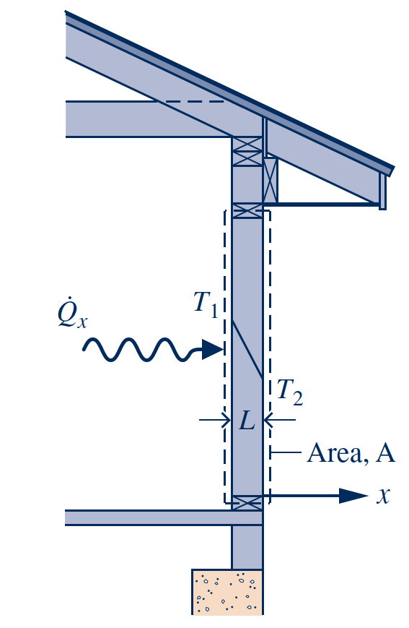
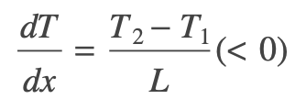
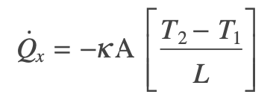
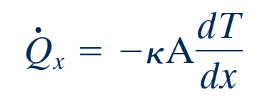
Heat Transfer Modes
Methods based on experiment are available for evaluating energy transfer by heat. These methods recognize two basic transfer mechanisms: conduction and thermal radiation.
where the proportionality constant k is a property called the thermal conductivity. The minus sign is a consequence of energy transfer in the direction of decreasing temperature.
Conduction
Energy transfer by conduction can take place in solids, liquids, and gases. Conduction can be thought of as the transfer of energy from the more energetic particles of a substance to adjacent particles that are less energetic due to interactions between particles.
Fourier’s law
The time rate of energy transfer by conduction is quantified macroscopically by Fourier’s law.
Illustration of Fourier’s conduction law.

Slide 18
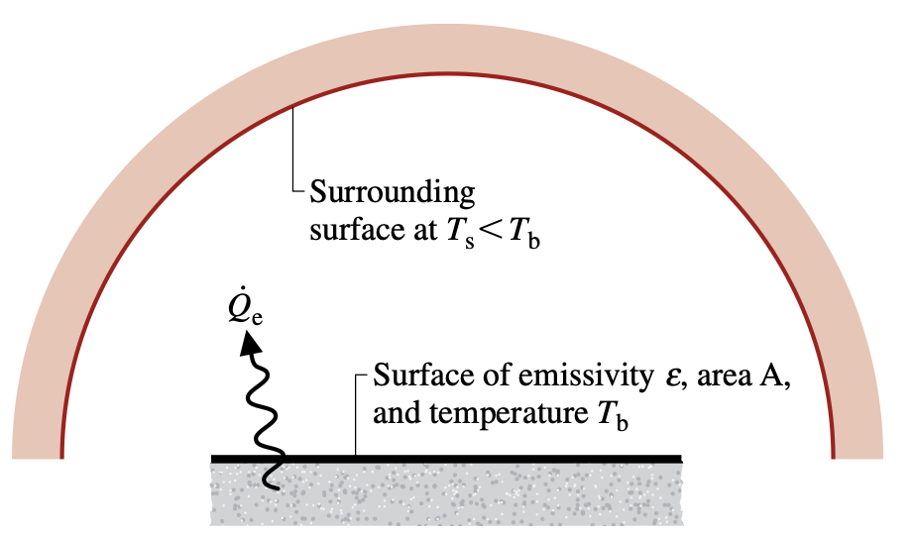
Heat Transfer Modes
Radiation
Stefan–Boltzmann law
Thermal radiation is emitted by matter as a result of changes in the electronic configurations of the atoms or molecules within it. The energy is transported by electromagnetic waves (or photons). Unlike conduction, thermal radiation requires no intervening medium to propagate and can even take place in a vacuum. Solid surfaces, gases, and liquids all emit, absorb, and transmit thermal radiation to varying degrees.
The rate at which energy is emitted, ${\dot{Q}}_{e}$, from a surface of area $A$ is quantified macroscopically by a modified form of the Stefan–Boltzmann law
which shows that thermal radiation is associated with the fourth power of the absolute temperature of the surface, T_{b}. The emissivity, ε, is a property of the surface that indicates how effectively the surface radiates 10 e 1.02 , and is the Stefan–Boltzmann constant:
Net rate of radiant exchange
Net radiation exchange.
The net rate of radiant exchange between the smaller surface, whose area is A and emissivity is ${\dot{Q}}_{e}$, and the larger surroundings is

Slide 19
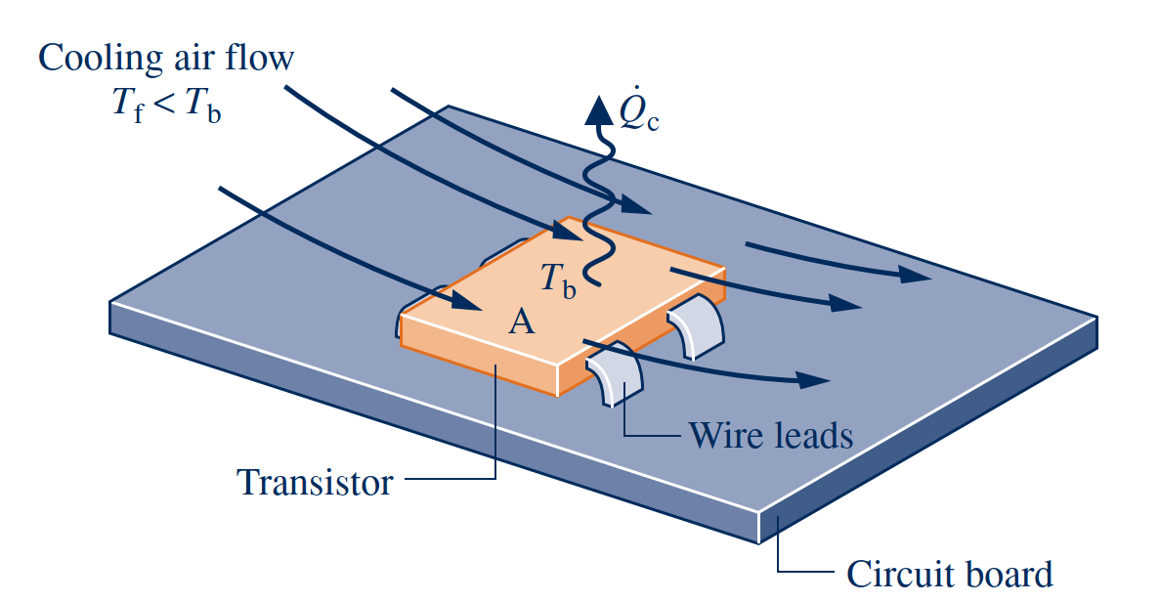
Heat Transfer Modes
Convection
Newton’s law of cooling
Energy transfer between a solid surface at a temperature $T_{b}$ and an adjacent gas or liquid at another temperature $T_{f}$ plays a prominent role in the performance of many devices of practical interest. This is commonly referred to as convection.
In this case, energy is transferred in the direction indicated by the arrow due to the combined effects of conduction within the air and the bulk motion of the air.
Where, a is the surface area and the proportionality factor h is called the heat transfer coefficient. The heat transfer coefficient is not a thermodynamic property. It is an empirical parameter that incorporates into the heat transfer relationship the nature of the flow pattern near the surface, the fluid properties, and the geometry.
Illustration of Newton’s law of cooling

Slide 20
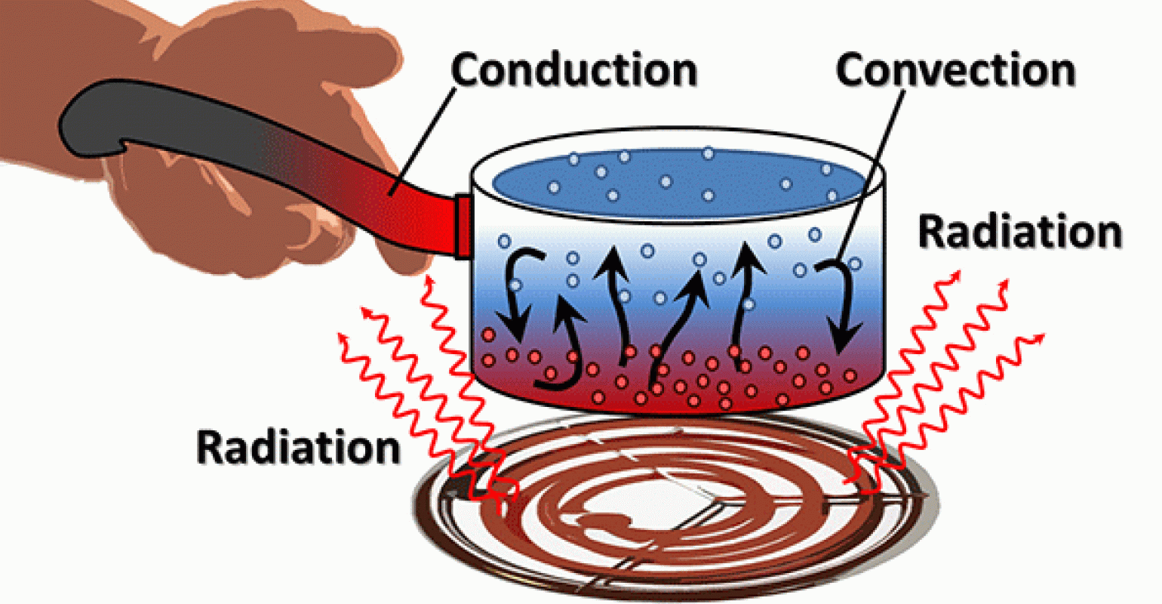
Summary of the Heat Transfer Mechanism
Heat can be transferred in three different ways: conduction, convection, and radiation.
Radiation is the energy emitted by matter in the form of electromagnetic waves (or photons) as a result of the changes in the electronic configurations of the atoms or molecules, which knows as Stefan-Boltzmann law.
Conduction is the transfer of energy from the more energetic particles of a substance to the adjacent less energetic ones as a result of interactions between the particles, which is known as Fourier’s law of heat conduction.
Convection is the mode of energy transfer between a solid surface and the adjacent liquid or gas that is in motion, and it involves the combined effects of conduction and fluid motion, which known as Newton’s law of cooling.

Slide 21
First Law of Thermodynamics

Slide 22
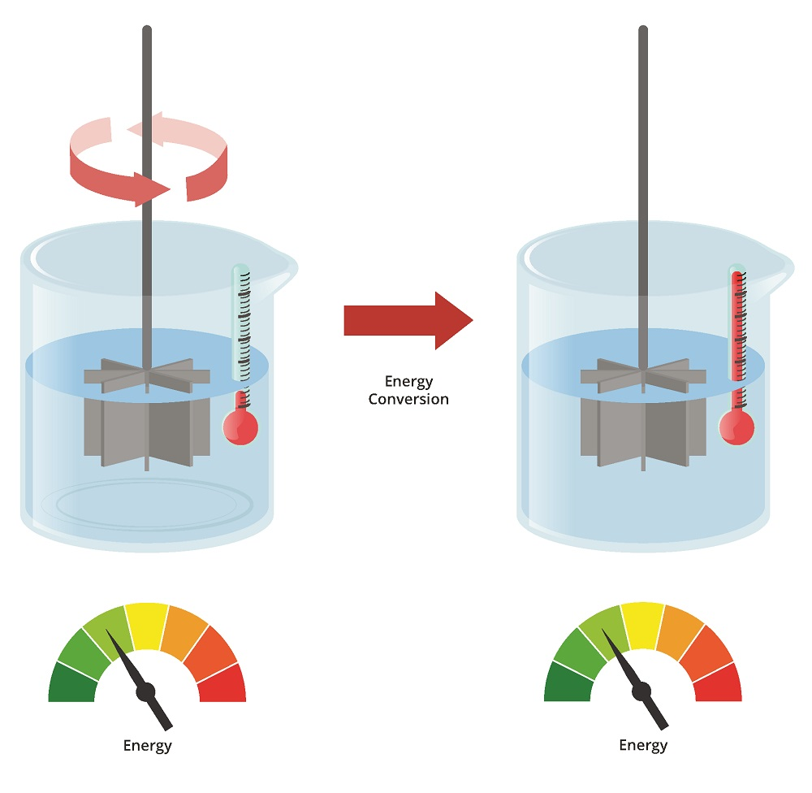
First Law of Thermodynamics
The first law of thermodynamics, also known as the conservation of energy principle, provides a sound basis for studying the relationships among the various forms of energy and energy interactions.
Based on experimental observations, the first law of thermodynamics states that energy can be neither created nor destroyed during a process; it can only change forms. Therefore, every bit of energy should be accounted for during a process.

Slide 23
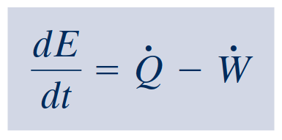
First Law of Thermodynamics
Energy Balance
Since the time rate of change of energy is given by
energy balance in differential form
or
time rate form of the energy balance

Slide 24
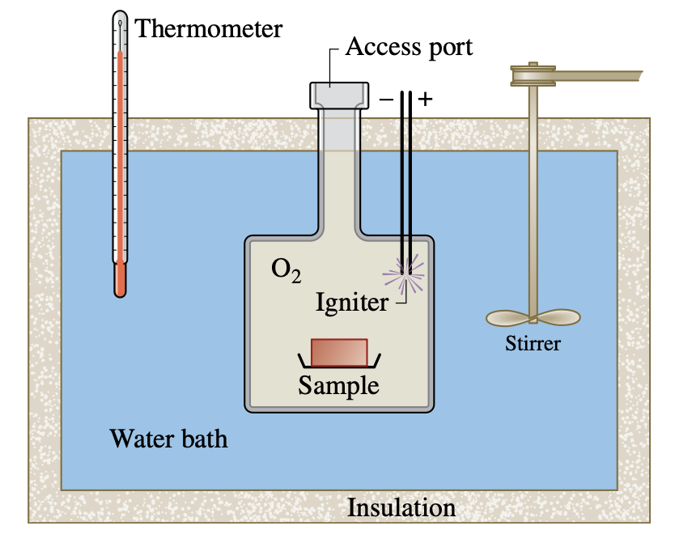
BioConnections
The energy required by animals to sustain life is derived from ox- idation of ingested food. We often speak of food being burned in the body. This is an appropriate expression because experiments show that when food is burned with oxygen, approximately the same energy is released as when the food is oxidized in the body. Such an experimental device is the well-insulated, constant- volume calorimeter shown in
Constant-volume calorimeter.

Slide 25
First Law of Thermodynamics

Slide 26
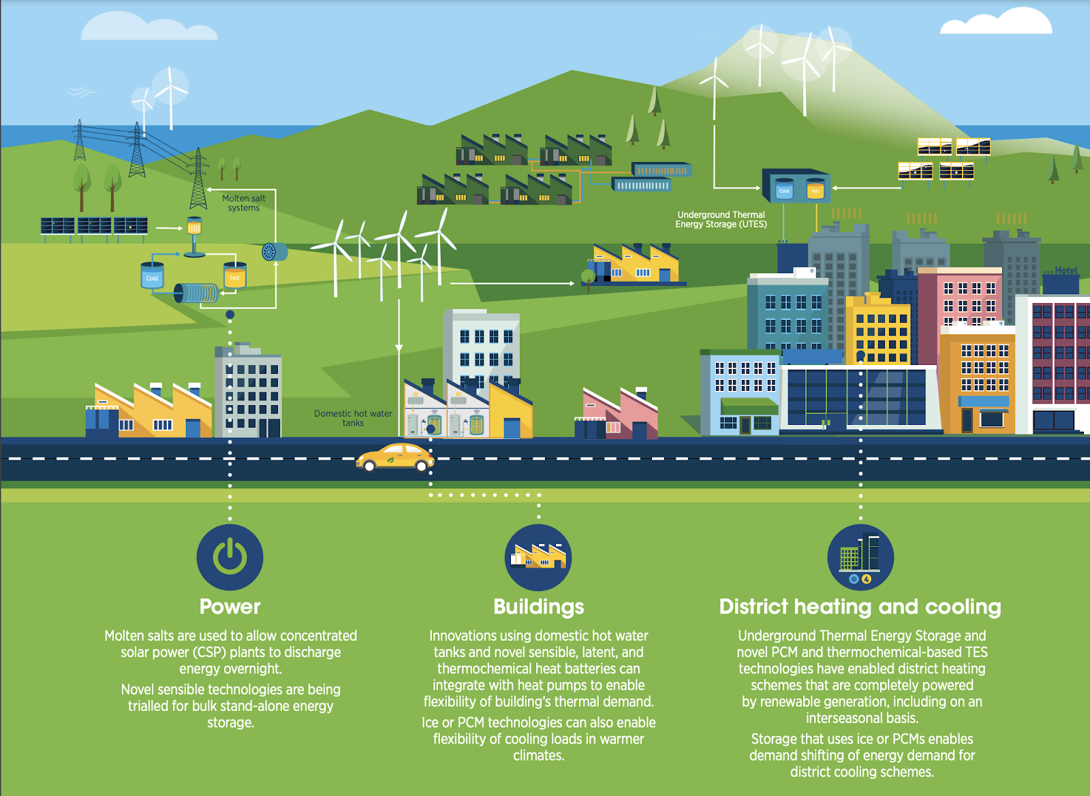
Renewable Energy Technologies
Renewables, including solar, wind, hydropower, biofuels and others, are at the centre of the transition to less carbon-intensive and more sustainable energy systems.
Generation capacity has grown rapidly in recent years, driven by policy support and sharp cost reductions for solar photovoltaics and wind power in particular.

Slide 27
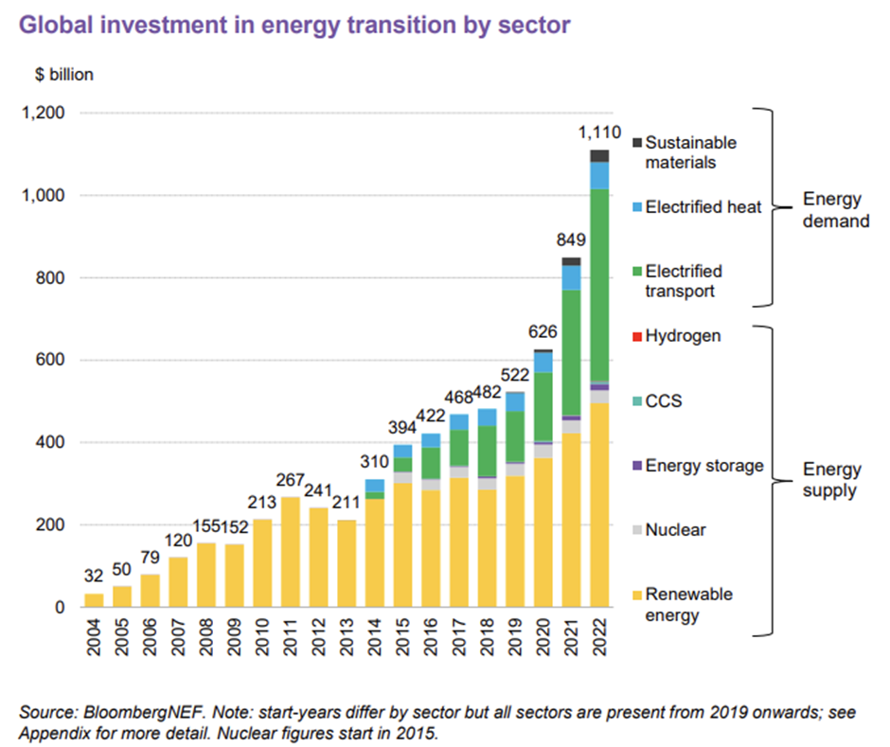
Renewable Energy Technologies
What is the role of renewables in clean energy transitions?
The deployment of renewables in the power, heat and transport sectors is one of the main enablers of keeping the rise in average global temperatures below 1.5°C.
In the Net Zero Emissions by 2050 scenario, renewables allow electricity generation to be almost completely decarbonised.
Meanwhile, renewable transport fuels and renewable heat contribute to significant emissions reductions in transport, buildings and industry.
https://medium.com/the-new-climate/energy-transition-investment-hits-1-trillion-matching-fossil-fuels-for-first-time-bf175b91a40a

Slide 28
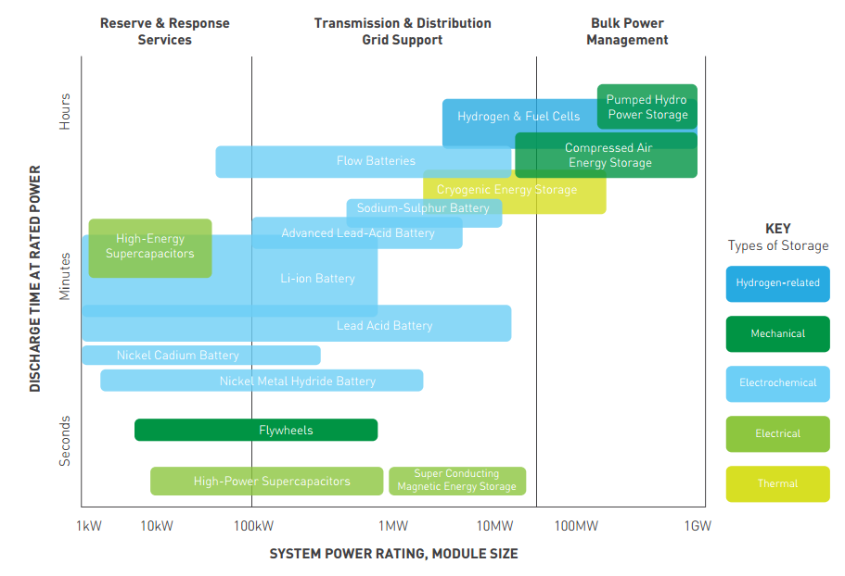
Energy Storage
The need is widespread, including use with conventional fossil- and nuclear-fueled power plants, power plants using renewable sources like solar and wind, and countless applications in transportation, industry, business, and the home.
Electricity can be stored as internal energy, kinetic energy, and gravitational potential energy and converted back to electricity when needed.
Owing to thermodynamic limitations associated with such conversions, the effects of friction and electrical resistance for instance, an overall input-to-output loss of electricity is always observed
Among technically feasible storage options, economics usually determines if, when, and how storage is implemented.
https://www.esru.strath.ac.uk/EandE/Web_sites/14-15/Industrial_autonomy/2_1_technology_options.html

Slide 29
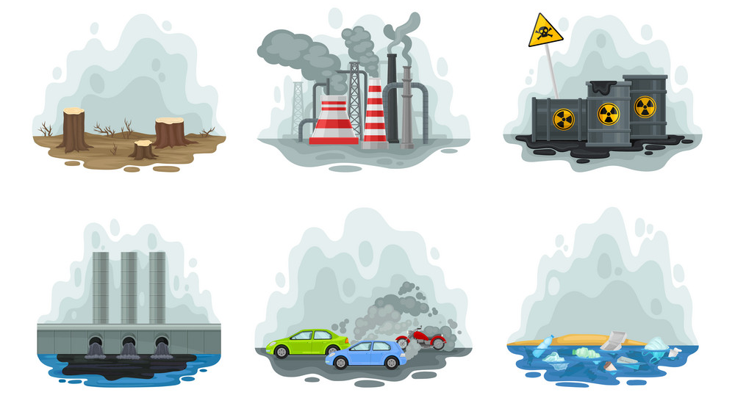
Energy & Environment
The conversion of energy from one form to another often affects the environment and the air we breathe in many ways, and thus the study of energy is not complete without considering its impact on the environment
The largest source of air pollution is the motor vehicles, and the pollutants released by the vehicles are usually grouped as hydrocarbons (HC), nitrogen oxides (NOx), and carbon monoxide (CO)
Ozone and Smog
Acid Rain
The Greenhouse Effect:
Global Warming and Climate Change

Slide 30
Energy & Environment

Slide 31
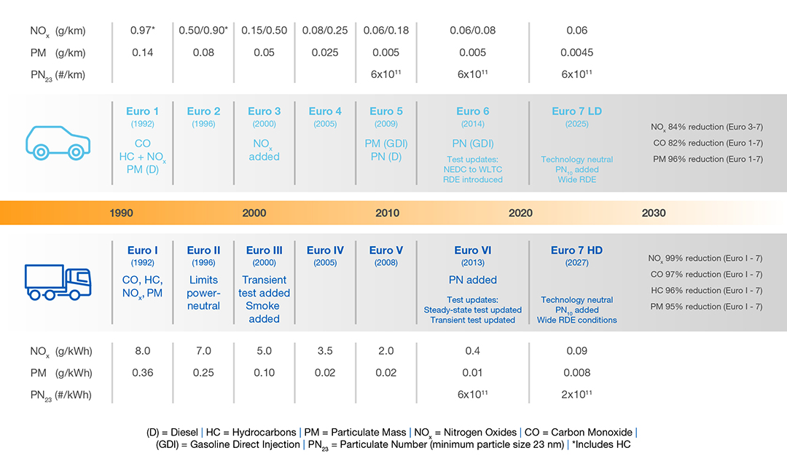
Energy & Environment

