Slide 1
Thermodynamics and Heat Transfer
Lecture 0: Before the Lecture
Qiang Cheng (Jonny)

Slide 2
Course Instruction
Student Workload:
Learning activity | Workload (hours) | Remarks
Activated lectures | 10*2=20
Additional reading materials | 4 | Preparing for the lectures.
Learning Exercises | 10+5
Learning Exercises deliverables | 5 | 10 hours learning exercises and 5 consultation sessions (3 for thermodynamics and 2 for heat transfer).
Project work (contact teaching) | 12 | Includes advisor consultation sessions + presentations.
Project work | 24 | Student group work
Self-studying and reflection | 50
In total | 130 | 5 cr (26 each)

Slide 3
Course Instruction
Grade assessment: the grade for this course will be based on the amount of achieved points. You can achieve a maximum of 100 points and the points will be distributed as follows:
Period IV
1. Presence in lectures: There are 12 lectures scheduled. No points for presence but highly recommended.
2. Learning exercise: There are 6 learning exercises scheduled which are compulsory to attend; five for Thermodynamics and one for Heat Transfer. You will have one week after each exercise to submit a solution via MyCourses, the six submissions will contribute 50% to your grade. An additional consultation session with the instructors is scheduled in the same week the specific learning exercise is given.
Period V
Each student will need to join a group of 3-5 members and learn how to use thermodynamics and heat transfer principles to solve the practical problems. More instructions on the project tasks will be shared before the end of period IV. The project work grade accounts for 50% of the grade.
Textbook
1. Thermodynamics: an engineering approach (9th Edition) / Yunus A. Çengel.
2. Introduction to Thermodynamics and Heat Transfer, 2nd Edition, Çengel.
3. Fundamentals of Engineering Thermodynamics (8th Edition), Michael J. Moran, Howard N. Shapiro, Daisie D. Boettner, Margaret B. Bailey

Slide 4
Schedule
COE-C2007 - Thermodynamics and Heat Transfer, (5 cr) |  |  |  |  | January, 2024
2024 | Periods III and IV |  |  |  | Version 1.0
Calender
Week | Date |  | Time | Event |  | Topic | Instructor | Note | Student Deliverables
2 | 9.1.2023 | Tue | 12-14 | Lecture | R9 - 309, Rakentajanaukio 4 | Lecture 1: Getting Started | Qiang Cheng
 | 10.1.2023 | Wed
 | 11.1.2023 | Thu | 12-14 | Lecture | R9 - 309, Rakentajanaukio 4 | Lecture 2: The First Law of Thermodynamics | Qiang Cheng
 | 12.1.2023 | Fri | 10-12 | Exercise (LE1) | 150 - 150, Konetekniikka 1 | Learning Exercise 1 | Qiang Cheng
3 | 15.1.2023 | Mon
 | 16.1.2023 | Tue | 12-14 | Lecture | R9 - 309, Rakentajanaukio 4 | Lecture 3: Evaluating Properties and Control Volume analysis Using energy | Qiang Cheng
 | 17.1.2023 | Wed
 | 18.1.2023 | Thu | 12-14 | Lecture | R9 - 309, Rakentajanaukio 4 | Lecture 4: The Second Law of Thermodynamics | Qiang Cheng
 | 19.1.2023 | Fri | 10-12 | Exercise (LE2) | 150 - 150, Konetekniikka 1 | Learning Exercise 2 | Qiang Cheng |  | LE1 deadline 14:00
4 | 22.1.2023 | Mon
 | 23.1.2023 | Tue | 12-14 | Lecture | R9 - 309, Rakentajanaukio 4 | Lecture 5: Energy Systems | Qiang Cheng
 | 24.1.2023 | Wed
 | 25.1.2023 | Thu | 12-14 | Lecture | R9 - 309, Rakentajanaukio 4 | Lecture 6: Reacting Mixtures and Combustion | Qiang Cheng
 | 26.1.2023 | Fri | 10-12 | Exercise (LE3) | 150 - 150, Konetekniikka 1 | Learning Exercise 3 | Qiang Cheng |  | LE2 deadline 14:00
5 | 29.1.2023 | Mon
 | 30.1.2023 | Tue | 12-14 | Lecture | R9 - 309, Rakentajanaukio 4 | Lecture 7: Basics of Heat Transfer | Qiang Cheng
 | 31.1.2023 | Wed
 | 1.2.2023 | Thu | 12-14 | Lecture | R9 - 309, Rakentajanaukio 4 | Lecture 8: Heat Conduction | Qiang Cheng
 | 2.2.2023 | Fri | 10-12 | Exercise (LE4) | 150 - 150, Konetekniikka 1 | Learning Exercise 4 | Qiang Cheng |  | LE3 deadline 14:00
6 | 5.2.2023 | Mon
 | 6.2.2023 | Tue | 12-14 | Lecture | R9 - 309, Rakentajanaukio 4 | Lecture 9: Fundamentals of Heat Convection | Qiang Cheng
 | 7.2.2023 | Wed
 | 8.2.2023 | Thu | 12-14 | Lecture | R9 - 309, Rakentajanaukio 4 | Lecture 10: Fundamentals of Heat Radiation | Qiang Cheng
 | 9.2.2023 | Fri | 10-12 | Exercise (LE5) | 150 - 150, Konetekniikka 1 | Learning Exercise 5 | Qiang Cheng |  | LE4 deadline 14:00
7 | 12.2.2023 | Mon
 | 13.2.2023 | Tue
 | 14.2.2023 | Wed
 | 15.2.2023 | Thu
 | 16.2.2023 | Fri |  |  |  |  |  |  | LE5 deadline 14:00
 | 17.2.2023 | Sat

Slide 5
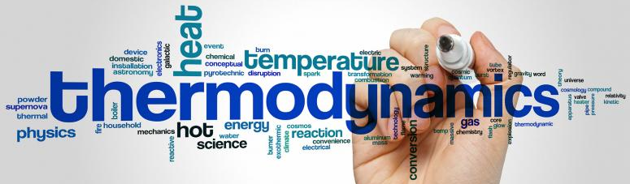
Background
Thermodynamics is a branch of physics that deals with heat, work, and temperature, and their relation to energy, radiation, and physical properties of matter.
The behavior of these quantities is governed by the four laws of thermodynamics which convey a quantitative description using measurable macroscopic physical quantities but may be explained in terms of microscopic constituents by statistical mechanics.
Thermodynamics applies to a wide variety of topics in science and engineering, especially physical chemistry, chemical engineering and mechanical engineering, but also in other complex fields such as meteorology, biology and phylosophy.
https://online.stanford.edu/courses/matsci204-thermodynamics-and-phase-equilibria
Notes:
Heat is energy can be converted from one form to another, or transferred from one object to another. For example, a stove burner converts electrical energy to heat and conducts that energy through the pot to the water. This increases the kinetic energy of the water molecules, causing them to move faster and faster. At a certain temperature (the boiling point), the atoms have gained enough energy to break free of the molecular bonds of the liquid and escape as vapor.

Slide 6
Objective
To cover the basic principles of thermodynamics and heat transfer.
To present a wealth of real-world engineering examples to give students a feel for how thermodynamics and heat transfer is applied in engineering practice.
To develop an intuitive understanding of thermodynamics and heat transfer by emphasizing the physics and physical arguments that underpin the theory.
To present a comprehensive and rigorous treatment of classical thermodynamics while retaining an engineering perspective.
To lay the groundwork for subsequent studies in such fields as fluid mechanics, heat transfer and to prepare the students to effectively use thermodynamics in the practice of engineering.
To gain a better understanding of our life and achieve a higher quality of lift!!!

Slide 7
Philosophy and Goals
In this course you will be introduced to properties of matter (Temperature, Pressure, Enthalpy, Specific Volume, Entropy, etc.) and governing laws which can be used to describe the behavior of matter and its interaction with the surrounding environment.
You will learn how to identify systems and to use thermodynamic analysis to describe the behavior of the system in terms of properties and processes.
Understanding how to apply these concepts is a powerful tool for the engineer, enabling the evaluation of material states (phases) under different conditions and the maximum efficiency achievable with various power cycles.
After completing this course, you should be able to define and describe properties and processes used in thermodynamic analysis and the governing laws.
In addition, you should be able to apply control volume analysis and thermodynamic principles to solve problems involving power and refrigeration cycles.
Communicates directly to the minds of tomorrow’s engineers in a simple yet precise manner.
Leads students toward a clear understanding and firm grasp of the basic principles of thermodynamics.
Encourages creative thinking and development of a deeper understanding and intuitive feel for thermodynamics.

Slide 8
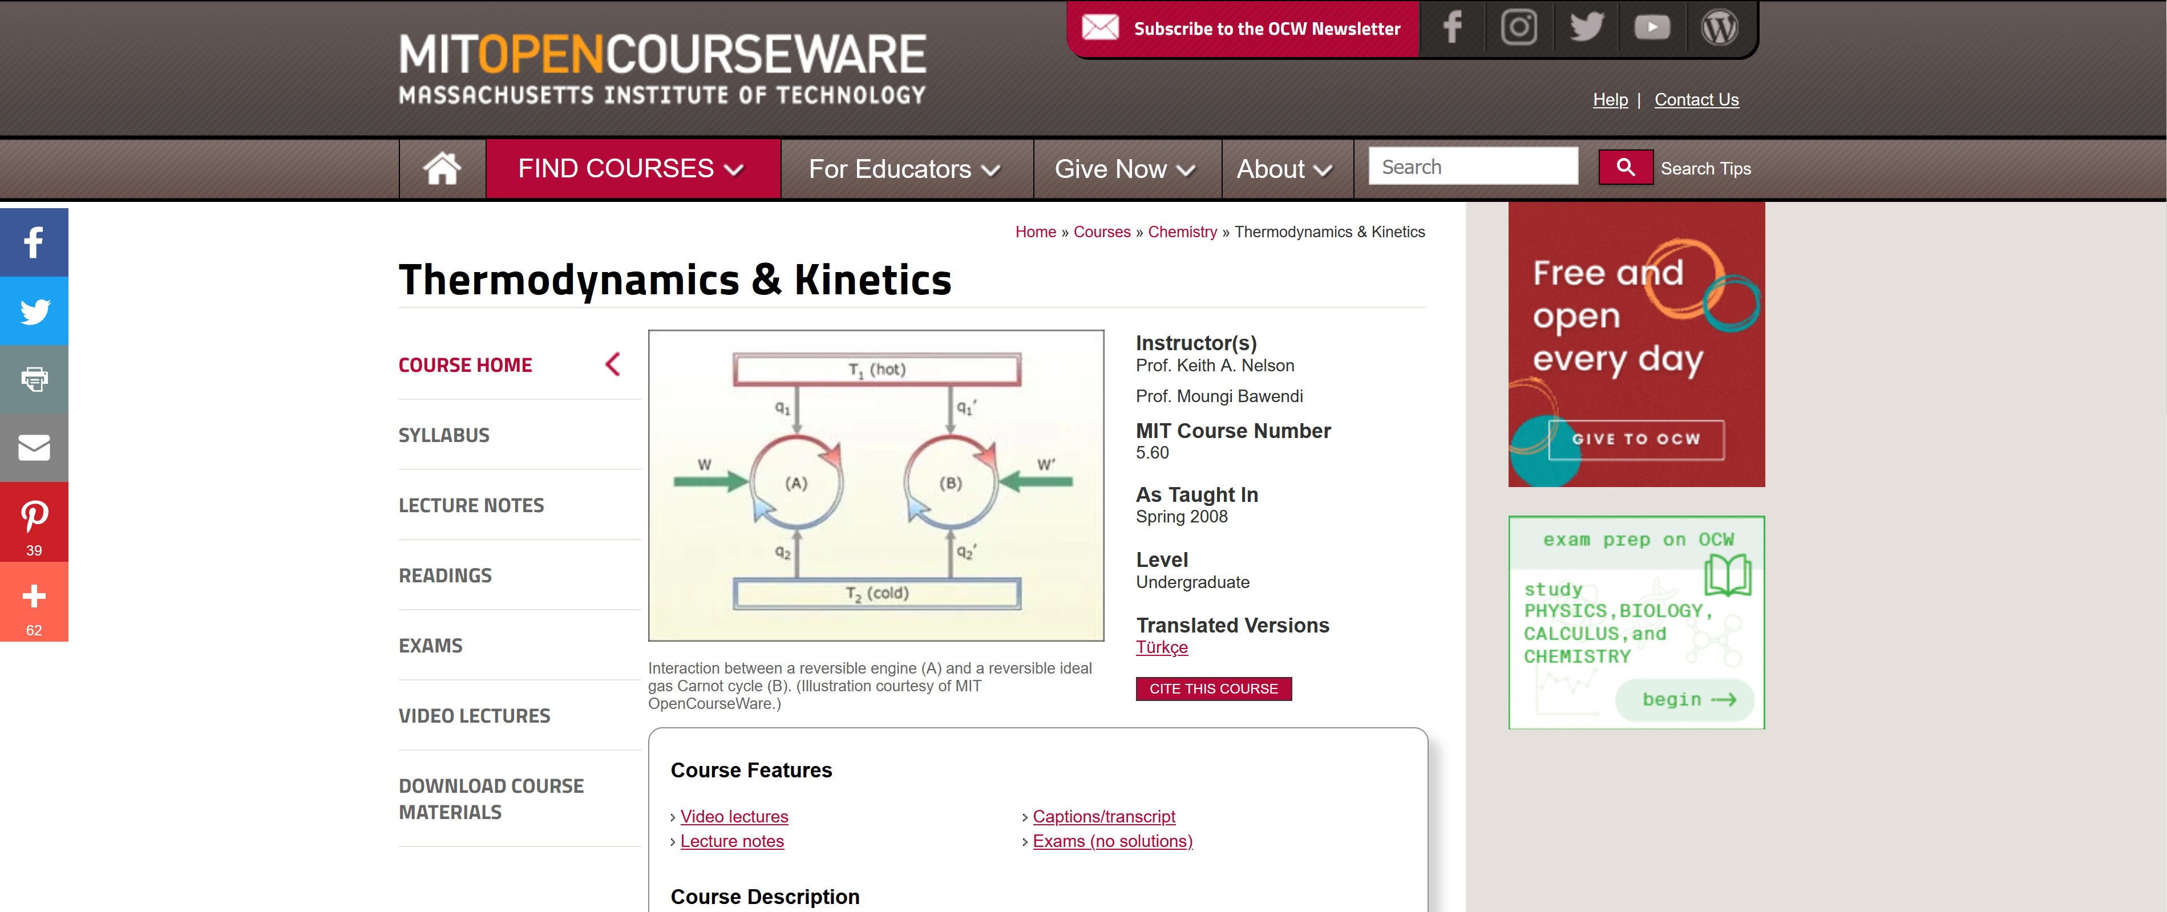
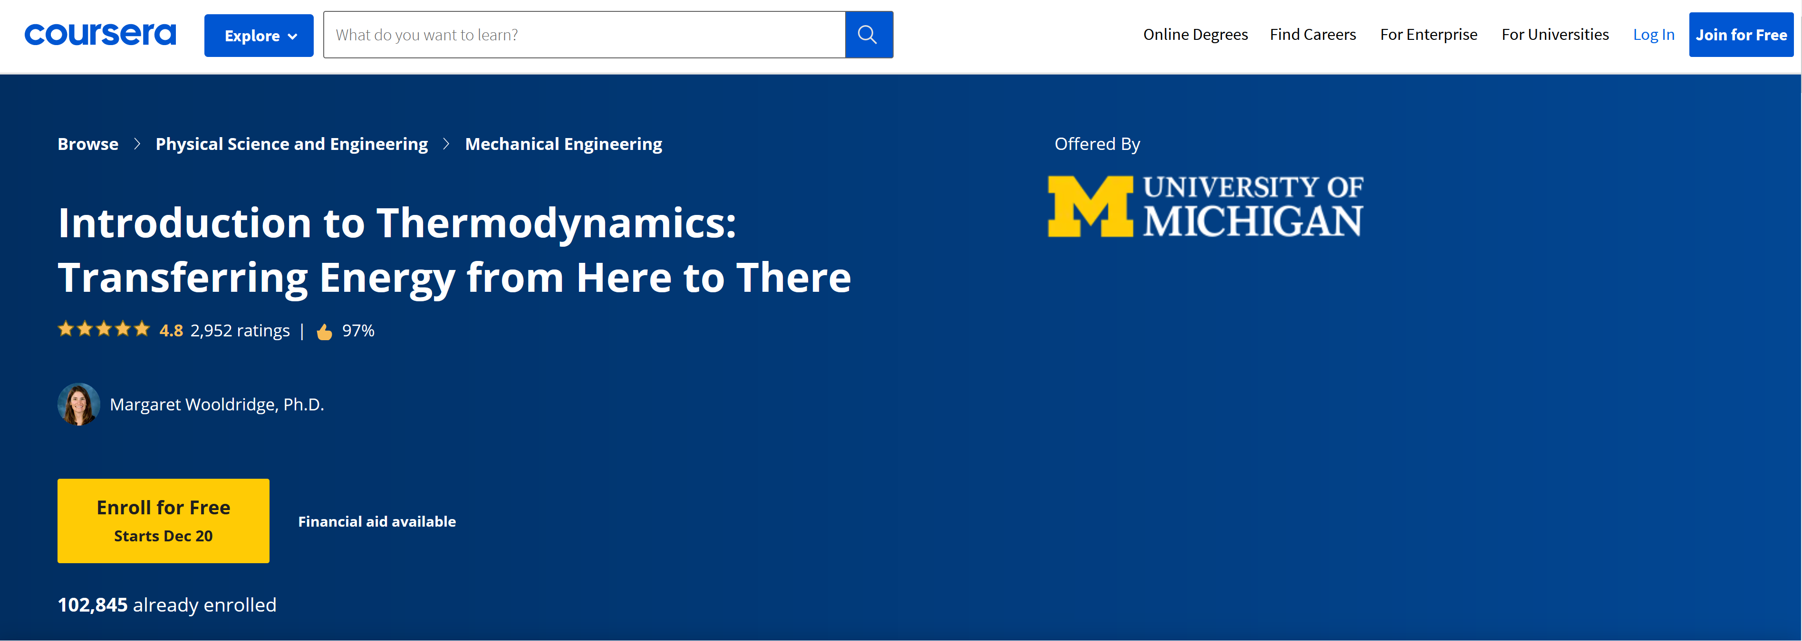
Other Materials and Sources
MITOPENCOURSEWARE:
https://ocw.mit.edu/courses/chemistry/5-60-thermodynamics-kinetics-spring-2008/video-lectures/
NASA
https://www.grc.nasa.gov/www/k-12/airplane/thermo.html
University of Michigan
https://www.coursera.org/learn/thermodynamics-intro

Slide 9
Problem-solving technique
Engineering Software Packages
Step 1: Problem Statement
Step 2: Schematic
Step 3: Assumptions and Approximations
Step 4: Physical Laws
Step 5: Properties
Step 6: Calculations
Step 7: Reasoning, Verification, Conclusion and Discussion

