Slide 1
Lecture
01
Web development recap

Slide 2
div
<
>

Slide 3
<div> < /div>

Slide 4
<div>
<p> hello < /p>
< /div>

Slide 5
<div>
<h1> Title < /h1>
<p> hello < /p>
< /div>

Slide 6
Attribute
<div class="myClass">
<h1> Title < /h1>
<p> hello < /p>
< /div>

Slide 7
.

Slide 8
Make sure that it is understandable
and easy to remember
\>
.myClassName{
height : 100px;
width : 100px;
}

Slide 9
#

Slide 10
#myId{
height : 100px;
width : 100px;
}

Slide 11
Attribute
<div style="width:100px">
<h1> Title < /h1>
<p> hello < /p>
< /div>

Slide 12
SVG

Slide 13
Scalable Vector Graphic

Slide 14
Svg geometry is described by Attributes
<svg>
<circle/ >
< /svg>

Slide 15
<svg>
<circle cx="100" cy="50" r="10"/ >
< /svg>

Slide 16
<svg>
<circle cx="100" cy="50" r="10"/ >
<rect x="100" y="50" width="10" height="10"/ >
< /svg>

Slide 17
Exercise
Meet Smiley

Slide 20
– Mood
Progress
Time (& effort)

Slide 21
Dev Community is not only online

Slide 22
Play with Geometry

Slide 23
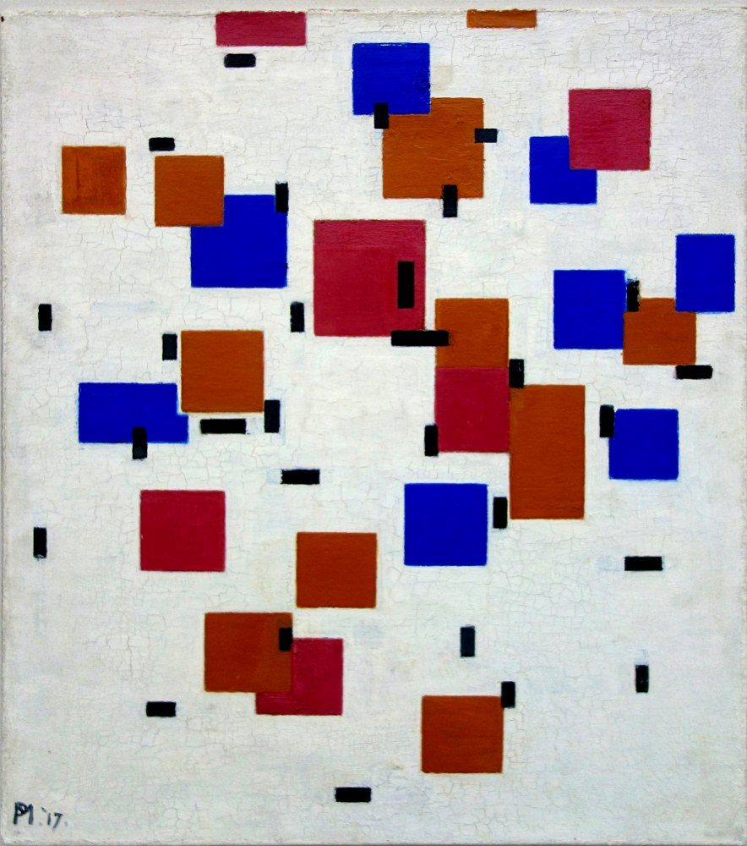
Composition in Color 1917 – Piet Mondrian – Kröller-Müller Museum

Slide 24
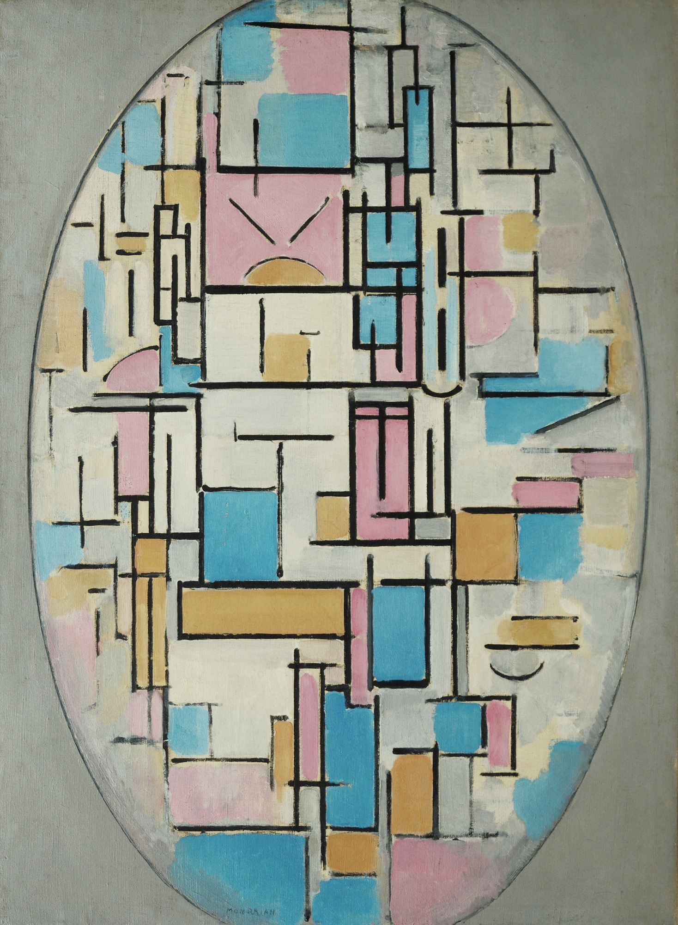
Composition in Oval with Color 1917 – Piet Mondrian – MoMA

Slide 25
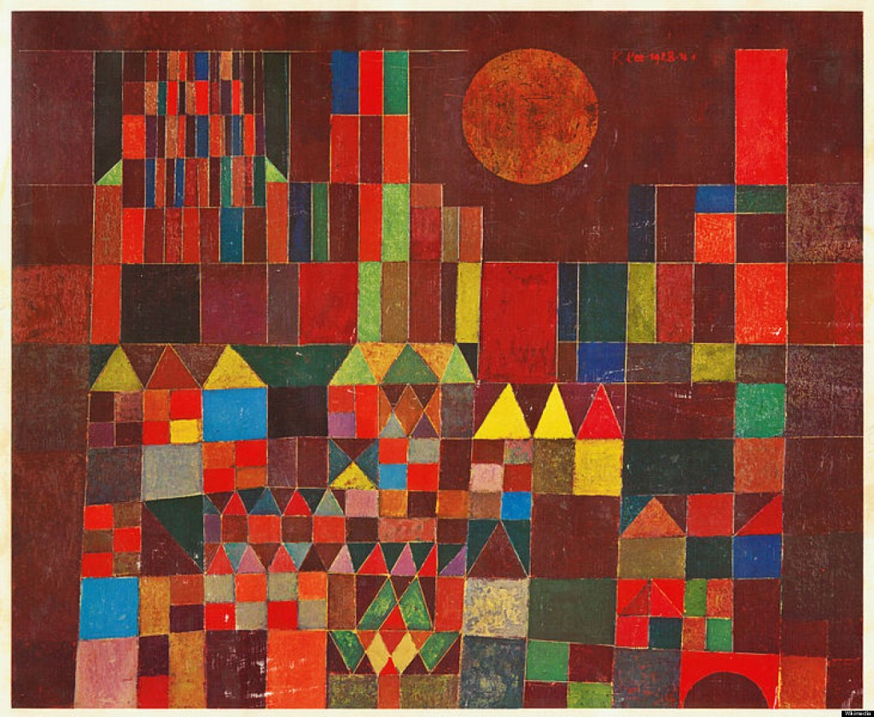
Burg un Sonne 1928 – Paul Klee – Private collection

Slide 26
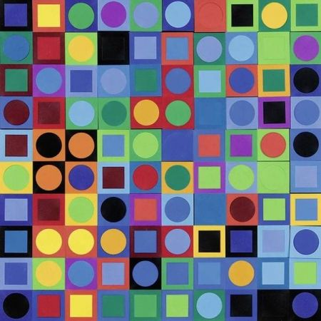
Vasarely Planetary Folklore Participations N° 1 1969 – Viktor Vasarely – Zurich, Editions Pyra.

Slide 27
Poster for Spacìo Arterial 2018 – Figura 4

Slide 28
Super Gradient 2017 serie – Just Patrice

Slide 29
Black Friday banner from Muzli 2019

Slide 30
Sharing my space wallpapers – Geometrieva

Slide 31
Vasarely poster design – Patrick Lindsay

