Slide 1
From project to plan!
^{Zoom | 19.1.2024} Roosa Mikkola, Finnish Maritime Spatial Planning Cooperation https://interreg-baltic.eu/project/balticsea2land/

Slide 2
Contents
Baltic Sea2Land project
Kymenlaakso regional pilot
Regional to national pilot –> input to MSP
Notes:
Lets walk thru the content of the presentation so that you know what is coming. Overall, the presentation title already gave a hint abput the focus, which is to explain the meaning of partcipating in projects and how to adapt the learnings from them in to planning. This presentation focuses only on the Baltic Sea2Land project but the Maritime Spatial Planning group is part of several different international projects and focus is the same – to be able to promote planning matters and implement keyfindings in planning.
So first of all I will explain why the project Baltic Sea2Land was created, then I will explain on a regional scale what we are doing with the help of the project, which is also the part that you students are involved in, and then I will explain how those regional finding will be upscaled to national level planning.

Slide 3
Notes:
Lets start by looking at a map so that we get a picture of the participating reagions.
The partners represent local to transnational scales, as well as academia, NGOs, associations – which will ensure horizontal and vertical integration of SBE development and support target group engagement in solving LSI issues.
These participant represent different planning levels – in Finland we have national authorities such as the Ministry of the Environment involved, then we have the maritime spatial planning group which is responsible for national scale and several regional councils who are involved in regional planning.

Slide 4
Baltic Sea2Land
The complexity of land-sea interactions (LSI) and overlapping jurisdictions of various public authorities calls for multi-level governance (MLG)
MLG balances different interests and drivers in coastal areas in order to achieve European Green Deal (EGD) goals and Sustainable Blue Economy (SBE).
MLG is needed for integrated planning to consider coastal communities, culture, environmental and economic interests
Notes:
Lets jump in to the project content and take a look at what the questions are that the project tries to aswer and what are the mutual challenges that the project partners try to tackle.
The project partners all work with coastal questions. What happens on land effects the sea and vice versa. The complexity of these interactions as well as all several authorities working on the same questions but on different levels requires multi-level governance.

Slide 5
Multi-level governance is a term used to describe the way power is spread vertically between many levels of government and horizontally across multiple quasi-government and non-governmental organizations and actors.

Slide 6
Baltic Sea2Land
The complexity of land-sea interactions (LSI) and overlapping jurisdictions of various public authorities calls for multi-level governance (MLG)
MLG balances different interests and drivers in coastal areas in order to achieve European Green Deal (EGD) goals and Sustainable Blue Economy (SBE).
MLG is needed for integrated planning to consider coastal communities, culture, environmental and economic interests
Notes:
The European Green Deal, approved in 2020, is a set of policy initiatives by the European Commission with the overarching aim of making the European Union (EU) climate neutral in 2050.^{[1][2]} The plan is to review each existing law on its climate merits, and also introduce new legislation on the circular economy, building renovation, biodiversity, farming and innovation.^{[2}
It underlines the need for a holistic and cross-sectoral approach in which all relevant policy areas contribute to the ultimate climate-related goal. The package includes initiatives covering the climate, the environment, energy, transport, industry, agriculture and sustainable finance – all of which are strongly interlinked.
With the help of a mlg approach it is easier to balance different interests so that the EGD goals are achieved

Slide 7
Baltic Sea2Land
The complexity of land-sea interactions (LSI) and overlapping jurisdictions of various public authorities calls for multi-level governance (MLG)
MLG balances different interests and drivers in coastal areas in order to achieve European Green Deal (EGD) goals and Sustainable Blue Economy (SBE)
MLG is needed for integrated planning to consider coastal communities, culture, environmental and economic interests
Notes:
So to be able to conduct integrated planning solutions that consider all relevant actors it is needed to apply a mlg appoach

Slide 8
Why integrated planning?
To balance interests between development and sustainable use of human and natural capital
Ensure co-work of authorities at early planning stage
Notes:
Balance interests to aid viable coastal development and sustainable use of human and natural capital in the Baltic Sea Region (BSR) and
foster integrated governance via multi-dimensional collaborations.
Integrated planning is often obstructed by unbalanced voices of different sectors and stakeholders, some stakeholders might have time and resources and other capaicities to participate in stakeholder prosesses and their voices might sound lauder than voices than the ones from stakeholders who are not capable of partivipating in such great extent.
Overlapping jurisdictions of various authorities, complexity of LSI, inefficientcoordination and non-collaboration.

Slide 9
Conceptual issues of Land-Sea interactions
Ensuring sustainable use of human and natural capital
Need for compromises and productive negotiations to reach energy independence and carbon neutrality
Competition for space and insufficiently integrated governance to balance various interests
Sectorally isolated thinking and lack of cooperation
Insufficient ocean literacy
Notes:
Ensuring sustainable use of human and natural capital to facilitate the EGD through SBE development
Need for compromises and productive negotiations to reach energy independence and carbon neutrality
Competition for space and insufficiently integrated governance to balance various interests.
Sectorally isolated thinking and lack of cooperation, including in stakeholder engagement in planning and tackling pressing strategic issues.
Insufficient ocean literacy – increasing knowledge and skills of public authorities. To be able to plan the ocean you need to understand the ocean.

Slide 10
Governance challenges of sustainable use of marine and terrestrial resources
Incomprehensive data and information management
Evaluating and monitoring the effectiveness of policies and plans
Insufficient training and lifelong learning opportunities
Insufficient collaboration mechanisms to reach stakeholders
Authorities lack professional capacity and digital skills to elaborate well-considered planning documents and afterwards ensure implementation
Notes:
Incomprehensive data and information management, e.g., leading to lack of equal information distribution causing a deficiency in different stakeholder level’s understanding of
other's interests
Evaluating and monitoring the effectiveness of policies and plans,
Insufficient training and lifelong learning opportunities,
Insufficient collaboration mechanisms to reach stakeholders, communities and between governance levels
Authorities lack professional capacity and digital skills to elaborate well-considered planning documents and afterwards ensure implementation.

Slide 11
The problem is…
The specific challenge to address is the current imbalance between human and natural capital in the near shore zone and the lack of integrated governance due to limited collaboration between different governance levels and SBE interests.
Notes:
The conditions above signal that the specific challenge to address in this project is the current imbalance between human and natural capital in the near shore zone and the lack of integrated governance due to limited collaboration between different governance levels and SBE interests.

Slide 12
Mutual responsibilities call for joint action
Integrated MLG as a potential solution to solve challenges
Notes:
Countries in the BSR have similar sets of challenges and face similar difficulties in balancing various sectoral and nature conservation interests to meet the objectives of EGD and EU Strategy for the Baltic Sea Region (EUSBSR).
Countries within the BSR have different governance systems, yet they are collectively responsible for the state and upkeep of the Baltic Sea. To find the right path for addressing challenges, engagement of stakeholders (target groups) from all governance levels is crucial.
This challenge of imbalance between human and natural capital in the near shore zone persists in all partner states in different situations and contexts. The partners see integrated MLG as a potential solution for future improvement.

Slide 13
Multi-Level-Governance in a nutshell
The MLG tool aims to enable, ease and encourage the implementation of multi-level governance in marine and coastal planning.
The tool is most suited for use by planners and policymakers in national, regional and local governance. However, NGOs and activists may also find useful ideas and tasks.
It is designed to walk experts through the steps of planning governance action through interactive tasks, prompting questions, links to informative and interactive resources in the Knowledge Hub collection and the Data Hub.

Slide 14
Multi-Level-Governance in a nutshell
More info in march!

Slide 15
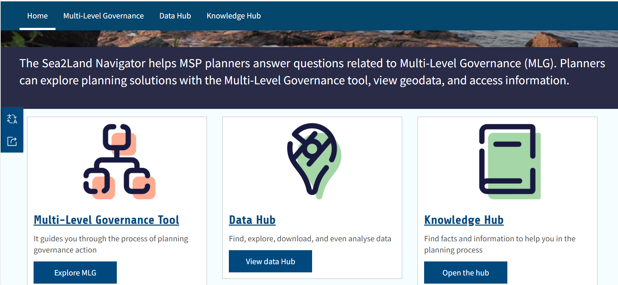
Navigator

Slide 16
Lets put this problem on a map!

Slide 17
Lets put this problem on a map!
But first a reminder of the context!

Slide 18
Notes:
I talked earlier about the Baltic Sea2Land project and what questions and challenges the project tries to adress. I also meantioned solutions which is tries to create that help reaching international goals such as the EGD and sustainable blue economy.
Lets now get back to Finland and look at the Multi-level-governance challenges on a regional scale when trying to promote The Coastal Zone Strategy. Elisa will tell you more about the Coastal Zone sgtrategy after lunch.
The main focus of the participation in the Baltic Sea2land project has been to promote the recently updated Finnish Coastal Zone Strategy and thru which we aim to improve multi-level-governance within maritime spatial planning.
So lets get back to the map. We will now have a look at our regional level question within the pilot.

Slide 19
Notes:
The regional plan 2040 of Kymenlaakso was approved 15.6.2020. That means that the plan has been legally binding since over three years.

Slide 20
Blue-green infrastructure
marking from stakeholder perspective
Actions already promoted in the area?
How could they be further promoted?
Are there areas of the designation that are problematic/challenging to implement?
Are there any gaps/needs for improvement?
Notes:
The regional council is now interrested to know….

Slide 21
Stakeholder questionnaire

Slide 24
Stakeholder workshop results

Slide 25
Preliminary workshop results – stakeholder assessment
Questions regarding migratory fish should be promoted
Promoting the marking to forest management associations
Combining nature and recreation in a single marking can be challenging
Promotion of the marking to private landowners

Slide 27
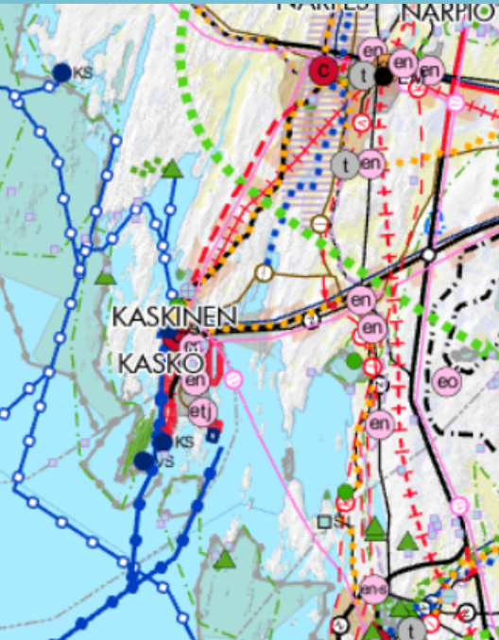
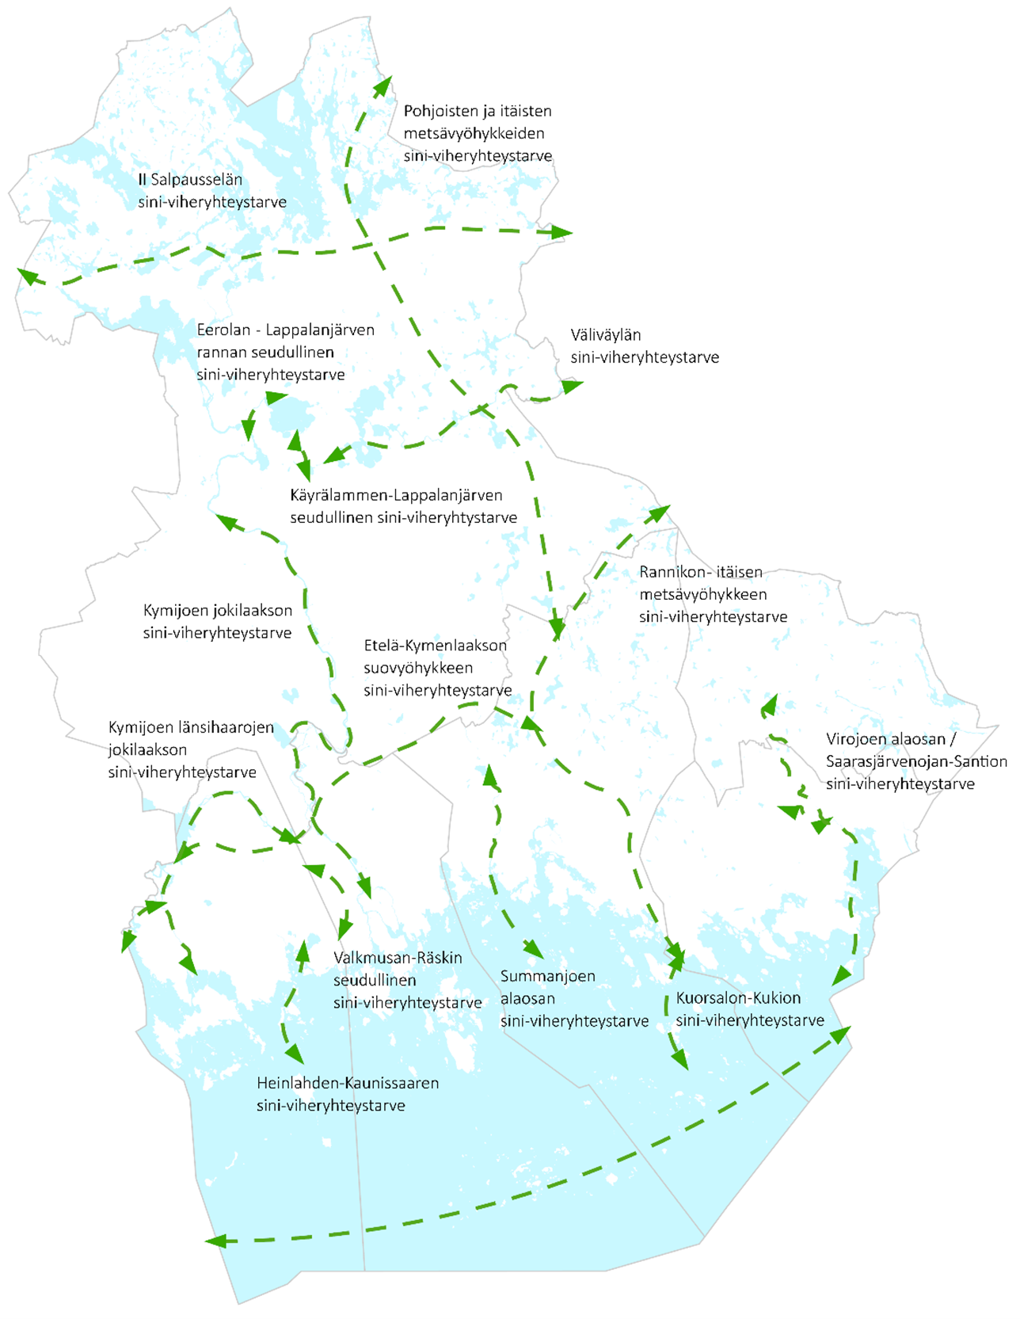
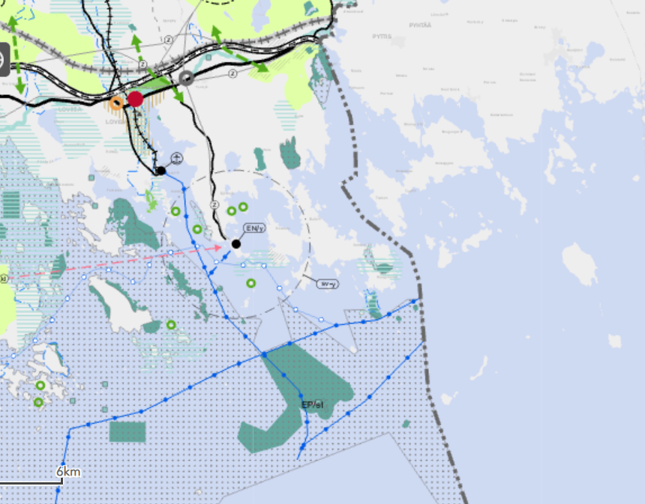
From regional scale to national scale!
What can we learn from regional experiences?

Slide 28
From regional to pilot scale!
What can we learn from regional experiences?
- Communication!
Notes:
Clear communication is a key element! We need to make it clear for ourselves who are our keystakeholders within maritime spatial planning, especially focusing on the blue-green infrastructure. After identifying our stakeholders we need to figure out how we will communicate about the marking so that it is clear. If the marking is only meant to be used by planners it might be clear but as soon as other stakeholders get involved they might get confused and read the marking in a diferent way that is meant. This also means that we need to communicate very clearly about what the marking cards are and how they should be used.

Slide 29
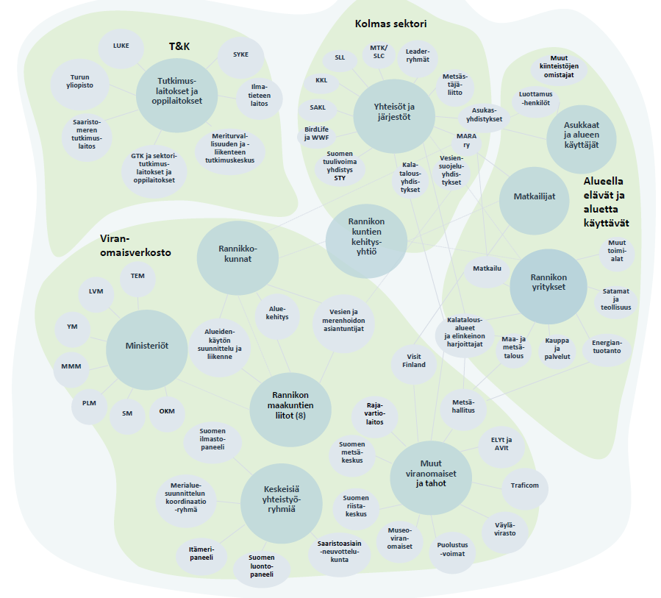
Do we know our stakeholders?
Notes:
A key element within communication is also to identify the right stakeholders and start the communication at the right time and find the right ways of engaging them.
Here you can se a picture from the Coastal Zone Strategy which tries to indicate which players are involved in lsi and should be reconsidered to involve

Slide 30
From regional to pilot scale!
What can we learn from regional experiences?
Communication!
Marking functionality on large scale?
Notes:
The maritime spatial plan

Slide 31
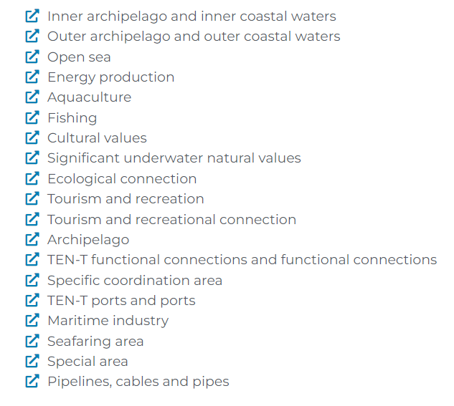
Maritime Spatial Plan Markings

Slide 33
From regional to pilot scale!
What can we learn from regional experiences?
Upscaling best practices

Slide 34
Contact & follow us:
interreg-baltic.eu/project/BalticSea2Land
Twitter: @BalticSea2Land
#BalticSea2Land

