Slide 1
Transportation research group
Janne Laitila
18.1.2024

Slide 2
The research group
3 professors, 5 PhD students + research assistants
Founded in 2019
Co-operation with the Ministry of Transport and Communications , Alma Media and the city of Helsinki

Slide 3
Data
Individual and firm level registry data
Statistics Finland, FOLK modules (1987-2021)
Basic demographics, income, co-habitation, employment
Trafi, Car registration database (2013-2021)
Car models, age, km readings, CO2 emissions
Nettiauto, car listings (2007-2023)
Date sold, last asking price, (km readings)

Slide 4
Recent projects
Helsinki project
How much would CO₂ emissions decrease by 2030, if gasoline cars were prohibited by 2035?
Fuel Shock
How have fuel prices affected the relative prices of cars in different consumption groups?
Car stock valuation
Changes in stock value and introduction of new technologies
The effect of fuel prices on income distribution

Slide 5
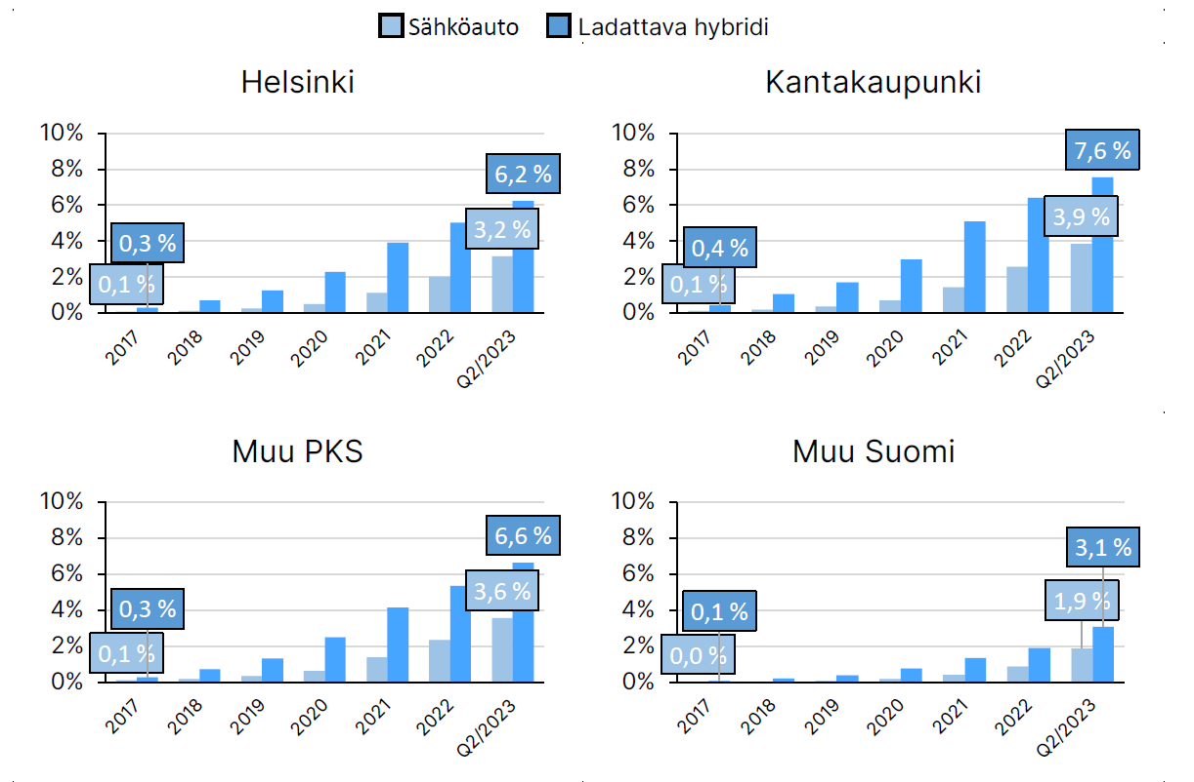
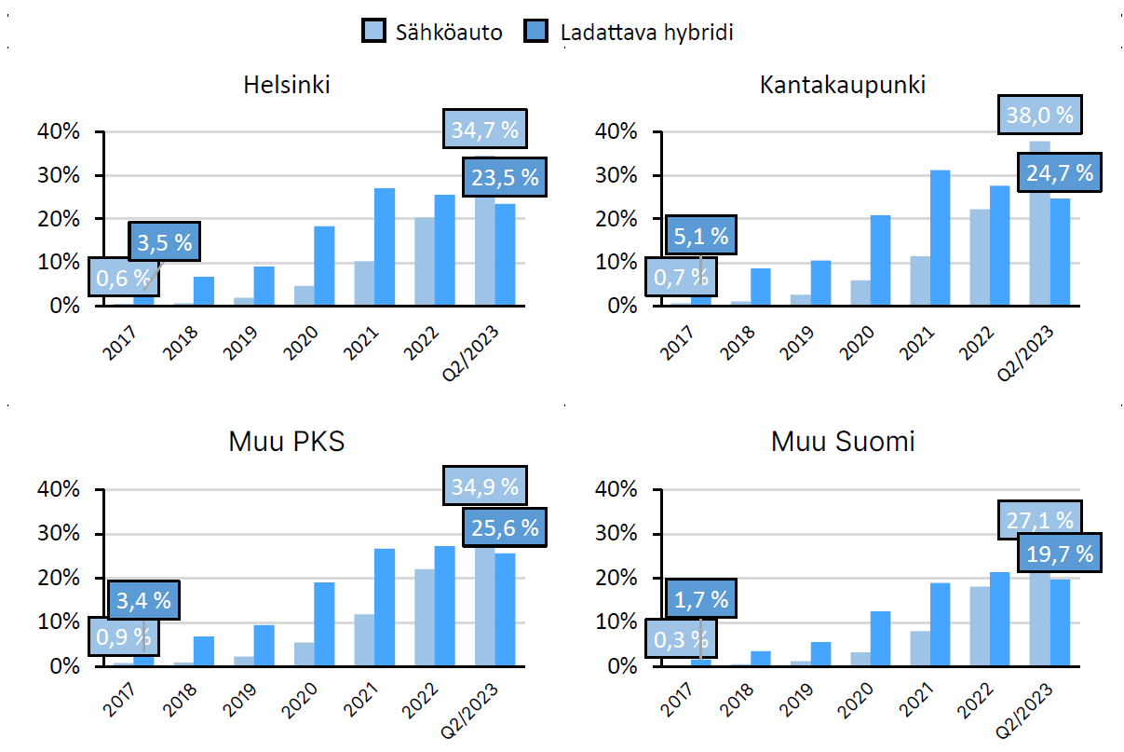
Results from Helsinki project
Share of electric cars out of all cars
Share of electric cars out of all first registrations

Slide 6
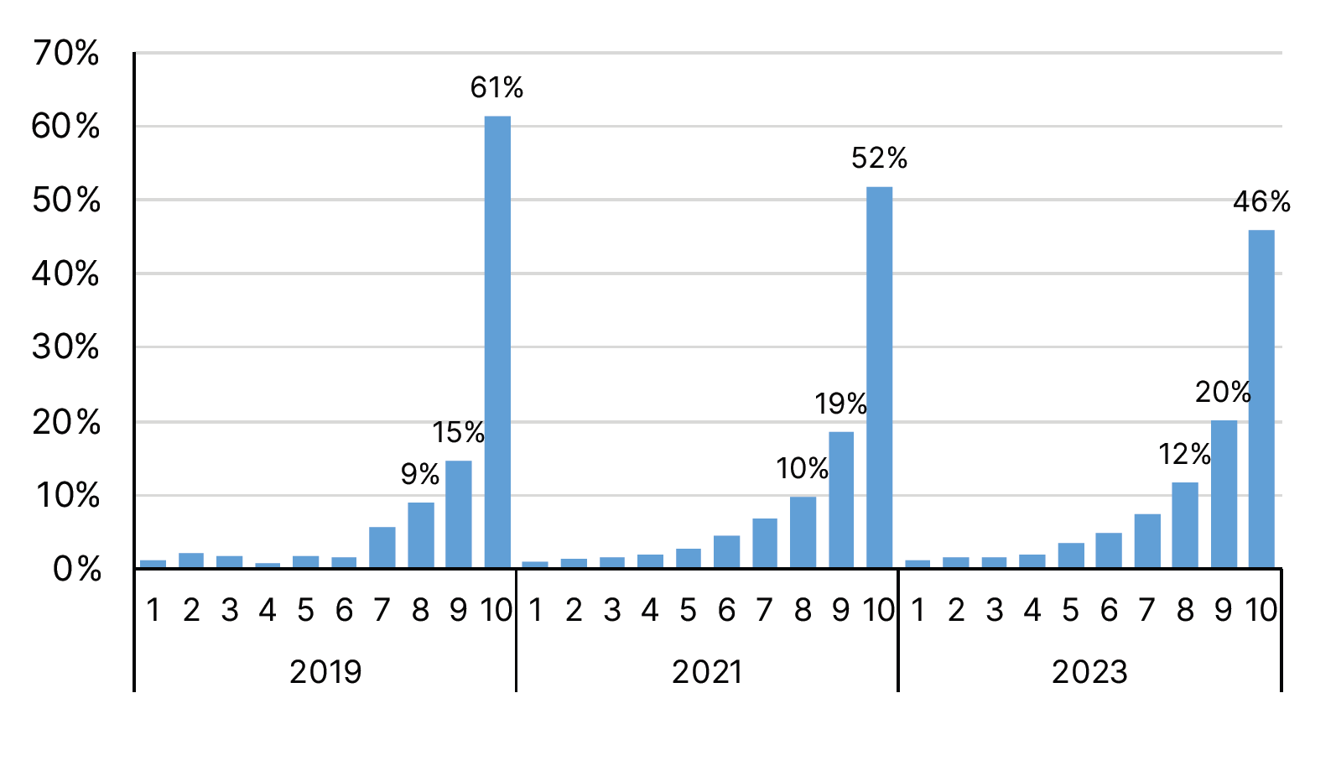
The distribution of electric cars between income deciles

Slide 7
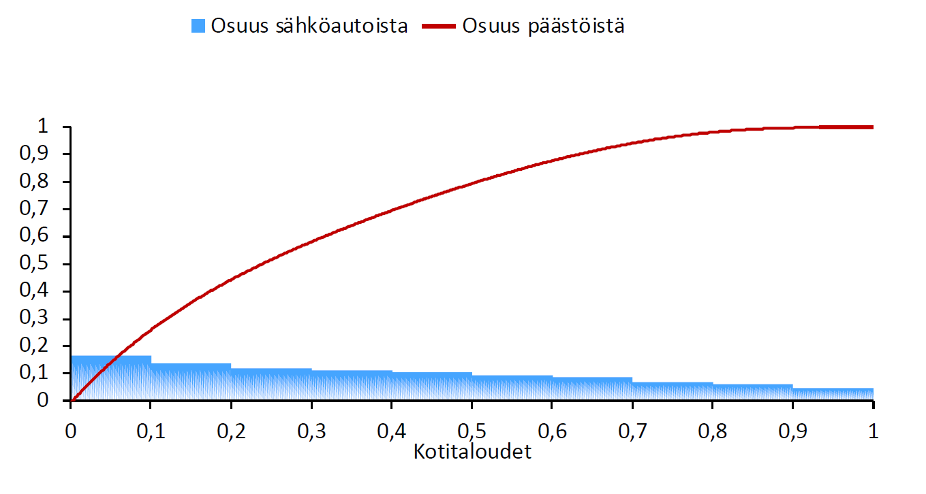
Distribution of EVs to households based on their CO₂ emissions from driving

Slide 8
Using data in Fiona
Data is accessed through a remote connection to Statistics Finland servers
A common drive where raw data is stored + everyone has their personal folders where code and other work files can be stored
Available statistical software: Stata, R
All exported results are checked by Statistics Finland before they are delivered
The data available in Fiona is used in large array of empirical research in economics in Finland spanning different fields

Slide 9
Pilot: Empirical analysis for Bachelor’s thesis
Possibility to include empirical work in the thesis work using the data from the research project
Spots for up to 5 students
Students need to have sufficient proficiency in either Stata or R
Support will be available
Project duration: ~2-3 months

