Slide 1
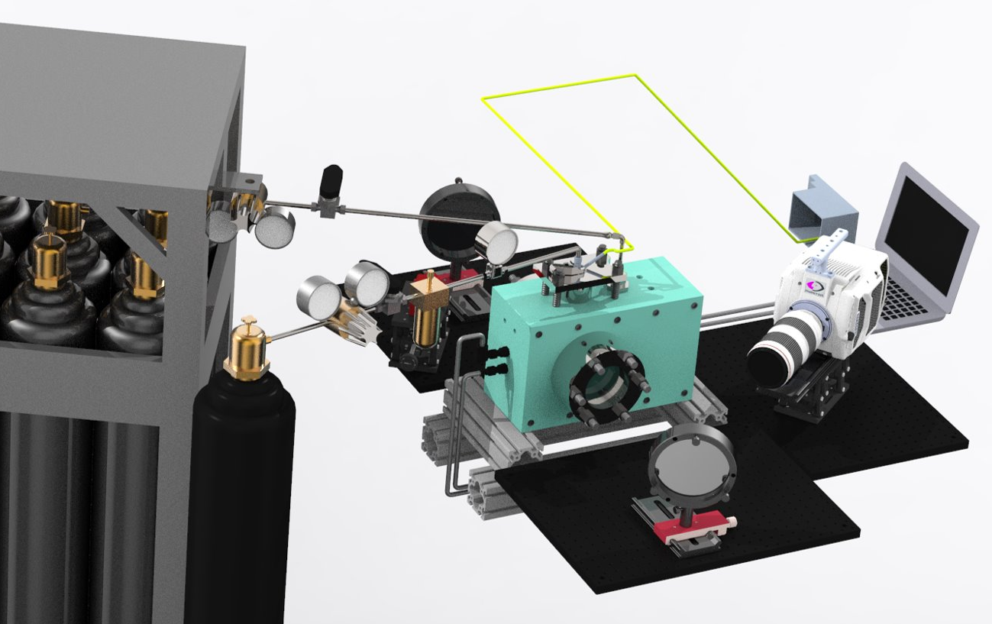
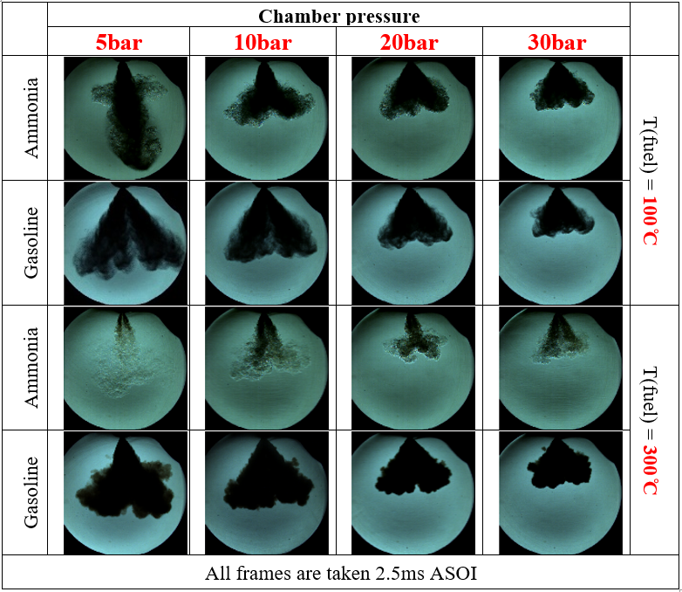
Research Group of Energy Conversion and Systems
Department of Mechanical Engineering
School of Engineering, Aalto University, Finland
Visualization of Phase Changing in Flash Boiling Spray-Group A
Abstract
Objective
The flash boiling phenomenon manifests when the atmospheric pressure surrounding the fuel drops below its saturation pressure, leading to the rapid formation and expansion of bubbles. Recognized as a promising technique, flash boiling has garnered attention for enhancing fuel spray atomization and mitigating emissions, particularly in the absence of a high-pressure injection system—a trend that has gained prominence in recent discussions. As such, it is imperative to consolidate and present the latest research findings on flash boiling sprays to comprehend the current state of knowledge in this area.
Investigate and optimize the utilization of flash boiling phenomena in the atomization process, specifically tailored for sustainable and renewable fuel sources.
Investigate the spatiotemporal evolution of the spray, including the formation, breakup, and dispersion of droplets during the flash boiling process.
Measure and quantify essential spray parameters, e.g., spray temperature, cone angle, and penetration.
Study how flash boiling interacts with different environmental conditions, such as varying ambient pressures or temperatures, to assess the robustness and adaptability of the flash boiling process.
Research Approaches
High-Speed Schlieren Imaging
Related to Thermodynamics and Heat Transfer
Understand the relation of fuel properties and boiling point.
Characterize the differences between sub-cool spray and flash boiling spray.
Explain the basics of thermodynamics behind the phenomena observed from the schlieren.
Estimate the effect of heat transfer on the change of the enthalpy, entropy, etc.
Explain how does the flash boiling spray affect the combustion in the internal combustion engine.
Project Benefits
Matlab Image Postprocessing
Collaborative Learning: Group projects foster collaborative learning, allowing students to work together, share ideas, and pool their collective knowledge.
Hands-On Experience: Engaging in a group project involving experimental setups and advanced imaging techniques provides hands-on experience, bridging the gap between theoretical knowledge and practical application. Problem-Solving Skills: The complexities of visualizing flash boiling sprays present students with challenges that require critical thinking and problem-solving.
Interdisciplinary Understanding: Flash boiling sprays involve aspects of thermodynamics, fluid mechanics, optics, and combustion science.
Project Management Skills: Group projects necessitate effective project management. Students will need to plan tasks, allocate responsibilities, and adhere to timelines.
Critical Evaluation of Data: Analyzing high-speed schlieren images involves critical evaluation and interpretation of data.
eng.aalto.fi/en

