Slide 1
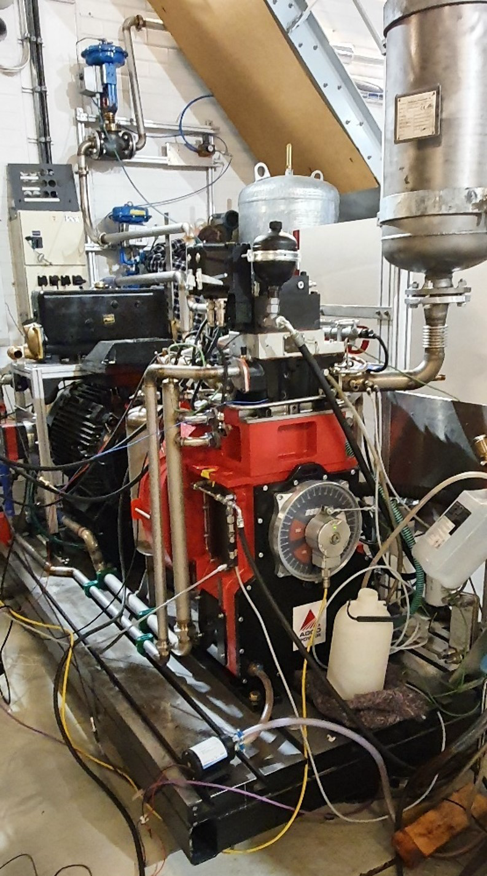
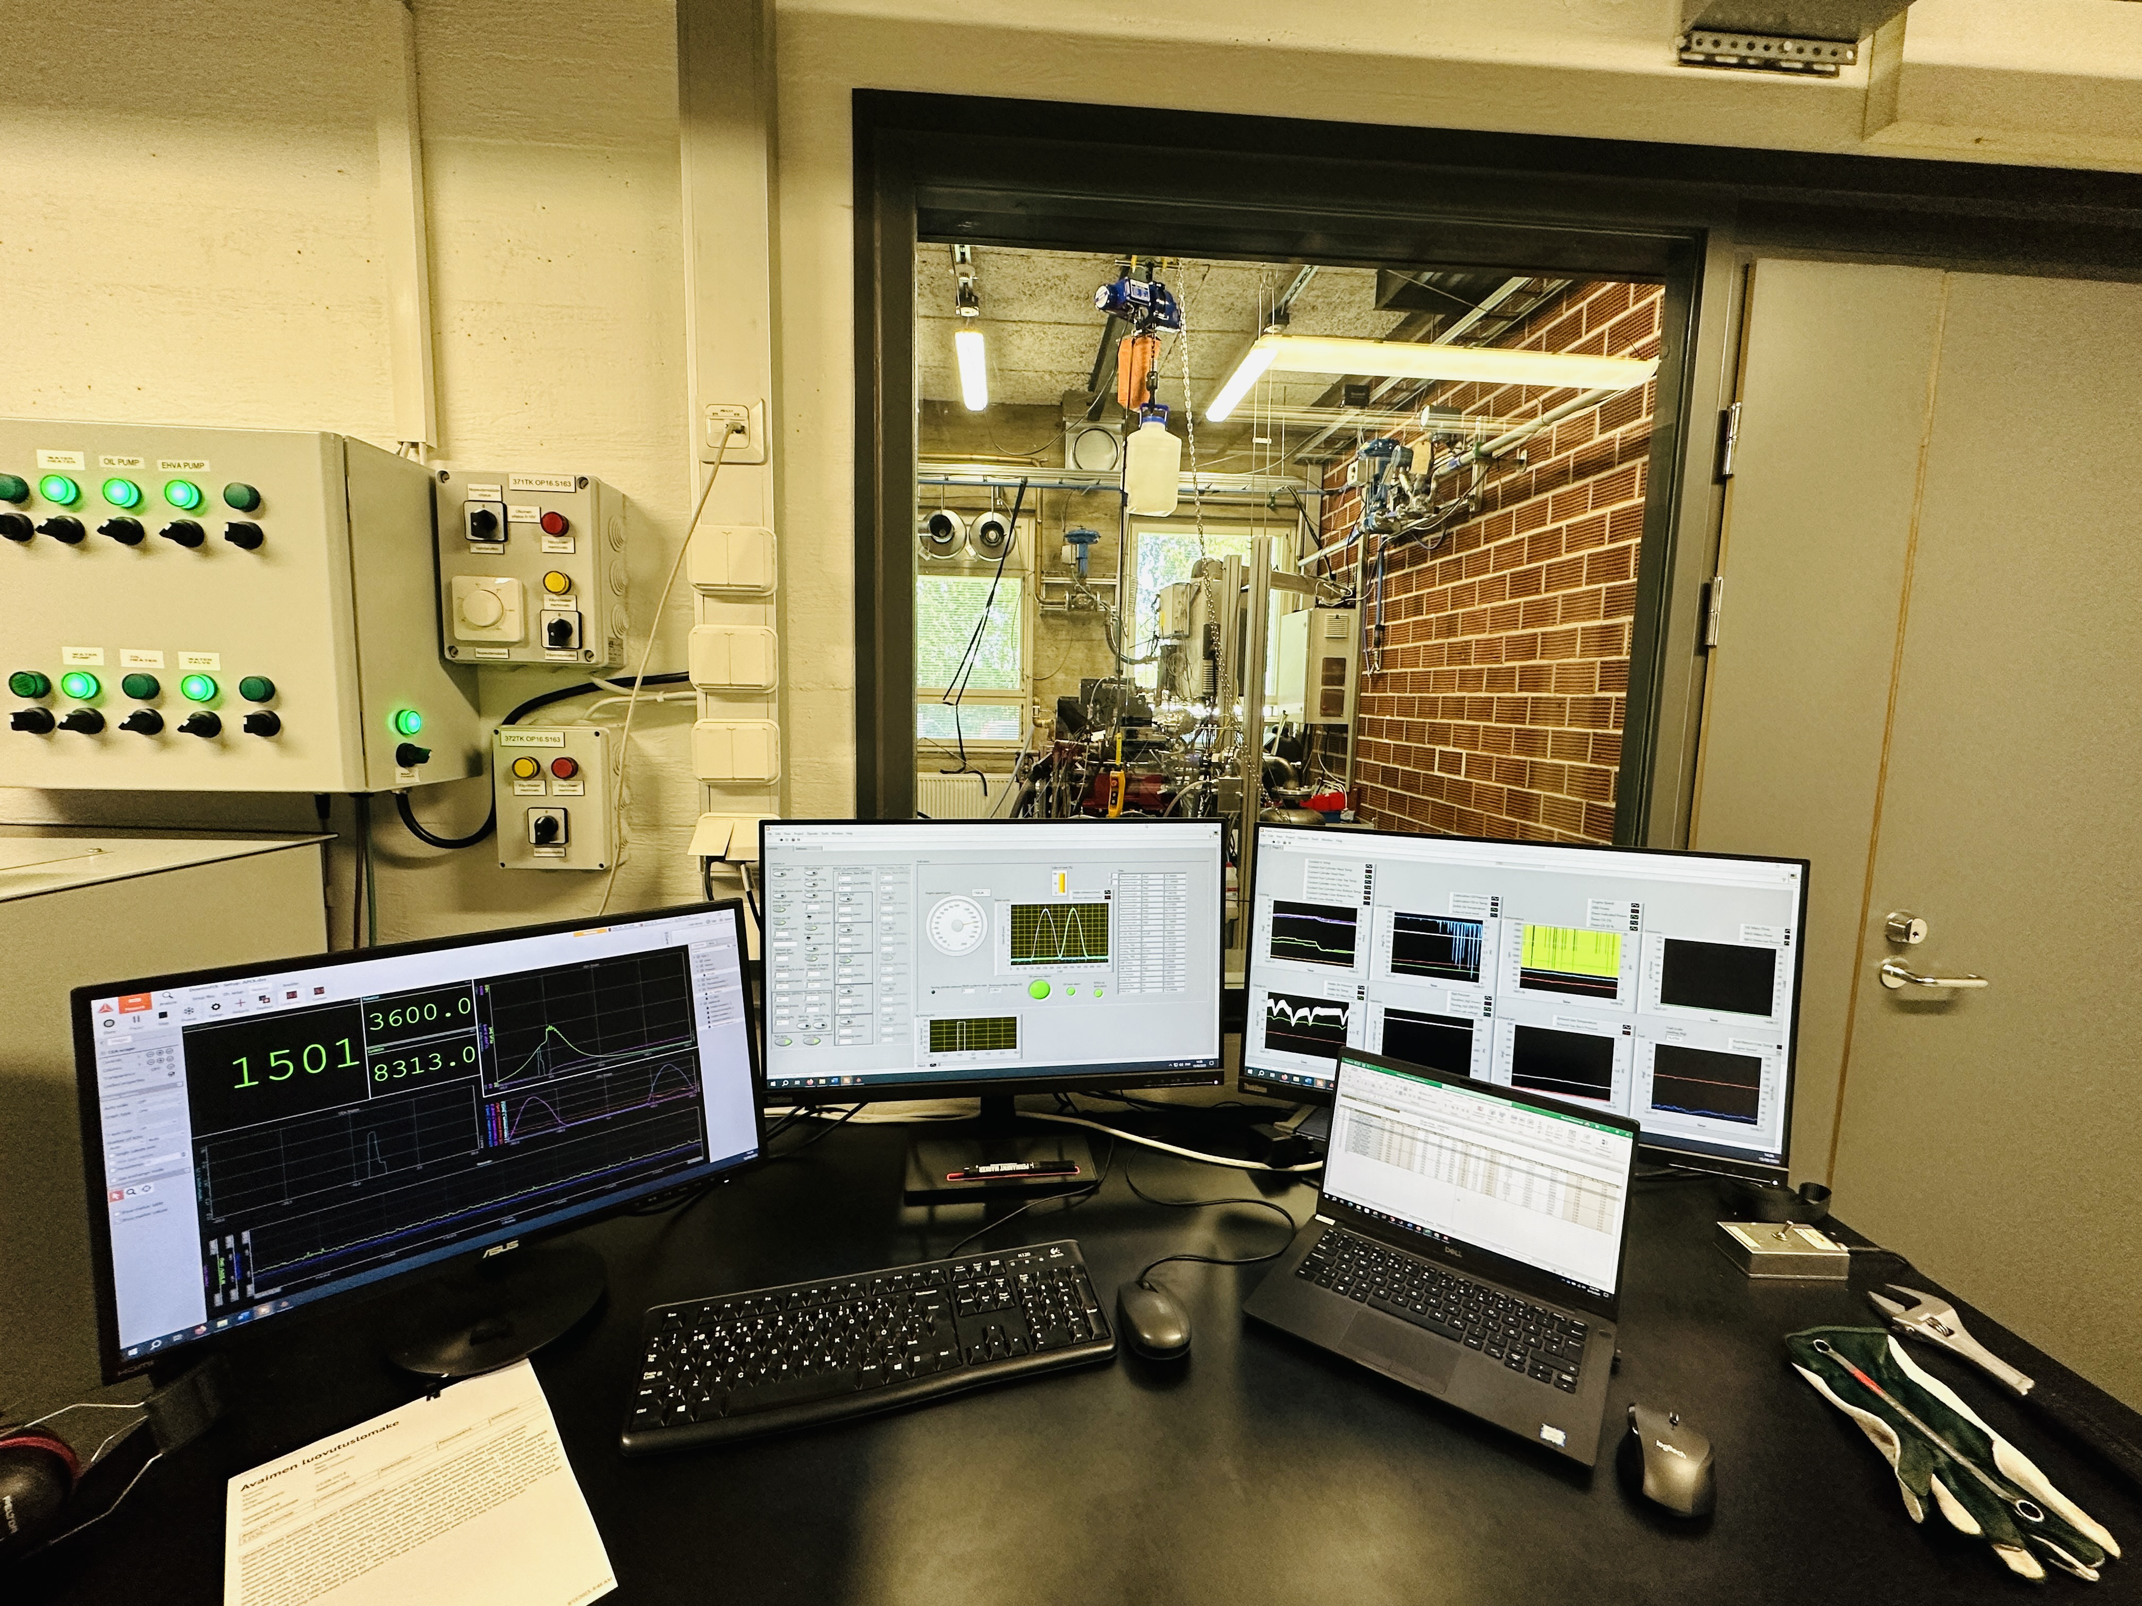
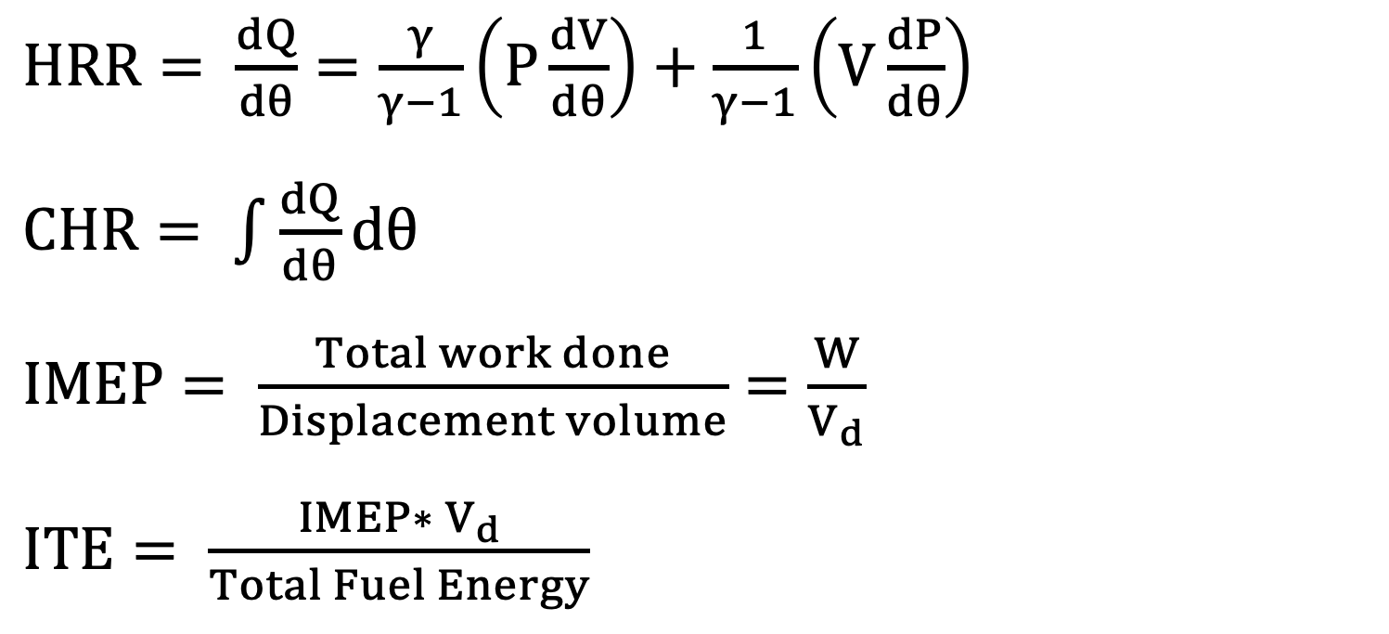
Research Group of Energy Conversion and Systems
Department of Mechanical Engineering
School of Engineering, Aalto University, Finland
Diesel-Ammonia-Hydrogen Tri-Fuel Combustion in a Full-metal Engine
Abstract
Objective
Ammonia (NH3) stands out as a crucial element in advancing the carbon neutrality agenda for ICEs. Its notable energy density, nearly double that of liquid hydrogen by volume, renders it more convenient for transportation and distribution. Leveraging an already well-established infrastructure, ammonia emerges as a versatile option that can also serve as a carrier for hydrogen energy. However, the practicality of using pure ammonia as a fuel has been deemed unfeasible, prompting researchers to explore innovative solutions. Concepts such as dual-fuel systems and advanced combustion techniques have since been developed to address this challenge and pave the way for the effective integration of ammonia in sustainable energy solutions for diesel engines..
Understand the working principle of the internal combustion engine and link to the thermodynamics.
Investigate and optimize the utilization of carbon-free fuels in internal combustion engine with diesel pilots.
Understand the basic data acquisition and learn how to do data post-processing.
Learn how to combine diesel, ammonia, and hydrogen for optimizing the combustion process. The unique properties of each fuel contribute to improved efficiency, potentially leading to better fuel economy and overall engine performance.
Explain how do the carbon-free fuels contribute to the environments.
Related to Thermodynamics and Heat Transfer
Research Approaches
Diesel-Ammonia-H2 Tri-fuel Combustion
Understand the relations between fuel properties and energy conversion in an internal combustion engine.
Understand the application of idea gas law in compression and expansion system.
Explain the energy balance based on intake and exhaust gases, coolant temperature.
Learn the basics of the combustion in high-pressure and high-temperature conditions.
Understand the relations between equivalence ratio and emissions.
Project Benefits
Matlab Data Postprocessing
Comprehensive Understanding: This includes combustion processes, fuel properties, and the environmental implications of different fuel combinations.
Experimental Design: Collaboratively design and plan the experiments. Students should focus on creating a well-thought-out experimental framework.
Data Collection and Analysis: Implement the experimental setup, collect relevant data, and use analytical tools to interpret the results.
Engine Performance Evaluation: Evaluate the performance of the diesel-ammonia-hydrogen engine by assessing key parameters such as efficiency, emissions, and fuel consumption.
Environmental Impact Assessment: Assess the environmental impact of the diesel-ammonia-hydrogen engine in terms of greenhouse gas emissions, air quality improvement, and sustainability.
Optimization Strategies: Explore optimization strategies for the engine system.
$HRR= \frac{dQ}{dθ}=\frac{γ}{γ−1}\left(P\frac{dV}{dθ}\right)+\frac{1}{γ−1}\left(V\frac{dP}{dθ}\right)$
$CHR= \int{\frac{dQ}{dθ}dθ}$
$IMEP= \frac{Total work done}{Displacement volume}=\frac{W}{V_{d}}$
$ITE= \frac{IMEP∗ V_{d}}{Total Fuel Energy}$
eng.aalto.fi/en

