Slide 1
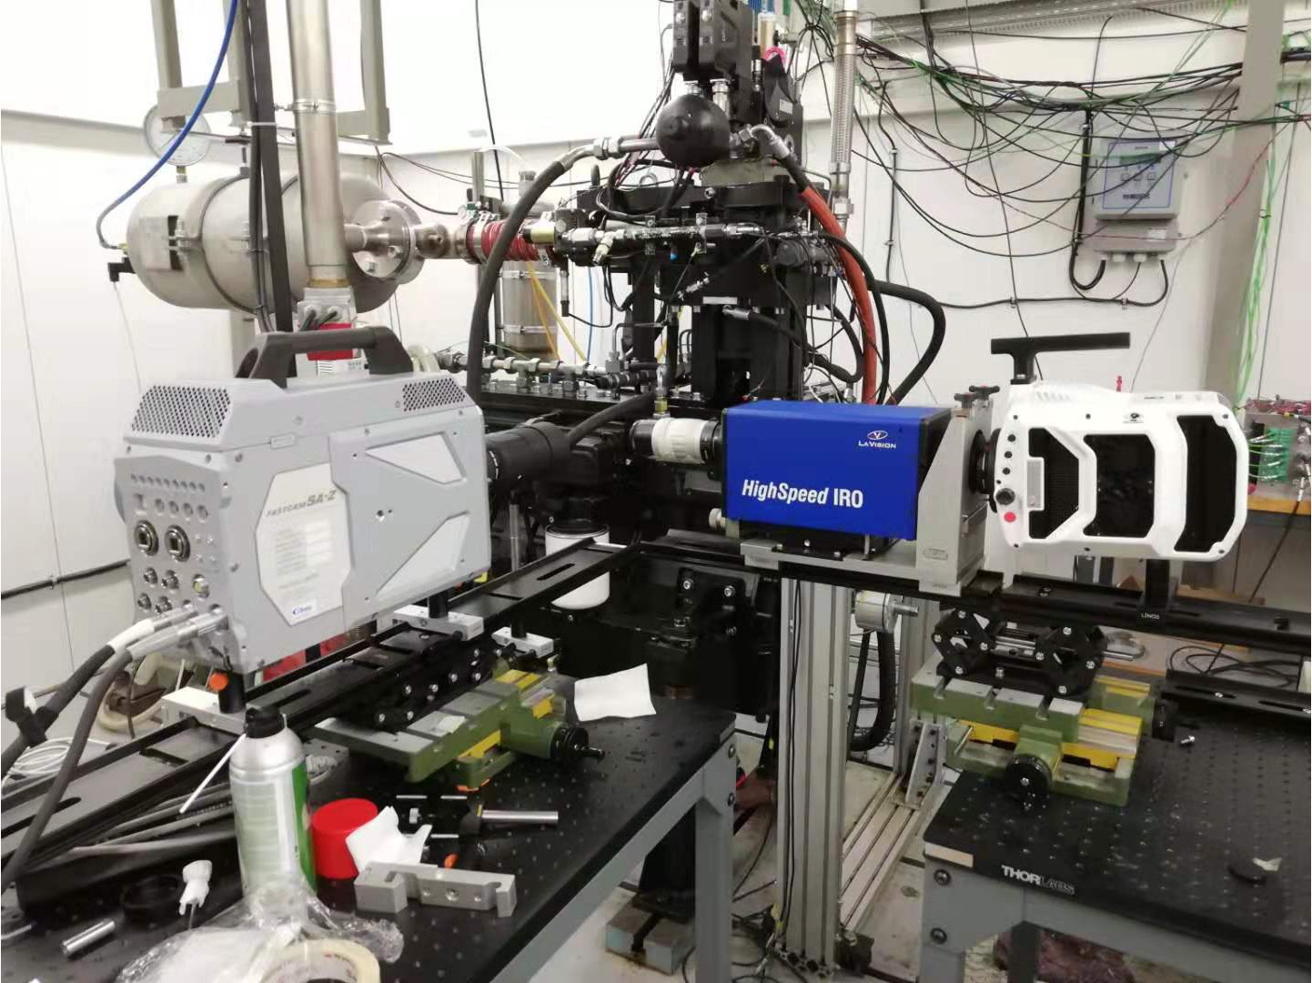
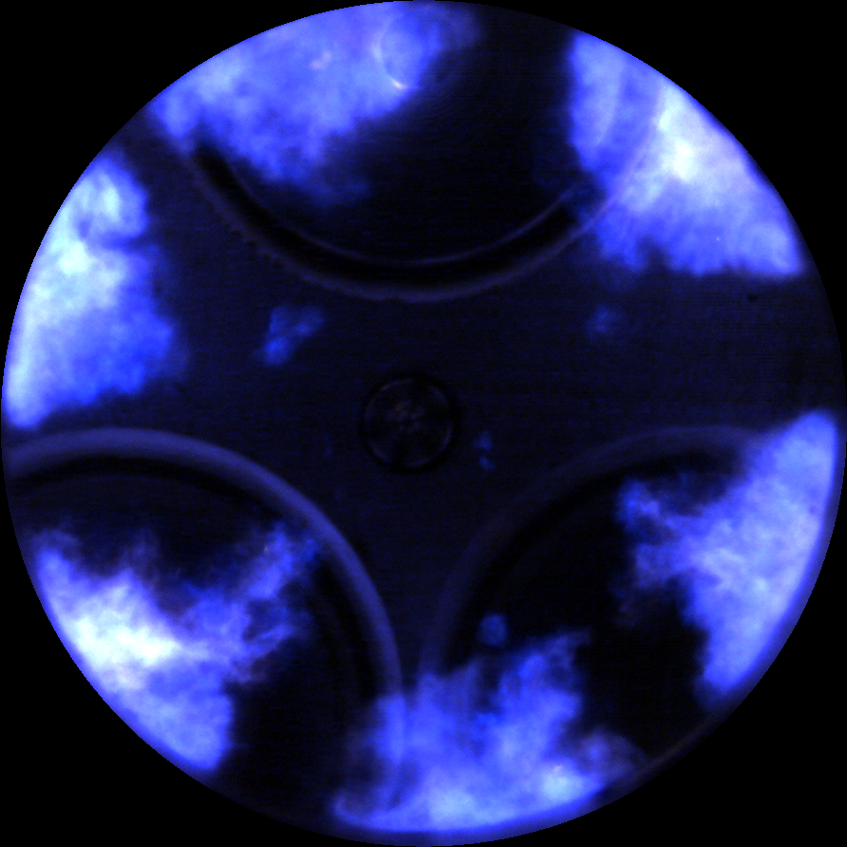
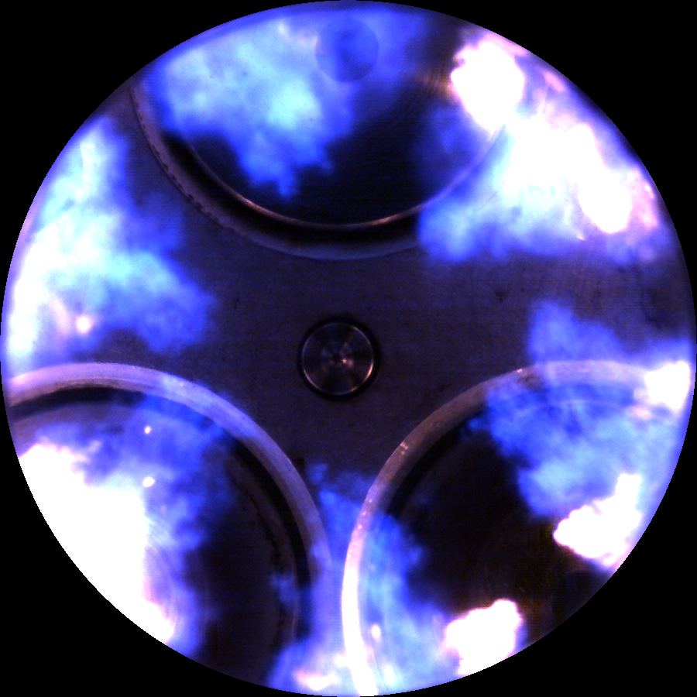
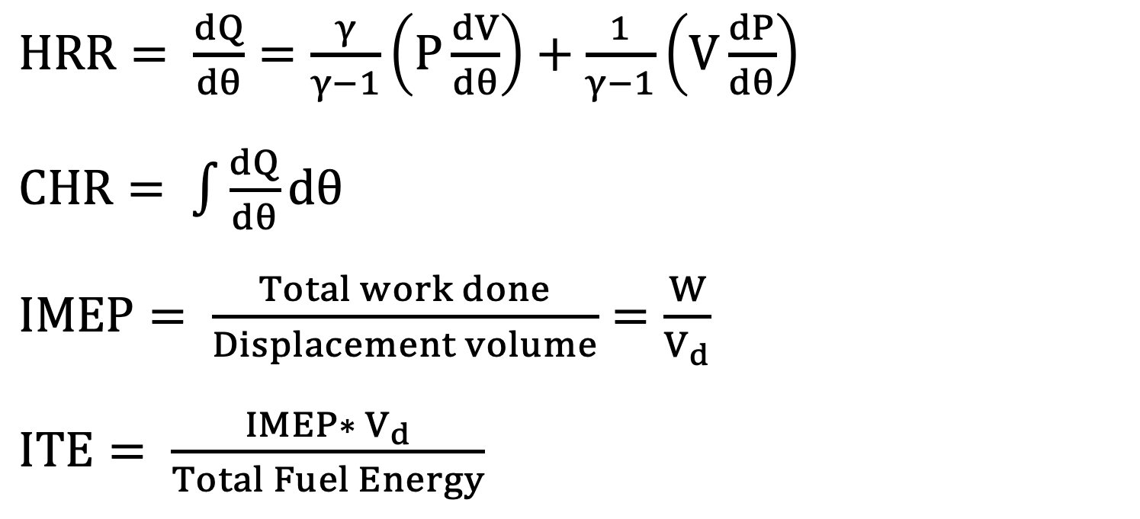
Research Group of Energy Conversion and Systems
Department of Mechanical Engineering
School of Engineering, Aalto University, Finland
Natural Gas Combustion in an Optical Engine
Abstract
Objective
This study investigates the combustion characteristics and emission performance of natural gas in an optical engine, providing valuable insights into the fundamental processes that govern natural gas combustion. The experimental setup incorporates a transparent combustion chamber, enabling real-time visualization of the combustion process. Through a systematic analysis of combustion phasing, flame propagation, and emissions, the study aims to elucidate the factors influencing the combustion behavior of natural gas. Additionally, the impact of varying engine parameters, such as ignition timing and air-fuel ratio, on combustion efficiency and emissions is explored. The findings contribute to a deeper understanding of natural gas combustion dynamics, offering implications for the optimization of engine performance and the reduction of environmental impact.
Understand the working principle of the internal combustion engine and link to the thermodynamics.
Learn how to use the advanced optical tools to visualize the combustion in an optical engine.
Investigate and optimize the spark and fuel-air mixing strategies for efficient and clean combustion.
Understand the basic data acquisition and learn how to do data post-processing.
Learn how to use optical diagnostics in internal combustion engine and how to explain the combustion and flame propagation based on the images.
Explain the relations between the color of the flame and temperature based on the basics of the thermal radiation.
Research Approaches
Related to Thermodynamics and Heat Transfer
Optical Engine Studies
Understand the relations between fuel-air mixing quality and energy conversion in an internal combustion engine.
Understand the application of idea gas law in compression and expansion system.
Explain the energy balance based on intake and exhaust gases, coolant temperature.
Learn the basics of the combustion and flame propagation in high-pressure and high-temperature conditions.
Understand the relations between flame color and spectral emissions.
Project Benefits
Hands-On Experimental Learning: Students gain practical experience by actively participating in the design, setup, and execution of experiments related to natural gas combustion in an optical engine. .
Interdisciplinary Understanding: The study of natural gas combustion involves elements of thermodynamics, fluid mechanics, optics, and combustion science..
Data Analysis Skills: Students develop data analysis skills by processing and interpreting real-time data from the optical engine experiments. This includes the analysis of combustion phasing, flame propagation, and emission levels. These skills are transferable to various scientific and engineering disciplines..
Understanding Optics in Engineering: Students gain a practical understanding of optical techniques used in engineering applications..
Problem-Solving and Optimization: Students are tasked with optimizing engine parameters, such as ignition timing and air-fuel ratio, to improve combustion efficiency and reduce emissions.
Matlab Data/Image Postprocessing
$HRR= \frac{dQ}{dθ}=\frac{γ}{γ−1}\left(P\frac{dV}{dθ}\right)+\frac{1}{γ−1}\left(V\frac{dP}{dθ}\right)$
$CHR= \int{\frac{dQ}{dθ}dθ}$
$IMEP= \frac{Total work done}{Displacement volume}=\frac{W}{V_{d}}$
$ITE= \frac{IMEP∗ V_{d}}{Total Fuel Energy}$
Diesel Only
Diesel-CH4 Dual-Fuel
Diesel-CH4-H2 Tri-Fuel
eng.aalto.fi/en

