Slide 1
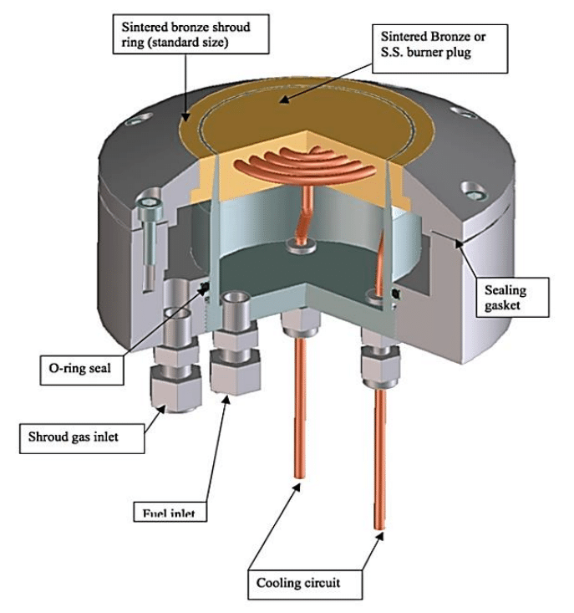
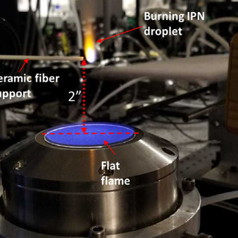
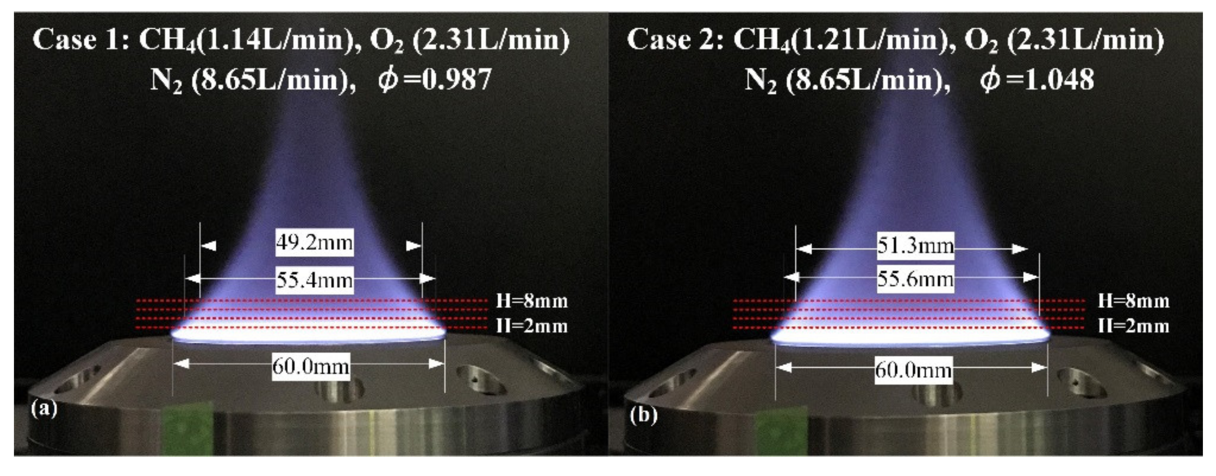
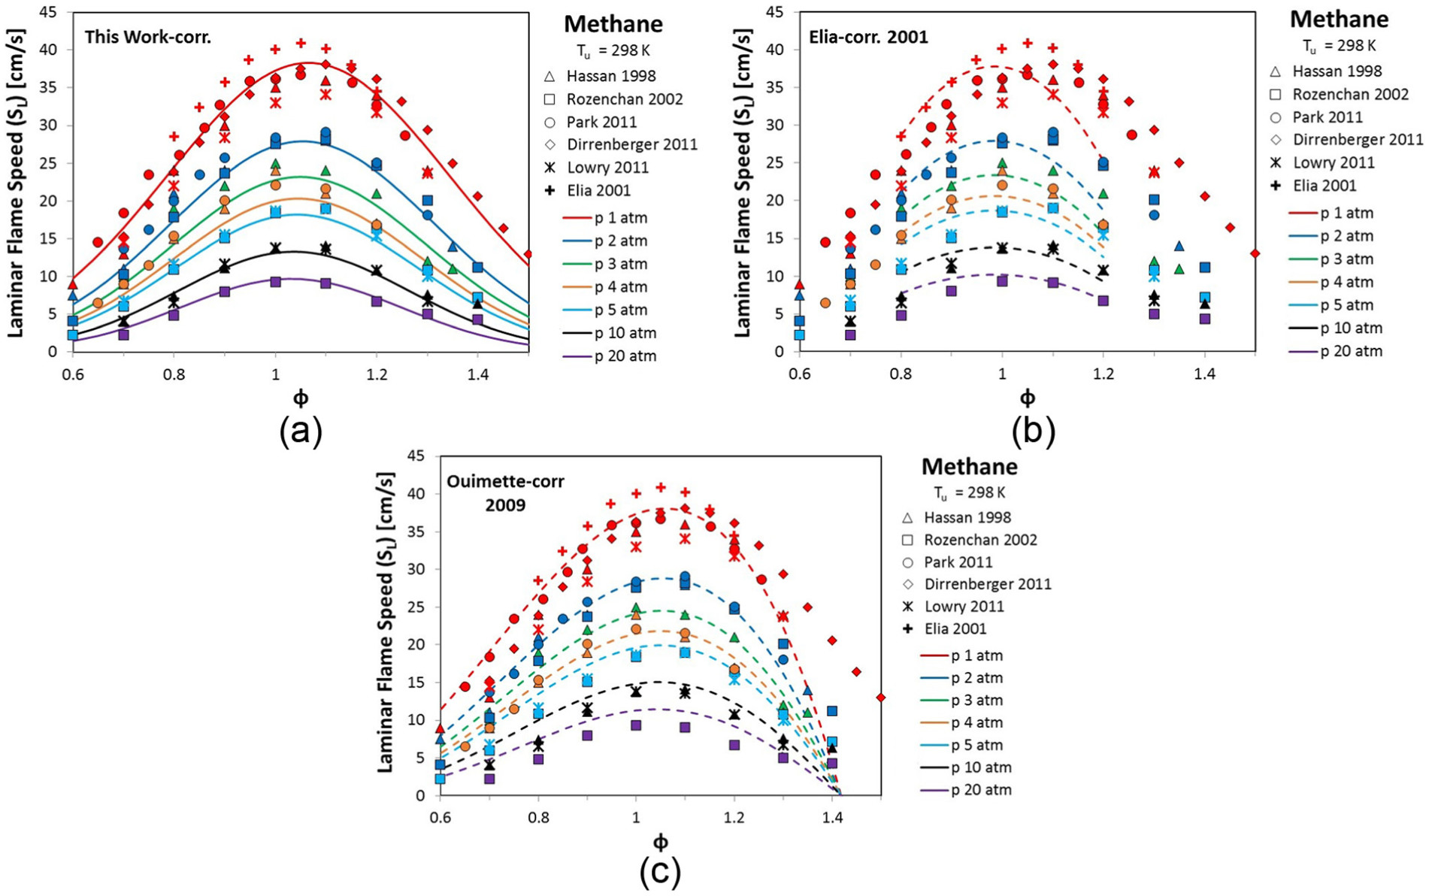
Research Group of Energy Conversion and Systems
Department of Mechanical Engineering
School of Engineering, Aalto University, Finland
Laminar Flame Speed Measurement Based on a McKenna Burning
Abstract
Objective
This study focuses on the measurement of laminar flame speed utilizing a McKenna burner, providing a comprehensive exploration of flame characteristics and combustion dynamics. The experimental setup involves the controlled ignition of a premixed fuel-air mixture in a quiescent environment using the McKenna burner, renowned for its versatility in laminar flame speed studies. Through a systematic variation of fuel compositions, equivalence ratios, and initial conditions, laminar flame speed is measured using advanced diagnostic techniques, including high-speed imaging and pressure transducers.
Quantify laminar flame speed under various conditions by systematically varying parameters such as fuel composition, equivalence ratios, and initial conditions.
Explore how variations in these parameters influence combustion and flame behavior, offering insights into the fundamental aspects of combustion kinetics..
Connect the research outcomes to potential applications in energy conversion, propulsion, and industrial processes..
Understand the impact of varying parameters on flame propagation and combustion stability..
Provide valuable data for validating combustion models and can guide future developments in combustion science and technology.
Research Approaches
Mckenna Burner
Related to Thermodynamics and Heat Transfer
Correlate the laminar flame speed with thermodynamic parameters such as adiabatic flame temperature and specific heat ratios to understand the energy dynamics of the combustion process.
Investigate the entropy change during combustion and assess the irreversibility of the process.
Quantify the heat release rate during laminar flame propagation and correlate it with the laminar flame speed.
Explore the influence of flow conditions and burner geometry on convective heat transfer rates, providing insights into the overall thermal behavior of the combustion system.
Matlab Data/Image Postprocessing
Project Benefits
Advanced Laboratory Techniques: The study involves sophisticated measurement techniques such as high-speed imaging, pressure transducers, and temperature sensors.
Interdisciplinary Understanding: The project integrates thermodynamics, heat transfer, and combustion science, providing students with an interdisciplinary perspective.
Practical Application of Theory: The project provides a platform for students to apply theoretical knowledge gained in thermodynamics and heat transfer courses to a real-world combustion scenario.
Critical Analysis of Experimental Data: Students learn to critically analyze experimental data, evaluate uncertainties, and draw meaningful conclusions.
Preparation for Industry: The skills developed through this project align with industry demands, particularly in areas related to combustion, alternative fuels, and heat transfer
eng.aalto.fi/en

