Slide 1
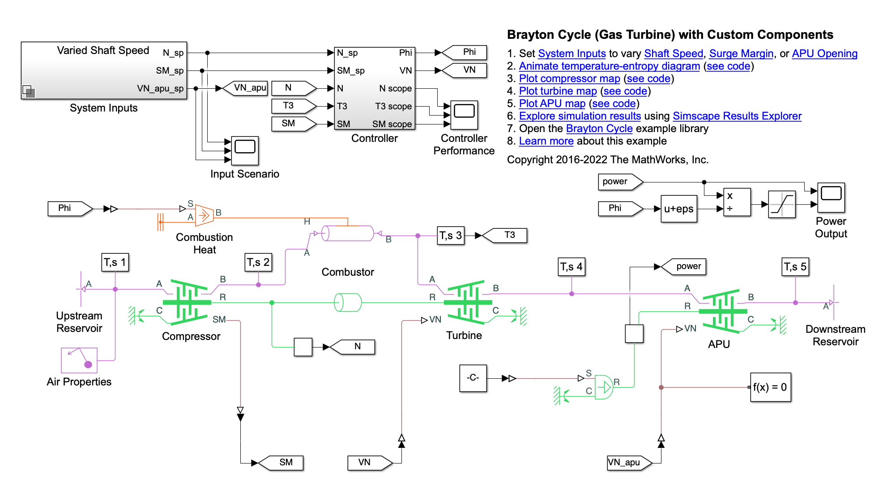
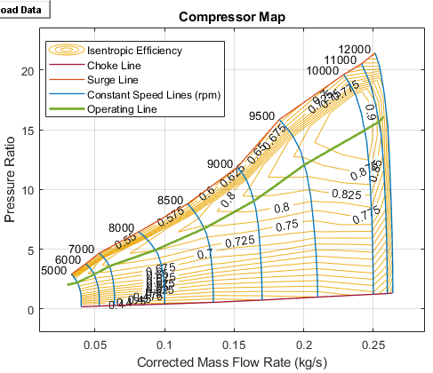
Research Group of Energy Conversion and Systems
Department of Mechanical Engineering
School of Engineering, Aalto University, Finland
Using Matlab/Simulink Simulate Brayton Cycle (Gas Turbine)
Abstract
Project Description
This study focuses on a gas turbine auxiliary power unit (APU) based on the Brayton Cycle. The power input to the system is represented by heat injection into the combustor; actual combustion chemistry is not modeled. A single shaft connects the compressor and the turbine so that the power from the turbine drives the compressor. The APU is a free turbine that further expands the exhaust stream to produce output power. More details can be seen in Matlab Example:https://se.mathworks.com/help/hydro/ug/sscfluids_brayton_cycle.html
Learn the working principle of the Brayton cycle based on the example.
Briefly analyze the isotropic efficiency of the compressor and turbine.
Estimate the total thermal efficiency of the gas turbine.
Optimize the system according to the basics of thermodynamics using superheating, reheating, intercooler, etc.
Compare the modified model with the original model and explain the change.
Simulation Model
Related to Thermodynamics and Heat Transfer
Understand the isentropic compression and expansion processing in Brayton cycle.
Understand the isobaric heat addition and heat rejection.
Know how to calculate the thermal efficiency based on the second law of thermodynamics.
Key parameters to consider include temperature, pressure, specific heat ratios, and efficiencies of the compressor and turbine.
Understand the change of internal energy, enthalpy, and entropy in Brayton cycle.
Expected Results
Project Benefits
Practical Understanding of Thermodynamic Principles: Allows students to apply theoretical knowledge of thermodynamics to practical engineering scenarios. Conceptualization of Gas Turbine Systems: Students can can visualize the entire Brayton cycle, including the roles of components such as compressors, combustion chambers, and turbines.
Critical Thinking and Problem-Solving: Working on Brayton cycle simulations requires critical thinking and problem-solving skills.
Application of Software Tools: Students can gain valuable experience in using tools like Matlab/Simulink with thermodynamics libraries, enhancing their proficiency in computational methods.
Preparation for Industry: Understanding the Brayton cycle and its simulation prepares students for careers in industries related to power generation, aerospace, and energy. Many engineering roles involve working with thermodynamic principles, and this practical experience can be valuable in their future careers.
eng.aalto.fi/en

