Slide 1
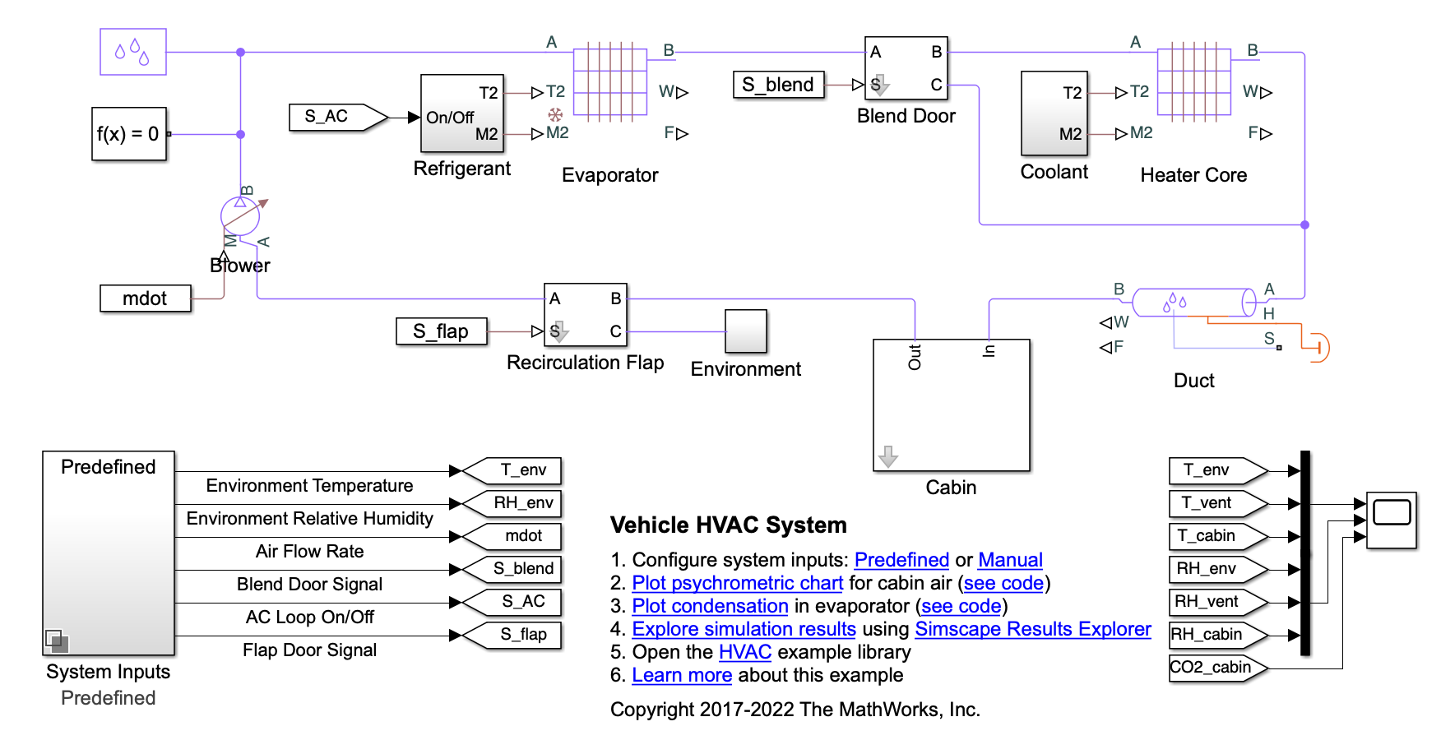
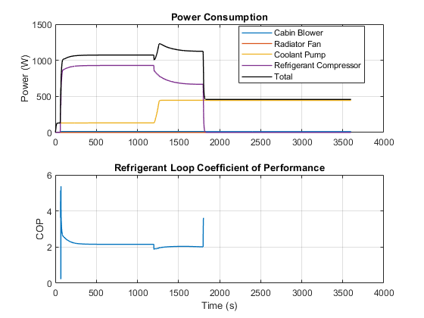
Research Group of Energy Conversion and Systems
Department of Mechanical Engineering
School of Engineering, Aalto University, Finland
Using Matlab/Simulink Simulate Vehicle HVAC System
Abstract
Project Description
This study focuses on moist air flow in a vehicle heating, ventilation, and air conditioning (HVAC) system. The vehicle cabin is represented as a volume of moist air exchanging heat with the external environment. The moist air flows through a recirculation flap, a blower, an evaporator, a blend door, and a heater before returning to the cabin. The recirculation flap selects flow intake from the cabin or from the external environment. The blender door diverts flow around the heater to control the temperature. More details can be seen in Matlab Example1:https://se.mathworks.com/help/hydro/ug/vehicle-hvac.html
Example2:https://se.mathworks.com/help/simscape/ug/vehicle-hvac-system.html
Learn the working principle of the Vehicle HVAC System based on the examples.
Briefly analyze the refrigerant loop and coolant loop.
Understand typical R-134a vapor-compression refrigeration cycle with a compressor, a condenser, a liquid receiver, a thermostatic expansion valve, and an evaporator.
Learn how to optimize the HVAC system according to two examples and your knowledge of thermodynamics.
Compare the modified model with the original model and explain the change.
Related to Thermodynamics and Heat Transfer
Simulation Model
Understand the isentropic compression and expansion processing in a typical R-134a vapor compression refrigeration system.
Understand the phase changing of the substance with in condenser and evaporator.
Understand the change of internal energy, enthalpy, and entropy during phase changing.
Know how to calculate the coefficient of performance based on the second law of thermodynamics.
Learn and draw the P-H Diagram of the thermodynamic states of the cycle during simulation.
Expected Results
Project Benefits
Practical Application of Thermodynamic Principles: Simulating a Vehicle HVAC system allows students to apply theoretical thermodynamic concepts to real-world engineering problems, reinforcing their understanding of fundamental principles.
System Analysis and Optimization: Simulations enable students to analyze and optimize the performance of the HVAC system.
Understanding Energy Consumption and Efficiency: Students can assess the energy consumption and efficiency of the HVAC system, considering factors like the power required by the compressor and the impact of different operating conditions on energy efficiency.
Problem-Solving Skills: Students can develop the ability to identify and address issues within the system, preparing them for real-world challenges in engineering and design.
Preparation for Industry:Practical experience with HVAC system simulations prepares students for careers in automotive engineering, HVAC design, and related industries.
eng.aalto.fi/en

