Slide 1
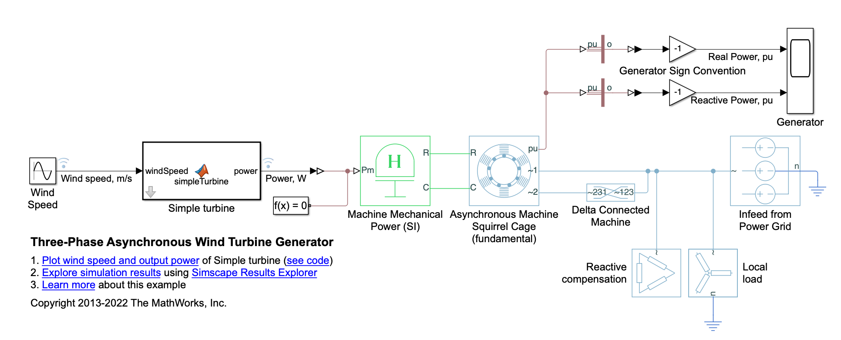
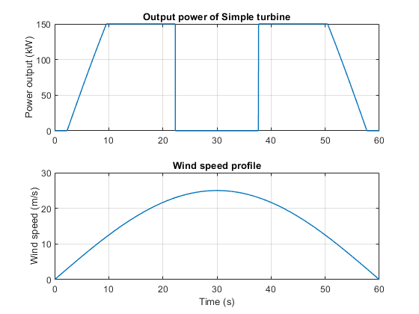
Research Group of Energy Conversion and Systems
Department of Mechanical Engineering
School of Engineering, Aalto University, Finland
Using Matlab/Simulink Simulate Three-Phase Asynchronous Wind Turbine Generator
Abstract
Project Description
an induction machine used as a wind turbine generator. The Simple Turbine block converts wind speed to turbine output power by a simple output power versus wind speed characteristic. When the wind speed is below the cut-in speed or above the cut-out speed, the machine generates zero real power. The machine always consumes reactive power. The Reactive Compensation block offsets the machine's reactive power requirement. The local load consumes 75kW. The infeed from the power grid meets any wind turbine generation shortfall. When the generator produces more than 75kW, excess power is exported to the grid.. More details can be seen in Matlab Example:https://se.mathworks.com/help/sps/ug/three-phase-asynchronous-wind-turbine-generator.html
Learn the working principle of the wind turbine based on the examples.
Use thermodynamics principles to analyze the overall efficiency of the wind turbine generator system.
Learn how to optimize the wind turbine system according to the example and your knowledge of thermodynamics.
Search the annual wind data in Finland and estimate the power generation based on this wind turbine.
Estimate how much carbon dioxide can be reduced by replacing the natural gas power station with wind turbine.
Related to Thermodynamics and Heat Transfer
Simulation Model
Fundamentally understand the conversion of wind energy into electrical energy based on thermodynamics.
Assess the efficiency of the energy conversion process, considering losses due to friction, heat, and other factors.
Thermodynamics is indirectly involved in the aerodynamics and fluid dynamics of the wind turbine.
As the wind's kinetic energy is harnessed and transformed into electricity, there are thermodynamic considerations related to entropy changes in the system.
Understand Betz's Law.
Expected Results
Project Benefits
Application of Theoretical Knowledge: Students can apply theoretical knowledge gained in thermodynamics courses to real-world engineering problems, reinforcing their understanding of fundamental principles.
Interdisciplinary Learning: Wind turbine projects involve multiple disciplines, including thermodynamics, fluid dynamics, aerodynamics, and electrical engineering. Understanding Energy Conversion: Students gain insights into how energy conversion processes work in practice. They learn how to optimize the efficiency of a wind turbine system, connecting thermodynamics principles to real-world applications.
Renewable Energy Focus: Wind turbine projects align with the growing importance of renewable energy sources. Preparation for Renewable Energy Careers: As renewable energy technologies, including wind power, continue to grow, students engaged in wind turbine projects are well-prepared for careers in the renewable energy sector. This experience is valuable for those pursuing roles in engineering, research, or environmental sustainability.
eng.aalto.fi/en

