Slide 1
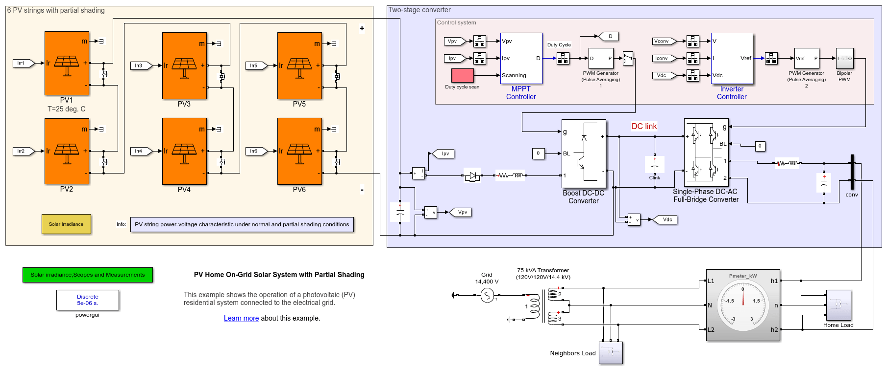
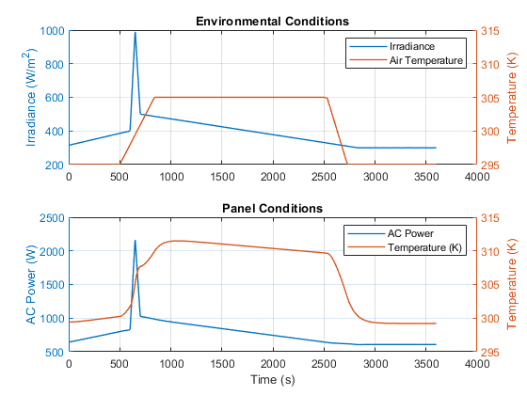
Research Group of Energy Conversion and Systems
Department of Mechanical Engineering
School of Engineering, Aalto University, Finland
Using Matlab/Simulink Simulate PV Home On-Grid Solar System
Abstract
Project Description
This project focuses on the PV Home On-Grid Solar System. Simulating a PV Home On-Grid Solar System using MATLAB/Simulink, the primary objectives are to model, analyze, and optimize the performance of the solar photovoltaic system within the context of a connected electrical grid. By accomplishing these simulation objectives, engineers and researchers can gain insights into the performance, efficiency, and reliability of PV Home On-Grid Solar Systems, facilitating the design, analysis, and optimization of such systems in real-world applications. Example: https://se.mathworks.com/help/sps/ug/pv-home-on-grid-solar-system.html
Learn the working principle of the photovoltaic (PV) in energy conversion based on the examples.
Understand the solar irradiance of the PV strings.
Learn two-stage converter: a boost DC-DC converter and a single-phase DC-AC full-bridge converter.
Search the annual solar data in Finland and estimate the power generation based on this PV solar system.
Estimate relation of the power generation and load for this system. Assess the cost and profit with the application of solar system in Finland based on Finnish average electricity price.
Related to Thermodynamics and Heat Transfer
Simulation Model
Fundamentally understand the conversion of solar energy into electrical energy based on thermodynamics.
Assess the efficiency of the energy conversion process and energy balance, considering the load, utilization, and transfer to the grid.
Thermodynamics is indirectly involved in the aerodynamics and fluid dynamics of the wind turbine.
Understand Maximum Power Point Tracking (MPPT).
The thermodynamics of power flow and electrical energy transmission play a role in ensuring the compatibility and stability of the grid-connected system..
Expected Results
Project Benefits
Practical Application of Theoretical Knowledge: Students can apply theoretical concepts learned in courses related to electrical engineering, control systems, and renewable energy to a real-world project.
System Modeling Skills: Building a simulation model of a PV Home On-Grid Solar System in MATLAB/Simulink enhances students' system modeling skills and learn how to represent complex electrical and control systems mathematically.
Understanding Renewable Energy Systems: Help students gain a deeper understanding of renewable energy systems, particularly how solar energy can be harnessed and integrated into the electrical grid.
Interdisciplinary Learning: The project involves elements of electrical engineering, control systems, and renewable energy. This interdisciplinary approach broadens students' perspectives and prepares them for the collaborative nature of engineering projects in the real world.
Research and Innovation Opportunities: Students may have the opportunity to explore advanced topics, conduct research, and propose innovative solutions within the context of the PV Home On-Grid Solar System project.
eng.aalto.fi/en

