Slide 1
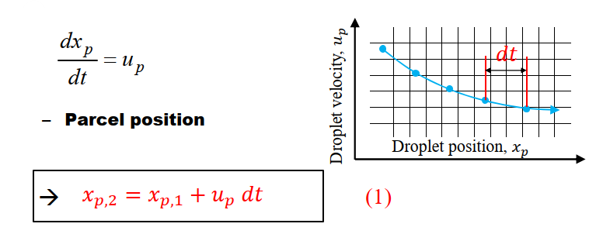
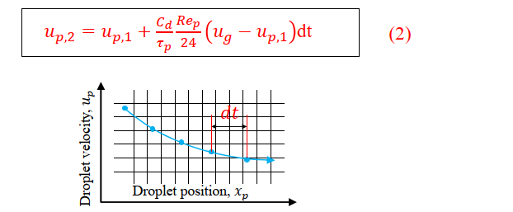
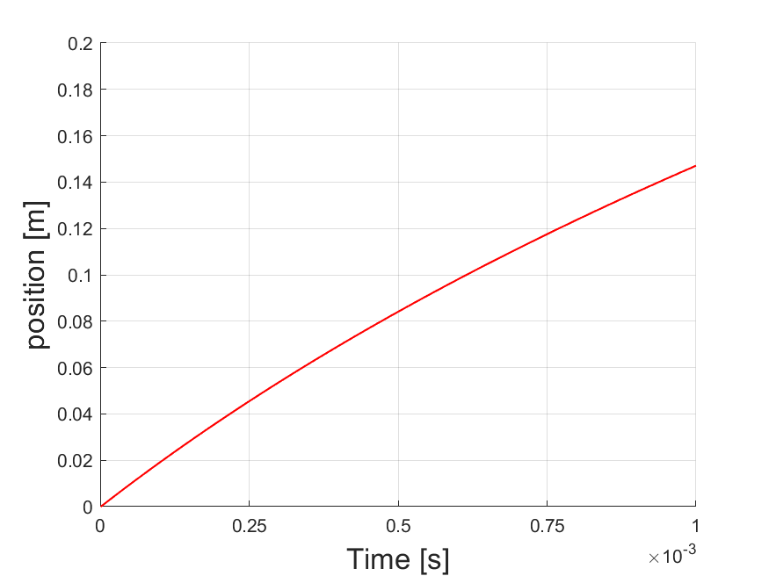
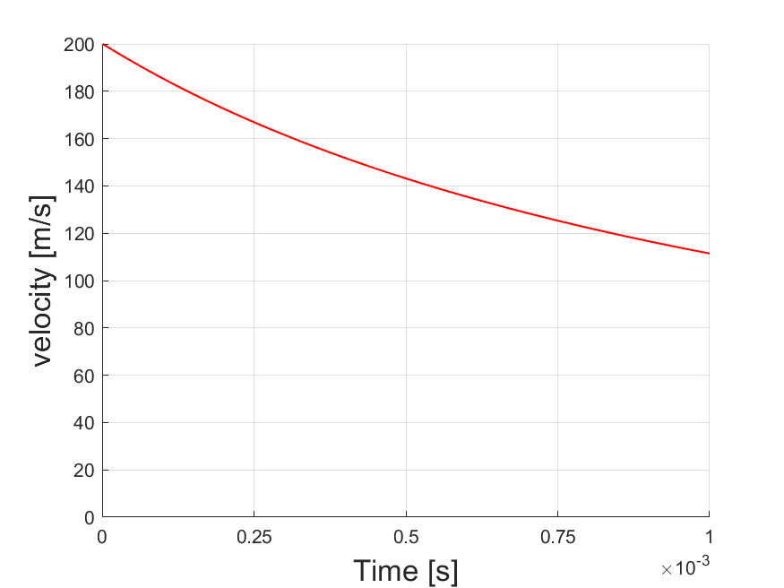
Research Group of Energy Conversion and Systems
Department of Mechanical Engineering
School of Engineering, Aalto University, Finland
Using MATLAB for Lagrangian spray modelling in IC Engines
Abstract
Project Description
This project focuses on the practical implementation of the Lagrangian Particle Tracking (LPT) method for simulating individual droplet trajectories in the context of internal combustion engines. The primary objective is to utilize MATLAB to calculate and visualize a single droplet's position and velocity over time, considering specified initial conditions and parameters. Through MATLAB programming, you will perform the numerical calculations required to track the droplet's motion over time and visualize the results. The plotted particle position and velocity as functions of time will provide valuable insights into the dynamic behavior of fuel droplets in internal combustion engine scenarios.
Understand the spray mechanism in IC engines
Differentiate between Lagrangian and Eulerian methods to comprehend their respective strengths and limitations in the context of spray modeling.
Gain practical insights into the dynamics of fuel droplets within internal combustion engines
Explore the sensitivity of droplet trajectory and velocity to key parameters, such as droplet diameter, particle density, and gas properties.
Related to Thermodynamics and Heat Transfer
Simulation Model
Explore the role of fuel spray dynamics in internal combustion engines, connecting the project to the thermodynamic principles governing the conversion of chemical energy to mechanical work.
Examine the effect of droplet dynamics on temperature distribution within the combustion chamber, linking the project to the spatial and temporal variations in temperature crucial for engine performance.
Investigate how understanding the behavior of individual droplets provides insights into heat release mechanisms during combustion, a key aspect of thermodynamics in engine operation.
Expected Results
Project Benefits
Enhanced Understanding: Deeper understanding of the intricate dynamics involved in fuel spray within internal combustion engines, fostering a comprehensive grasp of the underlying physical principles.
Numerical Proficiency: Developing proficiency in MATLAB programming for numerical simulations, a valuable skill applicable to various engineering disciplines.
Practical Application: The project bridges theoretical knowledge with practical application, allowing students to witness the direct impact of Lagrangian particle tracking on the performance and efficiency of internal combustion engines.
Insights into Engine Efficiency: Gaining insights into how spray modeling contributes to heat transfer mechanisms and, consequently, the overall thermal efficiency of internal combustion engines.
Interdisciplinary Skills: Development of interdisciplinary skills by integrating concepts from heat transfer, and numerical methods to solve a complex problem, preparing the students for diverse engineering challenges.
eng.aalto.fi/en

