Slide 1
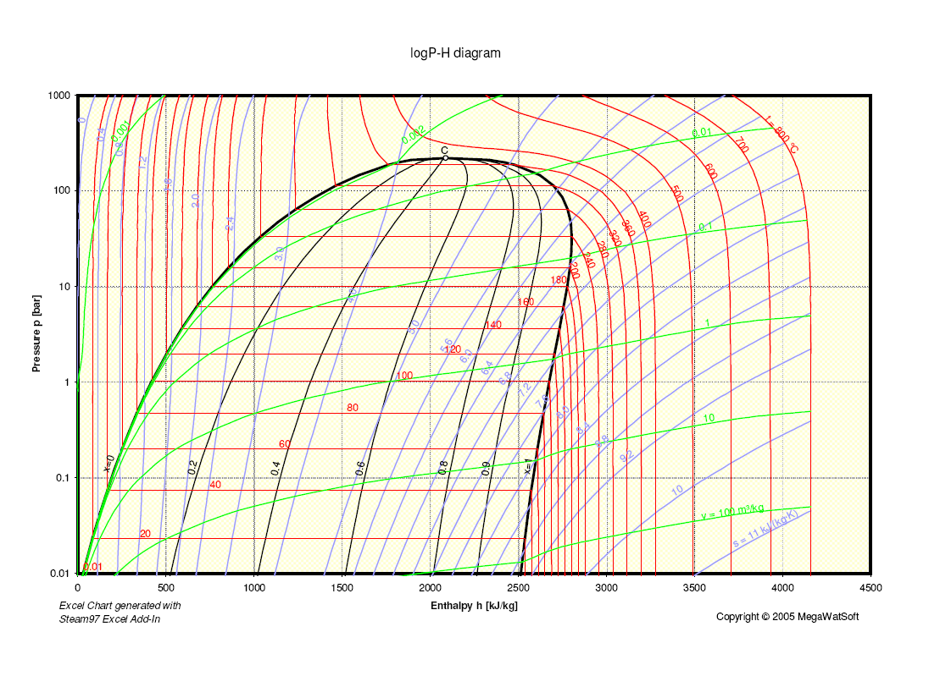
Research Group of Energy Conversion and Systems
Department of Mechanical Engineering
School of Engineering, Aalto University, Finland
Simplifying getting Steam and Water Properties Using MATLAB/Simulink
Abstract
Project Description
The efficient retrieval of steam and water properties is crucial for engineers, researchers, and practitioners across various fields—ranging from energy systems and chemical processes to environmental engineering. In this project, we delve into the realm of automation, leveraging the powerful combination of MATLAB and Simulink to streamline this essential process.
Our overarching goal is to simplify the acquisition of steam and water property data, transcending the limitations of manual methods. By automating this critical step, we unlock a multitude of benefits that resonate throughout the engineering community.
Our research approach involves:
Literature Review: Investigating existing methods for obtaining steam and water properties.
Model Development: Creating a MATLAB/Simulink model that interfaces with relevant databases or libraries.
Validation: Verifying the accuracy of the automated results against established data sources.
Relation to Thermodynamics and Heat Transfer
Expected Results
This project directly relates to the fields of thermodynamics and heat transfer. By simplifying property retrieval, engineers and researchers can focus more on system analysis and design.
Project Benefits
Enhanced Efficiency and Productivity:
By automating the retrieval of steam and water properties, engineers and researchers can save valuable time. No longer will they need to manually search for data or perform repetitive calculations.
The streamlined process allows professionals to focus on higher-level tasks, such as system design, optimization, and analysis. This increased efficiency translates to faster project completion and improved productivity.
Consistent and Reliable Results:
Automation ensures that property data is retrieved consistently across different scenarios. Whether it’s a small-scale simulation or a complex engineering project, the same reliable information is obtained every time.
Eliminating human error associated with manual data entry or calculations further enhances the reliability of results.
Integration with Existing Workflows:
The MATLAB/Simulink-based solution seamlessly integrates into existing engineering workflows. Engineers can incorporate the automated process without disrupting their established practices.
Whether you’re designing a heat exchanger, analyzing a power plant, or modeling a thermodynamic system, the automated property retrieval becomes an integral part of your toolkit.
eng.aalto.fi/en

