Slide 1
ASKET
PRESENTATION
Street style brand
since 1996

Slide 2
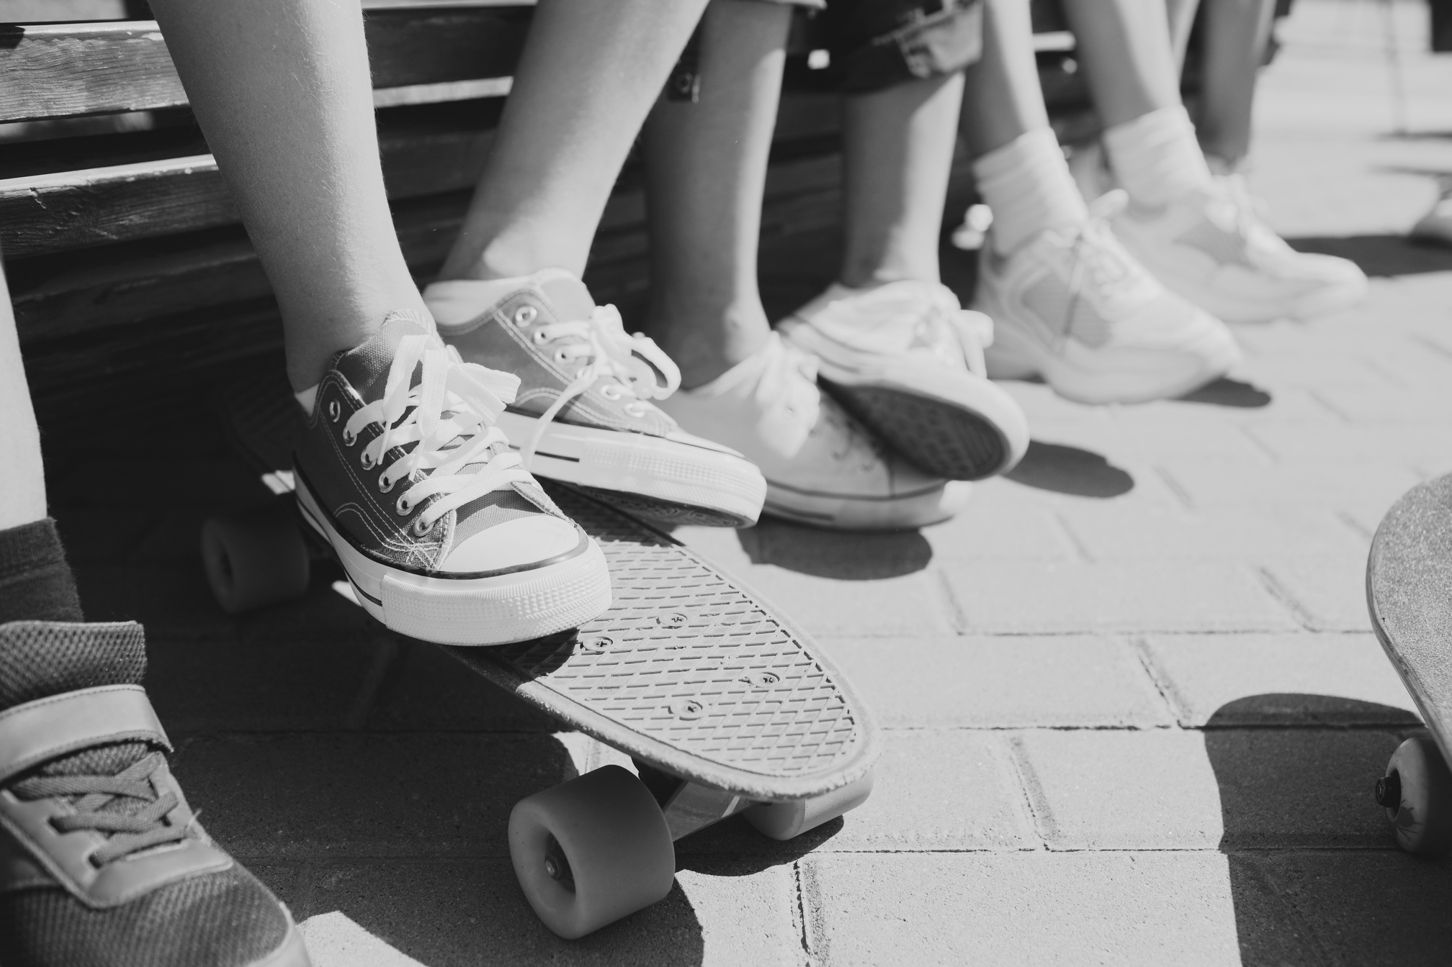
One!
Go!
Two!
Introduction
Founded ASKET in 2015 in Stockholm, Sweden, to create the perfect essential wardrobe -a permanent collection

Slide 3
Mission
We envision a world free of fast consumption.
A world with less clutter, less waste, less smoke and mirrors.
ASKET. The pursuit of less.
LOGO

Slide 4
3 Pillars
Full Transparency
Lifecycle Responsibility
Operations

Slide 6
Transparency
Cost Transparency
Origin
Transparency
Impact
Transparency
- Customers have the right to show you what you’re paying for.
- To understand the value of your clothing, you need to understand its costs too.
- Cost breakdown of every garment on each product page.
Full Traceability (own transparency standard) launched in 2018.
Developed a traceability score, grouping every garment into the three major tiers of creation and their minor components (trims)
- Provide scientific lifecycle impact assessments (LCIAs) on every ASKET garment, disclosing what a garment costs, where, how its made, and the environment resources consumed

Slide 7
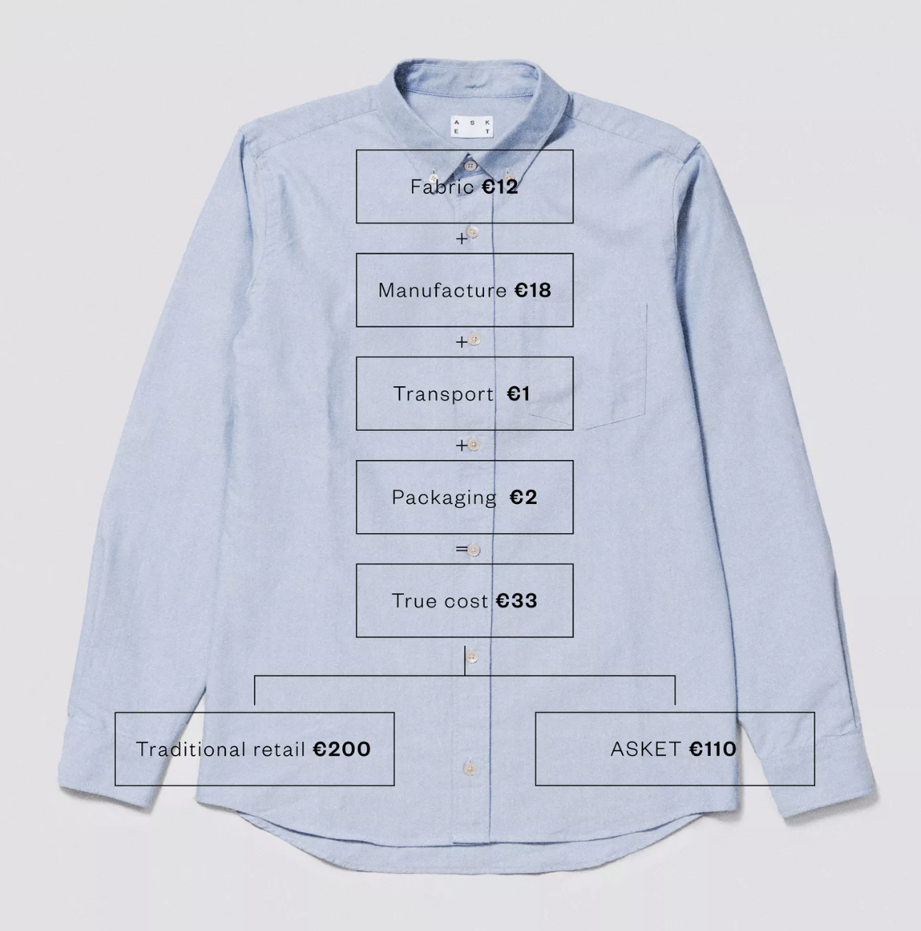
Transparency
Cost Transparency
Origin Transparency
Impact Transparency

Slide 8
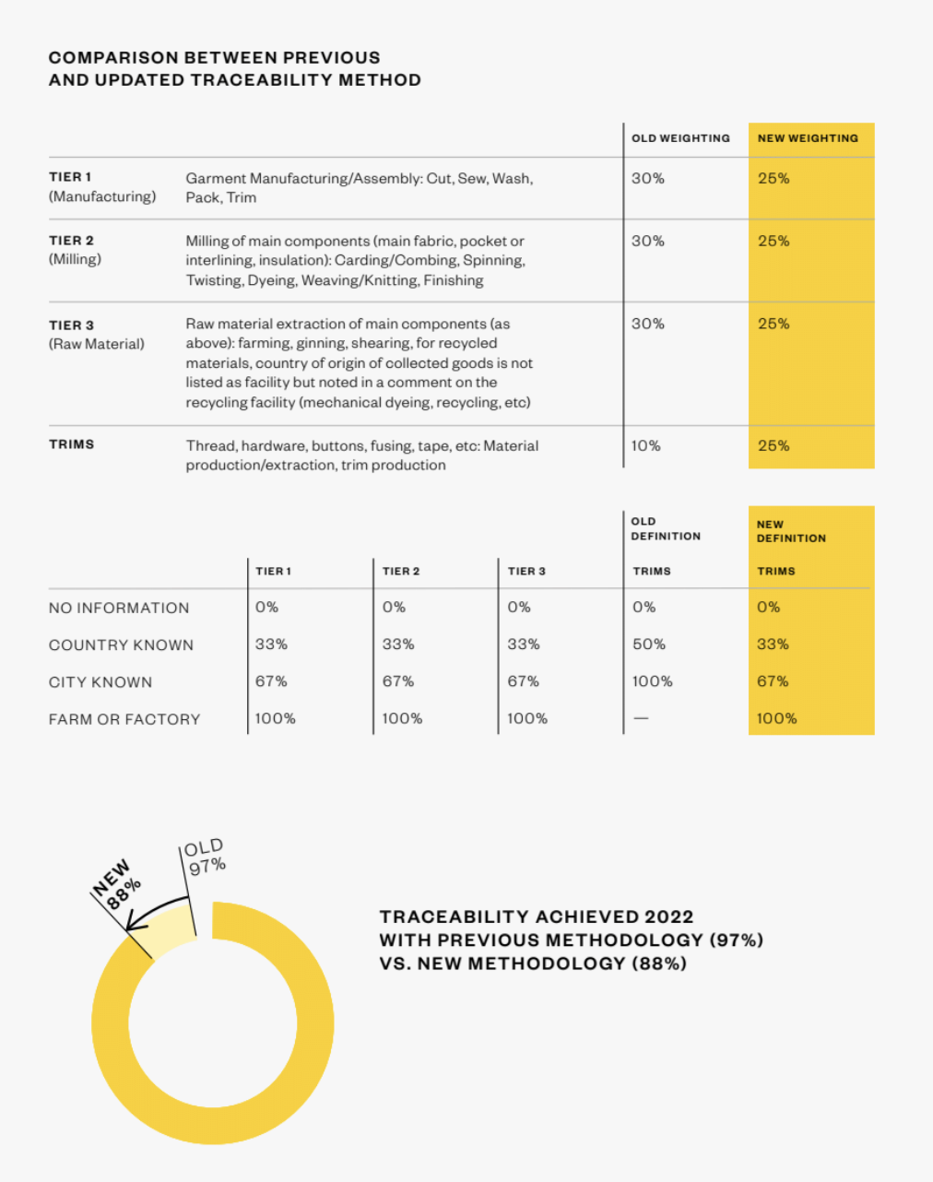
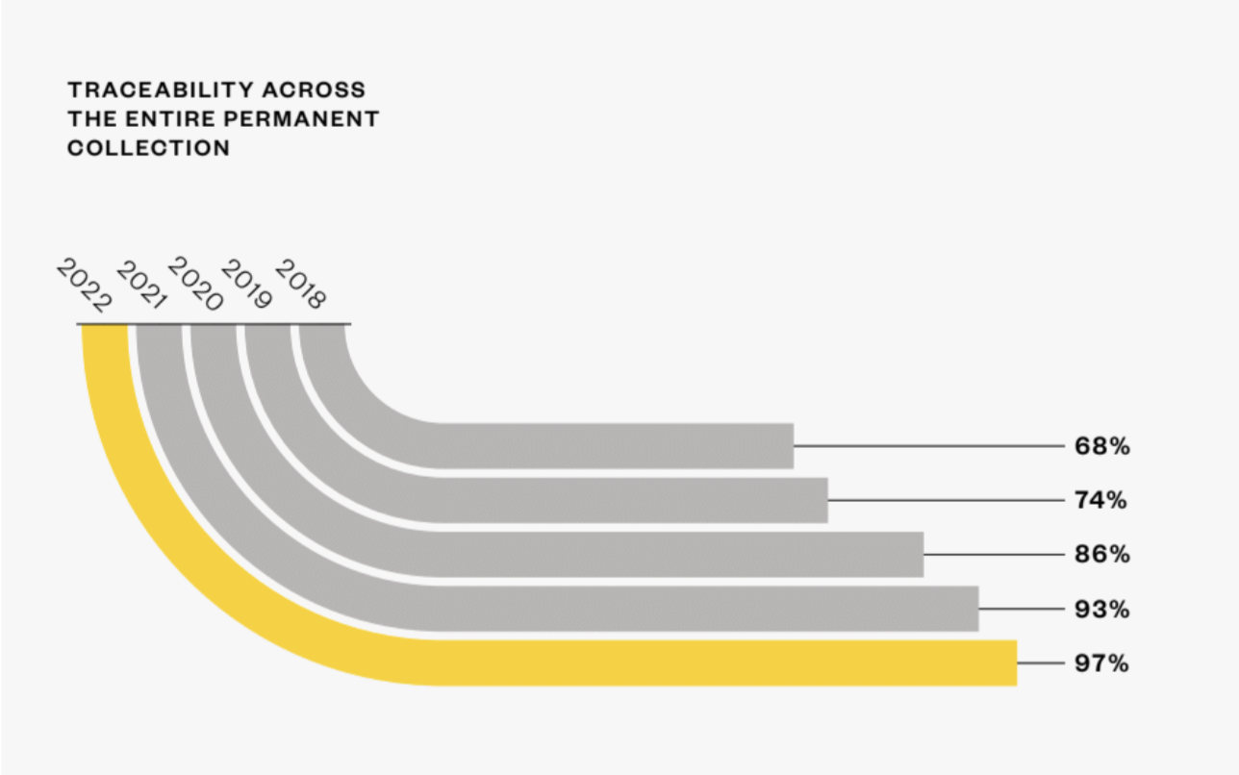
Traceability Transparency
Transparency
Origin Transparency
Impact Transparency

Slide 9
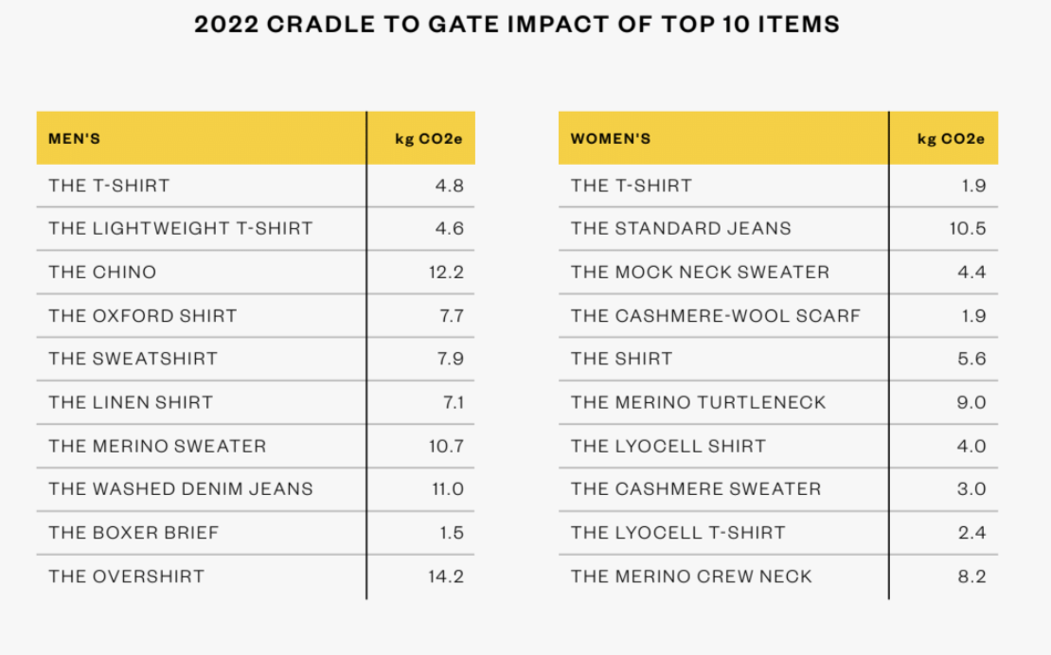
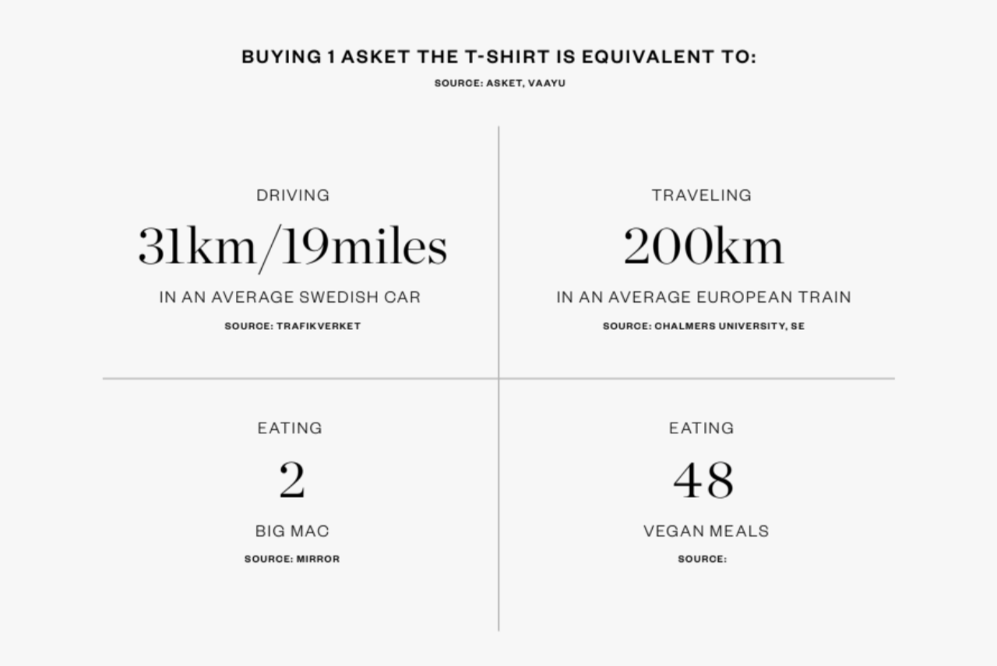
Impact Transparency
Transparency
Origin Transparency
Impact Transparency

Slide 10
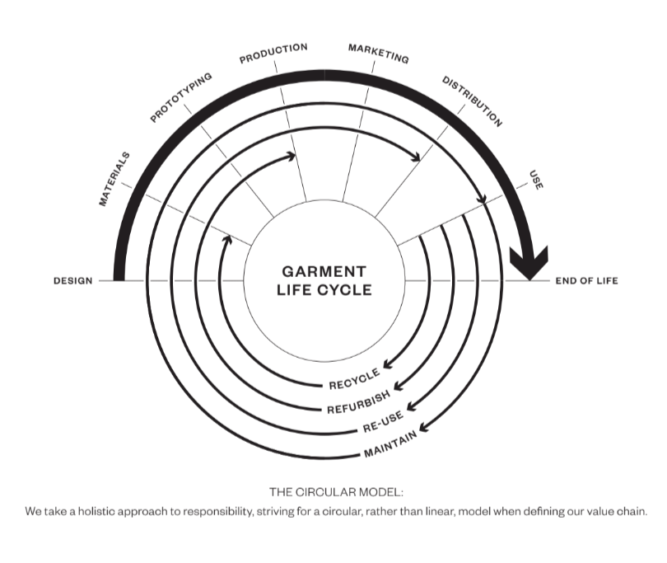
Garment Life Cycle

Slide 11
Operations
Onboarding & Education
Travel
Vacations
Activities
Office & Catering

