Slide 1
Fairphone

Slide 2
Company background
Smartphone company founded in 2013 and based in Dutch
Creation of sustainable alternative to conventional products
In 2022, 999 tons of CO2 were avoided, carbon emissions of 650 Dutch households

Slide 4
Fairphone initiatives for a greener planet
Repairable design
Phones are designed to be fixed
Carbon neutral
Phones are shipped sustainably
Recycling materials
Old phones are recycled

Slide 6
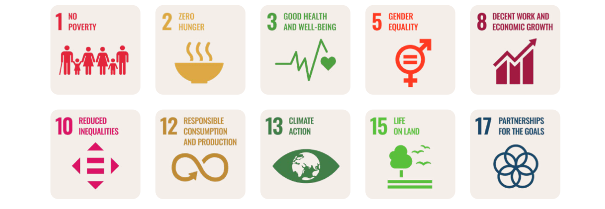
CSR strategies
KPIs and sustainable development goals
Minimizing the negative impacts of their products

Slide 7
KPIs

Slide 8
Actions
KPI 1: Fairphone sold : Establish a market for ethnic phones
KPI 2: Longevity: create product that last
KP1 3:E-waste neturality:Take back,reuse and recycling.
KPI 4: Fair materials: choosing fair materials
KPI 5: Fair factories: Decent work in manufacturing
KPI 6: Industry influence Score: Driving wider impact of our industry
KPI 7: Net financial results: Positive net reusly, company growth,and development

Slide 9
Aligns with our discussion
Corporate sustainability as integration
Focus on artisanal and small-scale mining (ASM). Often operating outside the formal mining sector (and related regulations)
Corporate sustainability as innovation
Innovative materials , e.g: Tin -->100% recycled tin in the solder of Fairphone 4
Plastic --> Over 50% of the phone plastic is post consumer recycled

Slide 10
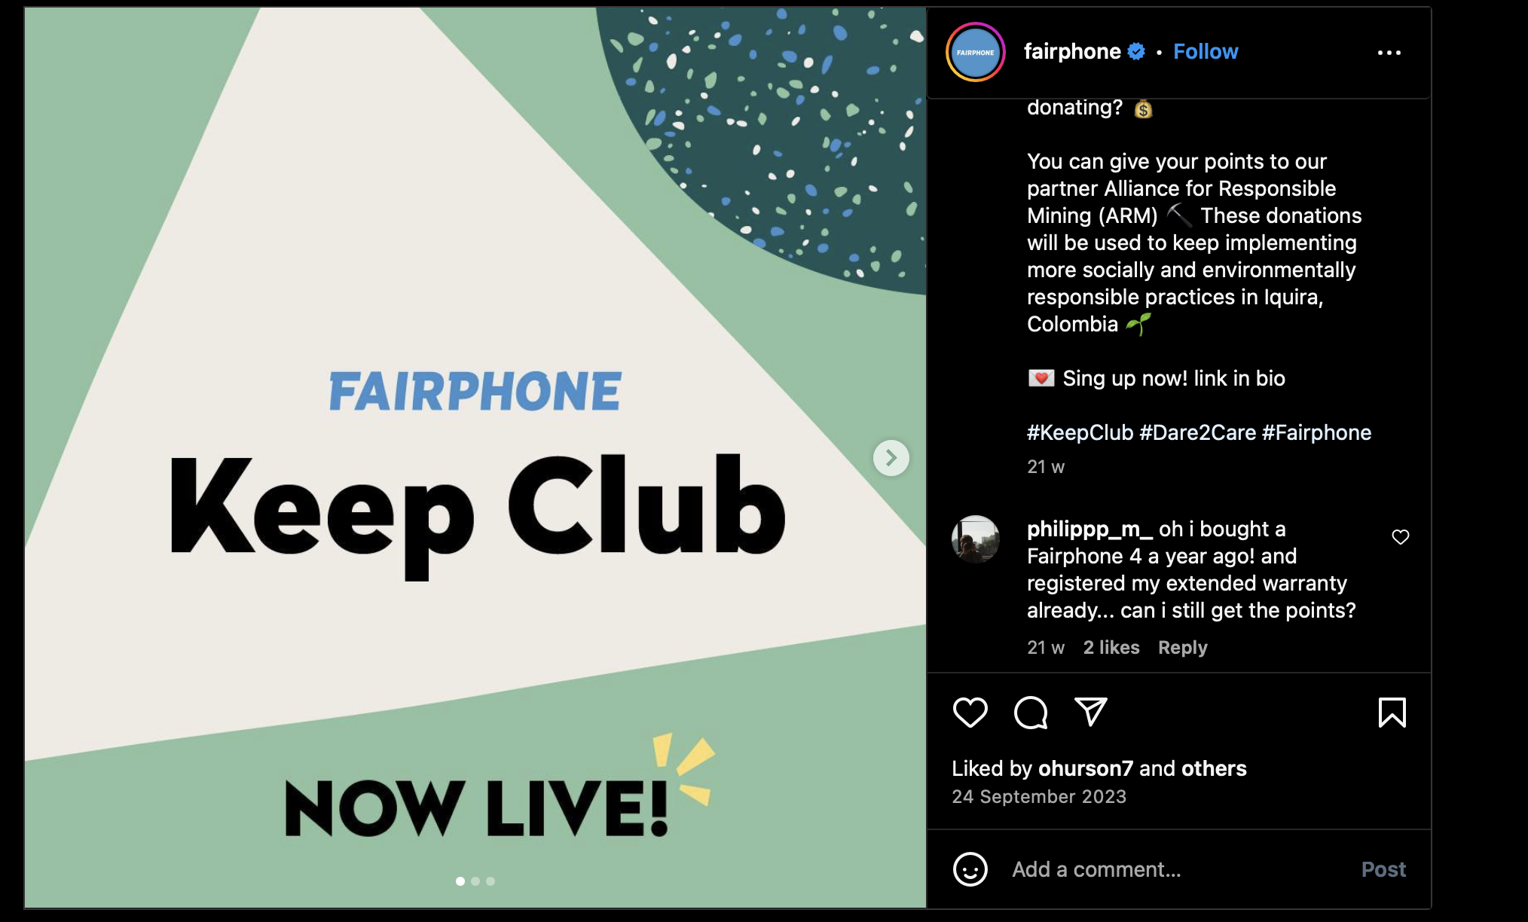
Aligns with our discussion ( CONT)
Corporate sustainability as philanthropy
Loyalty program

