Slide 1
Miele
Alisa Kyyriäinen, Liisa Saaranen, Nguyen Vo, Albert Jantunen

Slide 2
Introduction

Slide 3
What is Miele?
Miele is a German manufacturer of high-end domestic appliances and commercial equipment.
Miele is a family owned and run company, founded in 1899.
Miele's philosophy "Immer Besser" (Forever Better) shows its commitment to quality, innovation and to be the pioneer in the industry.
Miele has always been focused on being sustainable.
"Miele is dedicated to producing the best possible products and services with the least impact on the environment, with the ultimate aim to make them 100% carbon-neutral."

Slide 4
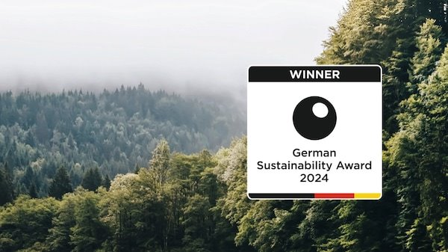
Global company - 4,5 billion euros in turnover generated in 2020. 2023 Green Product Award for dishwashers A is the energy-efficiency rating of most washing machines in the domestic sector German Sustainability Award 2014 & 2024
What is Miele?

Slide 5
Sustainability Reporting
Management and processes
Products and services
Supply chain and production
Employees and society

Slide 6
Products and Services
Development and innovations
Offer robust benefits to customers wile having as little environmental impacts as possible
Customer orientation and information
Maintain long-term relationships with retailers and suppliers; provide transparent information to stakeholders
Disposal and recycling
Product portfolio and quality
Improve return system in logistics and environmental impact
Offer long-service-life product with maximum energy efficiency and functional efficieny

Slide 7
Management and processes
Sustainability strategy
Sustainability management
Focuses on climate action, sustainable product and packaging, and digital responsibility
Review potential negative impacts and take preventive measures from the early stages
Stakeholder Management
Maintain close relationship through public relations, conferences and associations

Slide 8
Supply Chain and Production
Recycled Plastics
Material saving components
5k-7.5k tons per year by 2025
Save up to 30% of materials
Decrease CO2 emissions
Long term supplier relationships
Sourcing resources, in production, vehicle emissions

Slide 9
Employees and Society
Education and Training
Events and Campaigns
Car-free-day campaign

Slide 10
Three Pledges
Make sustainability happen at every step
Make appliances that won't leave a mark
End waste by giving our appliances new life
Ensuring sustainability at every stage, from services to customers homes
Producing appliances with the least possible impact to the environment and striving for 100% carbon neutrality.
Working towards a circular value chain and net-zero waste through recycling

Slide 11
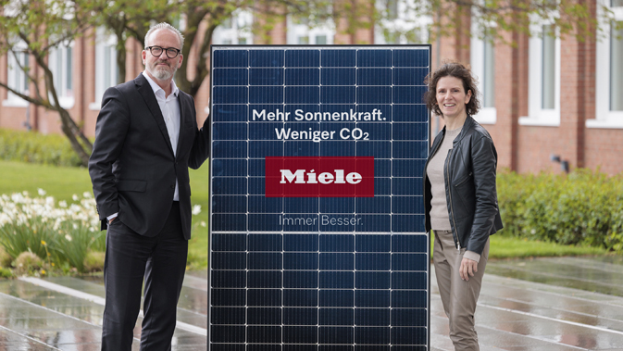
Investments in solar energy
Miele is constructing a solar array in the town of Gütersloh where they are headquartered.
The project will provide enough energy to power 250 homes per year.

Slide 12
Thanks

