Slide 1
Tilda Hyttinen, Otso Järvenpää, Max Mäkynen, Juho Jääskeläinen

Slide 2
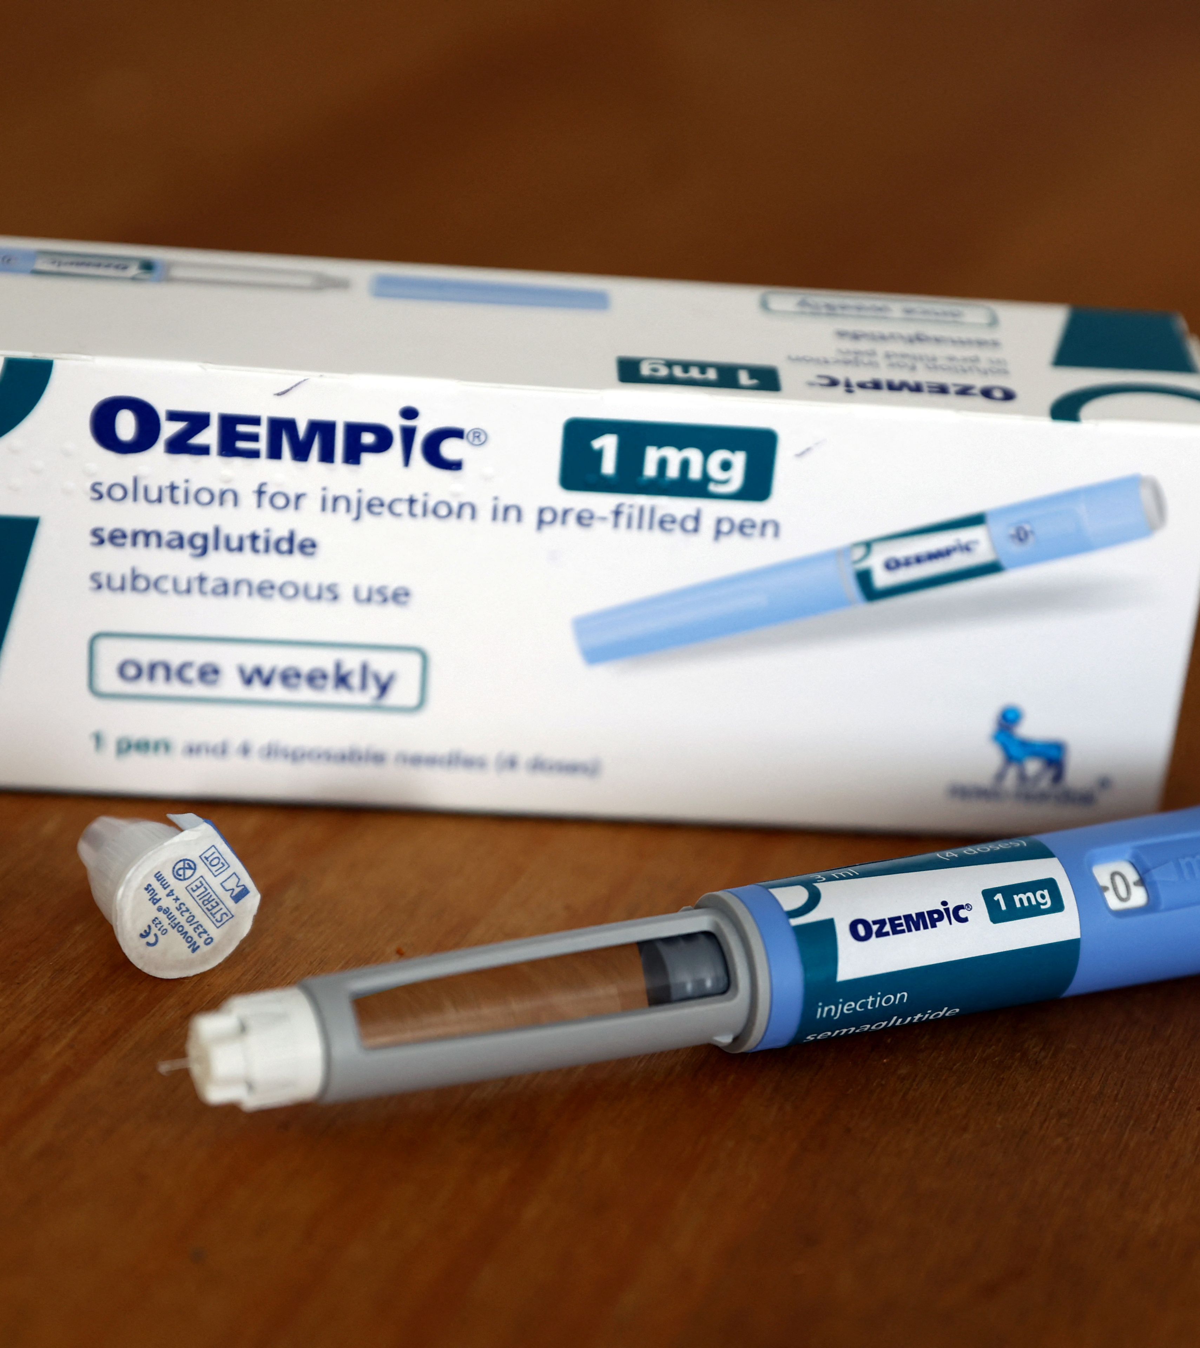
Company description
A Danish pharmaceutical company
Diabetes care medication and devices
One of the largest companies in the Nordics
48 000 employees
Products sold in 168 countries
https://www.novonordisk.com/content/dam/nncorp/global/en/investors/pdfs/capital-markets-day-2022/P14-full-presentation.pdf

Slide 3
Circular for Zero strategy

Slide 4
C02 Strategy
"Our CO₂ emissions continue to rise, especially in transportation. As 2045 approaches, we have an interim target to reach zero CO₂ emissions from operations and transport by 2030 – an important milestone in achieving our greater net zero commitment."
And a further goal of "net zero emissions across our entire value chain by 2045"
Zero environmental impact (novonordisk.com)

Slide 5
Plastic Strategy
CHANGE TO SUSTAINABLE PLASTIC:
Engage with suppliers to pursue shift to sustainable plastic
Drive innovation via partnerships to e.g. repurpose medical waste
REDUCE PLASTIC CONSUMPTION
• Drive portfolio decisions towards lower plastic consumption
• Drive switch towards durable devices in relevant markets
AVOID PLASTIC WASTE IN LANDFILLS
• Take-back1 pilot in Denmark with partners leading to >20% device return
• Take-back expansion to UK, Brazil and France with ambition to establish industry solution for scaling
Our approach to sustainability (novonordisk.com)

Slide 6
Promoting Social Sustainability
"Defeating Diabetes is the cornerstone of Novo Nordisk's Social sustainability"
3 USD ceiling price for human insulin vial offered to 76 low- and middle-income countries, reaching +1.7m patients in 2021
Ensure availability of affordable insulin for vulnerable patients
Providing care for children living with type 1 diabetes
In 2021, ~1m vulnerable patients reached with insulin
Access to Insulin Commitment
Changing Diabetes® in Children
Vulnerability assessments
US affordability offerings
https://www.novonordisk.com/content/dam/nncorp/global/en/investors/pdfs/capital-markets-day-2022/P14-full-presentation.pdf

Slide 7
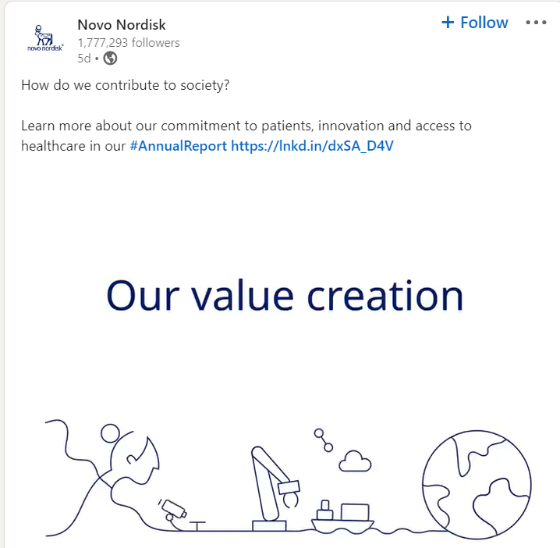
Promoting Social Sustainability
Social Media visibility
Social sustainability is a process for creating sustainable successful places that promote wellbeing, by understanding what people need from the places they live and work.
Novo Nordisk highlights social sustainability in their social media platforms. They have posts for example on how to support your close ones with diabetes. It can help to enhance the importance of their business, but to also improve credibility of the business among the public.

Slide 8
Strategic Partnerships
United Nations
Sustainable Development Goals
CDP
CDP is a not-for-profit charity that runs the global disclosure system for investors, companies, cities, states and regions to manage their environmental impacts.
THE 17 GOALS | Sustainable Development (un.org)
Home - CDP

