Slide 1
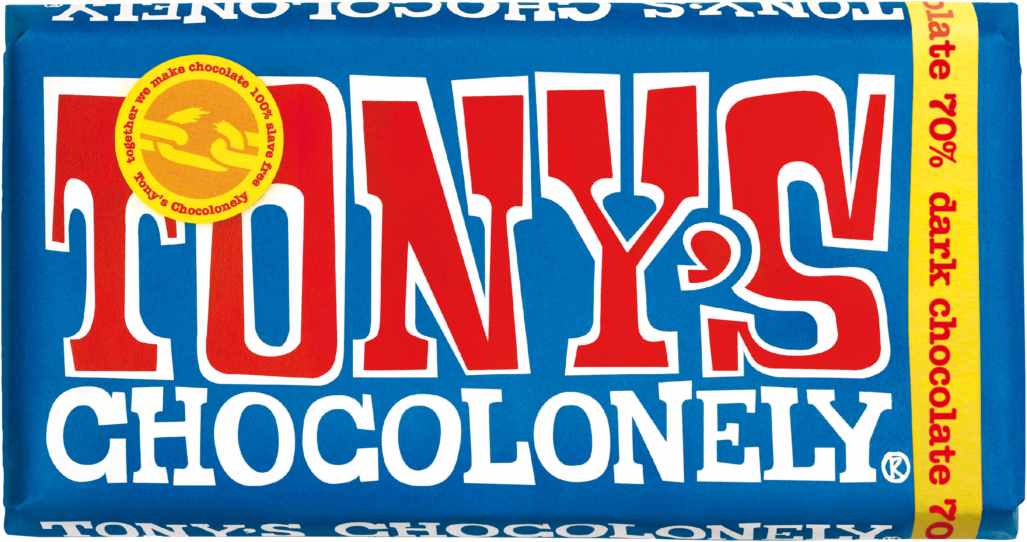
Anton, Pinja, Otava, and Onni

Slide 2
BEGINNINGS
TODAY
Revenue of 150 million in 2022-2023
23% higher than previous year
100% slave-free production, 90% recyclable paper
2018-2020 awarded as the most sustainable brand by Dutch consumers
Founded in 2005 in Amsterdam
Journalist Teun van den Keuken (Tony) became aware that many chocolate manufacturers use slave labor and other unethical methods
He asked to be prosecuted for buying illegally manufactured chocolate
After three years of unsuccessful attempts to change the industry, he decided to set up his own chocolate brand

Slide 3
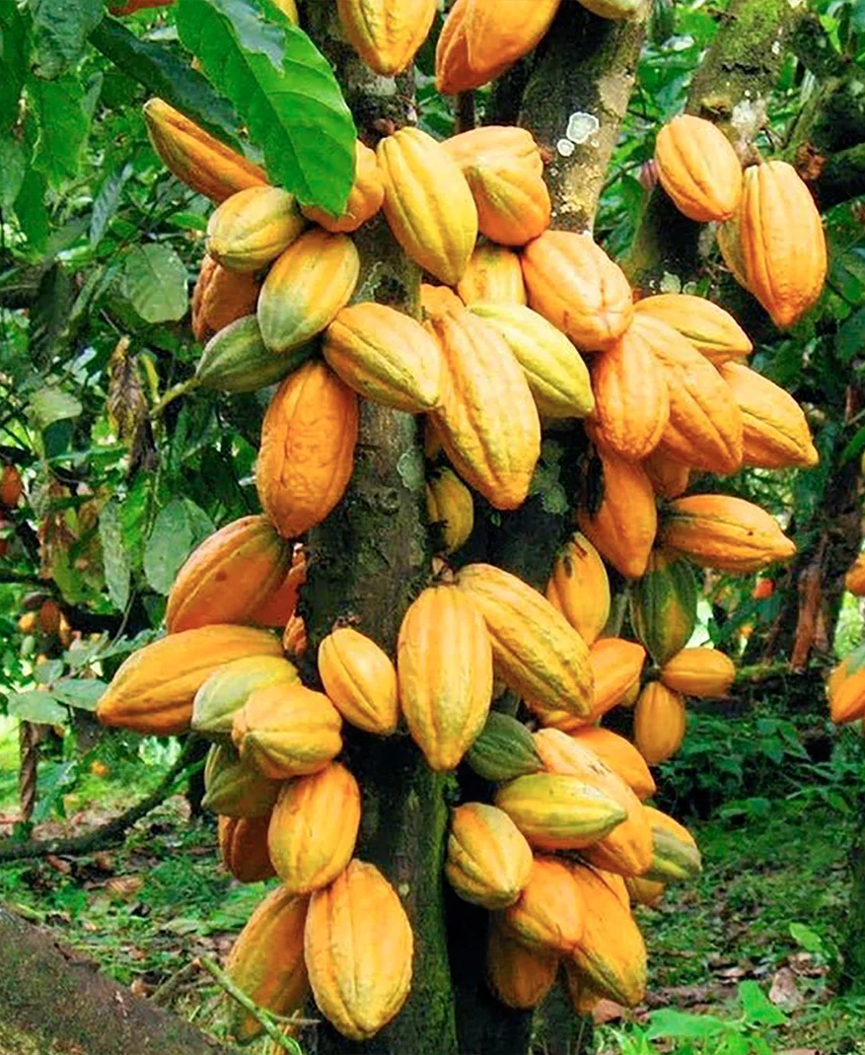
1. Environmental Impact
Investing in agricultural knowledge and training professional farmers
Make sure that the environmental conditions under which the cocoa is produced are known
Using GPS to make sure no cocoa is produced in protected areas
87% lower carbon footprint in Ghana and 95% lower in Ivory Coast compared to other producers
Deforestation-free supply chain
However, “social impact comes first” and for the environment “we do what we can”

Slide 4
2. Social Responsibility
Strong farmer collaboration: tackling sustainability issues together
Tony’s Living Income Model ensures a living income premium
Higher price for cocoa beans to support farmer wellbeing
Long-term cooperation ensures farmer income stability and development
“Memorandum of understanding” guarantees at least five years of collaboration with farmers
100% accountability over the supply chain
Child Labor Monitoring and Remediation System (CLMRS)

Slide 5
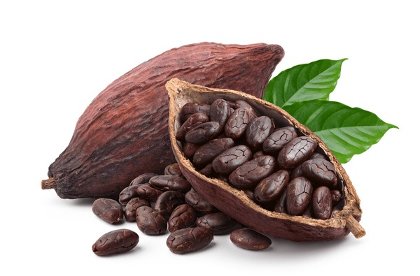
3. Ethical standards
5 Sourcing Principles:
Traceability
Higher price
Empowering farmers
Commitment
Agricultural quality and productivity

Slide 6
Focus on working conditions → “100% slave-free chocolate”
Stop Slavery Award in 2022
Only 9,000 farmers (2022) → better supply chain transparency
Fair compensation to farmers
No child labour → cases found!
Goal of continuous improvement
Vegan choices!

Slide 7
4. Governance & leadership
Tony’s chocolonely’s ”Mission lock”
A legal board structure created to ensure the application CSR variables in decision making.
A relevant share of the company’s voting power is given to an independent entity.

Slide 8
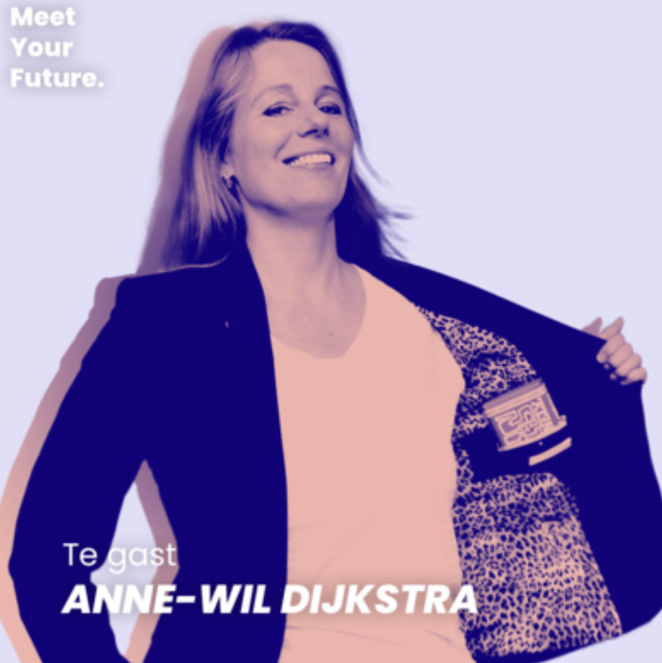
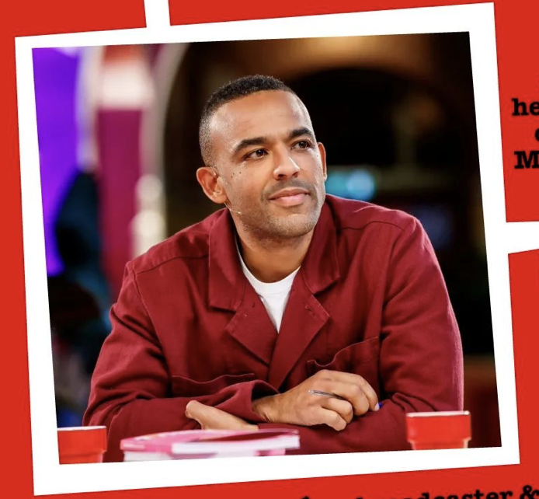
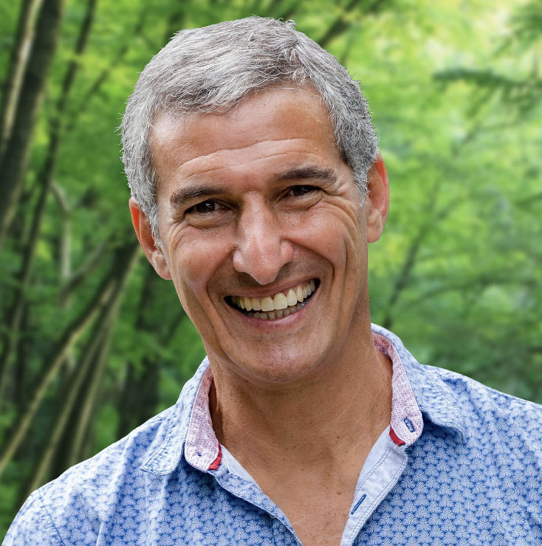
”Mission Guardians”
Three business professionals from various backgrounds selected to sit in the board of Tony’s Chocolonely:
Anne Wil Dijkstra (An experienced freelancer management consultant)
Ikenna Azuike (Business Lawyer for Philantrophy institutions)
Seth Goldman (Chief executive of Beyond Meat inc.)

Slide 9
References
https://edition.cnn.com/2017/06/02/world/tonys-chocolonely-slavery-free-chocolate/index.html
https://tonyschocolonely.com/us/en/annual-fair-reports/annual-fair-report-2022-2023
https://tonyschocolonely.com/nl/en/our-mission
https://tonyschocolonely.com/nl/en/our-mission#manifest-4
https://tonyschocolonely.com/uk/en/our-chocolate/products/vegan-bars
https://www.thetimes.co.uk/article/anti-slavery-chocolate-brand-tonys-chocolonely-finds-1-700-child-workers-in-supply-chain-0n87qj996
https://www.mashed.com/864912/the-untold-truth-of-tonys-chocolonely/
https://tonyschocolonely.com/nl/en/our-mission/news/cheers-to-a-stellar-year-of-making-impact-in-cocoa
https://www.shutterstock.com/image-photo/cocoa-beans-pod-isolated-on-600nw-2198952323.jpg
https://tonyschocolonely.com/int/en/our-story/news/tonys-mission-lock

