Slide 1

Sustainability & Strategy
Jukka Rintamäki
Martta Nieminen
Sustainability in Business 27 April, 2023

Slide 2
Group project
Be efficient with time – you have 20 minutes
  This is an exercise of presenting relevant information efficiently; it’s not easy to make an informative 20-minute presentation
Be analytical
  Don’t just regurgitate the company’s/organization’s/etc. own story; explore other sources, provide the viewer a thorough look
Refer and connect to course materials (concepts, topics)
  Use them in your analysis; that’s what they’re for
Your work will be evaluated based on the following:
  Coherence/flow
  Depth, critical discussion
  Use of sources and referencing
  Presentation/communication

Slide 3
Reviewing previous lecture
We discussed some primary sustainability problems that we’re collectively facing
  Biodiversity loss, climate change, chemical flows/accumulation...
  Poverty, modern slavery, human rights issues more broadly...
We learned to distinguish between weak and strong sustainability
What else?
Questions?

Slide 4
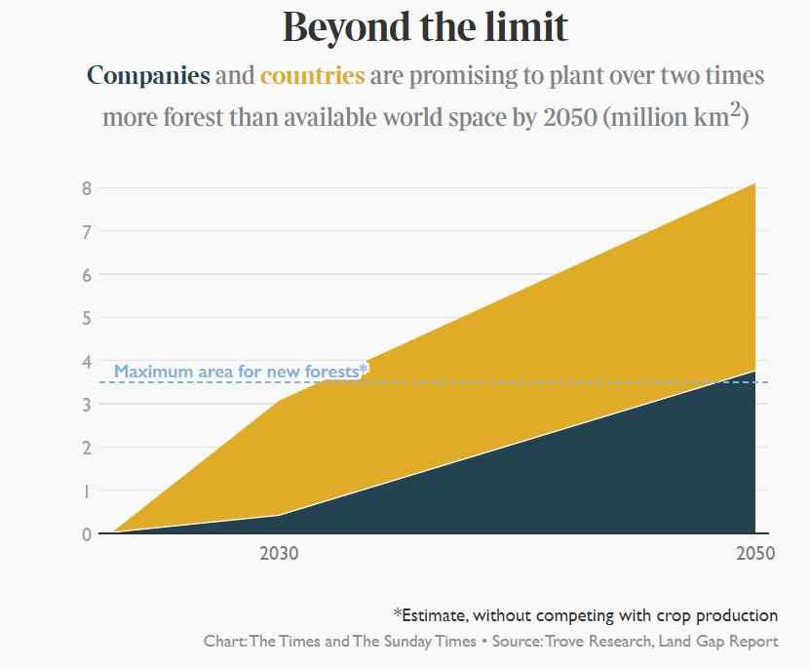
A reminder: systems perspective

Slide 5
Agenda
What is (strategic) corporate sustainability?
The story so far
What are the most common approaches to sustainability?
Critical evaluation of strategic sustainability

Slide 6

Expected learning outcomes
Develop a basic grasp of the background/history of corporate sustainability
Develop an understanding of what is meant by contemporary, strategic corporate sustainability
Learn basic concepts around corporate sustainability
Know the basic critiques of integrated/strategic corporate sustainability

Slide 7

The story so far

Slide 8
Three waves of business sustainability
Source:
Hoffman & Bansal, 2012

Slide 9
Late 1960s-1970s
First wave:
Regulatory compliance
Triggered by various acknowledged threats to the natural environment
  The Silent Spring (1968 book by Rachel Carson)
  The formation of the Club of Rome (1969); Santa Barbara oil spill (1969); the first Earth Day (1970)
Environmental government agencies were formed (e.g. EPA in the US)
Corporate departments in the style of ”Environmental Health & Safety” started appearing
  Environmental issues were not a matter of huge importance for corporations, and these departments mostly focused on fulfilling legal requirements

Slide 10
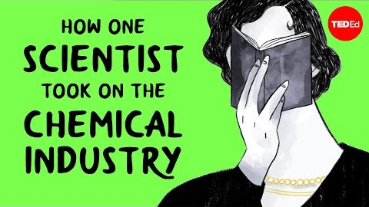
Rachel Carson’s Silent Spring

Slide 11
Late 1980s-1990s
Second wave:
Strategic environmentalism
Triggered by
  The Union Carbide Bhopal plant disaster of 1984
  Discovery of the Antarctic ozone hole, the Brundtland report, formation of IPCC, Exxon Valdez oil spill
Insurers started taking pollution issues into account
Investors started to consider environmental liabilities in their portfolio
Environmental issues thus became a strategic concern for firms
  Waste minimization and eco-efficiency became fashionable
  Increased organizational importance and power for environmental departments
Environmental issues entered the mainstream academic literature on business management

Slide 12
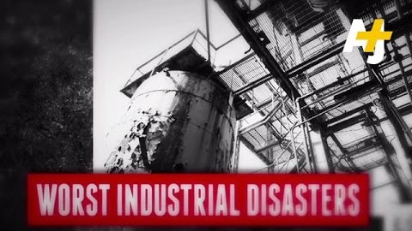
The Union Carbide Bhopal disaster

Slide 13
2010 →
Third wave:
Corporate sustainability
Triggered by
  Growing scientific consensus that humans are impacting the global climate through the release of greenhouse gases into the atmosphere
Characterized by mainstreaming of sustainability
  Firms integrate sustainability into their core strategies
  Universities promote sustainability in their curricula, and it’s mainstream in mgmt research
  Sustainable products, cars, food, transportation proliferate, and sustainability has become a token of legitimacy

Slide 14
Strategic sustainability?
”Strategic” refers to actions that are taken with particular purposes or goals in mind, typically with long-term considerations in mind
  Can be applied with all sorts of goals in mind
  With a typical business, this means that strategic CSR implies (expected) economic gains become a necessary condition for CSR-related activities

Slide 15
Strategic sustainability?
Sustainability strategies are choices available to managers to align environmental and social activities with the generic strategy of the company
Notes:
Creating shared value: akin to the Ford Model T, where Henry Ford’s idea was that by paying higher wages to workers they also generate demand for their products in the form of affluent consumers
2011: Something has been lost in the race for short-term profits; there are differences between kinds of profitability

Slide 16
Definitions are easy, but…
Sustainability is multi-faceted as it involves multiple goals areas: environmental, social, economic
  Triple bottom-line as opposed to single financial bottom-line
When planning a sustainability strategy, managers essentially have to consider and decide how to put together financial, environmental and social goals.

Slide 17
Definitions are easy, but…
Key questions:
  How can we combine ecological, social and financial goals?
  Are sustainability and corporate responsibility financially profitable? Is there a business case for sustainability? (“win-win”)
  Or is it just an additional cost? (“win-lose”)

Slide 18

Approaches to sustainability strategy

Slide 19
Three general approaches
Corporate sustainability as philanthropy
Charity, employee voluntarism, sponsorships etc.
Corporate sustainability as integration
Improving sustainability aspects of existing products, processes and operations
Comply with standards, acquire certificates, develop environmental management systems...
Corporate sustainability as innovation
Solving social and/or ecological problems with own (new) products, services and business models (e.g. eco-innovations or inclusive innovations for poverty alleviation)

Slide 20
Integrated corporate sustainability
Relationship to core business: Close to existing core business
Target of sustainability: Environmental and social performance of existing business operations
Expected benefits: Improvements of env. and soc. aspects of core business, image and reputation improvement
Aim: To conduct existing business more sustainably
Examples: Certification of facilities with environmental or social standards (e.g. ISO14001; SA8000), having environmental management systems in place, producing standardized sustainability information (e.g. GRI)
Source:
Halme & Laurila, 2008

Slide 21
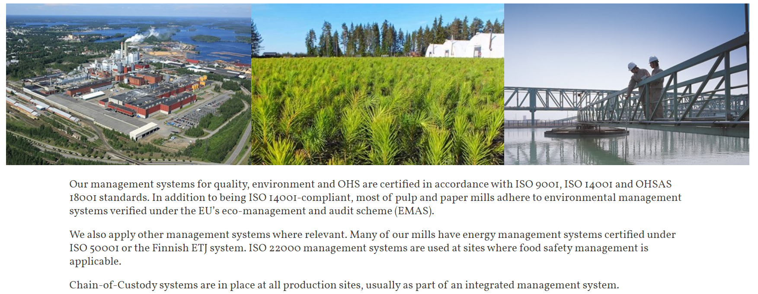

Example of integrated corporate sustainability

Slide 22

Triple-bottom line
A framework that stresses the reporting of social, environmental, and economic dimensions of corporate activity
Not a formal system of reporting as such, but is typically conducted through a more formal system such as the GRI
Impetus is on generating more value through consideration of a broader set of stakeholders; commonly associated with eco-efficiency
The background ’philosophy’ emphasizes win-win situations

Slide 23

Critiquing strategic corporate sustainability

Slide 24
Will sustainability strategy improve environmental and social performance?*
STRATEGIC sustainability management
OPERATIVE sustainability management: Implementation
Structures
”Hard”
Improved
sustainability performance
Sustainability pressures in institutional environment
Strategic goals
!
!
Practices
”Soft”
!
Risk of PRESSURE-POLICY decoupling
Risk of POLICY-PRACTICE decoupling
Risk of MEANS-ENDS decoupling
”Try but fail”: ineffective
implementation
Non-improved
sustainability performance
”Look as if”: symbolic or no implementation
”Not even try”: non-conforming response, unambitious goals
*Sustainability case
Halme, M., Rintamäki, J., Knudsen, J., Lankoski, L. and Kuisma, M. 2020. When Is There a Sustainability Case for CSR? Pathways to Environmental and Social Performance Improvements. Business and Society 59 (6): 1181-1227
Notes:
Halme, M., Rintamäki, J., Knudsen, J., Lankoski, L. and Kuisma, M. 2020. When Is There a Sustainability Case for CSR? Pathways to Environmental and Social Performance Improvements. Business and Society 59 (6): 1181-1227Best Paper Award of Business and Society 2020.

Slide 25
What’s wrong with corporate sustainability?
The business case for sustainability simply is not enough
  Prioritizing profits over planet and people leads to very little for the latter two
Talk vs walk (greenwashing)
  Glossy words alone don’t mean much
  Time frames businesses give themselves tend to be relaxed and flexible
Reducing unsustainability is different from sustainability
End-of-pipe solutions are not effective enough
Solutions per unit of production do not necessarily generate total output reductions in environmental harm
  If Zara says their target is to reduce CO2 generation per unit produced by 10% and increase sales by 20%, what will happen?

Slide 26
Problems with triple-bottom line
TBL, in practice, equates the reporting of environmental and social issues with doing something in their benefit
  As such, TBL communicates genuine impacts of corporate activity quite poorly
TBL is essentially a manifestation of weak sustainability
  The proposed equality of people, profit, planet end up in the dominance of profit
  This is evidenced (economic) value-generation impetus
It has in fact been argued that TBL has had a hand in the corporate ‘blanding’ of sustainability
Source:
Milne & Gray, 2013

Slide 27
Why is corporate sustainability so difficult?
Environmental strategy as a composite of existing business interests
Again: weak sustainability
Sustainability interests compete with many other issues that require attention and resources
They end up essentially an afterthought, typically
Source:
Hoffman, 2000
Notes:
Problems abound when no clear hierarchy between priorities – shareholder primacy tends to

Slide 28
Wrap-up
To summarize:
  Integrated corporate sustainability has enough scope, but lacks ambition
  Innovative corporate sustainability has enough ambition, but lacks scope
The most common, business-as-usual notion of corporate typically focuses on the business case of sustainability
  Profit before planets and people, though symbolically they’re equal

Slide 29
References
Ergene, S., Banerjee, S. B., & Hoffman, A. 2020. (Un)Sustainability and Organization Studies: Towards a Radical Engagement. Organization Studies, 017084062093789.
Hart, S. L. 1995. A Natural-Resource-Based View of the Firm. The Academy of Management Review, 20(4): 986.
Halme, M., & Laurila, J. 2008. Philanthropy, Integration or Innovation? Exploring the Financial and Societal Outcomes of Different Types of Corporate Responsibility. Journal of Business Ethics, 84(3): 325–339.
Halme, M., Rintamäki, J., Knudsen, J. S., Lankoski, L., & Kuisma, M. 2020. When Is There a Sustainability Case for CSR? Pathways to Environmental and Social Performance Improvements. Business and Society, 59(6): 1181–1227.
Hoffman, A. J., 2000. Competitive environmental strategy: A guide to the changing business landscape. Island press.
Hoffman, A. J., & Bansal, P. 2012. Retrospective, Perspective, and Prospective: Introduction to the Oxford Handbook on Business and the Natural Environment. The Oxford Handbook of Business and the Natural Environment, (October): 1–25.
Hoffman, A. J., & Ehrenfeld, J. R. 2015. The fourth wave: Management science and practice in the age of the anthropocene. In S. Mohrman, J. O’Toole, & E. Lawler (Eds.), Corporate Stewardship: Achieving Sustainable Effectiveness. Taylor & Francis.
Landrum, N. E., & Ohsowski, B. 2018. Identifying Worldviews on Corporate Sustainability: A Content Analysis of Corporate Sustainability Reports. Business Strategy and the Environment, 27(1): 128–151.

Slide 30
In-class task: Case investigations of strategic sustainability
Pick case companies and examine their CSR strategies / strategic aspects of their CSR
  Examine their websites on CSR/sustainability, and their latest CSR/Sustainability reports
  What can you say about them on the basis of what we have been discussing?
    Can you identify strategic elements? Such as?
Prepare a 5-7min presentation
Cases:
  Novo Nordisk
  Asket
  Fairphone
  Miele
  Tony’s Chocolonely

Slide 31
In-class task: Case investigations of strategic sustainability
Pick case companies and examine their CSR strategies / strategic aspects of their CSR
  Examine their websites on CSR/sustainability, and their latest CSR/Sustainability reports
  What can you say about them on the basis of what we have been discussing?
    Can you identify strategic elements? Such as?
Prepare a 5-7min presentation
Cases:
  Novo Nordisk
  Asket
  Fairphone
  Miele
  Tony’s Chocolonely

