Slide 1
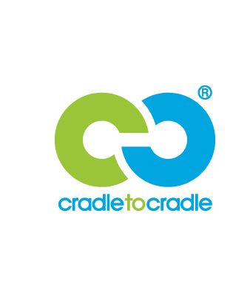
Cradle to Cradle
Sustainable design philosophy
Otso Järvenpää, Tilda Hyttinen, Max Mäkynen, and Juho Jääskeläinen

Slide 2
"Cradle to Cradle (C2C) is about seeing garbage as an eternal resource and doing the right thing from the beginning. It is about making community and product development function in the same way as a healthy ecological system where all resources are used effectively, and in a cyclical way''
https://sustainabilityguide.eu/methods/cradle-to-cradle/

Slide 3
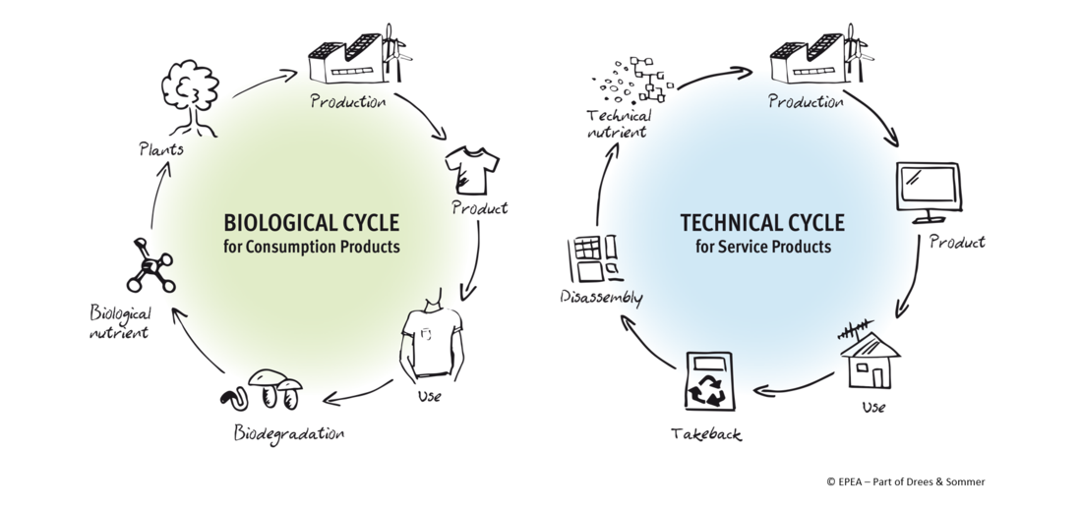
What is Cradle to Cradle? (C2C)
Introduced by William McDonough and Michael Braungart in their book "Cradle to Cradle: Remaking the Way We Make Things."
Created in contrast to Cradle to Grave model.
Cradle to Cradle is a sustainable design philosophy where products are designed according to the principles of an ideal waste-free ecosystem.
Materials are viewed as nutrients circulating in healthy safe metabolisms.
Some of the key principles include: Waste equals food, Use of renewable energy, Respect for diversity, Social fairness, and Water stewardship.

Slide 4
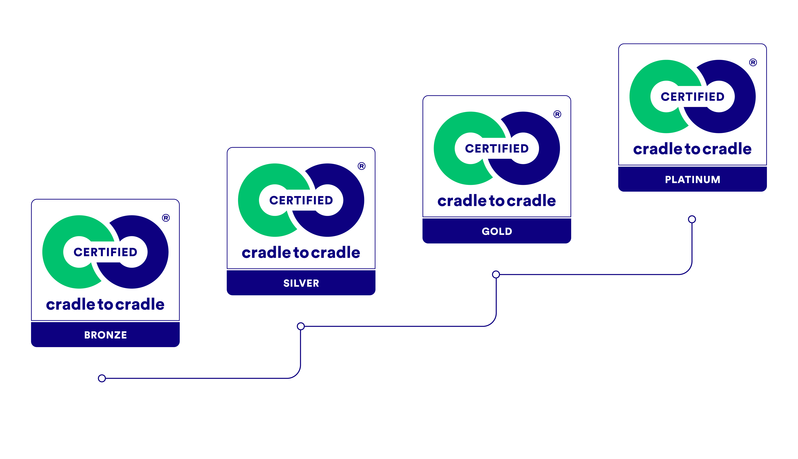
Notes:
Bronze level certification means that a company has assessed the environmental risks for the final manufacturing stage and the product and has an environmental policy in place. They developed a plan to implement said environmental policy at all their manufacturing facilities and will be evaluated on their progress at recertification. Executives of the company must also demonstrate their commitment to achieving high levels of environmental performance.
Silver level certification means that the company has management systems in place to support the implementation and oversight of their environmental policy at their manufacturing facilities.
Gold level certification means that the company has responsible sourcing management systems in place to support the implementation and oversight of the environmental policy within the product’s supply chain.
Platinum level certification is the highest level of recognition. The company has incorporated environmental objectives into their employee performance evaluations and provides incentives for top management and employees to actively participate in achieving the company’s environmental goals.

Slide 5
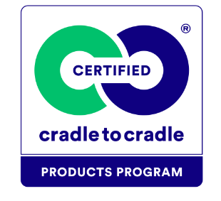

Slide 6
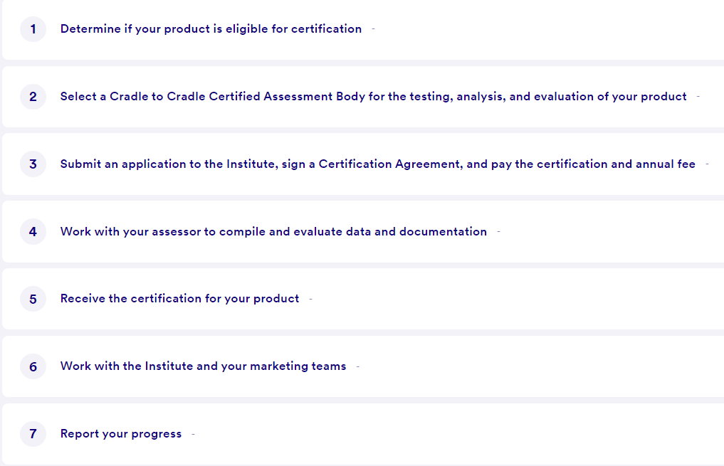
Process of certifying a product of material

Slide 7
References
https://c2ccertified.org/
https://getgreenbadger.com/cradle-to-cradle/
https://en.wikipedia.org/wiki/Cradle-to-cradle_design
https://sustainabilityguide.eu/methods/cradle-to-cradle/

