Slide 1
Jugaad - lifehacks for business
Anton, Otava, Onni, and Pinja

Slide 2
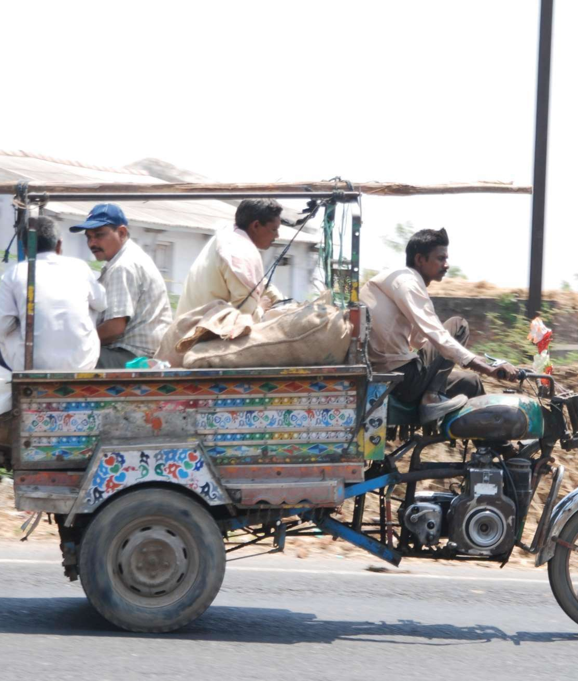
What is it?
Innovative fix, improvised solution, resourcefulness, working with what you have
Similar terms in other languages, “DIY”
Inventing things using everyday items/ideas
Etymology: Joining/union (yoke), fixing, solution (yukti)
Jugaad is also a vehicle made from recycled parts

Slide 3
Six principles
Seek opportunity in adversity.
Do more with less.
Think and act flexibly.
Keep it simple.
Include the margin.
Follow your heart.

Slide 4
1. Seek opportunity in adversity
See an opportunity in constraints or problems
Bring value to the entrepreneurs and their communities

Slide 5
2. Do more with less
Use “what you’ve got” to innovate
Optimize the use of scarce resources
Raising capitals is not a major concern

Slide 6
3. Think and act flexibly
Question everything and keep all options open
Transform existing products into something else
Thinking outside of the box

Slide 7
4. Keep it simple
Develop “good enough” solutions
Do not overengineer
Creative simplicity
Develop solutions easy to implement and understand

Slide 8
5. Include the Margin
Seek underserved markets
See these markets as cocreators of value and pull them into mainstream
Including bottom of the pyramid
In contrast, western companies typically only serve mainstream

Slide 9
6. Follow Your Heart
Do not rely on formal market research
Do not worry about investors
Trusting intuition rather than analytical thinking

Slide 10
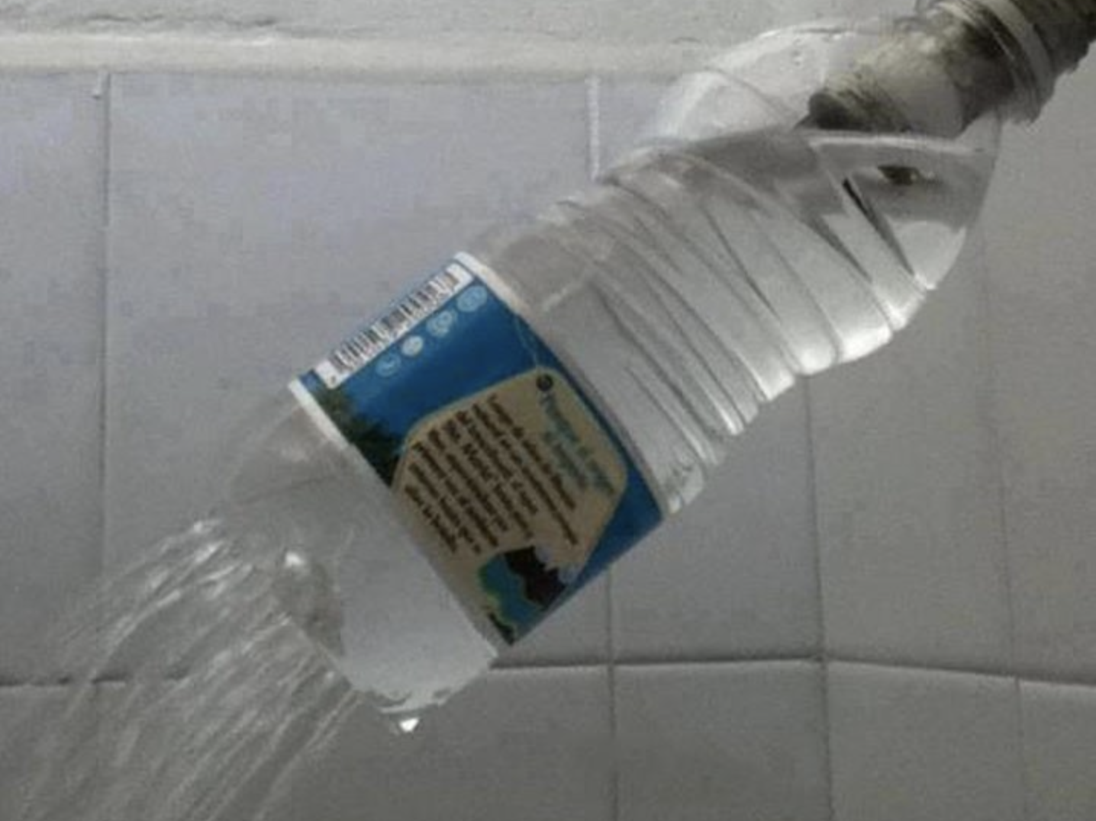
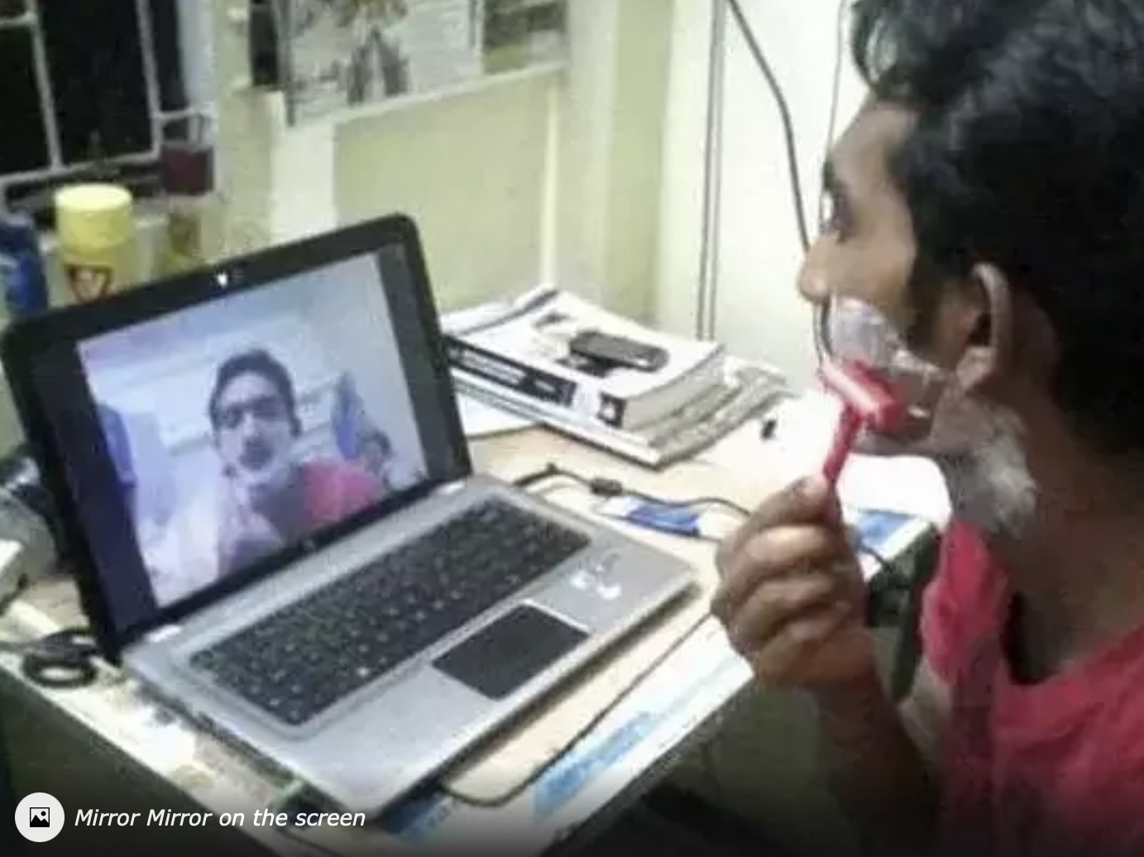
Examples

Slide 11
Case Viagra
Initial intent was to help in hypertension (high blood pressure) and angina pectoris.
Jugaad “happens”.
Created a solution for a challenge that wasn’t the first intent – create something from an existing good for a new purpose.
Helped tens of millions of men and generated over 30 billion usd in 17 years.

Slide 12
References
https://etimg.etb2bimg.com/photo/70390085.cms
https://en.wikipedia.org/wiki/Jugaad
https://www.academia.edu/42043702/JUGAAD_INNOVATION_TAKING_INTERNATIONAL_PRODUCT_LIFE_CYCLE_TO_REVERSE_INNOVATION

