Slide 1
Sustainability and innovations
Jukka Rintamäki

Slide 2
Agenda
What is the innovative sustainability approach?
Creating shared value and the base of the pyramid
Critical analysis of sustainable business model approaches

Slide 3
Innovative sustainable business
Creating shared value, or digging at the base of the pyramid?

Slide 4
What is a business model?
Business model commonly refers to the rationale of how a firm creates, delivers, and captures value
  I.e. How the firm makes a profit
The basic elements:
  Customer value proposition
  Profit formula
  Key resources and processes
Business models should
  Be difficult to imitate
  Depict the relationship between the firm, its customers, and its suppliers
Source:
Ludeke-Freund & Dembek, 2017
Palomares-Aguirre et al., 2018

Slide 5
Sustainability-oriented innovation
“An improvement of a product, technology, service, process, management technique or business model, which, in comparison to a prior version and based on a rigorous and traceable analysis, has a positive net effect” on the sustainability of the system”
Challenge: the double externality problem
Technology spillovers (with all innovation)
Positive environmental/societal externalities (with SOI)
-> Value appropriation is difficult, leads to underinvestment
Source:
Klewitz & Hansen, 2011

Slide 6
Innovative corporate sustainability
Relationship to core business: Enlarging core business or developing a new business model
Target of sustainability: New product or service development
Expected benefits: Alleviation of social or environmental problem
Aim: Generating genuine win-win situations where the benefits for the environment or people are (at least) on par with the business benefit
Examples: CEMEX’s Patrimonia Hoy, various forms of social entrepreneurship or base-of-the-pyramid business models

Slide 7
From integrated to innovative
Integrated corporate sustainability
Innovative corporate sustainability
Reducing unsustainability
Individual firm sustainability?
Business-case motivation
Shared-benefit aims

Slide 8
Creating shared value

Slide 9

Creating shared value

Slide 10

Creating shared value
How to create shared value:
Reconceive products and markets
  KQ: Is our product good for our customers?
Redefine productivity in the value chain
  KQ: How can externalities be addressed to create social value and avoid economic cost?
Enable local cluster development
  KQ: How can addressing gaps in a cluster’s framework conditions improve productivity?

Slide 11

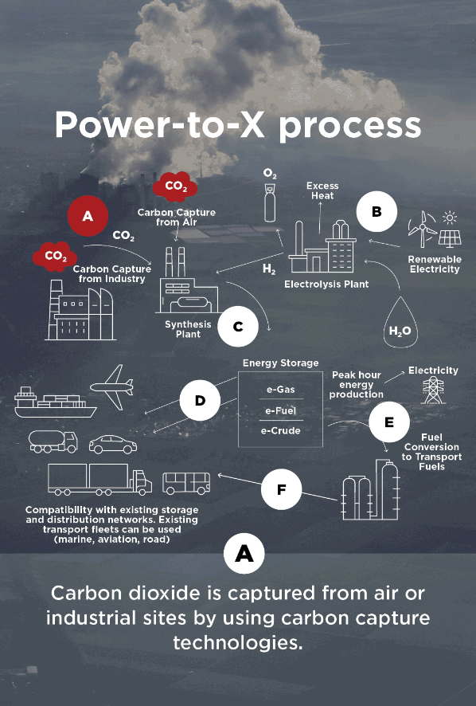
Case example: St1
St1 has been designing a variety of waste based or assisted fuel manufacturing facilities/technologies
E.g. producing methanol using CO2 captured from a local cement factory
St1 thus generate revenues through the reduction of CO2 emissions generated by other companies

Slide 12
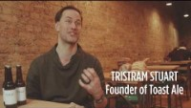
Case example: Toast Ale

Slide 13
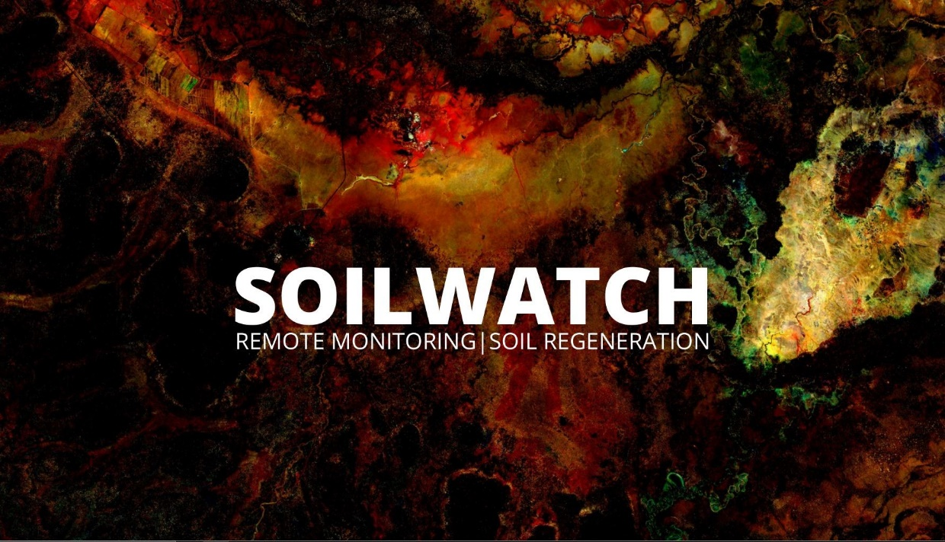
Case example: Soilwatch
A company aiming to connect farmers around Africa to the global carbon offset market
  Soilwatch (www.soilwatch.eu)
  Teach and incentivize farmers to take up regenerative farming practices that bind CO2 to the soil
    This makes the soil better for farming, too
  Use machine-learning to analyze satellite images to monitor results

Slide 14
Base of the pyramid

Slide 15
Base of the pyramid
Billions of people in the world live on very low income and lack access to the products and services needed to meet basic human needs
  In other words: Potential large, untapped markets and unrealized business opportunities
Central idea: Though these people have little purchasing power as individuals, their huge number makes up for it
Beginning in early 21st century, this was seen as a challenge MNCs could tackle
  In actuality, small firms target this field more frequently
Source:
Palomares-Aguirre et al., 2018
Notes:
In a large survey attempting to capture the situations of the poorest 4 billion, it turns out almost 60% of income is spent on food, followed by energy and housing at 9% and 7% respectively

Slide 16
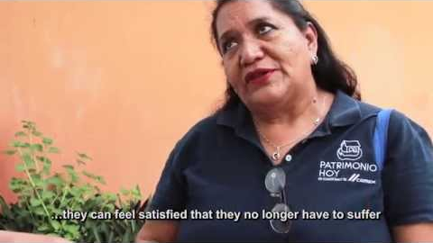
Base of the pyramid: case Cemex

Slide 17
Critical analysis of the sustainable business model approach

Slide 18
Revisiting CEMEX’s Patrimonio Hoy
The Patrimonio Hoy initiative eventually failed to grow into a truly large scale solution
  The base of the pyramid did not have the purchasing power to support the program’s infrastructure
  CEMEX begun tapping into the ”middle” of the pyramid to be able to maintain the program
CEMEX faced the problem for which sustainable business models are accused of perhaps the most: Lack of scalability
Scalability: ”The ability of a social business to increase the impact of a given program for more beneficiaries, while maintaining financial stability to ensure survival.”
Source:
Palomares-Aguirre et al., 2018
Notes:
Scalability: how many people can be reached, and how substantial problems can be remedied

Slide 19
How to remedy the scalability problem?
Source:
Palomares-Aguirre et al., 2018
Notes:
Mexico: 50+ million living in poverty, 11.5 million on less than 3 USD per day. Poor housing quality. Palomares-Aguirre et al studied three firms: Casa para Ensamblar, ¡?Echale! a tu Casa, and MIA.
Ensamblar: technological innovation in their special cement, modular housing, dependence on CEO
Echale: community model selling materials for several houses at a time and engaging the local population
MIA: Provides a structural support package with financial management, materials, and construction supervision

Slide 20
Problems with sustainable business models
Large scale problems require scalable business models
  Sustainable business models are typically not scalable
  The scale of these initiatives is miniscule in the grand scheme
Focus on small, isolated problems
  Large, complex (wicked) problems can rarely be broken down to small, atomized bits
Whether there is a business case or not determines if something can be done for a problem (and what and how)
  Generally a very selective way of solving issues

Slide 21
Wrap-up
Sustainable business models are an attempt to integrate sustainability goals into the earnings logic of the firm
  Find new sources of revenue from making the world a better place
  This can be called innovative corporate sustainability
Creating shared value and base-of-the-pyramid models are the most wide-spread manifestations
In many cases, they have yielded reasonable results
However, problems persist, such as scalability, isolated and selective issues, the poorest often being left out etc. etc.

Slide 22
References
Crane, A., Palazzo, G., Spence, L. J., & Matten, D. 2014. Contesting the Value of “Creating Shared Value.” California Management Review, 56(2): 130–153.
Halme, M., & Laurila, J. 2008. Philanthropy, Integration or Innovation? Exploring the Financial and Societal Outcomes of Different Types of Corporate Responsibility. Journal of Business Ethics, 84(3): 325–339.
Hart, S., Sharma, S., & Halme, M. 2016. Poverty, Business Strategy, and Sustainable Development. Organization and Environment, 29(4): 401–415.
Klewitz, J., & Hansen, E. G. 2011. Sustainability-oriented innvation in SME’s: A systematic literature review of existing practices and actors involved. ISPIM Conference (International Society for Professional Innovation Management), Sustainability in Innovation: Innovation Management Challenges, (June 2011): 12–15.
Kolk, A., Rivera-Santos, M., & Rufín, C. 2014. Reviewing a Decade of Research on the “Base/Bottom of the Pyramid” (BOP) Concept. Business and Society, 53(3): 338–377.
Lüdeke-Freund, F., & Dembek, K. 2017. Sustainable business model research and practice: Emerging field or passing fancy? Journal of Cleaner Production, 168: 1668–1678.
Palomares-Aguirre, I., Barnett, M., Layrisse, F., & Husted, B. W. 2018. Built to scale? How sustainable business models can better serve the base of the pyramid. Journal of Cleaner Production, 172: 4506–4513.
Porter, M. E., & Kramer, M. R. 2011. Creating Shared Value. Harvard Business Review, 89(1/2): 62–77.

Slide 23
In-class task: Sustainability and innovations
Craft a brief, 5-min presentation of one of the concepts listed below.
  The purpose is to introduce the concept for your classmates
  Think of yourselves as a team of teachers
  Give an example or two to illustrate
Cases
  Biomimicry
  Life-cycle assessment
  Cradle to cradle
  Kalundborg industrial symbiosis
  Jugaad

