Slide 1
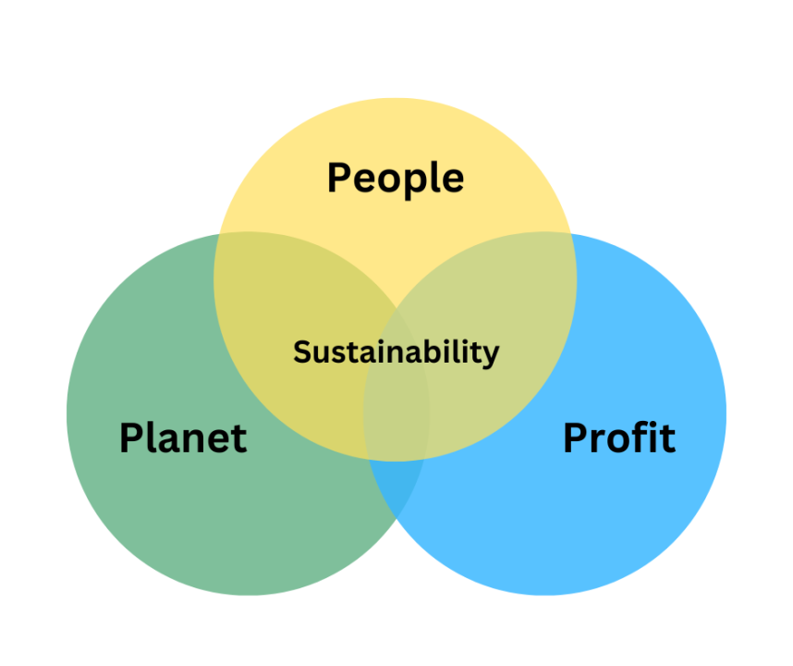
Triple Bottom Line
Sustainability Framework
Juho, Albert, Tilda, Max
22.02.2024

Slide 2
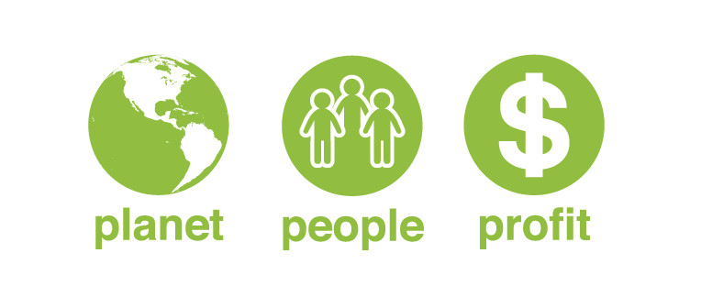
People, Profits, Planet
Coined by John Elkington in 1994
Expansion of traditions single bottom line (profit) reporting.
The addition of social (people) and environmental (planet) considerations
Aim is to encourage voluntary efforts towards three-pronged sustainability Triple Bottom Line
Marshall, J.D. and Toffel, M.W., 2005. Framing the Elusive Concept of Sustainability: A Sustainability Hierarchy. Environmental Science & Technology, [e-journal] 39(3), pp.673-682. Available at: https://pubs.acs.org/doi/full/10.1021/es040394k# (Accessed: 22 February 2024)

Slide 3
Stakeholder Theory vs Shareholder Theory
Value creation for all stakeholders
Employees
Customers
Owners
Government
Community
Long-term multifaceted gains orientation
Edward Freeman 1980s
Value creation solely for shareholders/owners
Continuous maximization of short-term profit
Milton Friedman 1970s

Slide 4
Pressures
Coercive isomorphisms:
The triple bottom line is a theory which isn't formally regulated.
Elements of triple bottom line may be regulated individually
Mimetic processes:
Many large firms have adopted and popularized the triple bottom line
Unilever, DHL, Patagonia, Novo Nordisk...
Normative pressures:
Triple bottom line is still widely recognized and taught but has its downsides.
https://managementweekly.org/triple-bottom-line-examples/

Slide 5
Legitimacy
The legitimacy of TBL is questionable
A term that companies throw around to promote their sustainability
Lack of benchmarks and clarity of real-world impact in TBL reports
John Elkington himself argues that TBL needs to be rethought
Used by companies as an accounting system
Thought of as a balancing act with trade-offs
Originally supposed to provoke change to capitalism
25 Years Ago I Coined the Phrase “Triple Bottom Line.” Here’s Why It’s Time to Rethink It. (hbr.org)
Notes:
Questionable whether the corporate triple bottom line reports help understand, and manage the systemic effects of human activity without standardized metrics. Whereas CEOs, CFOs, and other corporate leaders move heaven and earth to ensure that they hit their profit targets, the same is very rarely true of their people and planet targets. Clearly, the Triple Bottom Line has failed to bury the single bottom line paradigm.

