Slide 1


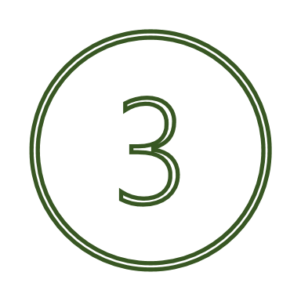

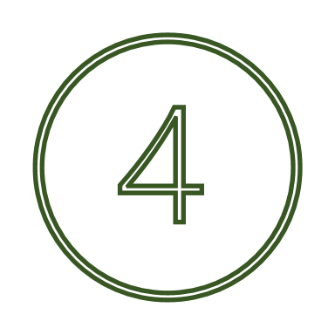

Mind
&
Study
Meaningful use of time
Towards being well in studying
Space for recovery and focus on studying
My key takeaways from each week that i want to implement into my everyday life are…
In search of a compassionate-self
A place to pause - time for thoughts and feelings
Study techniques: How do I study?

