Slide 1
Fairtrade
Sustainability Certifications
Juho, Tilda and Max
26.02.2024

Slide 2
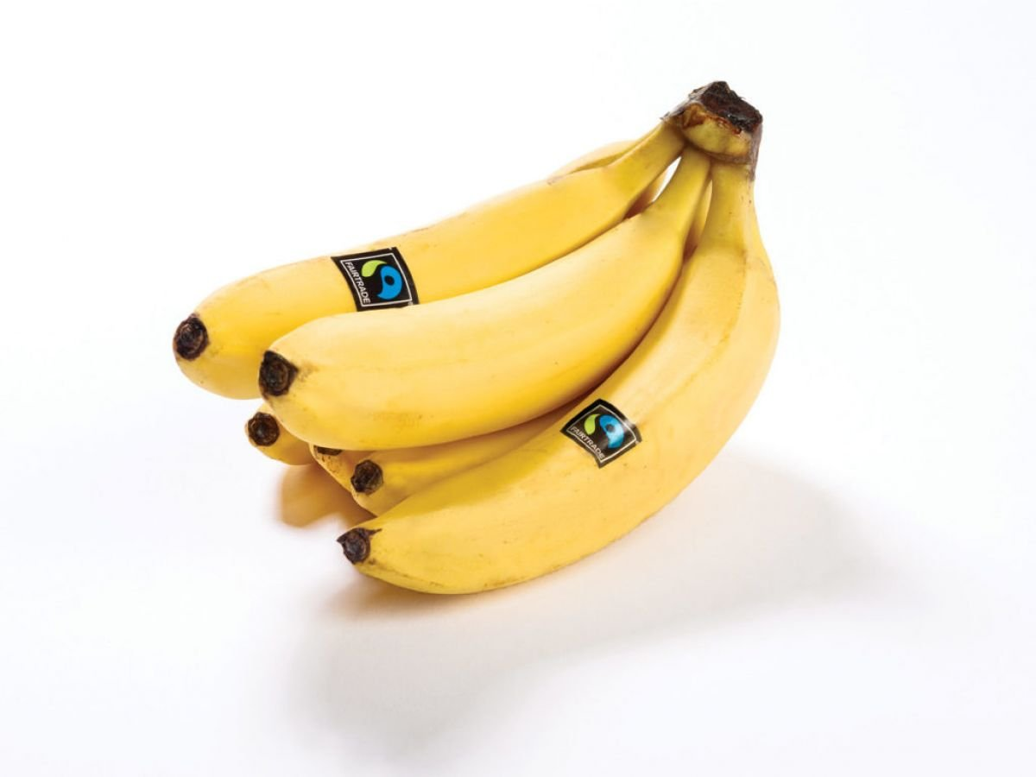
Introduction & Background
Established in 1997
The purpose is to ensure that farmers in developing countries get a fair price from their work
Main products are coffee, cocoa, banana, flowers, tea, and sugar.

Slide 3
Fairtrade Mark
"The FAIRTRADE Mark is the symbol of the international Fairtrade system – and the most globally recognized ethical label."
"The original FAIRTRADE Mark has always stood for fairly produced and fairly traded products. It also means the product is fully traceable"
"If you see the FAIRTRADE Mark with an arrow, it means to look on the back of the packaging to learn more about the ingredients and sourcing method."
https://www.fairtrade.net/

Slide 4
How Does Certification Work?
Economic, Environmental and Social Criteria
Fairtrade Minimum Price, Responsible water and waste management, preserving biodiversity and soil fertility, and minimal use of pesticides and agrochemicals
Mechanisms to report misuse
Independent Auditors investigate EES Criterion
FLOCERT is the largest certifier for Fairtrade, responsible for the certification
accredited under ISO 17065,
Compliant with ISEAL’s Assurance Code
https://www.fairtrade.net/about/certification

Slide 5
Signalling
Credibility:
Strong, most visible and trusted ethical label globally among consumers
Verifiability:
Easy to verify through Fairtrade's register of products
Understandability:
Fairtrade certification conveys a products adherence to sustainability easily
Imitability:
Requires producers to meet specific criteria and adhere to standards making it harder for less diligent competitors to copy

Slide 6
Criticism
Sainsbury's argues that Fairtrade system is “not bringing as much benefit to farmers as it could”.
Established its own "Fairly Traded" products
Fazer: "Fair Trade certification does not guarantee traceability in the case of cocoa"

Slide 7
Creditations, Affiliations and Organizations Mentioned by Fairtrade
ISEAL’s Assurance Code
FLOCERT
ISO 17065
German national Accreditation Body DAkkS.
Oversight Committee
Standards Committee at Fairtrade International.
Fairtrade Minimum Price and Premium
Fairtrade Trader Standard

Slide 8
Sources
https://www.flocert.net/approach-to-credibility/
https://www.fairtrade.net/finder
https://sustainablelivingassociation.org/the-real-problems-behind-fair-trade/
https://www.independent.co.uk/news/business/news/sainsburys-fairly-traded-tea-fairtrade-confusion-asa-advertising-a8244081.html

