Slide 1
AspenPlus Group A Final Presentation

Slide 2
Agenda
Base case
Alternative Fuel
Improvements
Sensitivity Analysis
Conclusion, Outlook and Question

Slide 3
Base case

Slide 4
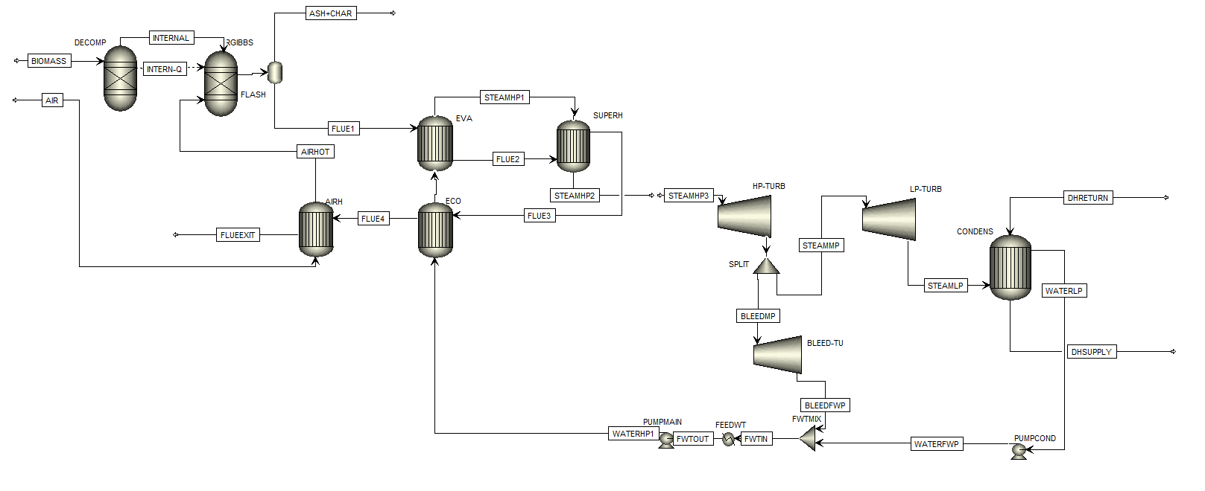
Base case
Combustion Unit
Power – and district heating unit
Heating Unit

Slide 5
Base case
Combustion Unit
Power – and district heating unit
Heating Unit

Slide 6
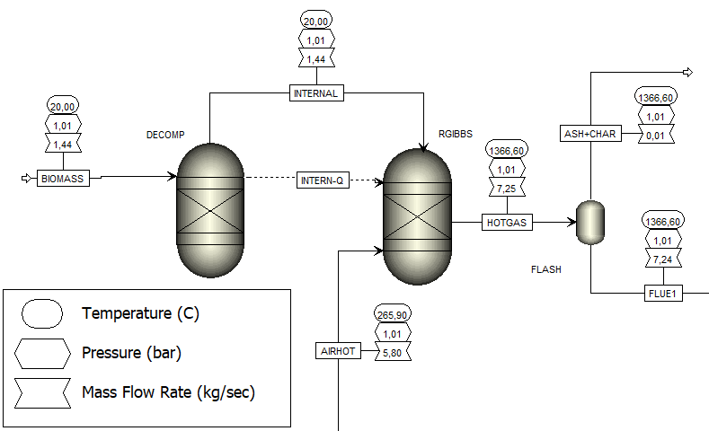
Combustion Unit
Design Spec:
O₂ output should be at least 0,5 mol-%
→ vary air mass flow

Slide 7
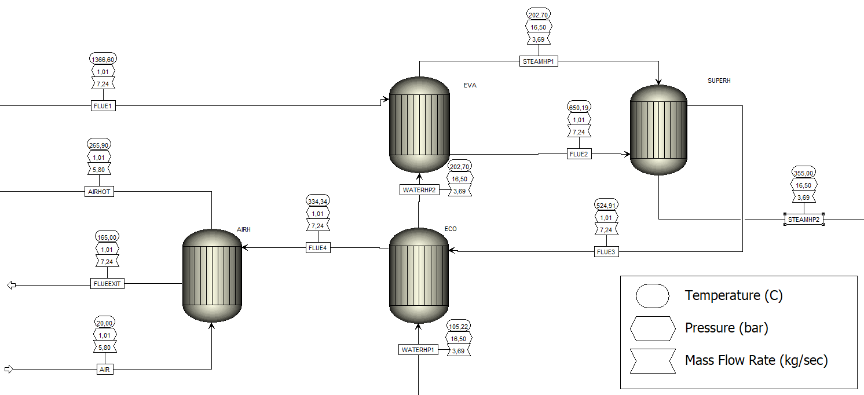
Heating Unit
Design Spec:
Flue gas temperature after the boiler should be 650 °C → vary live steam mass flow

Slide 8
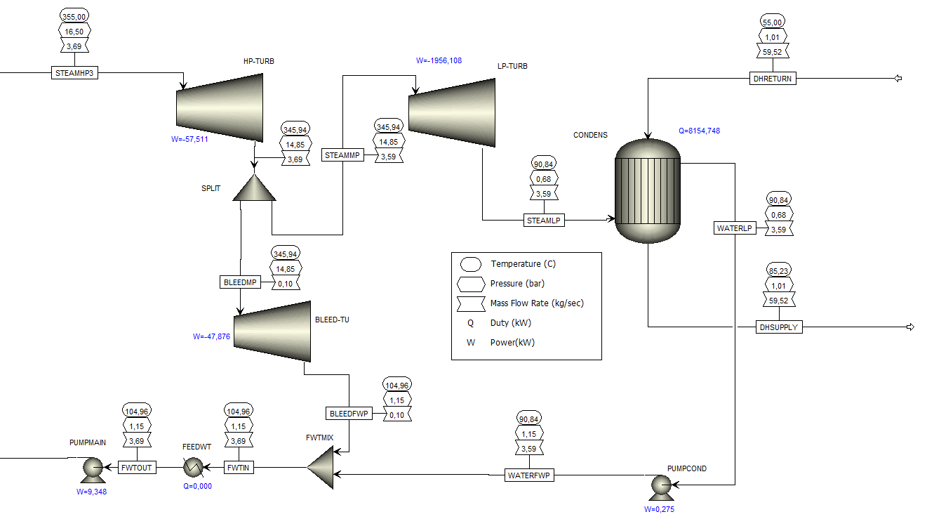
Power and district heating unit
Design Spec:
DH water supply temperature should be 85°C→ vary DH water flow
Design Spec: net additional duty should be 0 → vary flow split percentage

Slide 9
Alternative Fuel

Slide 10
Second fuel case – Municipal Solid Waste MSW (ECN classification)
Change in composition from the base case (Proximate analysis)
 | Wood fuel | MSW
FC (dry) | 20.83 | 26
VM (dry) | 78.37 | 18
Ash (dry) | 0.8 | 56
Moisture | 51 | 6.4
 | Wood fuel | MSW
LHV (MJ/kg) | 7.96 | 7.72
Boiler fuel input power (MW) | 11.5 | 11.5
Mass flow rate (kg/s) | 1.44 | 1.48

Slide 11
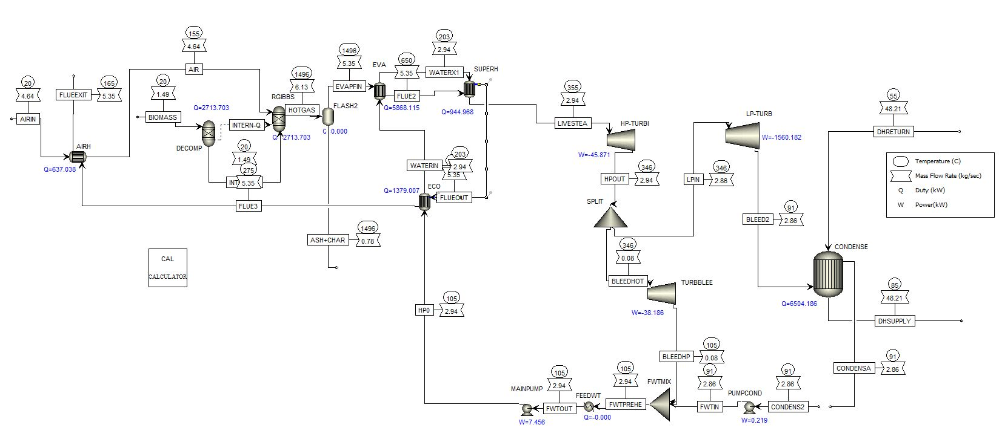
Changes from the base case
Combustion side
Reduction in flue gas flow rate to the evaporator
+Changes in other attributes of the streams (Temp)
High losses to ash content
Lower heat duties in all the heat exchangers than the base case

Slide 12
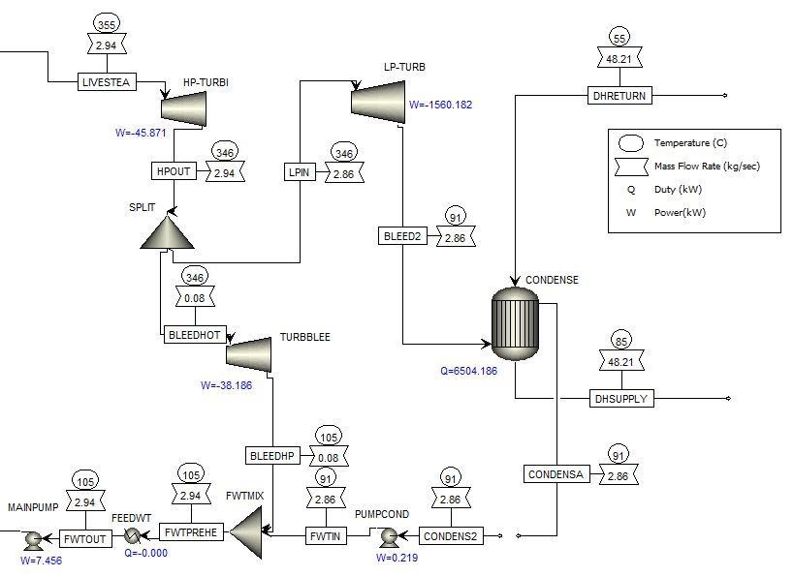
Power and district heating unit using MSW
 | Wood fuel case | MSW case
Power output (MW) | 2.06 | 1.64
Heat output (MW) | 8.15 | 6.50
Overall efficiency (%) | 88.7 | 70.8
More MSW fuel requirement

Slide 13
Improvements

Slide 14
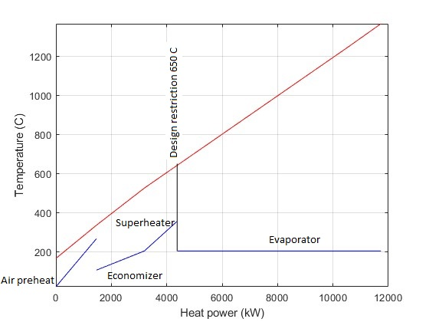
Improvements: Trading DH for electricity
Added 1 reheat cycle
Optimization: increased FWT pressure to 5 bar

Slide 15
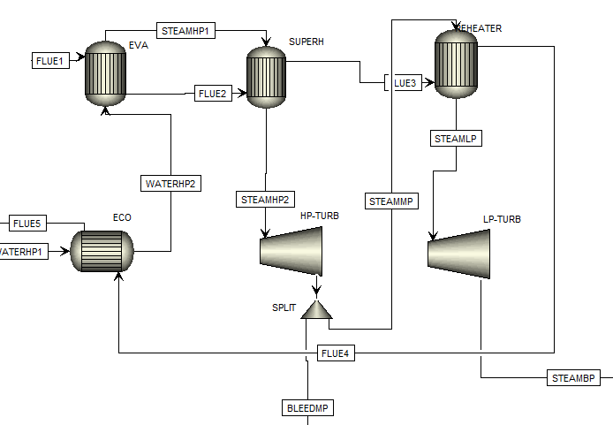
Reheating
Carnot theoretical efficiency $η=\frac{Th−Tc}{Th}$
Decreased steam mass flow -> decreased DH output
Increased work done per cycle -> increased total electricity output

Slide 16
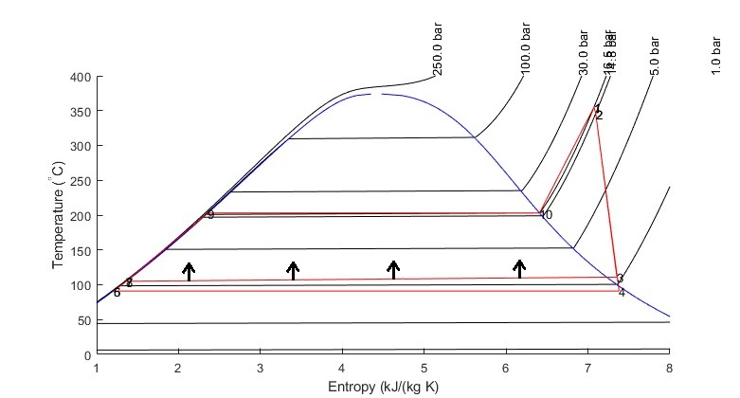
Optimizing: regeneration
Raising the FWT pressure -> reducing the condensate flow at the DH HEX.
Less heat is consumed in the economizer -> more heat available for evaporator and superheater.
Larger water mass flow -> larger electricity output.

Slide 17
Sensitivity Analysis

Slide 18
Case 1: Biomass Mass Flow Rate
Vary the mass flow rate of the fuel
Increase of steam production

Slide 19
Case 1: Biomass Mass Flow Rate
Case | Results with
1,0 | Errors
1,2 | Errors
1,4 | Warnings
1,43 | OK
1,6 | OK
1,8 | OK
2,0 | Warnings
2,2 | OK
2,4 | OK
2,6 | Warnings
2,8 | Errors
3,0 | Errors

Slide 20
Case 1: Biomass Mass Flow Rate

Slide 21
Case 2: Air Mass Flow Rate
Vary the mass flow rate of the air inlet
&
Deactivate the Design Spec to fix the oxygen content
Different Optimums for DH and Turbine Output

Slide 22
Case 2: Air Mass Flow Rate
The efficiency optimum is therefore at 5,5 kg/s with an ox content of 4,07 %.

Slide 23
Case 2: Air Mass Flow Rate

Slide 24
Conclusion, Callenges and Questions

Slide 25
What we did so far...
Simulation of both fuel cases
Inclusion of multiple improvements (only one improved something)
Sensitivity analyis of the mass-flow of the air and of the fuel

Slide 26
Challenges on the way
Errors (Convergence, Zero-Streams, Massimbalances)
Sensitivity of Aspen Plus
Overview over different versions

Slide 27
Open Questions
Did we understood everthing correctly?
Is our improvement sufficient for the final report?
Is the sensitivity analysis sufficient for the final report?

Slide 28
Thanks!
Any questions or advice ?

