Slide 1
IKEA

Slide 2
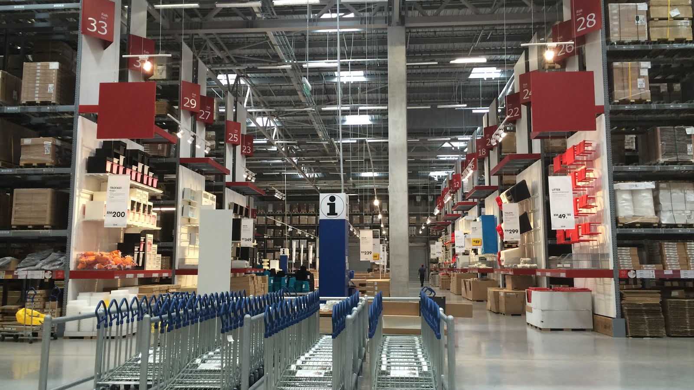
ReSOLVE framework
Regenerate:
Encourage the customer to share details about the issue with the product
2. Exchange:
Offer the option to exchange the faulty product for a new one.
3.Virtualise:
Provide virtual support options for troubleshooting or assistance.
4.Share:
Encourage customers to share their experiences and feedbacks.
5. Optimise:
Continuously optimize products&services based on customer feedback.
This Photo by Unknown author is licensed under CC BY-SA-NC.

Slide 3
ReSOLVE framework
Policy for exchange: offers a 365 days return policy for unopened items.
Open products: 180 days.
https://present.digital/ikea/--virtualise

Slide 4
Suggestions & Improvements
Community Engagement: Foster a sense of community among customers by creating online forums or social media groups where customers can share tips, experiences, and solutions related to IKEA products. This would encourage peer-to-peer support and knowledge sharing while strengthening brand loyalty.
Data-Driven Insights: Leverage customer data and analytics to gain insights into common customer concerns, pain points, and preferences. Use this data to inform product design improvements, service enhancements, and targeted customer communication strategies.
Empowerment and Training: Empower customer service representatives with comprehensive training and resources to effectively resolve customer concerns. Provide ongoing training on product knowledge, problem-solving techniques, and communication skills to ensure representatives are equipped to handle diverse customer issues with confidence and competence.

Slide 5
Narrowing loops
Revolutionary designs (flat packaging): reducing transportation costs, minimises storage space in warehouses and stores, and allowing customers to easily transport items home themselves. Flat packaging also contributes to environmental sustainability by reducing packaging materials and carbon emissions associated with transportation.
Lean manufacturing and product standardisation: eliminating waste and improving productivity in its manufacturing operations. Standardisation enables IKEA to achieve economies of scale by producing large quantities of a limited number of components, which can be used across multiple product lines.

Slide 6
Closing and slowing loops
Reuse
Refurbishment
Remanufacturing
Recycling

Slide 7
Closed innovation: Flat-pack furniture (developments using internal ideas and resources)
Open innovation: Customisation (developments using customers' preferences/suggestions/ideas)

