Slide 1
Pinja, Anton, Onni, Otava

Slide 2
What is Interface?
Global leader in modular flooring founded in 1973
Around 3600 employees and 1.2 Billion USD in global revenue (2021)
Sustainability actions in core of the business
The Carbon Neutral Floors program certified with PAS 2060

Slide 3
ReSOLVE Framework

Slide 4
Regenerate, Share & Optimize
Regenerate:
ReEntry and Reclamation™ - Guaranteed multiple lifecycles & Active contribution to regeneration (Yahoo Finance).
Share:
Circularity lighthouse recognition from WEF and McKinsey & Co – By participating in this network, the entity promises to share key findings for others to utilize (Yahoo Finance).
Optimize:
Carbon Neutral Floors Program – Interface achieves supply chain neutrality by innovating in sustainable production and recycling practices (Interface).

Slide 5
Loop, Virtualise & Exchange
Loop
Interface products are designed to be long-lasting and recyclable
ReEntry program: reusing products or recycling them if reusing is not possible
Virtualise
Interface Floor Design Studio
Offers virtual design tools to optimize material usage and minimize waste
Exchange
Interface has been a trendsetter in sustainable production
Committed publicly to sustainability in 1994
Sustainability in the core of the business

Slide 6
Closing loops – use again
The company has been collecting and recycling used carpets for 20 years
Interface offers the ReEntry service
Recycled and biobased materials are used in production
Has been designed to be movable and reusable

Slide 7
What about narrowing and slowing?
Slowing loops – use longer
Narrowing loops – use less
Movable → no glue (?)
Fibers designed to be durable
Sponge rubber
Mix-and-match colour design
Designs for different purposes → not all are interchangeable
Waste management
Designed for replacing only damaged components
Modular design for easy installation

Slide 8
Closed Innovations
CQuest™ backings
Example of biomimicry
Bio-based materials and recycled content –> carbon negativity

Slide 9
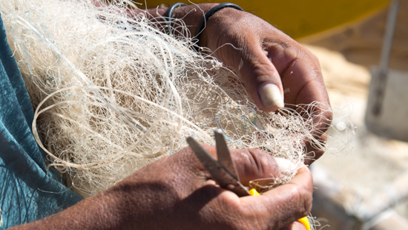
Open Innovations
Net-Works Program
Partnered with the Zoological Society of London and Project Seahorse Foundation for Marine Conservation Inc.
Buying used fishing nets and manufacture materials
Cleaning up coastlines and sea while including some of the world’s poorest communities to global supply chains

Slide 10
References
https://www.interface.com/US/en-US/more-from-interface/about.html
https://www.interface.com/GB/en-GB/sustainability/recycling.html
https://www.interface.com/US/en-US/sustainability/sustainability-overview.html
https://www.interface.com/US/en-US/sustainability/recycling.html
https://storiesflooring.co.uk/collections/interface-carpet-tiles
https://www.google.com/url?sa=i&url=http%3A%2F%2Fwww.corporate-workspace.com%2F%3Fpage_id%3D294&psig=AOvVaw2iy9V0zvbMNRqNjAvV9uV1&ust=1709195757152000&source=images&cd=vfe&opi=89978449&ved=0CBIQjRxqFwoTCMiC78HQzYQDFQAAAAAdAAAAABAV
https://www.interface.com/US/en-US/carpet-tile/backings.html
https://www.interface.com.cn/page/thenet-worksprogram
https://www.insideflows.org/project/net-works-interface/

