Slide 1
RENAULT
Juho, Otso, Max and Tilda

Slide 2
RENAULT
Founded 1898, Louis Renault, France
Major automotive manufacturer
Major presence in rally racing and Formula 1
Sustainability Examples
"The vehicle is manufactured in a plant that has been certified ISO 14001"
Since 1996 Renault has decreased: , its energy consumption by 25% (kW/vehicle), its water consumption by 57% (m³/vehicle), its waste by 65% (kg/vehicle), its water-borne effluents by 38% (kg/vehicle), its industrial liquid effluents by 44% (kg/j/vehicle)
https://www.renault.com.eg/AboutRenault/Renault-history.html

Slide 3
RENAULT and RESOLVE
"Re-cycle, Re-use, Re-nault!"
Regenerate
Biofuels help reduce CO2 emissions as the plants used to create them absorb the CO2 in the atmosphere through photosynthesis.
Share
Sustainable driving tips
Sponsor the Ellen MacArthur Foundation
Loop
The Espace model is 90 % recyclable
Optimize
Renault strives to minimize CO2 emissions from its gasoline and diesel engines
Exchange
ISO 14001 certifies the progress made by an industrial site to reduce its water and energy consumption and the visual and audible disturbances, as well as the discharge of pollutants into the air and water.
https://www.renault.com.eg/AboutRenault/Co2-Emmissions.html

Slide 4
Closing, narrowing, and slowing down loops
Closing the loop
Remanufacturing components
Recycling and re-use of end-of-life vehicles
Narrowing the loop
Increased recycled content
Efficiency in production
Slowing the loop
Vehicle and component longetivity
Repurpose of old car batteries

Slide 5
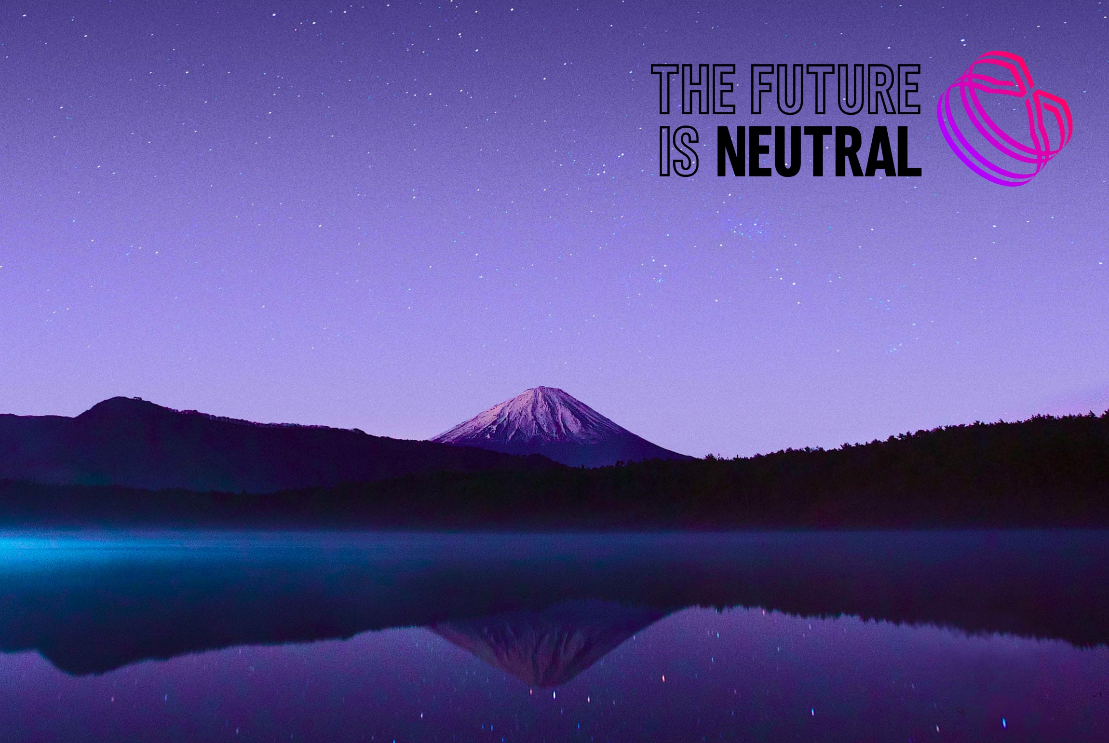
THE FUTURE IS NEUTRAL
Although a car is 85% recyclable, the vehicle itself is the most underused resource.
THE FUTURE IS NEUTRAL™ is the first 360° automotive circular-economy enterprise committed to creating sustainable value by closing the loop, from car to car.
It aims to increase the proportion of recycled resources in manufacturing.
"To obtain the Renault eco² signature, at least 5% of the vehicle's plastic content has to be made of plastic recovered from end-of-life products"
Notes:
Good to remember
Don’t paste text direct from other documents onto the PowerPoint template, as this will render incorrect formatting. Before pasting any text onto this template, use for example Notepad for removing the source text formatting.
To configure the display language:
Within any Office application, select File > Options > Language.
Under Office display Language, make sure the display language you want Office to use is listed.
Select the language you want, and then select Set as Preferred.
How to insert header & footer
1. Choose "Insert / Header & Footer" to change footer text.
2. In the panel you can change the footer, page number and date options.
How to add images
Click icon to add image. Or, you can choose one related to your content from a selection of photos available in Material Bank.
https://materialbank.aalto.fi/l/w2wWj_hmTJGx
***
Hyvä muistaa
Älä kopioi tekstiä suoraan muista sovelluksista tai dokumenteista, etteivät pohjan valmiit muotoiluasetukset muuttuisi. Käytä esimerkiksi Notepadia poistaaksesi tekstistä valmiit muotoiluasetukset.
Näyttökielen määrittäminen:
Valitse missä tahansa Office-sovelluksessa Tiedosto > Asetukset > Kieli.
Varmista Office-näytön kieli -kohdassa, että näyttökieli, jota haluat Officen käyttävän, on lueteltu.
Valitse haluamasi kieli ja valitse sitten Aseta ensisijaiseksi.
Näin lisäät ylä- tai alatunnisteet
1. Valitse “Lisää / Ylä- ja alatunniste”
2. Valintaikkunassa voit muuttaa ylä- ja alatunnisteiden, sivunumeroinnin ja päivämäärän asetuksia.
Uuden sivun luominen
Valitse valikosta ”Aloitus / Uusi dia” jolloin saat näkyviin listan valmiiksi määritellyistä mallipohjista.
Voit myös muuttaa olemassa olevan sivun ilmettä valikosta ”Aloitus / Asettelu”, jolloin saat näkyviin listan mallipohjan sivuista.
Kuvien lisääminen
Lisää kuva klikkaamalla ikonia. Vaihtoehtoisesti voit valita aiheeseen sopivan kuvan Materiaalipankissa olevista ehdotuksista.
https://materialbank.aalto.fi/l/w2wWj_hmTJGx

Slide 6
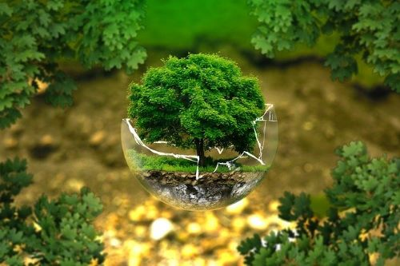
Renault's Eco-Design Strategy: Tackling Resource Scarcity
To tackle resource scarcity Renault has initiated the eco design philosophy.
Its objective is to pay attention to the selection of materials, the composition of products, the choice of suppliers, sustainability, management and recycling of used products.
In 2011 Renault was awarded the European Ecolabel certification for its Elastorem mattress.

Slide 7
