Slide 1


Jukka Rintamäki
Managing sustainability
The road ahead vol. 2: What kind of a system do we need?

Slide 2
Towards a sustainable global economy
Jukka Rintamäki

Slide 3
Agenda
From business interests to broader interests
The proposed road to sustainability
Green growth
Contesting the green growth agenda

Slide 4
From business interests to broader interests

Slide 5
What if business isn’t equipped to make these decisions?
A review of over 40,000 CSR reports around the globe
  Fewer than 5% referenced planetary limits
  31 organizations (fewer than 1%) set science-based sustainability goals
Source: Bjørn et al., 2017
Notes:
Think of some of the classical liberals and proponents of separating business and sustainability
Milton Friedman: ”the business of business is business”

Slide 6
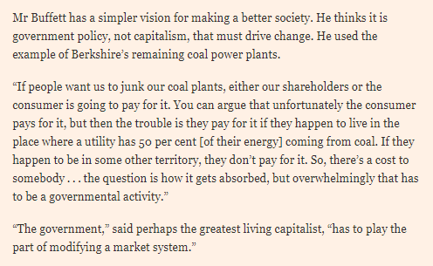
What if business doesn’t want to make these decisions?
Perhaps corporations want others to set the limits? Knowing that the dynamics of competition post hurdles for individual firms
Here is what Warren Buffett has to say:
Source:
https://www.ft.com/content/ebbc9b46-1754-11ea-9ee4-11f260415385

Slide 7
The proposed road to sustainability

Slide 8

The UN Sustainable Development Goals

Slide 9
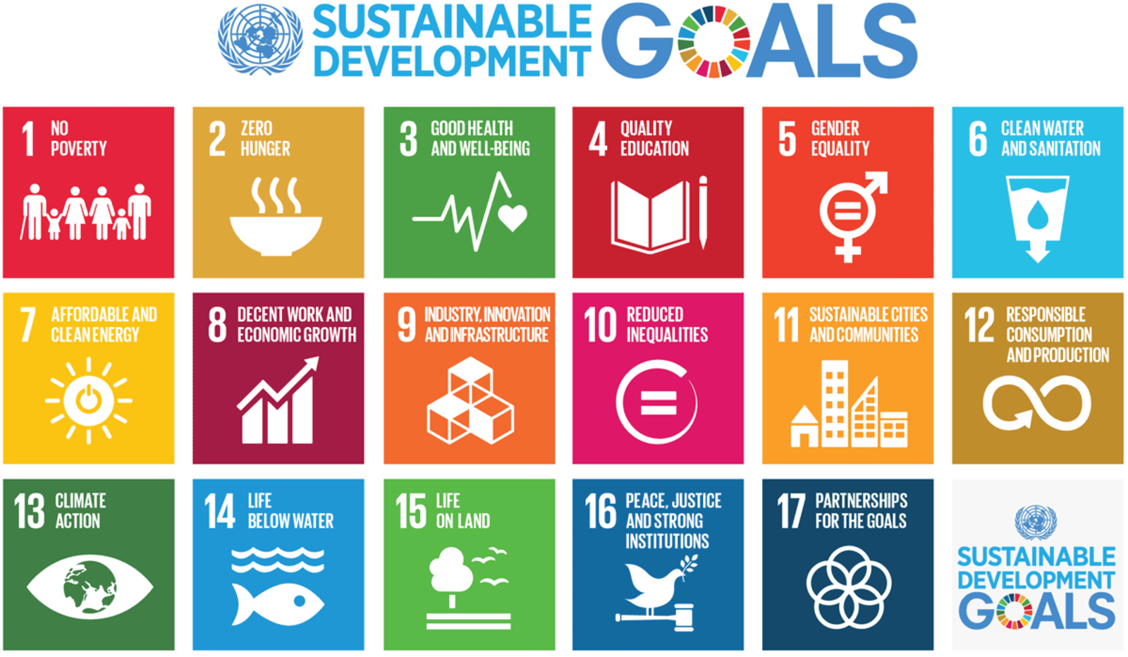
The UN Sustainable Development Goals
Notes:
There is evidence that such intl dev goals e.g. around public health can accelerate development towards complex dev goals – but big structural changes are required

Slide 10
Six transformations to achieve sustainable development goals
Education, gender and inequality
Health, well-being and demography
Energy decarbonization and sustainable industry
Sustainable food, land, water, and oceans
Sustainable cities and communities
Digital revolution for sustainable development
Source:
Sachs et al., 2019
Notes:
All of these aim at different subsets of business and civil society. Targeted problem solving, clear communication, and stakeholder mobilization are facilitated.
Government action!
These are all systems-based (systems-thinking!), aligned with gov organization, and easily communicable

Slide 11
Two principles for achieving SDGs
The leave no-one behind principle
  Equity and fairness
  Especially pertains to global inequality
The principle of circularity and decoupling
  Circularity
    Change patterns of consumption: take-make-waste -> reduce-reuse-recycle
  Decoupling
    Let’s talk about decoupling
(Third principle?: from voluntary to involuntary regulation)
Source: Sachs et al., 2019

Slide 12
Decoupling
When processes or attributes that are typically connected to each other – tightly coupled – begin to uncouple
The specific type of decoupling the authors refer to:
  Disconnecting economic growth from environmental degradation (decarbonization in particular)
Sources:
Sachs et al., 2019

Slide 13
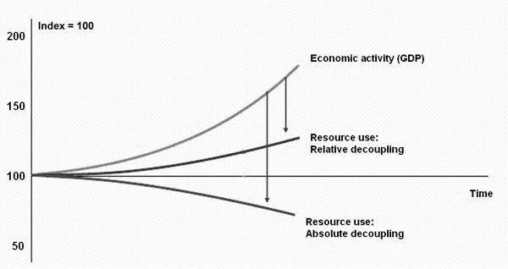
Decoupling economic growth from carbonization (unsustainability)
Relative decoupling
  Decreasing resource use whilst increasing economic activity
    Eco-efficiency, circular organizing of economic activity
Absolute decoupling
  Decreasing environmental impacts of economic activity, while the activity itself is increasing
    Clean energy, circular organizing of economic activity
Source:
Sachs et al., 2019

Slide 14
Decoupling economic growth from carbonization (unsustainability)
Green growth theory
  Central assumption: absolute decoupling of GDP growth from resource use and carbon emissions is feasible at a sufficient rate
  Mechanisms: Technological change and substitution will enable decoupling
But what do the empirics say?
Source:
Sachs et al., 2019

Slide 15
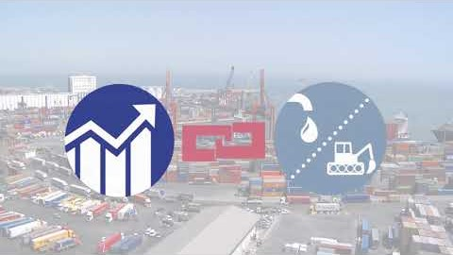
Decoupling in a nutshell

Slide 16
Critical analysis of green growth theory

Slide 17
Comparing material flows and economic growth
Material flows and GDP and been growing at a similar rate in the US, the EU, and the OECD countries
However, domestic material consumption (DMC) levels have decoupled from GDP
These indicators are typically used to show how European countries especially have achieved this type of decoupling
However, DMC does not take into account the fact that much of production has moved from OECD countries to elsewhere
  We need to have a look at different indicators
Source:
Hickel & Kallis, 2020

Slide 18
Comparing material flows and economic growth
When we look at global material footprints – taking into account economies outside of the OECD – we see a different picture
Resource use hasn’t decoupled from economic growth after all
Research indicates that material use will rise from 68 billion tonnes annually in 2008 to
  95 billion tonnes by 2050 in a ‘good’ scenario
  180 billion tonnes by 2050 in a ‘business-as-usual’ scenario
Source:
Hickel & Kallis, 2020

Slide 19
Can we achieve decoupling with a growing economy?
Relative decoupling
  Yes
  But it may not be enough
Absolute decoupling
  Momentarily and locally, perhaps
  Permanently, probably not
    There will be rebound effects from gained efficiencies
    There are physical boundaries such as
      Photosynthetic limit to plant productivity places boundaries for minimum land required for agricultural output
      Physiological limits to crop water use efficiency govern minimum agricultural water use
Source: Hickel & Kallis, 2020

Slide 20
However...there is hope!
Were there no or very low (less than 1%) global GDP growth, long-term absolute decline in material use could be possible
  Low-to-no growth GDP is already a reality in many developed economies
The best, most feasible models for emissions reductions consistent with the Paris Agreement involve Low Energy Demand
  Reduce global energy demand by 40% by 2050
    Decarbonization (circular economies, eco-efficiency, clean energy...)
    Afforestation
    Significant decline in material production and consumption (sharing economies, cultural shifts, roll-back of disposable/fast goods...)
The wild card: geoengineering like capturing carbon from the atmosphere
Source: Hickel & Kallis, 2020

Slide 21
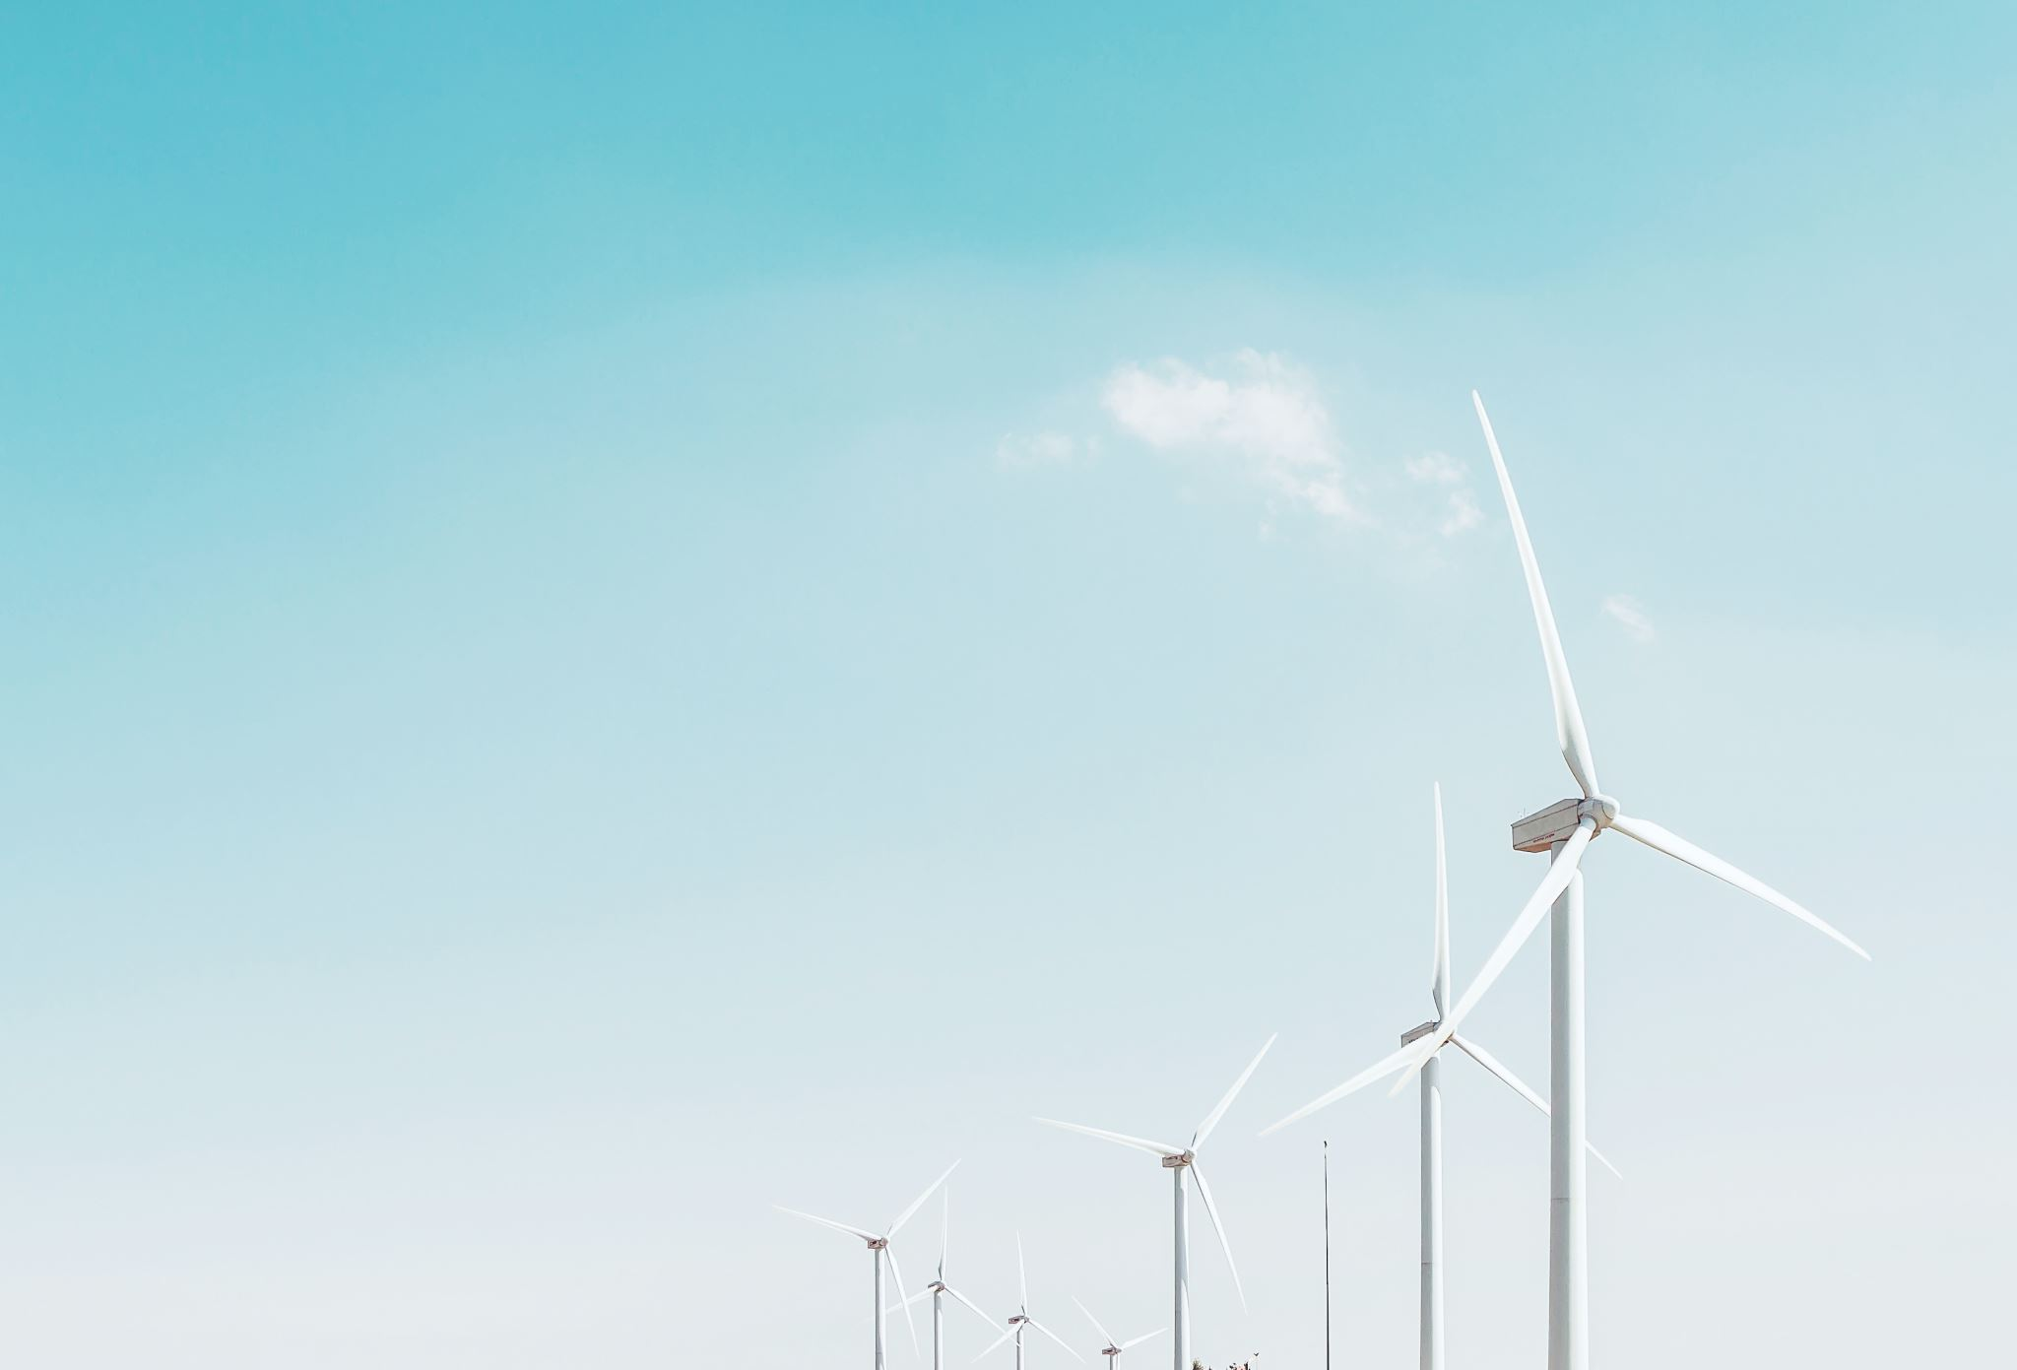
Where are the ”easy” fixes?
Clean energy
Reducing material flows
  Fashion 10% of global emissions
Sustainable transport
  Transport 25% of global emissions
  Road traffic, esp. everyday driving 15%
Low-carbon diets
  Global food system 1/3 of emissions

Slide 22
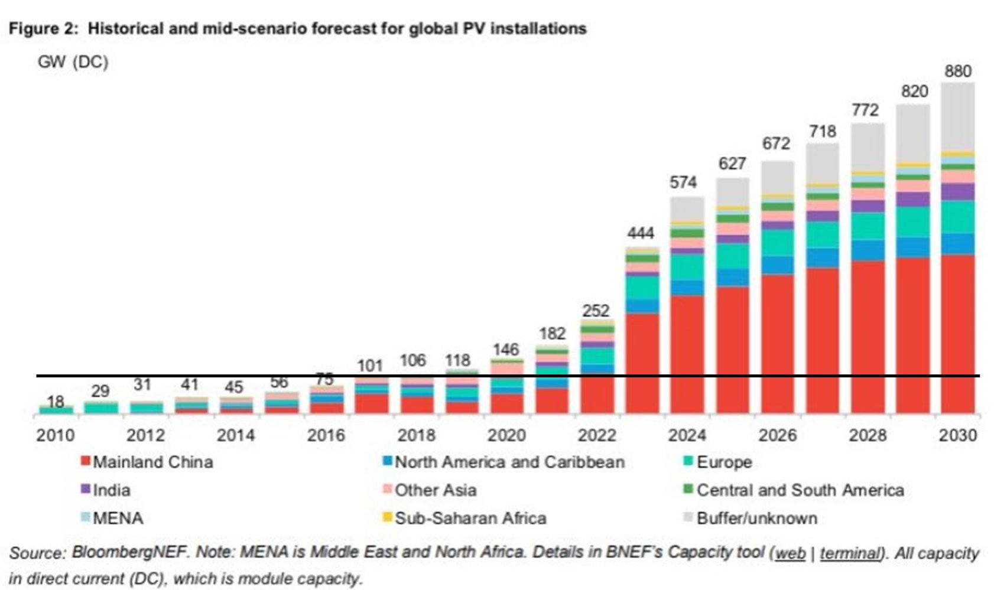
Clean energy
We are well on our way there!

Slide 23
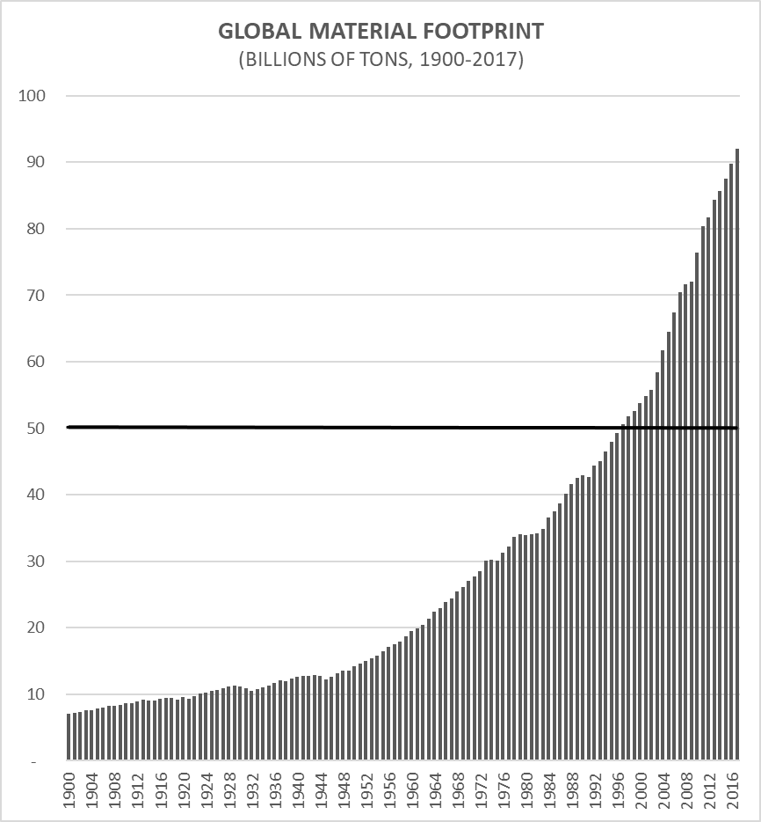
Reducing material flows
Global material footprint is increasing
What about circular economy?
  EU’s circular material use rate: 11.7%
    Target for 2030: 23.4%
      2010: 10.8%
  Municipal waste recycling rate: 50%
To do:
  Prolong life-cycles of consumer products, buildings etc. and decrease material intensity
    Slowing, narrowing, and closing loops
Sources: Hickel & Kallis, 2020;
https://www.eea.europa.eu/en/analysis/indicators/waste-recycling-in-europe https://www.eea.europa.eu/ims/circular-material-use-rate-in-europe

Slide 24
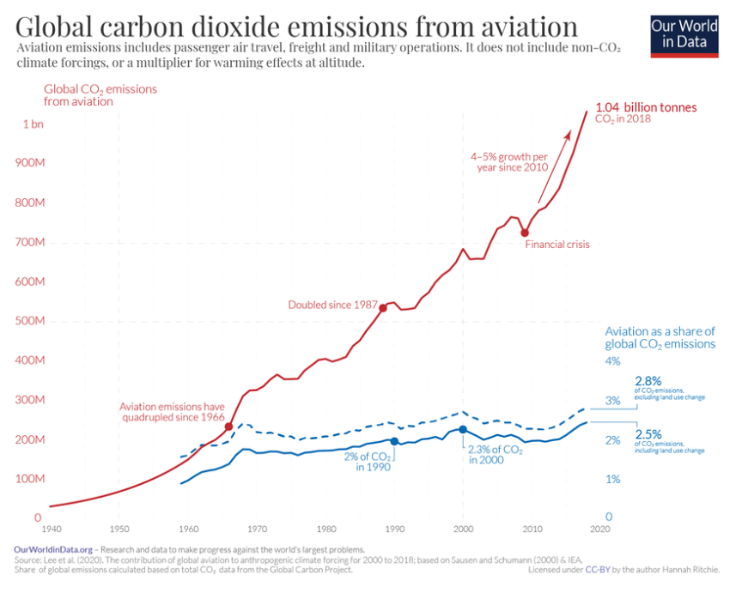
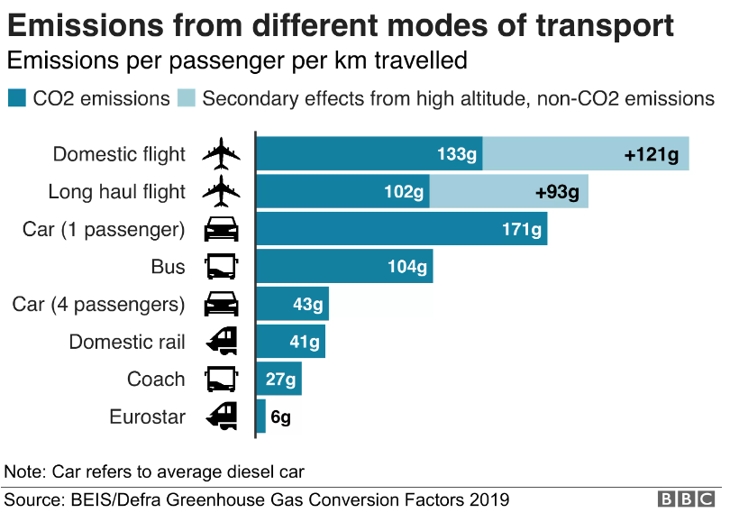
Sustainable transport
Walking, cycling, public transport
  Electric vehicles
    Tires still emit loads of particles
    High material intensity
Air travel
  ca. 3% of CO2 emissions
    Only ca. 5-10% of global population fly on an annual basis
Sources: https://ourworldindata.org/co2-emissions-from-aviation; https://www.bbc.com/news/science-environment-49349566

Slide 25
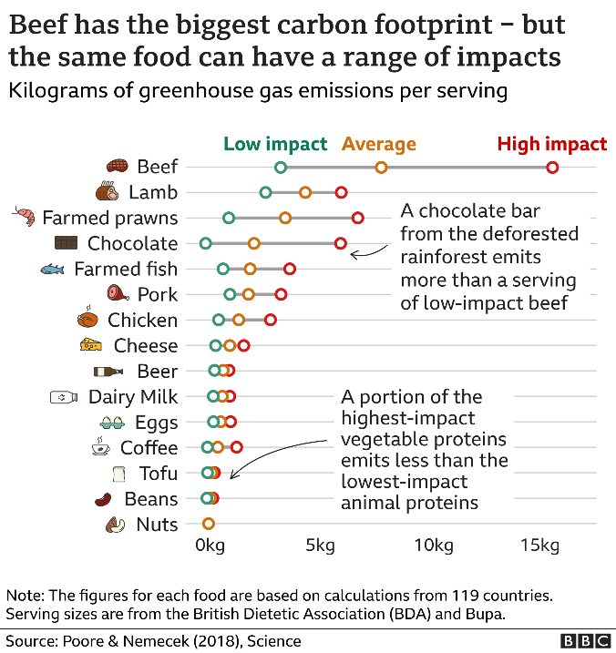
Low-carbon diets
New research shows how reducing meat consumption significantly reduces carbon emissions
Base level: 140g meat per day
  Vegan diet:
    25% carbon emissions
    Reduction in biodiversity loss 66%
    Reduction in water use 50%
  Reduced-meat, pescetarian, and vegetarian diets all brought 50%+ decrease to carbon emissions
Sources: https://www.bbc.com/news/science-environment-46459714; LUKE; Scarborough et al., 2023

Slide 26
References
Bjørn, A., Bey, N., Georg, S., Røpke, I., & Hauschild, M. Z. 2017. Is Earth recognized as a finite system in corporate responsibility reporting? Journal of Cleaner Production, 163: 106–117.
Bromley, P., & Powell, W. W. 2012. From Smoke and Mirrors to Walking the Talk: Decoupling in the Contemporary World. Academy of Management Annals, 6(1): 483–530.
Hickel, J., & Kallis, G. 2020. Is Green Growth Possible? New Political Economy, 25(4): 469–486.
Landrum, N. E. 2018. Stages of Corporate Sustainability: Integrating the Strong Sustainability Worldview. Organization and Environment, 31(4): 287–313.
O’Neill, D., Fanning, A., Lamb, W., & Steinberger, J. 2018. A good life for all within planetary boundaries. Nature Sustainability, 88(95).
Sachs, J. D., Schmidt-Traub, G., Mazzucato, M., Messner, D., Nakicenovic, N., et al. 2019. Six Transformations to achieve the Sustainable Development Goals. Nature Sustainability, 2(9): 805–814.
Scarborough, P., Clark, M., Cobiac, L., Papier, K., Knuppel, A., et al. 2023. Vegans, vegetarians, fish-eaters and meat-eaters in the UK show discrepant environmental impacts. Nature Food, 4(7): 565–574.
Wiedmann, T., Lenzen, M., Keyßer, L. T., & Steinberger, J. K. 2020. Scientists’ warning on affluence. Nature Communications, 11(1): 1–10.

Slide 27
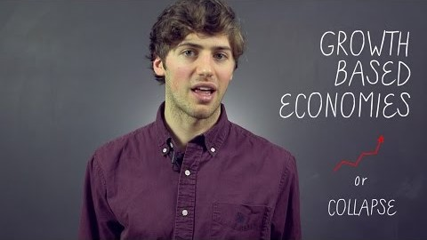
In-class case assignment:
Degrowth

Slide 28
Let’s have a discussion on (de)growth
Read the following pieces (35 minutes altogether – then we discuss as group):
https://theconversation.com/time-for-degrowth-to-save-the-planet-we-must-shrink-the-economy-64195
https://theconversation.com/degrowth-and-christiania-i-saw-how-copenhagens-collective-living-experiment-can-work-97621
  Discuss with your group members (or if you’re present, classmates if you prefer). Think of the following questions.
    What is the key message in each piece?
    Were there any interesting key figures or facts (claims)?
    What kinds of reactions did they cause in you? Positives, negatives?

Slide 29
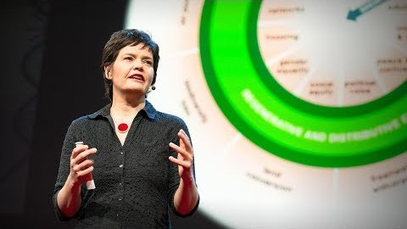
Let’s continue the conversation – Kate Raworth and growth

Slide 30
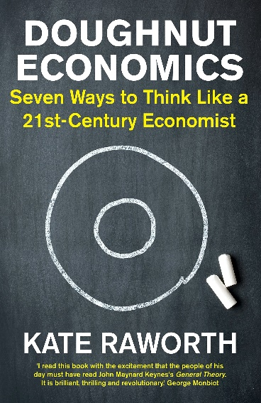
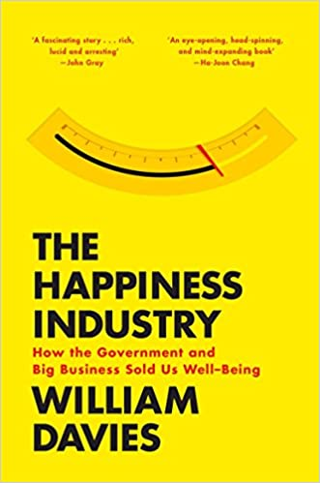
Raworth’s talk
What are the main points Raworth is trying make?
What is the point of Raworth’s donut?
  Are there connections to what we’ve been discussing?
What are your thoughts on all this?

