Slide 1
Disruption
Workshop

Slide 2
The world does not need another boring me-too idea, product or service.

Slide 3
Your boring, me-too, incrementally better product or service will not succeed – and it will not change the world.

Slide 4
In most categories, there is a lot of direct competition.

Slide 5
97,000
fitness and health apps

Slide 6
Do we really need another one?

Slide 7
There is also a lot of indirect competition, other ways to spend your time, money.

Slide 8
So when you start with the problem your product or service helps to solve, remember to check what how people are currently solving it.

Slide 9
Then you need to figure out how to solve it, not only 0,1%, or even 1% but in some way 10X better.

Slide 10
So before you commit to the idea, look hard the existing options.

Slide 11
You don’t need to come up with something totally unique.

Slide 12
But you need to do something differently in a truly relevant way.

Slide 13
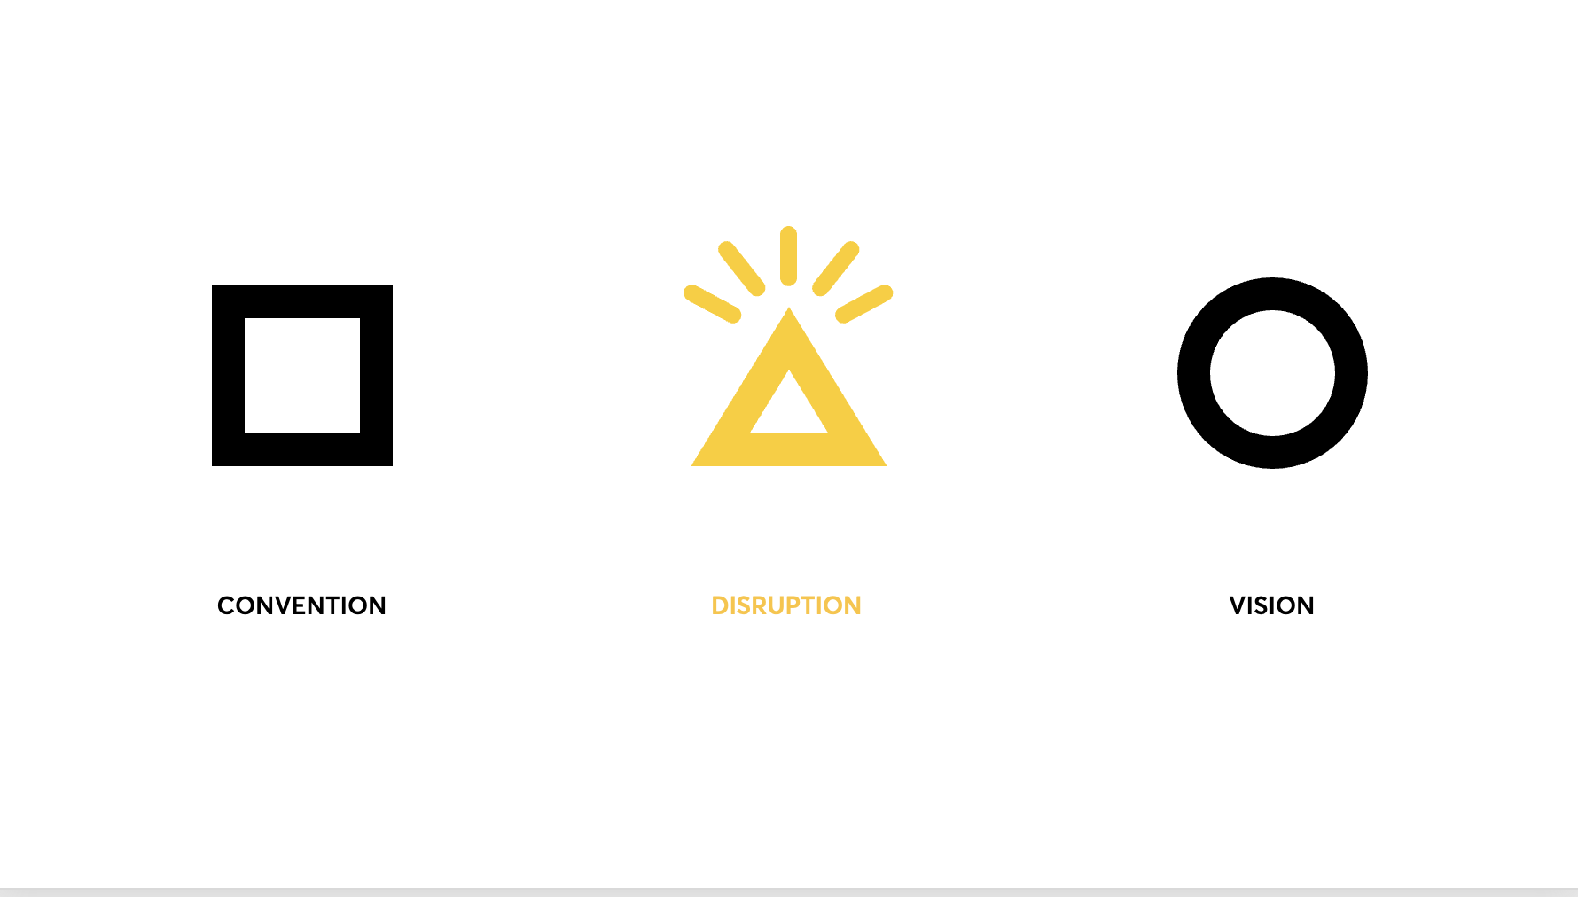

Slide 15
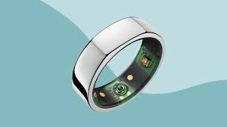
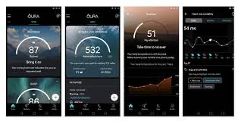

Slide 16
1. What is the job we are helping people/companies to get done?

Slide 17
2. How is it currently being done?

Slide 18
3. What are we doing that is 10X better?

Slide 19
Ambition: Create Your Own Category and Dominate It!

Slide 21
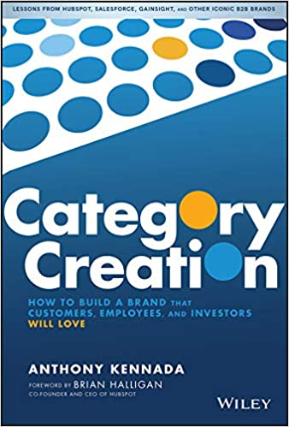
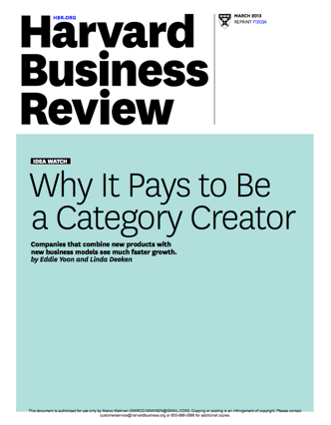

Slide 24
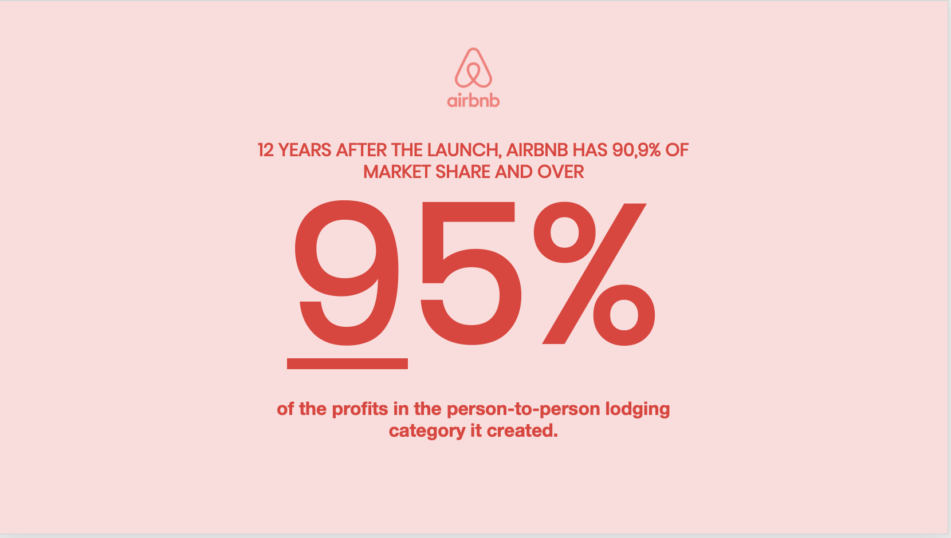

Slide 25
1. What is the job we are helping people/companies to get done? 2. How is it currently being done 3. What are we doing that is 10X better?

